Slide 1


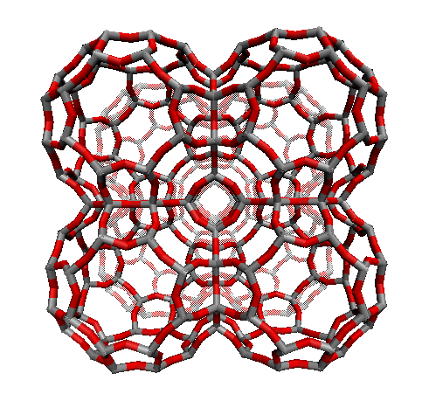
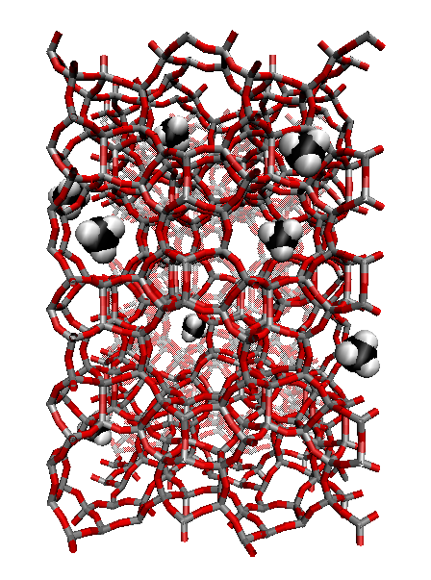
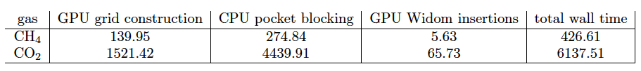
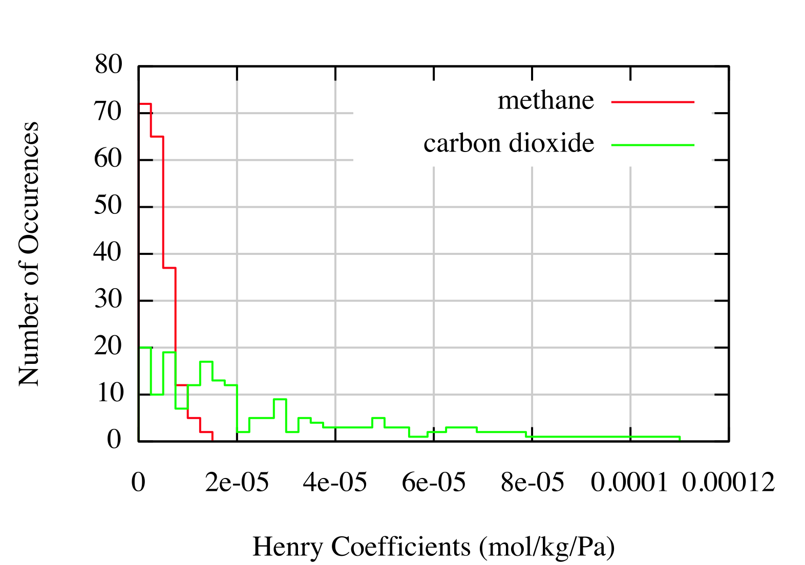
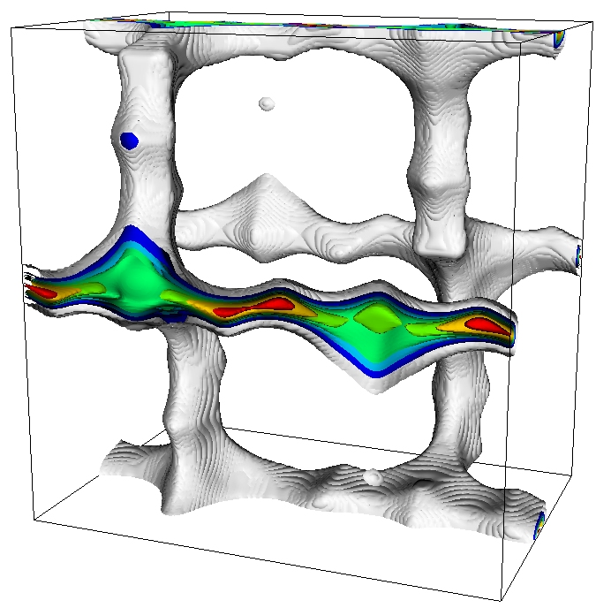

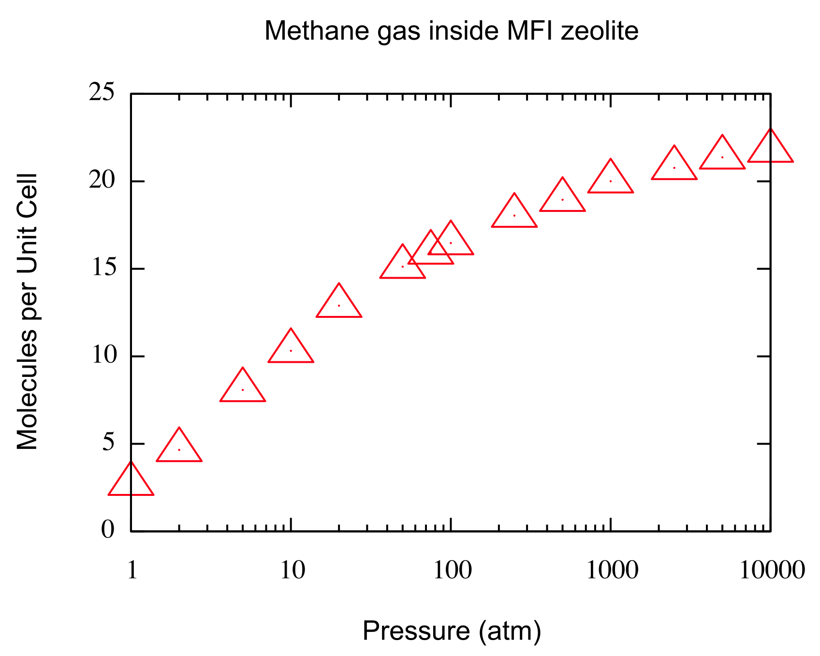
GPU Computational Screening of Carbon Capture Materials
J Kim¹, A Koniges¹, R Martin¹, M Haranczyk¹, J Swisher² and B Smit^{1,2}
¹Berkeley Lab (USA), ²Department of Chemical Engineering, University of California, Berkeley (USA)
application: Carbon Capture and Storage
ALGORITHM: Characterize Large Database of Carbon Capture Materials
Performance Results
Step 1: Energy Grid Construction
Test insert gas molecule at each grid point and calculate its energy
0.1 Angstroms grid size (10million+ grid points, GPU DRAM)
Framework atoms (< 2000), keep data in fast GPU memory
Number of GPU threads = number of grid points
Lennard-Jones + Coulomb potentials with periodic boundary conditions
…
Simulations of IZA structures: 190+ experimentally known zeolites
CH₄: 2.2 seconds/zeolite
CO₂: 31.8 seconds/zeolite
64(72)% of wall time spent in CPU pocket blocking
The code is compute bound (50x improvement from CPU single core implementation)
Successfully computed 120,000+ Henry coefficients for CH4 inside hypothetical zeolites: 5 GPUs, less than 1 day of wall time
Local Henry coefficient color map indicates the regions within the zeolite that contribute most to the overall Henry coefficients
Henry coefficients (IZA)
Thread 1
Thread 0
Thread 3
Thread 2
LTA zeolite
MFI zeolite
x
x
x
Project Goal: reduce the cost of separating CO₂ molecules from power
plant flue gases (46 Energy Frontier Research Centers established by the DOE)
Candidates for Carbon Capture: zeolites, metal-organic frameworks
Over a million hypothetical zeolite structures: how to determine the optimal structure?
Develop GPU code to accelerate screening a large database of carbon capture materials
Henry Coefficients (K_{H}): characterize selectivity of material at low pressure (used as an initial screening quantity for zeolites)
x
x
x
x
Local Henry coefficients (MFI)
X: framework atoms
Step 2: Pocket blocking
Motivation: need to block inaccessible regions (pockets) within the framework
Set threshold energy value such that accessible if exp(-E_{i}) > exp(-15k_{B}T)
Flood fill algorithm to detect pockets
Periodic Unit Cell
Architecture: NERSC Dirac GPU Cluster
(1)
(2)
CPU
(3)
Future work
Control
Logic
ALU
Adsorption Isotherm calculations using GPU for CO₂
Determine good parallelization strategy for the adsorption isotherms
Henry coefficient calculations for ZIFs, and metal-organic frameworks
Cache
(1) and (2) are disconnected and thus inaccessible (block)
(3) forms a channel (accessible)
GPU Adsorption Isotherm
GPU Tesla C2050 14 SMs
DRAM
Step 3: Monte Carlo Widom Insertion
SM1
SM2
…
SM14
Less than 20 cores
Designed for general programming
GPU racks (NERSC Dirac)
GPU
Test insert a gas molecule in simulation box (CH₄: one insertion, CO₂: three insertions)
Check for (a) out of boundary (redo) and (b) inside pocket sphere
Interpolate energy values from grid points
Accumulate Boltzmann factor and repeat
Utilize CURAND Library to generate random numbers
Periodic, Non-orthogonal
Unit Cell
GCMC
P = 1 atm
GCMC
P = 100 atm
New GPU cluster Dirac at NERSC
(44 Fermi Tesla C2050 GPU cards)
448 CUDA cores, 3GB GDDR5 memory, PCIe x16 Gen2, 55 (1030) GFLOPS peak DP(SP) performance
144 GB/sec memory bandwidth
Dirac node: 2 Intel 5530 2.4 GHz, 8MB cache, 5.86 GT/sec QPI Quad-core Nehalem, 24GB DDR3-1066 Reg ECC memory
(b)
ALU
(a)
acknowledgment
DRAM
More than 500 cores
Optimized for SIMD (same-instruction-multiple-data) problems
Blocking spheres
This work was supported by the Director, Office of Science, Advanced Scientific Computing Research, of the U.S. Department of Energy under Contract No. DE-AC02-05CH11231.

