Slide 1
Clayton Bagwell NIM Team / Account Support Oakland Scientific Facility Sept. 10, 2014
Automated Provisioning and Management of NGF via NIM

Slide 2
The “Old” Way of Processing NGF Changes
NERSC User
Account Support
Storage Systems Group
USG
Consultant
Wait Time:
???
Service Now
NGF
File System

Slide 3
The “New” Way of Processing NGF Changes
NERSC User
USG
Consultant
Wait Time:
10 Minutes
NIM
NGF Tool
NGF
File System

Slide 4
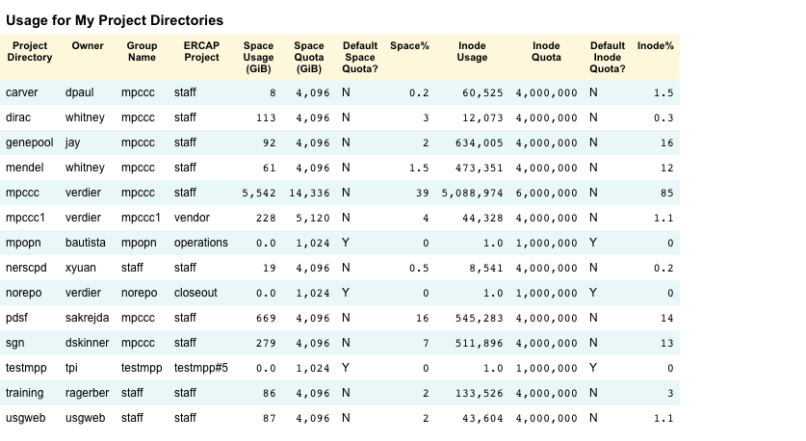
What is new for users to see

Slide 5
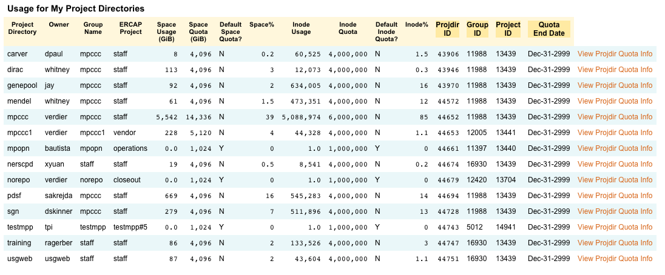
What Consultants see:

Slide 6
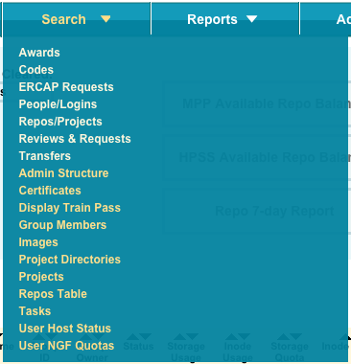
Searching for Project Directory information

Slide 7
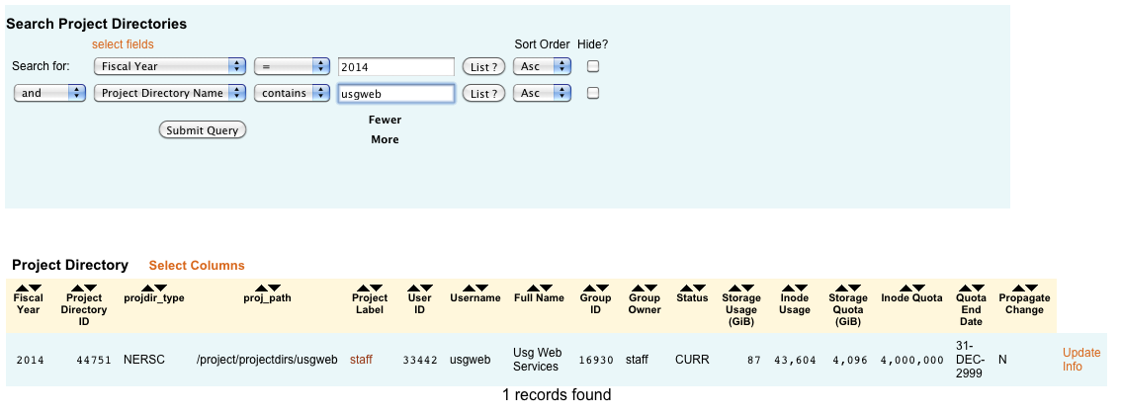
Project Directory Information

Slide 8
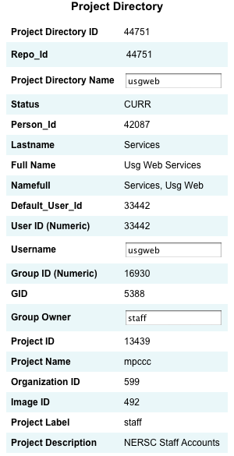
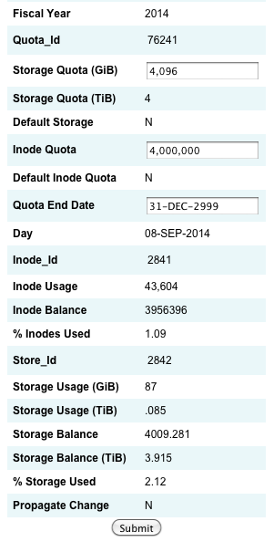
Modifying Project Directory Information

Slide 9
Changing the Inode Quota

Slide 10
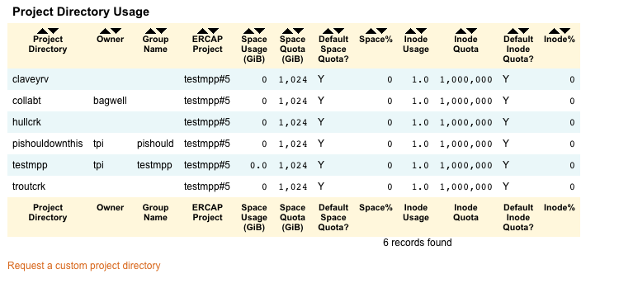
Projdir Usage from the Project Info Page

Slide 11
Requesting a Custom Project Directory
Notes:
Right now the Project Directory gets created automatically. Future enhancements will include a vetting process prior to provisioning.

Slide 12
Searching for User Quota Information

Slide 13
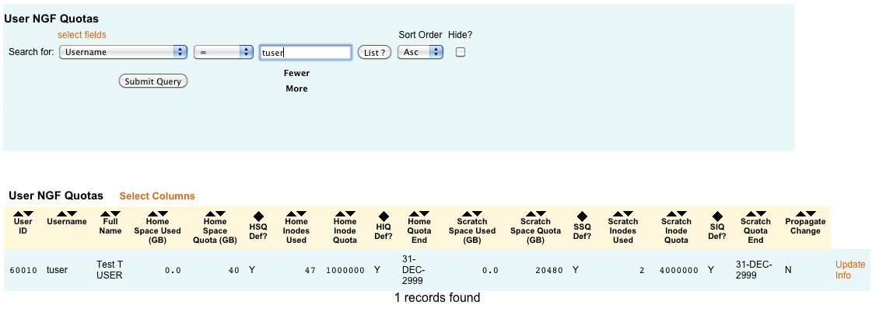
User Quota and Usage Information

Slide 14
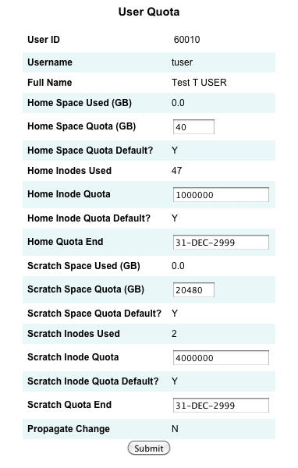
Modifying User Quotas

Slide 15
Checking User Quotas Using Myquota

Slide 16
Q & A

Slide 17
Thank you.

