Slide 1


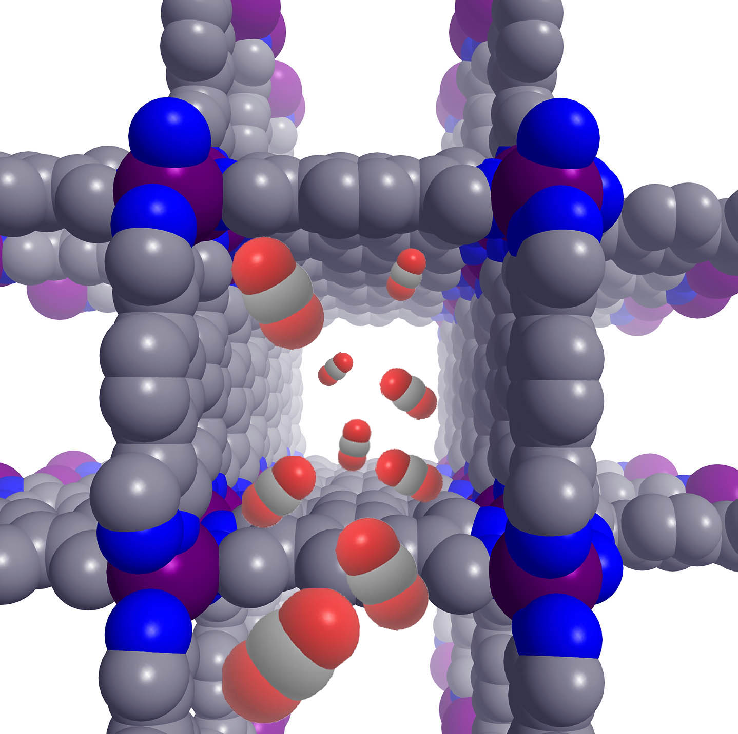
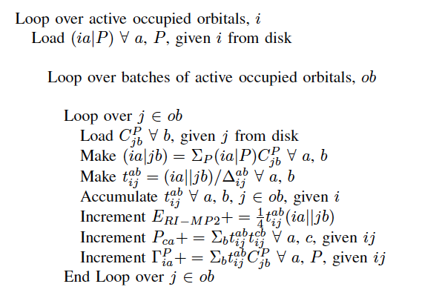
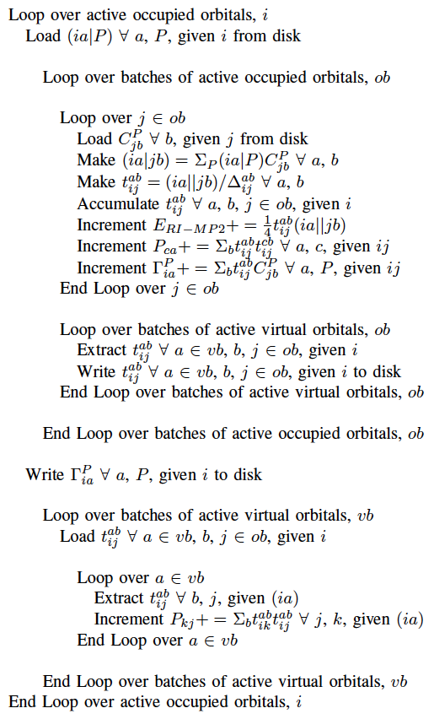
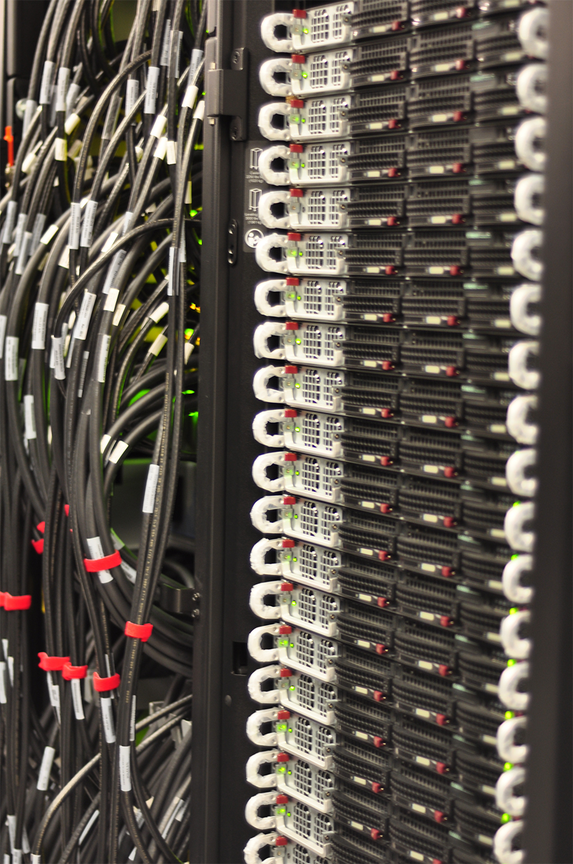
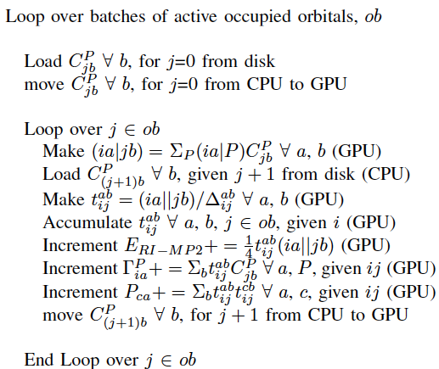
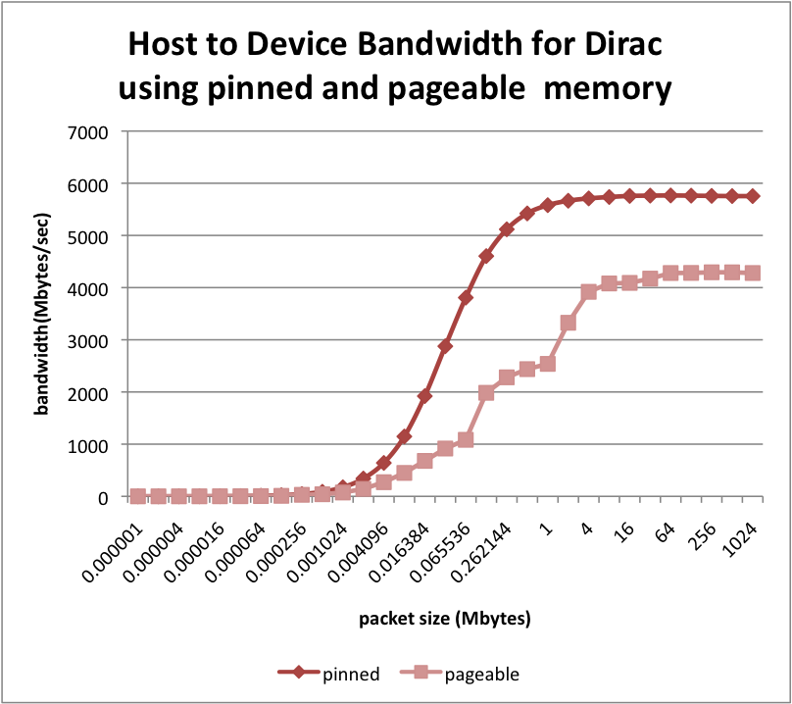
Calculation of RI-MP2 Gradient Using Fermi GPUs
Jihan Kim¹, Alice Koniges¹, Berend Smit^{1,2}, Martin Head-Gordon^{1,2}
¹Lawrence Berkeley National Laboratory, USA
²University of California Berkeley, USA
DIRAC GPU Cluster (NERSC)
Predict Molecular Equilibrium Structure
Hybrid CPU-GPU RI-MP2 Step 4 Algorithm
Exploit Data parallelism for general
purpose computing
New GPU cluster Dirac at NERSC
(44 Fermi Tesla C2050 GPU cards)
448 CUDA cores, 3 GB GDDR5
memory, PCIe x16 Gen2, 515
GFLOPS peak DP performance,
144 GB/sec memory bandwidth
Dirac node: 2 Intel 5530 2.4 GHz, 8MB cache, 5.86GT/sec QPI Quad-core Nehalem, 24GB DDR3-1066 Reg ECC memory
RI-MP2: resolution-of-the-identity second-order Möller-Plesset perturbation theory
  Treat correlation energy with 2nd order MP2
  Utilize auxiliary basis sets to approximate atomic orbital pair densities
  Strengths: no self-interaction problem (DFT), 80-90% of correlation energy
  Weakness: Computationally expensive (fifth-order terms)
Goal: Optimize Q-Chem RI-MP2 Routine
Q-Chem Requirements
  Quadratic memory, cubic storage, quartic I/O
Step 4 Algorithm
(Loop 1A + Loop1B + Loop2)
Loop 1A Algorithm
Pthreads: parallelize loop1 and loop2, further parallelize loop1 into loop1A and loop1B
Concurrent I/O File reads and GPU matrix-matrix multiplications (cublasDgemm)
Concurrent cudaMemcpy with GPU matrix-matrix multiplication kernel (Volkov): pinned memory
Loop 1A
Loop 1B
Loop 1A CPU + GPU Algorithm
Loop 2
Fermi GPU Racks - NERSC
Distasio et al., Journal of Computational Chemistry, Vol. 28, pg. 839, 2007
Courtesy of Viraj Paropkari (NERSC)
t
GPU DGEMM Performance
Seven Major Ri-MP2 Gradient steps
Speedup Comparison
Summary
  RI-overhead: formation of the (P|Q)⁻¹ matrix
  Construction and storage of the three-centered integrals in the mixed canonical MO basis/auxiliary basis
  Construction of the C_{ia}^{Q} matrix
  Assembly of the Γ_{ia}^{Q} matrix (RI-MP2 correction to the two particle density matrix), P_{ca}⁽²⁾ (virtual-virtual correction to the one-particle density matrix), and P_{kj}⁽²⁾ (active-active correction to the one-particle density matrix)
  Construction of Γ^{RS} (RI-MP2 specific two-particle density matrix)
  Γ_{ia}^{Q} transposition
  Assembly of the L, P, and W matrices; solution of the Z-vector equation and final gradient evaluation
Simulation of Glycine-n (1 CPU Thread)
x 2.9
Q-Chem CPU + GPU RI-MP2 Gradient code
Dirac Cluster (NERSC): Tesla C2050 Fermi GPUs (DGEMM 230GFLOPS)
CPU + GPU Algorithm: concurrent I/O + GPU DGEMM kernel, concurrent data copy + DGEMM
Glycine-20: Speedup of 18.8x in Step 4, 7.4x in total RI-MP2 time (more expected for larger molecules)
x 1.7
x 14.6
x 12.3
1 vs. 8 CPU Threads
29.7 hours
1
1
x 16.3
x 4.9
x 18.8
x 7.4
Future Work
8
New GPU DGEMM kernel suitable for the Fermi architecture (CUBLAS 3.1?, third-party kernel?)
DGEMM kernel that utilizes both the CPU (multiple threads) and the GPU?
RI-MP2 Gradient MPI + CUDA code
Explore OpenCL as an alternative framework for heterogeneous computing
DGEMM performance comparison (CUBLAS 3.0 Tesla C2050 vs. CUBLAS 2.0 Tesla C1060)
Uneven DGEMM performance on Fermi (70 to 230 GFLOPS)
Optimal performance at matrix sizes multiple of 48
Fermi DGEMM comparison (CUBLAS 3.0 vs. Volkov kernel)
CUDA stream + Volkov kernel: concurrent execution of matrix multiplication (GPU) and cudaMemcpyAsync
Performance jump at n = 672
1 thread
8
8
(glycine-n)
Blue: CPU 1 thread, Red: CPU 8 threads, Green: CPU + GPU
CPU multi-thread performance similar to CPU + GPU performance for smaller glycine molecules
GLYCINE-20: 18.8x speedup in Step 4, 7.4x speedup in total RI-MP2 time
+ SCF, step 4, and step 7: 95+% of total wall time
+ step 4 dominates for large input molecules
+ Eight CPU threads reduce step 4 wall time (around 4-5x speedup)

