Slide 1
Parallel I/O from a User’s Perspective HPC Advisory Council Stanford University, Dec. 6, 2011
Katie Antypas
Group Leader, NERSC User Services

Slide 2
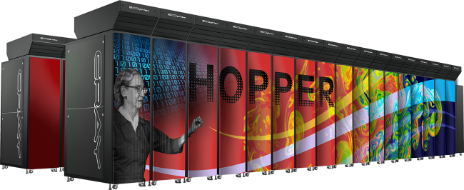
NERSC is DOE in HPC Production Computing Facility
NERSC computing for science
4000 users, 500 projects
From 48 states; 65% from universities
Hundreds of users each day
1500 publications per year
Systems designed for science
1.3PF Petaflop Cray system, Hopper
3nd Fastest computer in US
Fastest open Cray XE6 system
Additional .5 PF in Franklin system and smaller clusters

Slide 3
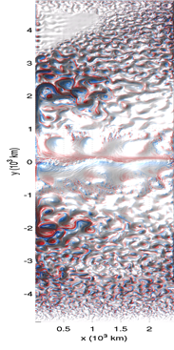
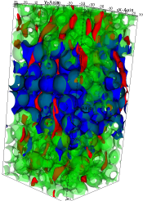
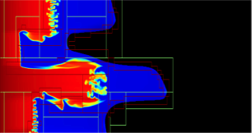
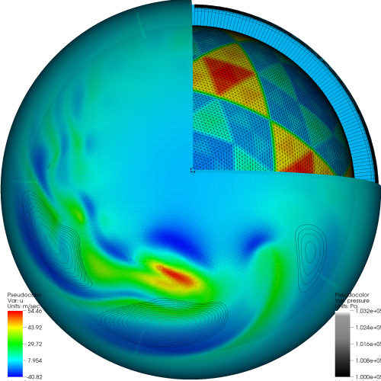
Ever Increasing Data Sets
User I/O needs growing each year in the scientific community
Data from sensors, detectors, telescopes, genomes adding flood of data
For many users I/O parallelism is mandatory
I/O remains a bottleneck for many groups
Images from David Randall, Paola Cessi, John Bell, T Scheibe
Notes:
First question -- Why is I/O for scientific applications difficult
Lots of it
hard to translate scientific data structures, grid, particles, molecules efficiently to disk
difficult to coordinate many processors – either many files
hard to analyze
expensive
last frontier -- technology

Slide 4
Why is Parallel I/O for science applications so difficult?
Scientists think about data in terms of their science problem: molecules, atoms, grid cells, particles
Ultimately, physical disks store bytes of data
Layers in between, the application and physical disks are at various levels of sophistication
Images from David Randall, Paola Cessi, John Bell, T Scheibe
Notes:
First question -- Why is I/O for scientific applications difficult
Lots of it
hard to translate scientific data structures, grid, particles, molecules efficiently to disk
difficult to coordinate many processors – either many files
hard to analyze
expensive
last frontier -- technology

Slide 5
Parallel I/O: A User Perspective
Wish List
Write data from multiple processors into a single file
File can be read in the same manner regardless of the number of CPUs that read from or write to the file.
Do so with the same performance as writing one-file-per-processor
And make all of the above portable from one machine to the next
Inconvenient Truth: Scientists need to understand I/O infrastructure in order to get good performance
Notes:
Google, iphone

Slide 6
I/O Hierarchy Slide
Application
High Level IO Library
MPI-IO Layer
Parallel File System
Storage Device

Slide 7
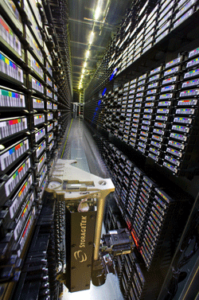
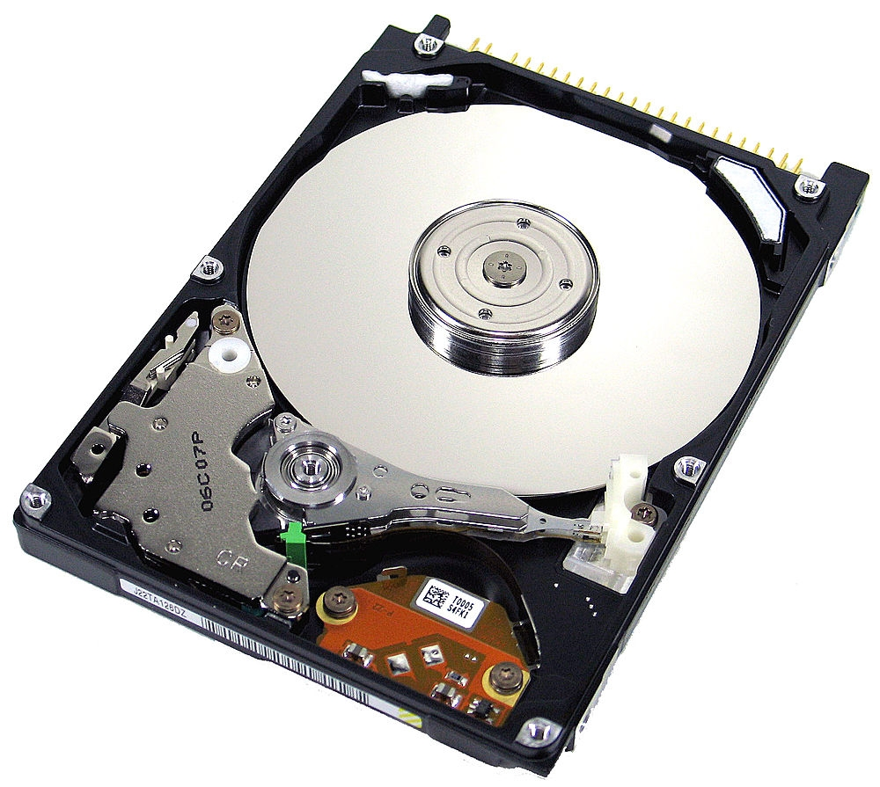
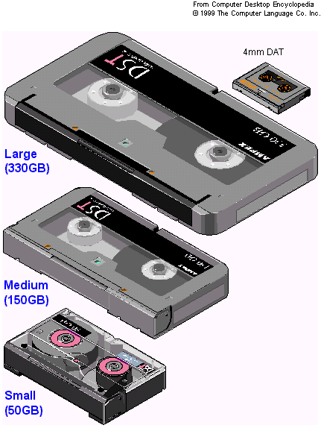
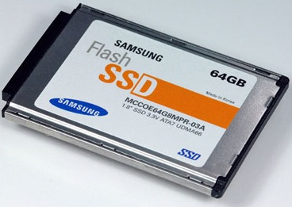
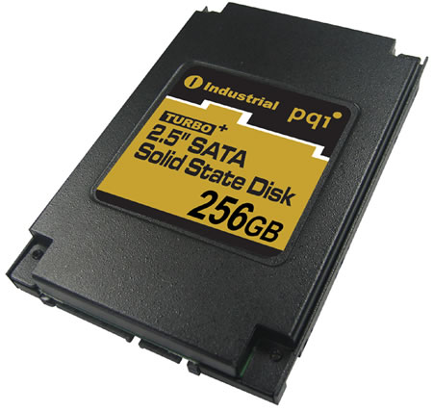
Storage Media
Magnetic Tape
Magnetic Hard Disk Drives
Notes:
Question: Why do we use tape?

Slide 8
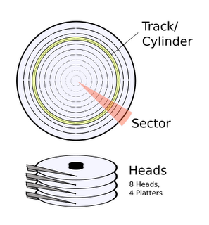
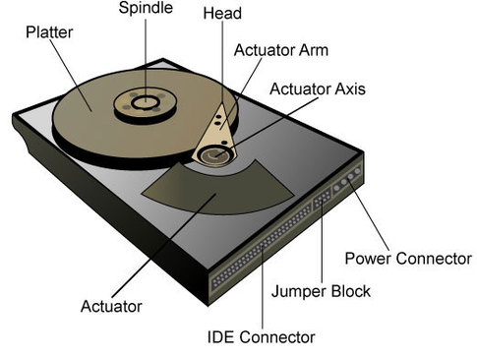
Magnetic Hard Disk Drives
Source: Popular Science, Wikimedia Commons
Notes:
Key points – actuator, head, glass platters, magnetic coating, platter is coated with magnetic material that responds to changing magnetic fields
Track – concentric circles
Sectors,
Sensitive, don’t want to drop your computer, head can crash into platter, dust can corrupt data
Disk is spinning all the time – head flies a few nanometers above.

Slide 9
Some definitions
Capacity (in MB, GB, TB)
Measured by areal density
Areal density = track density * linear density
Transfer Rate (bandwidth) – MB/sec
Rate at which a device reads or writes data
Access Time (milli-seconds)
Delay before the first byte is read

Slide 10
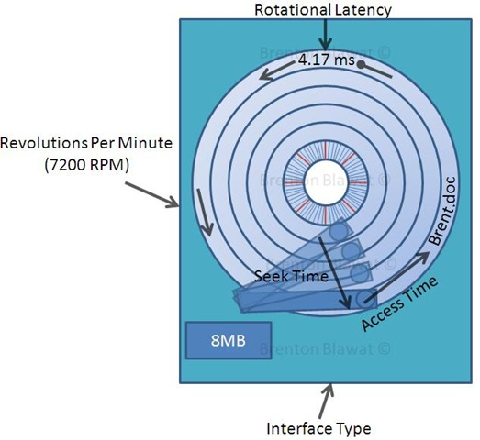
Access Time
T(access) = T(seek) + T(latency)
T(seek) = time to move head to correct track
T(latency) = time to rotate to correct sector
T(seek) = ~10 milli-sec
T(latency) = 4.2 milli-sec
T(access) = 14 milli-sec!!
How does this compare
to clock speed?
Latency
Image from Brenton Blawat
~100 Million flops in the time it takes to access disk

Slide 11
Why isn’t a hard drive faster?
Hard disk drives operate at about 30-~300s MB/s
Areal density getting higher
Improved magnetic coating on platters
More accurate control of head position on platter
Rotational rates slowly increasing
What’s the problem?
Electronics supporting the head can’t keep up with increases in density
Access time always a fixed cost

Slide 12
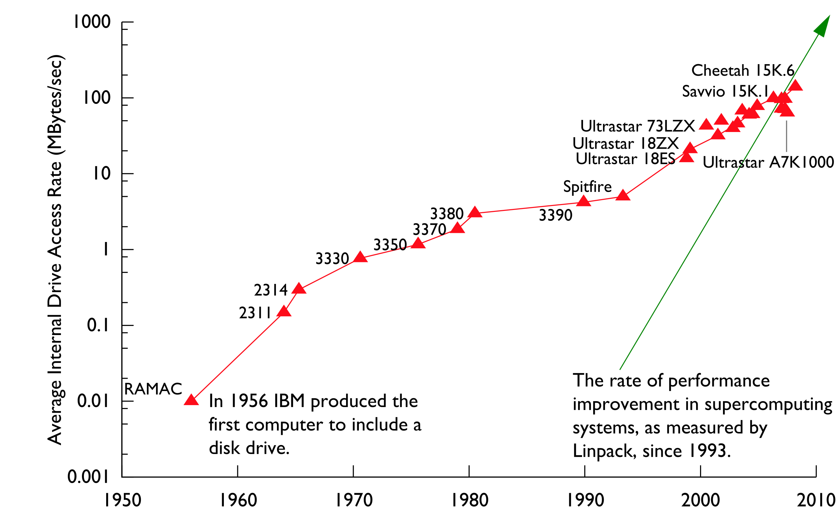
Disk Transfer Rates over Time
Thanks to R. Freitas of IBM Almaden Research Center for providing much of the data for this graph.
Slide from Rob Ross, Rob Latham at ANL
12
Notes:
12

Slide 13
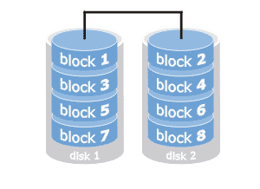
RAID
Individual disk drives obviously not fast enough for supercomputers
Need parallelism
Redundant Array of Independent Disks
Different configurations of RAID offer various levels of data redundancy and fail over protection

Slide 14
File Systems
14

Slide 15
What is a File System?
Software layer between the Operating System and Storage Device which creates abstractions for
Files
Directories
Access permissions
File pointers
File descriptors
Moving data between memory and storage devices
Coordinating concurrent access to files
Managing the allocation and deletion of data blocks on the storage devices
Data recovery
J.M. May “Parallel IO for High Performance Computing

Slide 16
From disk sectors to files
File systems allocate space in “blocks”, usually multiples of disk “sector”
A file is created by the file system on one or more unused blocks
The file system must keep track of used and unused blocks
Attempts to allocated nearby blocks to the same file
Notes:
-- For next slides – how big should a file system block be? This is configurable by the system admin.
Small blocks, good for small files – bad for big files, many transfers, blocks, scattered on disk, more entries into inode’s block list
Block to big, waste space, one file per block – (gpfs does some packing)

Slide 17
Inodes store Metadata
Data about data
File systems store information about files externally to those files.
Linux uses an inode, which stores information about files and directories (size in bytes, device id, user id, group id, mode, timestamps, link info, pointers to disk blocks, file size…)
Any time a file’s attributes change or info is desired (e.g., ls –l) metadata has to be retrieved from the metadata server

Slide 18
File Systems
Your laptop has a file system, referred to as a “local file system”
A networked file system allows multiple clients to access files
Treats concurrent access to the same file as a rare event
A parallel file system builds on concept of networked file system
Efficiently manages hundreds to thousands of processors accessing the same file concurrently
Coordinates locking, caching, buffering and file pointer challenges
Scalable and high performing
GPFS
J.M. May “Parallel IO for High Performance Computing

Slide 19
Generic Parallel File System Architecture
Compute Nodes
Internal Network
I/O Servers
MDS
I/O
I/O
I/O
I/O
I/O
I/O
I/O
External Network - (Likely FC)
Disk controllers - manage failover
Storage Hardware -- Disks

Slide 20
Lustre file system on Hopper
Note: SCRATCH1 and SCRATCH2 have identical configurations.

Slide 21
File Buffering and Caching
Buffering
Used to improve performance
File system collects full blocks of data before transferring data to disk
For large writes, can transfer many blocks at once
Caching
File system retrieves an entire block of data, even if all data was not requested, data remains in the cache
Can happen in many places, compute node, I/O server, disk
Not the same on all platforms
Important to study your own application’s performance rather than look at peak numbers
Notes:
Questions: What are the disadvantages to buffering? Answer – data may not be written immediately. In case of crashes, data won’t be written to disk and will be lost
Sometimes buffering and caching don’t help. “pre-fetching can slow performance if read sequence is not predictable” – For buffering, if large amounts of data are written, buffer copy will be a waste of time since all data needs to get to disk.

Slide 22
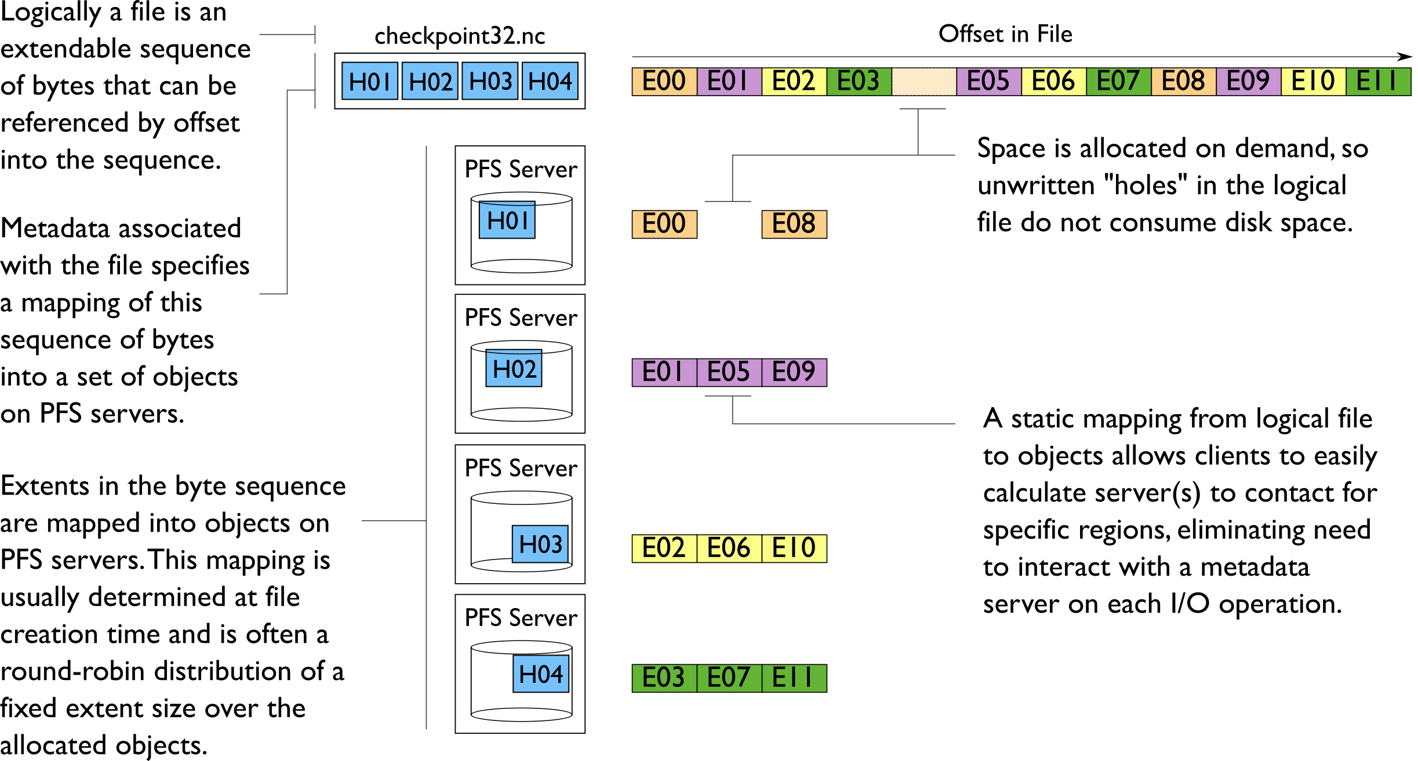
Data Distribution in Parallel File Systems
Slide Rob Ross, Rob Latham at ANL
22

Slide 23
Locking in Parallel File Systems
Most parallel file systems use locks to manage concurrent access to files
Files are broken up into lock units, (also called blocks)
Clients obtain locks on units that they will access before I/O occurs
Enables caching on clients as well (as long as client has a lock, it knows its cached data is valid)
Locks are reclaimed from clients when others desire access
If an access touches any data in a lock unit, the lock for that region must be obtained before access occurs.
Slide from Rob Ross, Rob Latham at ANL
23

Slide 24
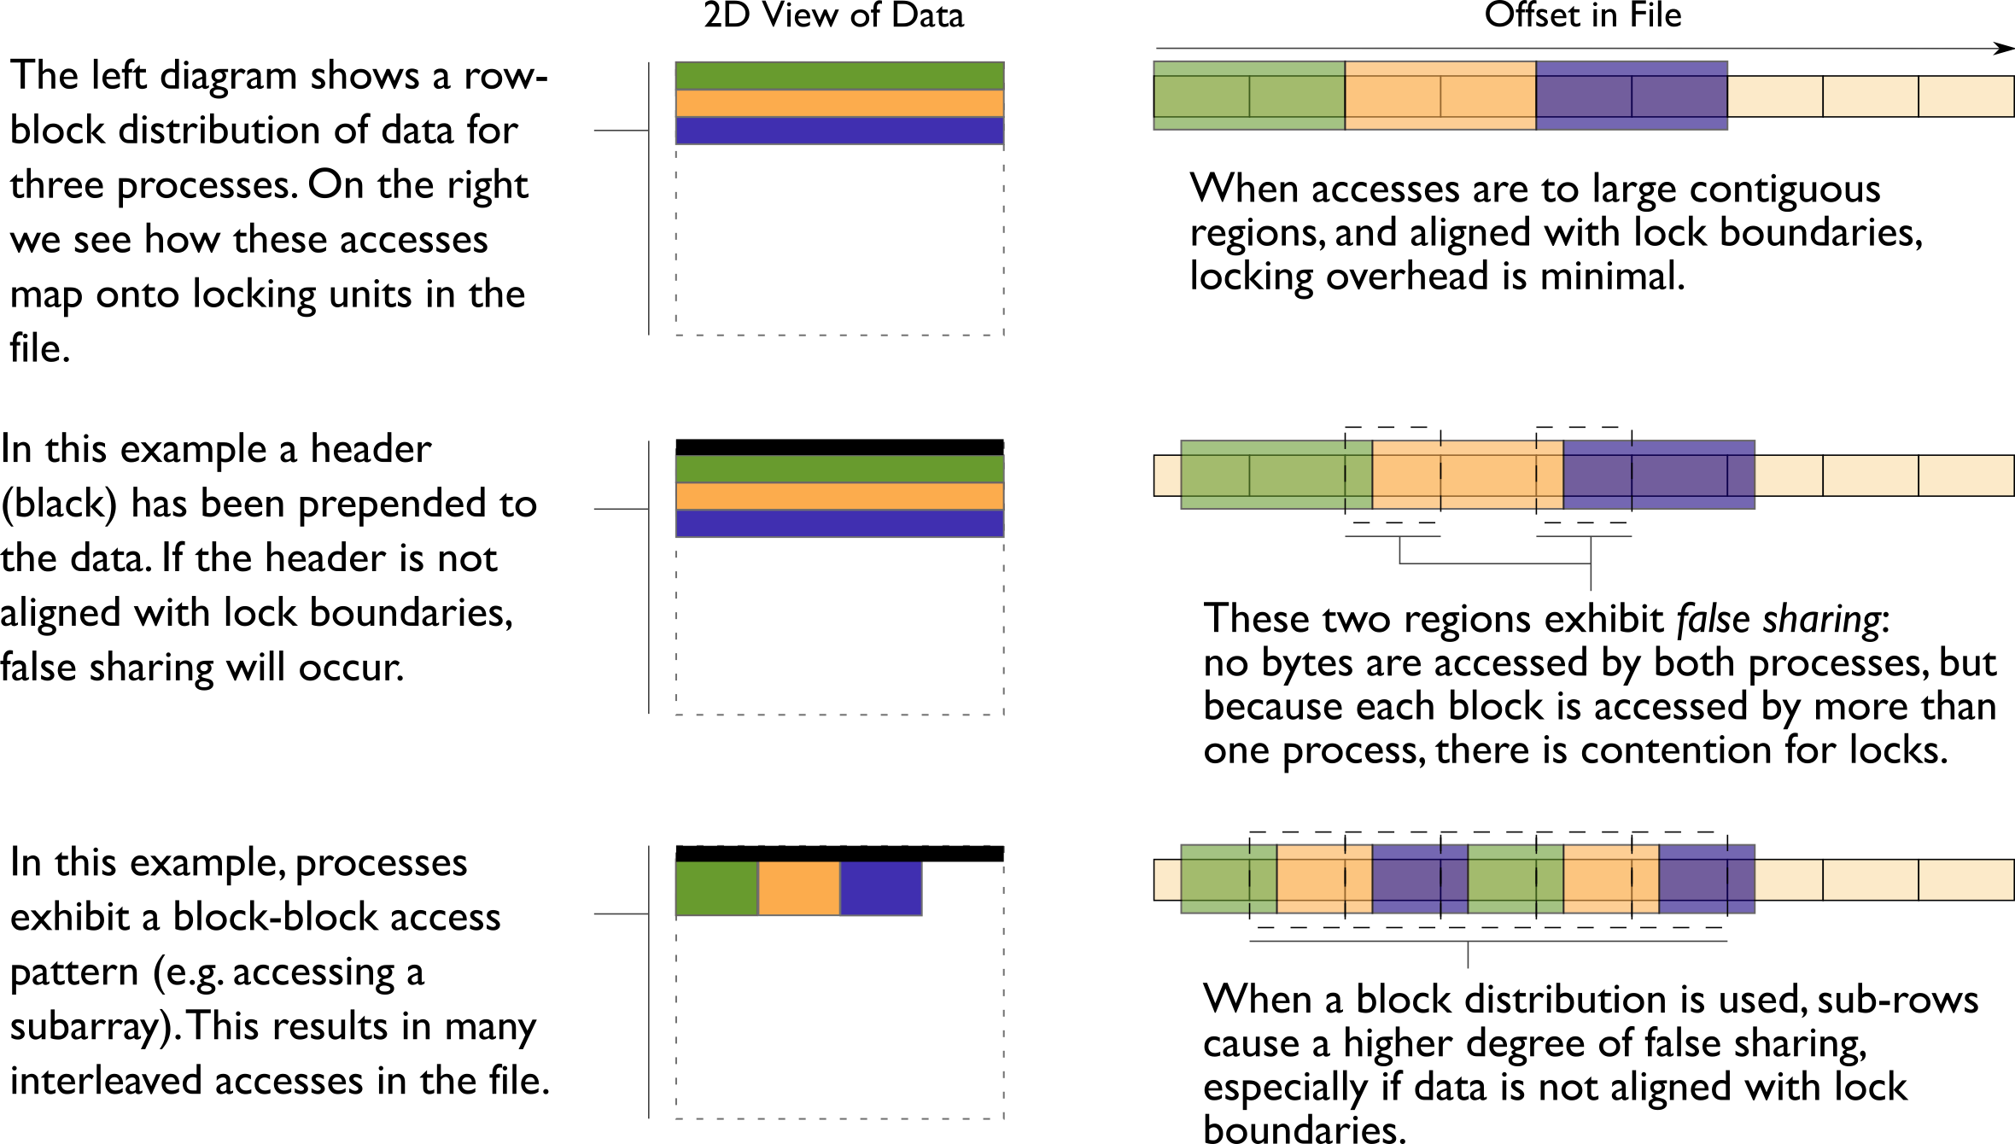
Locking and Concurrent Access
Question -- what would happen if writes were smaller than lock units?
Slide from Rob Ross, Rob Latham at ANL
24

Slide 25
Small Writes
How will the parallel file system perform with small writes (less than the size of a lock unit)?
25

Slide 26
Access Patterns
Contiguous
Contiguous in memory, not in file
Contiguous in file, not in memory
Memory
Memory
Memory
File
File
File
Dis-contiguous
Bursty
Out-of-Core
Mem
Memory
Memory
File
File
Time
File
Notes:
Which is the easiest for the file system to support?

Slide 27
Now from the user’s point of view
27

Slide 28
Serial I/O
processors
0
1
2
3
4
5
Each processor sends its data to the master who then writes the data to a file
Advantages
Simple
May perform ok for very small IO sizes
Disadvantages
Not scalable
Not efficient, slow for any large number of processors or data sizes
May not be possible if memory constrained
File

Slide 29
Parallel I/O Multi-file
0
1
2
3
4
5
processors
File
File
File
File
File
File
Each processor writes its own data to a separate file
Advantages
Simple to program
Can be fast -- (up to a point)
Disadvantages
Can quickly accumulate many files
Hard to manage
Requires post processing
Difficult for storage systems, HPSS, to handle many small files
Can overwhelm the file system with many writers

Slide 30
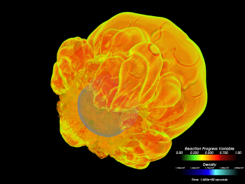
Flash Center IO Nightmare…
Large 32,000 processor run on LLNL BG/L
Parallel IO libraries not yet available
Intensive I/O application
checkpoint files .7 TB, dumped every 4 hours, 200 dumps
plotfiles - 20GB each, 700 dumps
particle files 1400 particle files 470MB each
154 TB of disk capacity
74 million files!
Unix tool problems
Took 2 years to sift though data, sew files together

Slide 31
Parallel I/O Single-file
0
1
2
3
4
5
processors
File
Each processor writes its own data to the same file using MPI-IO mapping
Advantages
Single file
Manageable data
Disadvantages
Shared files may not perform as well as one-file-per-processor models

Slide 32
MPI-IO
32

Slide 33
What is MPI-IO?
Parallel I/O interface for MPI programs
Allows users to write shared files with a simple interface
Key concepts:
MPI communicators
File views
Define which parts of a file are visible to a given processor
Can be shared by all processors, distinct or partially overlapped
Collective I/O for optimizations
33
Notes:
33

Slide 34
Independent and Collective I/O
P0
P1
P2
P3
P4
P5
P0
P1
P2
P3
P4
P5
Independent I/O
Collective I/O
Independent I/O operations specify only what a single process will do
obscures relationships between I/O on other processes
Collective I/O is coordinated access to storage by a group of processes
Functions are called by all processes participating in I/O
Allows I/O layers to know more about access as a whole, more opportunities for optimization in lower software layers, better performance
Slide from Rob Ross, Rob Latham at ANL
34
Notes:
34

Slide 35
MPI-IO Optimizations
Collective Buffering
Consolidates I/O requests from all procs
Only a subset of procs (called aggregators) write to the file
Key point is to limit writers so that tasks are not competing for same I/O block of data
Various algorithms exist for aligning data to block boundaries
Collective buffering is controlled by MPI-IO hints: romio_cb_read, romio_cb_write, cb_buffer_size, cb_nodes, cb_config_list
35
Notes:
35

Slide 36
When to use collective buffering
When to use collective buffering
The smaller the write, the more likely it is to benefit from collective buffering
Large contiguous I/O will not benefit from collective buffering. (If write size is larger than I/O block then there will not be contention from multiple procs for that block.)
Non-contiguous writes of any size will not see a benefit from collective buffering
36
Notes:
36

Slide 37
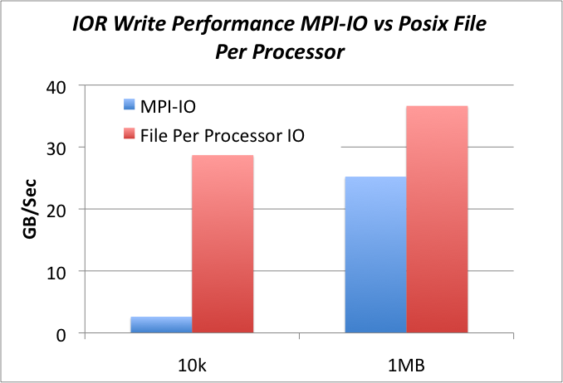
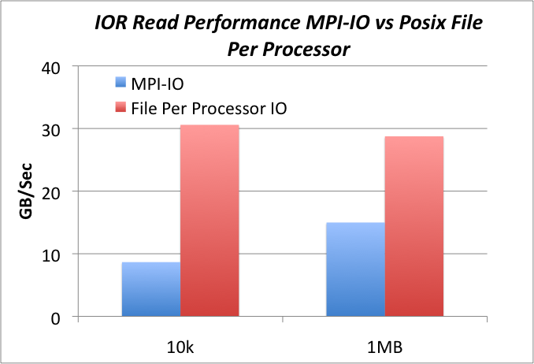
But how does MPI-IO perform?
IO Test using IOR benchmark on 576 cores on Hopper with Lustre file system
Transfer Size
Transfer Size
Hard sell to users
MPI-IO performance depends on the file system, MPI-IO layer and data access pattern

Slide 38
MPI-IO Summary
MPI-IO is in the middle of the I/O stack
Provides optimizations typically low performing I/O patterns (non-contiguous I/O and small block I/O)
Performance highly depends on the vendor implementation of MPI-IO
You could use MPI-IO directly, but better to use a high level I/O library
38
Notes:
38

Slide 39
High Level Parallel I/O Libraries (HDF5)
39

Slide 40
Common Storage Formats
ASCII:
Slow
Takes more space!
Inaccurate
Binary
Non-portable (eg. byte ordering and types sizes)
Not future proof
Parallel I/O using MPI-IO
Self-Describing formats
NetCDF/HDF4, HDF5, Parallel NetCDF
Example in HDF5: API implements Object DB model in portable file
Parallel I/O using: pHDF5/pNetCDF (hides MPI-IO)
Community File Formats
FITS, HDF-EOS, SAF, PDB, Plot3D
Modern Implementations built on top of HDF, NetCDF, or other self-describing object-model API
Many NERSC users at this level. We would like to encourage users to transition to a higher IO library

Slide 41
What is a High Level Parallel I/O Library?
An API which helps to express scientific simulation data in a more natural way
Multi-dimensional data, labels and tags, non-contiguous data, typed data
Sits on top of MPI-IO
Simplicity for visualization and analysis
Portable format -take input/output files to different machine
Examples:
HDF5 http://www.hdfgroup.org/HDF5/
Parallel NetCDF http://trac.mcs.anl.gov/projects/parallel-netcdf

Slide 42
HDF5 Data Model
Groups
Arranged in directory hierarchy
root group is always ‘/’
Datasets
Dataspace
Datatype
Attributes
Bind to Group & Dataset
“/”
(root)
“author”=Jane Doe
“date”=10/24/2006
“Dataset0”
type,space
“Dataset1”
type, space
“subgrp”
“time”=0.2345
“validity”=None
“Dataset0.1”
type,space
“Dataset0.2”
type,space

Slide 43
Example 1: Writing dataset by rows
P0
P1
File
P2
NX
P3
NY
count[1]=4
offset[1]=0
Each task must calculate an offset and count of data to store
count[0]=2
offset[0]=2

Slide 44
Writing by Chunks: Output of h5dump
HDF5 ”grid_rows.h5" {
GROUP "/" {
DATASET ”Dataset1" {
DATATYPE H5T_IEEE_F64LE
DATASPACE SIMPLE { ( 8, 4 ) / ( 8, 4 ) }
DATA {
3.2, 4.3, 5.6, 7.9,
5.2, 2.1, 4.5, 8.9,
5.7, 7.0, 3.4, 2.3,
2.1, 1.9, 5.4, 4.2,
3.3, 6.4, 4.7, 3.5,
3.5, 2.9, 2.3, 6.8,
4.8, 2.4, 8.1, 4.0,
7.3, 8.1, 4.8, 5.1
}
}
}

Slide 45
Example 2: Writing dataset by chunks
File
P0
P1
P2
P3
NX
NY
count[1]=2
offset[1]=0
count[0]=4
offset[0]=4

Slide 46
Writing by Chunks: Output of h5dump
HDF5 ”write_chunks.h5" {
GROUP "/" {
DATASET ”Dataset1" {
DATATYPE H5T_IEEE_F64LE
DATASPACE SIMPLE { ( 8, 4 ) / ( 8, 4 ) }
DATA {
3.2, 4.3, 5.6, 7.9,
5.2, 2.1, 4.5, 8.9,
5.7, 7.0, 3.4, 2.3,
2.1, 1.9, 5.4, 4.2,
3.3, 6.4, 4.7, 3.5,
3.5, 2.9, 2.3, 6.8,
4.8, 2.4, 8.1, 4.0,
7.3, 8.1, 4.8, 5.1
}
}
}

Slide 47
Basic Functions
H5Fcreate (H5Fopen) create (open) File
H5Screate_simple/H5Screate create dataSpace
H5Dcreate (H5Dopen) create (open) Dataset
H5Sselect_hyperslab select subsections of data
H5Dread, H5Dwrite access Dataset
H5Dclose close Dataset
H5Sclose close dataSpace
H5Fclose close File
NOTE: Order not strictly specified.

Slide 48
But what about performance?
Hand tuned I/O for a particular architecture will likely perform better, but …
Purpose of I/O libraries is portability, longevity, simplicity, and productivity
High level libraries follow performance of
When code is ported to a new machine user is required to make changes to improve IO performance
Let other people do the work
HDF5 can be optimized for given platforms and file systems by library developers
Notes:
Your code should outlive any system

Slide 49
Solid State Storage
More reliable than hard disk drives
No moving parts
Withstand shock and vibration
“Non-volatile” retain data without power
Slower than DRAM memory, faster than hard disk drives
Relatively cheap

Slide 50
New Technologies
In HPC we like to move data around
Fast interconnects
Parallel file systems
Diskless nodes
How does this contrast to other organizations with large data problems? (Google, Yahoo, Facebook)
Slow interconnects
Local disk on compute nodes
Move the computation to the data
Not all HPC problems can be setup in a map-reduce structure, but with more datasets coming from sensors, detectors and telescopes, what can HPC learn from the Hadoop model?

Slide 51
Recommendations
Think about the big picture
Run time vs Post Processing trade off
Decide how much IO overhead you can afford
Data Analysis
Portability
Longevity
Storability
Write and read large blocks of I/O where ever possible

Slide 52
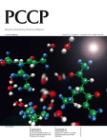
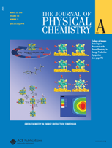
Recent Cover Stories from NERSC Research
H. Guo
2010
S. Salahuddin
2010
L.Sugiyama 2010
T Head-Gordon
2010
Pennycook 2010
V. Daggett
2010
A Fedorov
2010
W. Dorland 2010
U. Landman
2010
E. Bylaska
2010
T Head-Gordon
2010
P. Liu
2010
NERSC is enabling new high quality science across disciplines, with over 1,600 refereed publications last year

