Slide 1
Zhengji Zhao
NERSC User Services Group
CORI and NERSC Exascale Application Program (NESAP)

Slide 2
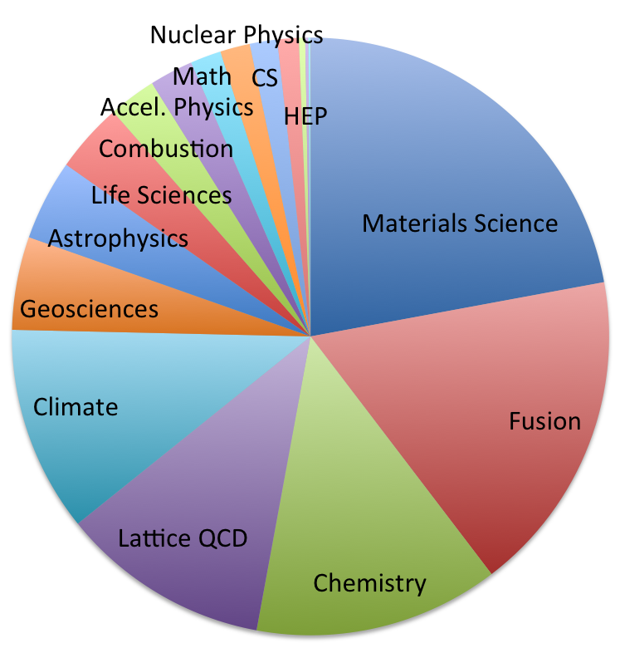
The National Energy Research Scientific Computing Center (NERSC)
NERSC is the primary scientific computing facility for the Office of Science in the U.S. Department of Energy. As one of the largest facilities in the world devoted to providing computational resources and expertise for basic scientific research, NERSC is a world leader in accelerating scientific discovery through computation. NERSC is a division of the Lawrence Berkeley National Laboratory, located in Berkeley, California. NERSC itself is located at the UC Oakland Scientific Facility in Oakland, California.
2013 Breakdown of Allocations by Science Area
More than 5,000 scientists from more than 700 research projects

Slide 3


NERSC Resources
Hopper: 1.3PF, 212 TB RAM
3.6 PB
5 x SFA12KE
2.2 PB Local Scratch
70 GB/s
80 GB/s
Global
Scratch
5 PB
DDN9900 & NexSAN
/project
Cray XE6, 150K Cores
16 x QDR IB
50 GB/s
Edison: >2PF, 333 TB RAM
6.4 PB Local Scratch
140 GB/s
/home
250 TB
NetApp 5460
5 GB/s
HPSS
50 PB stored, 240 PB capacity, 20 years of community data
16 x FDR IB
12 GB/s
Cray XC30, ~134K Cores
Production Clusters
Carver, PDSF, JGI,KBASE,HEP
14x QDR
Ethernet &
IB Fabric
Science Friendly Security
Production Monitoring
Power Efficiency
WAN
2 x 10 Gb
1 x 100 Gb
Vis & Analytics Data Transfer Nodes
Adv. Arch. Testbeds Science Gateways
Software Defined
Networking

Slide 4
Cori – NERSC’s next Supercomputer system

Slide 5
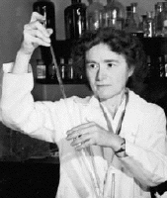
Cori – NERSC’s next supercomputer system
NERSC will be installing a 30-petaflop/s Intel KNL-based Cray system in the 2016 time frame, named after American biochemist Gerty Cori
Over 9,300 single-socket nodes in the system with each node > 3TeraFLOPS/s theoretical peak performance
Cray Aries high speed "dragonfly" topology interconnect
Liquid cooling
Gerty Cori
Next-generation Intel® Xeon Phi™ Knights Landing (KNL) product with improved single thread performance targeted for highly parallel computing
Intel® "Silvermont" architecture enhanced for high performance computing

Slide 6
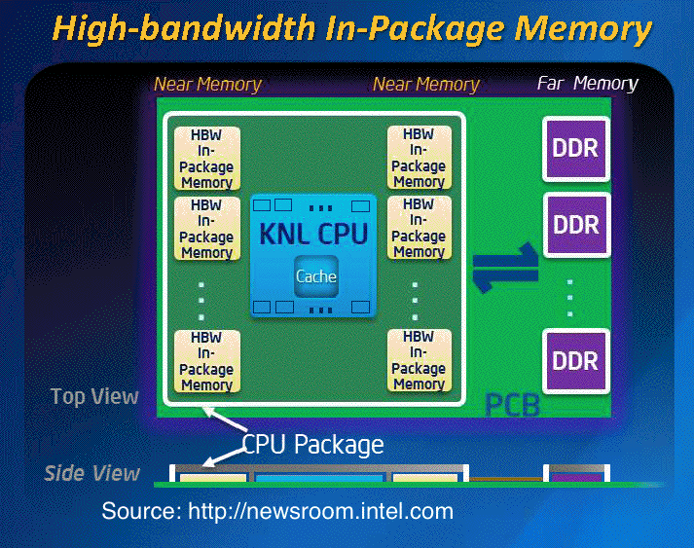
Cori – NERSC’s next supercomputer system
Better performance per watt than previous generation Xeon Phi™ systems and 3X single-thread performance
AVX512 Vector pipelines with a hardware vector length of 512 bits (eight double-precision elements)
On-package, high-bandwidth memory, up
to 16GB capacity with bandwidth projected to be 5X that of DDR4
DRAM memory; flexible memory modes including cache and flat
64-128 GB of DRAM memory per node
Greater than 60 cores per node with support for four hardware threads each
Lustre filesystem with > 430 GB/sec I/O bandwidth and 28 PB of disk capacity

Slide 7
Programming Model Considerations
Knight’s Landing is a self-hosted part
  Not a coprocessor; no PCI-bus transfers
MPI-only will work – performance not optimal;
  With 2 threads/core, memory/thread < 1 GB; 4 threads/core are available
More on-node parallelism required:
  OpenMP
  Vectorization
On package memory - How to optimally use?
  Cache Model: let the hardware manage it
  Flat Model: user manually manages it

Slide 8
NERSC Exascale Science Application Program (NESAP)

Slide 9
NERSC Exascale Science Application Program (NESAP)
NERSC partner with 20 application code teams to facilitate transition of user codes to Cori
Collaboration between code team, NERSC, and vendors
Code team role: identify science problems, characterize code, transform code
Vendor role: provide detailed consultation on specific optimization issues
NERSC role: provide consulting and expertise; connect you to the right vendor expert and help make best use of those experts; gather results and translate all lessons learned for entire community
Notes:
To accelerate early success on the system, NERSC created the NERSC Exascale Science Applications Program (NESAP) in which we will partner with 20 application code teams to facilitate transition of user codes to Cori. As part of NESAP we are also creating a Tools and Library Collaboration and we are writing now to ask you to participate. This collaboration includes developers of the core performance tools, debuggers, visualization tools, and libraries that we expect our user community will need to make effective use of Cori. The key is to have this software running as soon as Cori is deployed.

Slide 10
Twenty Applications Accepted into NESAP
Over 50 application teams applied.
  Many highly qualified teams not accepted at this level
Code selection:
DOE program manager input and interest in results
Today’s Codes
Today’s & Tomorrow’s Codes
NERSC Codes
NERSC + LCF + Other Sites
More Ready for Manycore
Less Ready for Manycore

Slide 11
Resources Available to Twenty NESAP Projects
Early access to hardware
  8 early “white box” test systems expected in 2015
  Early access and significant time on the full Cori system
Technical deep dives
  Access to Cray and Intel staff for application optimization and performance analysis
  Multi-day deep dive (‘dungeon’ session) with Intel staff at Oregon Campus to examine specific optimization issues
User Training Sessions
  From NERSC, Cray and Intel staff on OpenMP, vectorization, application profiling
  Knights Landing architectural briefings from Intel
Notes:
Code team needs to have OpenMP and detailed Profiles before Cray gate opens
Cray can examine OpenMP scaling of applications and MPI.

Slide 12
Postdocs
Postdoc job ad appeared on September 3
https://lbl.taleo.net/careersection/2/jobdetail.ftl?lang=en&job=80066
NERSC will perform initial evaluation of applicants and attempt to match with application teams based on applicant expertise and interests.
Application teams will then be contacted to participate in further evaluation.
Postdoc goal/metric for success is research; joint creation of job plan; NESAP code team will be expected to be the primary postdoc mentor
Please recommend qualified postdoc candidates at hjwasserman@lbl.gov (Harvey Wasserman)

Slide 13
20 NESAP Codes
ASCR (2)
Almgren (LBNL) – BoxLib AMR Framework
used in combustion, astrophysics
Trebotich (LBNL) – Chombo-crunch for subsurface flow
BES (5)
Kent (ORNL) – Quantum Espresso
Deslippe (NERSC) – BerkeleyGW
Chelikowsky (UT) – PARSEC for excited state materials
Bylaska (PNNL) – NWChem
Newman (LBNL) – EMGeo for geophysical modeling of Earth
BER (5)
Smith (ORNL) – Gromacs Molecular Dynamics
Yelick (LBNL) – Meraculous genomics
Ringler (LANL) – MPAS-O global ocean modeling
Johansen (LBNL) – ACME global climate
Dennis (NCAR) – CESM
HEP (3)
Vay (LBNL) – WARP & IMPACT-accelerator modeling
Toussaint (U Arizona) – MILC Lattice QCD
Habib (ANL) – HACC for
n-Body cosmology
NP (3)
Maris (Iowa State) – MFDn
ab initio nuclear structure
Joo (JLAB) – Chroma
Lattice QCD
Christ/Karsch (Columbia/BNL) – DWF/HISQ
Lattice QCD
FES (2)
Jardin (PPPL) – M3D continuum plasma physics
Chang (PPPL) – XGC1 PIC plasma
Notes:
Model for Prediction Across Scales
Accelerated Climate Modeling for Energy

Slide 14

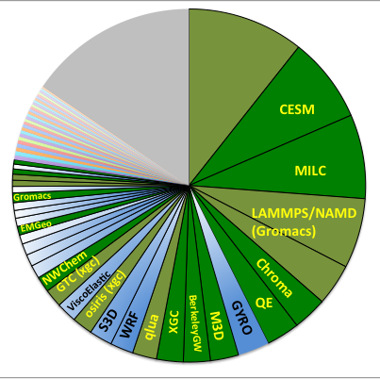
Comparison of Selected Apps with 2013 Usage
NESAP Code
Not NESAP
NESAP Proxy Code
Other Codes
VASP (QE)
Castro, Chombo-Crunch, Parsec, WARP, HACC, MFDn

Slide 15
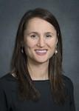
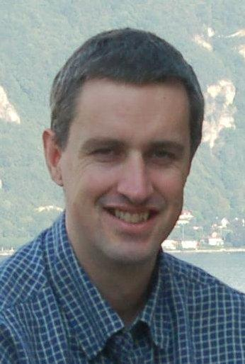
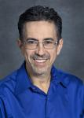
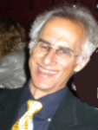
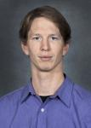
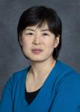
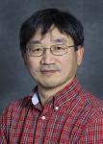
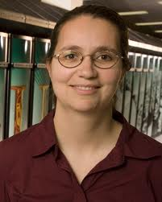
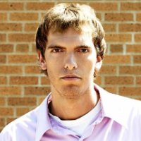
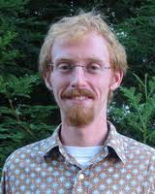
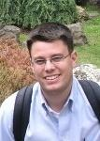
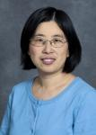
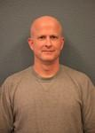
NERSC Application Readiness Staff
Katie Antypas
Nick Wright
Richard Gerber
Harvey Wasserman
Brian Austin
Zhengji Zhao
Target Application Team Concept
Woo-Sun Yang
Rebecca Hartman-Baker (starts Jan 2015)
Jon Rood (IPCC post-doc)
Scott French
(1 FTE Postdoc +)
0.2 FTE AR Staff
0.25 FTE COE
1.0 FTE User Dev.
1 Dungeon Ses. +
2 Week on site w/
Chip vendor staff
Jack Deslippe
Helen He
Matt Cordery

Slide 16
NESAP / NERSC Assignments
Almgren / Rebecca (Richard Gerber)
Trebotich / Scott French
Bylaska / Zhengji Zhao
Chelikowsky / Deslippe (ZZ)
Kent / Deslippe (ZZ)
Newman / Scott French
Dennis / Helen He (Matt)
Johansen / Matt Cordery
Ringler / Matt Cordery
Smith / Zhengji Zhao
Yelick / Scott French (Jon Rood)
Chang / Helen He (Harvey)
Jardin / Woo-Sun
Habib / Richard
Toussaint / Harvey (Woo-Sun)
Vay / Rebecca (Katie, Brian)
Christ / Woo-Sun
Joo / Richard
Maris / Harvey
Deslippe / Deslippe

Slide 17
Tools and Library Collaboration

Slide 18
Libraries used by 20 NESAP applications
 | ASCR |  | BER |  |  |  |  | BES |  |  |  |  | FES |  | HEP |  |  | NP
 | BoxLib | Chombo-Crunch | CESM | ACME | MPAS-O | Gromacs | Meraculous | NWChem | PARSEC | BerkeleyGW | QE | EMGeo | XGC1 | M3D | HACC | MILC | WARP | DWF | Chroma | MFDn
MPI | Y | Y | Y | Y | Y | Y |  | Y | Y | Y | Y | Y | Y | Y | Y | Y | Y | Y | Y | Y | 19
FFTW |  |  |  |  |  | Y |  | Y | Y | Y | Y |  |  | Y | Y | Y | Y |  |  |  | 9
LAPACK |  | Y |  |  |  |  |  | Y | Y | Y | Y |  |  |  |  |  | Y |  | Y |  | 7
MPI I/O |  |  | Y |  | Y |  | Y |  |  | Y |  |  | O |  | Y |  |  |  |  | Y | 7
HDF5 |  | Y |  |  |  |  | Y |  |  | Y |  |  | O | Y |  |  | Y |  |  | Y | 7
NETCDF |  |  | Y | Y | Y |  |  |  |  |  |  |  | Y |  | Y |  |  |  |  |  | 5
SCALapack |  |  |  |  |  |  |  | Y | Y | Y | Y |  |  |  |  |  |  |  |  |  | 4
PETSc |  | Y |  |  |  |  |  |  |  |  |  |  | Y | Y |  |  |  |  |  |  | 3
NCAR |  |  | Y |  | Y |  |  |  |  |  |  |  |  |  |  |  |  |  |  |  | 2
SuperLU |  |  |  |  |  |  |  |  |  |  |  |  | Y | Y |  |  |  |  |  |  | 2
HYPRE |  | Y |  |  |  |  |  |  |  |  |  |  | O |  |  |  |  |  |  |  | 2
ADIOS |  |  |  |  |  |  |  |  |  |  |  |  | Y | Y |  |  |  |  |  |  | 2
Pspline |  |  |  |  |  |  |  | Y |  |  |  |  | Y |  |  |  |  |  |  |  | 2
MUMPS |  |  |  |  |  |  |  |  |  |  |  |  |  | Y |  |  |  |  |  |  | 1
Trilinos |  |  |  | Y |  |  |  |  |  |  |  |  |  |  |  |  |  |  |  |  | 1
GA |  |  |  |  |  |  |  | Y |  |  |  |  |  |  |  |  |  |  |  |  | 1
SciDAC QCD |  |  |  |  |  |  |  |  |  |  |  |  |  |  |  | Y |  |  |  |  | 1

Slide 19
Selected Library and Tools code teams
Libraries
  FFTW
  PETSc
  SuperLU
  Hypre
  Parmetis
  MUMPS
  Scotch
  Sundials
  ScaLAPACK
  PARPACK
  Trilinos
  Global Array
Profilers
HPCToolkit
TAU
Open Speedshop
Vampir
PerfExpert
Scalasca
Allinea (MAP)
PAPI
Parallel debuggers
TotalView
Allinea (DDT)
Visualization tools
VisIt
ParaView

Slide 20
Library and Tools collaboration
Similar resources as for the NESAP projects are available to the selected library and tools teams except Postdocs and Dungeon Sessions.
Intel and Cray will provide:
  Intel will provide optimized MKL- LAPACK/ScaLAPACK, FFT
  Cray will provide optimized MPI, libsci for LAPACK/ScaLAPACK, FFT and other Math libraries, I/O, and many other scientific libraries
Developers transition codes to Cori
  FFTW, PETSc, Trilinos, HYPRE, SuperLU, MUMPS,GA
  Tools
NERSC will coordinate between vendors, developers and users to help focus optimization efforts on the most used library routines with your feedback. Will also coordinate with other labs.

Slide 21
Thank you

