Slide 1

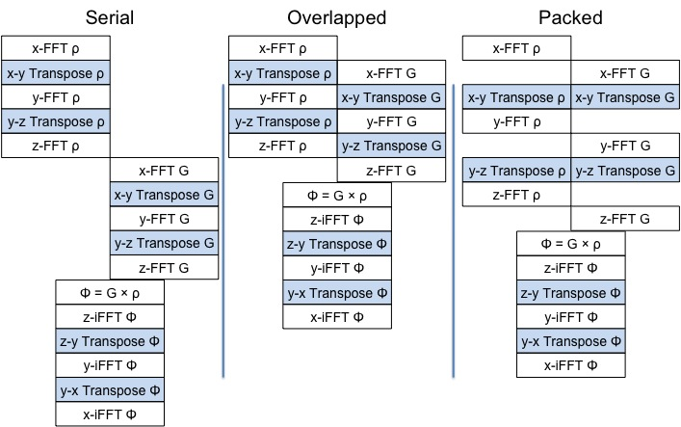
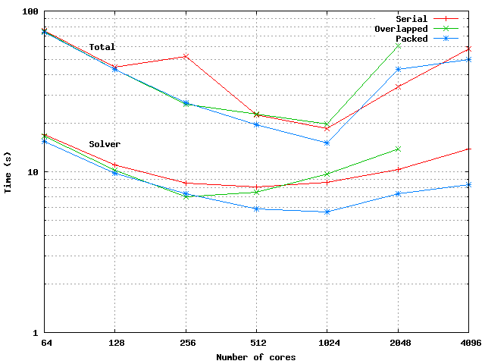
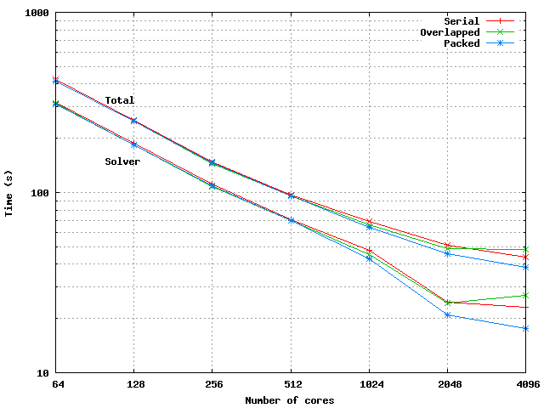
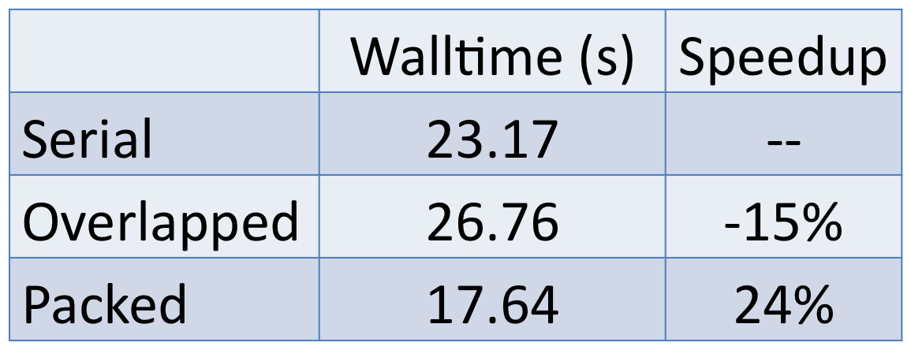
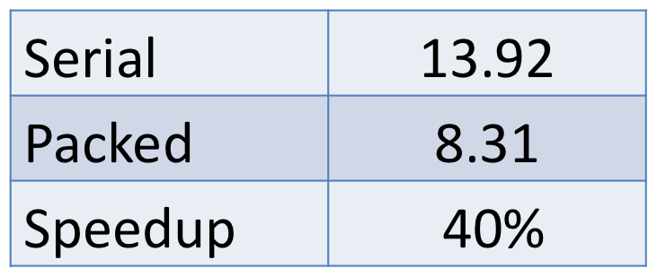
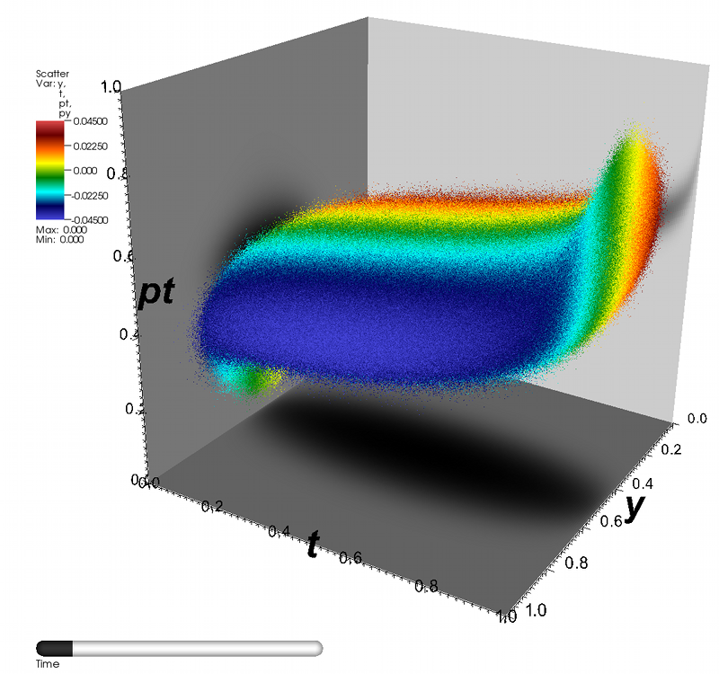
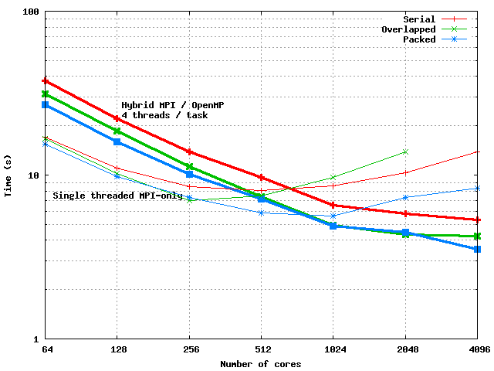
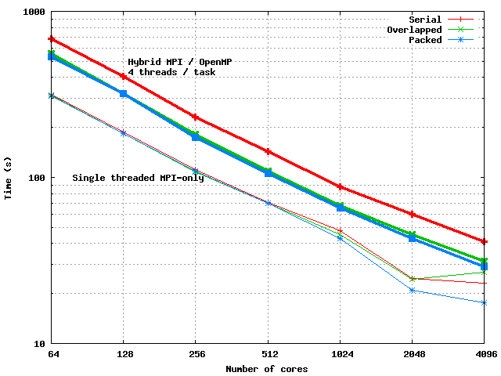

Influences of Threading on MPI Communication Strategies in an Accelerator Simulation Code
Brian Austin, Ji Qiang, Jonathan Wurtele and Alice Koniges
Lawrence Berkeley National Lab (USA)
This research used resources of the National Energy Research Scientific Computing Center, which is supported by the Office of Science of the U.S. Department of Energy under Contract No. DE-AC02-05CH11231.
This work was supported by the Director, Office of Science, Advanced Scientific Computing Research of the U.S. Department of Energy under Contract No. DE-AC02-05CH11231.
Algorithms:
Abstract: We describe two algorithms for improving the performance of an FFT-based Poisson solver in the IMPACT-T accelerator simulation code. Overlapping communication and computation improves upon our baseline algorithm when the compute load per node is large, but loses effectiveness at high concurrencies. Message consolidation provides increased speedups (up to 40%) when the number of MPI tasks is large. The current version of the solver is markedly less efficient when OpenMP threading is introduced. OpenMP nevertheless increases the parallel scalability of the solver and, for some jobs, is faster than the pure-MPI version at high concurrencies.
Serial: Original IMPACT implementation. The parallel-FFT of the charge density, ρ, and Green’s function, G, is done sequentially.
Overlapped: 1-D FFTs of G are overlapped with the transpose of ρ.
Packed: Messages are consolidated by packing the G and ρ into a single array.
Solver walltime is minimized at lower concurrency than total.
The packed algorithm is fastest in all cases, especially at high concurrency.
Motivation:
Emerging petascale computers, with several hundred thousand processing cores, have the potential to push many simulations to their diffuse-data limits.
Communication strategies for many applications can be modified to run more efficiently in the high-concurrency, low message size regime.
Use of OpenMP threading alters the relative advantages of these strategies.
An increasing trend toward multi-core architectures suggest that these trade-offs must be evaluated and understood in order to obtain optimal performance.
Results:
64 x 64 x 64 grid
10⁶ particles
64 x 64 x 1024 grid
10⁶ particles
Application: IMPACT-T
Large numbers of particles O(10⁹) may be needed for adequate simulation of many-body effects such as space-charge driven microbunching instability.
Second order leapfrog algorithm has two significant computational phases.
‘Kick’ phase updates the particles’ position and momentum; embarrassingly parallel if properly load-balanced.
‘Solver’ phase uses Particle-In-Cell (PIC) approach to compute space-charge forces. The transpose steps of IMPACT’s FFT-based Poisson solver require all-to-all communication and may be improved by alternative communication patterns.
Threading increases scalability by reducing the number of messages per node.
The overlapped algorithm is competitive with the packed one when threads are used.
A 3D particle tracking code propagates the equations of motion for relativistic particles through the external electric and magnetic fields of the accelerating structure.
Image by Oliver Ruebel, LBNL.
64 x 64 x64 grid
10⁶ particles;
64 x 64 x 1024 grid
10⁶ particles
Conclusion: Message consolidation is more important than overlapping communication and computation when running with large core counts. Threading improves the scalability of all solver algorithms tested. Improving the efficiency of our OpenMP code is an immediate goal of our future work. OpenMP must also be added to the kick phase to fully exploit threading in IMPACT-T.

