Slide 1

Perftools and using Cray Reveal to add OpenMP
Gene Wagenbreth
Cray’s Supercomputing Center of Excellence
Performance Engineer
gwagenbret@cray.com

Slide 2
Legal Disclaimer
Information in this document is provided in connection with Cray Inc. products. No license, express or implied, to any intellectual property rights is granted by this document.
Cray Inc. may make changes to specifications and product descriptions at any time, without notice.
All products, dates and figures specified are preliminary based on current expectations, and are subject to change without notice.
Cray hardware and software products may contain design defects or errors known as errata, which may cause the product to deviate from published specifications. Current characterized errata are available on request.
Cray uses codenames internally to identify products that are in development and not yet publicly announced for release. Customers and other third parties are not authorized by Cray Inc. to use codenames in advertising, promotion or marketing and any use of Cray Inc. internal codenames is at the sole risk of the user.
Performance tests and ratings are measured using specific systems and/or components and reflect the approximate performance of Cray Inc. products as measured by those tests. Any difference in system hardware or software design or configuration may affect actual performance.
The following are trademarks of Cray Inc. and are registered in the United States and other countries: CRAY and design, SONEXION, URIKA and YARCDATA. The following are trademarks of Cray Inc.: CHAPEL, CLUSTER CONNECT, CLUSTERSTOR, CRAYDOC, CRAYPAT, CRAYPORT,
DATAWARP, ECOPHLEX, LIBSCI, NODEKARE, REVEAL. The following system family marks, and associated model number marks, are trademarks of Cray Inc.: CS, CX, XC, XE, XK, XMT and XT. The registered trademark LINUX is used pursuant to a sublicense from LMI, the exclusive licensee of Linus Torvalds, owner of the mark on a worldwide basis. Other trademarks used on this website are the property of their respective owners.

Slide 3
Gene Wagenbreth
Cray Inc.
many years with vectorization, MPI, OpenMP, GPU
3 years LANL/Sandia Trinity COE
LLNL El Capitan COE
liaison to Cray software and tools groups
this presentation derived from:
  Heidi Poxon – Cray Programming Environment
  John Levesque – COE Trinity/El Capitan/Horizon

Slide 4
General advice
perftools
Reveal

Slide 5
General Advice - performance
vectorization
MPI
OMP
Memory/cache
GPU
After all optimization most codes are memory bandwidth limited

Slide 6
General Advice – measure performance
Always measure performance – what you think is going on is often incorrect, particularly at large node/cpu counts
measure performance at scale. bottlenecks for 100K MPI tasks are usually different from small MPI task count
use whatever tools you know or find convenient. Cray perftools works at high MPI task counts
OpenMP and GPUs add complexity to measuring performance

Slide 7
General Advice – OpenMP vs MPI on KNL
first thought – MPI across KNL nodes, OpenMP on node (shared memory)
some codes have worked better all MPI (even on-node) or 4-16 MPI tasks per KNL node and 4-16 OpenMP tasks per node
do experiments

Slide 8
General Advice – Look at compiler diagnostics
compiler listing:
  which loops vectorize
  why loops don’t vectorize
  how did compiler optimize:
    loop switching
    loop blocking
    loop fusion
    etc
Intel compiler: -qopt-report
Cray compiler: -hlist=a
  ‘classic’ cray compiler

Slide 9
General Advice – task placement on node
KNL – 64 or 68 cores
256 or 272 hyperthreads
cpus numbered 0-271 0-67 are on separate cores
srun/aprun commands are confusing
  there is a way to do what you want
  incorrect task placement can run much slower
  test to make sure you are doing what you want
hyperthreads can mask memory latency and add 10% performance

Slide 10
General Advice – xthi
xthi is a diagnostic program that prints MPI and OMP task placement
  email gwagenbret@cray.com for the source
export OMP_NUM_THREADS=2
srun -N 2 -n 4 ~/xthi/xthi | sort -n -k 4
Hello from rank 0, thread 0, on nid00010. (core affinity = 0)
Hello from rank 0, thread 1, on nid00010. (core affinity = 0)
Hello from rank 1, thread 0, on nid00010. (core affinity = 24)
Hello from rank 1, thread 1, on nid00010. (core affinity = 24)
Hello from rank 2, thread 0, on nid00011. (core affinity = 0)
Hello from rank 2, thread 1, on nid00011. (core affinity = 0)
Hello from rank 3, thread 0, on nid00011. (core affinity = 24)
Hello from rank 3, thread 1, on nid00011. (core affinity = 24)
srun -N 2 -n 4 --cpus-per-task=2 --exclusive --cpu_bind=cores --hint=nomultithread --threads-per-core=1 ~/xthi/xthi | sort -n -k 4
Hello from rank 0, thread 0, on nid00010. (core affinity = 0)
Hello from rank 0, thread 1, on nid00010. (core affinity = 1)
Hello from rank 1, thread 0, on nid00010. (core affinity = 2)
Hello from rank 1, thread 1, on nid00010. (core affinity = 3)
Hello from rank 2, thread 0, on nid00011. (core affinity = 0)
Hello from rank 2, thread 1, on nid00011. (core affinity = 1)
Hello from rank 3, thread 0, on nid00011. (core affinity = 2)
Hello from rank 3, thread 1, on nid00011. (core affinity = 3)

Slide 11
General Advice – math/sci libraries
vendors have highly optimized math/science libraries
linear algebra, FFT, etc
use them if important in your code

Slide 12
Cray Performance Tools
perftools
  automatic whole program instrumentation at scale
  line oriented output
apprentice2
  interactively display perftools results in various formats
reveal
  OpenMP variable classification
  create OpenMP directives
  cpu loop (not task) parallelism

Slide 13
Perftools
perftools
  automatic whole program instrumentation at scale
  line oriented output
  MPI statistics
  Fortran/C/C++ - C++ inlining/templates can be a problem – work in progress
  Cray compiler, Intel compiler, gcc
apprentice2
  interactively display perftools results in various formats
reveal
  OpenMP variable classification
  create OpenMP directives
  cpu loop (not task) parallelism
  Cray compiler only
many options – summary today

Slide 14
Perftools
3 ways to run:
  perftools-lite
    module load perftools-lite
    compile build program
    performance data at end of stdout
  perftools – pat_build/pat_report
    module load perftools
    compile/build program
    pat_build my_exe – creates my_exe+pat
    srun my_exe+pat - creates performance data directory
    pat_report my_exe+pat+29886-140s – generates performance report on stdout
    directory contains information for each MPI task
    pat_report combines and summarizes from all MPI tasks
pat_run – only with dynamic libraries

Slide 15
Perftools
2 instrumentation modes:
  sampling
    interrupt 100 times per sec
    save call stack
    very low overhead
  trace
    more detailed information
    pat_build puts entry/exit calls in routines
    can instrument loops, MPI, OMP, GPU – some Cray compiler only
    too much overhead if small routines are traced
    user can tell pat_build routines to not trace
    sampling run creates pat_build command with routines to not trace

Slide 16
Perftools-lite and cmake
perftools-lite output can break cmake
environment variable to not instrument selected binaries
  CRAYPAT_LITE_WHITELIST for binaries you DO want instrumented

Slide 17

pat_run
New!
Utility that allows you to profile un-instrumented, dynamically linked binaries with CrayPat!
Delivers Cray performance tools profiling information for codes that cannot easily be rebuilt
Makes profiling possible for a wider set of HPC applications
Available starting with perftools 7.0.1
Initially targets Cray XC systems running CLE 6 or later

Slide 18
Some Useful Experiments
Identify slowest areas and notable bottlenecks of a program
  Use perftools-lite
  Good for examining performance characteristics of a program and for scaling analysis
Focus on MPI communication
  Use perftools-lite first to determine if MPI time is dominant or if there is a load imbalance between ranks
  Use perftools (pat_build –g mpi) to collect more detailed MPI-specific information including MPI_SYNC time to detect late arrivers to collectives
  Good for identifying source of imbalance and scaling analysis at targeted final job size
Focus on loop optimization
  Use perftools-lite-loops
  Use perftools-lite-hbm for memory traffic analysis
  Good for vectorizing, parallelizing and cache optimization

Slide 19
How Do I See per-Rank or per-Thread Data?
pat_report –s pe=ALL
pat_report –s th=ALL

Slide 20
How to Identify Important Loops
High inclusive time
Create call tree with loops:
  user@login> pat_report –O calltree

Slide 21
Example: Memory Bandwidth per NUMA
8 MPI ranks, 4 on each of 2 nodes
Table 1: Memory Bandwidth by Numanode
Memory Traffic | | | | Local Memory | | | | Remote Memory | | | | Thread Time | | | | Memory Traffic | | | | Memory Traffic | | | | Numanode Node Id
GBytes | | | Traffic | | | Traffic | | |  | | | GBytes | | | / | | | PE=HIDE
 | | | GBytes | | | GBytes | | |  | | | / Sec | | | Nominal | | | Thread=HIDE
 | | |  | | |  | | |  | | |  | | | Peak | |
39,429 | | | 39,429 | | | 0 | | | 990.218871 | | | 39.82 | | | 33.4% | | | Max of Numanode values
|-----------------------------------------------------------------------------
| 39,429 | 39,429 | 0 | 990.217439 | 39.82 | 33.4% | numanode.0
||----------------------------------------------------------------------------
||============================================================================
| 38,857 | 38,857 | 0 | 990.218903 | 39.24 | 32.9% | numanode.1
||----------------------------------------------------------------------------
|| | 39,429 | 39,429 | | 0 | 990.217439 | | 39.82 | | 33.4% | nid.200
|| | 38,389 | 38,389 | | 0 | 990.224163 | | 38.77 | | 32.5% | nid.205
|| | 38,857 | 38,857 | | 0 | 990.211194 | | 39.24 | | 32.9% | nid.200
|| | 38,528 | 38,528 | | 0 | 990.226690 | | 38.91 | | 32.6% | nid.205

Slide 22
Examine NUMA Traffic
Table 3:
Memory Bandwidth by Numanode (limited entries shown)
Memory Traffic GBytes
| Local
| Memory
| Traffic
| GBytes
|
| Remote |
| Memory |
| Traffic |
| GBytes |
| |
Thread
Time
| Memory
| Traffic
| GBytes
| / Sec
|
| Memory
| Traffic
| /
| Nominal
| Peak
| Numanode
| Node Id=[max3,min3]
| PE=HIDE
|
|
|-----------------------------------------------------------------------------
| 172.95 | 171.48 | 1.48 | 19.755654 | 8.75 | 11.4% | numanode.0
||----------------------------------------------------------------------------
|| | 172.77 | | | 171.48 | | | 1.30 | | | 19.414237 | | | 8.90 | | | 11.6% | | | nid.68
|| | 172.09 | | | 170.61 | | | 1.48 | | | 19.071340 | | | 9.02 | | | 11.7% | | | nid.63
|| | 171.20 | | | 169.93 | | | 1.27 | | | 17.631761 | | | 9.71 | | | 12.6% | | | nid.62
|| | 162.51 | | | 161.07 | | | 1.43 | | | 19.675857 | | | 8.26 | | | 10.8% | | | nid.71
|| | 162.28 | | | 160.82 | | | 1.46 | | | 19.730793 | | | 8.22 | | | 10.7% | | | nid.72
|| | 161.75 | | | 160.29 | | | 1.46 | | | 19.755654 | | | 8.19 | | | 10.7% | | | nid.70
||============================================================================
| 168.69 | 166.81 | 1.89 | 19.781479 | 8.53 | 11.1% | numanode.1
||----------------------------------------------------------------------------
Example traffic from pure MPI run
|| | 168.69 | | | 166.81 | | | 1.89 | | | 19.454144 | | | 8.67 | | | 11.3% | | | nid.62
|| | 167.74 | | | 166.03 | | | 1.71 | | | 19.476164 | | | 8.61 | | | 11.2% | | | nid.63
|| | 166.66 | | | 164.88 | | | 1.78 | | | 19.225409 | | | 8.67 | | | 11.3% | | | nid.61
|| | 161.68 | | | 160.07 | | | 1.61 | | | 19.781479 | | | 8.17 | | | 10.6% | | | nid.71
|| | 161.60 | | | 159.99 | | | 1.62 | | | 19.642791 | | | 8.23 | | | 10.7% | | | nid.70
|| 157.32 | |============ |  |  | 156.01 | =========== |  | 1.31 | 18.036118 | ====================== |  |  |  | 8.72 | 11.4% | nid.72 =========================
=======

Slide 23
Example Traffic From an MPI+OpenMP Run
Table 3:
Memory Bandwidth by Numanode (limited entries shown)
Memory Traffic GBytes
| Local
| Memory
| Traffic
| GBytes
|
| Remote |
| Memory |
| Traffic |
| GBytes |
| |
Thread
Time
| Memory
| Traffic
| GBytes
| / Sec
|
| Memory
| Traffic
| /
| Nominal
| Peak
| Numanode
| Node Id=[max3,min3]
| PE=HIDE
| Thread=HIDE
|
|-----------------------------------------------------------------------------
| 184.47 | 173.59 |
10.89 | 11.578777 | 15.93 |
20.7% | numanode.0
||----------------------------------------------------------------------------
||
||
||
||
||
||
183.50 | 173.59 |
182.61 | 172.40 |
178.55 | 167.75 |
178.10 | 168.14 |
178.08 | 168.07 |
178.01 | 167.20 |
9.91 | 11.569322 |
10.21 | 11.578777 |
10.80 | 11.563156 |
9.96 | 11.562097 |
10.01 | 11.564512 |
10.82 | 11.572032 |
15.86 |
15.77 |
15.44 |
15.40 |
15.40 |
15.38 |
20.7%
20.5%
20.1%
20.1%
20.1%
20.0%
| nid.63
| nid.61
| nid.71
| nid.62
| nid.68
| nid.70
||============================================================================
| 60.36 |
14.73 | 45.62 | 9.073119 | 6.65 |
8.7% | numanode.1
||----------------------------------------------------------------------------
||
||
||
||
||
||
60.36 |
59.88 |
59.48 |
58.78 |
58.67 |
58.53 |
14.73 |
14.33 |
14.19 |
13.70 |
13.87 |
13.86 |
45.62 | 9.072693 |
45.55 | 9.071553 |
45.29 | 9.068044 |
45.08 | 9.069259 |
44.81 | 9.071591 |
44.67 | 9.067146 |
6.65 |
6.60 |
6.56 |
6.48 |
6.47 |
6.46 |
8.7%
8.6%
8.5%
8.4%
8.4%
8.4%
| nid.63
| nid.62
| nid.68
| nid.70
| nid.69
| nid.71
|=============================================================================

Slide 24
Summary of Cray Performance Tools
Focus on whole program analysis
Reduce the time investment associated with porting and tuning applications on new and existing Cray systems
Provide easy-to-use interfaces complimented with a wealth of capability when you need it for analyzing the most critical production codes
Offer analysis and recommendations that focus on areas that impact performance and scaling, such as
  Imbalance
  Communication overhead and inefficiencies
  Vectorization and memory utilization efficiency
24

Slide 25

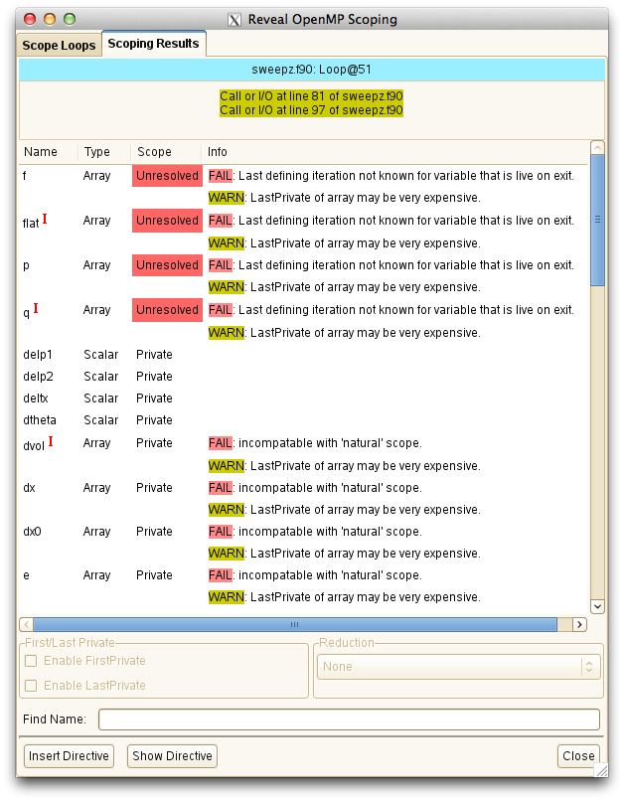
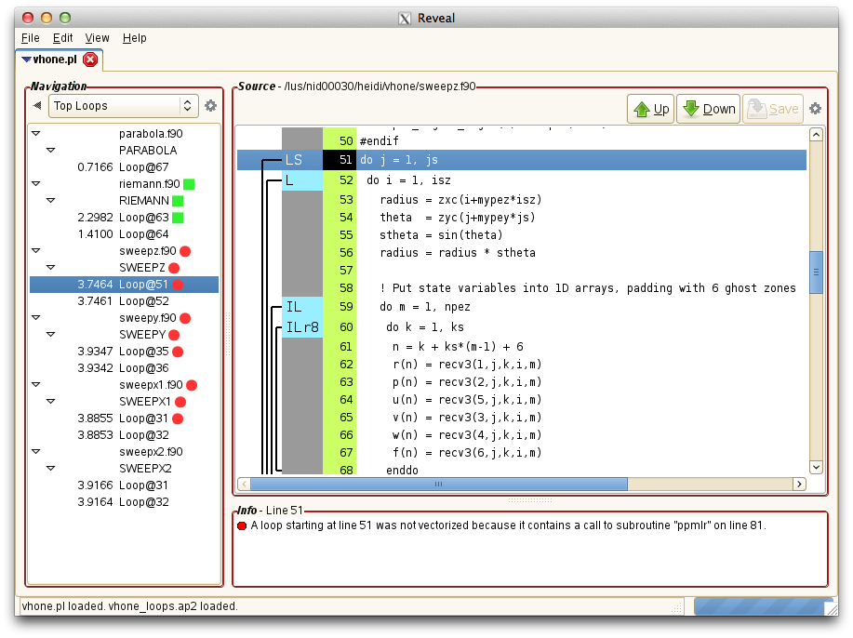
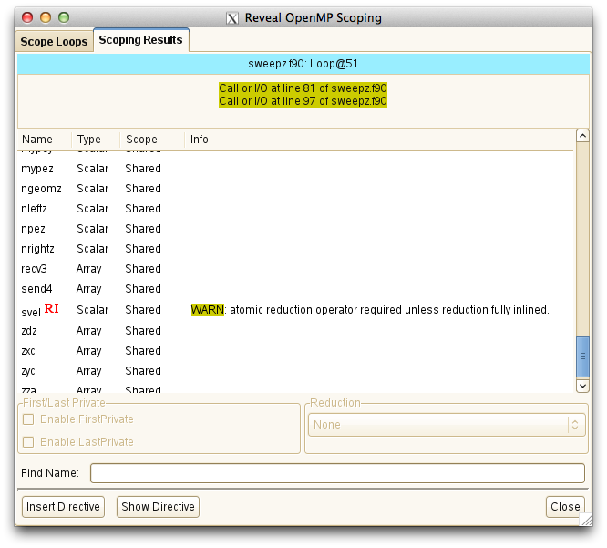
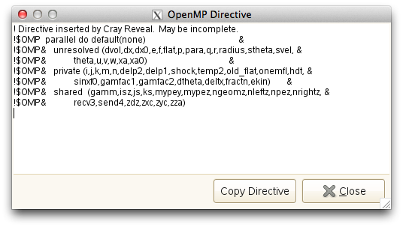
Reveal
Reduce effort associated with adding OpenMP to MPI programs
Get insight into optimizations performed by the Cray compiler
Add OpenMP as a first step to parallelize loops that will target GPUs
Track requests to memory and evaluate the bandwidth contribution of objects within a program for loop tuning
Notes:
Images show:
Program source code with compiler loopmark and optimization annotations which provides feedback on critical dependencies that prevent optimizations
Optionally include performance feedback provided by CrayPat to allow user to navigate by top time consuming, or relevant loops to parallelize
Scoped loops flagged with success (green) or issues (red)
Scoping issues identified with information on why, so that user can correct
Issues down the call chain highlighted, such as variables that don’t follow the OpenMP scoping rules and therefore cannot be included in the higher level parallel loop as is, or reduction variables that are shared and need a critical section (Reveal’s help includes OpenMP tips like this as well)
For debugging help, if there are existing OpenMP directives within the program and Reveal sees a conflict with what it believes to be correct scoping of a variable, this will be automatically flagged to the user
Reveal automatically generates directive that user can choose to have inserted into their source.
Special “unresolved” clause for any variables with issues so that user can take directive as a template and work on issues in their favorite editor (this clause prevents successful compilation, ensuring the user doesn’t forget to address the issues)
Reveal can automatically generate and insert parallel loop directives for all succesfully (green) scoped loops. These directives are “safe” and should preserve correctness.

Slide 26
Approach to Adding Parallelism
Identify key high-level loops
Perform parallel analysis and scoping
Add OpenMP directive layer of parallelism
Analyze performance for further optimization, specifically vectorization of innermost loops
Port parallel loops to GPU with OpenMP target directives

Slide 27
Collect Loop Work Estimates
Set up loop work estimates experiment with Cray compiler and Cray performance tools
  user@login> module load PrgEnv-cray perftools-lite-loops
Build program with Cray program library
  –h pl=/full_path/program.pl
Run program to get loop work estimates

Slide 28
Example Loop Statistics
Table 2: Loop Stats by Function
Loop | Loop | Loop | Loop | Loop |Function=/.LOOP[.]
Incl | Hit | Trips | Trips | Trips | PE=HIDE
Time | | Avg | Min | Max |
Total | | | | |
|------------------------------------------------------------------------
| 8.995914 | 100 | 25 | 0 | 25 |sweepy_.LOOP.1.li.33
| 8.995604 | 2500 | 25 | 0 | 25 |sweepy_.LOOP.2.li.34
| 8.894750 | 50 | 25 | 0 | 25 |sweepz_.LOOP.05.li.49
| 8.894637 | 1250 | 25 | 0 | 25 |sweepz_.LOOP.06.li.50
| 4.420629 | 50 | 25 | 0 | 25 |sweepx2_.LOOP.1.li.29
| 4.420536 | 1250 | 25 | 0 | 25 |sweepx2_.LOOP.2.li.30
| 4.387534 | 50 | 25 | 0 | 25 |sweepx1_.LOOP.1.li.29
| 4.387457 | 1250 | 25 | 0 | 25 |sweepx1_.LOOP.2.li.30
| 2.523214 | 187500 | 107 | 0 | 107 |riemann_.LOOP.2.li.63

Slide 29
Launch Reveal
Use program library created by CCE when program was built, and directory created by perftools-lite-loops experiment as input to reveal:
  user@login> reveal program.pl expdir
You can also use reveal with just program library to review CCE optimizations or scope loops without loop profile input:
  user@login> reveal program.pl

Slide 30
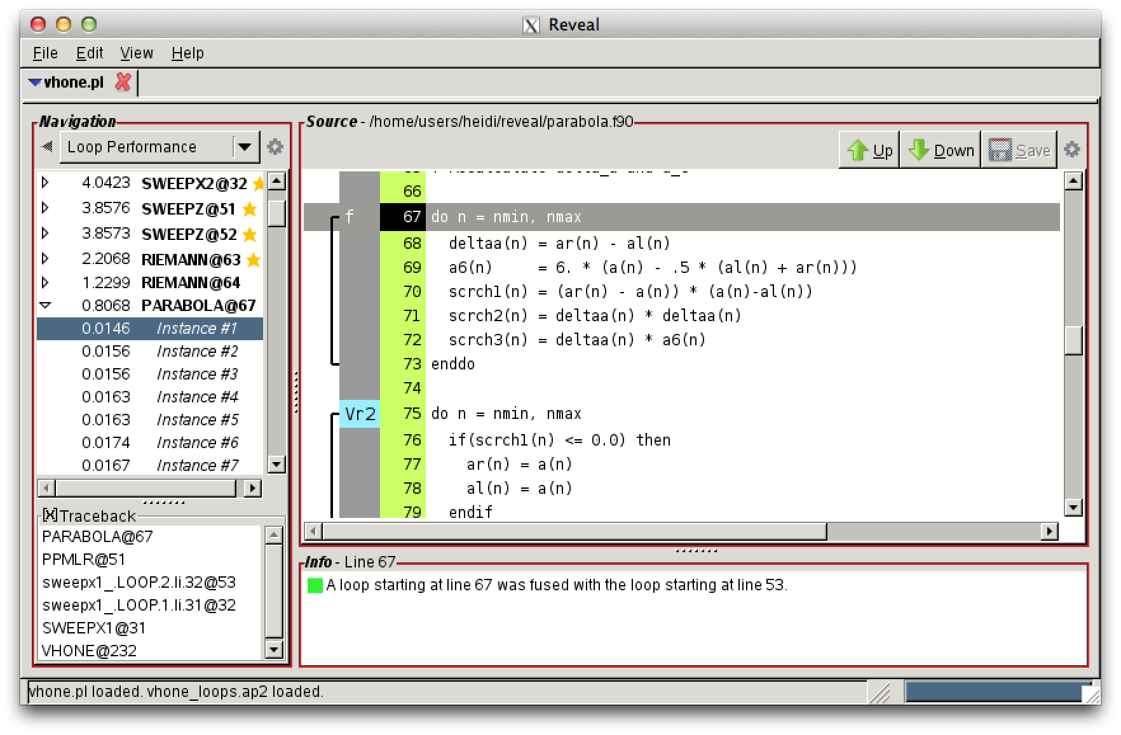
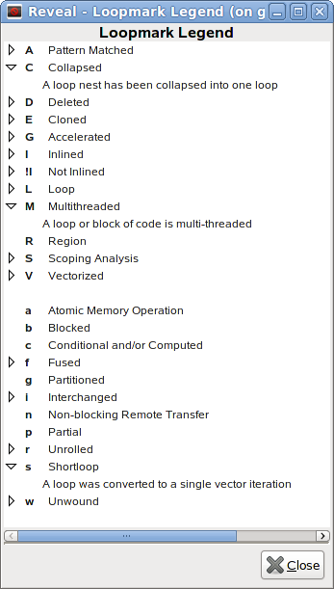
View Source and Optimization Information
Notes:
A recent feature added to Reveal allows the user to see all instances of a loop within their program. The left side of the tool shows a list of loops sorted by time (the loops with the highest time are the best candidates to optimize). When the user expands a loop on the left and selects an instance, a loop traceback is shown.
This allows the user to understand how the loop is accessed within the program. This is information that was not easily available to users until now.

Slide 31
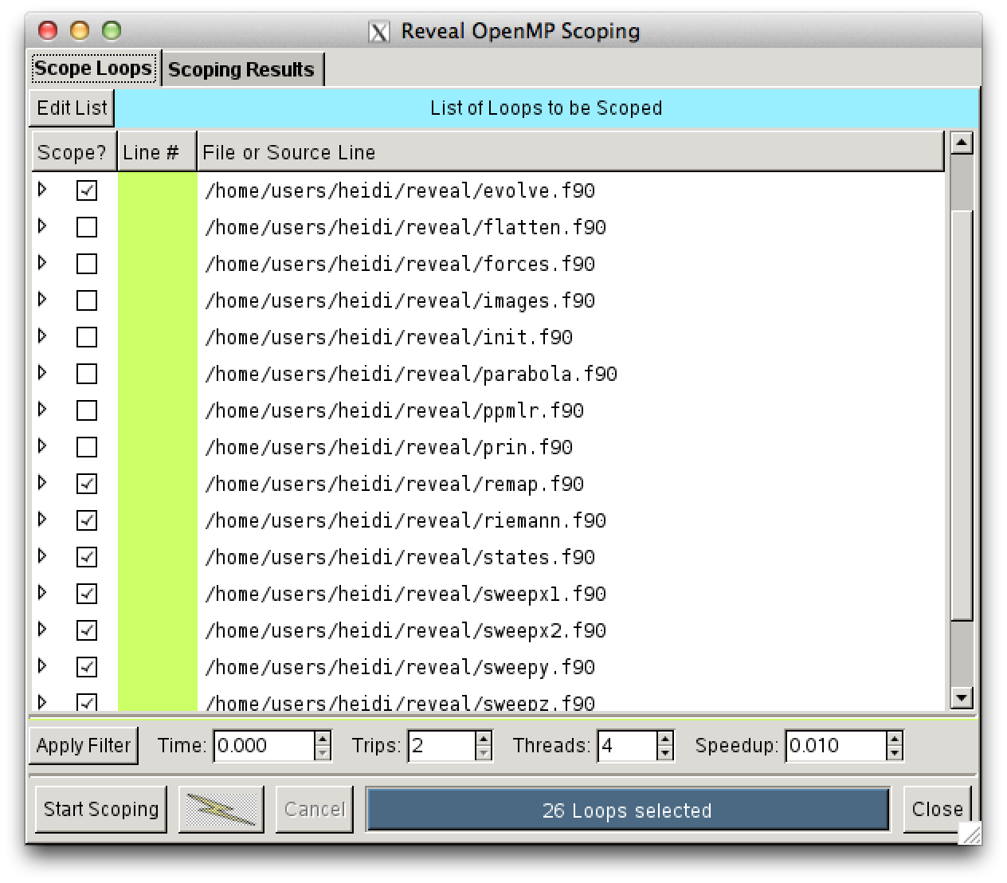
Scope Selected Loop(s)
Trigger dependence analysis
scope loops above given threshold
Notes:
The user selects a number of loops to analyze for OpenMP.
Users can filter loops based in time, trip count, etc.
We process several loops in bulk. In this case, 26 loops were chosen for analysis.

Slide 32
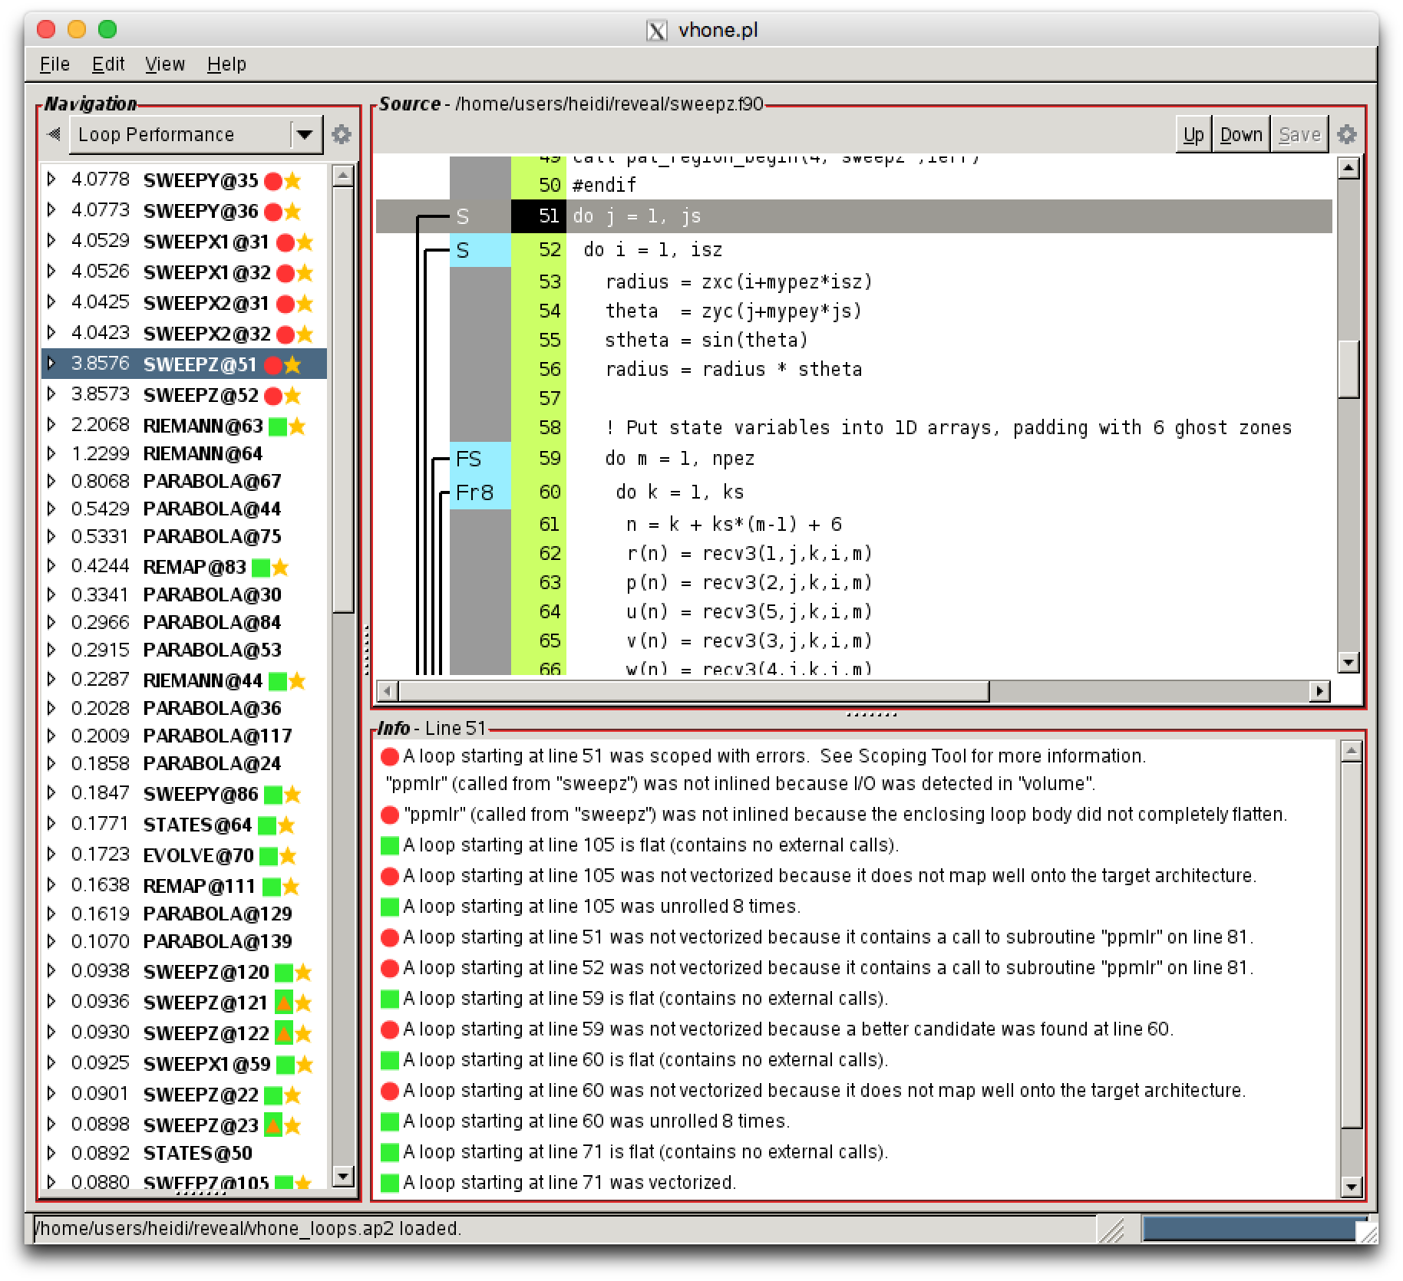
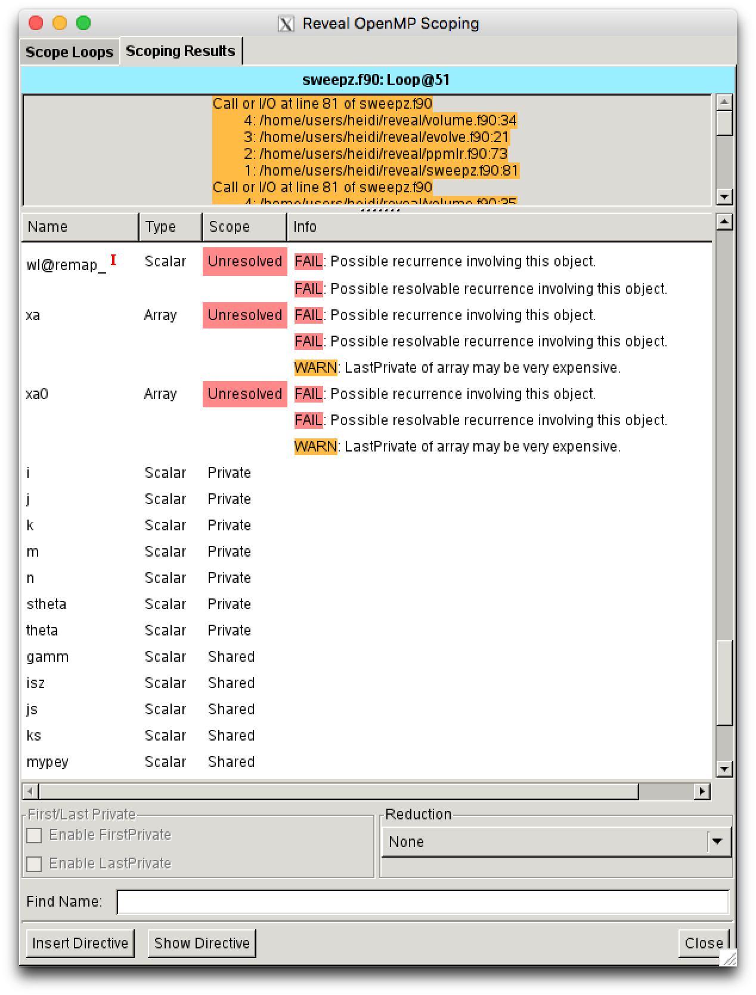
Review Scoping Results
Loops with scoping information are flagged. Red needs user assistance
Parallelization inhibitor messages are provided to assist user with analysis

Slide 33
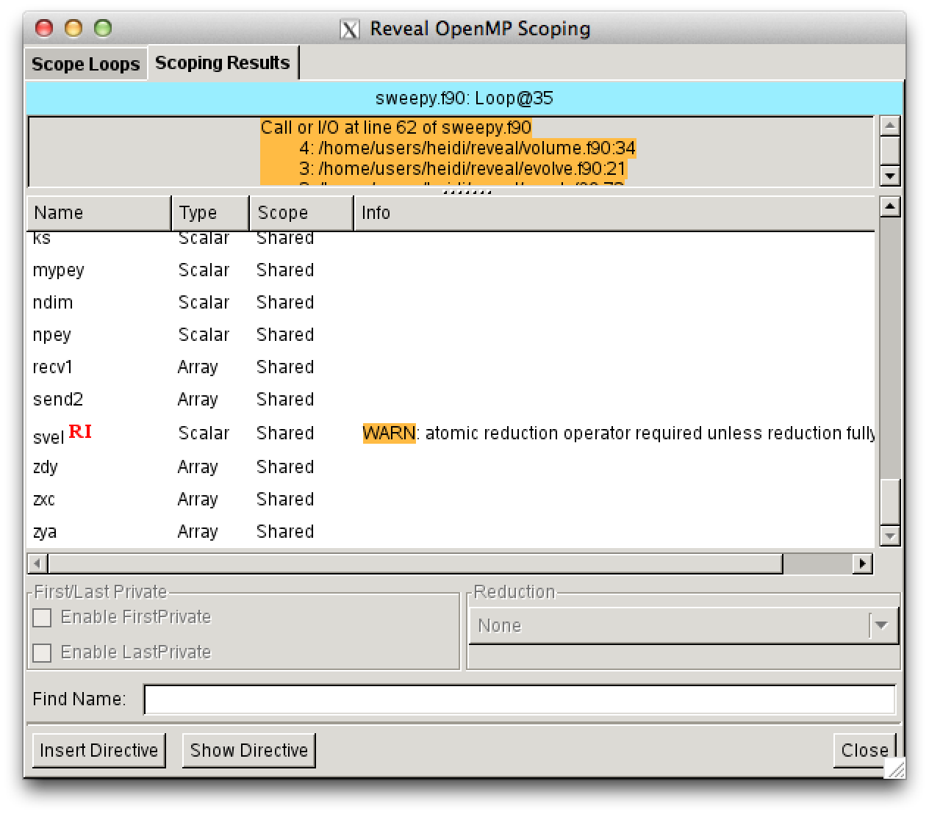
Review Scoping Results (continued)
Reveal identifies calls that prevent parallelization
Reveal identifies shared reductions down the call chain
Notes:
After the loops are analyzed, Reveal presents scoping results.
Variables that is marked shared or private with no warnings or conflicts are ready for inclusion in an OpenMP directive.
The user only has to focus on problem areas. Not on all variables.
Reveal can warn users about issues down the call chain within a loop. It can detect shared reductions for example, which need to be protected before an OpenMP directive can be used.

Slide 34
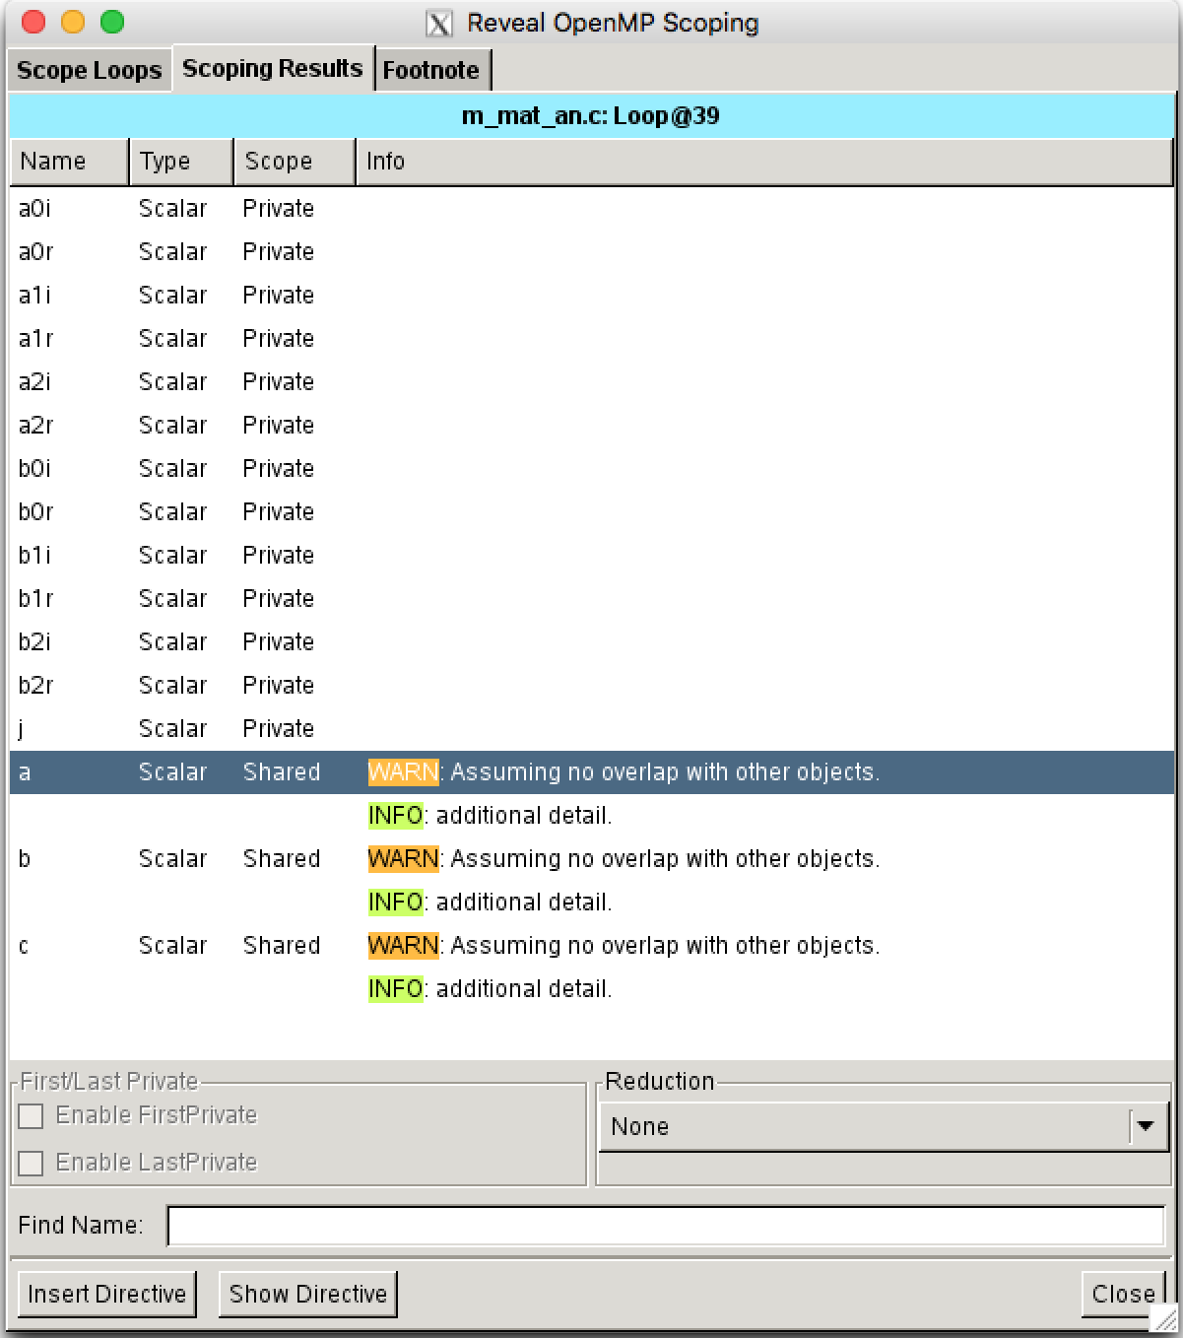
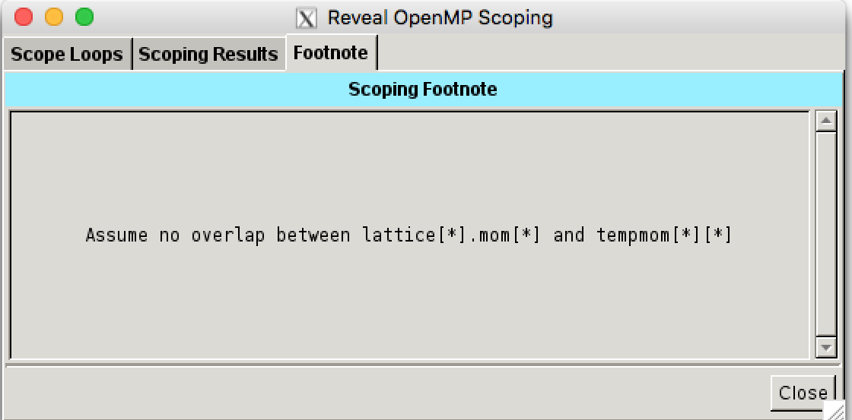
Review Scoping Results (continued)

Slide 35
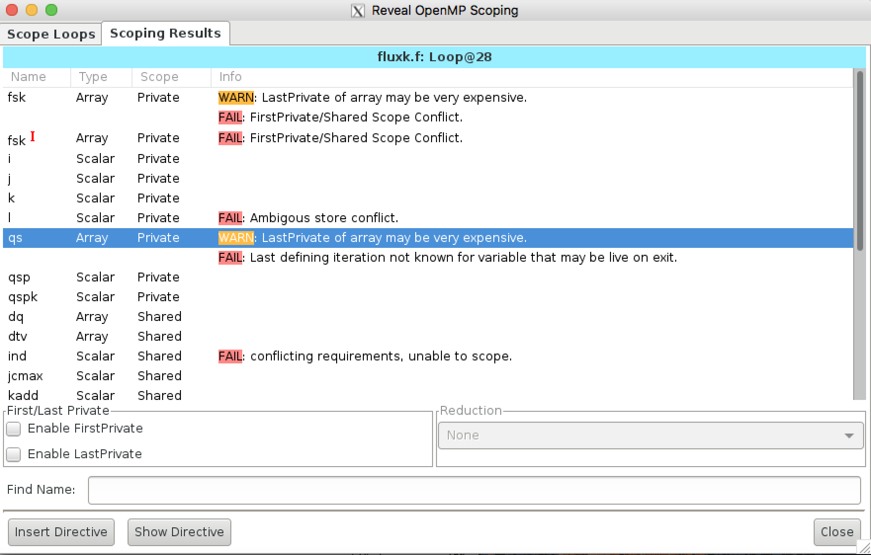
Review Scoping Results (continued)

Slide 36
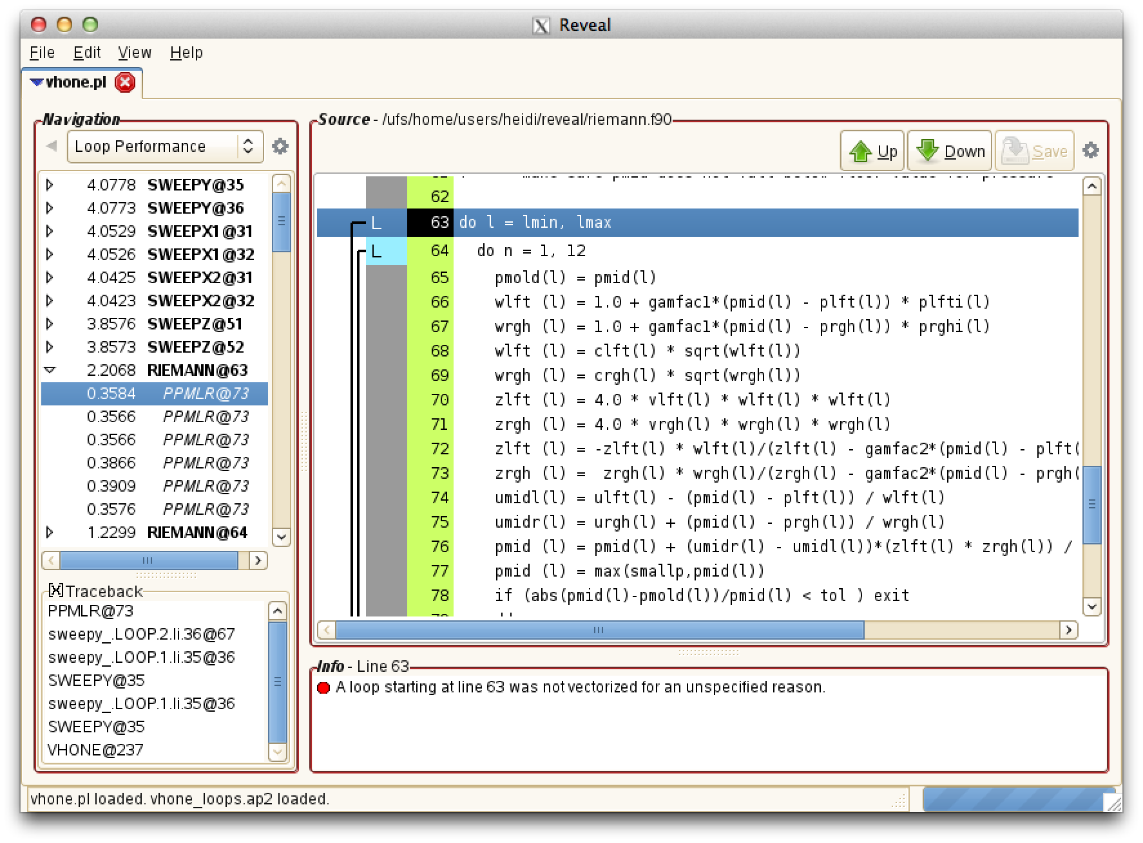
View Loops through Call Chain
Loop instances
Loop traceback

Slide 37
Generate OpenMP Directives
! Directive inserted by Cray Reveal. May be incomplete.
!$OMP parallel do default(none) &
!$OMP& unresolved (dvol,dx,dx0,e,f,flat,p,para,q,r,radius,svel,u,v,w, &
!$OMP& xa,xa0) &
!$OMP& private (i,j,k,m,n,$$_n,delp2,delp1,shock,temp2,old_flat, &
!$OMP& onemfl,hdt,sinxf0,gamfac1,gamfac2,dtheta,deltx,fractn, &
!$OMP& ekin) &
!$OMP& shared (gamm,isy,js,ks,mypey,ndim,ngeomy,nlefty,npey,nrighty, &
!$OMP& recv1,send2,zdy,zxc,zya)
do k = 1, ks
do i = 1, isy
radius = zxc(i+mypey*isy)
! Put state variables into 1D arrays, padding with 6 ghost zones
do m = 1, npey
do j = 1, js
n = j + js*(m-1) + 6
r(n) = recv1(1,k,j,i,m)
p(n) = recv1(2,k,j,i,m)
u(n) = recv1(4,k,j,i,m)
v(n) = recv1(5,k,j,i,m)
w(n) = recv1(3,k,j,i,m)
f(n) = recv1(6,k,j,i,m)
enddo
enddo
do j = 1, jmax
n = j + 6
Reveal generates OpenMP directive with illegal clause marking variables that need addressing
Notes:
Reveal can insert a directive into the user’s source code.
A feature of the tool is that it inserts an illegal OpenMP clause with the list of variables that the user needs to work on.
This illegal clause prevents the code from compiling.
The user can then move to their favorite editor and make any restructuring changes or clarifications necessary. The user only needs to focus on the variables in the unresolved list, not on all variables. This can be a big time saver.

Slide 38
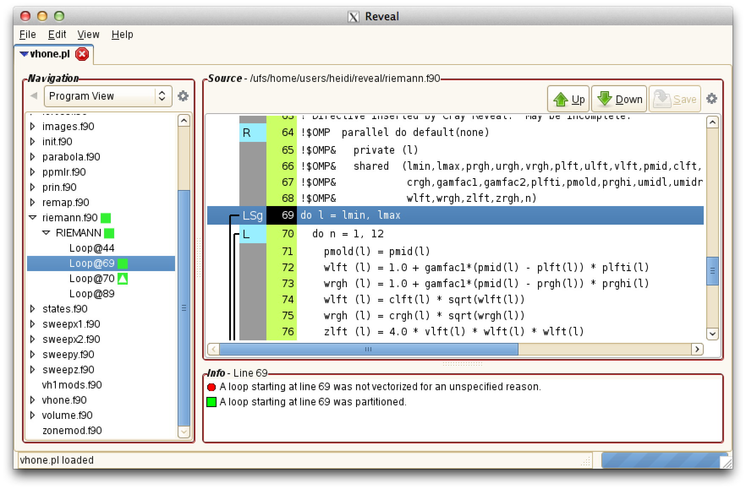
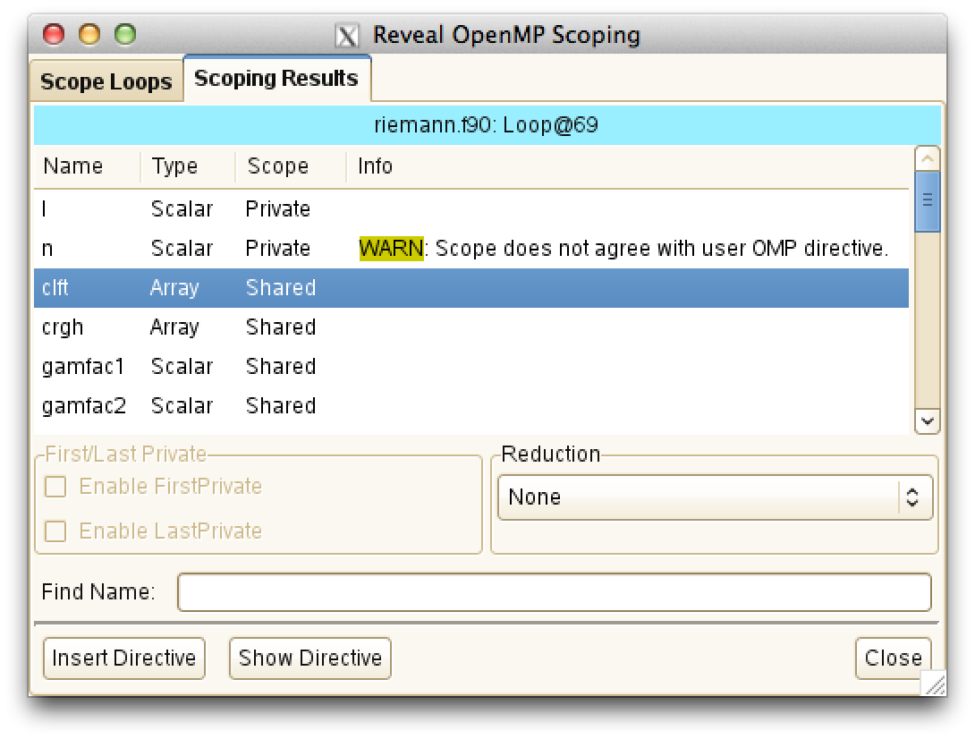
Validate User Inserted Directives
User inserted directive with mis-scoped variable ‘n’
Notes:
Users requested this functionality shortly after Reveal was released. They wanted to know if Reveal could be used to help debug OpenMP parallel loops that were inserted by the user and were getting incorrect results. Often mis-scoped variables are the cause for incorrect results.
Reveal can scope a loop and check its results against a user inserted directive. It calls out any scoping mismatches.

Slide 39
Lastprivate saving and Firstprivate getting
These two issues can drive you mad
  Last Value saving is when the last value of a private variable is used outside the parallel loop. I can say that I have seen this in about .00001 % of the applications I have looked at – very rare.
    When you select last value saving, the compiler has to make sure that the master thread either execute the last pass through the loop or have the thread, that does the last past, copy its private variable to the master
    Last value saving can have a big performance hit

Slide 40
Lastprivate saving and Firstprivate getting
These two issues can drive you mad
  First value saving is more common. This is when the master has to copy the value of it’s private variable to all other threads. There is not much of a performance hit from doing first value saving

Slide 41
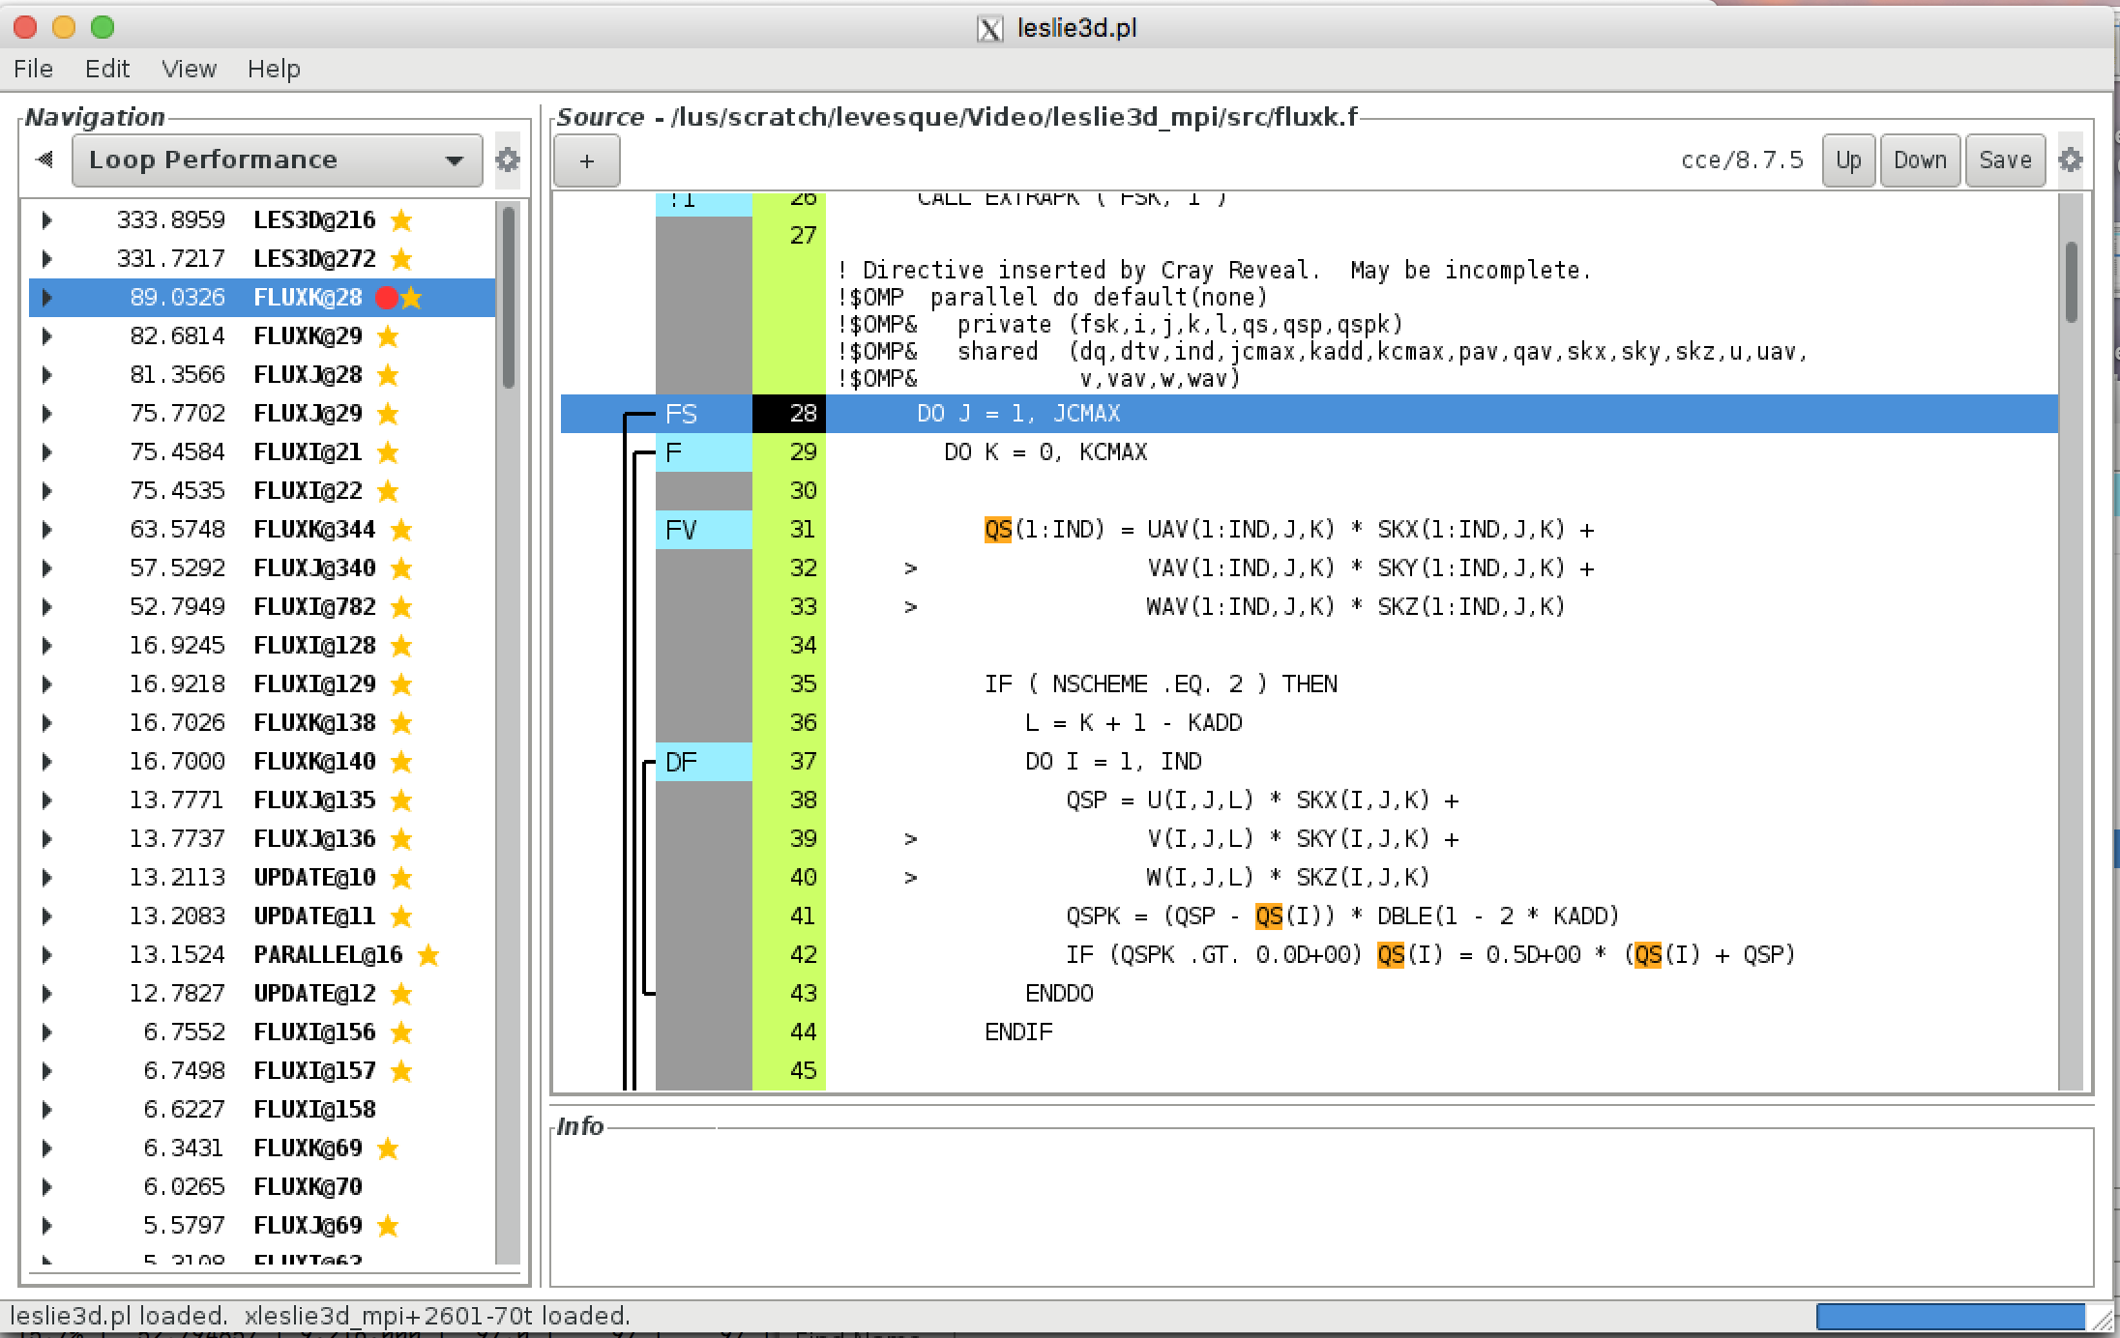

Slide 42
Reveal helped analyze this loop
28. ! Directive inserted by Cray Reveal. May be incomplete.
29. M-----------------< !$OMP parallel do default(none)
30. M !$OMP& private (fsk,i,j,k,l,qs,qsp,qspk)
31. M !$OMP& shared (dq,dtv,ind,jcmax,kadd,kcmax,pav,qav,skx,sky,skz,u,uav,
32. M !$OMP& v,vav,w,wav)
33. + M mF--------------< DO J = 1, JCMAX
34. + M mF F------------< DO K = 0, KCMAX
35. M mF F V----------< DO I = 1, IND
36. M mF F V QS(I) = UAV(I,J,K) * SKX(I,J,K) +
37. M mF F V > VAV(I,J,K) * SKY(I,J,K) +
38. M mF F V > WAV(I,J,K) * SKZ(I,J,K)
39. M mF F V
40. M mF F V IF ( NSCHEME .EQ. 2 ) THEN
41. M mF F V L = K + 1 - KADD
42. M mF F V QSP = U(I,J,L) * SKX(I,J,K) +
43. M mF F V > V(I,J,L) * SKY(I,J,K) +
44. M mF F V > W(I,J,L) * SKZ(I,J,K)
45. M mF F V QSPK = (QSP - QS(I)) * DBLE(1 - 2 * KADD)
46. M mF F V IF (QSPK .GT. 0.0D+00) QS(I) = 0.5D+00 * (QS(I) + QSP)
47. M mF F V ENDIF
48. M mF F V
49. M mF F V FSK(I,K,1) = QAV(I,J,K,1) * QS(I)
50. M mF F V FSK(I,K,2) = QAV(I,J,K,2) * QS(I) +
51. M mF F V > PAV(I,J,K) * SKX(I,J,K)
52. M mF F V FSK(I,K,3) = QAV(I,J,K,3) * QS(I) +
53. M mF F V > PAV(I,J,K) * SKY(I,J,K)
54. M mF F V FSK(I,K,4) = QAV(I,J,K,4) * QS(I) +
55. M mF F V > PAV(I,J,K) * SKZ(I,J,K)
56. M mF F V FSK(I,K,5) = (QAV(I,J,K,5) + PAV(I,J,K)) *
57. M mF F V > QS(I)
28. ! Directive inserted by Cray Reveal. May be incomplete.
29. M-----------------< !$OMP parallel do default(none)
30. M !$OMP& private (fsk,i,j,k,l,qs,qsp,qspk)
31. M !$OMP& shared (dq,dtv,ind,jcmax,kadd,kcmax,pav,qav,skx,sky,skz,u,uav,
32. M !$OMP& v,vav,w,wav)
Notice that Reveal doesn’t use default shared, primarily to illustrate that it has handled all variables

