Slide 1

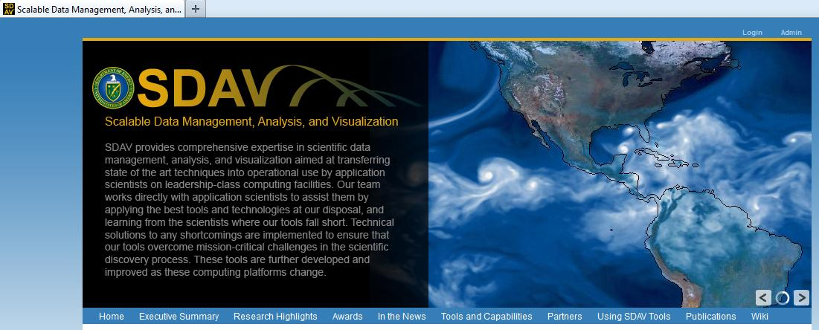
The Scalable Data Management,
Analysis, and Visualization
(SDAV) Institute
2012-2017
Member Institutions
Laboratories
ANL
LBNL
LLNL
ORNL
LANL
SNL
Kitware (Industry)
Universities
Georgia Tech
NCSU
NWU
OSU
UCD
Rutgers
UUtah
Hank Childs, LBNL
Chair, Software Infrastructure Committee
Member, Facilities Committee
http://sdav-scidac.org/

Slide 2
The purpose of this presentation is to connect NERSC Users with SDAV personnel.
This is a critical part of the SDAV mission.

Slide 3
SDAV Constituents and Goals
Constituents:
  SciDAC (1, 2) Scientific Data Management Center (Shoshani)
  SciDAC (2) Visualization and Analytics Center for Enabling Technologies (Bethel)
  SciDAC (2) Institute for Ultrascale SciDAC Visualization (Ma)
  New: LANL, Kitware, …
The Goals of SDAV Are:
  to actively work with application teams to assist them in achieving breakthrough science
  to provide technical solutions in the data management, analysis, and visualization regimes that are broadly used by the computational science community
What We Offer:
  ongoing relationships with science teams, technologies, expertise

Slide 4
SDAV Organization

Slide 5
The SDAV institute tools
Data Management tools
Data Analysis tools
Visualization tools
Frameworks for In Situ Processing
  ADIOS (ORNL)
  Glean (ANL)
In situ code coupling and data streaming
  Data Spaces (Rutgers)
  FlexPath (Gtech)
Indexing
  FastBit (LBNL)
In Situ Data Compression
  ISABELLA (NCSU)
Parallel I/O and File Formats
  PnetCDF, BP-files, HDF5
I/O monitoring
  Darshan (ANL)
Statistical and Data Mining Techniques
  NU-Minebench (NWU)
Importance-Driven Analysis Techniques (UCD, Utah)
  Domain-Knowledge Directed
  Geometry Based
Topological Methods
(UCD, Utah, LBNL)
  In Situ Topology
  (Topologika)
  Feature-Based Analysis
  High-Dimensional Analysis
Parallel visualization
  Visit (LBNL, SNL, LLNL)
  ParaView (LANL)
  VTK-m framework (Kitware)
Specialized Vis techniques
(UCD, Utah, LBNL, OSU)
  Flow Visualization Methods
  Rendering
  Ensembles, Uncertainty, and Higher-Dimensional Methods
Notes:
5

Slide 6
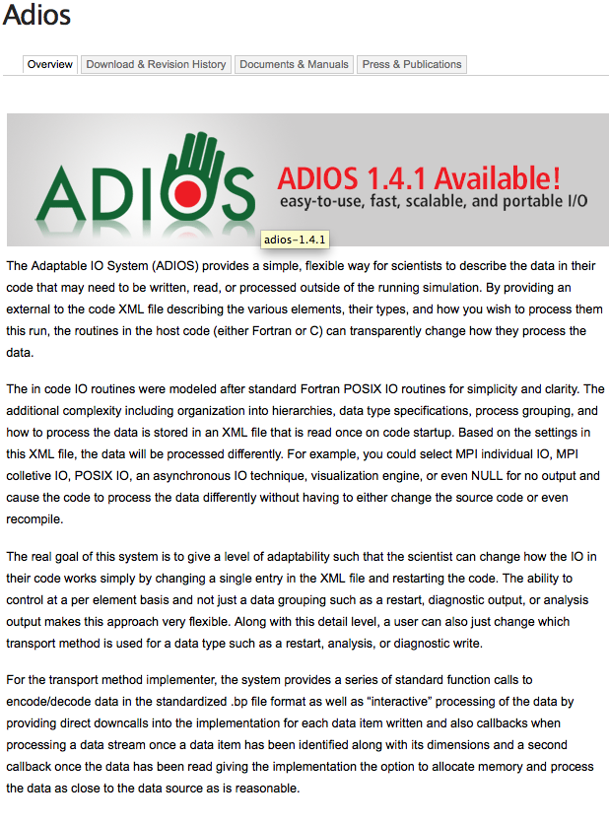
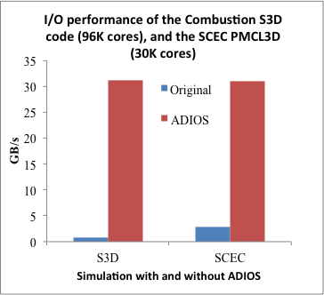
Adaptable I/O System
An I/O abstraction framework
Provides portable, fast, scalable, easy-to-use, metadata rich output with a simple API
Layered software architecture:
Change I/O method on-the-fly
  Aggregation methods, HDF5, Netcdf-4, Posix, MPI-IO
Abstracts the API from the method used for I/O
  http://www.nccs.gov/user-support/center-projects/adios/

Slide 7
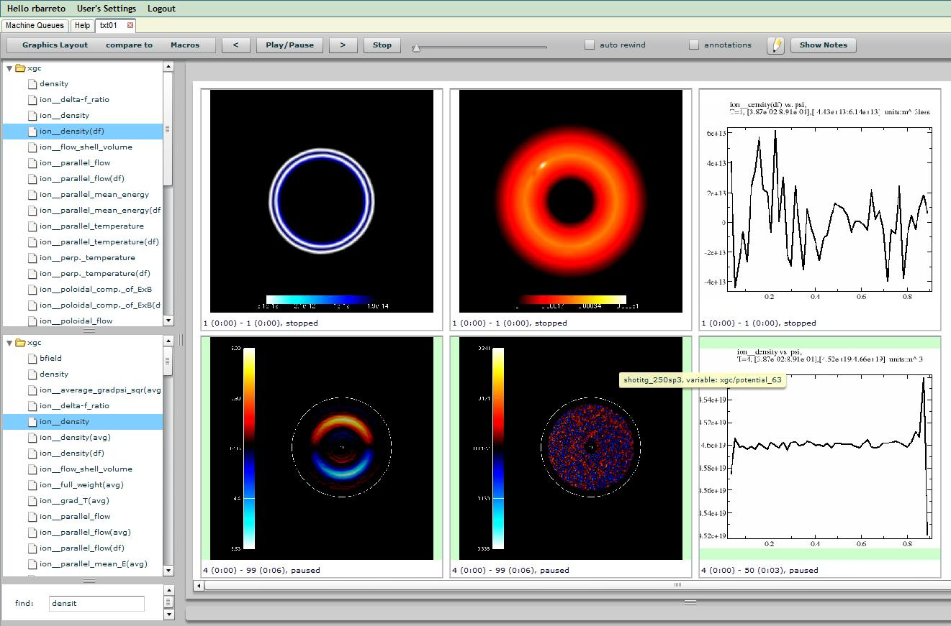
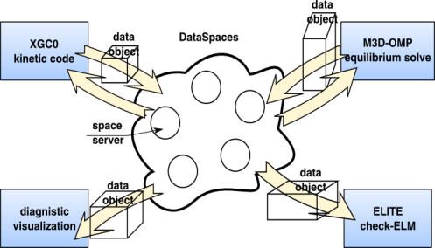
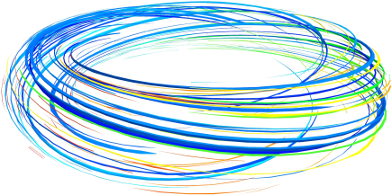
What else can be done when capturing I/O
Real-time monitoring on a Dashboard (ORNL)
Time-step data is captured and processed by a
workflow system
Images/graphs generated by a workflow
Code coupling with DataSpaces (Rutgers)
Virtual shared space
Constructed on-the-fly on staging nodes
Indexes data for quick access and retrieval
Provides asynchronous coordination and interaction and realizes the shared-space abstraction
In-space (online) data transformation and manipulations
Decentralized data analysis in-the-space
Imbed FastBit indexing to find regions of interest (LBNL)
Set of regions with high electromagnetic potential
in a torus modeled by GTC
Achieved speed up of 500-900 fold on magnetic
coordinates
Contact: Scott Klasky

Slide 8
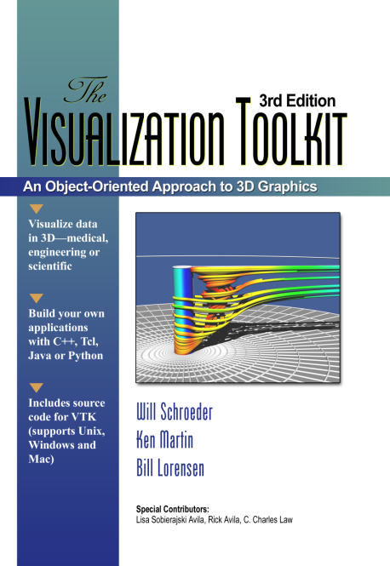
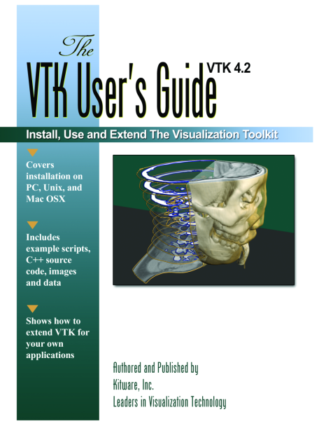
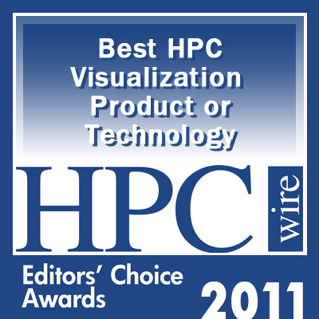
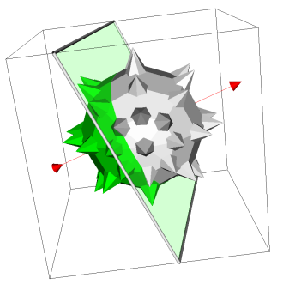
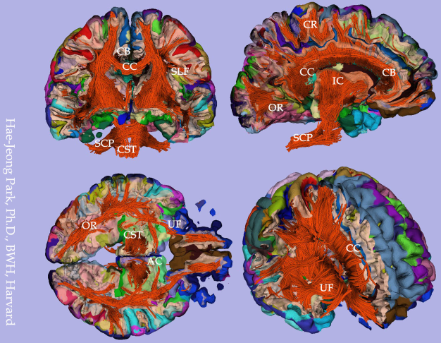
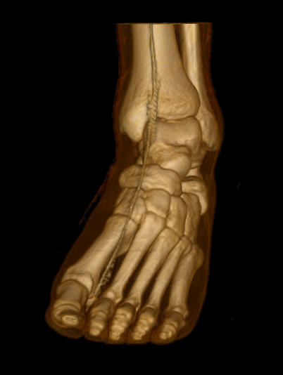
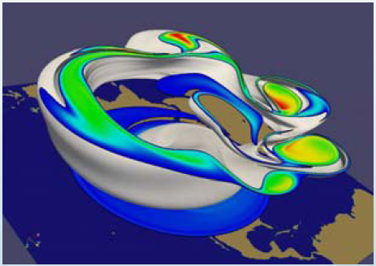
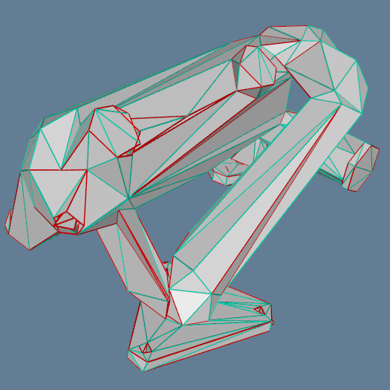
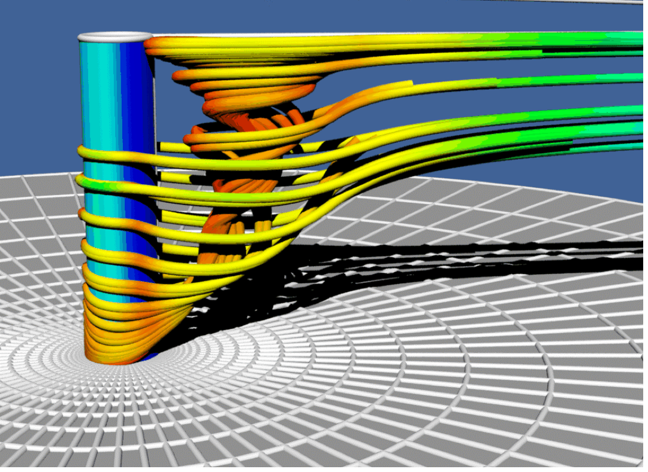
VTK: The Visualization ToolKit
Open source, freely available software for 3D computer graphics, image processing, and visualization
Managed by Kitware Inc.
Use C++, Tcl/Tk, Python, Java

Slide 9


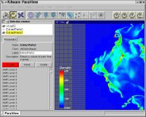
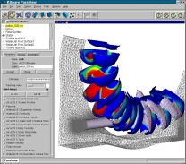

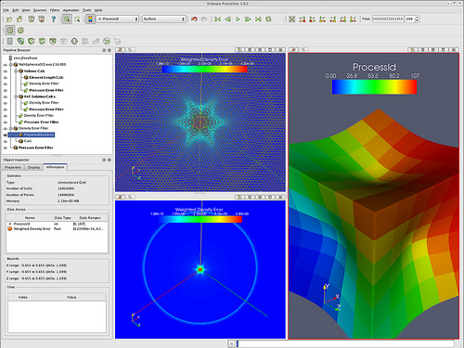
ParaView: end-user tool for parallel visualization and analysis
ParaView provides:
  Client-server computing
  State management
  Python modules
  Application/GUI framework
ParaView framework can be used to develop other applications
ParaView can be embedded in other application and frameworks
Organizations:

Slide 10
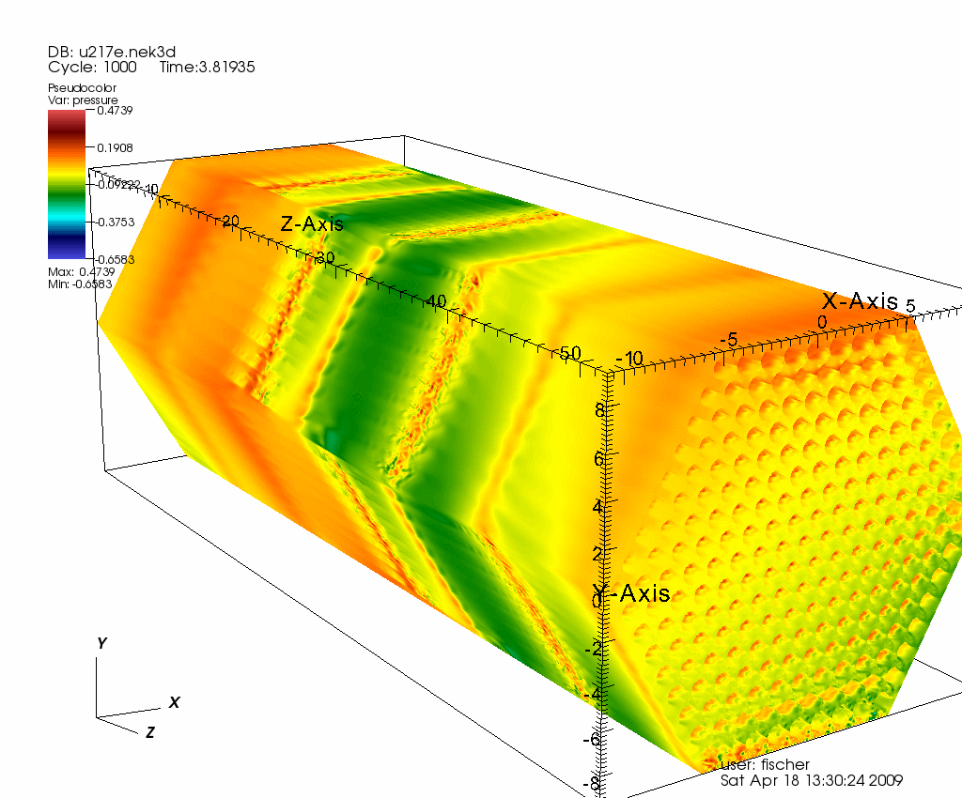

VisIt is an open source, richly featured, turn-key application for large data.
For data exploration, quantitative analysis, communication, debugging, & more.
1.5M lines of code
~15 active developers
Popular
  R&D 100 award in 2005
  Used on many of the Top500
  >200K downloads
  Funded by DOE/NNSA, DOE/NE, DOE/ASCR, NSF/XSEDE, & more
1 billion grid points / time slice
217 pin reactor cooling simulation
Run on ¼ of Argonne BG/P
Image credit: Paul Fischer, ANL

Slide 11
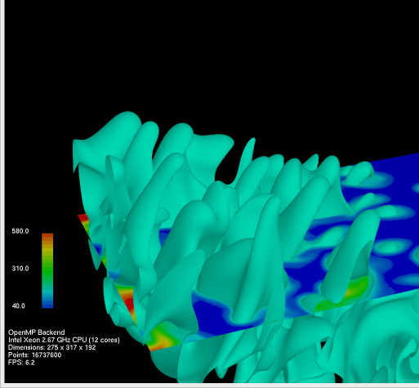
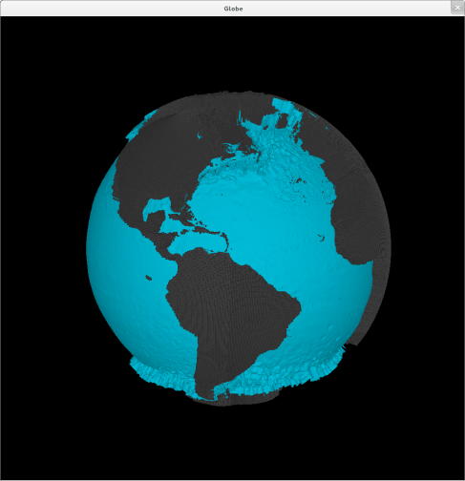
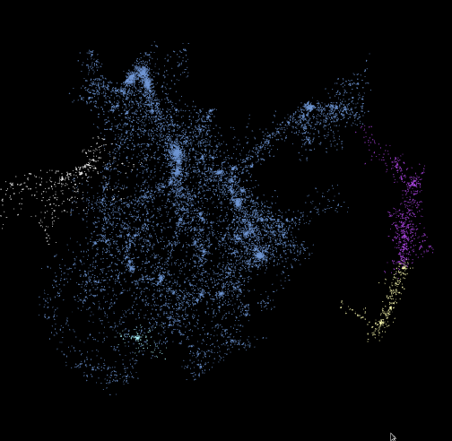
PISTON: A Portable Cross-Platform Framework for Data-Parallel Visualization Operators
Goal: Portability and performance for visualization and analysis operators on current and next- generation supercomputers
Main idea: Write operators using only data-parallel primitives (scan, reduce, etc.)
Requires architecture-specific optimizations for only for the small set of primitives
PISTON is built on top of NVIDIA’s Thrust library
We have run visualization algorithms on GPUs and on multi-core CPUs using the exact same operator code by compiling to CUDA and to OpenMP backends
Isosurface and cut plane operators
Curvilinear coordinates
Halo finder using KD-tree

Slide 12


EAVL: Extreme-scale Analysis and Visualization Library
Targets approaching hardware/software ecosystem:
Update traditional data model to handle modern simulation codes and a wider range of data.
Investigate how an updated data and execution model can achieve the necessary computational, I/O, and memory efficiency.
Explore methods for visualization algorithm developers to achieve these efficiency gains and better support exascale architectures.
http://ft.ornl.gov/eavl

Slide 13
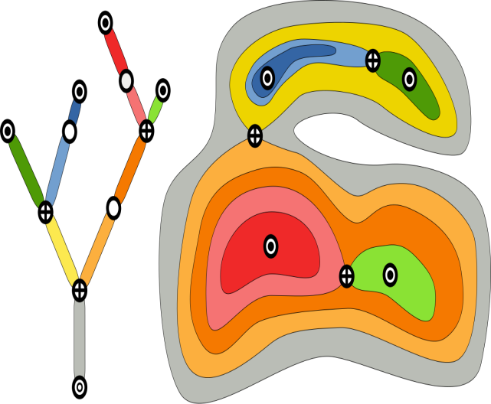
TOPOLOGIKA: in situ analysis
TOPOLOGIKA: Time-Varying Data Analysis with Time Activity Curves (U Utah)
  Fast parallel evaluation of dependent statistics
  Compute graph abstractions for multi-resolution feature representation
  Computer graph models of concurrent tracking of features at multiple scales
  Result/Impact
  Orders of magnitude in data reduction from
  raw data to unrestricted feature space
  Orders of magnitudes speedup reducing
  batch jobs into interactive processing
  Enable scientists to explore the feature
  space interactively
Topological model (left) representing multiple possible nested features of interest (right).

Slide 14
SDAV Summary
  Many of the tools in the SDAV institute have been developed over many years and are robust and well-documented
  Some of the tools have been designed to take advantage of high level parallelism
  Such tools have been used for multiple scientific domains, but often require collaboration between application scientists and tool experts; that is the role of SDAV
  For anticipated future needs, tools are being enhanced in several ways:
    Scale tools for high parallelization levels
    Adapt tools to take advantage of new hybrid hardware (CPUs + GPUs), and hybrid storage (disk and SSDs)
    Adapt tools for in situ processing and analysis to provide early insight of the generated data
    Compress and index data in situ for both in situ and post-processing analysis
  SDAV is highly productive: over 70 publications since March 2012

Slide 15
Please contact me if you would like assistance from SDAV in doing data management, analysis, and/or visualization on NERSC systems!
Hank Childs (hchilds@lbl.gov)

