Slide 1

NERSC
National Energy Research
Scientific Computing Center
Moving the NERSC Archive to a Green Data Center
Nick Balthaser
Wayne Hurlbert
Damian Hazen
Kristy Kallback-Rose
Kirill Lozinskiy
Owen James
NERSC Storage Systems Group

Slide 2
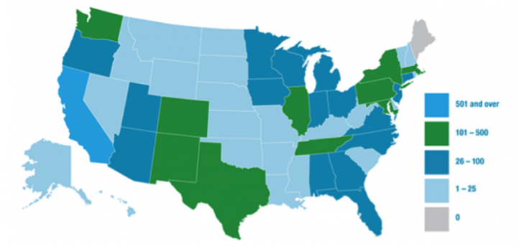
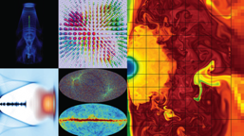
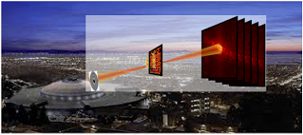
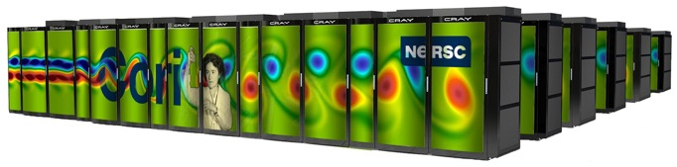
NERSC: the mission HPC facility for the U.S. Department of Energy Office of Science
Simulations at scale
7,000 users
800 projects
700 applications
~2,000 publications per year
Experimental/observational data analysis at scale

Slide 3
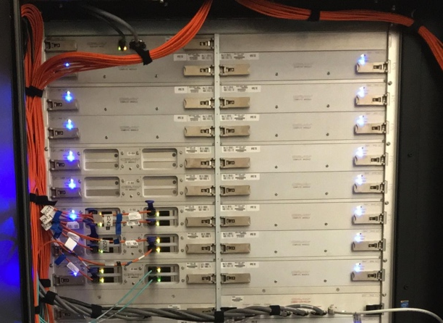
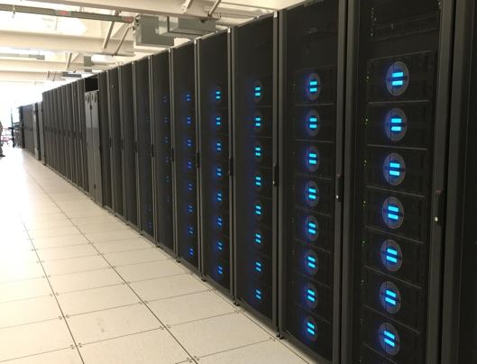
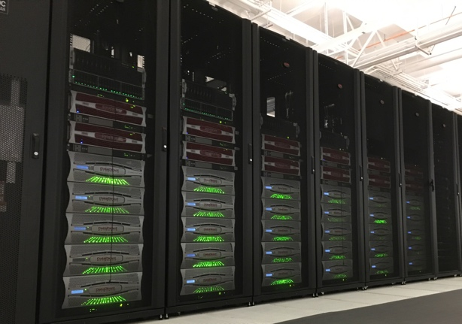
NERSC’s storage hierarchy
1.8 PB
1.7 TB/s
Burst Buffer
30 PB
700 GB/s
Performance
Capacity
Scratch
Community
60 PB
100 GB/s
Archive
180 PB

Slide 4
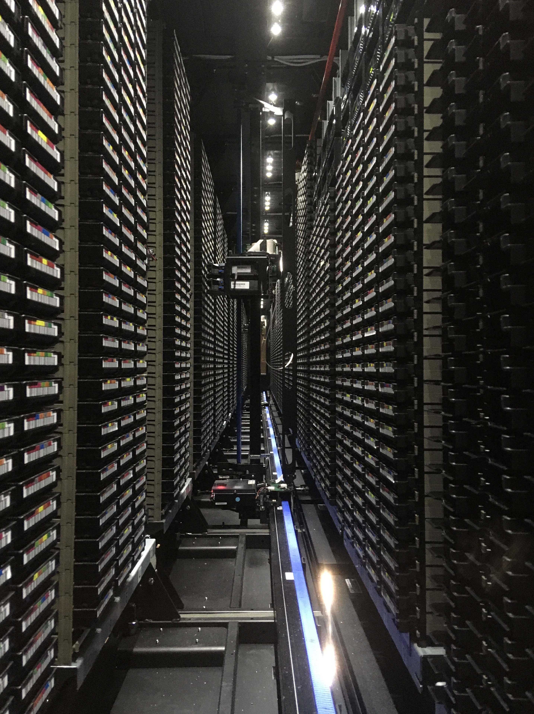
NERSC Data Archive
43 years of data archived by the scientific community
                ~15,000 tape cartridges in 3 IBM TS4500 libraries
                In some cases the NERSC archive is the only copy of the data
HPSS software in production since 1998
2 systems
Archive – user-facing: 180PB
    Regent – center backups: 30PB
Data transfers via client - no direct file system interface

Slide 5
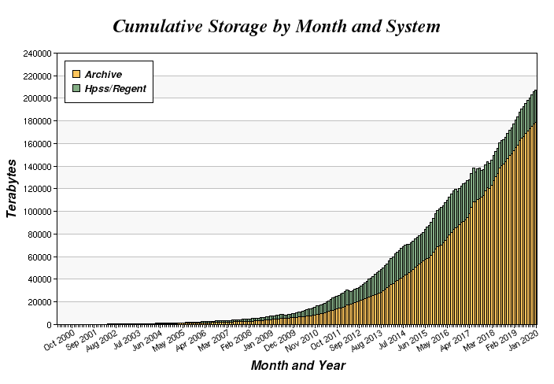
Archival Data Growth
Historically data has grown in the archive at a rate of 1.4x/year

Slide 6
Data Center Challenges
2015 NERSC Move
Environmental Challenges for Tape – Alternatives Considered
IBM Solution

Slide 7
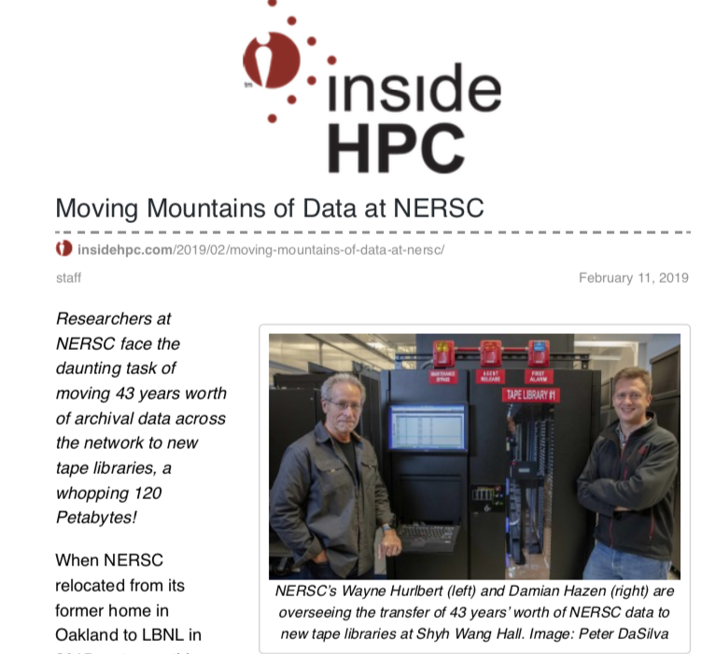
2015 NERSC Move
As published in Inside HPC, in 2015 NERSC moved from Oakland to a new LEED Gold rated data center in Berkeley
                For a variety of reasons the tape Archive remained in Oakland
Berkeley data center relies on ambient weather conditions for cooling
Temperature and humidity can fluctuate rapidly with changes in weather
Tape media reliability can decrease with rapid temperature and humidity fluctuations
Subsequent evaluation of where to relocate the archive

Slide 8
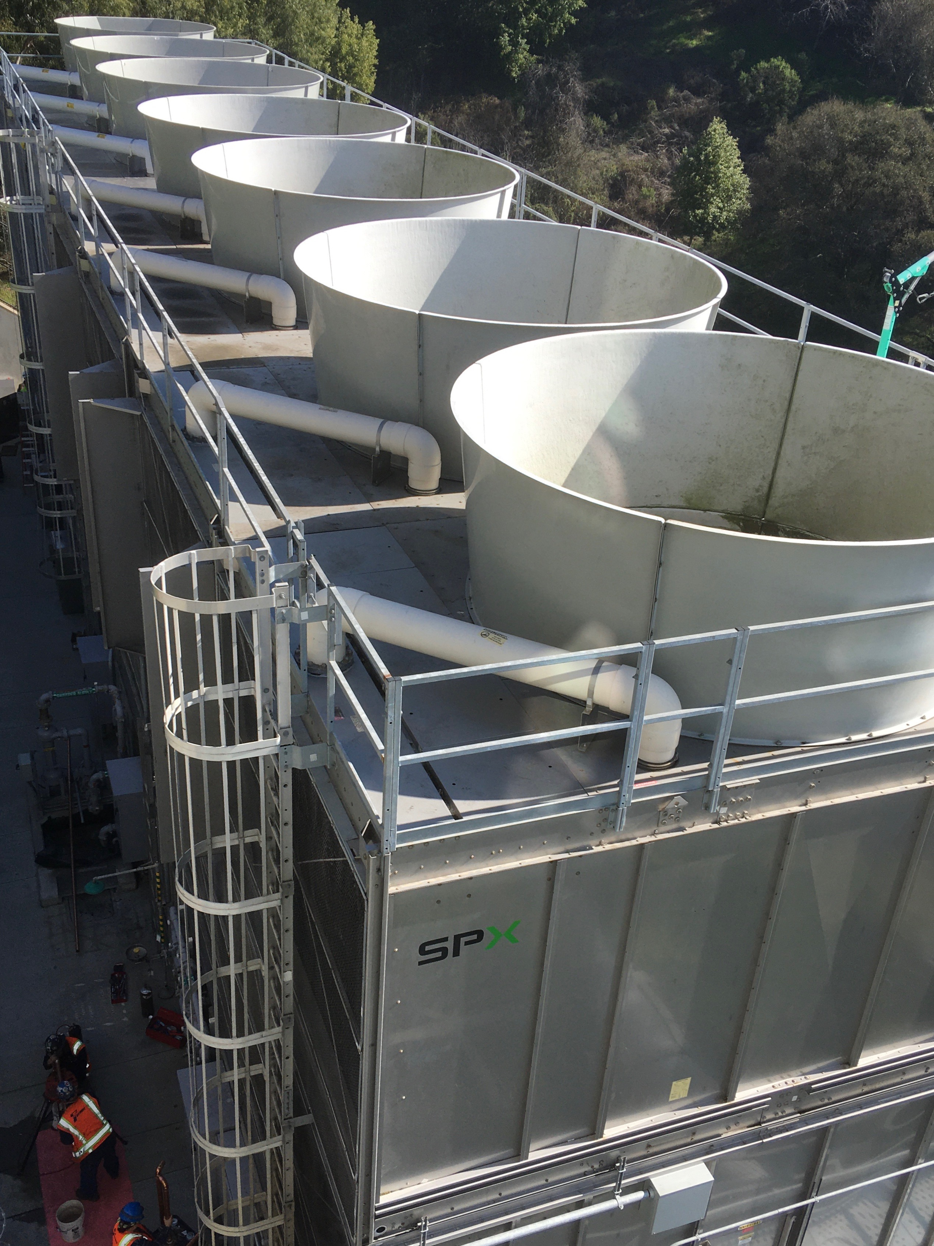
Archive Move Alternatives Considered
Commercial data center colo
                Costly
                System management concerns
Cloud
Not performant enough for user expectations
Batch queue wait, etc.
Higher TCO than on-prem archive
Room-within-a-room
Space utilization and budget constraints
Disk-only
Costly
Increased power consumption
No media diversity
IBM TS4500s with integrated cooling were a cost-effective solution

Slide 9
TS4500 Integrated Cooling Solution
Built-in AC units on top of library keep tape environment stable
AC uses recirculated air, library mostly sealed
System also resistant to airborne particulate
Library built out in 4-frame sections called Cooling Zones
Slide credit: IBM/Lee Jesionowski: https://conference-indico.kek.jp/indico/event/28/session/12/contribution/30/material/slides/0.pdf

Slide 10
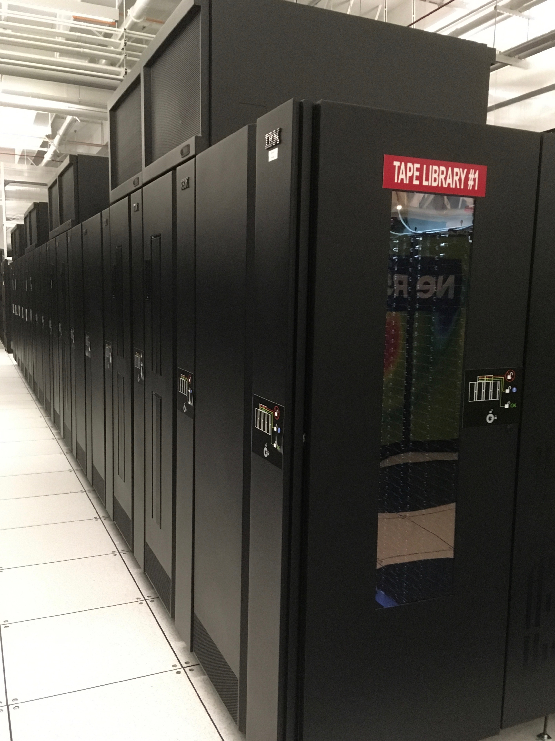
TS4500 Integrated Cooling Solution
NERSC Libraries have 4 Cooling Zones each
3 libraries,16 frames, 13k slots ea.
64 TS1155/3592-55F tape drives (libraries 1 & 2)
JD media, 15TB/cartridge

Slide 11
Moving Mountains of Data
2018 Archive Move
2019 Regent Move

Slide 12
2018 Archive move – prep and equipment moves
Guidance:
Minimize service disruption, watch costs
Staged ingest cutover to TS4500s to minimize downtime
12/2017: Minimize data ingest to Oracle/STK complex
S/M file ingest moved to TS3500 in Oakland on 32 newly purchased TS1150 (E08) drives
03/2018 – 09/2018: Deployed 2 x16 frame TS4500s in Berkeley
07/2018 – 09/2018: Series of equipment moves from Oakland to Berkeley:
Spare FC switch
Dev system
½ disk cache, data movers
Remote HPSS PVR server (library SCSI interface in Berkeley)
09/2018 – 11/2018: TS4500 fire suppression, testing
09/2018: 4 new tape movers installed in Berkeley

Slide 13
2018 Archive move – TS4500 ingest, “SneakerNet”
11/2018: Large file ingest cut over from Oracle/STK to TS4500s
HPSS “Technology Insertion” storage class config change
Production disk cache still in Oakland, tape movers in Berkeley
Disk/tape migration over dedicated 400Gb link between data centers
HPSS remote PVR used to control libraries in Berkeley
12/2018: Medium file ingest cut over to TS4500s
01/2019: “SneakerNet” - 30PB moved by truck
3k JD carts moved from TS3500 in Oakland to TS4500s over 2 weeks
Small file ingest moved to TS4500s at this time
02/2019: Core server, metadata physical move – 9 hour downtime
02/2019: 2nd half disk cache moved, cache ingest moved to Berkeley
02/2019 – 12/2019: Ongoing data copy out of Oracle/STK libraries
121PB repacked over 400Gb link between Oakland and Berkeley
Rates exceeding 500TB/day

Slide 14
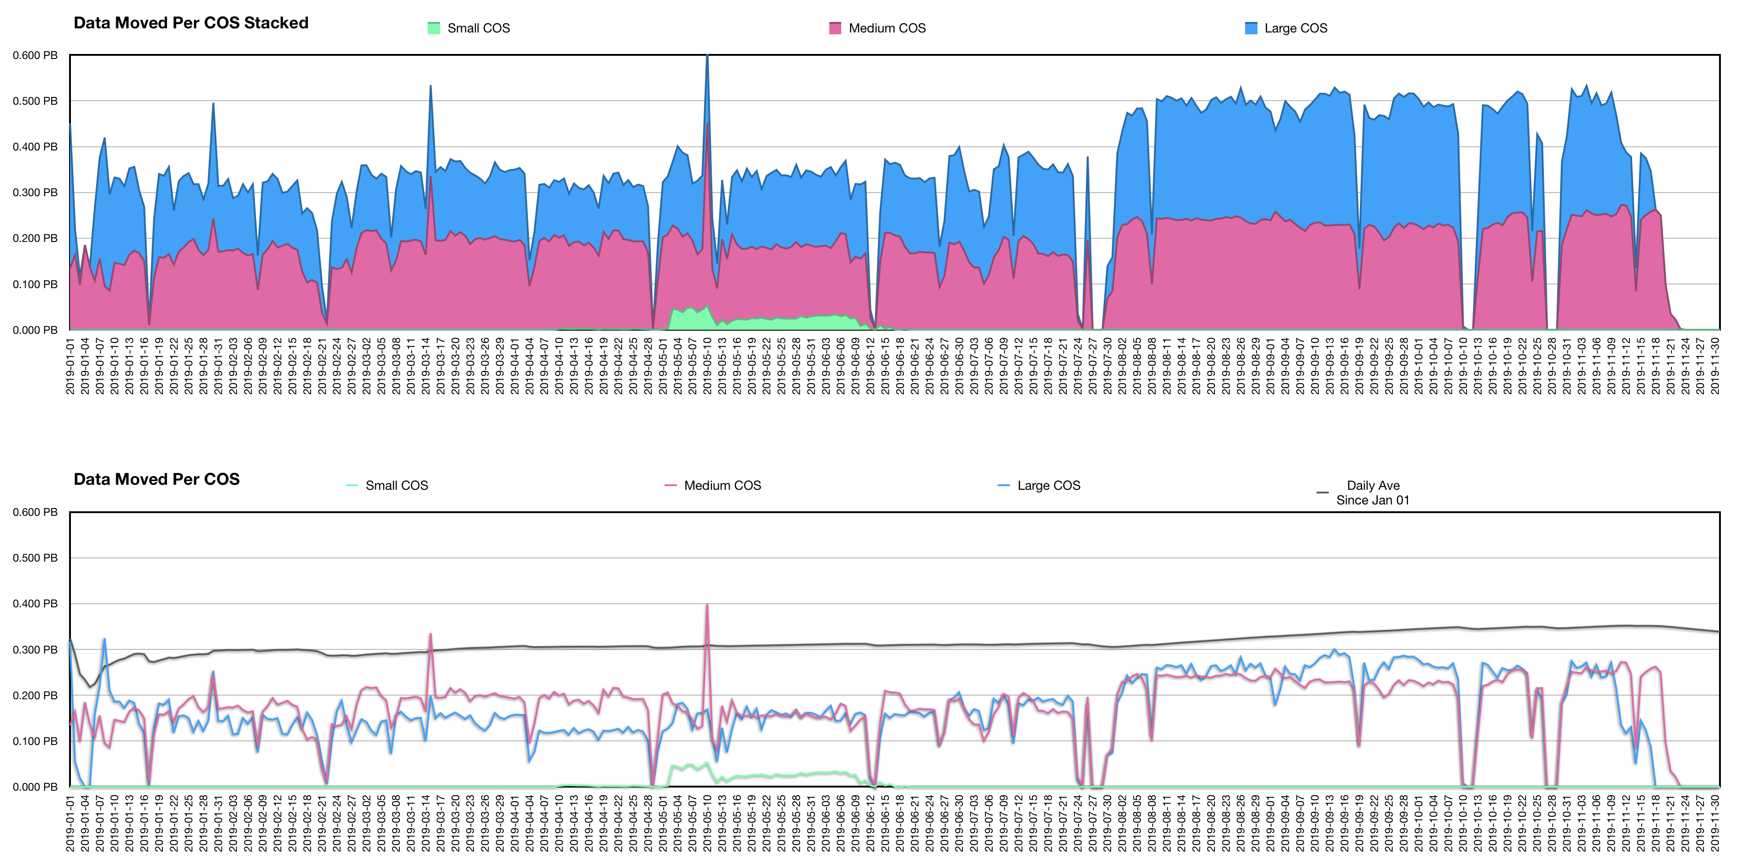
2019 Archive Data Migration by HPSS COS^{[2]}
^{[2]} Chart and stats credit: Wayne Hurlbert

Slide 15
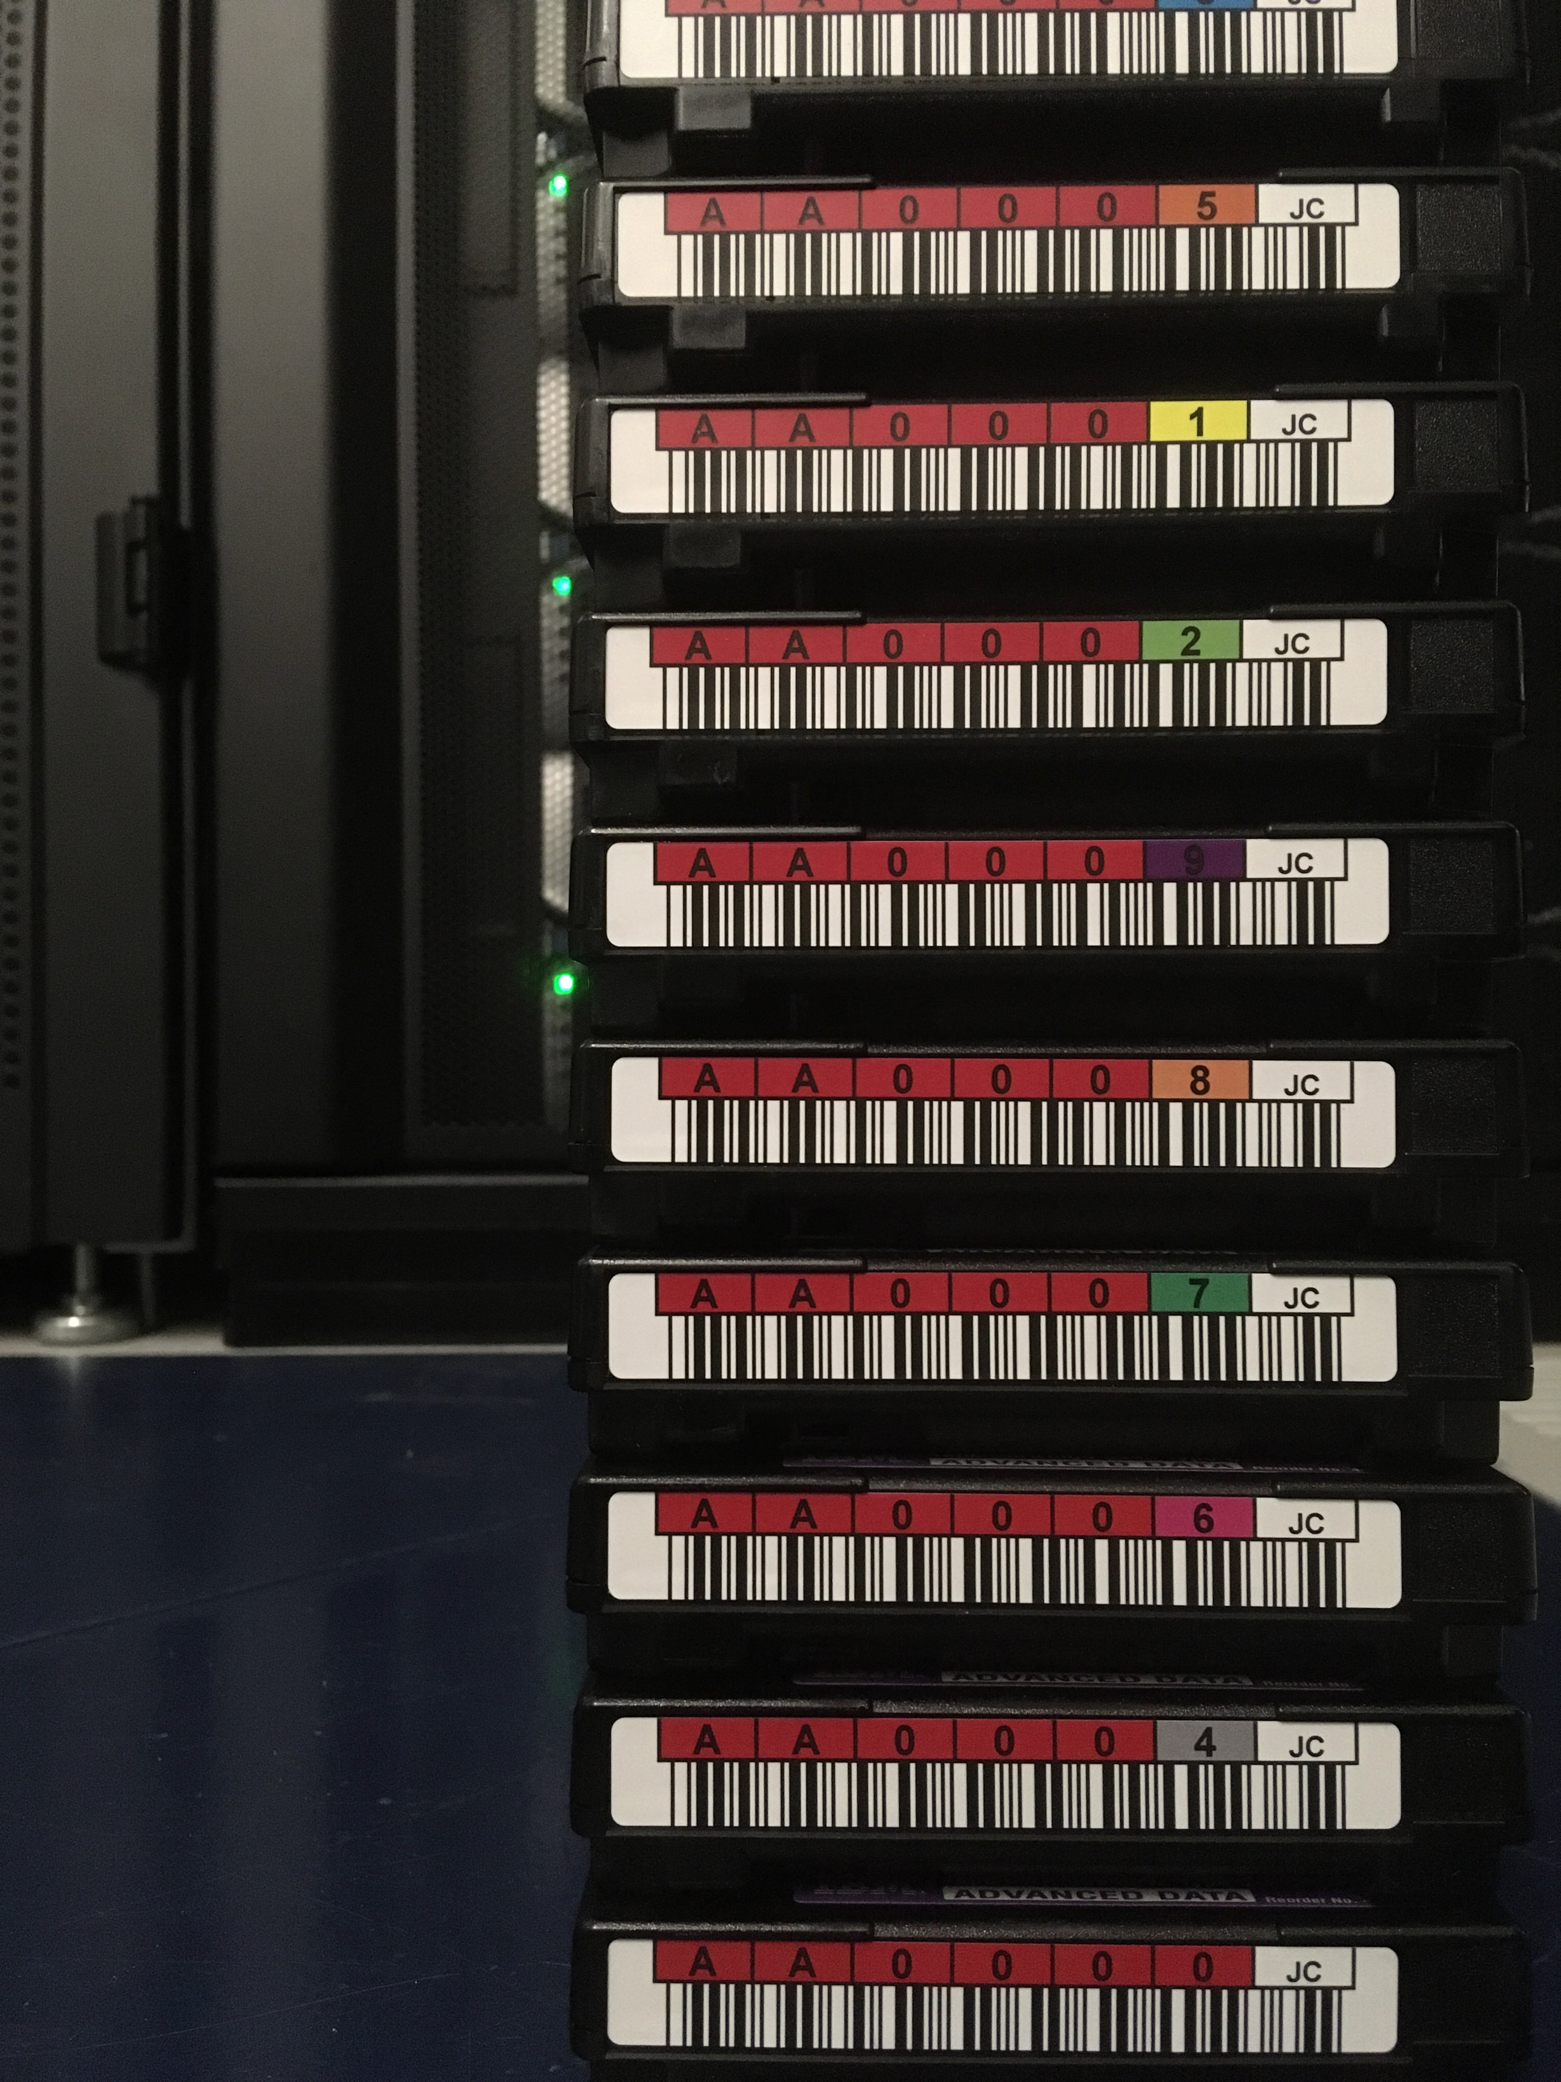
Archive move – Data Loss, Lessons Learned
Don’t know the state of your media until you read all of it:
Oracle/STK data move stats^{[1]}:
Total files moved: 230M
Total data moved: 121,000 TB
Total cartridges cleared: 29,094
Damaged cartridges: 90
Full loss cartridges: 3
Files lost: 1964 – 0.0008%
Data lost: 22 TB – 0.018%*
Users impacted: 148
Other issues
TS4500 FW bugs – library resets, IO station locate errors
Untested IO station configuration – 16 stations per library
Cycles for other projects (e.g. HW refresh, HPSS upgrade)
HPSS – unfulfilled cartridge requests while tapes in transit
^{[1]} Stats credit: Wayne Hurlbert
* Majority due to 2 large files on damaged cartridge

Slide 16
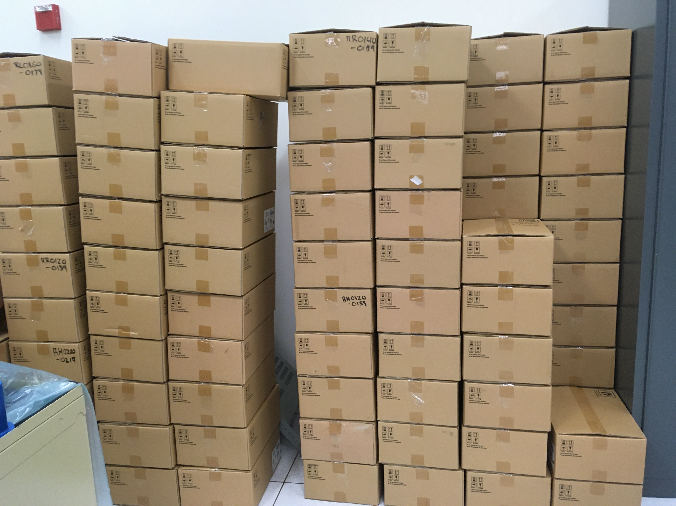
2019 Regent Move
Regent – Smaller (30PB) HPSS system – Center backups
Last production system in Oakland
Forklift move 12/2019
3rd 16-frame TS4500 installed mid-2019
FC switch, new movers installed in advance
Some tape drives moved ahead of time from TS3500 in Oakland
Cartridges ejected, packed in 1 week while system up
14 hour downtime for core server, metadata, disk cache move
Innovative use of HPSS “operator” PVR to transition tape volumes between SCSI libraries

Slide 17
Epilogue
Decommissioning OSF

Slide 18
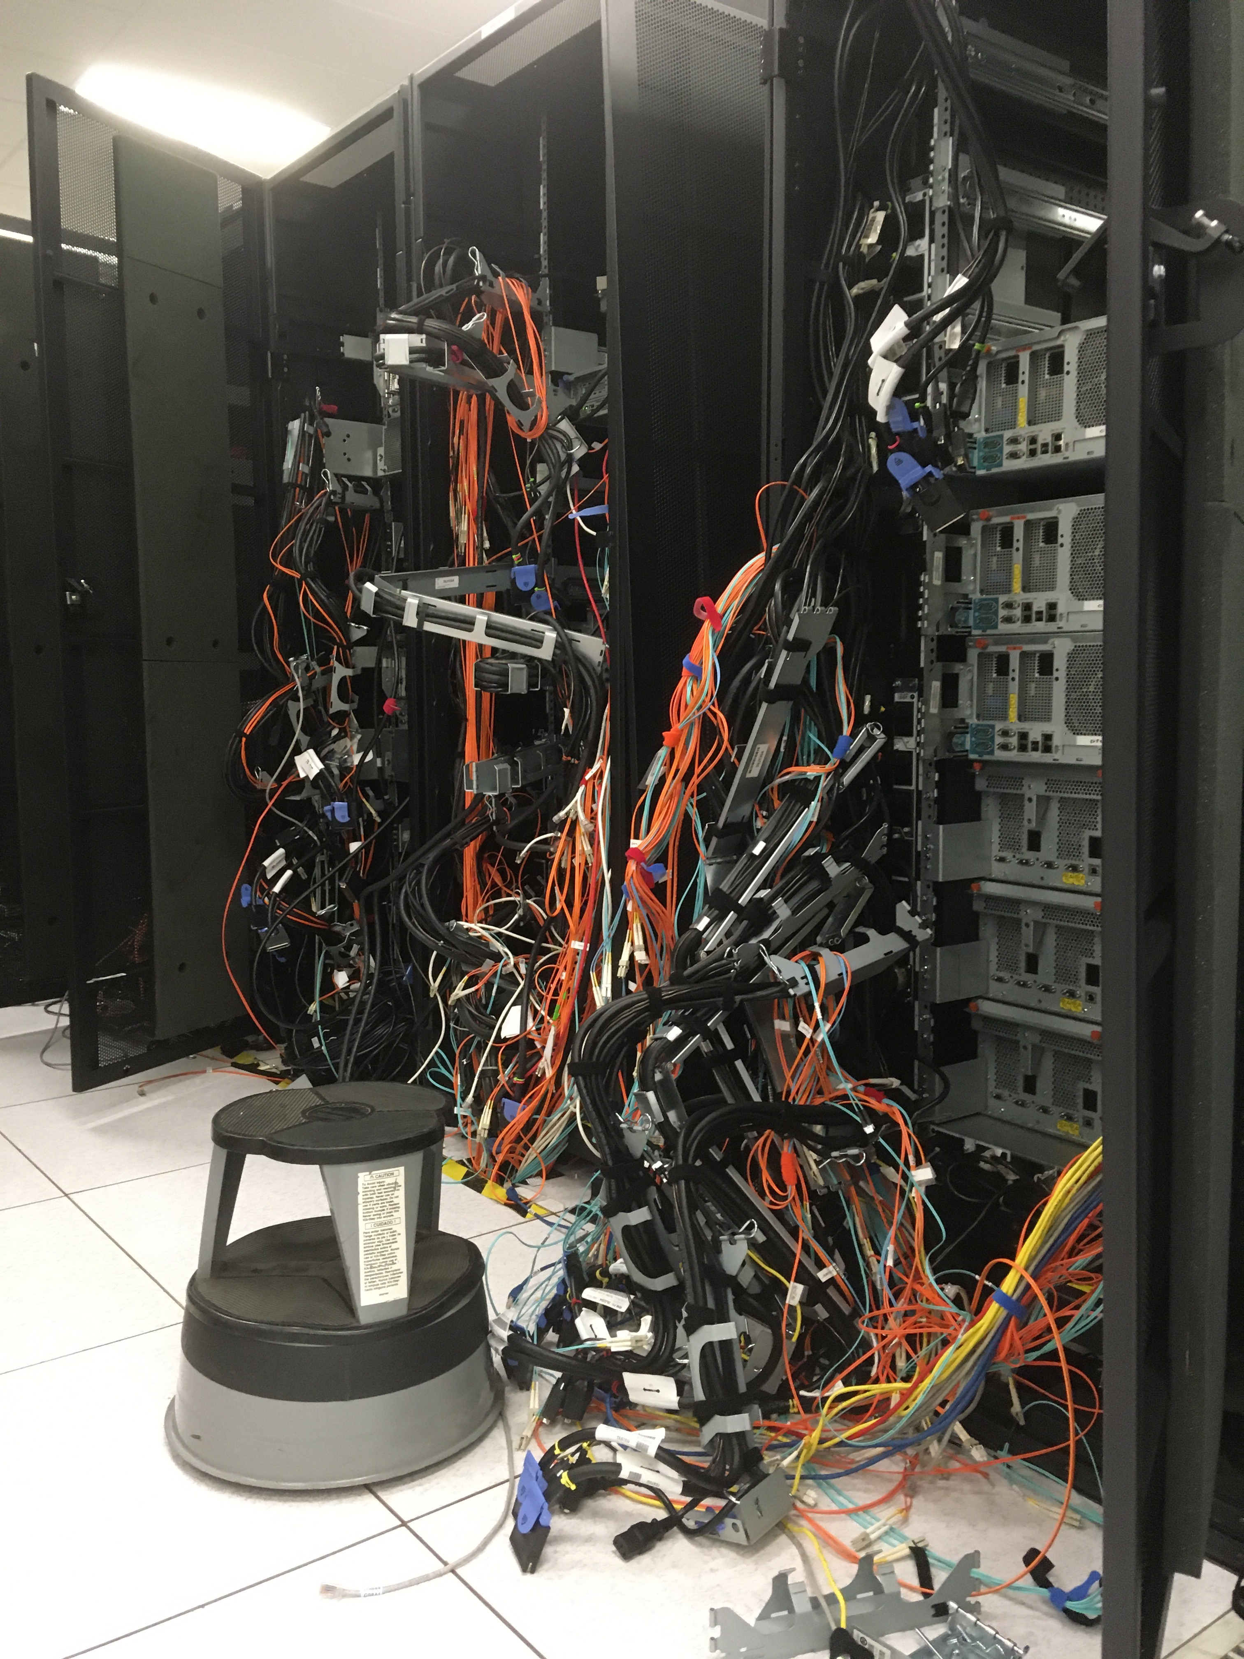
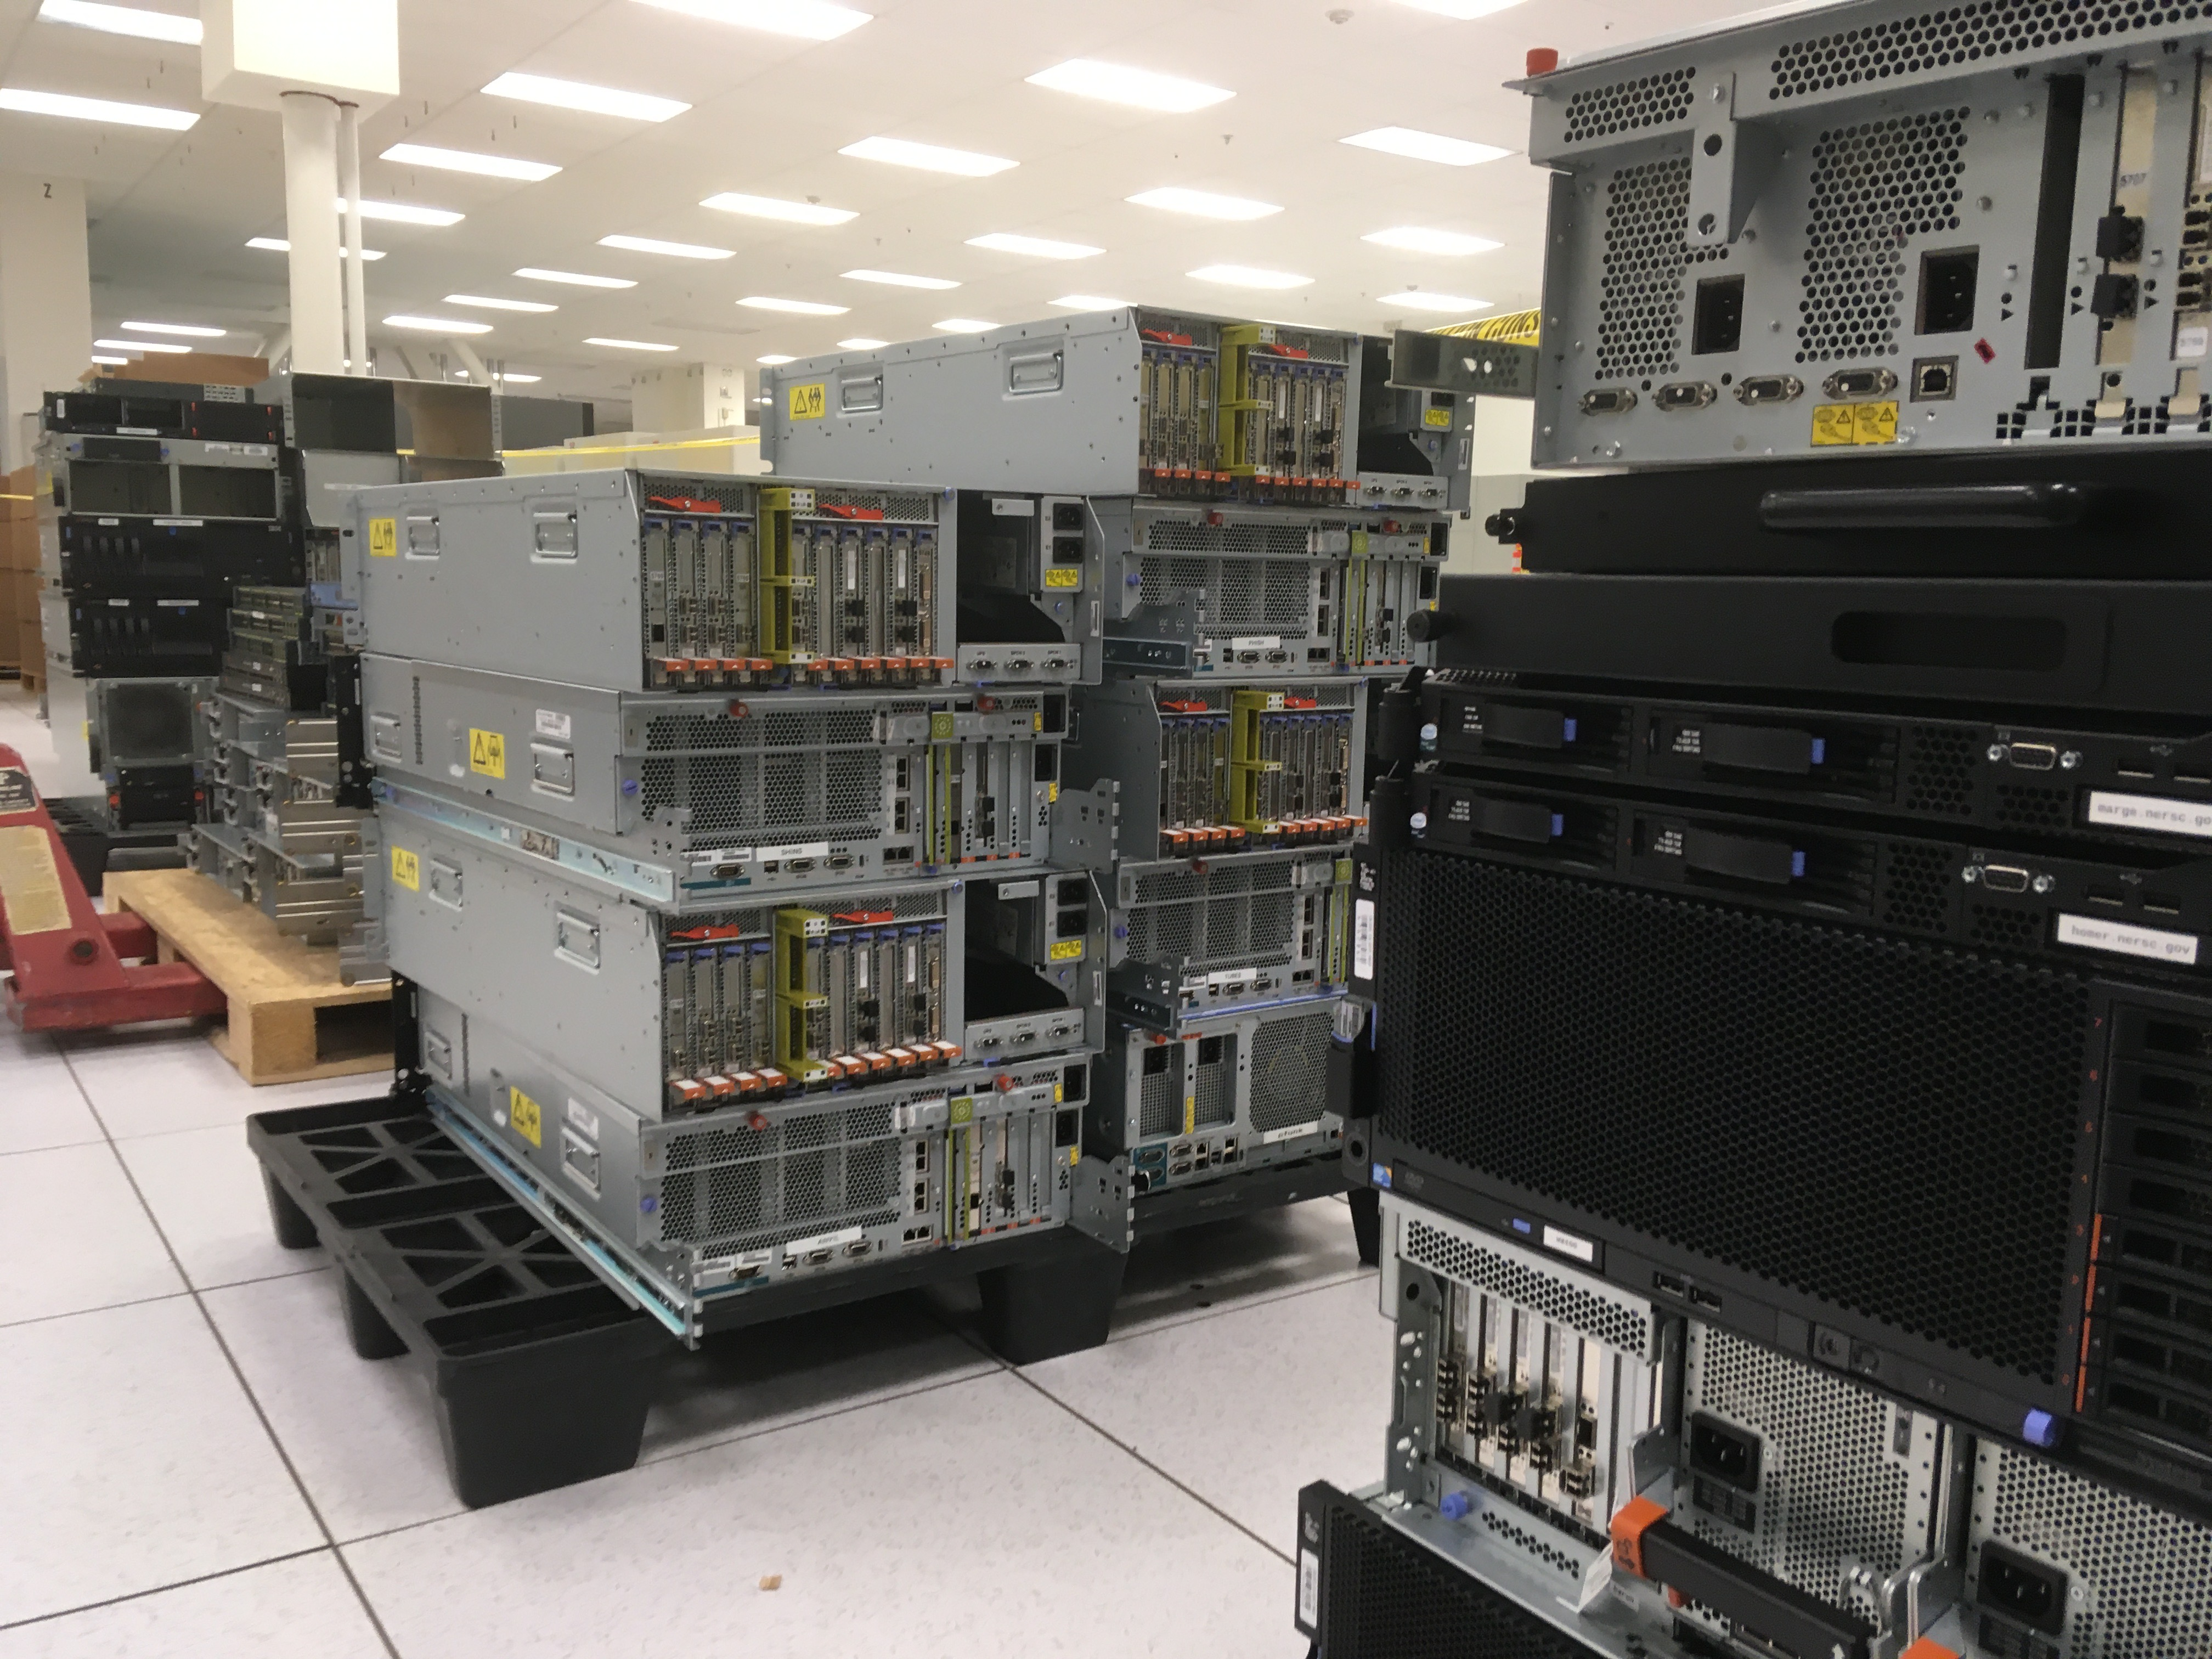
Decommissioning OSF
No production equipment left in Oakland
Huge uncabling, unracking, salvage effort over multiple weeks

