Slide 1
OpenMP intro and
Using Loop Scheduling in OpenMP
Vivek Kale
Brookhaven National Laboratory

Slide 2
Overview
  Introduction to OpenMP
  A primer of a loop construct.
  Definitions for schedules for OpenMP loops.
  The kind of a schedule.
  Modifiers for the schedule clause.
  Basic tips and tricks for using loop scheduling in OpenMP.

Slide 3
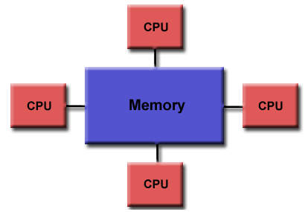
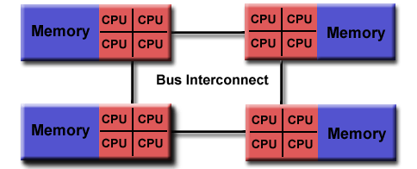
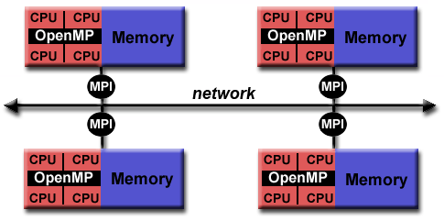
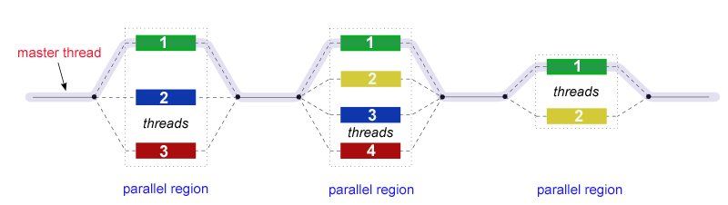
OpenMP
OpenMP is:
An Application Program Interface (API) that may be used to explicitly direct multi-threaded, shared memory parallelism.
Comprised of three primary API components:
  Compiler Directives
  Runtime Library Routines
  Environment Variables
An abbreviation for: Open Multi-Processing
Non-uniform Memory Access
Unified Memory Access
OpenMP is not:
Meant for distributed memory parallel systems (by itself)
Necessarily implemented identically by all vendors
Guaranteed to make the most efficient use of shared memory
Required to check for data dependencies, data conflicts, race conditions, deadlocks, or code sequences that cause a program to be classified as non-conforming
Designed to handle parallel I/O. The programmer is responsible for synchronizing input and output.
Hybrid MPI+OpenMP model
Fork/join model of parallelism
Courtesy Blaise Barney, computing.llnl.gov/tutorial/openmp

Slide 4
OpenMP
Syntax of OpenMP
- Fortran: case-insensitive
- Add: use omp_lib or include “omp_lib.h”–Fixed format
•Sentinel directive [clauses]
•Sentinel could be: !$OMP, *$OMP, c$OMP–Free format
•!$OMP directive [clauses]
•C/C++:casesensitive
•Add: #include “omp.h”
•#pragma omp directive [clauses] newline
Directives
Runtime System Functions
•Parallel Directive
–Fortran: PARALLEL ... END PARALLEL
C/C++: parallel
•Worksharing Constructs
–Fortran: DO ... END DO, WORKSHARE
–C/C++: for
–Both: sections
•Synchronization
–master, single, ordered, flush, atomic
•Tasking
–task, taskwait
•Number of threads:omp_{set,get}_num_threads
- ThreadID:omp_get_thread_num
•Scheduling:omp_{set,get}_dynamic
•Nested parallelism:omp_in_parallel
•Locking:omp_{init,set,unset}_lock
•Active levels:omp_get_thread_limit
•Wallclock Timer:omp_get_wtime
FORTRAN:
program main
use omp_lib (or: include “omp_lib.h”)
integer :: id, nthreads
!$OMP PARALLEL PRIVATE(id)
id = omp_get_thread_num()
write (*,*) ”Hello World from thread", id
!$OMP BARRIER
if ( id == 0 ) then
nthreads = omp_get_num_threads()
write (*,*) "Total threads=",nthreads
end if
!$OMP END PARALLEL
End program
Example
Compiling
C/C++:
gcc: -fopenmp
xlc: -mp
icc: -qopenmp
craycc: (none)
#include <omp.h>
#include <stdio.h> #include <stdlib.h> int main () {
int tid, nthreads;
#pragma omp parallel private(tid)
{
tid = omp_get_thread_num();
printf(”Hello World| thread %d\n", tid);
#pragma omp barrier
if ( tid == 0 ) {
nthreads = omp_get_num_threads();
printf(”Total threads= %d\n",nthreads);
}
}
}
Clauses
Enivronment Variables
Running
•private(list),shared(list)
•firstprivate(list),lastprivate(list)
•reduction(operator:list)
•schedule(method[,chunk_size])•nowait
•if(scalar_expression)
•num_thread(num)
•threadprivate(list),copyin(list)
•ordered
•collapse(n)
•tie,untie
OMP_NUM_THREADS
OMP_SCHEDULE
OMP_STACKSIZE
OMP_DYNAMIC
OMP_NESTED
OMP_WAIT_POLICY
OMP_ACTIVE_LEVELS
OMP_THREAD_LIMIT
(pure OpenMP example,
Using 6 OpenMP threads)
#PBS -q debug
#PBS -l mppwidth=64
#PBS -l walltime=00:10:00 #PBS -j eo
#PBS –V
cd $PBS_O_WORKDIR
setenv OMP_NUM_THREADS 16
aprun –n 1 -N 1 –d 6 ./mycode.exe
Cori node has 4 NUMA nodes, each with 16 UMA cores.
Courtesy: NERSC

Slide 5
OpenMP Loops: A Primer
  OpenMP provides a loop construct that specifies that the iterations of one or more associated loops will be executed in parallel by threads in the team in the context of their implicit tasks.¹
#pragma omp for [clause[ [,] clause] ... ]
for (int i=0; i<100; i++){}
  Loop needs to be in canonical form.
  The clause can be one or more of the following: private(…), firstprivate(…), lastprivate(…), linear(…), reduction(…), schedule(…), collapse(...), ordered[…], nowait, allocate(…)
  We focus on the clause schedule(…) in this presentation.

Slide 6
A Schedule of an OpenMP loop
#pragma omp parallel for schedule([modifier [modifier]:]kind[,chunk_size])
A schedule of an OpenMP parallel for loop is:
  a specification of how iterations of associated loops are divided into contiguous non-empty subsets
    We call each of the contiguous non-empty subsets a chunk
  and how these chunks are distributed to threads of the team.¹
The size of a chunk, denoted as chunk_size must be a positive integer.
Note: For OpenMP offload on GPUs, don’t specify a chunk size other than 1.
1: OpenMP Technical Report 6. November 2017. http://www.openmp.org/press-release/openmp-tr6/

Slide 7
The Kind of a Schedule
A schedule kind is passed to an OpenMP loop schedule clause:
  provides a hint for how iterations of the corresponding OpenMP loop should be assigned to threads in the team of the OpenMP region surrounding the loop.
Five kinds of schedules for OpenMP loop:
  static
  dynamic
  guided
  auto
  runtime
The OpenMP implementation and/or runtime defines how to assign chunks to threads of a team given the kind of schedule specified by as a hint.
1: OpenMP Technical Report 6. November 2017. http://www.openmp.org/press-release/openmp-tr6/

Slide 8
Modifiers of the Clause Schedule
simd: the chunk_size must be a multiple of the simd width. ¹
monotonic: If a thread executed iteration i, then the thread must execute iterations larger than i subsequently. ¹
non-monotonic: Execution order not subject to the monotonic restriction. ¹
1: OpenMP Technical Report 6. November 2017. http://www.openmp.org/press-release/openmp-tr6/

Slide 9
Tips and Tricks for Using Loop Scheduling
Use larger chunk sizes in dynamic for reducing dequeue overheads with large number of cores.
Don’t use guided for irregular computation such as sparse matrix vector multiplication.
Tune chunk size for each OpenMP loop run on each platform.
Can have variable -sized chunks through an augmentation of dynamic schedule.
Use static schedules for OpenMP offload, which can simplify partitioning of work across thread blocks.
Research:
Static/dynamic Scheduling for Already Optimized Dense Matrix Factorizations. Simplice Donfack, Laura Grigori, William Gropp, Vivek Kale
Vivek Kale, Christian Iwainsky, Michael Klemm, Jonas H. Muller Kondorfer and Florina Ciorba. Toward a Standard Interface for User-defined Scheduling in OpenMP. Fifteenth International Workshop on OpenMP. September 2019. Auckland, New Zealand.
Vivek Kale, Harshitha Menon, Karthik Senthil. Adaptive Loop Scheduling with Charm++ to Improve Performance of Scientific Applications. SC 2017 Poster. Denver, USA.

Slide 10
Tasking: A Generalization of Loop Parallelism
Loop Iteration Space
increasing loop iteration number
int fib(int n) {
if (n < 2) return n;
int x, y;
#pragma omp task shared(x)
if(n > 30){x=fib(n-1); }
#pragma omp task shared(y)
if(n > 30){y=fib(n-2);}
#pragma omp taskwait
return x+y;
}
Task Queue
increasing task ID
int main(int argc, char* argv[])
{
#pragma omp parallel {
#pragma omp single
{fib(input);}
}
}
Example Courtesy: Christian Terboven, Dirk Schmidl | IT Center der RWTH Aachen University

Slide 11
Task Scheduling
#include <omp.h>
void something_useful();
void something_critical();
void foo(omp_lock_t * lock, int n)
{
for(int i = 0; i < n; i++)
#pragma omp task { }
something_useful();
while( !omp_test_lock(lock) ) {
#pragma omp taskyield }
something_critical();
omp_unset_lock(lock);
}
Courtesy: Christian Terboven, Dirk Schmidl | IT Center der RWTH Aachen University
Research:
Enhancing Support in OpenMP to Improve DataLocality in Application Programs Using Task Scheduling
Vivek Kale and Martin Kong
Lingda Li Presenter
OpenMPCon 2018.

Slide 12
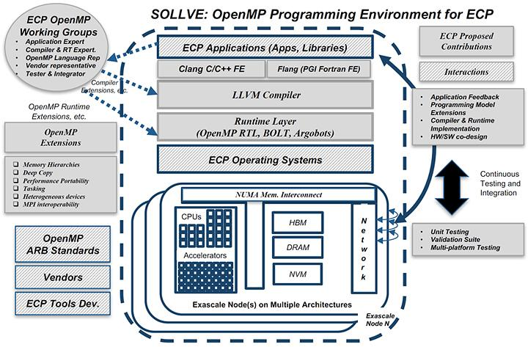
Using ECP’s SOLLVE for your Applications
SOLLVE is a project to develop OpenMP for exascale
Can link it to your app through following http://github.com/SOLLVE/sollve
I’m working on making it available on Spack.

Slide 13
Acknowledgements
Michael Klemm from Intel for general discussion and key points from OpenMP Technical Report 7.
Kent Millfield from TACC for examples for tips and tricks.
Chris Daley from NERSC @ LBNL for discussion of OpenMP offloading.

Slide 14
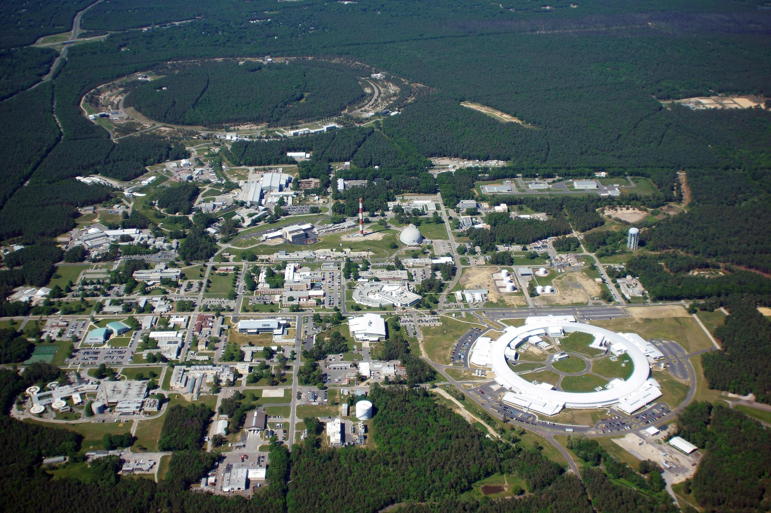
Brookhaven National Laboratory
Research Facilities
RHIC
NSRL
Computing Facility
Interdisciplinary Energy Science Building
Computational Science Initiative
CFN
NSLS-II
Long Island Solar Farm
Notes:
Optional to use this slide to introduce facilities or use next page slide

