Slide 1
Kirill Lozinskiy
NERSC Storage Systems Group
GPFS
&
HPSS
Interface (GHI)

Slide 2
Topics
Overview
  IBM Spectrum Scale | General Parallel File System (GPFS)
  High Performance Storage System (HPSS)
GPFS/HPSS Interface (GHI)
  GPFS HSM space management with ILM
  GPFS disaster recovery

Slide 3
Overview

Slide 4
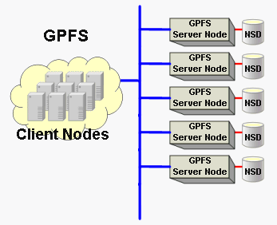
IBM Spectrum Scale
General Parallel File System (GPFS)
What is GPFS?

Slide 5
IBM Spectrum Scale
General Parallel File System (GPFS)
What is GPFS?
  A true parallel and clustered file system
  Performance and scalability
  Transparent cloud tiering
  Simplified administration
  Information Lifecycle Management (ILM) policy scans
  And more. . .

Slide 6

HPSS?
What is HPSS?

Slide 7
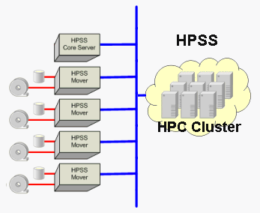
High Performance Storage System (HPSS)
Hierarchical storage manager (HSM)
  Disk
  Tape
  Object
HPSS system components
  HPSS Core Server
  HPSS Data Mover
Primarily tape oriented
Designed for very large (exascale) HPC storage
Developed in collaboration by five DOE Labs and IBM

Slide 8
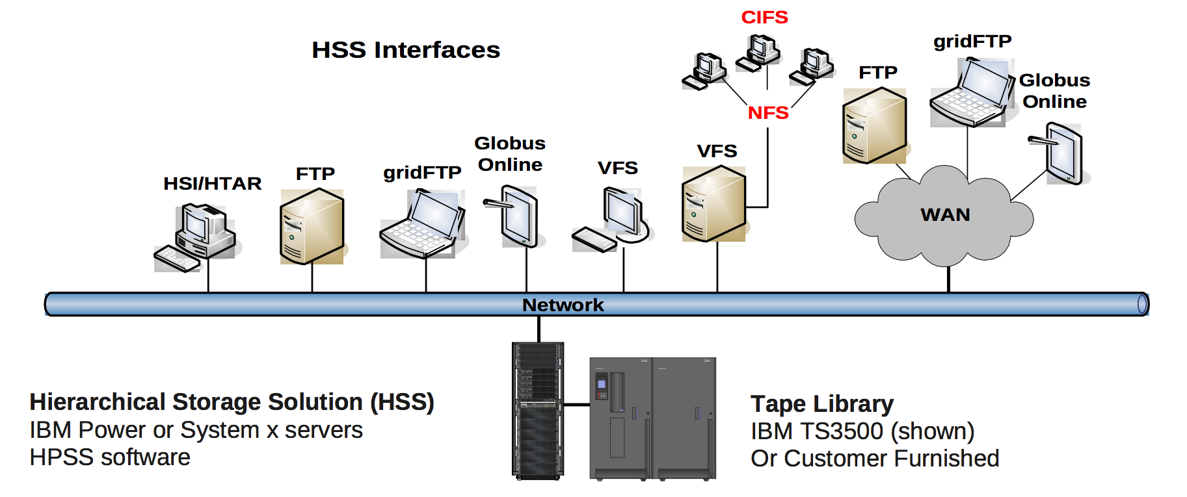
High Performance Storage System (HPSS)
Data protection
  Redundant Array of Independent Tapes (RAIT)
  Mirroring
Clients

Slide 9

Who uses HPSS?

Slide 10

High Performance Storage System (HPSS)
First NERSC deployment in 1998
100+ PB of data
Over 230 million files
~ 5 PB of disk cache
Grows at more than 1 PB per month
40 years of scientific data

Slide 11
GPFS/HPSS Interface (GHI)

Slide 12
GPFS/HPSS Interface (GHI)
GHI primary functions
  Space management
    Migrate
    Purge
    Recall
  Disaster recovery
    Backup
    Restore

Slide 13
GPFS/HPSS Interface (GHI)
GPFS HSM space management / file migrations
  GPFS Data Management API (DMAPI) notifies GHI of events
  HPSS references are stored as GPFS extended attributes
  GPFS ILM scans and policies
    ILM scans billions of files in minutes
    Files are continuously identified and migrated/purged/recalled to/from HPSS per policy
  If GPFS reaches a space threshold, candidates are purged
  When a user requests a file in HPSS, GHI stages it back
  Small files are aggregated with a tar like utility to improve performance
  Policy rules provide robust data management solutions

Slide 14
GPFS/HPSS Interface (GHI)
GPFS disaster recovery
  Provides continuous backup via GPFS snapshots
  Stores a snapshot of an entire GPFS cluster
    Namespace
    File attributes
    ACLs
    DMAPI attributes
  Restore aims to bring GPFS back as fast as possible
  ILM stages files back based on specified priority

Slide 15
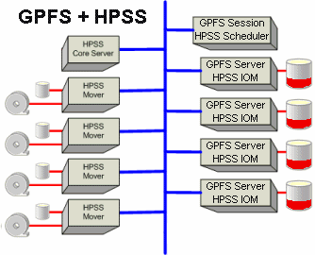
GPFS/HPSS Interface (GHI)
http://www.hpss-collaboration.org/hpss_for_gpfs.shtml

Slide 16
Questions?

