Slide 1
Dan Udwary and Tony Wildish NERSC Data Science Engagement Group August 24 and 31, 2017
Slurm Workshop
Intro

Slide 2
The State of JGI Computing at NERSC
Four HPC systems available to you:
Genepool
Denovo – test cluster for next version of Genepool
Genepool hardware with newer OS, SLURM, Shifter
Currently 2 login nodes + 6 compute nodes
Edison
Large system, fairly reliable, but system is aging
Jobs are charged, and no JGI Compute Capacity
Cori, with multiple options:
“Regular” Cori – charged like Edison
9688 68-core 96GB Knight’s Landing (KNL) nodes
2388 32-core 128GB Haswell nodes
JGI Cori Compute Capacity – charged to special JGI repos
192 Haswell nodes

Slide 3
A Timeline In Pictures (all of this is subject to change!)
Today
Jan 2018
Mar 2019
2020ish
High memory pool?
?
Genepool
(UGE)
Mendel
Hardware
Denovo
(Slurm)
Mendel goes
out of warranty
Cori
JGI compute
capacity
Early testing
Production availability
High memory pool?
Edison
NERSC-9
Construction
Deployment

Slide 4
The State of Denovo
Currently a small test cluster
OpenSUSE
SLURM, Shifter available
Some software modules available
Intention was to migrate Genepool to Denovo configuration this month
Testing revealed severe issues with system configuration
Limited system admin support to fix those issues
Migration delayed to end of 2017 calendar year
Expect us to encourage more user testing again very soon!

Slide 5
The State of Cori
Cori is NERSC’s flagship HPC
Still somewhat experimental, with new KNL node types
Challenges to system stability, optimization of scheduling
JGI has also purchased “Cori Compute Capacity”
192 nodes at a time reserved exclusively for JGI use
Usage charged to special JGI repos
Currently in early-access testing. Expecting to open in Jan

Slide 6
Documentation and Hands-On
NERSC Slurm webpages:
http://www.nersc.gov/users/computational-systems/cori/running-jobs/slurm-at-nersc-overview/
Cori for JGI users webpage
https://www.nersc.gov/users/computational-systems/genepool/cori-for-jgi/
Running Jobs on Cori
https://www.nersc.gov/users/computational-systems/cori/running-jobs/
man pages for slurm, sbatch, salloc, squeue, sinfo, sacct, scontrol, scancel, etc.
SchedMD web page:
http://www.schedmd.com/
Exercises used in a previous Slurm training:
https://github.com/Wildish-LBL/SLURM-demo/
http://www.nersc.gov/assets/Uploads/SLURMTraining-Oct13-2016.pptx

Slide 7
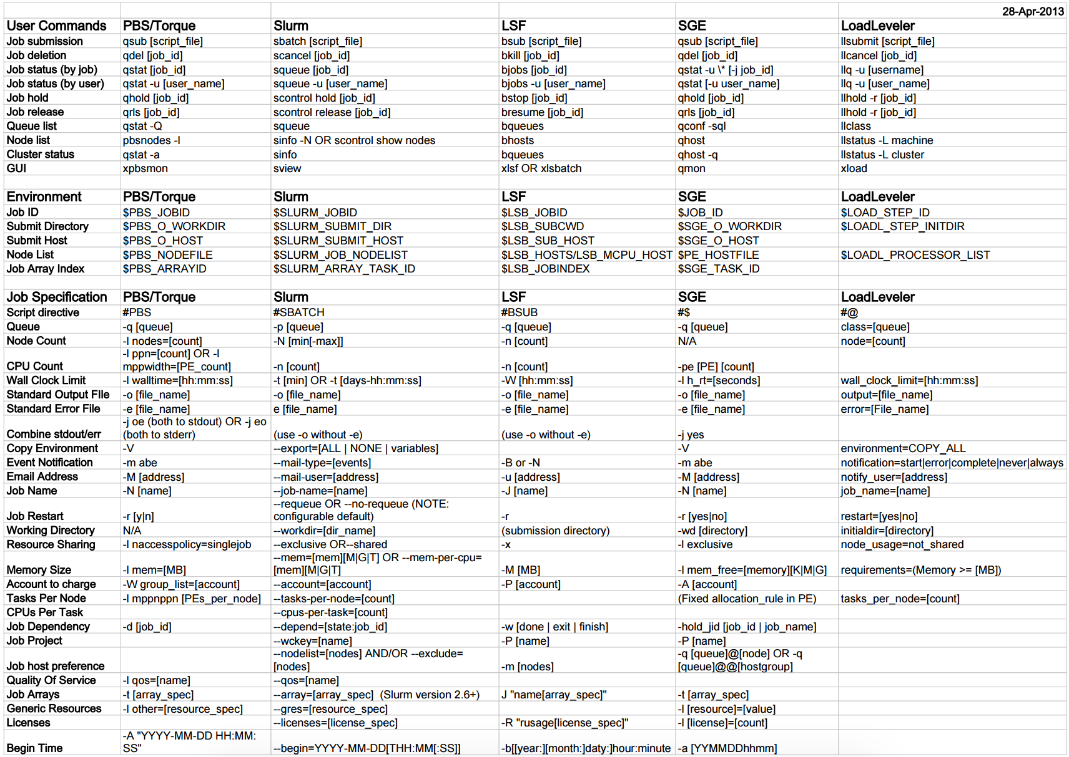
http://slurm.schedmd.com/rosetta.pdf

Slide 8
Some terminology
Node = Physical space where all the hardware lives
CPU, memory, cache, networking
Core = CPU = processor – unit that does computation
Thread = the road that goes through the CPU
Hyperthreading = two (or more) roads go through the CPU
So: A hyperthreaded 32-core node = 64 “virtual” cores

Slide 9
Job Charging
You MUST understand how accounting works, and how your job will be charged before you submit your job.
Mistakes can’t be undone once a job has run!
By default, JGI users run on Cori and Edison under a single repo (m342), which is shared by all of JGI
~11 million compute-hours remaining
Most JGI users have access to this account
It is possible for users to deplete the account!
The JGI Compute Capacity uses a separate accounting system
192 nodes set aside awaiting JGI use
Selected with a special qos (other qos/partition settings unavailable)
Talk to a consultant if you would like early access to this.
Unlike Genepool, jobs are still charged. It will be possible to deplete your project’s account!

Slide 10
UGE Scheduling vs Slurm Scheduling
UGE uses a concept of slots
On Genepool, 1 slot = 1 core + associated memory
JSV – takes your input and shapes the job to fit
Memory per slot can be confusing to consider
“-pe pe_16 16 -l ram.c=5G”
Slurm (on Cori JGI qos and Denovo) allows free scheduling
You pick the cores, memory (and nodes)
“--cpus_per_task=16 --ntasks=1 --mem=80000”
“-c 16 –n 1 –mem=80000”
Many other choices for partitions and qos on regular Cori

Slide 11
Slurm submission requirements
Cori –qos=jgi
Denovo
--qos=jgi
-A youraccount
-C haswell
-c # can be 1-64
--mem=<MB up to ~120G>
-t <minutes or h:min:sec>
-n 1 #unless MPI
-N 1 #unless MPI or TF
No qos on Denovo (yet)
Default accounts?
No node-types required
-c #depends on node-type
--mem=<MB>
-t <minutes or h:min:sec>
-n 1 #unless MPI
-N 1 #unless MPI or TF

Slide 12
Charge Calculations
Projects are assigned an allocation, and users who are part of that project draw from that allocation when they run jobs.
Number
of cores
per node
Machine
“charge
factor”
Quality of
service
(qos)
Wall
time
(hours)
Number
of nodes
x
x
x
x
Cori=2.5
Edison=2.0
Denovo=0
increases
job priority

Slide 13
The Key Slurm Commands
“sbatch”
Functionally, similar to “qsub”
Submit a script to the scheduler, to run on a new compute allocation
Can put resource requests on the sbatch command line, or in script headers
MUST specify CPU type on Cori with “–C haswell” or “–C knl”
Default = 1 node, “regular” partition, “normal” qos, for 30 min
#!/bin/bash -l
#SBATCH --qos=jgi
#SBATCH –A fungalp
#SBATCH –C haswell
#SBATCH –N 10
#SBATCH --time=00:30:00
module load python
python my_multinode_script.py
$ sbatch --qos=jgi –A \
fungalp –C haswell \
–N 10 --time=00:30:00 \
myscript.sh
or

Slide 14
The Key Slurm Commands
“salloc”
Requests a compute allocation
On Cori, operates similarly to the “qlogin” command
Will automatically ssh you into the first node granted to you
(This is not default SLURM behavior, and doesn’t yet work this way on Denovo)
Use the same sorts of resource request as for sbatch
$ salloc --qos=jgi –A fungalp –C haswell

Slide 15
The Key Slurm Commands
“srun”
An sbatched script will run on the first node of the allocation. Use “srun” within script or interactive session to run a parallel command within your allocation, usually across multiple nodes
Similar to “mpirun” for MPI, or “aprun” in Torque/MOAB
No need to repeat flags in the srun command if already defined in SBATCH keywords.
srun flags overwrite SBATCH keywords
Unless you’re using mpi, you probably don’t need to use this in simple scripts.

Slide 16
Slurm Task arrays
Task arrays work similarly to UGE
sbatch --array=1-100
Would start a 100 task job array
Job arrays will have two additional environment variables set:
$SLURM_ARRAY_JOB_ID will be set to the first job ID of the array.
$SLURM_ARRAY_TASK_ID will be set to the job array index value.

Slide 17
Non-Slurm considerations in converting your workflow
Are the software modules you use available?
Lots of system software and programming needs are
If not, and it’s bioinformatics, can you replace them?
Containers (Docker/Shifter)
Anaconda
Compile and maintain your own copy
Is there an upgrade you should adapt to?
Ask a consultant to install a module
Must be widely used throughout JGI
Need a compelling case for why it should be a module
Which system(s) does the module need to be on?

Slide 18
Non-Slurm considerations in converting your workflow
Lots of I/O? Many jobs utilizing the same files?
Consider using the Burst Buffer on Cori
Persistent BB options – ie Blast databases
Using a pipeline with threading variability?
ie mostly single-threaded operations, but maybe with multithreaded operations mixed in
Consider a workflow manager
Avoid getting charged for idle CPUs!
Long run times? (3-day limit on Cori JGI qos)
Checkpointing
Denovo will have longer runtime limit options

Slide 19
Let’s convert this to Slurm on Cori
#!/bin/bash –l
#$ -pe pe_8 8
#$ -l h_rt=10:00:00
#$ -t 1-1000:1
#$ -l ram.c=4G
#$ -cwd
#$ -tc 10
module load blast+
module load python
blastp –query $BSCRATCH/inputs/$SGE_TASK_ID.faa \
-db /global/dna/somewhere/mydb \
-out $BSCRATCH/outputs/$SGE_TASK_ID.out \
-num_threads 8 –outfmt 6 –evalue 1E10
python $BSCRATCH/bin/analyze_results.py –in $SGE_TASK_ID.out

