Slide 1
Dan Udwary and Tony Wildish NERSC Data Science Engagement Group October 13, 2016
SLURM Workshop

Slide 2
Outline
Differences between Crays and Genepool
Cori and Edison architecture and configurations
Queues and QOS
Job accounting and charge rates
Intro to SLURM
Commands and submission scripting
Monitoring your jobs
Hands-on
Get an interactive session
Write and submit jobs with SLURM

Slide 3
Key Differences Between Cori/Edison and Genepool
Cori and Edison
Genepool
Generally large, multi-node jobs
Jobs are charged
Wait time until job start measured in days
Users generally compile and install their own software – few modules
SLURM
Many small, single node and single-CPU jobs
No job charging
Wait time measured in hours, if not minutes
Awesome JGI consultants manage bioinformatics software as modules
UGE (moving to SLURM in
2017)

Slide 4
Basics of NERSC Cray architecture
Cori Phase I
Cray XC
1630 nodes
128 GB memory per node
32 cores per node
(2x16 core 2.3 GHz Haswell)
Cori Phase II in a few weeks
>9300 nodes
Knights Landing CPUs
68 cores/272 threads
96GB + 16GB high bwmemory
Edison
Cray XC30
5576 nodes
64 GB memory per node
24 cores per node
(2x12 core 2.4 GHz Ivy Bridge)
Clear trend toward multi-core, parallelism

Slide 5
What’s this about a charge?
Projects are assigned an allocation, and users who are part of that project draw from that allocation when they run jobs.
Number
of cores
per node
Machine
“charge
factor”
Quality of
service
(qos)
Wall
time
(hours)
Number
of nodes
x
x
x
x
Cori=2.5
Edison=2.0
increases
job priority
As of this morning, JGI allocation is 1.7M remaining

Slide 6
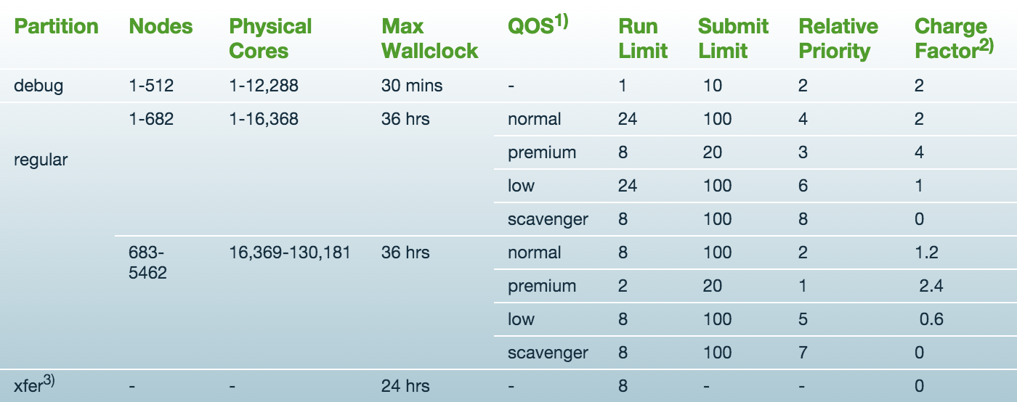
Edison Queue Structure
https://www.nersc.gov/users/computational-systems/edison/running-jobs/queues-and-policies/
So, until Cori Phase II adjustments, Edison is intended for
large parallel jobs using >682 nodes

Slide 7
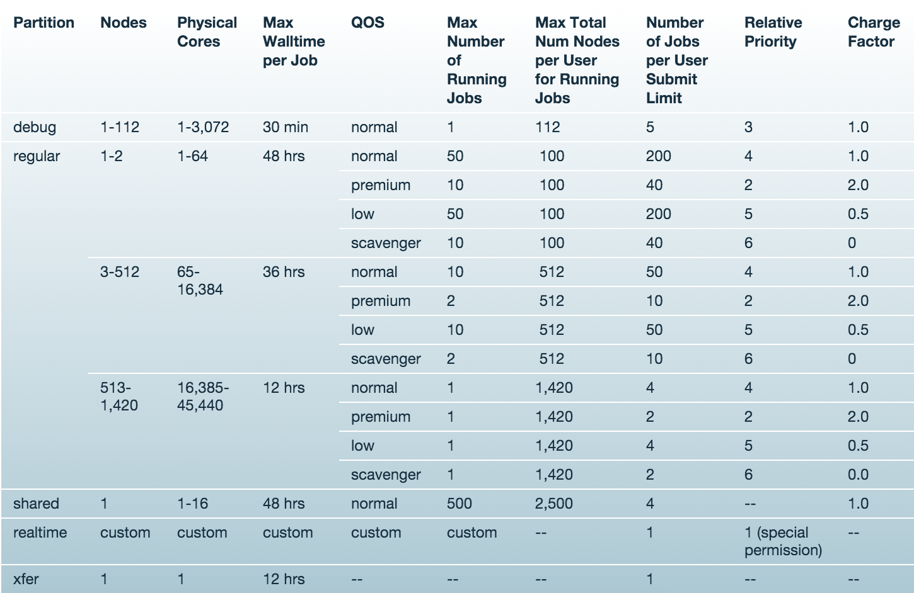
Cori Phase I queue structure
https://www.nersc.gov/users/computational-systems/cori/running-jobs/queues-and-policies/

Slide 8
What is SLURM?
In simple word, SLURM is a workload manager, or a batch scheduler, just like UGE
SLURM = Simple Linux Utility for Resource Management.
Open source
SLURM is used majority of top 10 computers.
Cori installed with SLURM, and Edison switched last Nov, after its move
Genepool will move to SLURM sometime in 2017
New Genepool test server, Denovo, is already running it

Slide 9
Advantages of Using SLURM
Fully open source.
SLURM is extensible (plugin architecture)
Low latency scheduling. Highly scalable.
Integrated “serial” or “shared” queue
Integrated Burst Buffer support
Good memory management
Built-in accounting and database support
Strategic: Moving Genepool to SLURM brings us closer to the rest of NERSC

Slide 10
SLURM User Commands
sbatch qsub submit a batch script
salloc qlogin request an interactive session
scancel qdel delete a batch job
scontrol hold qhold hold a job
scontrol release qrls release a job
sacct qacct display job accounting data
sqs qs NERSC custom queue display

Slide 11
Running with SLURM
Use “sbatch” (as “qsub” in UGE) to submit batch script or “salloc” (as “qlogin” in UGE) to request interactive batch session.
Need to specify which shell to use for batch script.
Environment is automatically imported (as “qsub -V” in UGE)
Lands on the submit directory
Batch script runs on the head compute node
No need to repeat flags in the srun command if already defined in SBATCH keywords.
Hyperthreading is enabled by default. Jobs requesting more than 32 cores (MPI tasks * OpenMP threads) per node will use hyperthreads automatically.

Slide 12
Running with SLURM continued
Use “srun” to launch parallel jobs (as with “aprun” with Torque/Moab)
srun flags overwrite SBATCH keywords
srun does most of optimal process and thread binding automatically. Only flags such as “-n” “-c”, along with OMP_NUM_THREADS are needed for most applications. Advanced users can experiment more options such as –num_tasks_per_socket, –cpu_bind, --mem, etc.

Slide 13
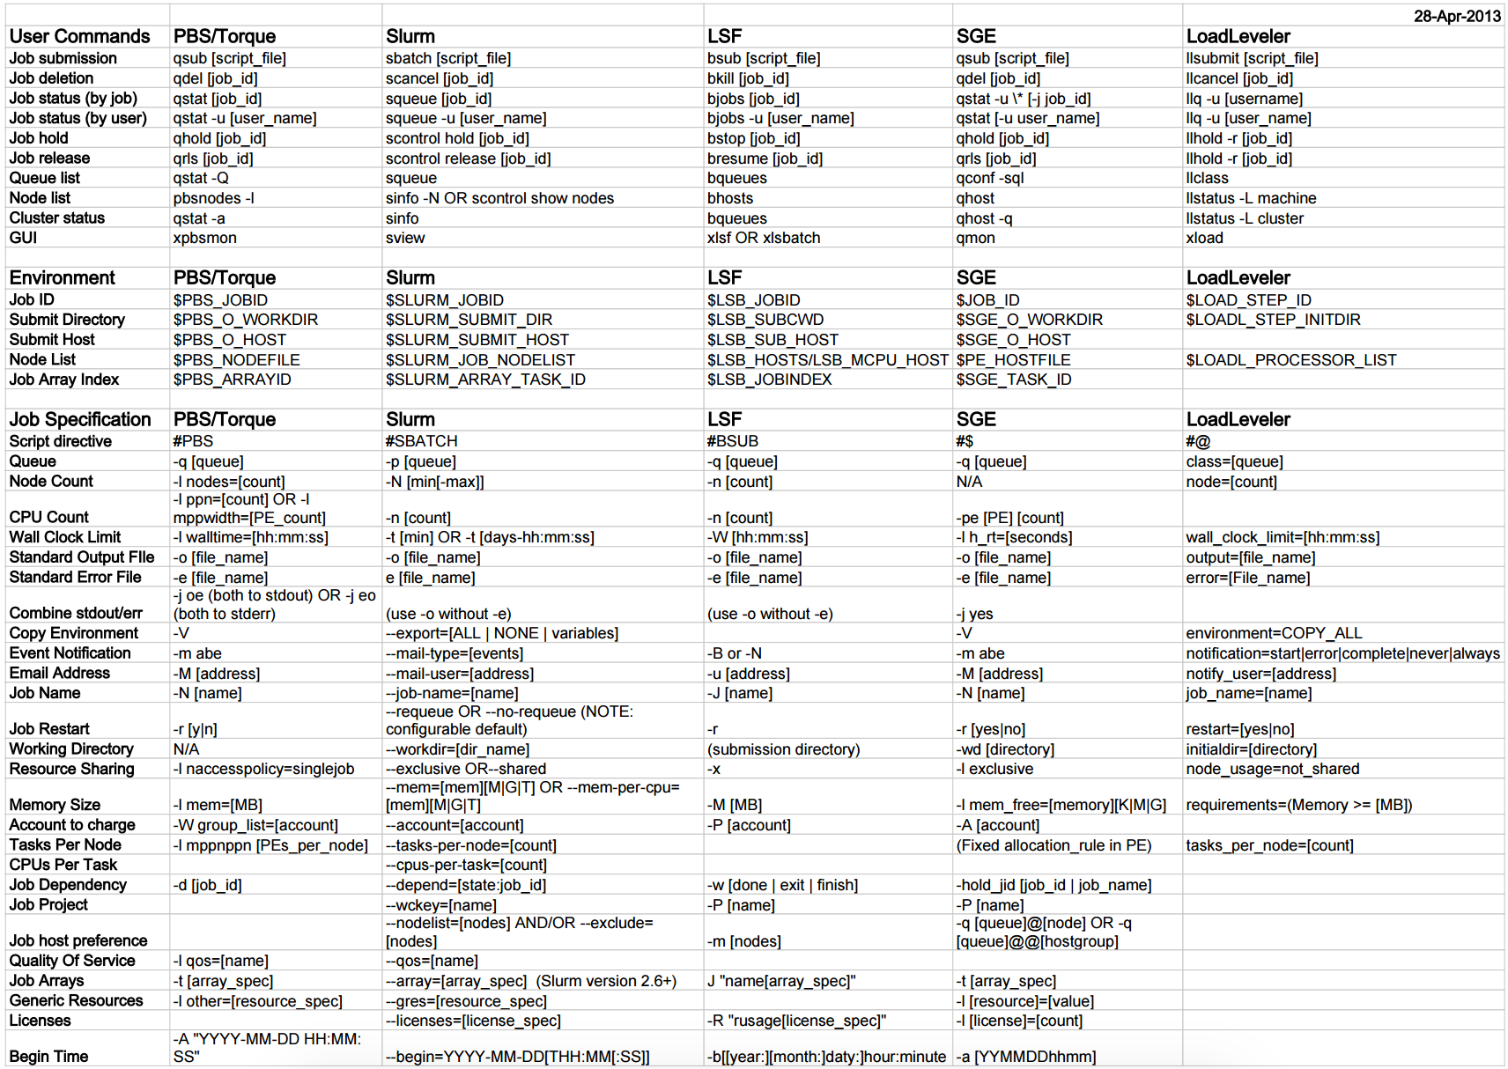
http://slurm.schedmd.com/rosetta.pdf

Slide 14
SLURM Task arrays
Task arrays work similarly to UGE
sbatch --array=1-100
Would start a 100 task job array
Job arrays will have two additional environment variables set:
$SLURM_ARRAY_JOB_ID will be set to the first job ID of the array.
$SLURM_ARRAY_TASK_ID will be set to the job array index value.

Slide 15
Sample SLURM Batch Script
Long command options
Short command options
#!/bin/bash -l
#SBATCH --partition=regular
#SBATCH --job-name=test
#SBATCH --account=mpccc
#SBATCH --nodes=2
#SBATCH --time=00:30:00
srun -n 16 ./mpi-hello
export OMP_NUM_THREADS=8
srun -n 8 -c 8 ./xthi
#!/bin/bash -l
#SBATCH -p regular
#SBATCH -J test
#SBATCH -A mpccc
#SBATCH -N 2
#SBATCH -t 00:30:00
srun -n 16 ./mpi-hello
export OMP_NUM_THREADS=8
srun -n 8 -c 8 ./xthi
To submit a batch job:
% sbatch mytest.sl
Submitted batch job 15400

Slide 16
A Spooky SLURM Story
A user types:
> sbatch -N 1024 -n 1024 -a 1-1024 mySingleThreadedRScript.sh
Suddenly, his entire allocation disappears!!!
(What happened here?)

Slide 17
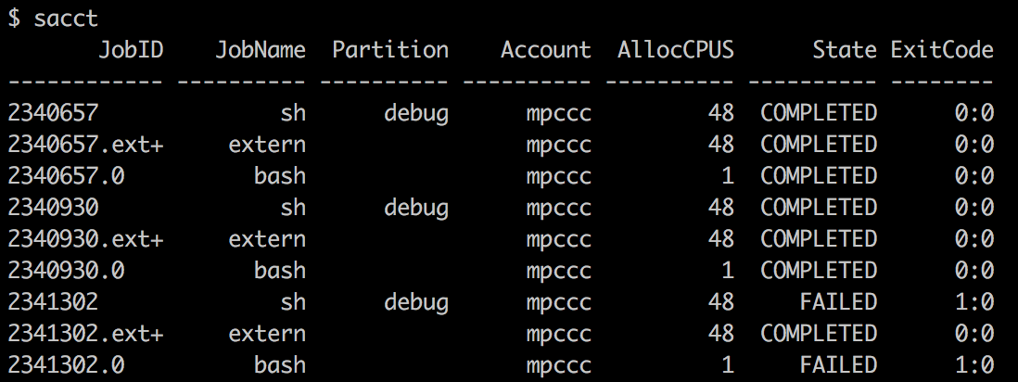
Monitoring your jobs
sqs – See queued and running jobs
Similar to Genepool qs or qstat
Is a NERSC-written wrapper for SLURM’s native “sinfo”
RANK_P and RANK_BF show the job’s ranks
sacct – See recently completed jobs
Similar to
Genepool’s
qacct or
qqacct

Slide 18
SLURMmary
SLURM is coming to Genepool!
SLURM provides equivalent or similar functionality with Torque/Moab and UGE.
There should be SLURM equivalents for nearly all UGE settings
Please let us know if you have an advanced or complicated workflow, and anticipate potential porting issues. We can work with you to migrate your scripts.
consult@nersc.gov
(and be sure to mention you’re a JGI user)

Slide 19
Documentation
SchedMD web page:
http://www.schedmd.com/
Running Jobs on Cori
https://www.nersc.gov/users/computational-systems/cori/running-jobs/
man pages for slurm, sbatch, salloc, squeue, sinfo, sacct, scontrol, scancel, etc.

Slide 20
Hands-On – Get an interactive login
Reservation: --reservation=jgitrain1013
Sample scripts and other materials:
https://github.com/Wildish-LBL/SLURM-demo/archive/master.zip
Log into an Edison login node
Request an interactive session with 48 cores for 30 min (be sure to use your reservation!)
How many nodes are you on? Why?
Hint: There are $SLURM_xx env variables…
Have a look at your jobs with the accounting tools

Slide 21
Hands On – Do some work!
Goal: We need to blastp unknown sequences against a specific database
query1 and query2 from training materials
db: /global/dna/shared/databases/ncbi/nr/2014-02-07/nr
Task 0: Where’s the blast+ module?
Task 1: Do it interactively
Task 2: Write a submission script
Task 3: Write a submission script to do both blasts at the same time

