Slide 1
Dan Udwary and Tony Wildish NERSC Data Science Engagement Group August 24 and 31, 2017
Denovo/Cori/SLURM Training

Slide 2
Outline
The future of JGI computing: Denovo, Cori, and beyond
Genepool/Denovo/Cori timelines
What you need to know about Cori, and how it differs
JGI’s Cori Compute Capacity
“Regular” Cori and KNL nodes
Job charging
SLURM
How to access the JGI Cori Compute Capacity
Shifter
Burst Buffer
Cori testimonials from JGI users
Open discussion

Slide 3
What can we accomplish today?
Many users of varying skillsets here
Many topics to cover
You will need to do more work outside of this session to get yourself ready for the coming changes!
We’re going to give you the broad strokes with time we have today, and point you to additional resources
We can and will run more training sessions as needed

Slide 4
The State of JGI Computing at NERSC
Four HPC systems available to you:
Genepool
Denovo – test cluster for next version of Genepool
Genepool hardware with newer OS, SLURM, Shifter
Currently 2 login nodes + 6 compute nodes
Edison
Large system, fairly reliable, but system is aging
Jobs are charged, and no JGI Compute Capacity
Cori, with multiple options:
“Regular” Cori – charged like Edison
9688 68-core 96GB Knight’s Landing (KNL) nodes
2388 32-core 128GB Haswell nodes
JGI Cori Compute Capacity – charged to special JGI repos
192 Haswell nodes

Slide 5
A Timeline In Pictures (all of this is subject to change!)
Today
Jan 2018
Mar 2019
2020ish
High memory pool?
?
Genepool
(UGE)
Mendel
Hardware
Denovo
(SLURM)
Mendel goes
out of warranty
Cori
JGI compute
capacity
Early testing
Production availability
High memory pool?
Edison
NERSC-9
Construction
Deployment

Slide 6
The State of Genepool
Genepool is fairly stable, and most users have adapted to its quirks
Heterogeneous node configurations
Parallel filesystem slowdowns our most common issue
UGE (unlike the rest of NERSC)
Heavy use of bioinformatics software through hundreds of modules has caused difficulties in porting JGI workloads to new systems.
Too much software for Consultants to maintain adequately
NERSC is encouraging JGI to move from module system to containers
Limited capability to introduce new technology due to obsolete OS

Slide 7
The State of Denovo
Currently a small test cluster
Scientific Linux 6.9
SLURM, Shifter available
Some software modules available
Intention was to migrate Genepool to Denovo configuration this month
Testing revealed severe issues with system configuration
Limited system admin support to fix those issues
Migration delayed to end of 2017 calendar year
Expect us to encourage more user testing again very soon!

Slide 8
The State of Cori
Cori is NERSC’s flagship HPC
Still somewhat experimental, with new KNL node types
Challenges to system stability, optimization of scheduling
JGI has also purchased “Cori Compute Capacity”
192 nodes at a time reserved exclusively for JGI use
Usage charged to special JGI repos
Currently in early-access testing. Expecting to open in Jan

Slide 9
Scratch Filesystems
All GPFS filesystems are available on Cori, Edison
/global/projectb/scratch/$USER
/global/dna
projectdirs, sandboxes
Cori, Edison have their own $SCRATCH
Edison scratch is not accessible outside Edison
Cori scratch IS accessible from Edison
Cori scratch IS NOT accessible from Genepool/Denovo
Burst Buffer only accessible on Cori
Performance of scratch systems will vary by machine

Slide 10
Job Charging
You MUST understand how accounting works, and how your job will be charged before you submit your job.
Mistakes can’t be undone once a job has run!
By default, JGI users run on Cori and Edison under a single repo (m342), which is shared by all of JGI
~11 million compute-hours remaining
Most JGI users have access to this account
It is possible for users to deplete the account!
The JGI Compute Capacity uses a separate accounting system
192 nodes set aside awaiting JGI use
Selected with a special qos (other qos/partition settings unavailable)
Talk to a consultant if you would like early access to this.
Unlike Genepool, jobs are still charged. It will be possible to deplete your project’s account!

Slide 11
Charge Calculations
Projects are assigned an allocation, and users who are part of that project draw from that allocation when they run jobs.
Number
of cores
per node
Machine
“charge
factor”
Quality of
service
(qos)
Wall
time
(hours)
Number
of nodes
x
x
x
x
Cori=2.5
Edison=2.0
increases
job priority

Slide 12
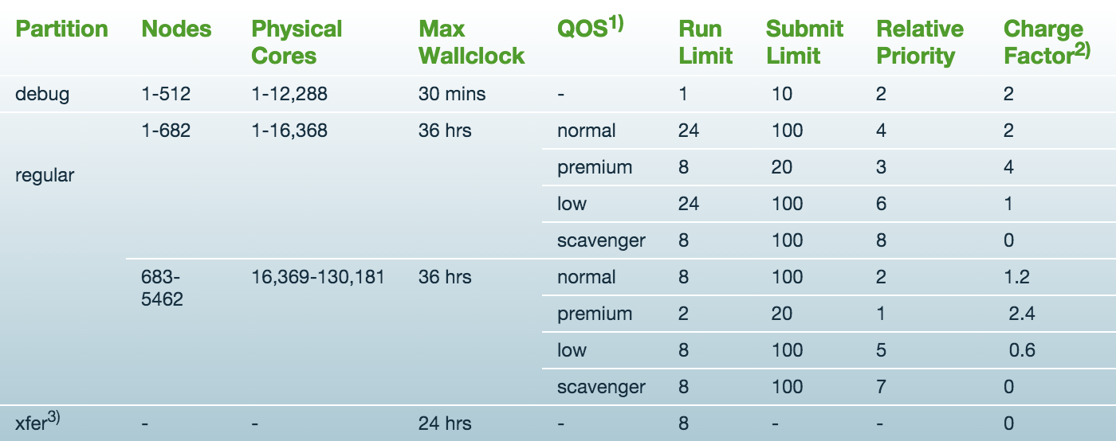
Edison Queue Structure
https://www.nersc.gov/users/computational-systems/edison/running-jobs/queues-and-policies/

Slide 13
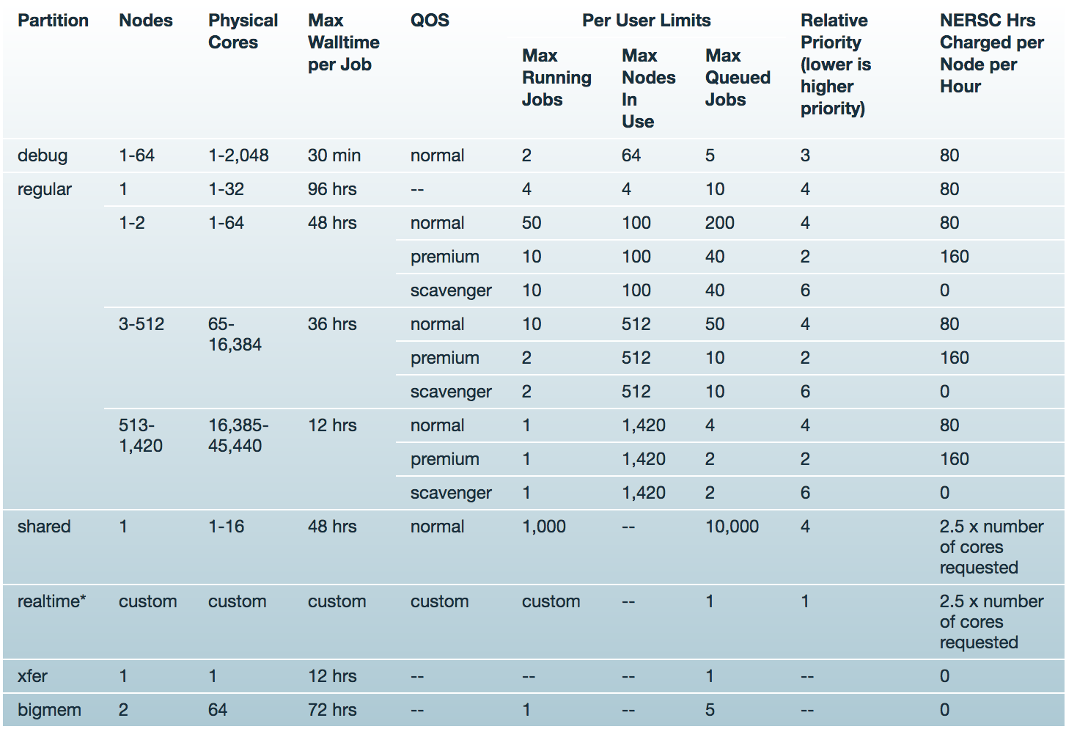
Cori queue structure (Haswell)

Slide 14
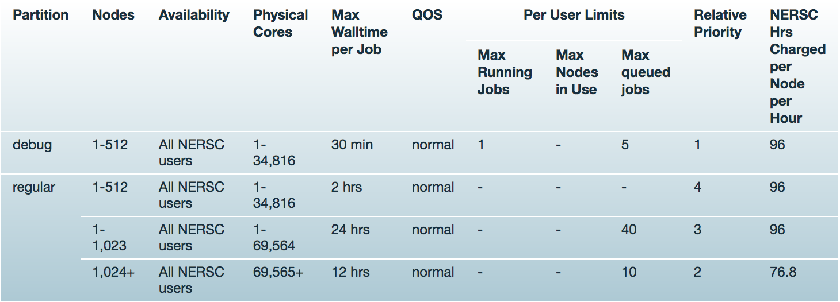
Cori queue structure (KNL)
https://www.nersc.gov/users/computational-systems/cori/running-jobs/queues-and-policies/
These settings DO NOT APPLY to the JGI Compute Capacity!!

Slide 15
Dan Udwary and Tony Wildish NERSC Data Science Engagement Group August 24, 2017
SLURM

Slide 16
What is SLURM?
SLURM is a workload manager, or a batch scheduler, just like UGE
SLURM = Simple Linux Utility for Resource Management.
Open source
SLURM is used on majority of top 10 computers.
Genepool will entirely move to SLURM sometime in 2018
Denovo is already running it

Slide 17
Advantages of Using SLURM
Fully open source – many modifications made at NERSC
SLURM is extensible (plugin architecture)
Low latency scheduling. Highly scalable.
Integrated “serial” or “shared” queue
Integrated Burst Buffer support
Good memory management
Built-in accounting and database support
Strategic: Moving Genepool to SLURM brings us closer to the rest of NERSC

Slide 18
SLURM User Commands
sbatch qsub submit a batch script
salloc qlogin request an interactive session
srun run a command in your allocation
scancel qdel delete a batch job
scontrol hold qhold hold a job
scontrol release qrls release a job
sacct qacct display recent job accounting data
sqs, squeue qs NERSC custom queue displays

Slide 19
The Key SLURM Commands
“sbatch”
Functionally, similar to “qsub”
Submit a script to the scheduler, to run on a new compute allocation
Can put resource requests on the sbatch command line, or in script headers
MUST specify CPU type on Cori with “–C haswell” or “–C knl”
Default = 1 node, “regular” partition, “normal” qos, for 30 min
#!/bin/bash -l
#SBATCH --qos=jgi
#SBATCH –A fungalp
#SBATCH –C haswell
#SBATCH –N 10
#SBATCH --time=00:30:00
module load python
python my_multinode_script.py
$ sbatch --qos=jgi –A \
fungalp –C haswell \
–N 10 --time=00:30:00 \
myscript.sh
or

Slide 20
The Key SLURM Commands
“salloc”
Requests a compute allocation
On Cori, operates similarly to the “qlogin” command
Will automatically ssh you into the first node granted to you
(This is not default SLURM behavior, and doesn’t yet work this way on Denovo)
Use the same sorts of resource request as for sbatch
$ salloc --qos=jgi –A fungalp –C haswell

Slide 21
The Key SLURM Commands
“srun”
An sbatched script will run on the first node of the allocation. Use “srun” within script or interactive session to run a parallel command within your allocation, usually across multiple nodes
Similar to “mpirun” for MPI, or “aprun” in Torque/MOAB
No need to repeat flags in the srun command if already defined in SBATCH keywords.
srun flags overwrite SBATCH keywords
srun does optimal process and thread binding automatically. Only flags such as “-n” “-c”, along with OMP_NUM_THREADS are needed for most applications.
More options such as --num_tasks_per_socket, --mem, etc.

Slide 22
Sample SLURM Batch Script
Long command options
Short command options
#!/bin/bash -l
#SBATCH --partition=regular
#SBATCH --job-name=test
#SBATCH --account=mpccc
#SBATCH --nodes=2
#SBATCH --time=00:30:00
srun -n 16 ./mpi-hello
export OMP_NUM_THREADS=8
srun -n 8 -c 8 ./xthi
#!/bin/bash -l
#SBATCH -p regular
#SBATCH -J test
#SBATCH -A mpccc
#SBATCH -N 2
#SBATCH -t 00:30:00
srun -n 16 ./mpi-hello
export OMP_NUM_THREADS=8
srun -n 8 -c 8 ./xthi

Slide 23
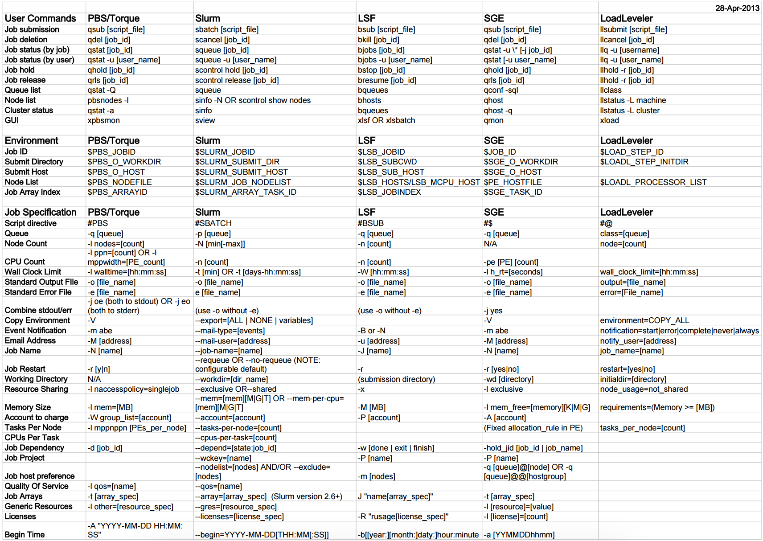
http://slurm.schedmd.com/rosetta.pdf

Slide 24
SLURM Task arrays
Task arrays work similarly to UGE
sbatch --array=1-100
Would start a 100 task job array
Job arrays will have two additional environment variables set:
$SLURM_ARRAY_JOB_ID will be set to the first job ID of the array.
$SLURM_ARRAY_TASK_ID will be set to the job array index value.

Slide 25
A True SLURM Story
A user types:
> sbatch -N 1024 -a 1-1024 mySingleThreadedRScript.sh
Suddenly, 10% of the entire JGI allocation disappears!!!
(What happened here?)

Slide 26
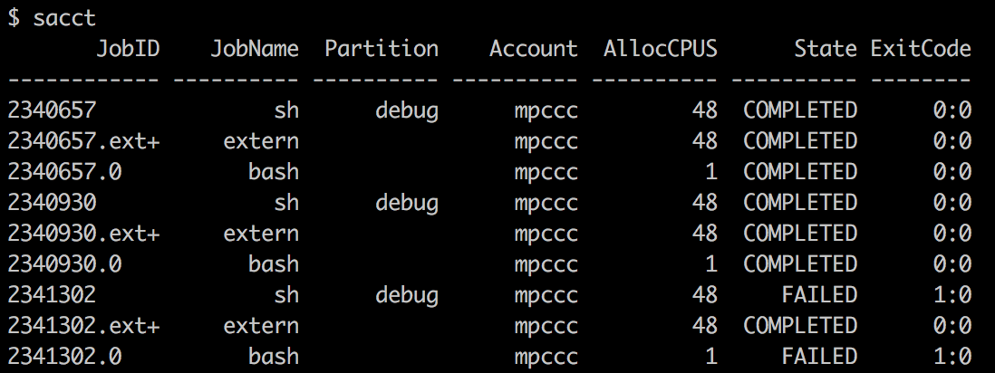
Monitoring your jobs
sqs – See queued and running jobs
Similar to Genepool qs or qstat
Is a NERSC-written wrapper for SLURM’s native “sinfo”
RANK_P and RANK_BF show the job’s ranks
sacct – See recently completed jobs
Similar to
Genepool’s
qacct or
qqacct

Slide 27
Documentation and Hands-On
Cori for JGI users webpage
https://www.nersc.gov/users/computational-systems/genepool/cori-for-jgi/
Running Jobs on Cori
https://www.nersc.gov/users/computational-systems/cori/running-jobs/
man pages for slurm, sbatch, salloc, squeue, sinfo, sacct, scontrol, scancel, etc.
SchedMD web page:
http://www.schedmd.com/
Exercises used in a previous SLURM training:
https://github.com/Wildish-LBL/SLURM-demo/
http://www.nersc.gov/assets/Uploads/SLURMTraining-Oct13-2016.pptx

