Slide 1
Running VASP on Cori KNL
Zhengji Zhao
User Engagement Group
Hands-on VASP User Training, Bekerley CA
June 18, 2019

Slide 2
Outline
Available VASP modules
Running VASP on Cori
Performance of Hybrid MPI+OpenMP VASP
Using “flex” QOS on Cori KNL
Summary
Hands-on (11:00am-2:00pm PDT)

Slide 3
Available VASP modules
The precompiled VASP binaries are available via modules.
module load vasp #to access the VASP binaries
module avail vasp #to see the available modules
module show vasp #to see what vasp modules do

Slide 4
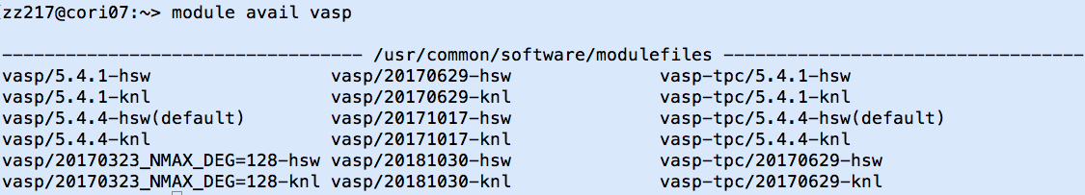
Available VASP modules on Cori
Type “module avail vasp” to see the available VASP modules
Three different VASP builds
-knl: for KNL; -hsw: for Haswell
vasp/5.4.4, vasp/5.4.1,…: pure MPI VASP
vasp-tpc: VASP with third party codes (Wannier90,VTST,BEEF,VASPSol) enabled
vasp/20181030-knl: hybrid MPI+OpenMP VASP
vasp/20170323_NMAX_DEG=128: builds with NMAX_DEG=128

Slide 5
Available VASP modules on Cori (cont.)
Type “ls –l <bin directory>” to see the available VASP binaries
Do “module load vasp” to access the VASP binaries
VTST Scripts, pseudo potential files and makefiles are available (check the installation directories)
zz217@cori03:~> ls -l /global/common/sw/cray/cnl6/haswell/vasp/5.4.4/intel/17.0.2.174/4bqi2il/bin
total 326064
-rwxrwxr-x 1 swowner swowner 110751840 Feb 10 14:59 vasp_gam
-rwxrwxr-x 1 swowner swowner 111592800 Feb 10 14:59 vasp_ncl
-rwxrwxr-x 1 swowner swowner 111541384 Feb 10 14:59 vasp_std
vasp_gam: the Gamma point only version
vasp_ncl: the non-collinear version
vasp_std: the standard kpoint version
zz217@cori03:~> module load vasp
zz217@cori03:~> which vasp_std
/global/common/sw/cray/cnl6/haswell/vasp/5.4.4/intel/17.0.2.174/4bqi2il/bin/vasp_std
zz217@cori03:~> which vasp_gam
/global/common/sw/cray/cnl6/haswell/vasp/5.4.4/intel/17.0.2.174/4bqi2il/bin/vasp_gam

Slide 6
Running VASP on Cori

Slide 7
System configurations
The memory available to user applications is 87GB (out of 96GB) per Haswell node, and 118GB (out of 128GB) per KNL node
System | # of cores/ CPUs per node | # of sockets per node | Clock Speed (GHz) | Memory /node | Memory/core
Cori KNL (9688 nodes) | 68/272 | 1 | 1.4 | 96 GB DDR4 @2400 MHz; 16GB MCDRAM as cache | 1.4 GB DDR 325 MB MCDRAM
Cori Haswell (2388 nodes) | 32/64 | 2 | 2.3 | 128 GB DDR4 @2133 MHz | 4.0 GB
Core
Core

Slide 8
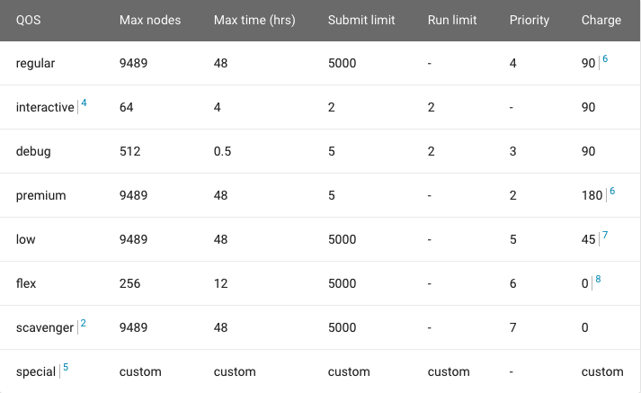
Cori KNL queue policy
Jobs that use 1024+ nodes on Cori KNL get a 20% charging discount
The “interactive” QOS starts jobs immediately (when nodes are available) or cancels them in 5 minutes (when no nodes are available).
    382 nodes (192 Haswell; 192 KNL) are reserved for the interactive QOS

Slide 9
Running interactive VASP jobs on Cori
The interactive QOS allows quick access to compute nodes
Up to 64 nodes for 4 hours, run limit is 2, 64 nodes per repo
zz217@cori03:/global/cscratch1/sd/zz217/PdO4> salloc -N4 -C knl -q interactive -t 4:00:00
salloc: Granted job allocation 13460931
zz217@nid02305:/global/cscratch1/sd/zz217/PdO4> module load vasp/20171017-knl
zz217@nid02305:/global/cscratch1/sd/zz217/PdO4> export OMP_NUM_THREADS=4
zz217@nid02305:/global/cscratch1/sd/zz217/PdO4> srun -n64 -c16 –cpu-bind=cores vasp_std
----------------------------------------------------
OOO PPPP EEEEE N N M M PPPP
O O P P E NN N MM MM P P
O O PPPP EEEEE N N N M M M PPPP -- VERSION
O O P E N NN M M P
OOO P EEEEE N N M M P
----------------------------------------------------
running 64 mpi-ranks, with 4 threads/rank
…
  The interactive QOS can not be used with batch jobs
  Use the command “squeue -A <your repo> -q interactive” to check how many nodes are used by your repo

Slide 10
Sample job scripts to run pure MPI VASP jobs on Cori
Cori KNL:
#!/bin/bash -l
#SBATCH –N 1
#SBATCH -C knl
#SBATCH –q regular
#SBATCH –t 6:00:00
module load vasp/5.4.4-knl
srun –n64 -c4 --cpu-bind=cores vasp_std
Cori Haswell:
#!/bin/bash -l
#SBATCH –N 1
#SBATCH -C haswell
#SBATCH –q regular
#SBATCH –t 6:00:00
module load vasp/5.4.4-hsw #or module load vasp
srun –n32 –c2 --cpu-bind=cores vasp_std
1 node
1 node
Cori KNL:
#!/bin/bash -l
#SBATCH –N 2
#SBATCH -C knl
#SBATCH –q regular
#SBATCH –t 6:00:00
module load vasp/5.4.4-knl
srun –n128 -c4 --cpu-bind=cores vasp_std
Cori Haswell:
#!/bin/bash -l
#SBATCH –N 2
#SBATCH -C haswell
#SBATCH –q regular
#SBATCH –t 6:00:00
module load vasp/5.4.4-hsw
srun –n64–c2 --cpu-bind=cores vasp_std
2 nodes
2 nodes

Slide 11
Sample job scripts to run pure MPI VASP jobs on Cori
Cori KNL:
#!/bin/bash -l
#SBATCH –N 1
#SBATCH -C knl
#SBATCH –q regular
#SBATCH –t 6:00:00
module load vasp/5.4.4-knl
srun –n64 -c4 --cpu-bind=cores vasp_std
Cori Haswell:
#!/bin/bash -l
#SBATCH –N 1
#SBATCH -C haswell
#SBATCH –q regular
#SBATCH –t 6:00:00
module load vasp/5.4.4-hsw
srun –n32 –c2 --cpu-bind=cores vasp_std
1 node
1 node
Cori KNL:
#!/bin/bash -l
#SBATCH –N 4
#SBATCH -C knl
#SBATCH –q regular
#SBATCH –t 6:00:00
module load vasp/5.4.4-knl
srun –n256 -c4 --cpu-bind=cores vasp_std
Cori Haswell:
#!/bin/bash -l
#SBATCH –N 4
#SBATCH -C haswell
#SBATCH –q regular
#SBATCH –t 6:00:00
module load vasp/5.4.4-hsw
srun –n128 –c2 --cpu-bind=cores vasp_std
4 nodes
4 nodes

Slide 12
Sample job scripts to run hybrid MPI + OpenMP VASP jobs
Cori KNL:
#!/bin/bash -l
#SBATCH –N 1
#SBATCH –q regular
#SBATCH –t 6:00:00
#SBATCH -C knl
module load vasp/20181030-knl
export OMP_NUM_THREADS=4
# launching 1 task every 4 cores (16 CPUs)
srun –n16 –c16 --cpu-bind=cores vasp_std
Cori Haswell:
#!/bin/bash -l
#SBATCH –N 1
#SBATCH –q regular
#SBATCH –t 6:00:00
#SBATCH -C haswell
module load vasp/20181030-hsw
export OMP_NUM_THREADS=4
# launching 1 task every 4 cores (8 CPUs)
srun –n8 –c8 --cpu-bind=cores vasp_std
Use the “–c <#CPUs>” option to spread processes evenly over the CPUs on the node
Use the “–cpu-bind=cores” option to pin the processes to the cores
Use OMP environment variables, “OMP_PROC_BIND” and “OMP_PLACES”, to fine control the thread affinity (not shown in the job script above, but they are set inside the hybrid vasp modules)
In the KNL example above, 64 cores (256 CPUs) out of 68 cores (272 CPUs) are used

Slide 13
Sample job scripts to run hybrid MPI + OpenMP VASP Jobs
Cori KNL:
#!/bin/bash -l
#SBATCH –N 1
#SBATCH –q regular
#SBATCH –t 6:00:00
#SBATCH -C knl
module load vasp/20181030-knl
export OMP_NUM_THREADS=4
# launching 1 task every 4 cores (16 CPUs)
srun –n16 –c16 --cpu-bind=cores vasp_std
Cori Haswell:
#!/bin/bash -l
#SBATCH –N 1
#SBATCH –q regular
#SBATCH –t 6:00:00
#SBATCH -C haswell
module load vasp/20181030-hsw
export OMP_NUM_THREADS=4
# launching 1 task every 4 cores (8 CPUs)
srun –n8 –c8 --cpu-bind=cores vasp_std
1 node
1 node
Cori KNL:
#!/bin/bash -l
#SBATCH –N 2
#SBATCH –q regular
#SBATCH –t 6:00:00
#SBATCH -C knl
module load vasp/20181030-knl
export OMP_NUM_THREADS=4
# launching 1 task every 4 cores (16 CPUs)
srun –n32 –c16 --cpu-bind=cores vasp_std
Cori Haswell:
#!/bin/bash -l
#SBATCH –N 2
#SBATCH –q regular
#SBATCH –t 6:00:00
#SBATCH -C haswell
module load vasp/20181030-hsw
export OMP_NUM_THREADS=4
# launching 1 task every 4 cores (8 CPUs)
srun –n16 –c8 --cpu-bind=cores vasp_std
2 nodes
2 nodes

Slide 14
Sample job scripts to run hybrid MPI + OpenMP VASP Jobs
Cori KNL:
#!/bin/bash -l
#SBATCH –N 1
#SBATCH –q regular
#SBATCH –t 6:00:00
#SBATCH -C knl
module load vasp/20181030-knl
export OMP_NUM_THREADS=4
# launching 1 task every 4 cores (16 CPUs)
srun –n16 –c16 --cpu-bind=cores vasp_std
Cori Haswell:
#!/bin/bash -l
#SBATCH –N 1
#SBATCH –q regular
#SBATCH –t 6:00:00
#SBATCH -C haswell
module load vasp/20181030-hsw
export OMP_NUM_THREADS=4
# launching 1 task every 4 cores (8 CPUs)
srun –n8 –c8 --cpu-bind=cores vasp_std
1 node
1 node
Cori KNL:
#!/bin/bash -l
#SBATCH –N 4
#SBATCH –q regular
#SBATCH –t 6:00:00
#SBATCH -C knl
module load vasp/20181030-knl
export OMP_NUM_THREADS=4
# launching 1 task every 4 cores (16 CPUs)
srun –n64 –c16 --cpu-bind=cores vasp_std
Cori Haswell:
#!/bin/bash -l
#SBATCH –N 4
#SBATCH –q regular
#SBATCH –t 6:00:00
#SBATCH -C haswell
module load vasp/20181030-hsw
export OMP_NUM_THREADS=4
# launching 1 task every 4 cores (8 CPUs)
srun –n32 –c8 --cpu-bind=cores vasp_std
4 node
4 node

Slide 15
Sample job scripts to run hybrid MPI + OpenMP VASP Jobs
Cori KNL:
#!/bin/bash -l
#SBATCH –N 1
#SBATCH –q regular
#SBATCH –t 6:00:00
#SBATCH -C knl
module load vasp/20181030-knl
export OMP_NUM_THREADS=4
# launching 1 task every 4 cores (16 CPUs)
srun –n16 –c16 --cpu-bind=cores vasp_std
Cori Haswell:
#!/bin/bash -l
#SBATCH –N 1
#SBATCH –q regular
#SBATCH –t 6:00:00
#SBATCH -C haswell
module load vasp/20181030-hsw
export OMP_NUM_THREADS=4
# launching 1 task every 4 cores (8 CPUs)
srun –n8 –c8 --cpu-bind=cores vasp_std
1 node
1 node
Cori KNL:
#!/bin/bash -l
#SBATCH –N 1
#SBATCH –q regular
#SBATCH –t 6:00:00
#SBATCH -C knl
module load vasp/20181030-knl
export OMP_NUM_THREADS=8
# launching 1 task every 8 cores (32 CPUs)
srun –n8 –c32 --cpu-bind=cores vasp_std
Cori Haswell:
#!/bin/bash -l
#SBATCH –N 1
#SBATCH –q regular
#SBATCH –t 6:00:00
#SBATCH -C haswell
module load vasp/20181030-hsw
export OMP_NUM_THREADS=8
# launching 1 task every 8 cores (16 CPUs)
srun –n4 –c16 --cpu-bind=cores vasp_std
1 node
1 node

Slide 16
Sample job scripts to run hybrid MPI + OpenMP VASP jobs
Cori KNL:
#!/bin/bash -l
#SBATCH –N 1
#SBATCH –q regular
#SBATCH –t 6:00:00
#SBATCH -C knl
module load vasp/20181030-knl
export OMP_NUM_THREADS=8
# launching 1 task every 8 cores (32 CPUs)
srun –n8 –c32 --cpu-bind=cores vasp_std
Cori Haswell:
#!/bin/bash -l
#SBATCH –N 1
#SBATCH –q regular
#SBATCH –t 6:00:00
#SBATCH -C haswell
module load vasp/20181030-hsw
export OMP_NUM_THREADS=8
# launching 1 task every 8 cores (16 CPUs)
srun –n4 –c16 --cpu-bind=cores vasp_std
1 node
1 node
Cori KNL:
#!/bin/bash -l
#SBATCH –N 2
#SBATCH –q regular
#SBATCH –t 6:00:00
#SBATCH -C knl
module load vasp/20181030-knl
export OMP_NUM_THREADS=8
# launching 1 task every 8 cores (32 CPUs)
srun –n16 –c32 --cpu-bind=cores vasp_std
Cori Haswell:
#!/bin/bash -l
#SBATCH –N 2
#SBATCH –q regular
#SBATCH –t 6:00:00
#SBATCH -C haswell
module load vasp/20181030-hsw
export OMP_NUM_THREADS=8
# launching 1 task every 8 cores (16 CPUs)
srun –n8 –c16 --cpu-bind=cores vasp_std
2 nodes
2 nodes

Slide 17
Sample job scripts to run hybrid MPI + OpenMP VASP jobs
Cori KNL:
#!/bin/bash -l
#SBATCH –N 1
#SBATCH –q regular
#SBATCH –t 6:00:00
#SBATCH -C knl
module load vasp/20181030-knl
export OMP_NUM_THREADS=8
# launching 1 task every 8 cores (32 CPUs)
srun –n8 –c32 --cpu-bind=cores vasp_std
Cori Haswell:
#!/bin/bash -l
#SBATCH –N 1
#SBATCH –q regular
#SBATCH –t 6:00:00
#SBATCH -C haswell
module load vasp/20181030-hsw
export OMP_NUM_THREADS=8
# launching 1 task every 8 cores (16 CPUs)
srun –n4 –c16 --cpu-bind=cores vasp_std
1 node
1 node
Cori KNL:
#!/bin/bash -l
#SBATCH –N 4
#SBATCH –q regular
#SBATCH –t 6:00:00
#SBATCH -C knl
module load vasp/20181030-knl
export OMP_NUM_THREADS=8
# launching 1 task every 8 cores (32 CPUs)
srun –n32 –c32 --cpu-bind=cores vasp_std
Cori Haswell:
#!/bin/bash -l
#SBATCH –N 4
#SBATCH –q regular
#SBATCH –t 6:00:00
#SBATCH -C haswell
module load vasp/20181030-hsw
export OMP_NUM_THREADS=8
# launching 1 task every 8 cores (16 CPUs)
srun –n16 -c16 --cpu-bind=cores vasp_std
4 nodes
4 nodes

Slide 18
Process affinity is important for optimal performance
The performance effect of process affinity on Edison
Run date: July 2017

Slide 19
Default Slurm behavior with respect to process/thread affinity
By Slurm default, a decent CPU binding is set only when the MPI tasks per node x CPUs per task = the total number of CPUs allocated per node
  e.g., 68x4=272 on KNL
The srun’s “--cpu-bind” and “–c” options must be used explicitly to achieve optimal process/thread affinity
Use OMP environment variables to fine control the thread affinity.
  export OMP_PROC_BIND=true
  export OMP_PLACES=threads

Slide 20
Affinity verification methods
NERSC has provided pre-built binaries from a Cray code (xthi.c) to display process thread affinity: check-mpi.intel.cori, check-hybrid.intel.cori, etc.
% srun -n 32 -c 8 –cpu-bind=cores check-mpi.intel.cori|sort -nk 4
Hello from rank 0, on nid02305. (core affinity = 0,1,68,69,136,137,204,205)
Hello from rank 1, on nid02305. (core affinity = 2,3,70,71,138,139,206,207)
Hello from rank 2, on nid02305. (core affinity = 4,5,72,73,140,141,208,209)
Hello from rank 3, on nid02305. (core affinity = 6,7,74,75,142,143,210,211)
Intel compiler has a run time environment variable “KMP_AFFINITY”; when set to "verbose”:
  OMP: Info #242: KMP_AFFINITY: pid 255705 thread 0 bound to OS proc set {55}
  OMP: Info #242: KMP_AFFINITY: pid 255660 thread 1 bound to OS proc set {10,78}
  OMP: Info #242: OMP_PROC_BIND: pid 255660 thread 1 bound to OS proc set {78} …
Slide from Helen He

Slide 21
A few useful commands
Commonly used commands: sbatch, salloc, scancel, srun, squeue, sinfo, sqs, scontrol, sacct
“sinfo --format=‘%F %b’” for available features of nodes, or “sinfo --format=‘%C %b’”
“scontrol show node <nid>” for node info
“ssh_job <jobid>” to ssh to the head compute nodes of your running jobs, then you can run your favorite commands to monitor your jobs, e.g., the top command

Slide 22
Performance of hybrid VASP on Cori

Slide 23
Benchmarks used
 | PdO4 | GaAsBi -64 | CuC | Si256 | B.hR105 | PdO2
Electrons (Ions) | 3288 (348) | 266 (64) | 1064 (98) | 1020 (255) | 315 (105) | 1644(174)
Functional | DFT | DFT | VDW | HSE | HSE | DFT
Algo | RMM (VeryFast) | BD+RMM (Fast) | RMM (VeryFast) | CG (Damped) | CG (Damped) | RMM (VeryFast)
NEML(NELMDL) | 5 (3) | 8 (0) | 10 (5) | 3(0) | 10 (5) | 10 (4)
NBANDS | 2048 | 192 | 640 | 640 | 256 | 1024
FFT grids | 80x120x54 160x240x108 | 70x70x70 140x140x140 | 70x70x210 120x120x350 | 80x80x80 160x160x160 | 48x48x48 96x96x96 | 80x60x54 160x120x108
NPLWV | 518400 | 343000 | 1029000 | 512000 | 110592 | 259200
IRMAX | 1445 | 4177 | 3797 | 1579 | 1847 | 1445
IRDMAX | 3515 | 17249 | 50841 | 4998 | 2358 | 3515
LMDIM | 18 | 18 | 18 | 18 | 8 | 18
KPOINTS | 1 1 1 | 4 4 4 | 3 3 1 | 1 1 1 | 1 1 1 | 1 1 1
Selected 6 benchmarks cover representative VASP workloads, exercising different code paths, ionic constituent and problem sizes
Notes:
KPAR=2 for GaAsBi -64
KPAR=1 CuC
Both cases, the number of kpoints is 5 for each kpoint group
The first test case, denoted as PdO4 in Table 1, is a PdO slab containing 348 atoms in total (300 Pd atoms and 48 O atoms). This system was chosen to test the most commonly used (and basic) code path, the DFT functional calculation with PBE potentials using the RMM-DIIS iteration scheme. Since problem size matters in benchmarking, we added a smaller PdO slab (denoted as PdO2 in Table 1), which has 174 atoms (150 Pd and 24 O atoms) in the tests.
A ternary alloy structure, GaAsBi64, was included to cover the metalic systems with the default iteration scheme, Block Davidson + RMM-DIIS algorithms.
Two HSE hybrid functional calculations with different atomic configurations and problem sizes were included in the tests, because hybrid functional calculations are increasingly important workloads in VASP. Si256_hse is a 256-atom silicon supershell with a vacancy, and B.hR105_hse is a small hexa-boron structure (105 atoms). The Van Der Waals functional calculation was also included (denoted as CuO_vdw in Table 1).

Slide 24
VASP versions, compilers and libraries used
Hybrid MPI+OpenMP VASP (last commit date 10/30/2018) and pure MPI VASP 5.4.4 were used
Intel compiler and MKL from 2018 Update 1 + ELPA (version 2016.005) and cray-mpich/7.7.3 were used
Cori runs CLE 6.0 UP7, and SLURM 18.08.7
Used a couple figures from https://cug.org/proceedings/cug2017_proceedings/includes/files/pap134s2-file1.pdf
(confirmed with recent runs)

Slide 25
Hyper-Threading helps HSE workloads, but not other workloads

Slide 26
Hybrid VASP performs best with 4 or 8 OpenMP threads/task

Slide 27
Hybrid MPI+OpenMP VASP performance on Cori KNL & Haswell

Slide 28
Hybrid MPI+OpenMP VASP performance on Cori KNL & Haswell (cont.)

Slide 29
Hybrid MPI+OpenMP VASP performance on Cori KNL & Haswell (cont.)
The hybrid VASP performs better on KNL than on Haswell with Si256_hse, PdO4 and CuC_vdw, but not with GaAsBi-64, PdO2, and B.hR105_hse benchmarks, which have relatively smaller problem sizes

Slide 30
Pure MPI VASP performance on Cori KNL & Haswell

Slide 31
Pure MPI VASP performance on Cori KNL & Haswell (cont.)

Slide 32
Pure MPI VASP performance on Cori KNL & Haswell (cont.)
The pure MPI VASP performs better on KNL than on Haswell with Si256_hse, PdO4 and CuC_vdw, but not with GaAsBi-64, PdO2, and B.hR105_hse benchmarks that are relatively smaller in sizes

Slide 33
Performance comparisons: pure MPI vs hybrid VASP

Slide 34
Performance comparisons: pure MPI vs hybrid VASP (cont.)

Slide 35
Performance comparisons: pure MPI vs hybrid VASP (cont.)
On KNL, the hybrid VASP outperforms the pure MPI code at the parallel scaling region with the Si256_hse, B.hR105_hse, PdO4 and CuC_vdw benchmarks , but not with the GaAsBi-64, and PdO2 cases
On Haswell, the pure MPI code outperforms the hybrid code with most of the benchmarks (except Si256_hse)

Slide 36
Using “flex” QOS on Cori KNL for improved job throughput and charging discount

Slide 37
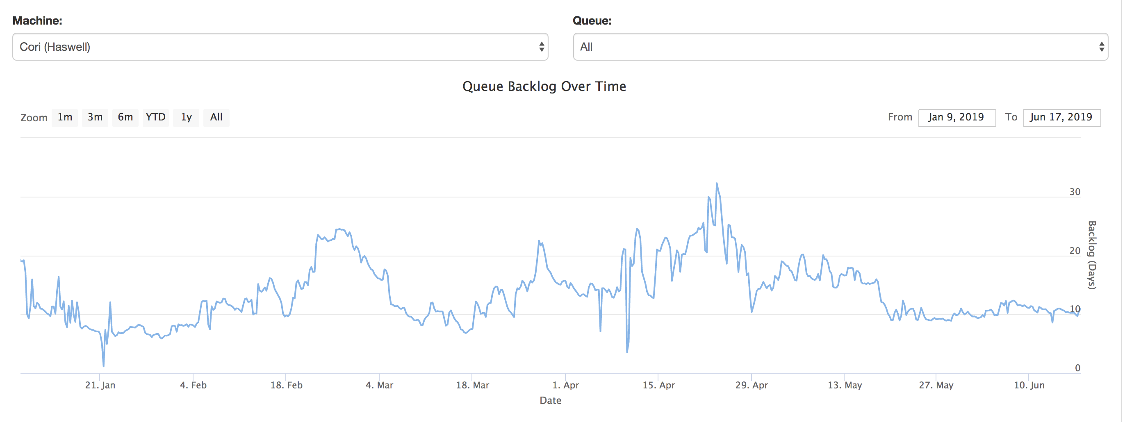
System backlogs
Backlog (days) = <sum of the requested node hours from all jobs in the queue>/<the max node hours delivered by the system per day>
There are 2388 Haswell nodes, and 9688 KNL nodes on Cori

Slide 38
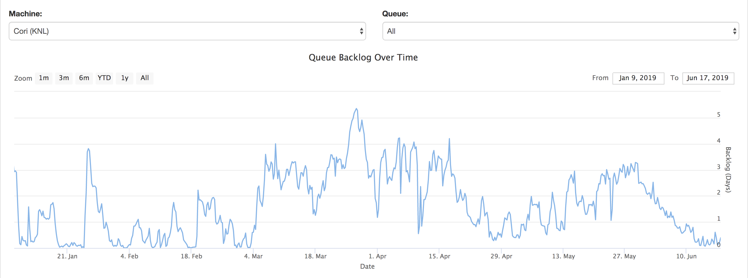
System backlogs
Cori KNL has a shorter backlog, so for a better job throughput we recommend users to use Cori KNL

Slide 39
System utilizations
Cori KNL
Cori Haswell
Can we make use of the idle nodes when the system drains for larger jobs? We need shorter jobs to make use of the backfill opportunity

Slide 40
The “flex” QOS is available for you (on Cori KNL only)
The flex QOS is for user jobs that can produce useful work with a relatively short amount of run time before terminating
  For example, jobs that are capable of checkpointing and restarting where they left off
Benefits to using the flex QOS include improved job throughput and a 75% discount in charging for your jobs
Access via “#SBATCH -q flex” and must use “#SBATCH --time-min=2:00:00” or less
A flex QOS job can use up to 256 KNL nodes for 48 hours

Slide 41
Sample job script to run VASP with flex QOS (KNL only)
Regular QOS VASP job
Flex jobs are required to use --time-min flag to specify a minimum time <= 2 hours
Jobs that specify the --time-min can start the execution earlier, with a time limit anywhere between the time-min and the max time limit
Pre-terminated jobs can be requeued to resume from where the previous executions left off, until the cumulative execution time reaches the requested time limit or the job completes
Requeuing can be done automatically
Applications are required to be capable of checkpointing and restarting by themselves. Some VASP jobs, e.g., atomic relaxation jobs, can checkpoint/restart
#!/bin/bash
#SBATCH -q regular
#SBATCH -N 2
#SBATCH -C knl
#SBATCH -t 48:00:00
module load vasp/20181030-knl
export OMP_NUM_THREADS=4
# launching 1 task every 4 cores (16 CPUs)
srun –n32 –c16 --cpu-bind=cores vasp_std
#!/bin/bash
#SBATCH -q flex
#SBATCH –N 2
#SBATCH -C knl
#SBATCH –t 48:00:00
#SBATCH --time-min=2:00:00
module load vasp/20181030-knl
export OMP_NUM_THREADS=4
# launching 1 task every 4 cores (16 CPUs)
srun –n32 –c16 --cpu-bind=cores vasp_std
Flex QOS VASP job

Slide 42
Automatic resubmissions of VASP flex jobs
# put any commands that need to run to continue the next job here
ckpt_vasp() {
set -x
restarts=`squeue -h -O restartcnt -j $SLURM_JOB_ID`
echo checkpointing the ${restarts}-th job
# to terminate VASP at the next ionic step
echo LSTOP = .TRUE. > STOPCAR
# wait until VASP to complete the current ionic step, write WAVECAR file and quit
srun_pid=`ps -fle|grep srun|head -1|awk '{print $4}’`
wait $srun_pid
# copy CONTCAR to POSCAR
cp -p CONTCAR POSCAR
set +x
}
ckpt_command=ckpt_vasp
max_timelimit=48:00:00
ckpt_overhead=300
# requeueing the job if remaining time >0
. /global/common/cori/software/variable-time-job/setup.sh
requeue_job func_trap USR1
For automatic resubmissions of pre-terminated jobs
#!/bin/bash
#SBATCH -q regular
#SBATCH -N 2
#SBATCH -C knl
#SBATCH -t 48:00:00
module load vasp/20181030-knl
export OMP_NUM_THREADS=4
# launching 1 task every 4 cores (16 CPUs)
srun –n32 –c16 --cpu_bind=cores vasp_std
Regular QOS VASP jobs
#!/bin/bash
#SBATCH -q flex
#SBATCH –N 2
#SBATCH -C knl
#SBATCH –t 48:00:00
#SBATCH --time-min=2:00:00
module load vasp/20181030-knl
export OMP_NUM_THREADS=4
# launching 1 task every 4 cores (16 CPUs)
srun –n32 –c16 --cpu-bind=cores vasp_std
#SBATCH --comment=48:00:00
#SBATCH --signal=B:USR1@300
#SBATCH --requeue
#SBATCH --open-mode=append
#!/bin/bash
#SBATCH -q flex
#SBATCH –N 2
#SBATCH -C knl
#SBATCH –t 48:00:00
#SBATCH --time-min=2:00:00
module load vasp/20181030-knl
export OMP_NUM_THREADS=4
# launching 1 task every 4 cores (16 CPUs)
srun –n32 –c16 --cpu_bind=cores vasp_std
Flex QOS VASP jobs
(manual resubmissions)
# srun must execute in background and catch signal on wait command
&
wait
https://docs.nersc.gov/jobs/examples/#vasp-example

Slide 43
Automatic resubmissions of VASP flex jobs (cont.)
#SBATCH --comment=48:00:00
        A flag to add comments about the job. The script uses it to specify the desired walltime and to track the remaining walltime for the pre-terminated jobs. You can specify any length of time, e.g., a week or even longer
#SBATCH --time-min=02:00:00
This is to specify the minimum time for your job. Flex QOS requires time-min to be 2 hours or less.
#SBATCH --signal=B:USR1@<sig_time>
Request the batch system to send a user defined signal USR1 to the batch shell (where the job is running) sig_time seconds (e.g., 300) before the job hits the wall clock limit
#SBATCH --requeue
Specify the job is eligible to requeue
#SBATCH --open-mode=append
Append the standard output/error of the requeued job to the same standard out/error
files from the previously terminated job.
#SBATCH --comment=48:00:00
#SBATCH --time-min=02:00:00
#SBATCH --signal=B:USR1@300
#SBATCH --requeue
#SBATCH --open-mode=append
Notes:
--requeue
Specifies that the batch job should eligible to being requeue. The job may be requeued explicitly by a system administrator, after
node failure, or upon preemption by a higher priority job. When a job is requeued, the batch script is initiated from its beginning.
Also see the --no-requeue option. The JobRequeue configuration parameter controls the default behavior on the cluster.

Slide 44
Automatic resubmissions of VASP flex jobs (cont.)
ckpt_vasp()
This is a bash function where you can put any commands to checkpoint the current running job (e.g., creating a STOPCAR file), wait for the currently running job to gracefully exit, and prepare the input files to restart the pre-terminated job (e.g., copy CONTCAR to POSCAR).
ckpt_command=ckpt_vasp
The ckpt_command is run inside the function requeue_job upon receiving the USR1 signal.
max_timelimit=48:00:00
Use this to specify the max time for the requeued job. This can be any time less than or equal to the max time limit allowed by the batch system. It is used in the function requeue_job.
ckpt_overhead=300
Use this variable to specify the checkpoint overhead. This should match
the sig_time in the “#SBATCH --signal:USR1@<sig_time>” flag
/global/common/cori/software/variable-time-job/setup.sh
A few bash functions are defined in this setup script to automate the job
resubmissions, e.g., requeue_job and func_trap.
# put any commands that need to run to continue the next job here
ckpt_vasp() {
…
}
ckpt_command=ckpt_vasp
max_timelimit=48:00:00
ckpt_overhead=300
# requeueing the job if remaining time >0
. /global/common/cori/software/variable-time-job/setup.sh
requeue_job func_trap USR1

Slide 45
Automatic resubmissions of VASP flex jobs (cont.)
requeue_job
This function traps the user defined signal (e.g., USR1). Upon receiving the signal, it executes a
function (e.g., func_trap below) provided on the command line.
func_trap
This function contains the list of commands to be executed to initiate the
checkpointing, prepare inputs for the next job, requeue the job,
and update the remaining walltime.
requeue_job() {
parse_job # to calculate the remaining walltime
if [ -n $remainingTimeSec ] && [ $remainingTimeSec -gt 0 ]; then
commands=$1
signal=$2
trap $commands $signal
fi
}
# put any commands that need to run to continue the next job here
ckpt_vasp() {
…
}
ckpt_command=ckpt_vasp
max_timelimit=48:00:00
ckpt_overhead=300
# requeueing the job if remaining time >0
. /global/common/cori/software/variable-time-job/setup.sh
requeue_job func_trap USR1
func_trap() {
$ckpt_command
scontrol requeue ${SLURM_JOB_ID}
scontrol update JobId=${SLURM_JOB_ID} TimeLimit=${requestTime}
}

Slide 46
How does the automatic resubmission work?
User submits the above job script.
The batch system looks for a backfill opportunity for the job. If it can allocate the requested number of nodes for this job for any duration (e.g., 6 hours) between the specified minimum time (2 hours) and the time limit (48 hours) before those nodes are used for other higher priority jobs, the job starts execution.
The job runs until it receives a signal USR1 (--signal=B:USR1@300) 300 seconds before it hits the allocated time limit (6 hours).
Upon receiving the signal, the func_trap function gets executed, which in turn executes
  ckpt_vasp, which creates the STOPCAR file, and wait for the VASP job to complete the current ionic steps, write WAVECAR file and quit. Then copy the CONTCAR to POSCAR.
  Requeues the job and then update the remailing walltime for requeued job.
Steps 2-4 repeat until the job runs for the desired amount of time (48 hours) or the job completes.
User check the results
ckpt_vasp() {
echo LSTOP = .TRUE. > STOPCAR
srun_pid=`ps -fle|grep srun|head -1|awk '{print $4}’`
wait $srun_pid
cp -p CONTCAR POSCAR
}
func_trap() {
$ckpt_command
scontrol requeue ${SLURM_JOB_ID}
scontrol update JobId=${SLURM_JOB_ID} TimeLimit=${requestTime}
}

Slide 47
Notes on the VASP flex QOS jobs
Using the VASP flex QOS, you can run VASP jobs with any length, e.g., a week or even longer, as long as the jobs can restart by themselves. Use the “--comment” flag to specify your desired walltime
Make sure to put the srun command line to the background (“&”), so that when the batch shell traps signal, the srun (vasp_std, etc.) command can continue running to complete the current ionic step, write the WAVECAR file, and quit within the given checkpoint overhead time (<sig_time>)
Put any commands you need to run for VASP to checkpoint and restart in the ckpt_vasp bash function

Slide 48
Summary

Slide 49
Summary
Explicit use of the srun’s --cpu-bind and -c options is recommended to spread the MPI tasks evenly over the CPUs on the node and to achieve optimal performance
Consider using 64 cores out of 68 on KNL in most cases
Running VASP on KNL is highly recommended as Cori KNL has a much shorter backlog in comparison to Cori Haswell
Use flex QOS for a charging discount and improved job throughput
Use variable-time job scripts to automatically restart previously terminated jobs

Slide 50
Summary (cont.)
On KNL, the hybrid MPI+OpenMP VASP is recommended as it outperforms the pure MPI VASP especially with larger problems
For the hybrid version, 4 or 8 OpenMP threads per MPI task is recommended
In general, Hyper-Threading does not help VASP performance; using one hardware thread per core is recommended. However, two hardware threads/core may help with the HSE workloads, especially when running at small node counts

Slide 51
Hands-on 11:00am-2:00pm
Please join the vasp-training Slack channel by clicking here.
Please share your performance results at here
Notes:
https://join.slack.com/t/vasp-training/shared_invite/enQtNjU2NTU2MjEwMTE0LTIxNGEzY2MwZGQxYzJlMjY4NjRjNWM4N2Y2YmEwMjI2ZmQ3ODJlM2MyZTYwMmE1ZmY5ZTNmZWY0MmQzMjk2MWU
https://docs.google.com/spreadsheets/d/1_Ve3DDAJoKJo61G7W5Hjr4pvvZ6e0yQ6p_MjaQ_AzC0/edit#gid=369290435

Slide 52
Use the reservations “vasp_knl” and “vasp_hsw”
There are 300 KNL and 150 Haswell nodes reserved for the hands-on
To run jobs interactively
  salloc -N 2 -C knl –t 1:00:00 --reservation=vap_knl -A nintern
  salloc -N 1 -C haswell –t 1:00:00 --reservation=vasp_hsw -A nintern
To run batch jobs
  “#SBATCH -A nintern” #to charge to the nintern repo
  “#SBATCH --reservation=vasp_knl” #or “#SBATCH --reservation=vasp_hsw”

Slide 53
If you can not access the reservations
Use the interactive QOS, which allows you to use up to 64 nodes for 4 hours immediately or cancel your job in 5 minutes if no nodes available.
  Run jobs interactively with the interactive QOS:
    salloc -N 2 –C knl –t 2:00:00 -q interactive
  You can run your job script as a shell script directly if convenient for you:
    salloc -N 2 –C knl –t 2:00:00 -q interactive bash run.slurm

Slide 54
For short VASP benchmark runs
Disable I/O
  LWAVE =.FALSE.
  LCHARG=.FALSE.
Run only a few iterations
  NELM=3
Figure of Merit: LOOP+ time in OUTCAR
  grep LOOP+ OUTCAR (use the real time, not the CPU time)

Slide 55
Thank You!

