Slide 1
Introduction to Quantum Espresso at NERSC
Taylor Barnes
June 10, 2016

Slide 2
Introduction
Sub-Codes:
PW Plane Wave DFT
CP Car-Parrinello MD
PH Phonons
XSPECTRA X-Ray Absorption
NEB Reaction Pathways
Nudged Elastic Band
TDDFT Time-Dependent DFT
PP Post Processing
Supported Features:
Both Γ-point only and k-point calculations
Norm-conserving and ultrasoft pseudopotentials
Most commonly used functionals, including hybrids
Spin-polarization, noncolinear magnetism
Notes:
DFT users moving towards hybrid

Slide 3
Sample Script
#!/bin/bash –l
#SBATCH --partition=debug
#SBATCH --nodes=96
#SBATCH --time=0:30:00
#SBATCH --job-name=qe_test
module load espresso
export OMP_NUM_THREADS=1
srun -n 2304 pw.x -npools 4 -ntg 3 -in infile.in > outfile.out
Notes:
DFT users moving towards hybrid

Slide 4
Sample Script
#!/bin/bash –l
#SBATCH --partition=debug
#SBATCH --nodes=96
#SBATCH --time=0:30:00
#SBATCH --job-name=qe_test
module load espresso
export OMP_NUM_THREADS=1
srun -n 2304 pw.x -npools 4 –ntg 3 -in input > input.out
% module avail espresso
------------------------------- /usr/common/usg/Modules/modulefiles --------------------------------
espresso/5.0.0 espresso/5.0.3-2(default) espresso/5.2.0 espresso/5.0.2
espresso/5.1 espresso/5.4.0 espresso/5.0.2-2 espresso/5.1.1
espresso/5.0.3 espresso/5.1.2
Notes:
DFT users moving towards hybrid

Slide 5
Sample Script
#!/bin/bash –l
#SBATCH --partition=debug
#SBATCH --nodes=96
#SBATCH --time=0:30:00
#SBATCH --job-name=qe_test
module load espresso
export OMP_NUM_THREADS=1
srun -n 2304 pw.x -npools 4 –ntg 3 -in input > input.out
Controls number of OpenMP threads per MPI task.
Notes:
DFT users moving towards hybrid

Slide 6
Sample Script
#!/bin/bash –l
#SBATCH --partition=debug
#SBATCH --nodes=96
#SBATCH --time=0:30:00
#SBATCH --job-name=qe_test
module load espresso
export OMP_NUM_THREADS=1
srun -n 2304 pw.x -npools 4 -ntg 3 -in infile.in > outfile.out
Options to control the way that QE handles parallelization
Notes:
DFT users moving towards hybrid

Slide 7
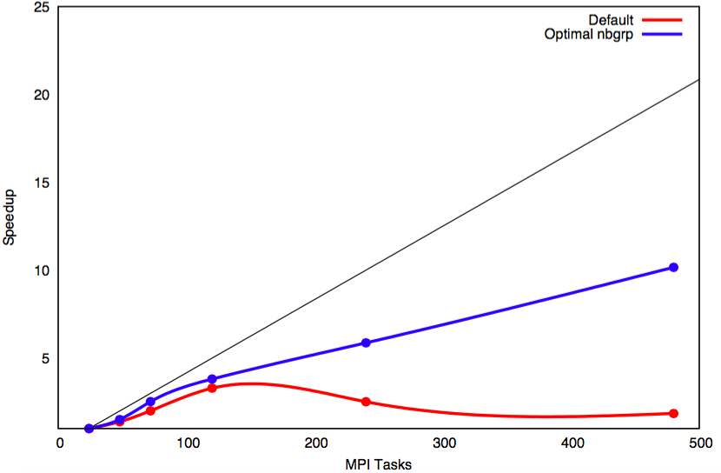
Parallelization Options Matter!
Notes:
DFT users moving towards hybrid

Slide 8
QE Parallelization Hierarchy
QE Parallelization Overview:
Pools Parallelization
Pools
Parallelization over k-points
Nearly perfect efficiency
Set by the -npools option.
Can use at most 1 pool / k-point
Should be a divisor of the number of nodes
Task Groups
Only for local DFT
Band Groups
Only for hybrid DFT
FFTs
FFTs

Slide 9
QE Parallelization Hierarchy
QE Parallelization Overview:
Task Group Parallelization
Pools
The number of task groups per pool is set by the -ntg option
Processors in different task groups work on FFTs corresponding to differnet bands
Should be a divisor of the number of nodes / npools.
Only works with local/semi-local DFT functionals
Task Groups
Only for local DFT
Band Groups
Only for hybrid DFT
FFTs
FFTs

Slide 10
QE Parallelization Hierarchy
QE Parallelization Overview:
Band Group Parallelization
Pools
The number of band groups per pool is set by the -ntg option
Similar to task group parallelization, except only for the calculation of exact exchange.
Should be a divisor of the number of nodes / npools.
Only works with hybrid DFT functionals
Task Groups
Only for local DFT
Band Groups
Only for hybrid DFT
FFTs
FFTs

Slide 11
QE Parallelization Hierarchy
QE Parallelization Overview:
Band Group Parallelization
Pools
All processors within a band group / task group work simultaneously on the same FFT
Best for on-node parallelization
Task Groups
Only for local DFT
Band Groups
Only for hybrid DFT
FFTs
FFTs
Default QE Behavior: Only FFT parallelization is used.
Best Performance: Use band parallelization between nodes, and FFT parallelization within nodes.

Slide 12
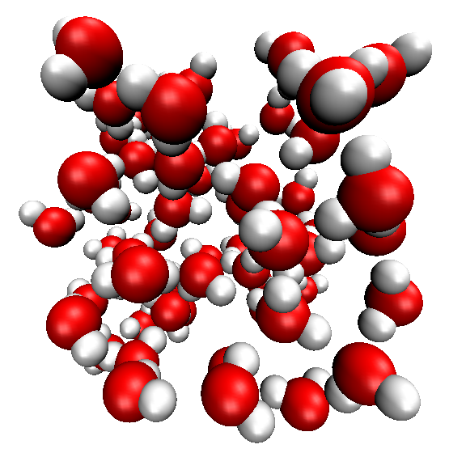
QE Parallelization Hierarchy
QE Parallelization Overview:
Example
Pools
SCF calculation on a box of 64 water molecules, using the PBE functional and 96 Edison nodes.
Task Groups
Only for local DFT
Band Groups
Only for hybrid DFT
FFTs
FFTs
Walltime with QE Defaults: 81.27 seconds
Walltime using “-ntg 6”: 28.4 seconds

Slide 13
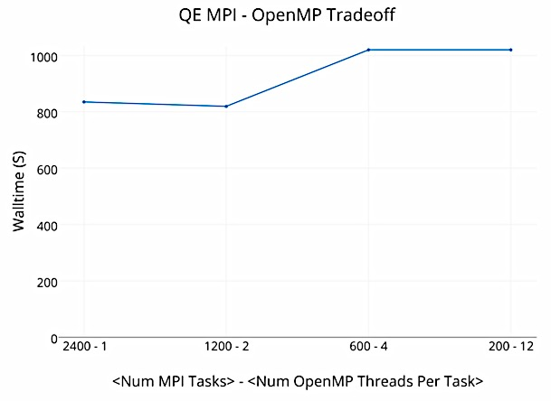
MPI vs. OpenMP

Slide 14
MPI vs. OpenMP
#!/bin/bash –l
#SBATCH --partition=regular
#SBATCH --nodes=96
#SBATCH --time=0:30:00
#SBATCH --job-name=qe_test
module load espresso
srun -n 2304 pw.x -ntg 12
-in infile.in > outfile.out
#!/bin/bash –l
#SBATCH --partition=regular
#SBATCH --nodes=96
#SBATCH --time=0:30:00
#SBATCH --job-name=qe_test
module load espresso
export OMP_NUM_THREADS=1
srun -n 2304 pw.x -ntg 12
-in infile.in > outfile.out
Walltime: 198 seconds
Walltime: 108 seconds
Default on Cori: OMP_NUM_THREADS=2
Best Performance: OMP_NUM_THREADS=1

Slide 15
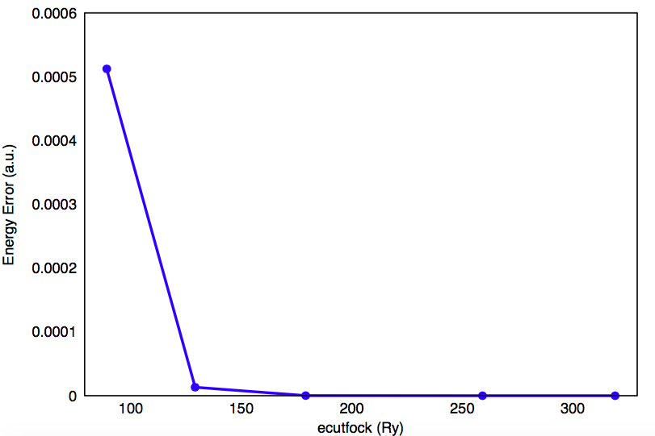
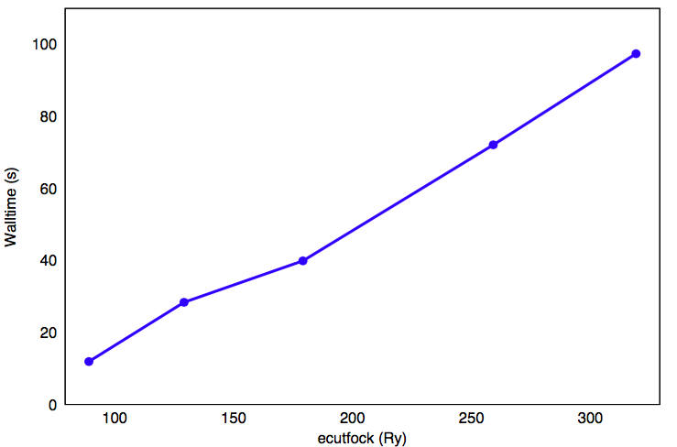
Energy Cutoffs
ecutwfc – kinetic energy cutoff for wavefunctions
ecutfock – kinetic energy cutoff for exact exchange operator (default: 4*ecutwfc)
When using hybrid DFT, it is a good idea to test for the optimal value of ecutfock.
Above: The default value of ecutfock is often larger than necessary (ecutwfc = 80 Ry).
Left: Reducing ecutfock can lead to large speed benefits

Slide 16
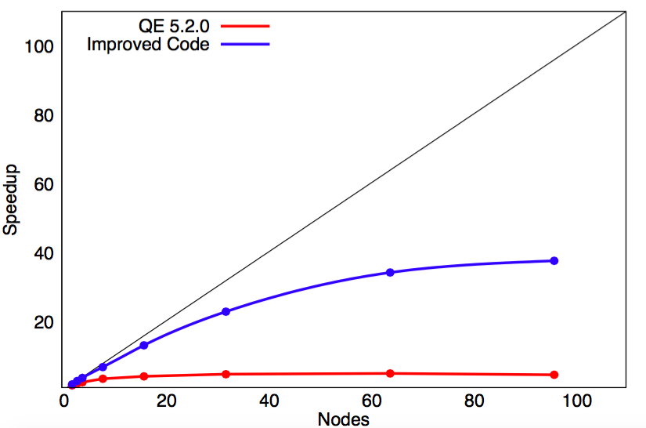
NESAP Efforts
QE is a Tier 1 NESAP project, and is currently being prepared for execution on many-core architectures, such as NERSC’s upcoming Cori Phase II.
Code Improvements:
Improved parallelization of a PBE0 calculation on Edison:
Independent parallelization of the exact exchange code
Can simultaneously use task groups and band groups
Improved band parallelization
Improved communication within exact exchange code

Slide 17
Summary of Best Practices
Pools – Set npools to the number of k-points, whenever possible.
Task Groups – Set ntg when using local or semi-local DFT functionals. A total of one task group per 8 nodes is usually reasonable.
Band Groups – Set nbgrp when using a hybrid DFT functional. A total of one band group per node is usually reasonable.
MPI vs. OpenMP – When in doubt, use pure MPI by setting OMP_NUM_THREADS=1.
Energy Cutoffs – Find the optimal value of all cutoffs, including both ecutwfc and ecutfock (if using hybrid functionals).

