Slide 1
Daniel Udwary NERSC Data Science Engagement Group June 22, 2016
Getting Started at NERSC
Notes:
Welcome everybody. And thanks for joining today’s presentation on Getting Started at NERSC. Today we’ll be talking about some of the things new users need to know to work smoothly at NERSC. I think that you will find that there’s lot of things to know, but that we’re here to help you get things done and be successful.

Slide 2
Purpose
This presentation will help you get familiar with NERSC and its facilities
Practical information
Introduction to terms and acronyms
This is not a programming tutorial
But you will learn how to get help and what kind of help is available
We can give presentations on programming languages and parallel libraries – just ask
Notes:
Today’s presentation is about how to get things done at NERSC. This is not an introduction to programming– although we can do that if there is demand and interest . But today we’re going to talk about the practical aspects of using NERSC.

Slide 3
Outline
NERSC and its computing systems
How to get help
Running and Monitoring Jobs
Managing Software
Notes:
Here’s today’s outline. There’s going to be a lot information presented and I don’t expect you to remember it all the first time. So the slides and audio will be available on the web site after we’re finished. So now just sit back and listen and ask lots of questions. You can ask via the phone or type into the WebEx chat windows. We’ll try to monitor the chat as best we can.

Slide 4
What’s a NERSC?
Notes:
Let’s talk about what NERSC has to offer you in terms of compute power.

Slide 5
NERSC Is a Scientific User Facility
NERSC’s emphasis is on enabling scientific discovery
User-oriented systems and services
We think this is what sets NERSC apart from other centers
Help Desk / Consulting
Immediate direct access to consulting staff that includes many PhDs
User group (NUG) has tremendous influence
Monthly teleconferences & yearly meetings
Requirement-gathering workshops with top scientists
One each for the six DOE Program Offices in the Office of Science
http://www.nersc.gov/science/requirements-workshops/
Ask, and we’ll do whatever we can to fulfill your request
Notes:
One of the things that sets NERSC aside from all other centers, is our emphasis on providing services that enable you to be successful. At the forefront of this effort are our HPC consultants. When you contact our help desk either by email, phone, through the web, you immediately get in touch with an HPC expert, no matter how big or small your issue. I think you’ll find that we’ll do as much as we can to solve your problem or honor your request.

Slide 6
The JGI-NERSC Consulting Team
Bill Arndt
Computer Science
Kjiersten Fagnan
JGI’s CIO
Mario Melara
Molecular Bio
Dan Udwary
Bioorganic chemistry
Deborah Bard
NERSC DSEG
Office hours are W & Th, 10-12.
Stop by 400-413 if you have questions!
consult@nersc.gov

Slide 7
What do your Consultants do?
Software installation, troubleshooting, optimization
Genepool account support
Setting up project membership, disk quotas
Liaison for other NERSC departments
Computing Services (CSG): keeps your servers maintained
Ershaad Basheer
Infrastructure Services (ISG): web and db services
Cory Snavely, Brian Yumae, Matt Dunford
Global filesystem admins (NGF)
Ravi Cheema
Data and Analytical Services (DAS): tool support
NoMachine, Jupyter, Rstudio, Globus, machine learning
Advice on software, computation, bioinformatics
Data Science Engagement Group (DSEG)
Documentation on the websites
Monthly Trainings and Workshops

Slide 8
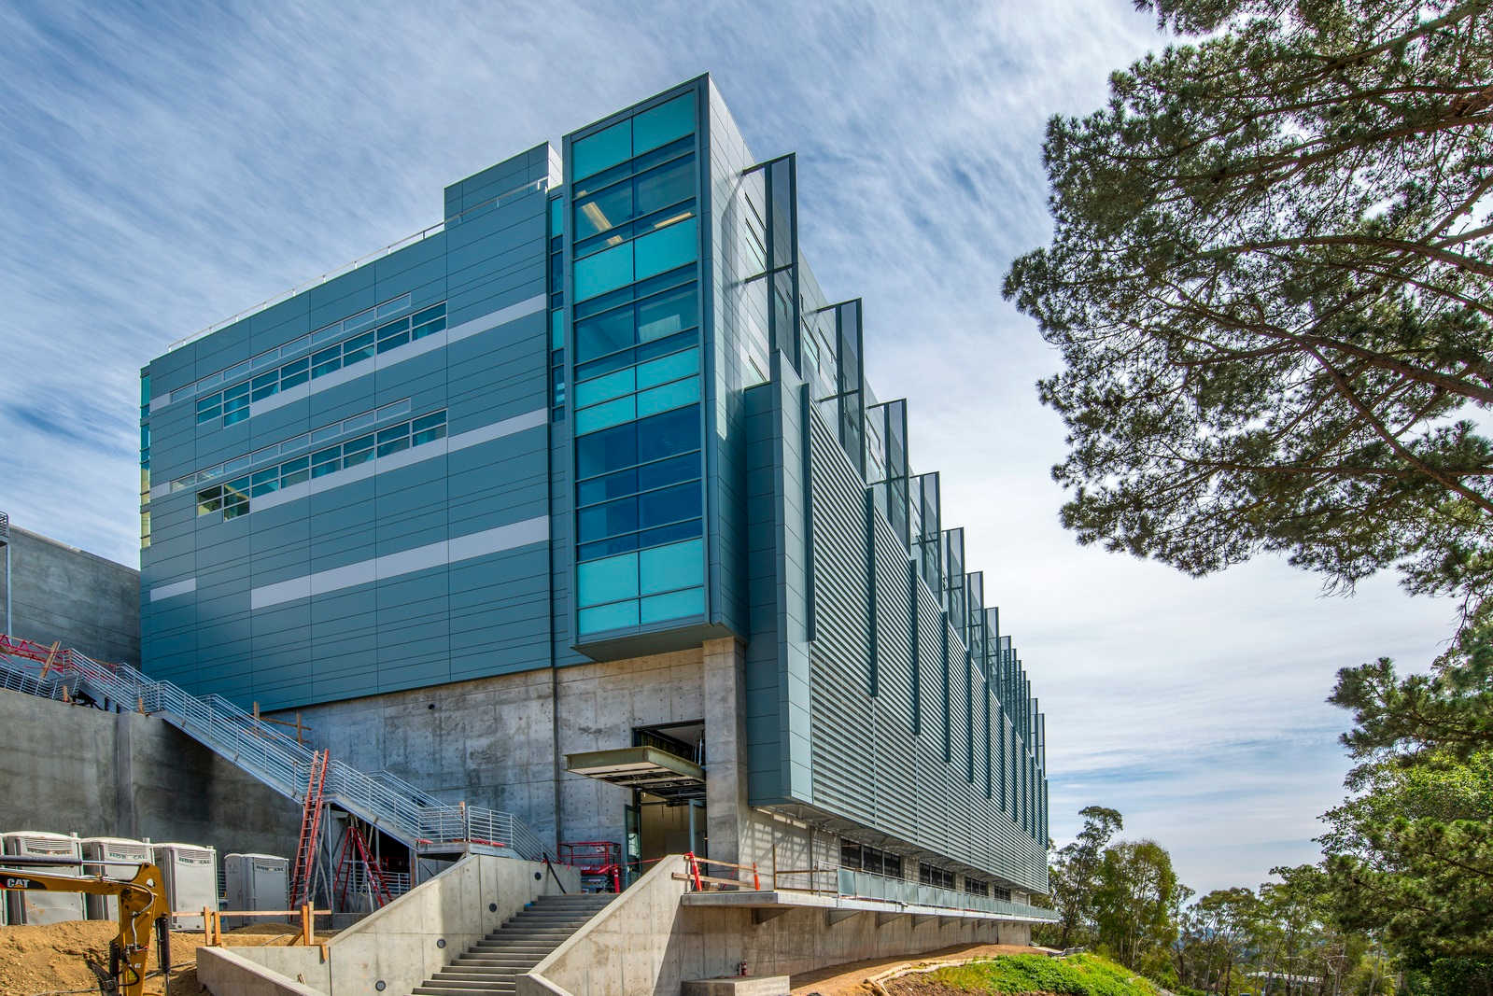
NERSC is in a newish building at LBL
Wang Hall or Building 59 or “CRT”

Slide 9
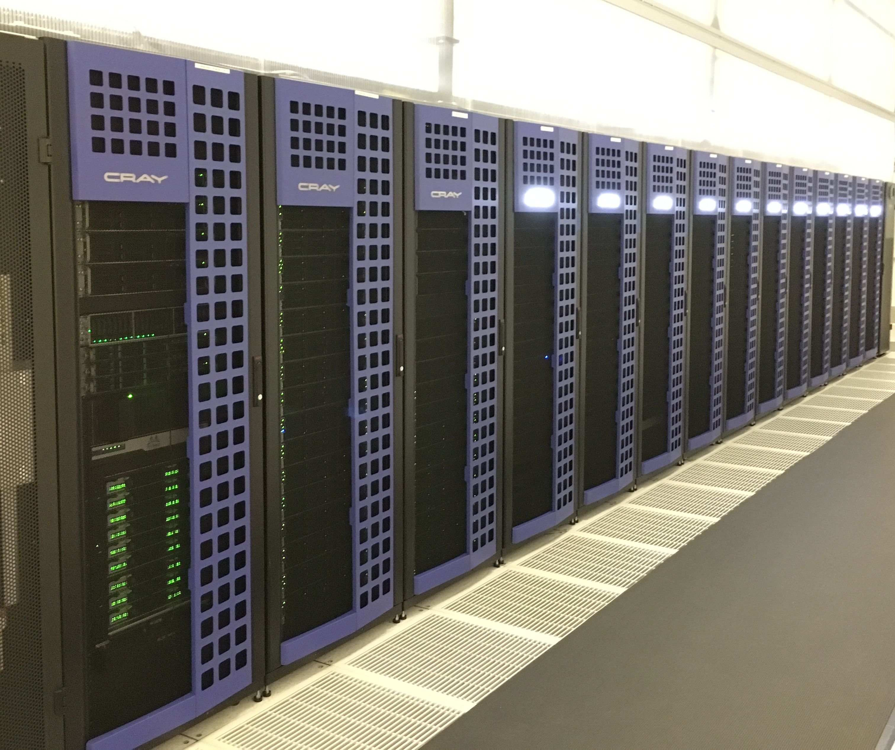
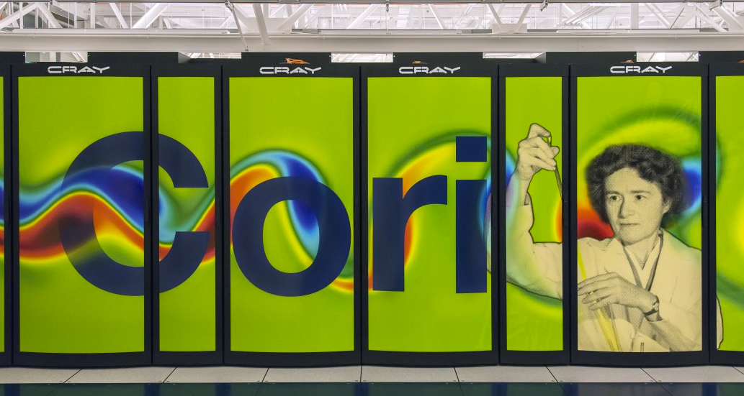
NERSC Computing Systems
Denovo
Mendel cluster
Genepool is a “meta-cluster”
Denovo – JGI-dedicated cluster. Main workhorse for JGI
Cori – newest generation Cray supercomputer
JGI recently acquired a Cori partition

Slide 10
Where to get started on getting help
NERSC webpage
https://www.nersc.gov - Some info may be slightly outdated
Soon: http://docs.nersc.gov
Online Helpdesk – http://help.nersc.gov
Create and monitor trouble tickets
Or email consult@nersc.gov
NERSC Information management (NIM) webpage
https://nim.nersc.gov/ - change NERSC password
my.nersc.gov
More information on your account and usage
Consulting line – 1-800-66-NERSC (menu option 3)
Talk to a real live consultant 8-5, M-F

Slide 11
NERSC Information Management (NIM)
http://nim.nersc.gov
NERSC-wide management of passwords and other account information
Same password used for all NERSC systems
5 consecutive unsuccessful logins will lock you out
Log into NIM to reset failures, or reset password
ssh public keys should be deposited here
Be sure contact info (especially email) is kept up-to-date
Change your default shell (per system)
View NERSC account usage: compute time, quotas

Slide 12
Computing resources
Notes:
Computing is only part of the story. The world is becoming full of detectors and sensors of all kinds and they’re producing lots of data. Even if all you do is simulations, the data you are producing when you run on thousands of cores can be staggering. NERSC is innovating to help you deal with data in today’s environment.

Slide 13
The NERSC computing world
Mendel
Edison
4182 nodes,134k cores
Denovo
PDSF
“Denovo”
test cluster
Cori
12k nodes,745k cores
GPFS
web
servers
“Knight’s Landing” (KNL) nodes
projectb
Global filesystem
HPSS
>250Pb tape storage
“Haswell” nodes
“Genepool”
partition

Slide 14
Where should you be computing?
Denovo is JGI’s primary computing resource
Login nodes for routine job and file maintenance
Anything parallelized or requiring >5GB memory belongs on a compute node
~340 batch nodes for Slurm-scheduled jobs
Interactive nodes (gpints and dints)
Configured identically to login nodes
Are assigned to specific projects/groups – ask your supervisor if you have access to one
Cori
“Genepool” partitions
192 compute nodes dedicated to JGI use
All are 32-core, 128GB Haswell nodes
Regular partitions
>9000 KNL nodes – 68-cores and 96GB memory

Slide 15
JGI Dedicated Computing Resources
User Access
Command Line
Scheduler
Service
ssh denovo.nersc.gov
http://…jgi-psf.org
web services
gpwebs
gnwebs
login nodes
reserved
interactive
nodes
gpdbs
scidbs
Oracle dbs
database services
compute nodes
~400 nodes
>8000 cores
80+M Core Hours
/homes
/scratch
7.1 PB of Storage
/seqfs
/dataNarchive
/software
JGI File Systems
Notes:
282 128GB nodes
88 256GB
20 512GB
2 1TB,2TB

Slide 16
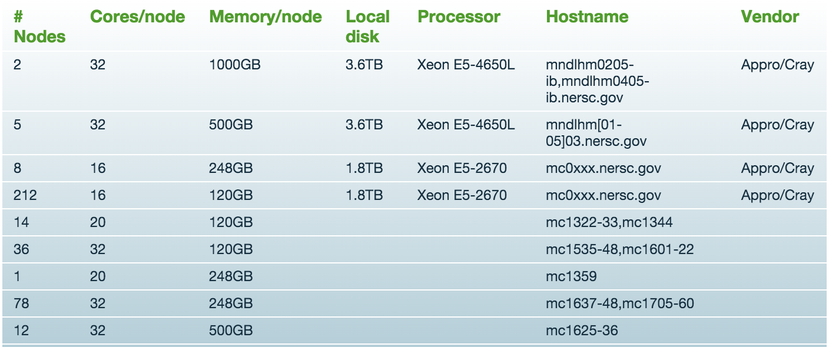
Denovo is a heterogeneous computing environment

Slide 17
Connecting to Denovo
ssh denovo.nersc.gov
Will take you to the least-utilized login node
ssh in MacOS, Linux. Putty commonly used in Windows
ssh gpint[xxx].nersc.gov
If your group owns its own interactive node
Use NX for graphical (X-Windows) applications
https://www.nersc.gov/users/connecting-to-nersc/using-nx/
Managed and supported by NERSC’s DAS group

Slide 18
Home Directory
When you log in you are in your "Home" directory.
Permanent storage
Weeklong daily snapshots taken: $HOME/.snapshots
The full UNIX pathname is stored in the environment variable $HOME
$HOME is a global file system
You see all the same directories and files when you log in to any NERSC computer.
Your quota in $HOME is 40 GB and 1M inodes (files and directories).
Use “myquota” command to check your usage and quota
denovo2% echo $HOME
/global/homes/d/dudwary
Notes:
The first data storage area you’ll be concerned about is your home directory. This is the directory you see when you first log into NERSC. Data and files stored in your home directory are permanent, but home is limited in size: 40 GB and 1M inodes, or files and directories. NERSC does not delete files in your home directory, but we don’t back them up for you either. You must store copies of important files in HPSS or elsewhere. It’s important to note that your home directory is common to all NERSC machines. So if you log into Franklin, you’ll see the same files and directories as when you log into Hopper. This puts a bit of a burden on you to keep separate any files that might be relevant to only one system. For example, non of these systems are binary compatible, so a code compiled on one system will not run on another.

Slide 19
Scratch Directories
Each Genepool user may have, on request, a personal directory referenced by $SCRATCH and $BSCRATCH
on Denovo, this points to /global/projectb/scratch/<username>
$SCRATCH is local on Edison and Cori (ie does not point to projectb).
“Scratch” file systems are large, high-performance file systems, intended to be temporary.
Standard projectb scratch size: 20TB and 1M inodes
Significant I/O from your compute jobs should be directed to scratch
Data in $BSCRATCH is purged (90 days from last access)
Always save data you want to keep to HPSS
Data in $BSCRATCH is not backed up and could be lost if a file system fails.
Notes:
Scratch directories, on the other hand, are large and tuned for streaming large amount of data from your programs. All significant IO from your applications should be reading and writing from the scratch file system. Each user has their own private space in scratch, referenced by the $SCRATH environment variable. Scratch data that has not been accessed in 12 weeks is purged to make room for newer data.

Slide 20
Project Directories
All NERSC systems mount the NERSC global "Project” file systems.
Projectb is specific to the JGI, but is also accessible on Edison and Cori.
"Project directories” are created upon request for projects (groups of researchers) to store and share data.
Data in /projectb/projectdirs is not purged. This may change in the future, but for long term storage, you should use the archive.
Notes:
To make it easy for collaborators to share data, NERSC has a project file system. Project directories are available to any NERSC group of researchers upon request. Project, like home, is permanent, but not backed up. Performance is not as good as scratch, but recent upgrades have made it close.

Slide 21
IO Tips
Use $SCRATCH or $BSCRATCH for good IO performance
Write large chunks of data (MBs or more) at a time
Use a parallel IO library (e.g. HDF5)
Read/write to as few files as practical from your code (try to avoid 1 file per MPI task)
Use $HOME to compile unless you have too many source files or intermediate (*.o) files
Do not put more than a few 1,000s of files in a single directory
Save any and everything important to HPSS
Notes:
Before leaving the topic of disk storage I wanted to throw in a few random tips that might help you. The first is to use $SCRATCH for big IO; it’s tuned for performance. When reading and writing to disk, do so using large chunks of data. Also, use a parallel IO library. These are tuned for performance and offer data portability. When building a code $SCRATCH is not necessarily the best file system for the many small IO operations that might be be. You can use $HOME for that, but not if you’re exceeding the limit of 1M files and directories. Another tip: our high-performance storage systems perform very poorly if you put 1000s of individual files in a single directory. And finally, you have to back up all your important data yourself.

Slide 22
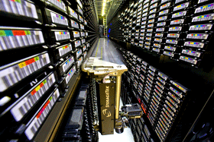
Archival Storage (HPSS)
For permanent, archival storage
Permanent storage is magnetic tape, disk cache is transient
100PB data in >400M files written to 32k cartridges
Cartridges are loaded/unloaded into tape drives by sophisticated library robotics
Front-ending the tape subsystem is 150TB fast-access disk
Hostname: archive.nersc.gov
Over 100 Petabyes of data stored
Data increasing by 1.7X per year
150 TB disk cache
8 STK robots
44,000 tape slots
Average data xfer rate: 100 MB/sec
Notes:
As I mentioned before, HPSS is NERSC’s archival storage system. The HPSS system you will be using is named “archive.nersc.gov” Data is stored and retrieved from HPSS with an HPSS utility named “hsi” or by ftp. NERSC provides hsi on all machines at the center and you can download a client from our website for many popular operating systems. If you want to access HPSS directly from outside NERSC, you have to follow a procedure that you can read about on our web pages.

Slide 23
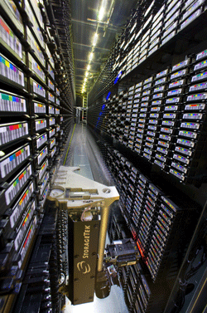
HPSS Clients
Parallel, threaded, high performance:
HSI
Unix shell-like interface
HTAR
Like Unix tar, for aggregation of small files
PFTP
Parallel FTP
Non-parallel:
FTP
Ubiquitous, many free scripting utilities
GridFTP interface (garchive)
Connect to other grid-enabled storage systems

Slide 24
Running and Monitoring Jobs

Slide 25
Types of Jobs on Genepool
Batch – Scheduled
sbatch
Interactive – Scheduled
salloc
Interactive – Unscheduled
2 login nodes, 17 gpint interactive nodes
direct login via ssh
Services – Unscheduled
Web services
Database Services
Automated job submissions

Slide 26
Basics of Batch Jobs
Denovo and Cori are shared resources
All NERSC systems now use Slurm for job scheduling
Each calculation usually only takes a small portion of the system
Every job is strictly limited on the consumption of those resources
You’ll use batch directives (ie Slurm script headers or command line flags) to specify the resource limits
The fewer resources you request, the less time you’ll wait in the queue (usually)

Slide 27
The Key Slurm Commands
“sbatch”
Submit a script to the scheduler, to run on a new compute allocation
Can put resource requests on the sbatch command line, or in script headers
#!/bin/bash -l
#SBATCH --qos=jgi
#SBATCH –A fungalp
#SBATCH –C haswell
#SBATCH –N 10
#SBATCH --time=00:30:00
module load python
python my_multinode_script.py
$ sbatch --qos=jgi –A \
fungalp –C haswell \
–N 10 --time=00:30:00 \
myscript.sh
or

Slide 28
The Key Slurm Commands
“salloc”
Requests a compute allocation
You’ll automatically be logged into that allocation
Will automatically ssh you into the first node granted to you
(This is not default SLURM behavior, so might be different outside of NERSC)
Use the same sorts of resource request as for sbatch
Denovo example:
$ salloc –N 1 –c 64 –t 1:00:00
Cori example:
$ salloc --qos=genepool -A fungalp –t 1:00:00

Slide 29
Slurm submission requirements
Genepool Cori
Denovo
--qos=genepool
or --qos=genepool_shared
-A youraccount
-c # can be 1-64
--mem=<MB up to ~120G>
-t <minutes or h:min:sec>
No qos on Denovo (yet)
Default accounts
-c #depends on node-type
--mem=<MB up to ~950G>
-t <minutes or h:min:sec>
Eventually, unification of the scheduler behavior across all NERSC systems – possible changes this summer

Slide 30
Slurm Task arrays
Task arrays
sbatch --array=1-100 –c 8 --mem=20G
Would start a 100 task job array
Each task will run on 8 cpus and 20GB memory
(Does NOT divide up across the resources requested)
Job arrays will have two additional environment variables set:
$SLURM_ARRAY_JOB_ID will be set to the first job ID of the array.
$SLURM_ARRAY_TASK_ID will be set to the job array index value.

Slide 31
Pointers to avoid common mistakes
For new users, trust the scheduler
Slurm will do its best to place your job where it will run best given your resource specifications.
It helps to know 3 things:
Max runtime: -t 6:00:00 run for up to 6 hours
Number of CPUs -c 8 give me 8 CPUs (hyperthreads)
Memory --mem=120G I need 120G total memory
Asking for fewer resources usually helps your job start sooner.
At the moment, there is extra capacity.
Don’t bother to try and “game” the system to get your jobs to start faster
You’ll probably just make your JGI colleagues mad

Slide 32
Check queued job status with squeue
Many additional options (including for formatting)
See “sinfo --help” for the full listing

Slide 33
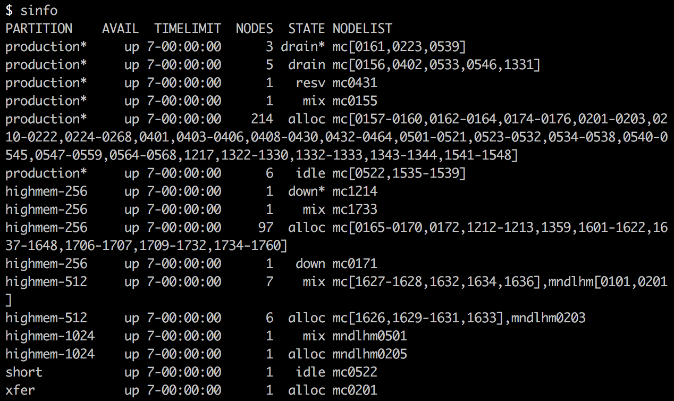
What’s going on with the cluster?
Use “sinfo” to get info on the state of the cluster

Slide 34
Investigating Completed Jobs
Slurm saves accounting information for all completed and errored-out jobs
Can use this info to diagnose what went wrong with your job
Use “sacct” commands to investigate completed jobs
Example: show all of qc_user’s jobs that timed out in the first week of June
sacct -u qc_user –s to -S 2018-06-01 -E 2018-06-07
See “sacct --help” or the sacct man page for all the options

Slide 35
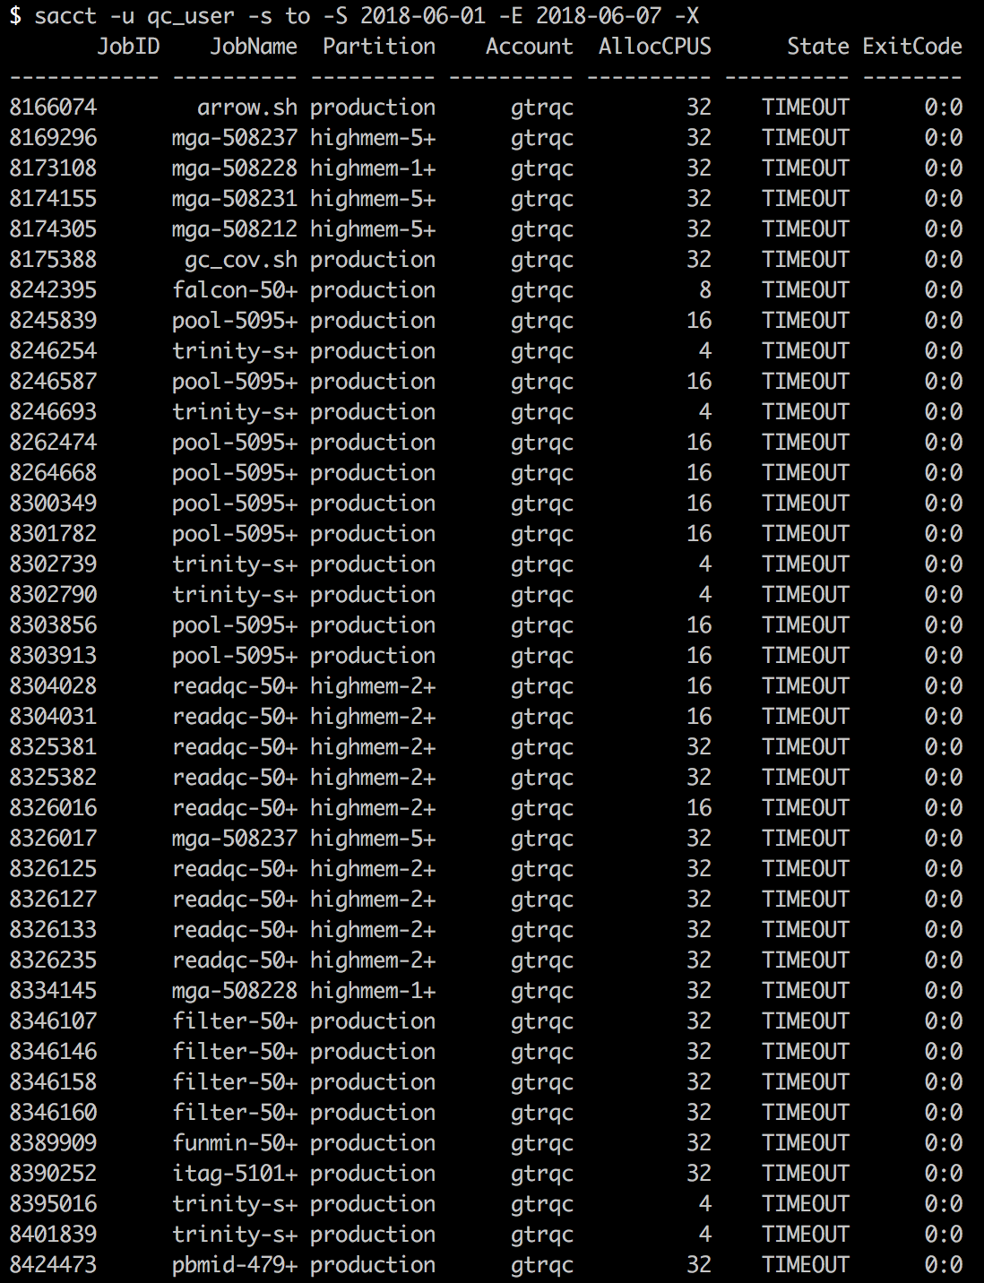
TLDR:
sinfo – cluster status
squeue – queue status
sacct – job status

Slide 36
Projects and Accounts
When you got a NERSC account, you were assigned a project
You can have multiple projects
On Cori, you’ll need to specify your project with “-A” flag
sbatch ––qos=genepool –A pkanot –c 8 –t 10:00 –mem=5G test.sh
JGI sometimes uses project activity logs to allocate resources, so let us know if you’re assigned to the wrong project, or if you switch groups!
What projects are you attached to?
$ sacctmgr show assoc where user=$USER

Slide 37
Software: Modules, Conda, Shifter

Slide 38
Using Software and the UNIX Environment
Providing large-scale installations of software for many different users on an HPC system presents a number of challenges:
Different users need different software, use different shells
Some users need different specific versions, including older versions
All users need to access the software quickly and easily from “everywhere” [network-mounted, non-standard paths]
Providing a user interface for accessing that software can be challenging

Slide 39
NERSC-Recommended Software Solutions
Use the module system
Mainly for system and programming tools
Modules installed and maintained by NERSC
Lots of JGI software and scripts rely on this
Though we’ve been directed to move away from it!
Use Anaconda
It’s not just a python package manager
Over 3000 bioinformatics tools in Bioconda channel
Use Docker containers with Shifter
Install your own software
You’re welcome to download, code, compile, and run anything you like in your own directories
Just don’t do a bunch of I/O from $HOME!

Slide 40
What are Modules?
Modules have a name
A “module” is something that can be loaded or unloaded dynamically into the environment.
Modules can have a default version
Modules have a version
can have many versions
To refer to the default version of a module, use: <name>
e.g. module load gcc
To refer to a specific version of a module, use: <name>/<version>
e.g. module load gcc/4.8.1

Slide 41
Basic Modules Functionality
Modules manipulate the environment
Loading can:
Set an environment variable (possibly by replacing)
Append (or prepend) to a compound environment variable
Unset an environment variable
Modules might have dependencies
So, loading one module could load several others
‘module unload’ tries to reverse the effects of ‘module load’
unset env variable changes, unload dependent modules, etc

Slide 42
Module commands reference
module list
show all loaded modules
module avail <module name>
list modules with <module name> that can be loaded
module load <module name>
module unload
module swap <current module> <new module>
unload a loaded module and load the new one
module purge
unload all modules (it’s a good idea to start a batch script this way!)
module use <a directory>
Use a different $MODULEPATH
For installation of new modules, or software upgrades, contact your consultants!

Slide 43
Anaconda
Anaconda is a software package manager
Started life as a python package manager
But has expanded to include binaries and other languages
Use it to create conda environments
Similar to python virtualenvs
Add all the software and libraries you need for a project, then activate the environment to make it available to your scripts
Is the default NERSC python module, so no need to install it yourself
Several NERSC training sessions available, and lots of good documentation available online:
http://docs.anaconda.com
NERSC Trainings and Tutorials page

Slide 44
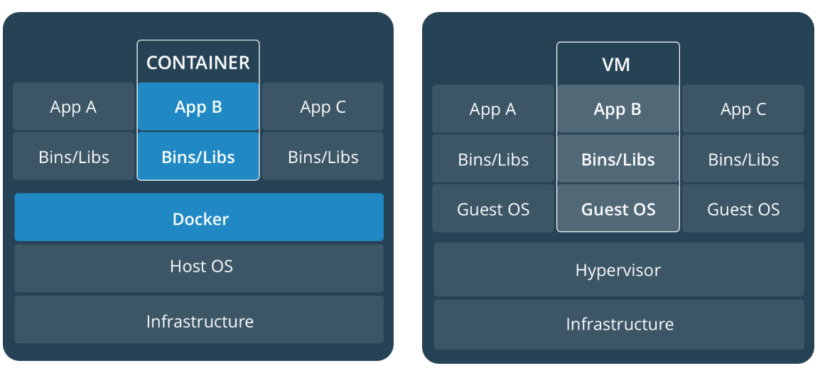
Shifter
Containerization is a common application deployment tool
Docker is the most commonly-used container tool
Shifter is an HPC-enabled Docker-like tool
Run Docker containers without security issues, and across multiple nodes
See our trainings and tutorials page, and NERSC website

Slide 45
Where to get started on getting help
NERSC webpage
https://www.nersc.gov - Some info may be slightly outdated
Soon: http://docs.nersc.gov
Online Helpdesk – http://help.nersc.gov
Create and monitor trouble tickets
Or email consult@nersc.gov
NERSC Information management (NIM) webpage
https://nim.nersc.gov/ - change NERSC password
my.nersc.gov
More information on your account and usage
Consulting line – 1-800-66-NERSC (menu option 3)
Talk to a real live consultant 8-5, M-F

