Slide 1
Nanopore Sequencing
Marcus Stoiber, PhD, LBL EGSB Postdoc

Slide 2
Nanopore Sequencing
Outline
Nanopore Sequencing Technology
Raw Data
Transformations and Raw Data Processing
Toward Producing a Basecaller
Future Directions
Notes:
Single molecule
Long read
Publicly available through select community starting April 2014

Slide 3
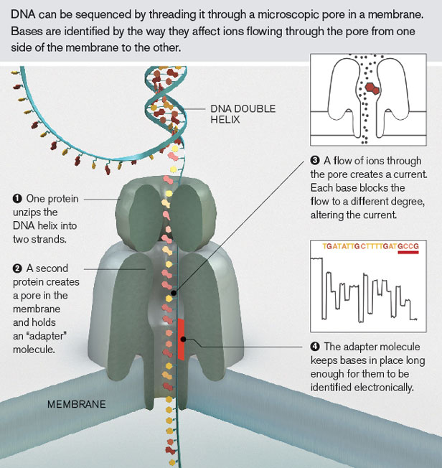
What is Nanopore Sequencing?
Determine the sequence of DNA fragments by passing DNA through a protein (or other) pore in a membrane
Notes:
Single molecule
Long read
Publicly available through select community starting April 2014

Slide 4
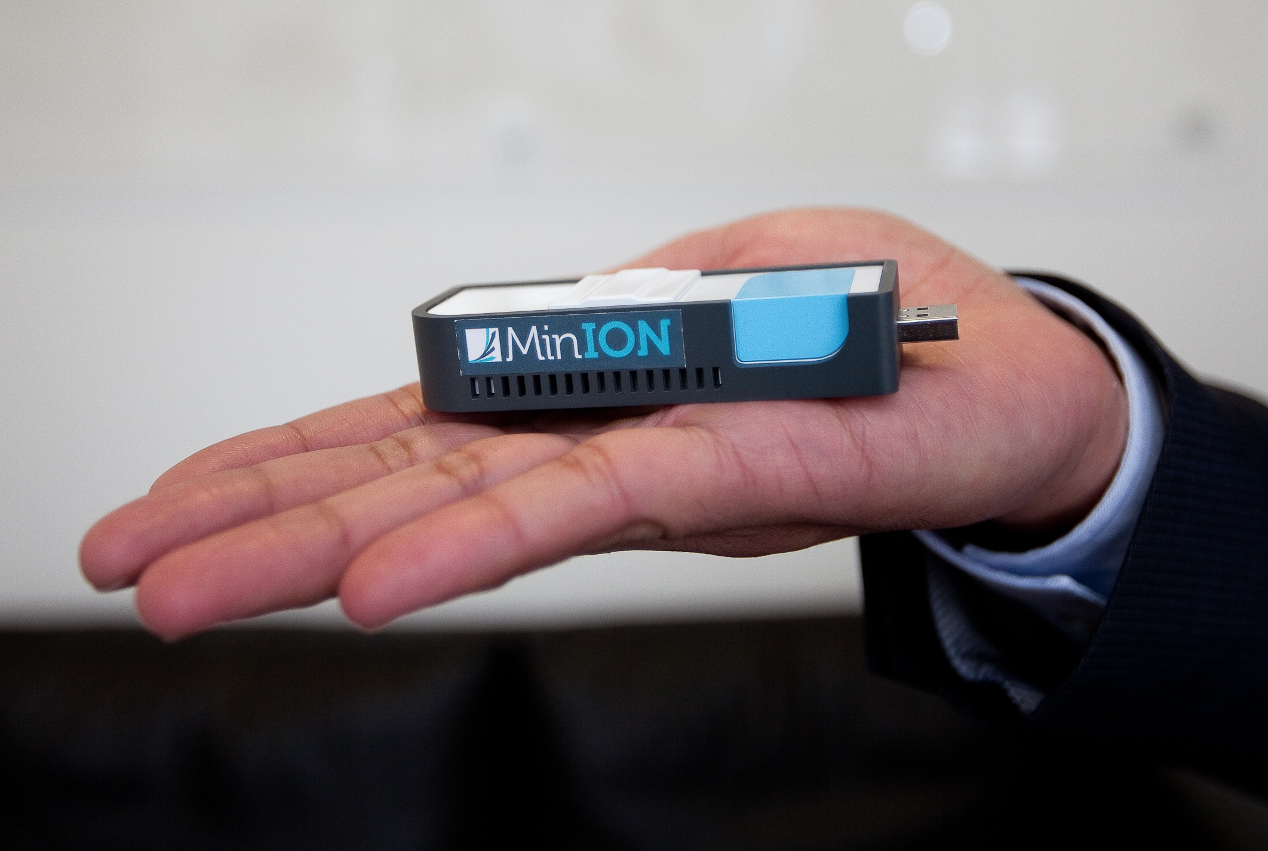
What is Nanopore Sequencing?
Oxford Nanopore became the first company to provide a commercially available nanopore sequencer in 2015 (available to community in 2012)
Notes:
Single molecule
Long read
Publicly available through select community starting April 2014

Slide 5
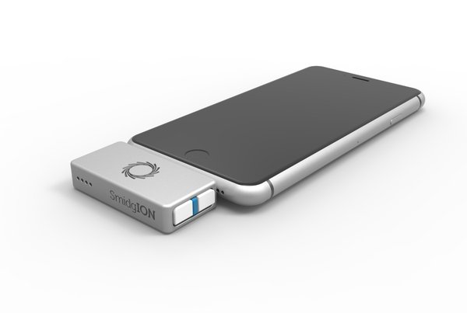
What is Nanopore Sequencing?
Nanopore is a disruptive technology:
Sequencer Size
Read Length
Potential direct RNA sequencing
Biology Problem with Data Velocity Issues
  Currently ~400GB/24 hours needs to be processed
Notes:
Single molecule
Long read
Publicly available through select community starting April 2014

Slide 6
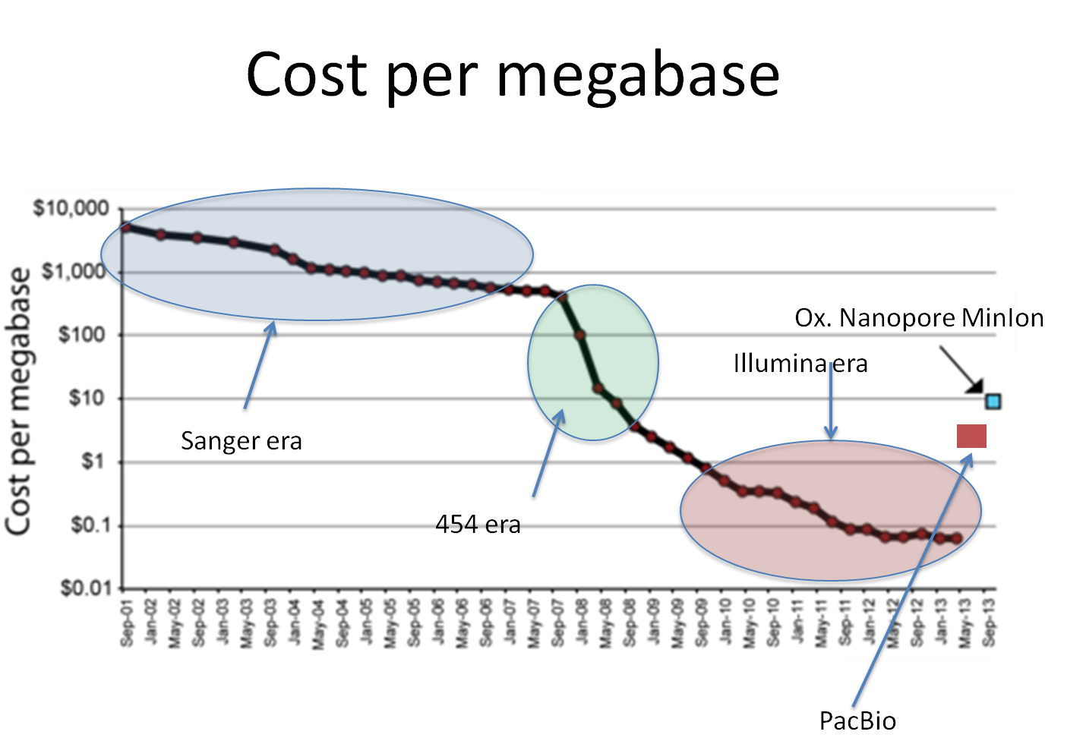
What is Nanopore Sequencing?
Notes:
Single molecule
Long read
Publicly available through select community starting April 2014

Slide 7
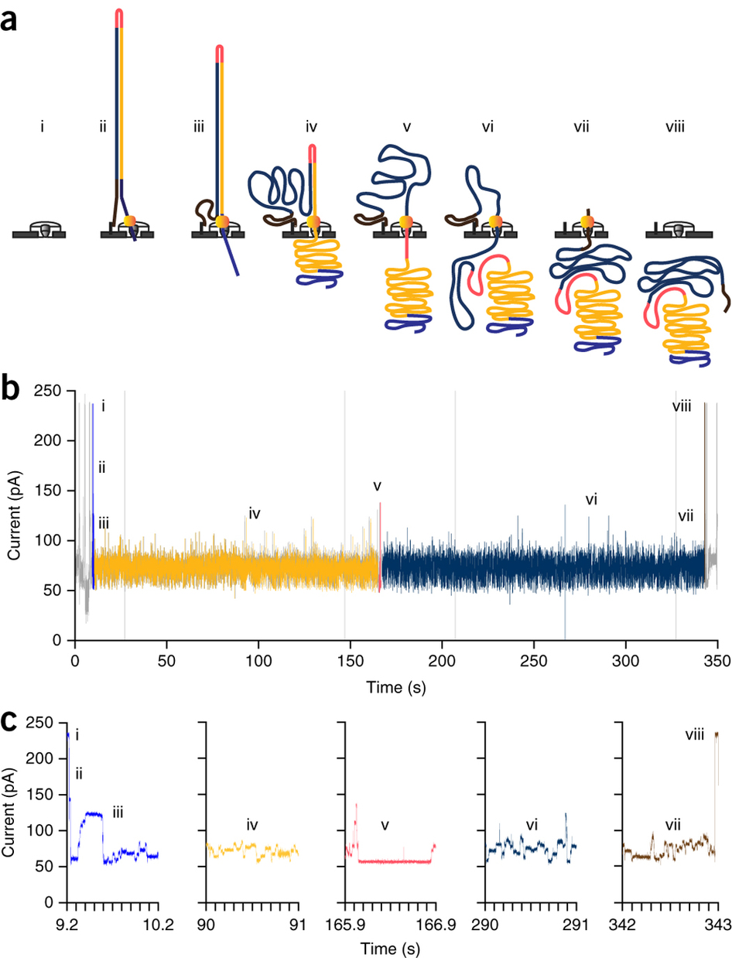
Raw Nanopore Data
Notes:
Single molecule
Long read
New chemistry (R7) showing as low as 26% error rate (for 2D reads) 37% error for 1D reads

Slide 8
Processing Raw Data
First step is to create a training data set
Starting from provided raw data followed by processing to produce useful data set for training to predict genomic bases
Goal is to release this package to the community for greater access to create training data sets for this data

Slide 9
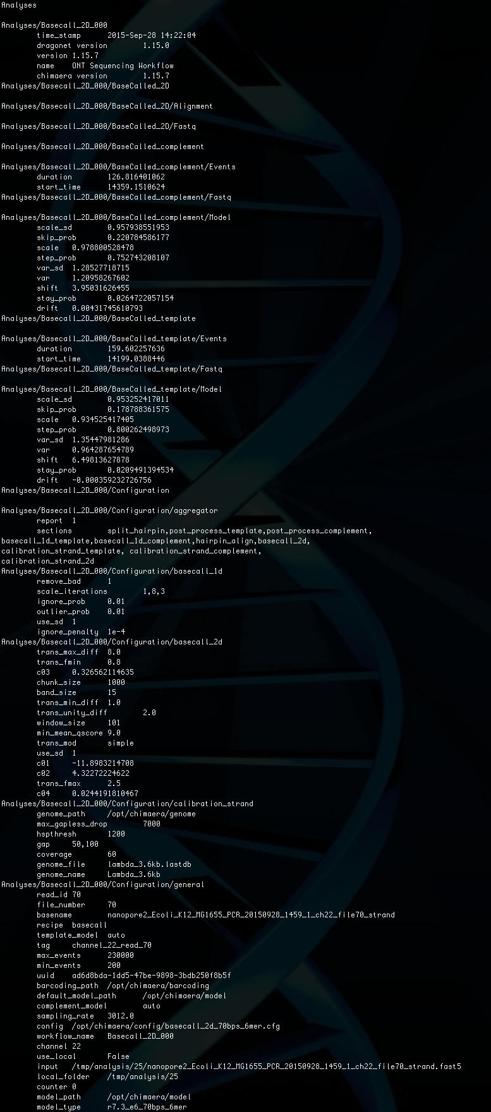
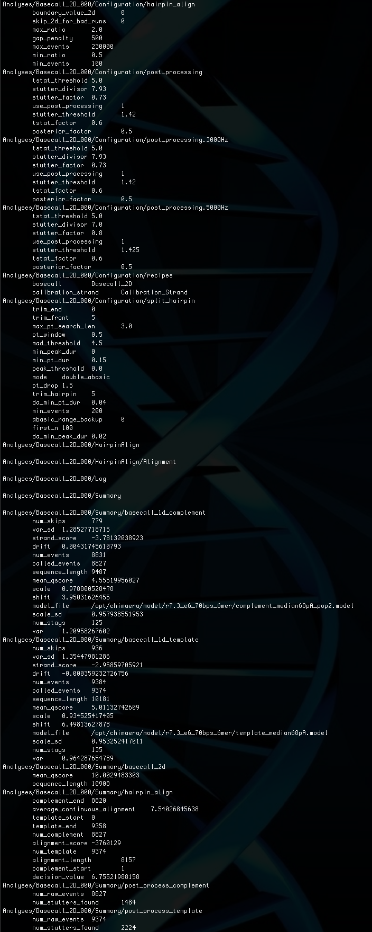
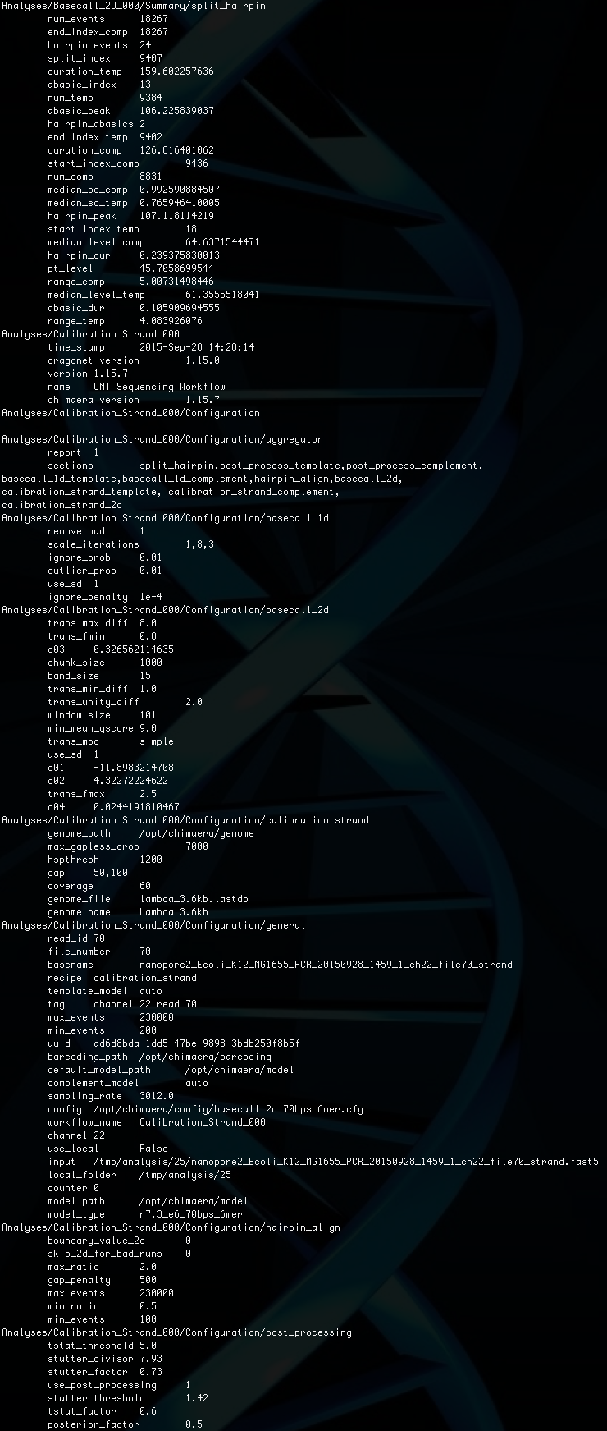
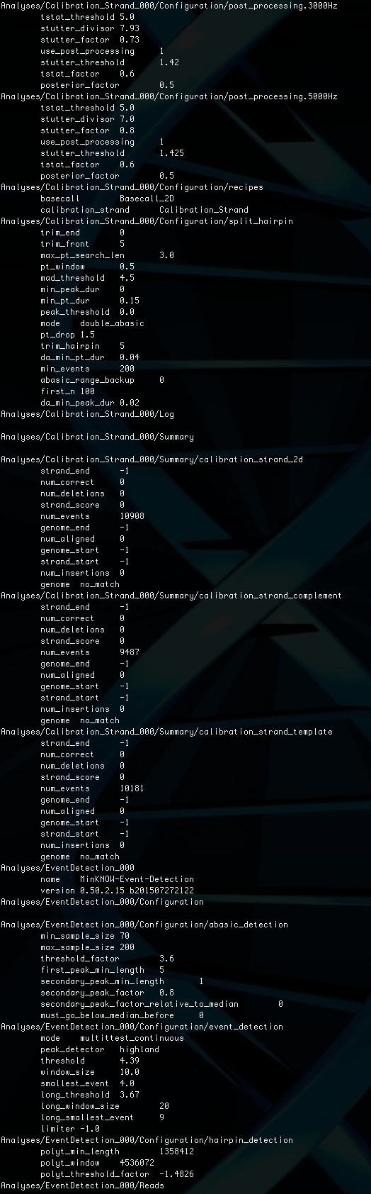
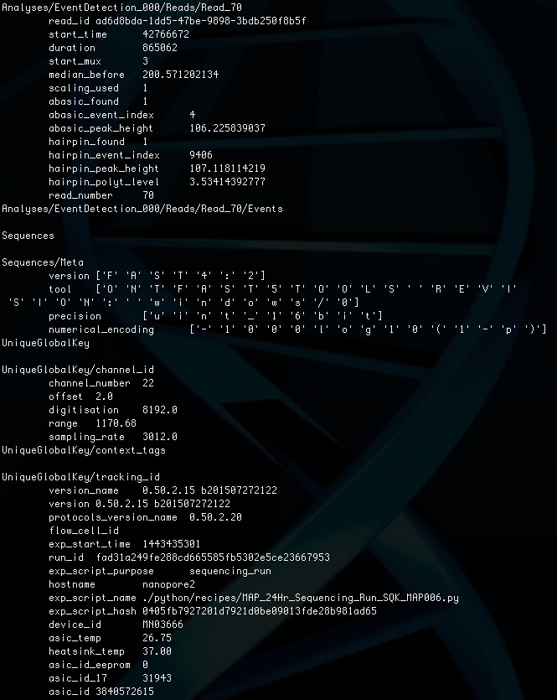
Poorly Documented Metadata

Slide 10
Raw Nanopore Data
~50 (250-400 with new R9 pore) base pairs per second pass through a pore
Need to segment signal into individual events representing base pairs and determine to which base each event corresponds
Notes:
Single molecule
Long read
Publicly available through select community starting April 2014

Slide 11
Nanopore Raw Correction
Segmentation
Call Bases
Align to
Genome

Slide 12
Nanopore Raw Correction

Slide 13
Nanopore Raw Correction
Correct deletions:
Center on deletion
Expand to neighboring regions
Segment using mean changepoint

Slide 14
Nanopore Raw Correction
Correct insertions:
Center on insertion
Expand to neighboring regions
Segment using mean changepoint

Slide 15
Nanopore Raw Correction
Complex Corrections:
Determine if multiple corrections “intersect”
Expand selection to entire region
Segment using mean changepoint

Slide 16
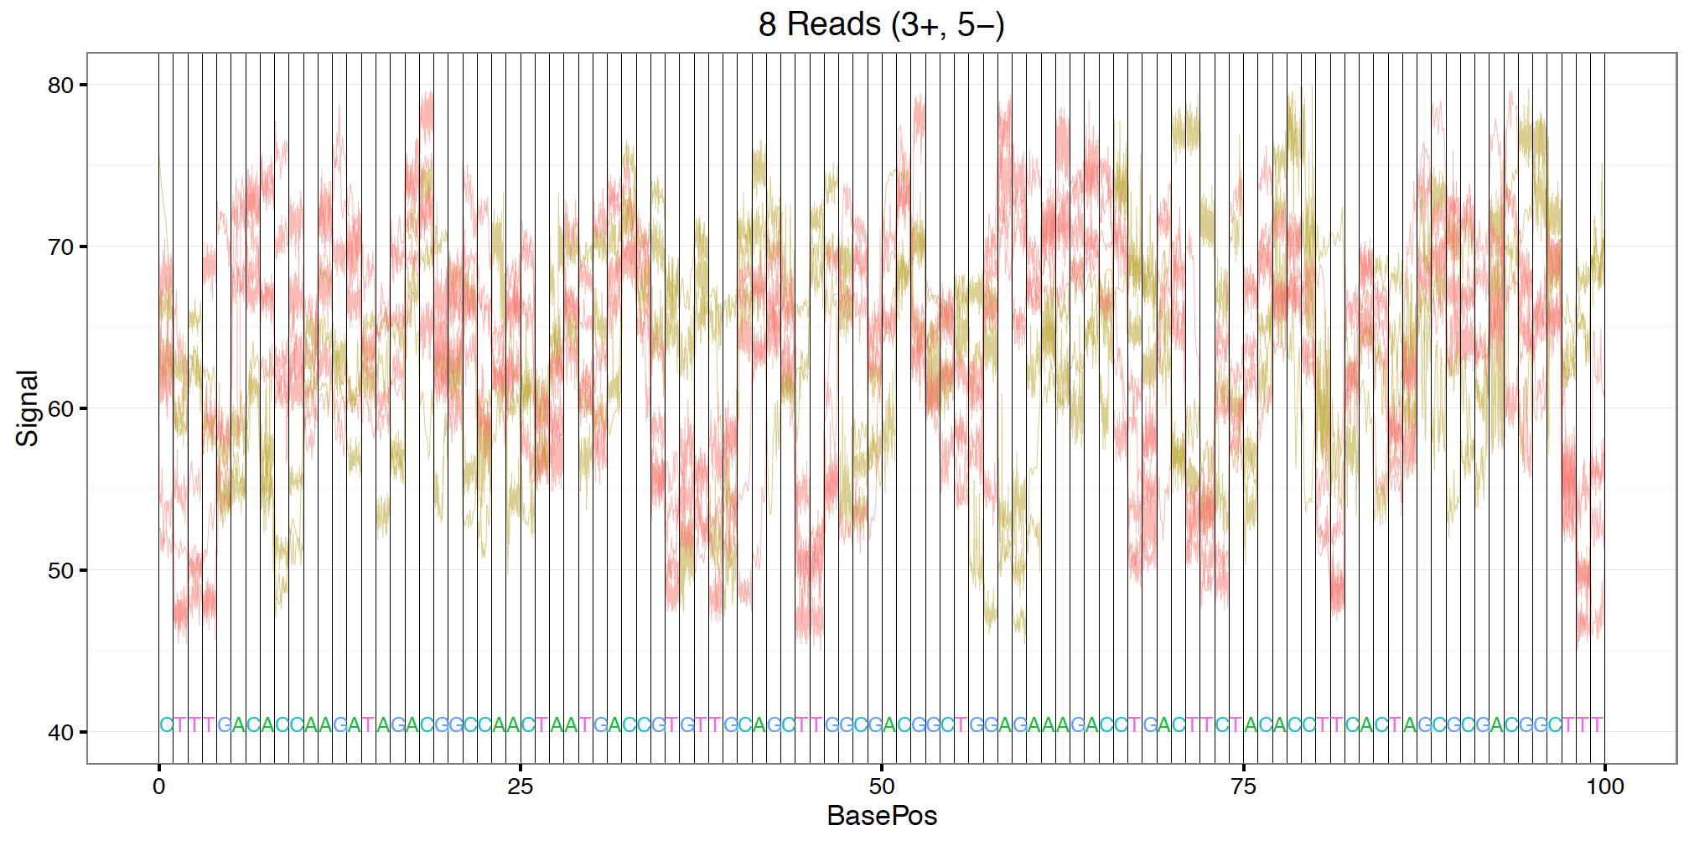
Raw Nanopore Data
Noise level is quite high (hopeful for improvements in base technology)
  Shown above is the same DNA sequence observed 8 times
Notes:
Single molecule
Long read
Publicly available through select community starting April 2014

Slide 17
Toward a Basecaller
Post correction and normalization distributions
Clearly some signal exists before complex machine learning
~13% accuracy achievable by nearest mean calculations

Slide 18
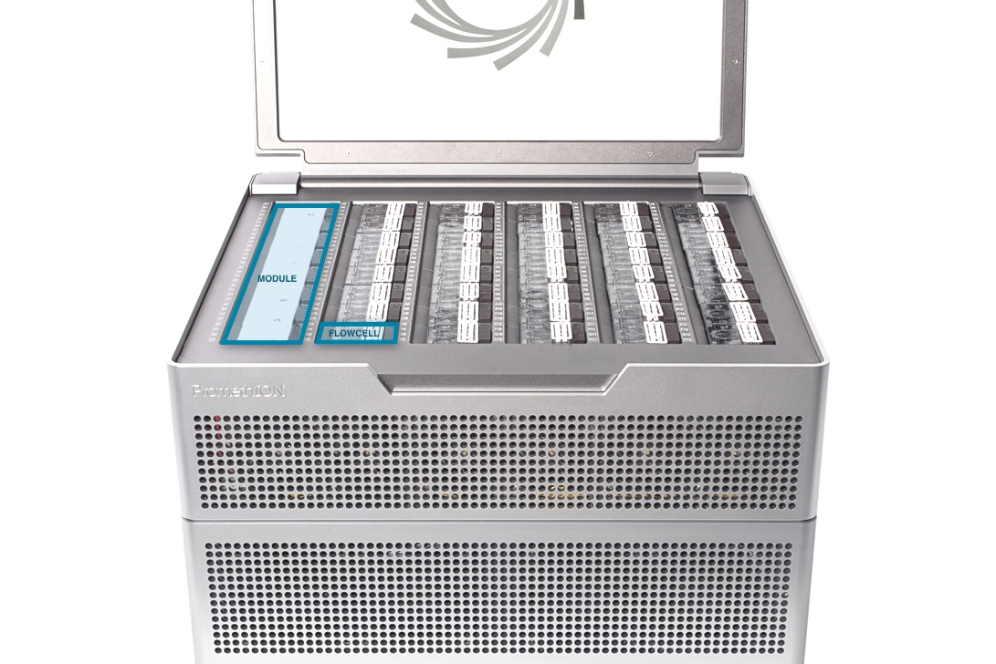
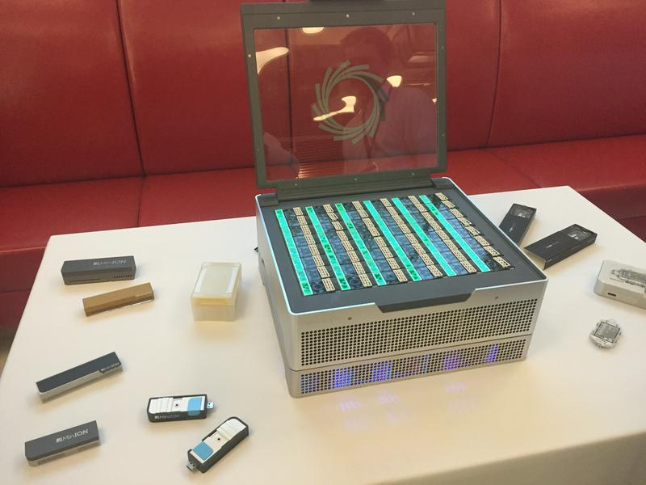
Toward a Basecaller
Oxford Nanopore has recently upgraded to a RNN basecaller which produces reads with ~85% accuracy, thought it is still computationally intensive
Larger sequencer (PromethION) produces 12Tb of data in 48 hours (up to 1.44GBps) with current machine requiring ~1kW.

Slide 19
Toward a Basecaller
Current event (base) segmentation is done using an FPGA t-test and all computation (RNN) is completed on the mean and SD of these segments
We are currently working to integrate basecalling and segmentation directly from the raw data via an RNN with potentially vast improvements in accuracy as well as speed which will become increasingly important with throughput improvements.

Slide 20
Challenges
Data Velocity
  Basecaller must be able to keep up with the increasing speed of the data
Accuracy
  Basecaller must be accurate enough to provide meaningful biological insight
Adaptabiltiy
  Would like to be able to interrogate the data in order to assess confidence as well as possible alterations outside of the given model

Slide 21
Future Directions
Produce 1D basecalls on par with current algorithms ~70-80%
  Exploring architectures and pre-processing
Investigate base alterations (methylation, acetylation, etc.) via encoding layers
Release package to create raw data training sets and provide QC metrics for raw reads.

Slide 22
Nanopore Sequencing
Thanks!

