Slide 1
NERSC
National Energy Research
Scientific Computing Center
Kristy Kallback-Rose
NERSC Senior HPC Storage Systems Analyst
April 4, 2019

Slide 2
Agenda
General NERSC & Systems Overview
Storage 2020 Strategy & Progress
Superfacility Initiative

Slide 3
NERSC & Systems Overview

Slide 4
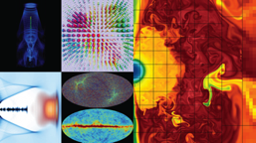
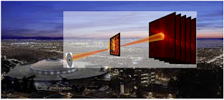
NERSC is the mission HPC computing center for the DOE Office of Science
HPC and data systems for the broad Office of Science community
Approximately 7,000 users and 870 projects
Diverse workload type and size
Biology, Environment, Materials, Chemistry, Geophysics, Nuclear Physics, Fusion Energy, Plasma Physics, Computing Research
Simulations at Scale
Experimental & Observational Data Analysis at Scale
Notes:
NERSC is a division of Lawrence Berkeley National Laboratory,

Slide 5
NERSC - Resources at a Glance 2019
Retiring Summer 2019
Retiring Summer 2020
Edison: Cray XC-30
7.6 PB Local Scratch
163 GB/s
130 GB/s
/project
7.1 PB
DDN SFA12KE
Sponsored Storage
5.1 PB
DDN SFA12KE
16x FDR IB
40 GB/s
5,576 nodes, 133K 2.4GHz Intel IvyBridge Cores, 357TB RAM
Cori: Cray XC-40
30 PB Local Scratch
700 GB/s
275 TB
NetApp 5460
5 GB/s
/home
1.8 PB DataWarp I/O Burst Buffer
1.5 TB/s
HPSS
~140 PB stored, 390 PB capacity, ~40 years of community data
100 GB/s
2,004 nodes, 64K 2.3GHz Intel Haswell Cores, 203TB RAM
9,688 nodes, with 1.4GHz Intel KNL Cores, 1PB RAM
32x FDR IB
Data-Intensive Systems
PDSF, JGI, Materials
14x FDR IB
Ethernet &
IB Fabric
Production Monitoring
WAN
Retiring Fall 2019
2 x 100 Gb
Data Transfer Nodes
Science Gateways
Software Defined
Networking
Notes:
Cori - Heterogeneous compute architecture, installed in 2015-2016.
2004 Dual socket Haswell nodes (32 cores per node at 2.3 GHz)
9,300 Intel Knights Landing compute nodes
68 cores per node
16GB on-package high-bandwidth memory at ~490GB/s
96 GB DRAM
Storage
NVRAM Burst Buffer with 1.6PB of disk and 1.7TB/sec
28 PB of disk, >700 GB/sec I/O bandwidth in Lustre bandwidth
Plans for NERSC-9 Underway
The Burst Buffer is a layer of SSD storage in Cori that sits within the high-speed network.
per-job or "scratch" reservation:
persistent reservation: - Multiple compute jobs can access a persistent reservation, and if the permissions are set appropriately, multiple users as well.
Users have a quota of 50TB on the Burst Buffer.
The burst buffer is not mounted on the login nodes, so it must be accessed via a compute node. If you want to work interactively with the Burst Buffer, you can use the interactive queue
PDSF is a networked distributed computing cluster designed primarily to meet the detector simulation and data analysis requirements of Physics, Astrophysics, and Nuclear Science collaborations. These collaborations are often data intensive and use grid technologies both for remote job submission and data transfer. They are also among the heaviest users of NERSC HPSS. Historically PDSF workflows have been almost completely serial jobs so the cluster is not optimized for parallel jobs but they are not expressly prohibited either.
Yes, you’d use JD, in particular since at some point the JCs will go away. The libraries have 13,000 slots each, So total capacity would be 13,000 * 15TB = 195PB/library * 2 = 390PB capacity on the floor right now. Since we’re currently using 6,000 slots, you might say that we have 20,000 * 15TB = 300PB available space.

Slide 6
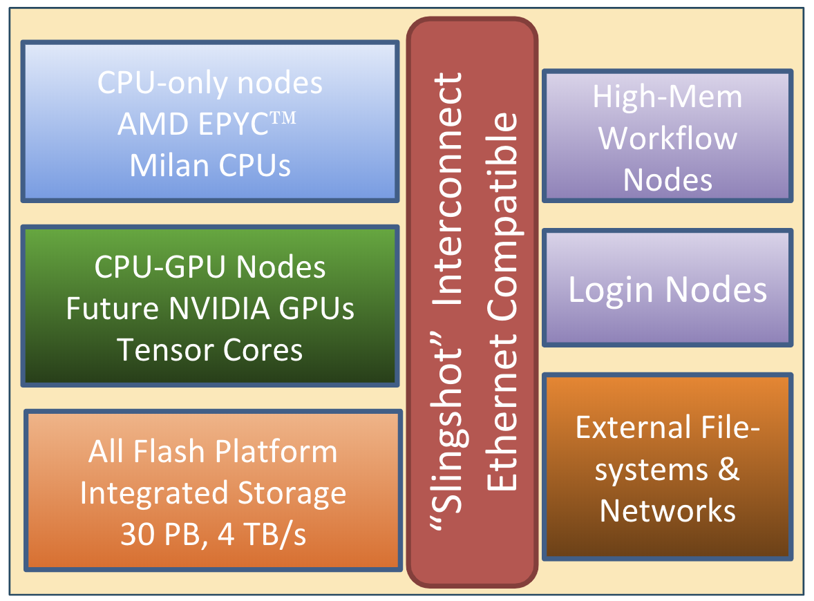
NERSC-9 aka Perlmutter
Designed for both large scale simulation and data analysis from experimental facilities
Overall 3x to 4x capability of Cori
Includes both NVIDIA GPU-accelerated and AMD CPU-only nodes
>4,000 node CPU-only partition provides (same capability as all of Cori)
GPU nodes: 1 AMD Milan CPU + 4 NVIDIA GPUs
Slingshot Interconnect
Capable of Terabit connections to/from the system
Ethernet compatibility
Adaptive Routing/Congestion Control
Single Tier, All-Flash Lustre scratch filesystem
Robust readiness program (NERSC Exascale Science Applications Program, NESAP)
Delivery in late 2020
Notes:
NESAP is a collaborative effort in which NERSC partners with code teams, vendors, and library and tools developers to prepare for advanced architectures and new systems.
Winner of 2011 Nobel Prize in Physics for discovery of the accelerating expansion of the universe.
Supernova Cosmology Project, lead by Perlmutter, was a pioneer in using NERSC supercomputers to combine large scale simulations with experimental data analysis
Early access to Cori’s GPU testbed
Quarterly hackathons with NERSC, Cray, NVIDIA engineer
General programming, performance and tools training
Early access to Perlmutter
4.2.2 Using SMWflow on Cori to Deploy an External GPU Partition
In preparation for Perlmutter, NERSC has deployed a new GPU partition for Cori to support application performance tuning for GPUs. The system will be available for key engagements, including the NESAP program. This partition comprises 18 Cray CS-Storm 500NX nodes, each with 8 NVIDIA Tesla V100 accelerators, one Intel Skylake processor, and 384 GiB of memory. The onboard GPUs are connected via NVLink, and four dual-port EDR Infiniband NICs provide network connectivity to the nodes. Four of these ports connect to an internal Infiniband network to enable fast MPI communications. The remaining four ports connect the GPU nodes directly to NERSC's internal 100 GbE network, the NGF (GPFS) network, and Cori's Lustre network.
The software configuration of this system is notable both from a user perspective and a systems management perspective. Although the GPU systems were procured as an entirely distinct cluster, NERSC presents these nodes to users as an extension of Cori. NERSC runs the same operating system (CLE from Cray) and configuration used on Cori's login nodes for the GPU systems. Thus, to users, nodes in the GPU partition look and feel like a Cori node. The partition uses the same file systems, applications, and development tools for the GPU nodes as Cori, providing a familiar environment for users. The GPU partition's management environment also parallels Cori's environment by using the SMW software from Cray. This has enabled NERSC to use SMWflow, our git-based software configuration process, to manage multiple systems, such as the GPU cabinet. In addition to easing the development, testing, and deployment of new software across NERSC's systems, by adopting this process we are able to unify the systems software between the large-scale Cray systems and any add-on nodes or racks, such as the GPU rack on Cori.

Slide 7
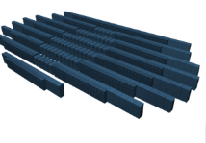
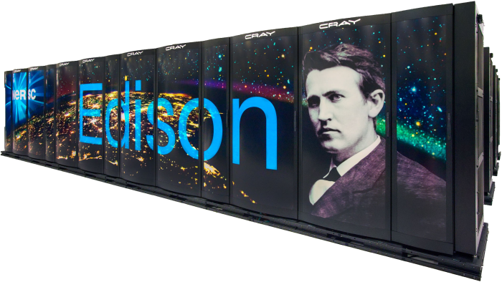
NERSC Systems Roadmap
NERSC-10
ExaSystem
~20MW
NERSC-9: Perlmutter
3-4x Cori
CPU and GPU nodes
>5 MW
NERSC-8: Cori
30PFs
Manycore CPU
4MW
NERSC-7: Edison
2.5 PFs
Multi-core CPU
3MW
2013
2016
2020
2024

Slide 8
Storage 2020 Strategy

Slide 9
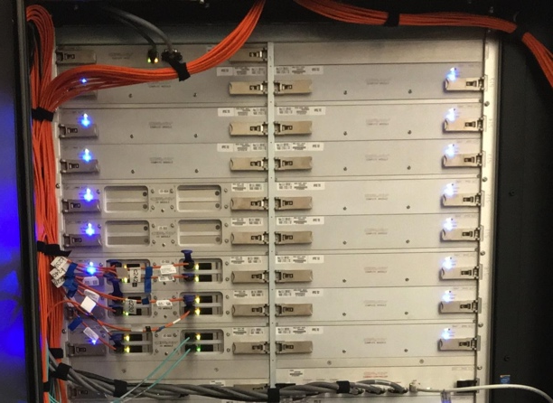
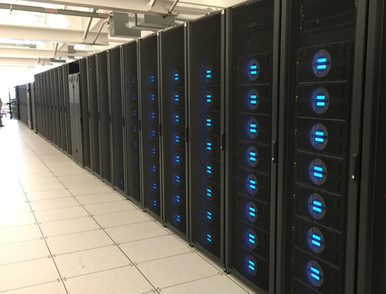
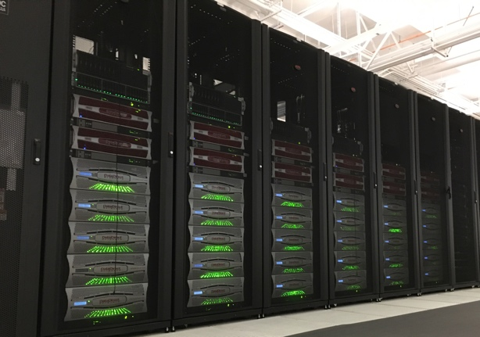
NERSC’s storage hierarchy (Current)
1.8 PB
1.5 TB/s
Burst Buffer
30 PB
700 GB/s
Performance
Capacity
Scratch
12 PB
130 GB/s
Campaign
Archive
140 PB
100GB/s

Slide 10
Not really a balanced pyramid
1.8 PB
1.5 TB/s
Burst Buffer
30 PB
700 GB/s
Performance
Capacity
Scratch
12 PB
130 GB/s
Campaign
Archive
140 PB
100GB/s
New detectors, experiments
Exascale == massive data
HPC tech landscape changing

Slide 11
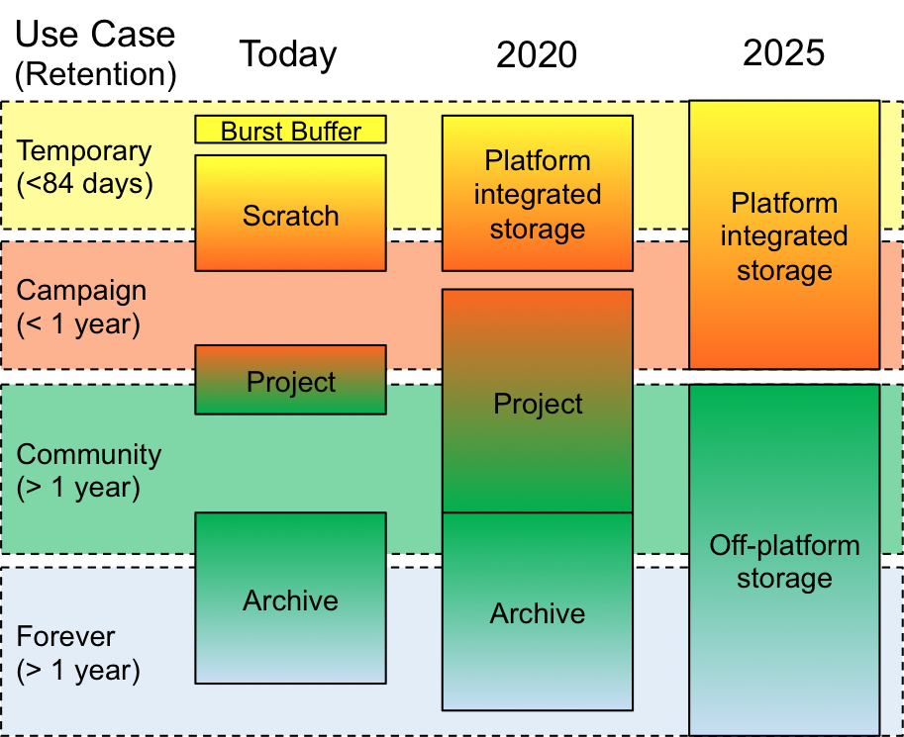
NERSC Storage 2020: Design goals
Target 2020
Collapse burst buffer and scratch into all-flash scratch
Invest in large disk tier for capacity
Long-term investment in tape to minimize overall costs
Target 2025
Use single namespace to manage tiers of SCM and flash for scratch
Use single namespace to manage tiers of disk and tape for long-term repository
Storage 2020: A Vision for the Future of HPC Storage https://escholarship.org/uc/item/744479dp

Slide 12
NERSC Storage 2020: Implementation
All-flash parallel file system on Perlmutter
Performance object store w/ SCM+SLC+QLC? on NERSC-10
Capacity-focused, disk-based file system
Archival object store w/ HDD+tape
(GHI+HPSS? Versity? Others?)
> 390 PB HPSS archive w/
IBM TS4500
+Integrated Cooling
Notes:
Forget to stripe? Lustre Progressive File Layouts will do it for you automatically
Have many files? Lustre Distributed Namespace adds more metadata processing muscle
Must do small I/O? Lustre Data-on-MDT stores smaller files on IOPS-optimized storage

Slide 13
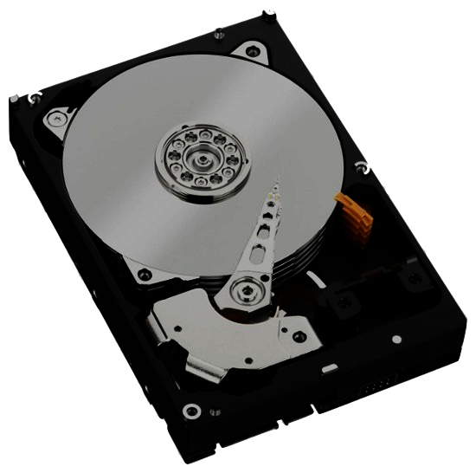
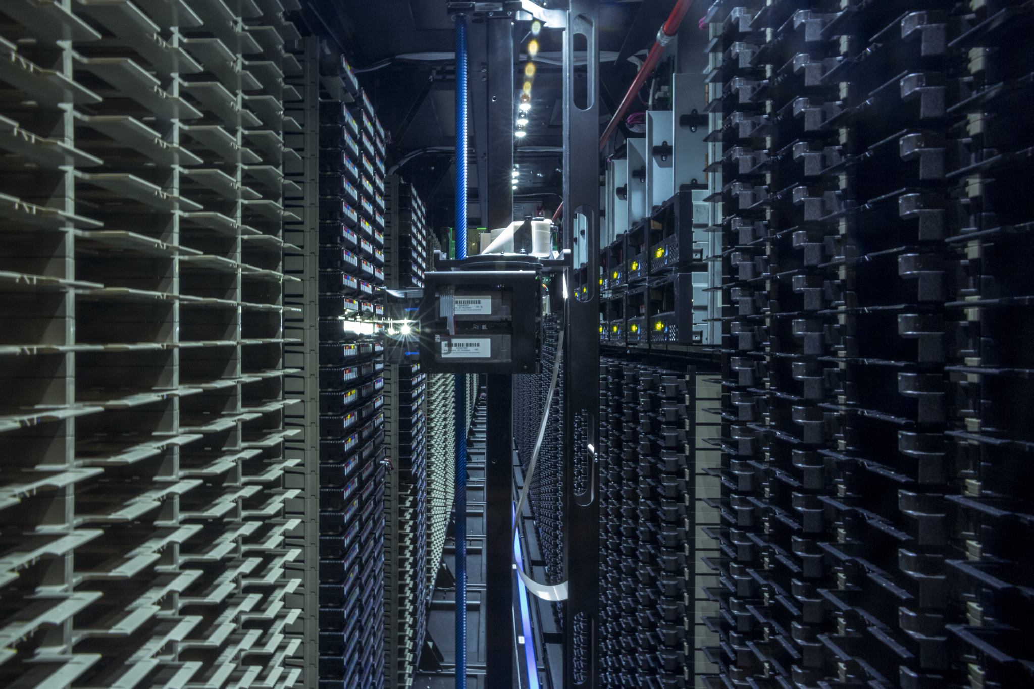
NERSC’s storage infrastructure (2020)
>30 PB
>4.0 TB/s
Performance
Capacity
~200 PB
>>100 GB/s
Scratch
Community
Archive
>>200 PB
100 GB/s
Notes:
2018/2019: 128 drives, 26K slots, 15 TB carts in 2018 (390 PB slot capacity)
2021/2022: 240 drives, 52K slots, 25 TB carts in 2020 (1.3 EB slot capacity--but data will exist at old formatted density)

Slide 14
Tape System Migration Update

Slide 15
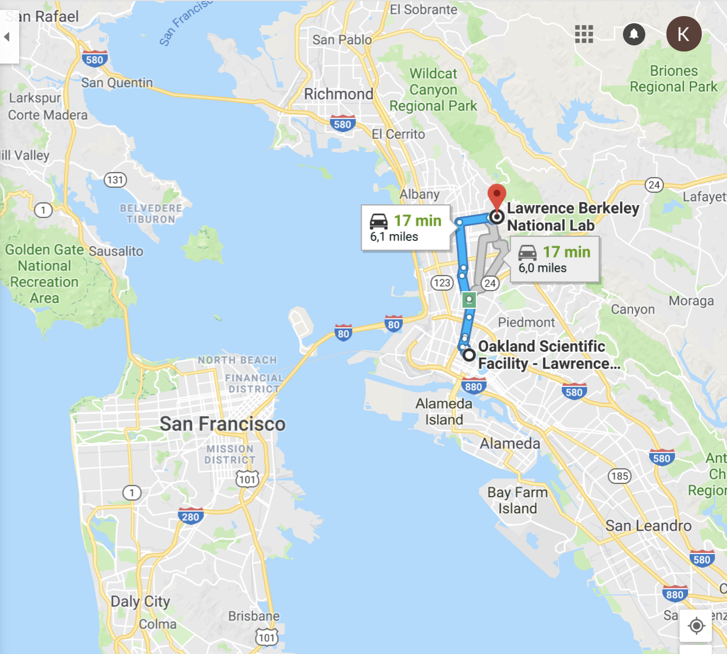
HPSS Archive – Two significant needs
Technology decision
Discontinued Oracle Enterprise Tape Drive
4 Fully configured Oracle SL8500 libraries (archive)
60 Oracle T10KC tape drives (archive)
1 IBM TS3500 (mainly system backups)
36 IBM TS1150 tape drives (mainly system backups)
Physical move required
Oakland to Berkeley (~6 mi/~9 km)

Slide 16
HPSS Archive – Data Center Constraints
Berkeley Data Center (BDC) is green (LEED Gold)
Reliance on ambient conditions for year-round “free” air and water cooling
Intakes outside air, optionally cooled with tower water or heated with system exhaust
No chillers
(Ideally) take advantage of:
<75°F (23.9C) air year round
<70°F (21.1C)for 85% of year
RH 10% to 80%, but can change quickly
Usually more in 30% - 70% range
Space utilization goals and budget constraints make a room-within-a-room a less desirable choice
Notes:
Room within a room much larger foot print.
Eval’d doing colo or other off site options

Slide 17
HPSS Archive – Green Data Center Solution
IBM TS4500 Tape Library with Integrated Cooling
seals off the library from ambient temperature and humidity
built-in AC units (atop library) keeps tapes and drives within operating spec
Notes:
The Integrated Cooling TS4500 tape libraries to be installed in datacenters where the environmental controls are outside of the normal operating parameters for the tape library.

Slide 18
HPSS Archive – Tech Change
One “Storage Unit” (my term) [Cooling Zone]
Two S25 frames sandwich, one L25 and one D25 frame
S25: High-density frame, tape slots (798-1000)
D25: Expansion frame, drive (12-16), tape slots (590-740)
L25: Base frame, drive (12-16), tape slots (550-660), I/O station and control electronics (for subsequent libraries no L25)
Each one of these storage units considered it’s own cooling zone
AC units go atop L and D frames
Air recirculated, no special filters
Fire suppression a little trickier, but possible
Notes:
he client must supply drains for air conditioning condensation that will have two drain hoses per air conditioner.
AC goes where top rack would normally be installed:
The top rack, 3584 Model TR1, provides an extra 10U of rack space on any frame in a library without requiring more floor space.
The optional top rack (Figure 1) reduces the storage footprint. It also simplifies cabling by providing extra rack space above the library for power distribution units, Fibre Channel switches, tape data movers, or IBM® Linear Tape File System™ (LTFS) nodes.

Slide 19
HPSS Archive – Tech Change (CRT)
Each library has 4 cooling zones
16 frames
64 TS1155/3592-55F(FC)/Jag(uar)6 tape drives
~13,000 tape slots
JD media @15TB/cartridge
We have installed 2 of the above

Slide 20
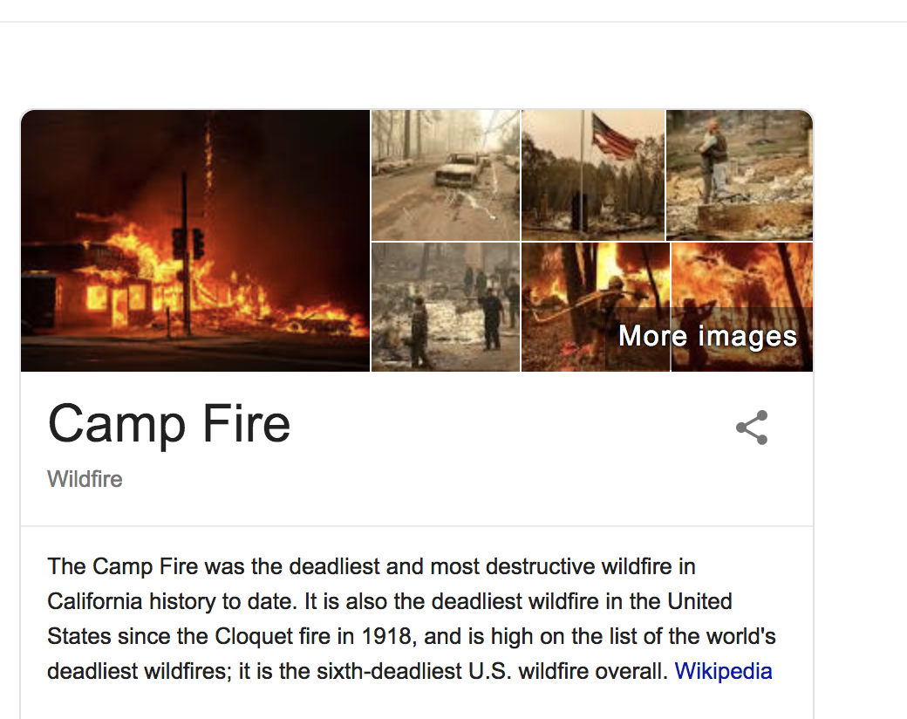
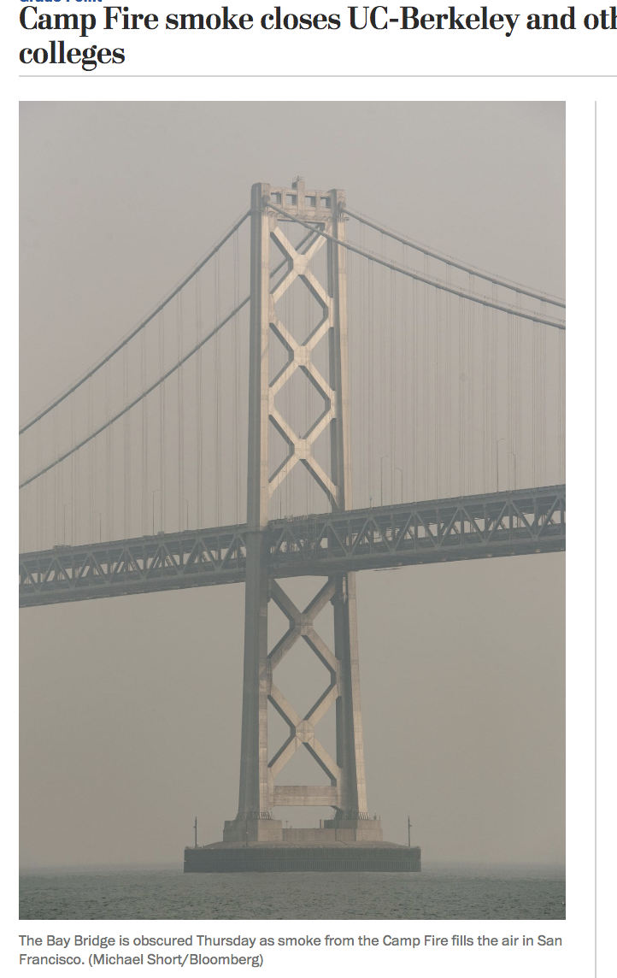
Effectiveness of Recycling Air!
Location | PPM (Particulate size of .5 Microns)
Operating Envelope | 3.5M
Computer Room @ Berkeley | 4.7M
Berkeley IBM TS4500 w/Integrated Cooling | 2.0M, 1.8M
Oakland IBM TS3500 Standard | 20M [shut down for days]
Near back of Oracle SL8500 Library | 34M [shut down for days]

Slide 21
HPSS Archive – Loose timeline
Now:
Oakland tapes read-only
Data migrating to BDC via HPSS repack functionality
400Gbps Oakland <-> BDC link
300TB/day from OSF to CRT (Oracle → IBMmedia)
Sneakernet: 30PB IBM media moved out of OSF by truck
2020 (or earlier?) data migration complete
Notes:
Anyhow, in 2018 we grew by ~40 PB which represents a growth rate of 1.66x over 2017. Our historical rate is 1.4x or 1.45x, and by that metric we would grow by ~56 PB this year, but based on ingest so far we won’t see that, or anywhere near it.

Slide 22
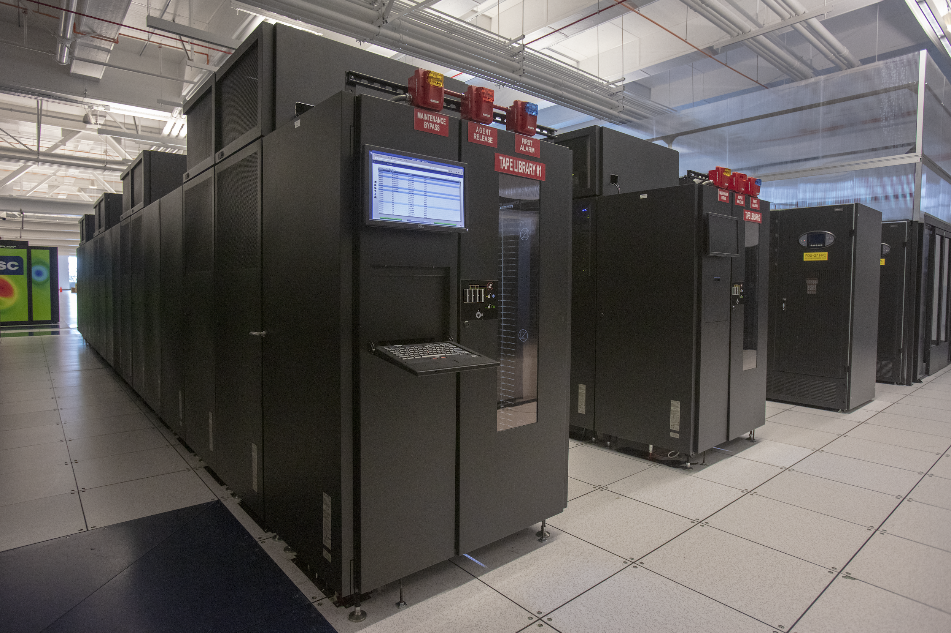
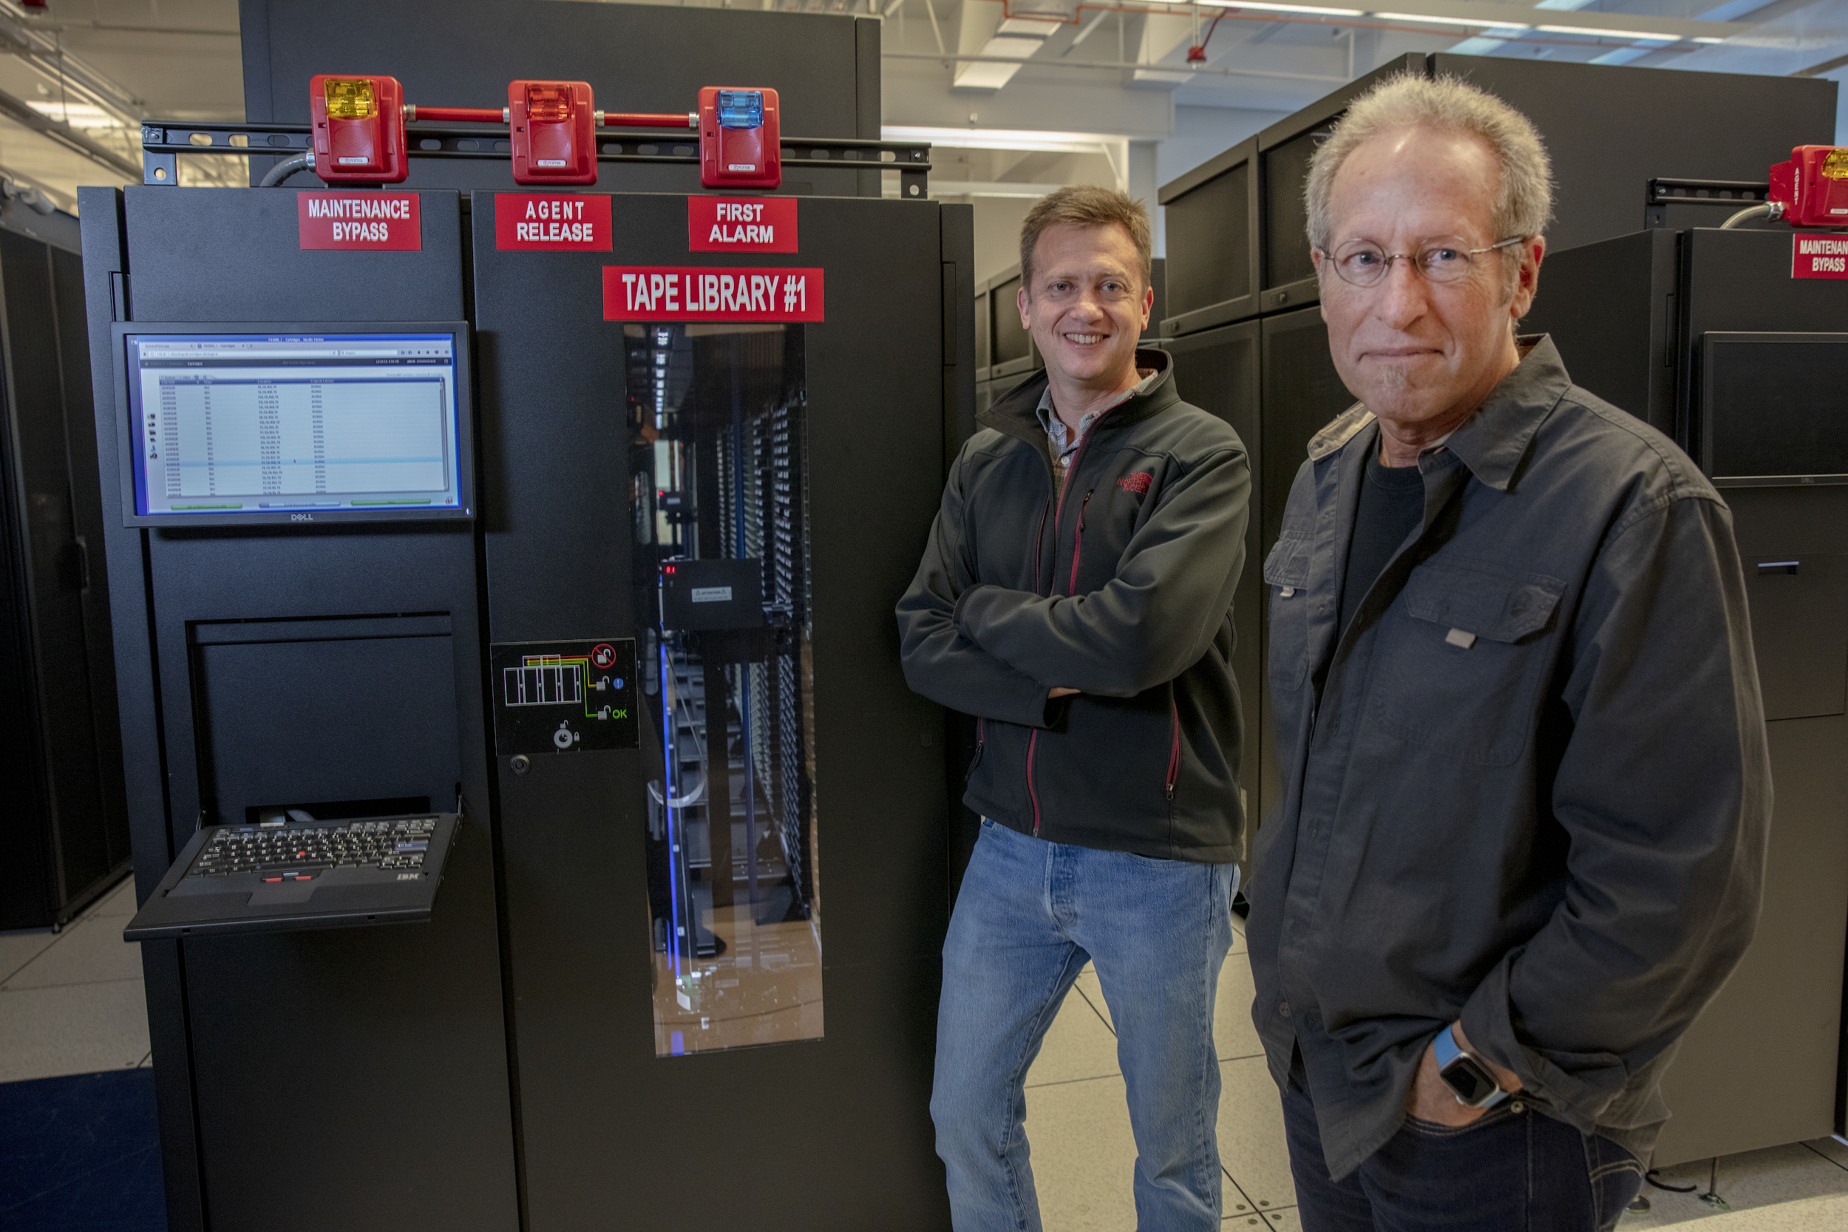
New Tape Libraries at Berkeley
Nice article in HPCWire: https://bit.ly/2OwX24N
Notes:
Anyhow, in 2018 we grew by ~40 PB which represents a growth rate of 1.66x over 2017. Our historical rate is 1.4x or 1.45x, and by that metric we would grow by ~56 PB this year, but based on ingest so far we won’t see that, or anywhere near it.

Slide 23
Superfacility Initiative

Slide 24
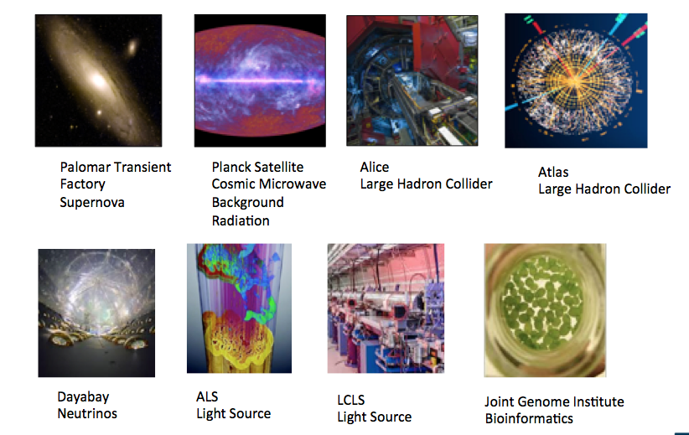
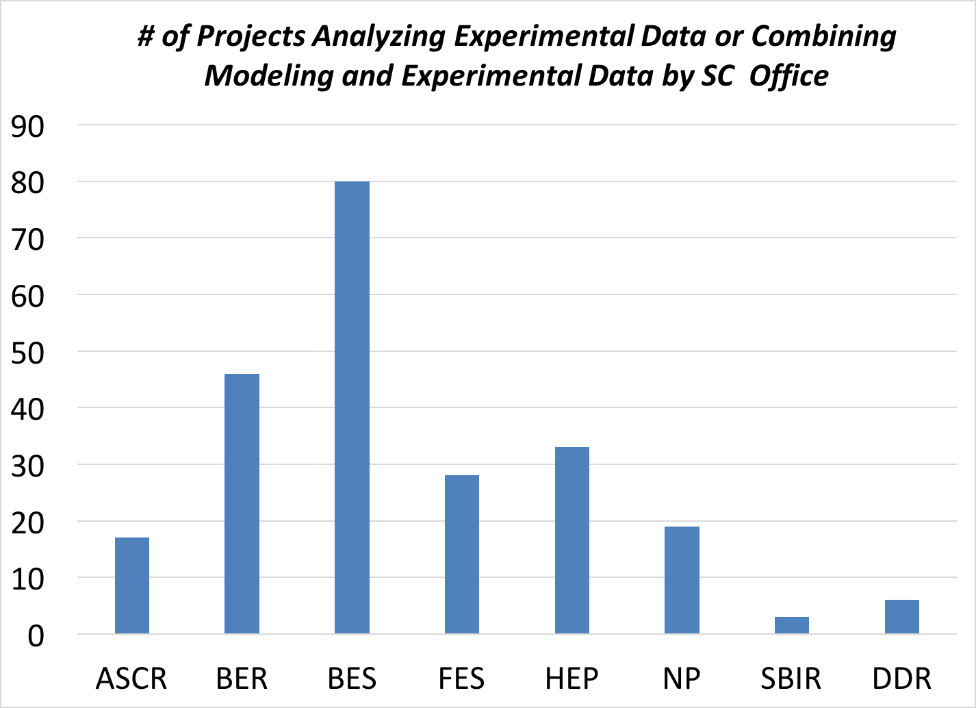
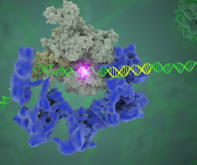
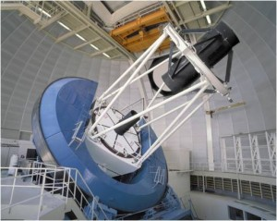
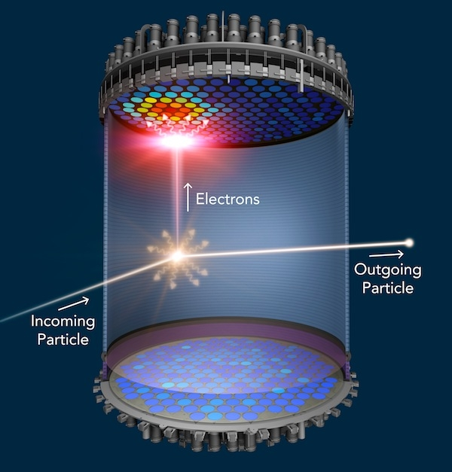
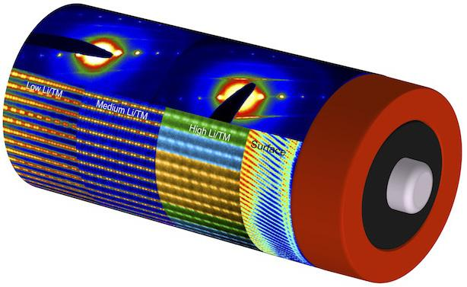
Increasing Number of Experimental Data Projects
24%
Star
Particle Physics
40%
56%
37%
30%
26%
21%
17%
~35% (235) of ERCAP projects self identified as confirming the primary role of the project is to 1) analyze experimental data or; 2) create tools for experimental data analysis or; 3) combine experimental data with simulations and modeling
Cryo-EM
NCEM
DESI
LSST-DESC
LZ
Notes:
Broad initiative, all offices represented, makes sense that BES is largest since most projects.

Slide 25
Requirements reviews and users from experimental facilities describe numerous pain points
Workflows require manual intervention and custom implementations
Difficult to surge experimental pipelines at HPC facility in ‘real-time’
I/O performance, storage space and access methods for large datasets remain a challenge
Searching, publishing and sharing data are difficult
Analysis codes need to be adapted to advanced architectures
Lack of scalable analytics software
Resilience strategy needed for fast-turnaround analysis needs
including: coordinating maintenances, fault tolerant pipelines, rolling upgrades, alternative compute facilities...
No federated identity between experimental facilities and NERSC
Not all scientists want command-line access.

Slide 26
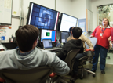
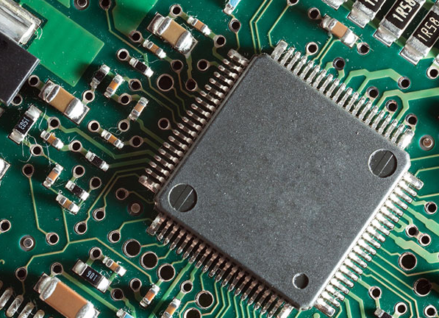
Elements of Superfacility Model
User Engagement
Data Lifecycle
Automated Resource Allocation
Computing at the Edge
Engage with experimental, observational and distributed sensor user communities to deploy and optimize data pipelines for large-scale systems.
Mange the generation, movement and analysis of data for scalability, efficiency and usability. Enable data reuse and search to increase the impact of experimental, observational and simulation data.
Deliver a framework for seamless resource allocation, calendaring and management of compute, storage and network assets across administrative boundaries.
Design and deploy specialised computing devices for real-time data handling and computation at experimental and computational facilities.

Slide 27
Other Projects – Future Talks?
GPFS HPSS Integration (GHI) – DMAPI-based integration of GPFS filesystem and HPSS tape archive (DR, Space Management)
Community File System – Capacity tier details
Superfacility – Full talk

