Slide 1
Checkpoint/Restart VASP Jobs Using MANA on Cori
User Training on Checkpoint/Restart (III)
Acknowledgement
DMTCP/MANA team: Gene Cooperman, Yao Xu, Prashant Chouhan, Rohan Garg at Northeastern University;
Rebecca Hartman-Baker at NERSC
Zhengji Zhao
User Engagement Group
May 25, 2021

Slide 2
Outline
Introduction
Overview of MANA (MPI-Agnostic Network-Agnostic Transparent Checkpointing)
Checkpoint/Restart VASP jobs with MANA on Cori
Automating Checkpointing/Restarting with variable-time job scripts
Summary
Hands-on (90 minutes)

Slide 3
Introduction

Slide 4
Why Use C/R at NERSC?
C/R is integral to many future plans at NERSC
  e.g., supporting real-time workloads in 2025 timeframe
Enable long-running jobs
Improved queue turnaround
  A job split into smaller segments could complete before full-length job due to difficulty of scheduling long jobs
Prepare for system failures, including PG&E Public Safety Power Shutdowns (California wildfires, extreme weather)

Slide 5
C/R Approaches
Application-initiated checkpointing
  Most applications at NERSC have some internal C/R support
  Limited, inflexible (e.g., checkpoint only at end of iteration)
  Burden for application developers
Transparent checkpointing
  Flexible, can stop/resume the execution at any point
  No extra work for application developers
  Vital for system-level checkpointing

Slide 6
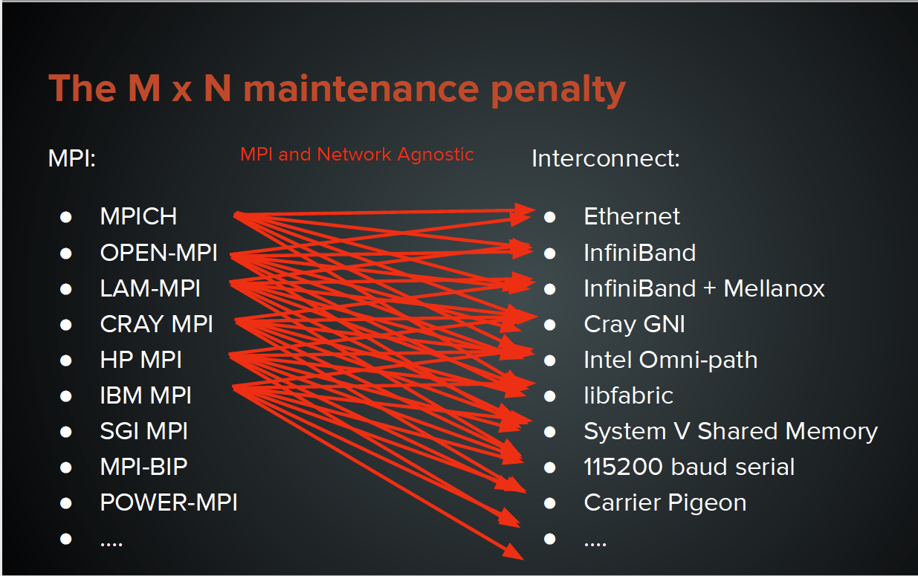
But Transparent C/R in Production Is Hard!
Developing and maintaining C/R tools for HPC applications is labor-intensive and highly complex because of
  Ever-changing HPC systems
  Diverse production workloads at all scales
Courtesy of Rohan Garg
Major issue: maintainability of C/R tools over M (# of MPI implementations) × N (# of Networks)
Maintaining C/R codes for production use has low priority compared to research
Long-term coordination between MPI library, kernel, & resource manager/scheduler developers has proven unsustainable
MANA for NERSC workloads
Notes:
Frequent OS updates on HPC systems can easily break C/R tools
C/R tools incur runtime overheads & impose extra work upon users
Hinders the uptake of the C/R approach
MPI+OpenMP applications dominate HPC workloads
We retire a HPC system every few years at NERSC
No ready-to-use transparent C/R tools are available on front-edge HPC systems

Slide 7
MANA Overview

Slide 8
What is MANA?
MANA: MPI-Agnostic Network-Agnostic transparent checkpointing
MANA achieves MPI agnositic by not checkpointing MPI libraries and network agnostic by draining the network before checkpointing
  A huge step forward towards ready-to-use C/R tools for future HPC platforms!
MANA is implemented as a plugin in DMTCP: Distributed MultiThreaded CheckPointing - a transparent checkpointing tool that lives completely in user space

Slide 9
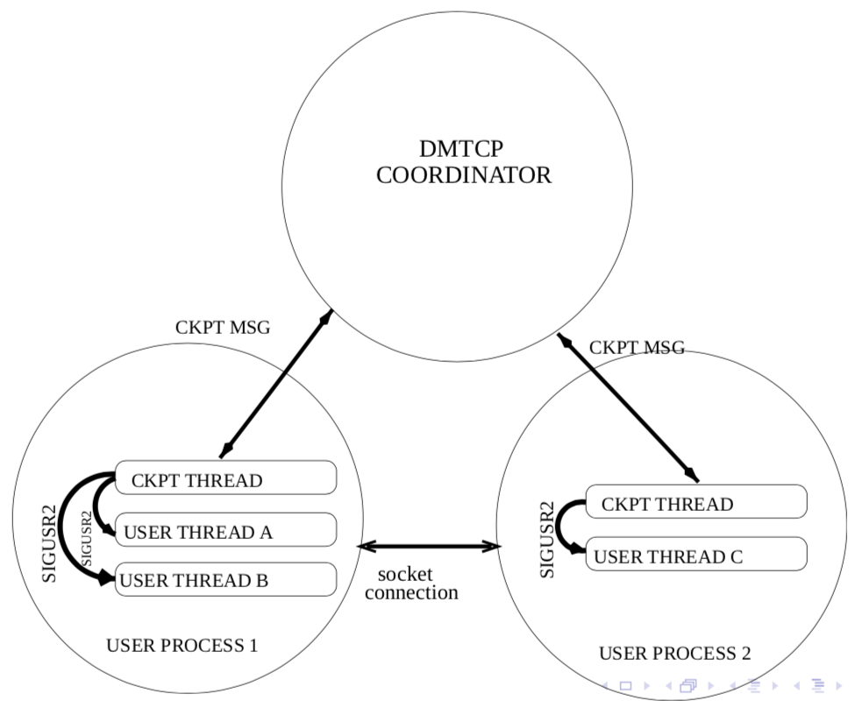
DMTCP Architecture: Coordinated Checkpointing
One coordinator per computation
One checkpoint thread per process, executing commands from the coordinator
Either the checkpoint thread is active or the user thread, but not both at the same time
Checkpoint files are backed up
Everything is in user space, no admin privileges needed
Notes:
DMTCP uses plugins internally, and it's easy to extend DMTCP with
plugins (similarly to browser plugins). Two useful user plugins that
are already provided with DMTCP are:
a. pathvirt - Change prefix of all paths.
EXAMPLE: /home/batch/slot5 -> /home/batch/slot7 (on restart)
b. modify-env
EXAMPLE: Assume the user's code frequently reads the
the environment variable DEBUG, using getenv().
Then: DEBUG=0 [on launch]
On restart, use the plugin with modify-env.txt to set DEBUG=1

Slide 10

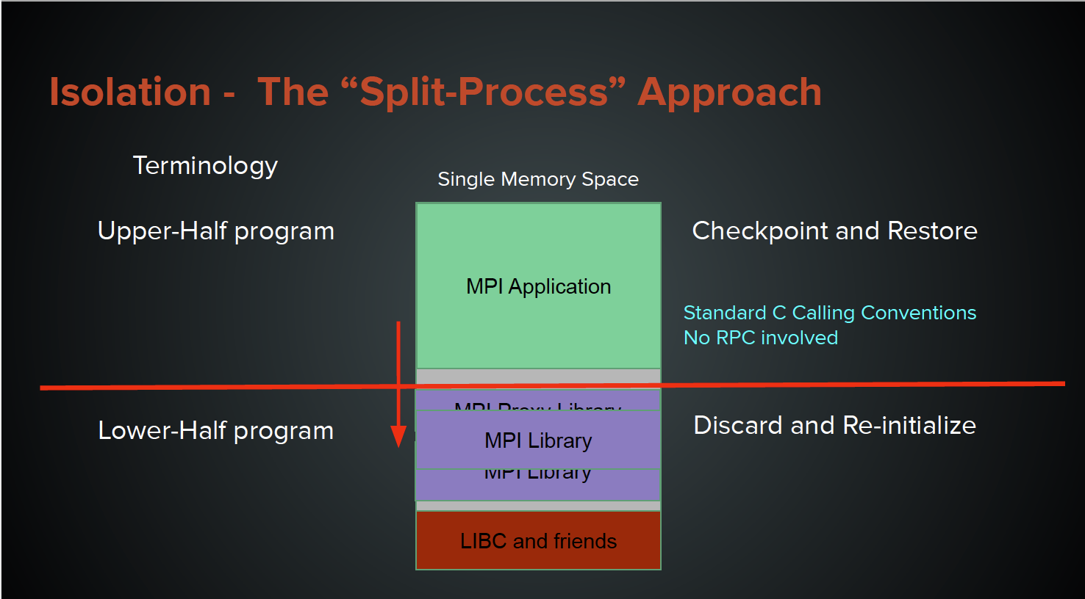
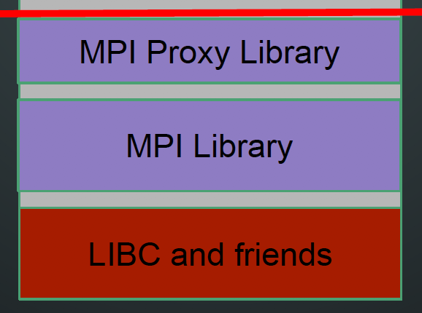
MANA: MPI Agnostic
MANA employs a “split-process” approach
  A single process contains two programs in its memory address space: upper-half and lower-half
  Checkpoint upper-half
  only, & discard lower half
  At restart time, lower half is re-initialized
Courtesy of Rohan Garg
Courtesy of Rohan Garg

Slide 11
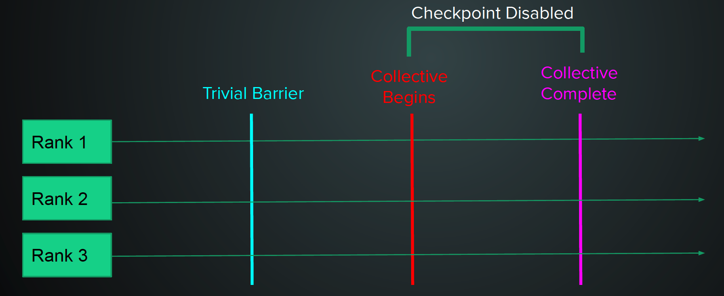
MANA: Network Agnostic
MANA drains network before checkpointing
For MPI collectives,
  Preface all collective calls with a trivial barrier
  When the trivial barrier is completed call the original collective
  Prevent checkpointing in the middle of collective call
Courtesy of Rohan Garg

Slide 12
MANA Commands
mana_coordinator - Coordinates checkpoints between multiple processes.
mana_launch -- Start a process under MANA control.
mana_restart -- Restart processes from a checkpoint image.
mana_status -- Send a command to the mana_coordinator remotely
use --help option for more information
Note: These are the wrappers for the dmtcp_coordinator, dmtcp_launch, dmtcp_restart, dmtcp_command commands

Slide 13
Runtime Overhead
MANA Paper (HPDC’19)
  Used up to 64 Haswell nodes/2048 MPI ranks
  <2% for MiniFE, HPCG, CLAMR, and LULUSH; 4.5% for GROMACS
  With a Linux kernel patch GROMACS overhead down to 0.6% on a single Haswell node
VASP Runtime Overhead:
  Application dependent
  Very high overhead now: 13.5% on Haswell (2 nodes, 64 ranks total); 24% on KNL (2 nodes, 16 MPI ranks, 8 threads/node)
Expect to lower the runtime overhead down to <2%
  Developers are actively investigating this; will be fixed this issue soon.
Notes:
<2% for MiniFE, HPCG, CLAMR, and LULUSH; 4.5% for GROMACS
Kernel patch Gromacs down to 0.6% on a single Haswell node

Slide 14
C/R Overhead Evaluation
Working to scale-up MANA, so limited scaling tests were done
C/R overhead was evaluated using HPCG with up to 512 MPI ranks on both Cori’s Lustre file system (cscratch1) and burst buffer
  HPCG was run with 512 MPI ranks, 8 OpenMP threads per task on 64 Haswell nodes on Cori
 | Lustre File System | Burst Buffer | Total Memory Usage (GB)
Checkpoint Time (s) | 640.3 | 30.1 | 5793.3
Restart Time (s) | 110.3 | 39.2
Work from Harsh Khetawat

Slide 15
How to Use MANA on Cori
Link to the MANA library
  Must link applications dynamically
Run/Restart jobs under MANA
  checkpoint periodically, once, or remotely as needed
module unload darshan altd
module load mana
ftn -qopenmp -o jacobi.x jacobi.f90
For manual linking:
-L$MANA_ROOT/lib/dmtcp -lmpidummy
salloc -q interactive -N1 -C haswell -t 1:00:00
module load mana
mana_cooridinator -i30
srun -n 32 mana_launch ./jacobi.x
mana_cooridinator -i30
srun -n 32 mana_restart
mana_cooridinator -i30
srun -n 32 mana_restart
...
Run
Restart
Restart

Slide 16
How to Use MANA on Cori (Cont.)
Static libraries must be converted to shared libraries for MANA to properly checkpoint/restart your code
MANA wraps MPI libraries. Load the mana module only when you run your applications under MANA control
  Other MPI applications will fail if the mana module is loaded
The jtiming.csv file in your run directory provides C/R overhead
  The mana modules on Cori were configured with --enable-timing option

Slide 17
MANA Status on Cori and Planned Work
MANA is for applications that have no internal C/R support, or the internal C/R is not sufficient and flexible
So far tested with various VASP workloads, and GROMACS, HPCG but not with large scale runs
MANA use on Cori is experimental. Please report bugs/issues/feature requests at help.nersc.gov
Static linking is not supported yet, but will be supported by this summer
GPU support is not available yet, but it is planned for Perlmutter

Slide 18
Checkpoint/Restart VASP Jobs with MANA

Slide 19
Sample Job Script: C/R Using MANA on Cori Haswell
run.slurm
restart.slurm
#!/bin/bash
#SBATCH -J test_cr
#SBATCH -q regular
#SBATCH -N 2
#SBATCH -C haswell
#SBATCH -t 48:00:00
#SBATCH -o %x-%j.out
#SBATCH -e %x-%j.err
#SBATCH --time-min=6:00:00
#for c/r with mana
module load vasp mana
#checkpointing once every hour
mana_coordinator -i3600
#run job under dmtcp control
srun -n64 mana_launch vasp_std.mana
#!/bin/bash
#SBATCH -J test_cr
#SBATCH -q regular
#SBATCH -N 2
#SBATCH -C haswell
#SBATCH -t 48:00:00
#SBATCH -o %x-%j.out
#SBATCH -e %x-%j.err
#SBATCH --time-min=6:00:00
#for c/r with mana
module load vasp mana
#checkpointing once every hour
mana_coordinator -i3600
#restart the job from checkpoint files
srun -n64 mana_restart
Job script
#!/bin/bash
#SBATCH –J test
#SBATCH -q regular
#SBATCH -N 2
#SBATCH -C haswell
#SBATCH -t 48:00:00
#SBATCH –o %x-%j.out
#SBATCH –e %x-%j.err
module load vasp
srun -n 64 vasp_std
To run: sbatch run.slurm; sbatch restart.slurm; sbatch restart.slurm; …
or submit dependency jobs

Slide 20
The “flex” QOS is Available for C/R Jobs
The flex QOS is for user jobs that can produce useful work with a relatively short amount of run time before terminating
Benefits to using the flex QOS include improved job throughput and a large discount in charging: 75% on KNL; 50% on Haswell
Access via “#SBATCH -q flex” and must use “#SBATCH --time-min=2:00:00” or less
A flex QOS job can use up to 256 KNL/64 Haswell nodes for 48 hours

Slide 21
Sample Job Script: C/R Using MANA with “flex” QOS on Cori KNL
run.slurm
restart.slurm
Job script
#!/bin/bash
#SBATCH -J test_cr
#SBATCH -q flex
#SBATCH -N 2
#SBATCH -C knl
#SBATCH -t 48:00:00
#SBATCH -o %x-%j.out
#SBATCH -e %x-%j.err
#SBATCH --time-min=2:00:00
#user settings
module load vasp/6.1.2-hsw mana
export OMP_PROC_BIND=true
export OMP_PLACES=threads
export OMP_NUM_THREADS=8
#checkpointing once every hour
mana_coordinator -i 3600
#run job under mana control
srun -n16 -c32 --cpu-bind=cores mana_launch vasp_std.mana
#!/bin/bash
#SBATCH -J test_cr
#SBATCH -q flex
#SBATCH -N 2
#SBATCH -C knl
#SBATCH -t 48:00:00
#SBATCH -o %x-%j.out
#SBATCH -e %x-%j.err
#SBATCH --time-min=2:00:00
#user settings
module load vasp/6.1.2-hsw mana
export OMP_PROC_BIND=true
export OMP_PLACES=threads
export OMP_NUM_THREADS=8
#checkpointing once every hour
mana_coordinator -i 3600
#restart job from checkpoint files
srun -n16 -c32 --cpu-bind=cores mana_restart
#!/bin/bash
#SBATCH –J test
#SBATCH -q regular
#SBATCH -N 2
#SBATCH -C knl
#SBATCH -t 48:00:00
#SBATCH –o %x-%j.out
#SBATCH –e %x-%j.err
#user settings
module load vasp/6.1.2-hsw
export OMP_PROC_BIND=true
export OMP_PLACES=threads
export OMP_NUM_THREADS=8
srun -n16 -c32 --cpu-bind=cores vasp_std

Slide 22
Automating Checkpointing/Restarting with Variable-time Job Scripts

Slide 23
Variable-Time Job (VTJ) Scripts
C/R imposes extra work for users
  Resubmitting pre-terminated jobs multiple times until the job completes
Variable-time job (VTJ) scripts are used to simplify this process, and to enable jobs of any length, e.g., weeks, months
VTJ scripts add a few sbatch directives and bash functions in the Slurm job scripts, automatically splitting a long running job into multiple shorter ones, and self-resubmitting until the job completes
sbatch directives:
#SBATCH --time-min=2:00:00
#SBATCH --comment=48:00:00
#SBATCH --signal=B:USR1@<sig_time>
#SBATCH --requeue
bash functions:
Requeue_job #trap signals
func_trap #action upon trap
parse_job #process job info

Slide 24
Variable-Time Job Script with “flex” Queue
#!/bin/bash
#SBATCH -J test_vtj
#SBATCH -q flex
#SBATCH --time=48:00:00
#SBATCH --time-min=2:00:00 #the minimum amount of time your job should run
#SBATCH -C knl
#SBATCH -N 2
#SBATCH --error=%x-%j.err
#SBATCH --output=%x-%j.out
#SBATCH --comment=96:00:00 #desired time limit
#SBATCH --signal=B:USR1@300 #sig_time (300 secs)should match your checkpoint overhead time
#SBATCH --requeue
#SBATCH --open-mode=append
#user setting goes here
export OMP_PROC_BIND=true
export OMP_PLACES=threads
export OMP_NUM_THREADS=4
#srun must execute in background and catch signal on wait command
srun -n32 -c16 --cpu_bind=cores ./a.out &
module load nersc_cr
ckpt_command=
#requeueing the job if remaining time >0
requeue_job func_trap USR1
wait
Original job script
Allow allocated time to vary
#!/bin/bash
#SBATCH -J test
#SBATCH -q regular
#SBATCH --time=48:00:00
#SBATCH -C knl
#SBATCH -N 2
#SBATCH --error=%x-%j.err
#SBATCH --output=%x-%j.out
export OMP_PROC_BIND=true
export OMP_PLACES=threads
export OMP_NUM_THREADS=4
srun -n32 -c16 --cpu_bind=cores ./a.out
Max walltime limit on Cori
Specify desired run time; tracking remaining time for pre-terminated jobs
Triggers checkpoint and restart actions before terminating the job
Defines a few bash functions
func_trap() {
$ckpt_command
scontrol requeue ${SLURM_JOB_ID}
scontrol update JobId=${SLURM_JOB_ID} TimeLimit=${requestTime}
}
Specify checkpoint command if any
Execute commands in “func_trap” upon receiving “USR1” signal

Slide 25
SBATCH Directives Used to Automate Job Resubmission
#SBATCH --time-min=02:00:00
Specify the minimum time for your job. Flex QOS requires time-min to be no more than 2 hours.
#SBATCH --comment=48:00:00
        A flag to add comments about the job, used by the script to specify the desired walltime and to track the remaining walltime for the requeued jobs (after pre-termination). You can specify any length of time, e.g., a week or even longer
#SBATCH --signal=B:USR1@<sig_time>
Request the batch system to send user-defined signal USR1 to the batch shell (where the job is running) sig_time seconds (e.g., 300) before the job hits the wall clock limit.
#SBATCH --requeue
Specify the job is eligible to requeue
#SBATCH --open-mode=append
Append the standard output/error of the requeued job to the
same standard out/error files from the previously terminated job.
#SBATCH --comment=48:00:00
#SBATCH --signal=B:USR1@300
#SBATCH --requeue
#SBATCH --open-mode=append
Notes:
--requeue
Specifies that the batch job should eligible to being requeue. The job may be requeued explicitly by a system administrator, after
node failure, or upon preemption by a higher priority job. When a job is requeued, the batch script is initiated from its beginning.
Also see the --no-requeue option. The JobRequeue configuration parameter controls the default behavior on the cluster.

Slide 26
Bash Functions Used to Automate Job Resubmission
requeue_job
This function traps the user defined signal (e.g., USR1). Upon receiving the signal, it executes a function (e.g., func_trap below) provided on the command line.
func_trap
This function contains the list of commands to be executed to initiate checkpointing, prepare inputs for the next job if needed, requeue the job, and update the remaining walltime.
requeue_job() {
parse_job # to calculate the remaining walltime
if [ -n $remainingTimeSec ] && [ $remainingTimeSec -gt 0 ]; then
commands=$1
signal=$2
trap $commands $signal
fi
}
func_trap() {
$ckpt_command
scontrol requeue ${SLURM_JOB_ID}
scontrol update JobId=${SLURM_JOB_ID} TimeLimit=${requestTime}
}
#requeueing the job if remaining time >0
ckpt_command=
requeue_job func_trap USR1
wait

Slide 27

Variable-Time Job Flowchart
Updates remaining walltime for the job
Batch system backfills the job
User submits job
Requeues the job
Job starts execution
Earlier with a shorter allocation
Job checkpoints
User checks results
Batch system sends signal
Job completes or desired walltime achieved
Job traps signal and is suspended
Notes:
User submits job script.
The batch system looks for a backfill opportunity for the job. If it can allocate the requested number of nodes for this job for any duration (e.g., 6 hours) between the specified minimum time (2 hours) and the time limit (48 hours) before those nodes are used for other higher priority jobs, the job starts execution.
The job runs until it receives signal USR1 (--signal=B:USR1@300) 300 seconds before it hits the allocated time limit (6 hours).
Upon receiving the signal, the func_trap gets executed, which in turn executes
ckpt_command if specified
Requeues the job and then updates remaining walltime for requeued job.
Steps 2-4 repeat until job runs for the desired amount of time (48 hours) or job completes.
User checks results.
func_trap() {
$ckpt_command
scontrol requeue ${SLURM_JOB_ID}
scontrol update JobId=${SLURM_JOB_ID} TimeLimit=${requestTime}
}

Slide 28
Variable-time Job Script for VASP Atomic Relaxation Jobs - Using Internal C/R Support
#put any commands that need to run to continue
#the next job here
ckpt_vasp() {
set -x
restarts=`squeue -h -O restartcnt -j $SLURM_JOB_ID`
echo checkpointing the ${restarts}-th job
#to terminate VASP at the next ionic step
echo LSTOP = .TRUE. > STOPCAR
#wait until VASP to complete the current ionic step,
#write WAVECAR file and quit
srun_pid=`ps -fle|grep srun|head -1|awk '{print $4}’`
wait $srun_pid
#copy CONTCAR to POSCAR for next job
cp -p CONTCAR POSCAR
set +x
}
ckpt_command=ckpt_vasp
#requeueing the job if remaining time >0
module load nersc_cr
requeue_job func_trap USR1
#!/bin/bash
#SBATCH -q flex
#SBATCH –N 2
#SBATCH -C knl
#SBATCH –t 48:00:00
#SBATCH --time-min=2:00:00
module load vasp/6.1.2-knl
export OMP_NUM_THREADS=4
#launching 1 task every 4 cores (16 CPUs)
srun –n32 –c16 --cpu-bind=cores vasp_std
Regular QOS VASP jobs
#!/bin/bash
#SBATCH -q regular
#SBATCH -N 2
#SBATCH -C knl
#SBATCH -t 48:00:00
module load vasp/6.1.0-knl
export OMP_NUM_THREADS=4
# launching 1 task every 4 cores (16 CPUs)
srun –n32 –c16 --cpu_bind=cores vasp_std
#SBATCH --comment=48:00:00
#SBATCH --signal=B:USR1@900
#SBATCH --requeue
#SBATCH --open-mode=append
&
wait

Slide 29
VTJ Script for Checkpointing/Restarting VASP6 with MANA
Original Job Script
#!/bin/bash
#SBATCH -J test
#SBATCH -q flex
#SBATCH -N 2
#SBATCH -C KNL
#SBATCH --time=48:00:00
#SBATCH --error=test%j.err
#SBATCH --output=test%j.out
#SBATCH --time-min=02:00:00
module load vasp/6.1.2-knl mana nersc_cr
#checkpoint/restart job
mana_coordinator -i3600 #checkpointing once every hour
if [[ $(restart_count) == 0 ]]; then
#user setting
export OMP_NUM_THREADS=8
export OMP_PROC_BIND=spread
export OMP_PLACES=threads
srun -n16 -c32 --cpu-bind=cores mana_launch vasp_std.mana &
elif [[ $(restart_count) > 0 ]] && [[ -e dmtcp_restart_script.sh ]]; then
srun -n 16 -c32 --cpu-bind=cores mana_restart &
else
echo "Failed to restart the job, exit”; exit
fi
Variable-Time Job script for C/R with MANA
#!/bin/bash
#SBATCH –J test
#SBATCH -q regular
#SBATCH -N 2
#SBATCH -C knl
#SBATCH -t 48:00:00
#SBATCH –o test-%j.out
#SBATCH –e test-%j.err
#user setting
module load vasp/6.1.2-knl
export OMP_PROC_BIND=true
export OMP_PLACES=threads
export OMP_NUM_THREADS=8
srun -n16 -c32 --cpu-bind=cores vasp_std
C/R Jobs with MANA
Manual Resubmission
#!/bin/bash
#SBATCH –J test_cr
#SBATCH -q flex
#SBATCH -N 2
#SBATCH -C knl
#SBATCH -t 48:00:00
#SBATCH –o test_cr-%j.out
#SBATCH –e test_cr-%j.err
#SBATCH –time-min=2:00:00
#user setting
module load vasp/6.1.2-knl mana
export OMP_PROC_BIND=true
export OMP_PLACES=threads
export OMP_NUM_THREADS=8
#checkpointing once every hour
mana_coordinator -i3600
#run job under mana control
srun -n16 -c32 --cpu-bind=cores mana_launch vasp_std.mana
#SBATCH --comment=48:00:00
#SBATCH --signal=B:USR1@300
#SBATCH --requeue
#SBATCH --open-mode=append
#!/bin/bash
#SBATCH –J test
#SBATCH -q flex
#SBATCH -N 2
#SBATCH -C knl
#SBATCH -t 48:00:00
#SBATCH –o test_cr-%j.out
#SBATCH –e test_cr-%j.er
#SBATCH –time-min=2:00:00
module load vasp/6.1.2-knl mana
#checkpointing once every hour
mana_coordinator -i3600
#restart job from checkpoint files
srun -n16 -c32 --cpu-bind=cores mana_restart
# requeueing the job if remaining time >0
ckpt_command=ckpt_mana #additional checkpointing before pre-emption
requeue_job func_trap USR1
wait

Slide 30
VTJ Script for Checkpointing/Restarting VASP5 with MANA
Original Job Script
Variable-Time Job script for C/R with MANA
#!/bin/bash
#SBATCH –J test
#SBATCH -q regular
#SBATCH -N 2
#SBATCH -C knl
#SBATCH -t 48:00:00
#SBATCH –o test-%j.out
#SBATCH –e test-%j.err
#user setting
module load vasp/5.4.4-knl
srun -n128 -c4 --cpu-bind=cores vasp_std
#!/bin/bash
#SBATCH -J test
#SBATCH -q flex
#SBATCH -N 2
#SBATCH -C KNL
#SBATCH --time=48:00:00
#SBATCH --error=test%j.err
#SBATCH --output=test%j.out
#SBATCH --time-min=02:00:00
module load vasp/5.4.4-knl mana nersc_cr
#checkpoint/restart job
mana_coordinator -i3600 #checkpointing once every hour
if [[ $(restart_count) == 0 ]]; then
srun -n128 -c4 --cpu-bind=cores mana_launch vasp_std.mana &
elif [[ $(restart_count) > 0 ]] && [[ -e dmtcp_restart_script.sh ]]; then
srun -n128 -c4 --cpu-bind=cores mana_restart &
else
echo "Failed to restart the job, exit”; exit
fi
C/R Jobs with MANA
Manual Resubmission
#!/bin/bash
#SBATCH –J test_cr
#SBATCH -q flex
#SBATCH -N 2
#SBATCH -C knl
#SBATCH -t 48:00:00
#SBATCH –o test_cr-%j.out
#SBATCH –e test_cr-%j.err
#SBATCH –time-min=2:00:00
#user setting
module load vasp/5.4.4-knl mana
#checkpointing once every hour
mana_coordinator -i3600
#run job under mana control
srun -n128 -c4 --cpu-bind=cores mana_launch vasp_std.mana
#SBATCH --comment=48:00:00
#SBATCH --signal=B:USR1@300
#SBATCH --requeue
#SBATCH --open-mode=append
#!/bin/bash
#SBATCH –J test
#SBATCH -q flex
#SBATCH -N 2
#SBATCH -C knl
#SBATCH -t 48:00:00
#SBATCH –o test_cr-%j.out
#SBATCH –e test_cr-%j.er
#SBATCH –time-min=2:00:00
module load vasp/5.4.4-knl mana
#checkpointing once every hour
mana_coordinator -i3600
#restart job from checkpoint files
srun -n128 -c4 --cpu-bind=cores mana_restart
# requeueing the job if remaining time >0
ckpt_command=ckpt_mana #additional checkpointing before pre-emption
requeue_job func_trap USR1
wait

Slide 31
Notes on VTJ Scripts Using MANA
Variable-time job scripts work with internal checkpointing support
  But, may need to deal with input/output files
  C/R overhead may be unpredictable, depending on where the execution is at at the time of checkpoint, e.g., VASP
VTJ scripts using MANA for C/R are better
  Easier to use as the C/R overhead is more predictable
  Resumes execution exactly from where it left off
  All output files after multiple checkpoint/restart will be exactly the same as the job that runs without C/R
Notes:
MANA finds the length of each open file at the time of checkpoint. Then at the time of restart, it truncates the file back to the length that it had at the time of checkpoint.

Slide 32
Summary

Slide 33
Summary
MANA is capable of checkpointing/restarting VASP on Cori
Benefits of checkpoint/restart jobs with MANA
  Increased job throughput, a large charging discount (with flex QOS), and capability of running jobs of any length
  Preparing for future workloads on the systems
Using variable-time job scripts, checkpointing/restarting can be automated
You are encouraged to experiment with your production workloads
  MANA is still experimental for production use
  Please report bugs at help.nersc.gov

Slide 34
Resources
MANA and DMTCP References
  R. Garg, G. Price, and G. Cooperman, “MANA for MPI: MPI-Agnostic Network-Agnostic Transparent Checkpointing”, Proceedings of the 28th International Symposium on High-Performance Parallel and Distributed Computing, June 2019, Pages 49-60. Slides
  Gene Cooperman, “Checkpointing the Un-checkpointable: MANA and the Split-Process Approach”, MVAPICH User Group (MUG'19), Columbus, Ohio. Slides Video
  Jason Ansel, Kapil Arya, and Gene Cooperman, "DMTCP: Transparent checkpointing for cluster computations and the desktop", IEEE International Parallel and Distributed Processing Symposium (IPDPS’09), Rome, Italy, May, 2009. DMTCP website
NERSC Documentation
  NERSC website for checkpoint/restart: DMTCP MANA
  Variable-time job script
Training Materials
  MANA for checkpointing MPI jobs : Slides Video
  DMTCP for checkpointing serial and threaded applications: Slides
  Variable-time job scripts: Slides
Codes and Scripts
  MANA code: https://github.com/mpickpt/mana (branch: interface6)
  Variable-time job script: github repo

Slide 35
Acknowledgements
Gene Cooperman, Yao Xu, Prashant Chouhan, and Rohan Garg for collaborations on getting MANA (technical support, quick bug fixes, etc.)
Thanks Rebecca help with preparing the training slides

Slide 36
Thank You!

Slide 37
Hands-on

Slide 38
Compute Node Reservations
150 KNL/50 Haswell nodes are reserved under nintern account from 10:30am - 12:30pm
The reservation ids: mana (KNL) and mana_hsw
To access the reservation, add
--reservation=mana -A nintern #for KNL nodes
--reservation=mana_hsw -A nintern #for Haswell nodes
e.g., salloc -N 1 -C haswell -q regular -t 2:00:00 --reservation=mana_hsw -A nintern
You are encouraged to use your production VASP jobs. The sample job scripts are available at /global/cfs/cdirs/training/2021/mana-vasp.
Notes:
ReservationName=mana_hsw StartTime=2021-05-25T10:30:00 EndTime=2021-05-25T12:30:00 Duration=02:00:00
Nodes=nid00[794-831,845-856] NodeCnt=50 CoreCnt=1600 Features=haswell PartitionName=regular_hsw Flags=
TRES=cpu=3200
Users=(null) Accounts=nintern Licenses=(null) State=INACTIVE BurstBuffer=(null) Watts=n/a
MaxStartDelay=(null)
ReservationName=mana StartTime=2021-05-25T10:30:00 EndTime=2021-05-25T12:30:00 Duration=02:00:00
Nodes=nid[02520-02522,02525-02529,02531,02533-02535,02537,02539,02541,02543-02544,02547-02549,02551-02552,02554,02556-02558,02560-02561,02565-02566,02568-02570,02573-02574,02584-02590,02592-02603,02606,02608,02614-02619,02623-02624,02626-02627,02629,02631-02633,02635,02640-02643,02647-02648,02650-02652,02656,02658-02659,02661,02664,02668,02671,02673-02674,02676-02679,10752-10756,10762,10764,10767,10773-10774,10776,10779-10782,10787-10788,10790-10793,10795,10797-10799,10801-10802,10806,10808-10811,10813-10814,10816-10817,10819,10823,10825-10827,10832-10833,10838,10841,10844-10845,10848,10851,10854-10857,10859,10863,10865,10870] NodeCnt=150 CoreCnt=10200 Features=knl PartitionName=regular_knl Flags=
TRES=cpu=40800
Users=(null) Accounts=nintern Licenses=(null) State=INACTIVE BurstBuffer=(null) Watts=n/a
MaxStartDelay=(null)

Slide 39
Backup Slides

