Slide 1
Kristy Kallback-Rose
Senior HPC Storage Systems Analyst
NERSC
Site Update @LTUG

Slide 2
Agenda
General Systems and Storage Overview
Current Storage Challenges

Slide 3
Systems & Storage Overview

Slide 4

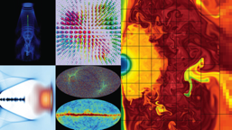
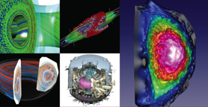
NERSC is the mission HPC computing center for the DOE Office of Science
HPC and data systems for the broad Office of Science community
Approximately 7,000 users and 750 projects
Diverse workload type and size
  Biology, Environment, Materials, Chemistry, Geophysics, Nuclear Physics, Fusion Energy, Plasma Physics, Computing Research
  Single-core (not many, but some) to whole-system jobs
Notes:
NERSC is a division of Lawrence Berkeley National Laboratory,

Slide 5



NERSC - Resources at a Glance 2018
Edison: Cray XC-30
7.6 PB Local Scratch
163 GB/s
136 GB/s
/project
7.1 PB
DDN SFA12KE
Sponsored Storage
5.1 PB
DDN SFA12KE
16x FDR IB
40 GB/s
5,576 nodes, 133K 2.4GHz Intel “IvyBridge” Cores, 357TB RAM
Cori: Cray XC-40
28 PB Local Scratch
>700 GB/s
275 TB
NetApp 5460
5 GB/s
/home
2PB “DataWarp” I/O Accl. Layer
>1.5 TB/s
HPSS
150 PB stored, 240 PB capacity, 42 years of community data
24 GB/s
2,004 nodes, 64K 2.3GHz Intel “Haswell” Cores, 203TB RAM
9,688 nodes, with 1.4GHz Intel “KNL” Cores, 1PB RAM
32x FDR IB
Data-Intensive Systems
PDSF, JGI, Materials
14x FDR IB
Ethernet &
IB Fabric
Science Friendly Security
Production Monitoring
Power Efficiency
WAN
2 x 10 Gb
2 x 100 Gb
Data Transfer Nodes
Science Gateways
Software Defined
Networking
Notes:
Cori - Heterogeneous compute architecture, installed in 2015-2016.
2004 Dual socket Haswell nodes (32 cores per node at 2.3 GHz)
9,300 Intel Knights Landing compute nodes
68 cores per node
16GB on-package high-bandwidth memory at ~490GB/s
96 GB DRAM
Storage
NVRAM Burst Buffer with 1.6PB of disk and 1.7TB/sec
28 PB of disk, >700 GB/sec I/O bandwidth in Lustre bandwidth
Plans for NERSC-9 Underway
The Burst Buffer is a layer of SSD storage in Cori that sits within the high-speed network.
per-job or "scratch" reservation:
persistent reservation: - Multiple compute jobs can access a persistent reservation, and if the permissions are set appropriately, multiple users as well.
Users have a quota of 50TB on the Burst Buffer.
The burst buffer is not mounted on the login nodes, so it must be accessed via a compute node. If you want to work interactively with the Burst Buffer, you can use the interactive queue
Plans for NERSC-9 Underway

Slide 6
File Systems
GPFS
Lustre scratch for Large Compute systems
  Edison: 7.6 PB with 168 GB/s aggregate bandwidth
  Cori: 28 PB with ~700 GB/s aggregate bandwidth
  Periodically purged
GPFS mounted across all compute platforms
  Home Directories: 275 TB, optimized (SSDs) for small files, and high number of I/O operations
  Project directories: 7.1 PB, 4TB/1M inode quota by default. Intended for larger files (SSD for metadata only), streaming I/O, and data that is actively being used. There is no purge policy, however inactive projects may be moved to the tape archive
  Sponsored File System Storage: 5.1 PB on a separate file system, but with the same I/O characteristics as the Project file system (minus SSDs). This is a ‘buy-in’ program for projects that need additional space on disk. Program has a fixed $/TB, and a 5 year service agreement
  GPFS file systems accessible from Cray compute nodes via DVS I/O forwarding

Slide 7
Tape Archive - HPSS
High Performance Storage System (HPSS)
  Developed over >20 years of collaboration among five Department of Energy laboratories and IBM, with significant contributions by universities and other laboratories worldwide.
  archival storage system for long term data retention since 1998
  Tiered storage system with a disk cache in front of a pool of tapes
    On tape: ~150 PB
    Disk Cache: 4 PB
  Contains 42 years of data archived by the scientific community
Data Transfers via transfer client - there is no direct file system interface
  We provide numerous clients: HSI/HTAR (proprietary tools), FTP, pFTP, gridFTP, Globus Online, etc. [VFS is an option which we don’t use]
Notes:
Primary goals for HPSS software
Stability
Performance
Scalability
It is unique in its ability to scale to support HPC workload

Slide 8
Current Storage Challenges

Slide 9
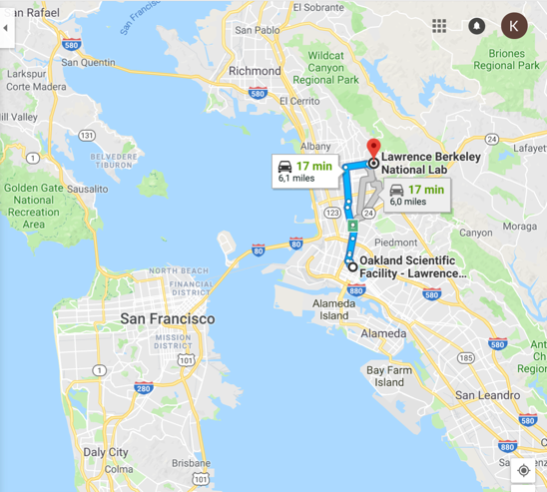
HPSS Archive – Two significant needs
Technology decision needed
  Discontinued Oracle Enterprise Tape Drive
    4 fully-configured Oracle SL8500 libraries (archive)
    60 Oracle T10KC tape drives (archive)
    1 IBM TS3500 (mainly system backups)
    36 IBM TS1150 tape drives (mainly system backups)
Physical move required
  Oakland to Berkeley (~6 mi/~9 km)

Slide 10
HPSS Archive – Data Center Constraints
Berkeley Data Center (BDC) is green (LEED Gold)
  Reliance on ambient conditions for year-round “free” air and water cooling
    Intakes outside air, optionally cooled with tower water or heated with system exhaust
    No chillers
  (Ideally) take advantage of:
    <75°F (23.9C) air year round
    <70°F (21.1C)for 85% of year
    RH 10% to 80%, but can change quickly
      Usually more in 30% - 70% range
Notes:
Room within a room much larger foot print.
Eval’d doing colo or other off site options

Slide 11
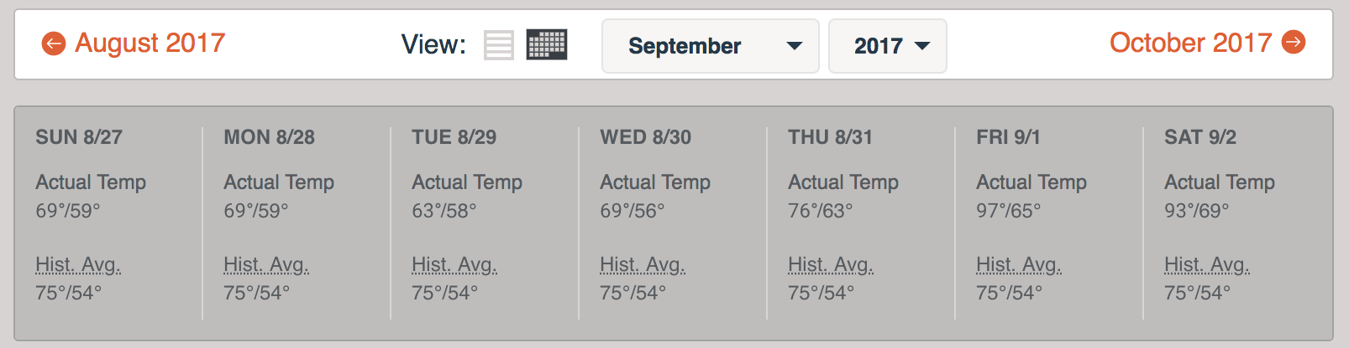
HPSS Archive – Data Center Realities
  And, sometimes it’s too sunny in California
Notes:
Building position with cool air coming in from the bay was a design point for the building and generally this is effective.

Slide 12
Alternatives to Consider
Co-lo to a data center elsewhere
  Costly
  System management concerns
Cloud
  not performant enough
    queue issues – need my data now
  too costly
    General expectation that data retrieval is the cloud killer,
      but just letting 150PBs sit is more expensive
        e.g. Amazon Glacier, gov’t option 2-5x more expensive
        Pricing model of course different starting from 0 vs. starting with 150PBs, YMMV
Room-within-a-room
  Space utilization goals and budget constraints
Disk-only
  Too costly
  Increased power consumption
Notes:
Space utilization goals and budget constraints make a room-within-a-room a less desirable choice

Slide 13
HPSS Archive – Tape Tech Decision
Value in staying with Enterprise drives over LTO
  Growth Rates: 2 PB/month (2016-2017); 2018 so far is 3+ PB/month
    Especially, gains from reformatting media at higher density
      E.g. JC Media 4TB capacity with TS1140 drive→7TB with reformat and TS1150/TS1155 drives
  Time to first byte is important
    Recommended Access Order (RAO)
      NERSC read-back rate is high ~40%
    High Resolution Tape Directory
      1/64th of a tape wrap resolution per block versus 1⁄2 wrap for LTO
        reach the target data block more efficiently
    Higher search and rewind velocity about 30% faster then LTO
  Data as old as 42 years, stewardship
    Media Physical durability
      Improved materials/construction over LTO.
Notes:
For enterprise drives now choice of 1…
Compariosn of T10KD to LTO 8 is not a reasonable comparison…IMO. T10KD release 2013

Slide 14
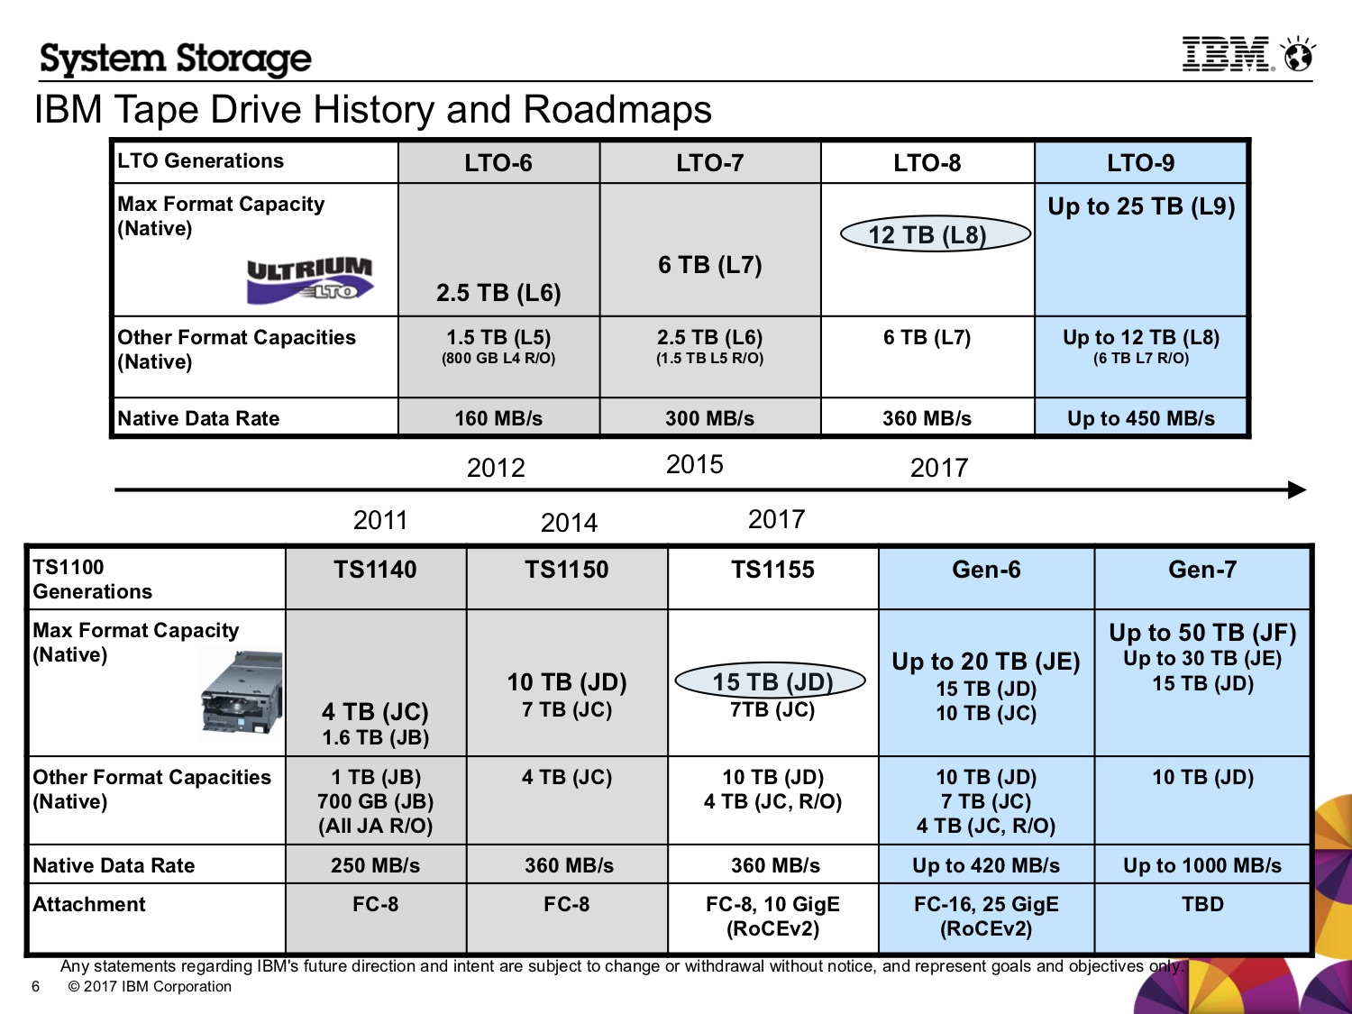
LTO vs. 3592 Media

Slide 15
That being said…
We will have some LTO drives and media for second copies
  Gain experience
  Diversity of technology

Slide 16
HPSS Archive – Green Data Center Solution
IBM TS4500 Tape Library with Integrated Cooling
  seals off the library from ambient temperature and humidity
  built-in AC units (atop library) keeps tapes and drives within operating spec
Notes:
The Integrated Cooling TS4500 tape libraries to be installed in datacenters where the environmental controls are outside of the normal operating parameters for the tape library.

Slide 17
HPSS Archive – Tape Tech Decision
IBM had the library tech ready
We have experience with TS3500/3592 drives for our backup system
Notes:
For enterprise drives now choice of 1…

Slide 18
HPSS Archive – Tech Change
Slide from Lee Jesionowski: https://conference-indico.kek.jp/indico/event/28/session/12/contribution/30/material/slides/0.pdf
Notes:
Some discussions with IBM indicate dips outside of acceptable range are probably OK, as long as they are not prolonged
Red – what can be handled in the room

Slide 19
HPSS Archive – Tech Change
One “Storage Unit” (my term) [Cooling Zone]
  Two S25 frames sandwich, one L25 and one D25 frame
    S25: High-density frame, tape slots (798-1000)
    D25: Expansion frame, drive (12-16), tape slots (590-740)
    L25: Base frame, drive (12-16), tape slots (550-660), I/O station and control electronics (for subsequent libraries no L25)
  Each one of these storage units considered it’s own cooling zone
AC units go atop L and D frames
  Air recirculated, no special filters
  Fire suppression a little trickier, but possible
Notes:
he client must supply drains for air conditioning condensation that will have two drain hoses per air conditioner.
AC goes where top rack would normally be installed:
The top rack, 3584 Model TR1, provides an extra 10U of rack space on any frame in a library without requiring more floor space.
The optional top rack (Figure 1) reduces the storage footprint. It also simplifies cabling by providing extra rack space above the library for power distribution units, Fibre Channel switches, tape data movers, or IBM® Linear Tape File System™ (LTFS) nodes.

Slide 20
HPSS Archive – Tech Change
Slide from Lee Jesionowski: https://conference-indico.kek.jp/indico/event/28/session/12/contribution/30/material/slides/0.pdf

Slide 21
HPSS Archive – Tech Change (CRT)
Each library will be 4 “cooling zones”
  Cooling zone –logical separation
  16 frames
  64 TS1155/3592-55F(FC)/Jag(uar)6 tape drives
  ~13,000 tape slots
    JD media @15TB/cartridge
We’ll install 2 of the above

Slide 22
HPSS Archive – Tech Change (CRT)
Some things to get used to/improve
  No ACSLS
  Can get some data out of IBM library, but
      Need to re-do/build some tools
      AFAIK, no pre-aggregated data like ACSLS
  No Pass Through Port (PTP)
    One Physical Volume Repository (PVR) per library
      Since no shuttle option with IBM libraries
      Could need more drives
    But time to first byte should improve
      PTP can fail, be slow

Slide 23
HPSS Archive – Loose timeline
April:
TS4500s w/integrated cooling were delivered at BDC
May:
½ Disk Cache + ½ of disk movers moved to Berkeley DC (BDC)
  Not yet enabled, just in preparation
½ Disk Cache + ½ of disk movers remain at Oakland
June:
TS4500s w/integrated cooling installed at BDC
July:
Move HPSS core server to BDC
Enable ½ Disk Cache, ½ disk movers at BDC
Enable Writes to new library at BDC
Oakland tapes now read-only [user access, repacks]
Remaining ½ disk cache made read-only, drained
Move remaining ½ disk cache, movers to BDC
Data migrated to BDC via HPSS “repack” functionality
  >= 20 Oracle T10KC source drives at Oakland
  >= 20 TS1155 destination drives at BDC
  400Gbps Oakland <-> BDC link
2020 (or earlier?) data migration complete
We’re not in Oakland any more, Dorothy.
Notes:
Library install in June due to fire suppression install and AC install

Slide 24
NERSC Storage Team & Fellow Contributors
Right to Left:
Greg Butler
Kirill Lozinskiy
Nick Balthaser
Ravi Cheema
Damian Hazen (Group Lead)
Rei Lee
Kristy Kallback-Rose
Wayne Hurlbert
Thank you. Questions?

Slide 25
National Energy Research Scientific Computing Center

Slide 26
Backup Slides

Slide 27
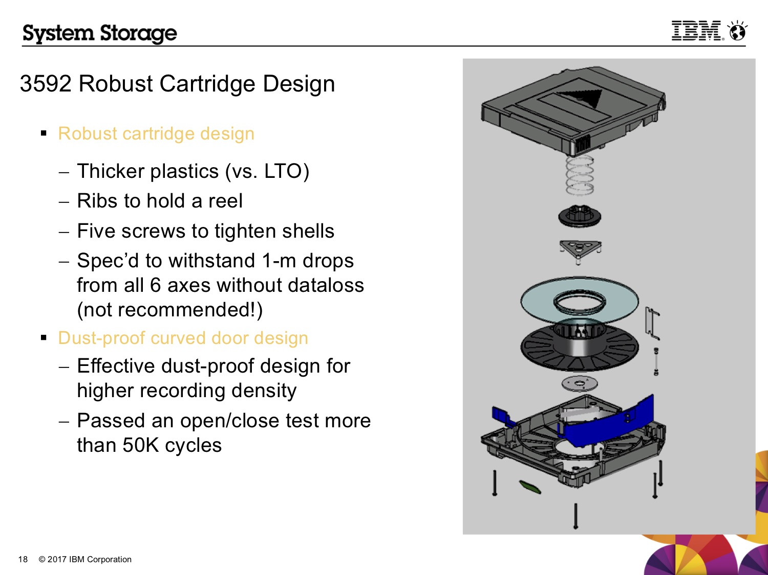
3592 Cartridge Details

Slide 28
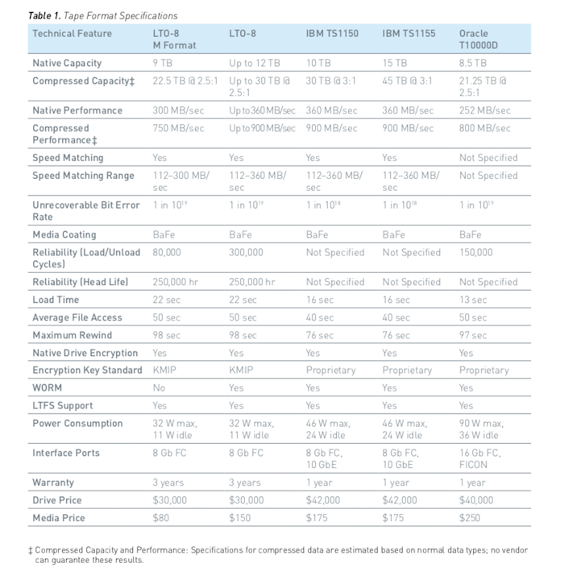
LTO v. Enterprise Media
Notes:
https://iq.quantum.com/exLink.asp?49663734OA24V33I185023536&WP00233A&view=1

Slide 29
Other Projects – Future Talks?
  GPFS HPSS Integration (GHI)– DMAPI-based integration of GPFS filesystem and HPSS tape archive (DR, Space Management)
  Storage 2020 – Discussion of storage strategy at NERSC looking forward to 2020 and 2025
  https://escholarship.org/uc/item/744479dp

Slide 30

Cori is NERSC’s Newest System
Heterogeneous compute architecture
2004 Dual socket Haswell nodes (32 cores per node at 2.3 GHz)
9,300 Intel Knights Landing compute nodes
  68 cores per node
  16GB on-package high-bandwidth memory at ~490GB/s
  96 GB DRAM
Storage
  NVRAM Burst Buffer with 1.6PB of disk and 1.7TB/sec
  28 PB of disk, >700 GB/sec I/O bandwidth in Lustre bandwidth
Plans for NERSC-9 Underway

Slide 31
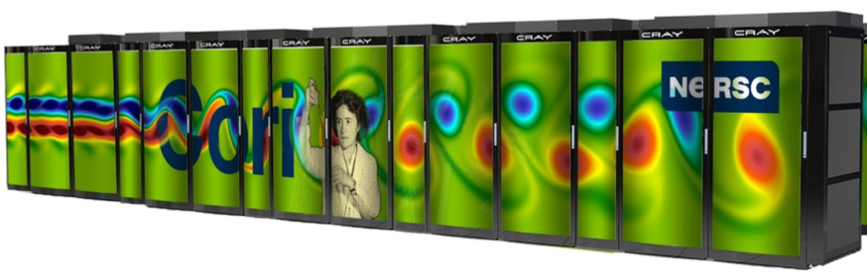
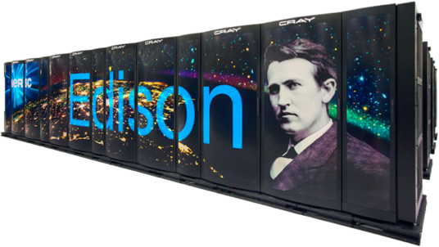
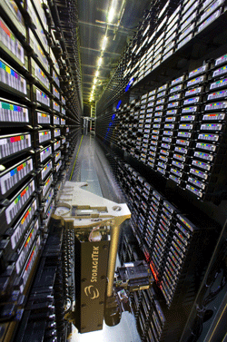
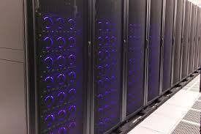
NERSC Resources at a Glance
Cori: 30PFs, 30PB disk
Deployed: 2015/2016
Edison: ~3PFs, 8PB disk
Deployed: 2013
Global File System: 20 PBs
HPSS Archive: ~140 PBs

