Slide 1
Daniel Udwary NERSC Data Science Engagement Group June 22, 2016
Getting Started at NERSC
Notes:
Welcome everybody. And thanks for joining today’s presentation on Getting Started at NERSC. Today we’ll be talking about some of the things new users need to know to work smoothly at NERSC. I think that you will find that there’s lot of things to know, but that we’re here to help you get things done and be successful.

Slide 2
Purpose
This presentation will help you get familiar with NERSC and its facilities
Practical information
Introduction to terms and acronyms
This is not a programming tutorial
But you will learn how to get help and what kind of help is available
We can give presentations on programming languages and parallel libraries – just ask
Notes:
Today’s presentation is about how to get things done at NERSC. This is not an introduction to programming– although we can do that if there is demand and interest . But today we’re going to talk about the practical aspects of using NERSC.

Slide 3
Outline
NERSC and its computing systems
How to get help
Running and Monitoring Jobs
Software Modules
Notes:
Here’s today’s outline. There’s going to be a lot information presented and I don’t expect you to remember it all the first time. So the slides and audio will be available on the web site after we’re finished. So now just sit back and listen and ask lots of questions. You can ask via the phone or type into the WebEx chat windows. We’ll try to monitor the chat as best we can.

Slide 4
What’s a NERSC?
Notes:
Let’s talk about what NERSC has to offer you in terms of compute power.

Slide 5
NERSC Services
NERSC’s emphasis is on enabling scientific discovery
User-oriented systems and services
We think this is what sets NERSC apart from other centers
Help Desk / Consulting
Immediate direct access to consulting staff that includes many Ph.Ds
User group (NUG) has tremendous influence
Monthly teleconferences & yearly meetings
Requirement-gathering workshops with top scientists
One each for the six DOE Program Offices in the Office of Science
http://www.nersc.gov/science/requirements-workshops/
Ask, and we’ll do whatever we can to fulfill your request
Notes:
One of the things that sets NERSC aside from all other centers, is our emphasis on providing services that enable you to be successful. At the forefront of this effort are our HPC consultants. When you contact our help desk either by email, phone, through the web, you immediately get in touch with an HPC expert, no matter how big or small your issue. I think you’ll find that we’ll do as much as we can to solve your problem or honor your request.

Slide 6
Your NERSC Consultants
Kjiersten Fagnan
Applied Math
JGI’s CIO
and Head of NERSC’s
Data Science Engagement Group (DSEG)
Dan Udwary
Bioorganic chemistry
Tony Wildish
High Energy Particle Physics
Office hours are W & Th, 10-12.
Stop by 400-413 if you have questions!
consult@nersc.gov

Slide 7
What do your Consultants do?
Software installation, troubleshooting, optimization
Genepool account support
Setting up project membership, disk quotas
Liaison for other NERSC departments
Computing Services (CSG): keeps your servers maintained
Bhupender Thakur position open
Infrastructure Services (ISG): web and db services
Cory Snavely, Brian Yumae, Matt Dunford
Filesystem admins (NGF)
Ravi Cheema
Data and Analytical Services (DAS): tool support
NoMachine, ipython, Globus, machine learning
Advice on software, computation, bioinformatics
Data Science Engagement Group (DSEG)

Slide 8
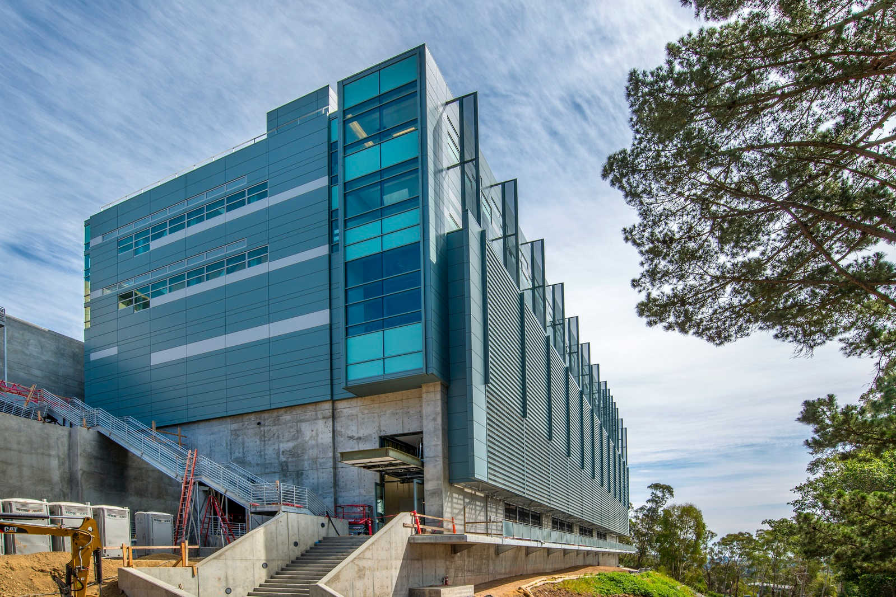
NERSC is in a new building at LBL
Wang Hall or Building 59 or “CRT”
Notes:
We thought we would be done by now!

Slide 9
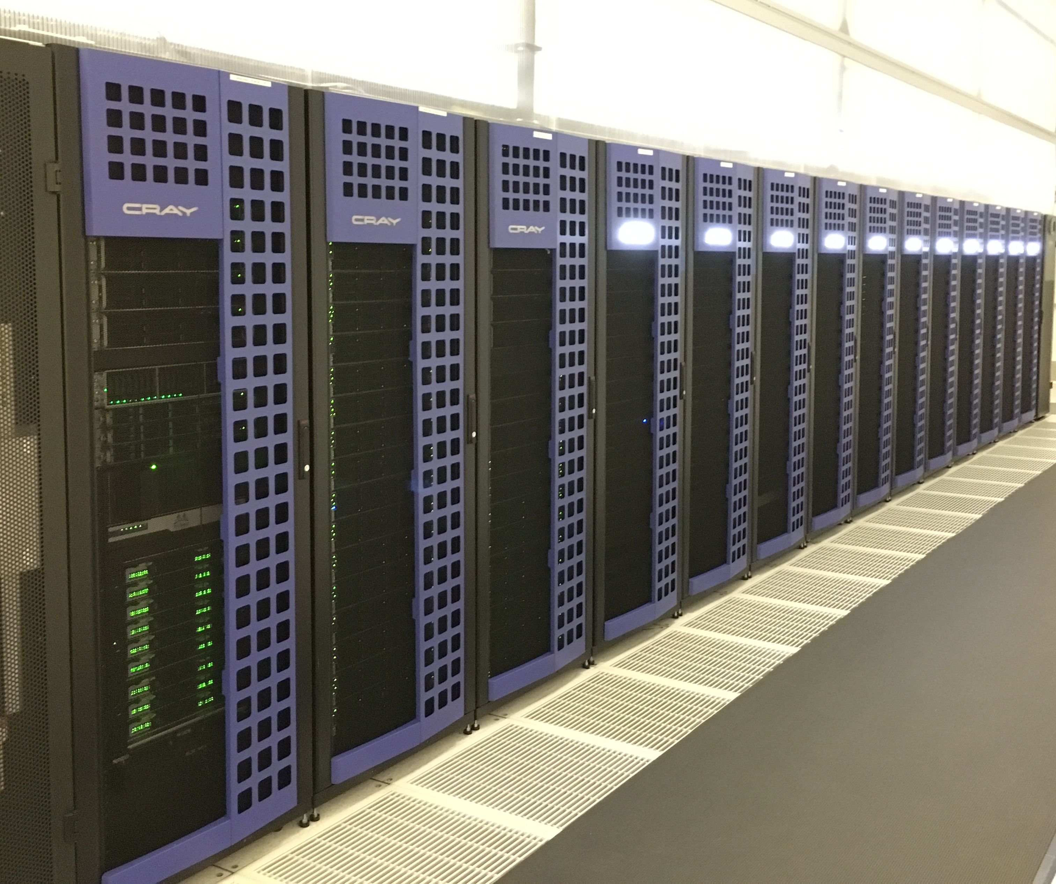
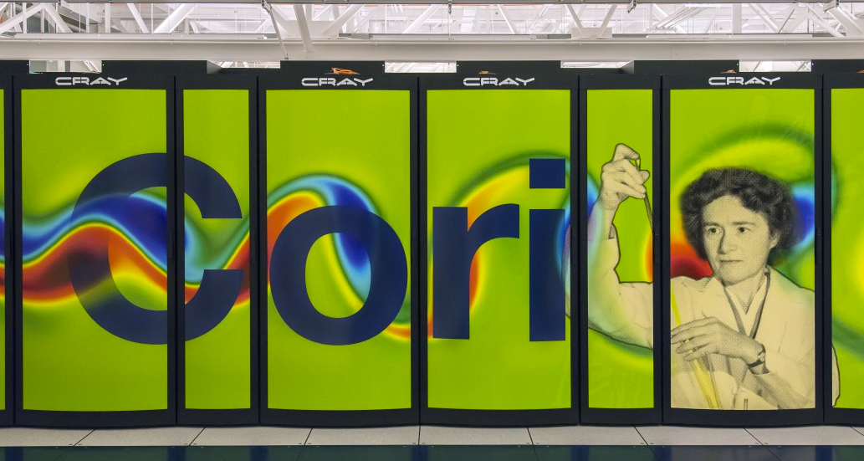
NERSC Systems
Genepool
Mendel cluster
Genepool – JGI-specific cluster. Main workhorse for JGI
Edison
Cori – newest generation Cray supercomputer (5th in world)
JGI recently acquired a Cori partition

Slide 10
Where to get started on getting help
NERSC Genepool webpage
https://www.nersc.gov/users/computational-systems/genepool/
Online Helpdesk – http://help.nersc.gov
Create and monitor trouble tickets
Or email consult@nersc.gov
NERSC Information management (NIM) webpage
https://nim.nersc.gov/ - change NERSC password
my.nersc.gov
More information on your account and usage
Consulting line – 1-800-66-NERSC (menu option 3)
Talk to a real live consultant 8-5, M-F

Slide 11
NERSC Information Management (NIM)
http://nim.nersc.gov
NERSC-wide management of passwords and other account information
Same password used for all NERSC systems
5 consecutive unsuccessful logins will lock you out
Log into NIM to reset failures, or reset password
ssh public keys should be deposited here
Be sure contact info (especially email) is kept up-to-date
Change your default shell (per system)
View NERSC account usage: compute time, quotas

Slide 12
Computing resources
Notes:
Computing is only part of the story. The world is becoming full of detectors and sensors of all kinds and they’re producing lots of data. Even if all you do is simulations, the data you are producing when you run on thousands of cores can be staggering. NERSC is innovating to help you deal with data in today’s environment.

Slide 13
The NERSC computing world
Mendel
Edison
4182 nodes,134k cores
Genepool
PDSF
“Denovo”
test cluster
Cori
12k nodes,745k cores
GPFS
web
servers
“Knight’s Landing” (KNL) nodes
projectb
Global filesystem
jgi partition
HPSS
>250Pb tape storage
“Haswell” nodes

Slide 14
Structure of the Genepool system
User Access
Command Line
Scheduler
Service
ssh genepool.nersc.gov
http://…jgi-psf.org
web services
gpwebs
gnwebs
login nodes
gpdbs
scidbs
Oracle dbs
gpint
nodes
database services
compute nodes
~400 nodes
>8000 cores
80+M Core Hours
/homes
/scratch
7.1 PB of Storage
/seqfs
/dataNarchive
/software
JGI File Systems
Notes:
282 128GB nodes
88 256GB
20 512GB
2 1TB,2TB

Slide 15
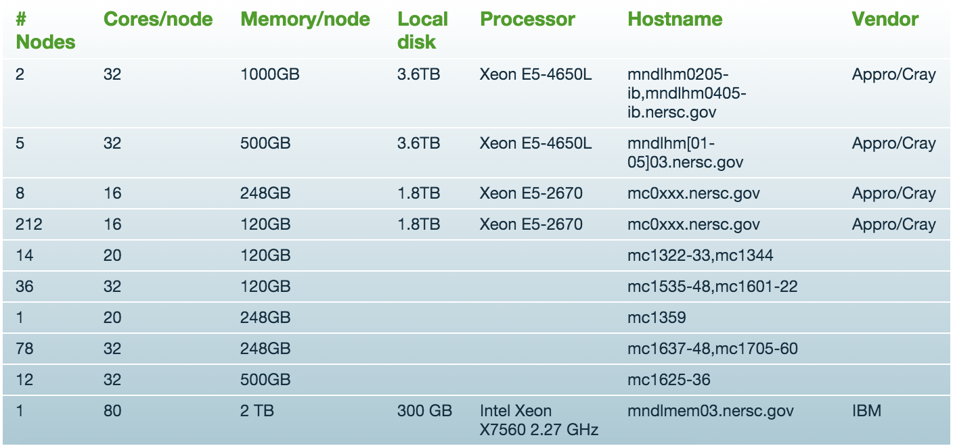
Genepool is a heterogeneous computing environment

Slide 16
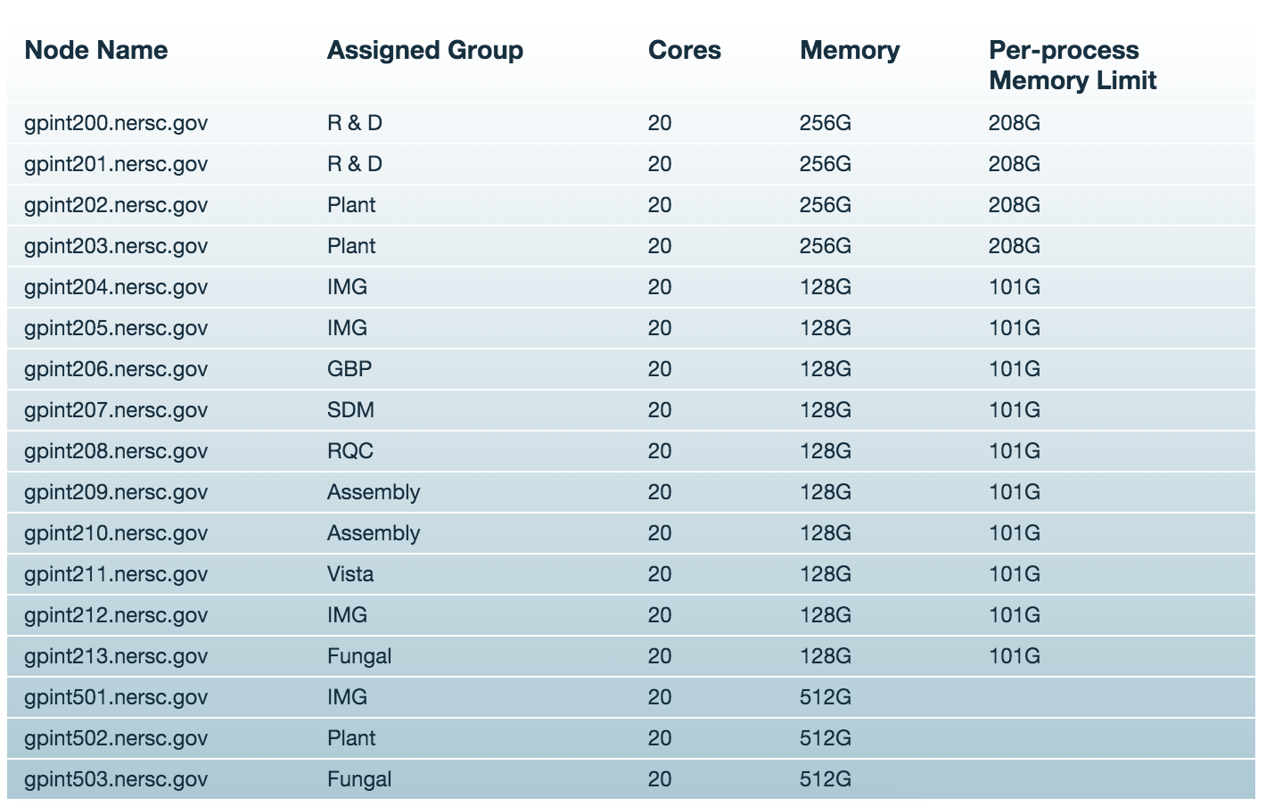
Interactive nodes (GPINTs)

Slide 17
Connecting to Genepool
ssh genepool.nersc.gov
Will take you to the least-utilized login node
ssh in MacOS, Linux. Putty commonly used in Windows
ssh gpint[xxx].nersc.gov
If your group owns its own interactive node
Use NX for graphical (X-Windows) applications
https://www.nersc.gov/users/connecting-to-nersc/using-nx/
Managed and supported by NERSC’s DAS group

Slide 18
Home Directory
When you log in you are in your "Home" directory.
Permanent storage
Weeklong daily snapshots taken: $HOME/.snapshots
The full UNIX pathname is stored in the environment variable $HOME
$HOME is a global file system
You see all the same directories and files when you log in to any NERSC computer.
Your quota in $HOME is 40 GB and 1M inodes (files and directories).
Use “myquota” command to check your usage and quota
genepool04% echo $HOME
/global/homes/d/dudwary
Notes:
The first data storage area you’ll be concerned about is your home directory. This is the directory you see when you first log into NERSC. Data and files stored in your home directory are permanent, but home is limited in size: 40 GB and 1M inodes, or files and directories. NERSC does not delete files in your home directory, but we don’t back them up for you either. You must store copies of important files in HPSS or elsewhere. It’s important to note that your home directory is common to all NERSC machines. So if you log into Franklin, you’ll see the same files and directories as when you log into Hopper. This puts a bit of a burden on you to keep separate any files that might be relevant to only one system. For example, non of these systems are binary compatible, so a code compiled on one system will not run on another.

Slide 19
Scratch Directories
Each Genepool user may have, on request, a personal directory referenced by $SCRATCH and $BSCRATCH
on Genepool this points to /global/projectb/scratch/<username>
$SCRATCH is local on Edison and Cori (ie does not point to projectb).
“Scratch” file systems are large, high-performance file systems, intended to be temporary.
Standard projectb scratch size: 20TB and 1M inodes
Significant I/O from your compute jobs should be directed to $SCRATCH
Data in $BSCRATCH is purged (12 weeks from last access)
Always save data you want to keep to HPSS (see below)
Data in $BSCRATCH is not backed up and could be lost if a file system fails.
Notes:
Scratch directories, on the other hand, are large and tuned for streaming large amount of data from your programs. All significant IO from your applications should be reading and writing from the scratch file system. Each user has their own private space in scratch, referenced by the $SCRATH environment variable. Scratch data that has not been accessed in 12 weeks is purged to make room for newer data.

Slide 20
Project Directories
All NERSC systems mount the NERSC global "Project” file systems.
Projectb is specific to the JGI, but is also accessible on Edison and Cori.
"Project directories” are created upon request for projects (groups of researchers) to store and share data.
Data in /projectb/projectdirs is not purged. This may change in the future, but for long term storage, you should use the archive.
Notes:
To make it easy for collaborators to share data, NERSC has a project file system. Project directories are available to any NERSC group of researchers upon request. Project, like home, is permanent, but not backed up. Performance is not as good as scratch, but recent upgrades have made it close.

Slide 21
IO Tips
Use $SCRATCH or $BSCRATCH for good IO performance
Write large chunks of data (MBs or more) at a time
Use a parallel IO library (e.g. HDF5)
Read/write to as few files as practical from your code (try to avoid 1 file per MPI task)
Use $HOME to compile unless you have too many source files or intermediate (*.o) files
Do not put more than a few 1,000s of files in a single directory
Save any and everything important to HPSS
Notes:
Before leaving the topic of disk storage I wanted to throw in a few random tips that might help you. The first is to use $SCRATCH for big IO; it’s tuned for performance. When reading and writing to disk, do so using large chunks of data. Also, use a parallel IO library. These are tuned for performance and offer data portability. When building a code $SCRATCH is not necessarily the best file system for the many small IO operations that might be be. You can use $HOME for that, but not if you’re exceeding the limit of 1M files and directories. Another tip: our high-performance storage systems perform very poorly if you put 1000s of individual files in a single directory. And finally, you have to back up all your important data yourself.

Slide 22
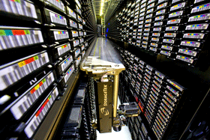
Archival Storage (HPSS)
For permanent, archival storage
Permanent storage is magnetic tape, disk cache is transient
100PB data in >400M files written to 32k cartridges
Cartridges are loaded/unloaded into tape drives by sophisticated library robotics
Front-ending the tape subsystem is 150TB fast-access disk
Hostname: archive.nersc.gov
Over 100 Petabyes of data stored
Data increasing by 1.7X per year
150 TB disk cache
8 STK robots
44,000 tape slots
Average data xfer rate: 100 MB/sec
Notes:
As I mentioned before, HPSS is NERSC’s archival storage system. The HPSS system you will be using is named “archive.nersc.gov” Data is stored and retrieved from HPSS with an HPSS utility named “hsi” or by ftp. NERSC provides hsi on all machines at the center and you can download a client from our website for many popular operating systems. If you want to access HPSS directly from outside NERSC, you have to follow a procedure that you can read about on our web pages.

Slide 23
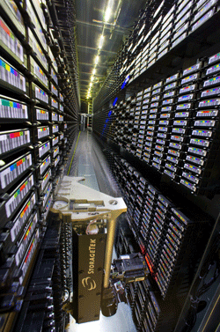
HPSS Clients
Parallel, threaded, high performance:
HSI
Unix shell-like interface
HTAR
Like Unix tar, for aggregation of small files
PFTP
Parallel FTP
Non-parallel:
FTP
Ubiquitous, many free scripting utilities
GridFTP interface (garchive)
Connect to other grid-enabled storage systems

Slide 24
Running and Monitoring Jobs

Slide 25
Types of Jobs on Genepool
Batch – Scheduled
qsub
Interactive – Scheduled
qlogin
Interactive – Unscheduled
2 login nodes, 17 gpint interactive nodes
direct login via ssh
Services – Unscheduled
Web services
Database Services
Automated job submissions

Slide 28
What is a JSV?
Job Schedule Verifier
Upon job submission, evaluates the requirements you provided (if you did), and sends the job to the right queue
Occasionally adjusted by CSG staff at NERSC to accommodate changes in Genepool configuration

Slide 30
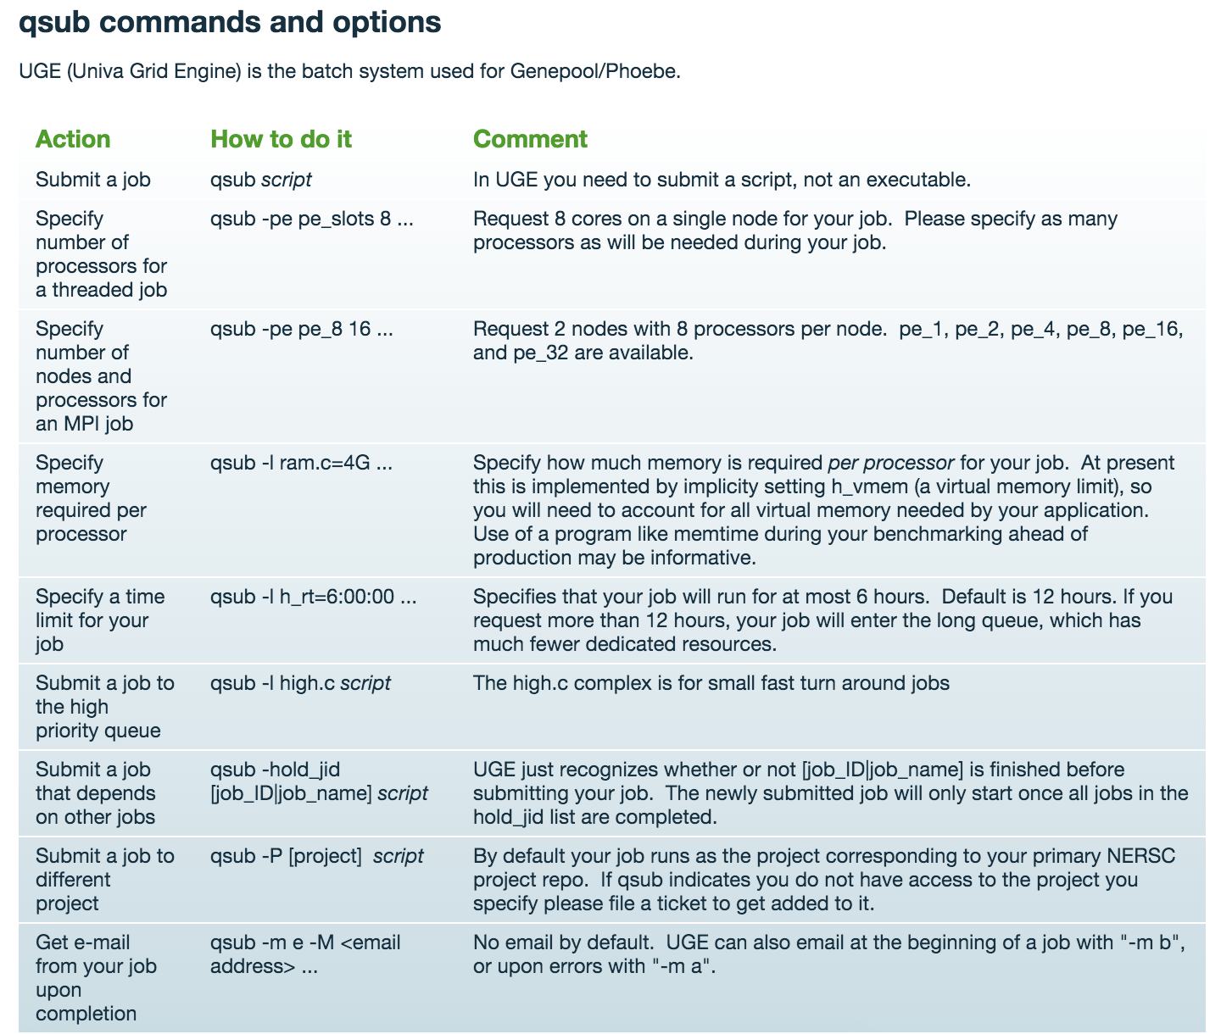
Many examples on the NERSC webpage
https://www.nersc.gov/users/computational-systems/genepool/running-jobs/submitting-jobs/

Slide 31
Genepool Queues
Exclusive = all CPUs on a node
Queue Name | Purpose | User Requestable | Slot Limit | Wall Clock Limit
normal.q | Default queue | No | 2460 | 12 hours
normal_excl.q |  | No | 3348 | 12 hours
long.q | Workflows that need more than 12 hours | No | 320 | 240 hours
long_excl.q |  | No | 1548 | 240 hours
high.q | High priority jobs and debugging jobs | Yes | 32 | 240 hours
high_exclusive.q |  | Yes | 64 | 72 hours
xfer.q | Data Transfer Queue on genepool; Use this to transfer data to /global/dna | Yes, request "-l xfer.c". | 2 | 72 hours
The number of nodes devoted to each queue is highly variable at the moment as we examine queue wait times

Slide 32
Pointers to avoid common mistakes
For new users, trust the JSV
The JSV will do its best to place your job where it will run best given your specifications.
It helps to know 3 things:
Max runtime: -l h_rt=6:00:00 run for up to 6 hours
Number of CPUs -pe pe_slots 8 give me 8 slots
Memory -l ram.c=120G I need 120G memory
Problems come in when memory and CPUs get combined.
ram.c specifies memory PER CPU
so: qsub -pe pe_slots 8 –l ram.c=120G would only run on 1TB nodes

Slide 33
More pointers
Be aware of how many threads your software will use, and be sure you’ve requested the right number (typically with “qsub –pe pe_slots 8”)
hmmer is commonly problematic – by default will try to take all CPUs on a machine, unless otherwise specified
If at all possible, use 12 hours or less
The long queue has few nodes, and usage is constrained
Use –cwd or –wd <directory> with qsub
Writing output to your home directory can slow everyone down. Write to scratch!
For exclusive nodes:
qsub –l exclusive.c

Slide 34
Check job status with qs (cached qstat)

Slide 35
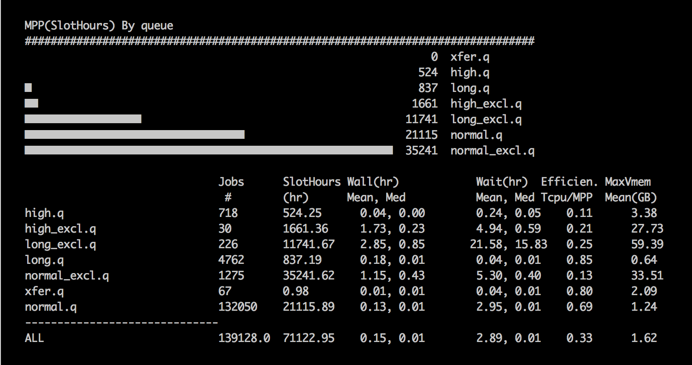
Why hasn’t my job run yet?
sh /genepool/nsg/opt/scripts/daily_summary/show_summary.sh

Slide 38
Running Jobs on Cori
Over time, we’re aiming to move JGI to Cori-like systems
Cori differences:
uses SLURM scheduler, not UGE
Users urged to provide and run their software in containers
Anaconda Python (NERSC will not manage packages for you)
Jobs may be charged to JGI
Software may need to be recompiled due to OS differences
If you think you’ll need to run jobs on Cori, please talk to a consultant!

Slide 39
Running Jobs on Denovo
Denovo is Genepool’s test cluster
Runs SLURM, Shifter, has upgraded OS
Over time, Genepool will transition to become more like Denovo
Long-term projects should consider how/whether they’ll run on Cori/Denovo with SLURM
Containers instead of NERSC-supplied modules
Anaconda Python for user-maintained environments

Slide 40
Modules

Slide 41
Using Software and the UNIX Environment
Providing large-scale installations of software for many different users on an HPC system presents a number of challenges:
Different users need different software, use different shells
Some users need different specific versions, including older versions
All users need to access the software quickly and easily from “everywhere” [network-mounted, non-standard paths]
Providing a user interface for accessing that software can be challenging
Example: How would you use software installed in
/usr/common/jgi/aligners/blast+/2.2.28
Answer:
Add /usr/common/jgi/aligners/blast+/2.2.28/bin to PATH;
csh: setenv PATH /usr/common/jgi/aligners/blast+/2.2.28/bin:$PATH
bash: export PATH=/usr/common/jgi/aligners/blast+/2.2.28/bin:$PATH

Slide 42
What are Modules?
Modules have a name
A “module” is something that can be loaded or unloaded dynamically into the environment.
Modules can have a default version
Modules have a version
can have many versions
To refer to the default version of a module, use: <name>
e.g. module load gcc
To refer to a specific version of a module, use: <name>/<version>
e.g. module load gcc/4.8.1

Slide 43
Basic Modules Functionality
Modules manipulate the environment
Loading can:
Set an environment variable (possibly by replacing)
Append (or prepend) to a compound environment variable
Unset an environment variable
*can* execute a command (not recommended if the command changes the state of the system)
‘module unload’ reverses the effects of the ‘module load’
Which effects of a module might be irreversible?
Answer:
setenv won’t restore the environment to its original state
multiple modules calling ‘setenv’ or ‘unsetenv’ on the same variable might lead to an inconsistent state (those modules should conflict)
Executing system calls which change system state (e.g. xhost) are not trivially reversible by unloading the module

Slide 44
Modules: conflicting and swapping
Some modules are incompatible
E.g. both wublast and blast+ provide different blastn, blastx, etc. executables
To prevent these modules from being simultaneously loaded, they conflict
dmj@genepool02:~$ module load wublast
dmj@genepool02:~$ module load blast+
blast+/2.2.26(25):ERROR:150: Module 'blast+/2.2.26' conflicts with the currently loaded module(s) 'wublast/20060510’
Most of the time, only a single version of a module should be loaded at a time:
e.g., doesn’t make sense to load more than one version of gcc
Try:
module purge ## cleans everything out
module load gcc
Module load gcc/4.8.1
Error? to change from gcc/4.6.3 (the default) to gcc/4.8.1 (the latest), swap!
module swap gcc gcc/4.8.1 -or- module swap gcc/4.8.1

Slide 45
Common Environment Variables in Modules
Modules for software packages commonly set:
PATH
LD_LIBRARY_PATH
PYTHONPATH
PERL5DIR
Every usg/jgi module for software also sets an environment variable pointing to the base of the distribution:
E.g. BOOST_ROOT, PERL_DIR, PYTHON_DIR, GIT_PATH
Exercise:
Load the python module first
Use ‘module info’ to investigate the effects of:
graphviz
RSeQC
Smrtanalysis
Are there commonalities? Differences?
Be VERY careful about manipulating these environment variables!!!

Slide 46
Modules may have dependencies
For the python module to function, both the gcc and readline modules need to be loaded
For the perl module to function, the gcc module needs to be loaded
Python needs some of gcc’s libraries
Perl needs some of gcc’s libraries
Python also needs readline’s libraries

Slide 47
Module commands reference
module list
show all loaded modules
module avail <module name>
list modules with <module name> that can be loaded
module load <module name>
module unload
module swap <current module> <new module>
unload a loaded module and load the new one
module purge
unload all modules (it’s a good idea to start a batch script this way!)
module use <a directory>
Use a different $MODULEPATH
For Genepool-wide installation of new modules, or software upgrades, contact your consultants!

Slide 48
Using Modules in Batch Scripts
Ensures login environment is initialized
#!/bin/bash –l
#$ -l ram.c=10G
#$ -l h_rt=8:00:00
set –e
module purge
module load PrgEnv-gnu/4.6
module load python/2.7.4
module use /path/to/my/groups/modulefiles
module load MyPipeline/1.0
#…. Run your programs here ….
UGE options
Kill script if any commands give non-zero exit status
Clear all the modules, load any needed variant-provider modules
Add your modulefiles to MODULEPATH (module use)
Load your pipeline module

Slide 49
What’s coming up next for Genepool?
OS Upgrade this year
Deb6 -> CentOS7?
Expecting lots of software re-installation
Move scheduler from UGE to SLURM (Nov 2017?)
Standardization with other NERSC systems
Move more computation to Cori/Edison/NERSC9
Large Cray systems designed around heavy parallelization
Use of Docker/Shifter containers
Adaptation of pipelines to workflow managers
Taskfarmer, NextFlow, FireWorks

Slide 50
Getting Started Checklist
Get a NERSC account
https://nim.nersc.gov/nersc_account_request.php
Get added to a project in UGE on Genepool
Request $BSCRATCH space
(Optional) Get activated on Denovo
(Optional) Get activated on Cori
Addition to a project repo
or
Activation on JGI Cori partition

