Slide 1
Daniel Udwary NERSC Data Science Engagement Group June 22, 2016
TaskFarmer
Notes:
Welcome everybody. And thanks for joining today’s presentation on Getting Started at NERSC. Today we’ll be talking about some of the things new users need to know to work smoothly at NERSC. I think that you will find that there’s lot of things to know, but that we’re here to help you get things done and be successful.

Slide 2
Task arrays
Task array = a scheduled job with multiple independent steps (or tasks)
Why use a task array?
Often, especially in bioinformatics, you need to do repetitive analysis on many inputs
Task arrays let you submit a single job to effectively parallelize many independent tasks.
UGE: “qsub -t 1-100” for a 100-task array
$SGE_TASK_ID is array variable
SLURM: “sbatch --array=1-100”
$SLURM_ARRAY_TASK_ID

Slide 3
What’s wrong with task arrays?
Nothing, if used correctly!
LOTS of task arrays go through Genepool daily
How to use Task arrays incorrectly on Genepool:
Create a very large array (>1000s) of very short (<30s) single-slot tasks
Bonus points: Read and write to the same directory or file with all tasks
Why?
Schedulers schedule jobs on a fixed cycle (30s in UGE)
In UGE, a task array is considered a single job
Each task in the job has the exact same priority
Once a job starts to run, all the tasks will run through the system
In UGE, scheduler needs to look at top priority jobs and determine if/how to schedule them. Has <30s to do this.
For a high-priority array, ALL tasks in job need to get examined.
So, not all tasks even get scheduled, and large chunks of the system go idle.
Fast tasks can easily finish before next scheduler cycle.
More free nodes = more jobs to look through. Problem spirals.
Other people’s jobs don’t get through because this job ends up with priority.

Slide 4
Task Arrays on Cori
SLURM allows task arrays
And is more resilient in terms of scheduler overhead
But Cori has:
job submission limits
running job limits
Wall time limit is much lower on Cori than max on Genepool, so serializing is also problematic
So, moving some task array workloads to Cori will be a problem
Unless people start using workflow managers!

Slide 5
What is TaskFarmer?
A NERSC-written simple workflow manager
Available on Genepool, Edison, and Cori
Can be a solution for large/short task arrays and won’t break the scheduler
Uses MPI, so avoids scheduler overhead issues
Tasks can be single- or multi-core
Allows resuming
system failures
or if you exceed your wall-time limit

Slide 6
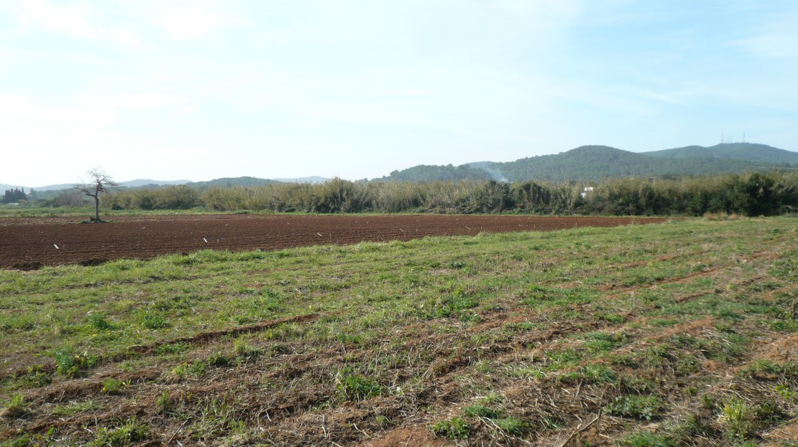
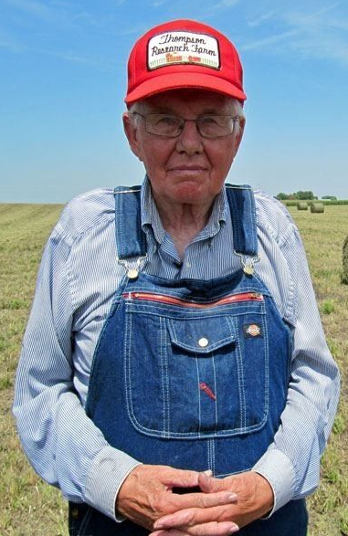
How does Farming Tasks work?
List of stuff to do
Grow corn
Grow beans
Grow potatoes
Milk the cow
List of stuff to do
Grow corn
Plant seeds
Water
Weed
Harvest
Grow beans
Grow potatoes
Milk the cow

Slide 7
How does Farming Tasks work?
Task list
list of independent tasks that need to be executed
Worker node
Node
running
“tfrun”
Worker node
All you need to do is:
start a job with at least two nodes
provide a list of tasks
load and run taskfarmer
Worker node

Slide 8
Let’s farm some tasks!
https://bitbucket.org/dwudwary/tftraining
> git clone git@bitbucket.org:dwudwary/tftraining.git
Let’s start with example1:
submission.sh Cori/SLURM submit script
uge_submission.sh Genepool/UGE submit script
tasks.txt Example task list
Exercise: run a task farm
Objective: what are the output files created?

Slide 9
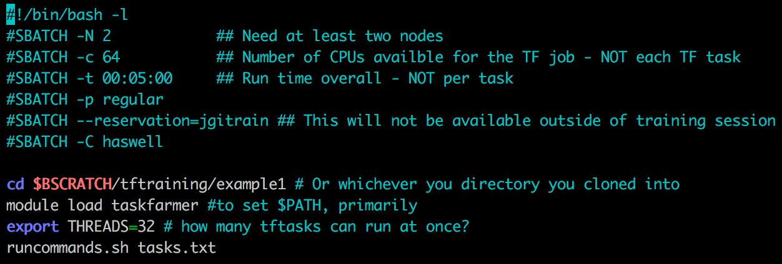
UGE submission example
SLURM submission example

Slide 10
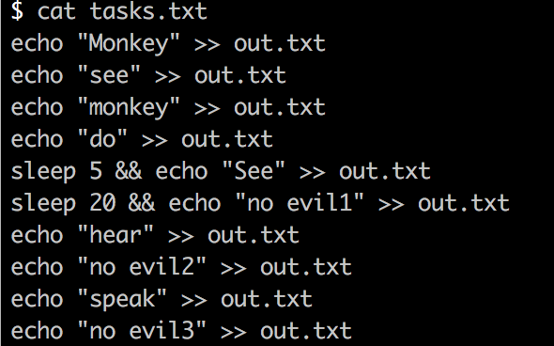
Sample task list
Just a text file listing a series of tasks to be executed.
Could be executing a script.
What am I doing here that’s bad?

Slide 11
Progress files
When complete, you should see:
$ ls -l
total 64
-rw-rw---- 1 dudwary dudwary 4 Jun 28 10:23 done.tasks.txt.tfin
-rw-rw---- 1 dudwary dudwary 63 Jun 28 10:23 out.txt
-rw-rw---- 1 dudwary dudwary 312 Jun 28 10:23 progress.tasks.txt.tfin
-rw-rw---- 1 dudwary dudwary 523 Jun 27 10:51 submission.sh
-rw-rw---- 1 dudwary dudwary 266 Jun 27 10:42 tasks.txt
-rw-rw---- 1 dudwary dudwary 286 Jun 28 10:23 tasks.txt.tfin
-rw-rw---- 1 dudwary dudwary 401 Jun 27 13:16 uge_submission.sh
*.tfin files are keeping track of progress of the tasks
done.*.tfin will appear when the entire tasklist is complete
If you need to restart your job, if progress files are present, taskfarmer will pick up wherever you left off.

Slide 12
Words of warning
As with a task array, BE CAREFUL with your I/O
Don’t write output for each task to the same file
Please don’t use $HOME
Especially if you have a large number of tasks, or heavy reads/writes
Definitely don’t write to files another task needs to read
Tasks will be farmed in the order of the task list, but a task might stall or may not complete
In this case, serialize more than one task list
Just like with a large task array, it will be possible to break the filesystem with a poorly designed taskfarm.

Slide 13
DON’T USE TASKFARMER FOR BLAST
Modern Blast+ does not have to be run serially.
There is no need to blast a single input sequence at a time
Use a multi-fasta file input file, then parse the output
Use a “-num_threads” value
Blast stats are more meaningful with a large database
Avoid using species-specific blast databases.
The same advice applies to hmmsearch
hmmsearch can take 200k inputs at a time
Try NERSC’s hmmer/3.1b2-opt module
Optimized threading and much faster with large datasets

Slide 14
Exercise 2
Problem: We have a bunch of genomes we want to run gene prediction on
We want to use GLIMMER, which is single-threaded
Let’s assume this doesn’t take seconds, so parallelizing would actually be useful.
Write a Cori submission script that will:
run glimmer3 against the 10 provided Streptococcus genomes

