Slide 1
Daniel Udwary Tony Wildish NERSC Data Science Engagement Group
Where is Genepool headed, and why do containers matter?

Slide 2
Why are we here?
Didn’t we just do a container training?
Yes! Link to Docker workshop
What makes today different?
Upcoming changes to Genepool
Review of Docker containers, and running them with Shifter
What does a containerized JGI look like, and how could we get there?
Hands-On Running Docker on the Google cloud
Hackathon to build containers that can be used at JGI

Slide 3
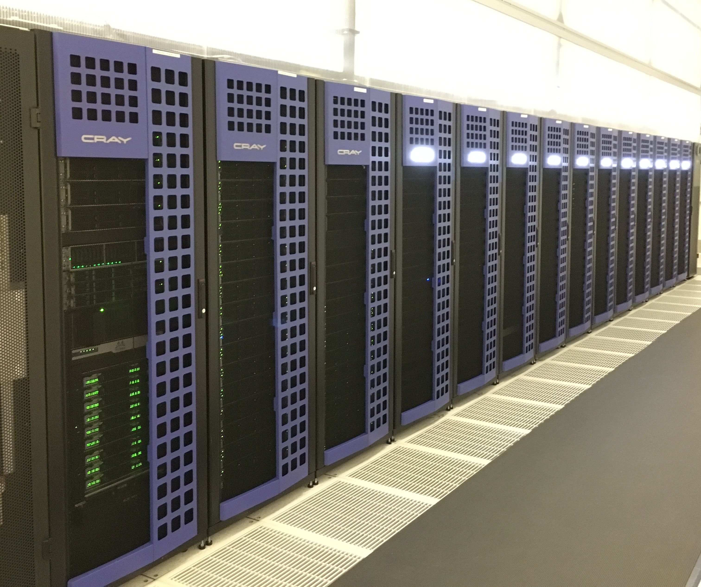
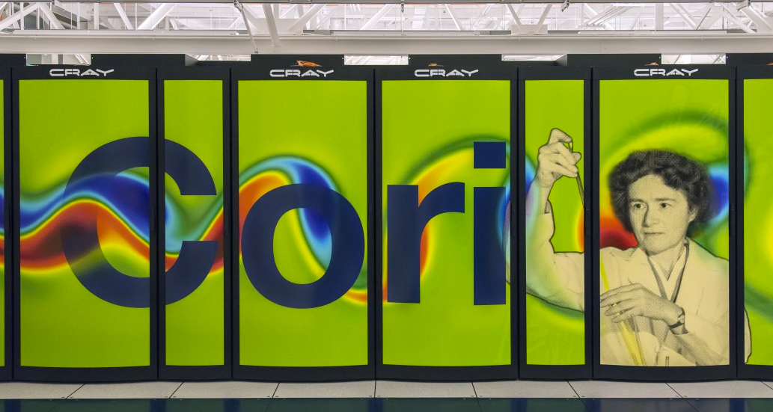
NERSC Systems
Genepool
Mendel cluster
Genepool is aging. Replacement uncertain.
NERSC will keep building Cori-like supercomputers.
So, can we transition JGI’s workload to Cori-like systems?

Slide 4
Genepool node count warranty lifespan

Slide 5
Profile with Cori
Extra capacity for a year to help with transition to Cori
Renew Mendel Phase 2 for at least 1 year – replace large memory capacity FY18/19

Slide 6
How do we start migrating workloads?
Answer: make Genepool more like the systems we need to move to
SLURM Scheduler
Anaconda as default python
Major OS Upgrade
Availability of Shifter to run containers
But, the systems are different enough, that we take the opportunity to produce programs/pipelines/workflows that can run anywhere code can run.
ie, let’s not just adapt to Cori

Slide 7
Genepool System Upgrade Roadmap
Genepool must transition to SLURM by August 2017
Parity with other NERSC systems (Cori, Edison, N9)
More consultants and admins available to help
More training and educational resources
Ability to run your software/pipelines on other NERSC systems
Avoid costly licensing fee for UGE
Interesting features that may be useful to JGI
Shifter integration
Better resource management
Opportunities for more customization than UGE

Slide 8
Genepool also needs an OS upgrade
361 nodes
8
Genepool
Denovo
default “deb6gp”
“sl6gp”
CHOS
environments
“deb6gp”?
“sles12”
Scientific Linux 6.3 (->6.8)
Scientific Linux 7.2
Root OS
Different modules on each CHOS environment
deb6gp (Genepool default) = 933 modules
Switching OSs:
env CHOS=deb6gp chos /bin/bash -l
env CHOS=sl6gp chos /bin/bash -l
env CHOS=sles12 chos /bin/bash -l

Slide 9
What we’d like to do
Denovo-like
Genepool
Genepool
default “deb6gp”
“sl6gp”
“sles12”
Scientific Linux 6.3 (->6.8)
Scientific Linux 7.2
SLURM
Shifter-capable
More Cori-compatible
Explicit versioning of modules
(ie no defaults!)
Removal of inefficient/outdated bioinformatics software

Slide 10
Talk with a consultant about adapting your pipelines
Help us help you adapt, test, benchmark your pipeline on the new OS and scheduler
Work out a schedule with us, and you’ll get focused consulting attention
When you’re ready, we’ll open up more Denovo nodes to accommodate your pipeline
Now
June
August

Slide 11
Goals for JGI-NERSC computing
Short term:
Transition to adaptable pipelines that can run on Genepool/Denovo, Cori, N9, or the cloud
Adapt job submissions to SLURM
Get away from module dependency for bioinformatics code
Long term:
Build a portable, reproducible set of containers that can be used by all of JGI, or by external scientists

Slide 12
Pros and Cons of Containerization
Advantages:
Portability of software
Easier distribution
Reproducibility and transparency
Opportunity to revisit some stale workflows
Users have control of the software
Disadvantages
Users have control of the software
Time and effort and some basic knowledge required to adapt workflows

Slide 13
What should go in a container?
#!/bin/bash –l
module load spades
module load blast+
python myscript.py –in=reads.fasta -out=gene_hits.out
env
reads.fasta
spades
your
python
script
blast
db
blast+
contigs.temp
gene_hits.out

Slide 14
So, it might look like this, instead:
#!/bin/bash –l
python myscript.py –in=reads.fasta -out=gene_hits.out
Less importance in defining env through modules
Various pieces can live and run wherever you need them to
env
spades
reads.fasta
your
python
script
(maybe the db goes in the container, maybe not)
blast
db
blast+
contigs.temp
gene_hits.out

Slide 15
In a “container world” many things don’t change
Python, Perl, bash, common tools will all still be in the new OS
Python moves to Anaconda, so virtualenvs will be more transportable as well
Modules will still exist
On Cori, modules typically for system and programming tools, users responsible for their software
~650 modules, across many consultants and DAS
Many (most?) bioinformatics applications could be containerized (or already are)
Filesystems won’t change

