Slide 1
Machine Learning
Prabhat
Data Day
August 22, 2016

Slide 2
Roadmap
Why you should care about Machine Learning?
  Trends in Industry
  Trends in Science
What is Machine Learning?
  Taxonomy
  Methods
  Tools (Evan Racah)
Science Applications (Evan Racah + Marcus Stoiber)

Slide 3
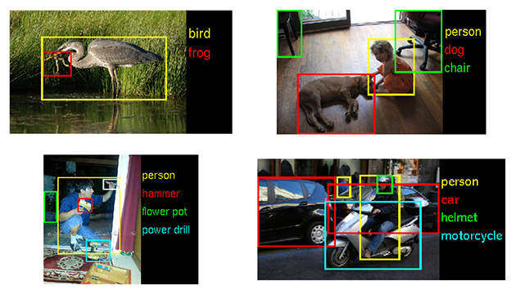
ImageNet Challenge

Slide 4
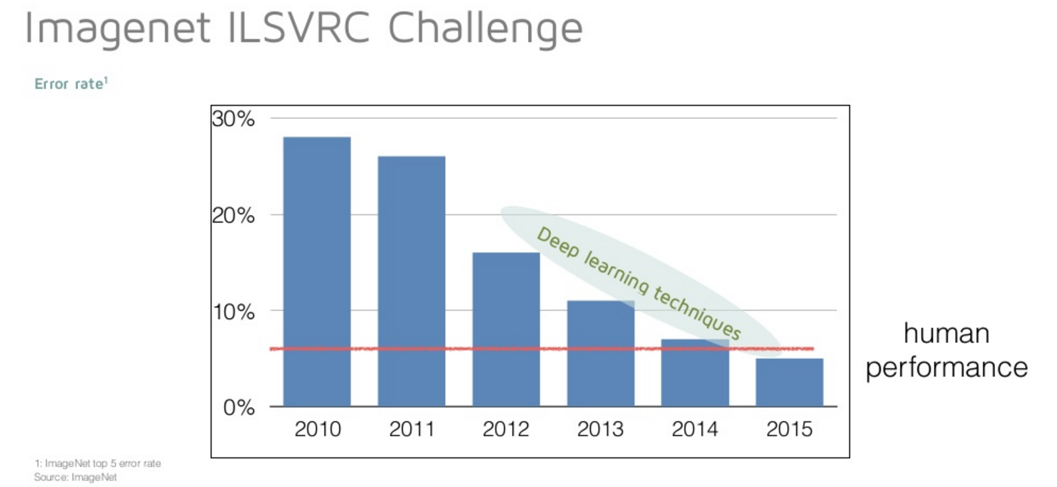
Slide Courtesy of Nervana Systems

Slide 5
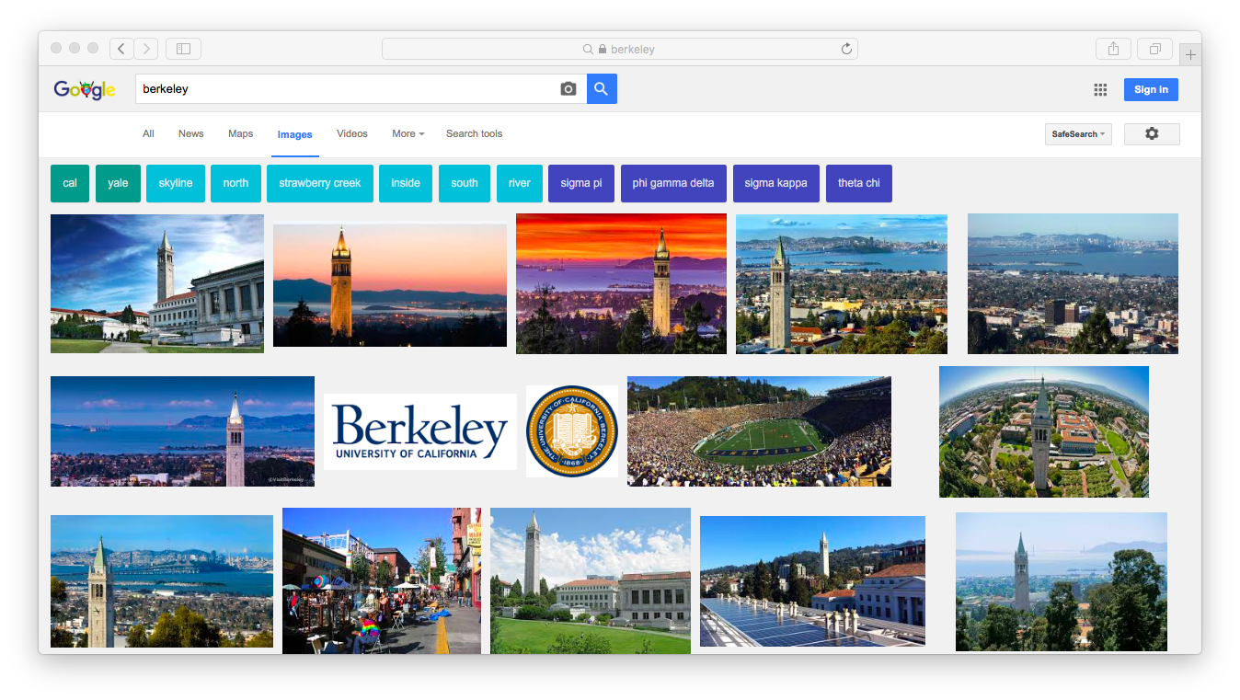
Image Recognition in Practice

Slide 6
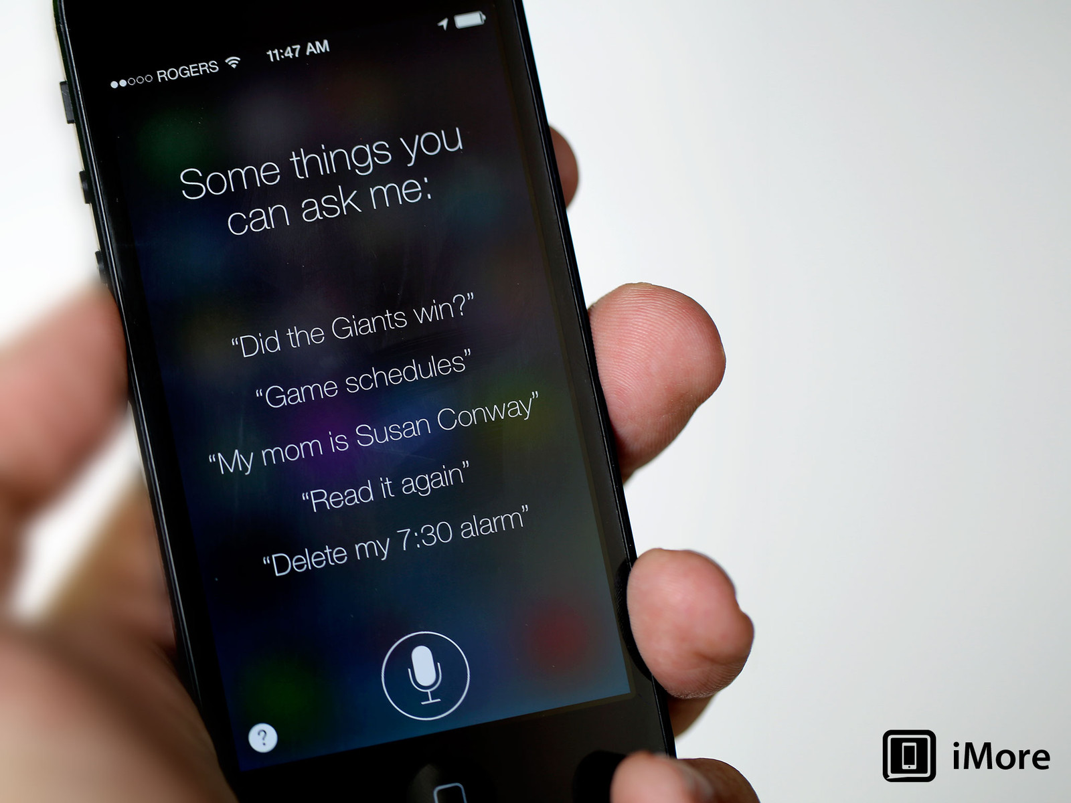
Speech Recognition in Practice

Slide 7
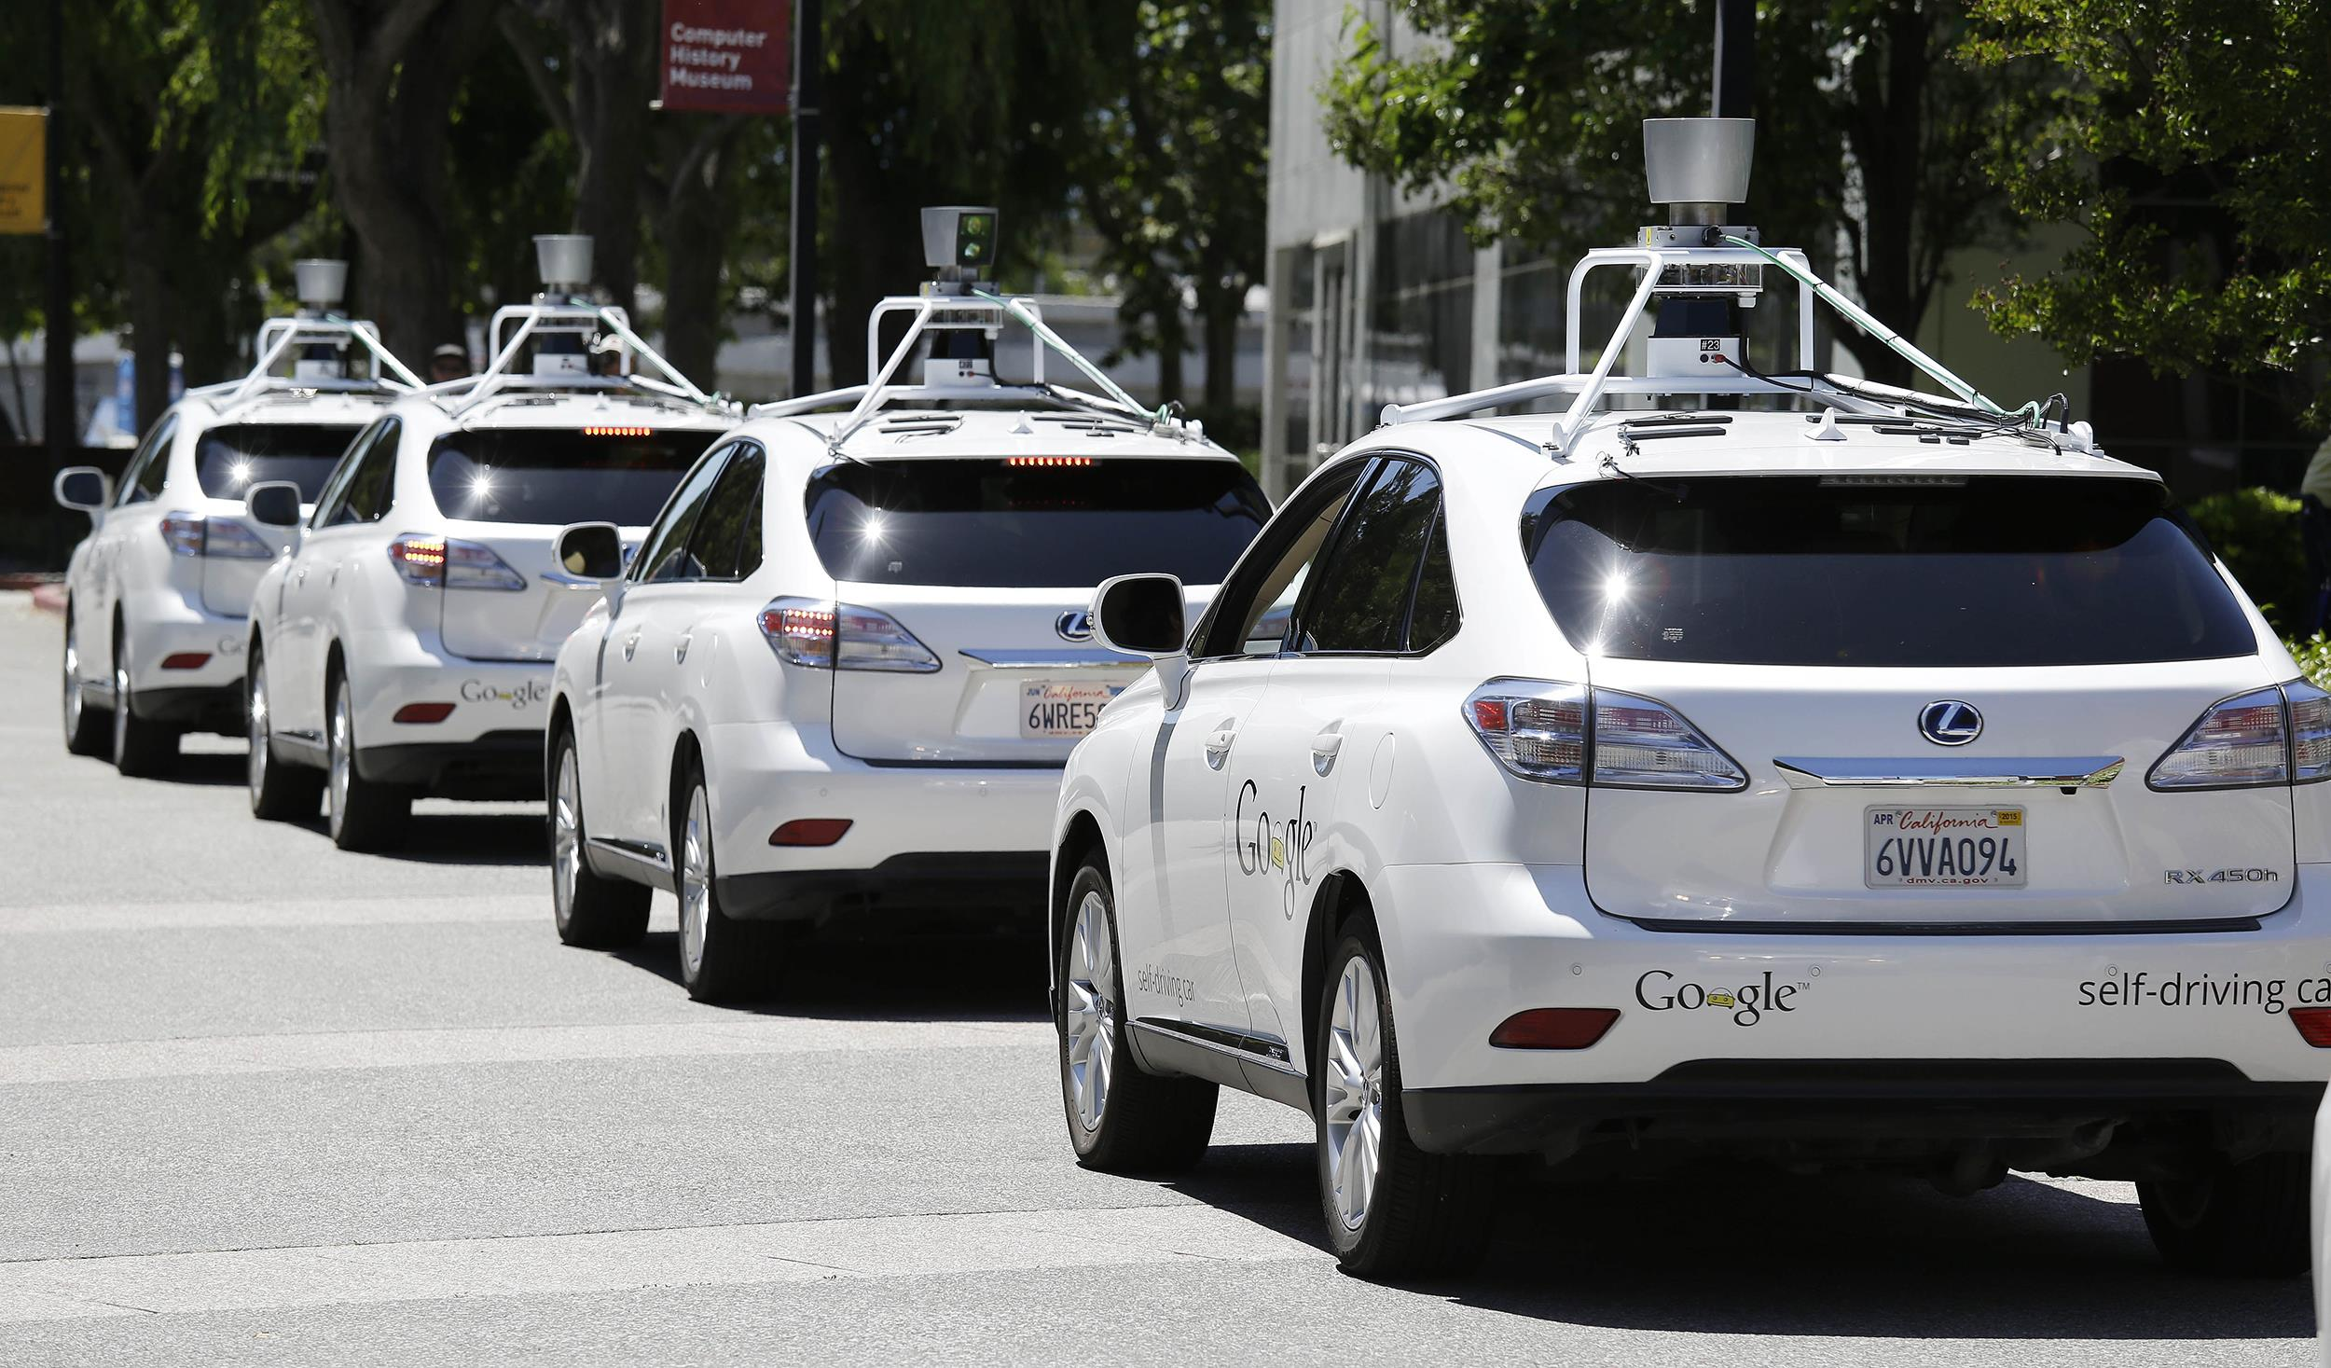

Slide 8
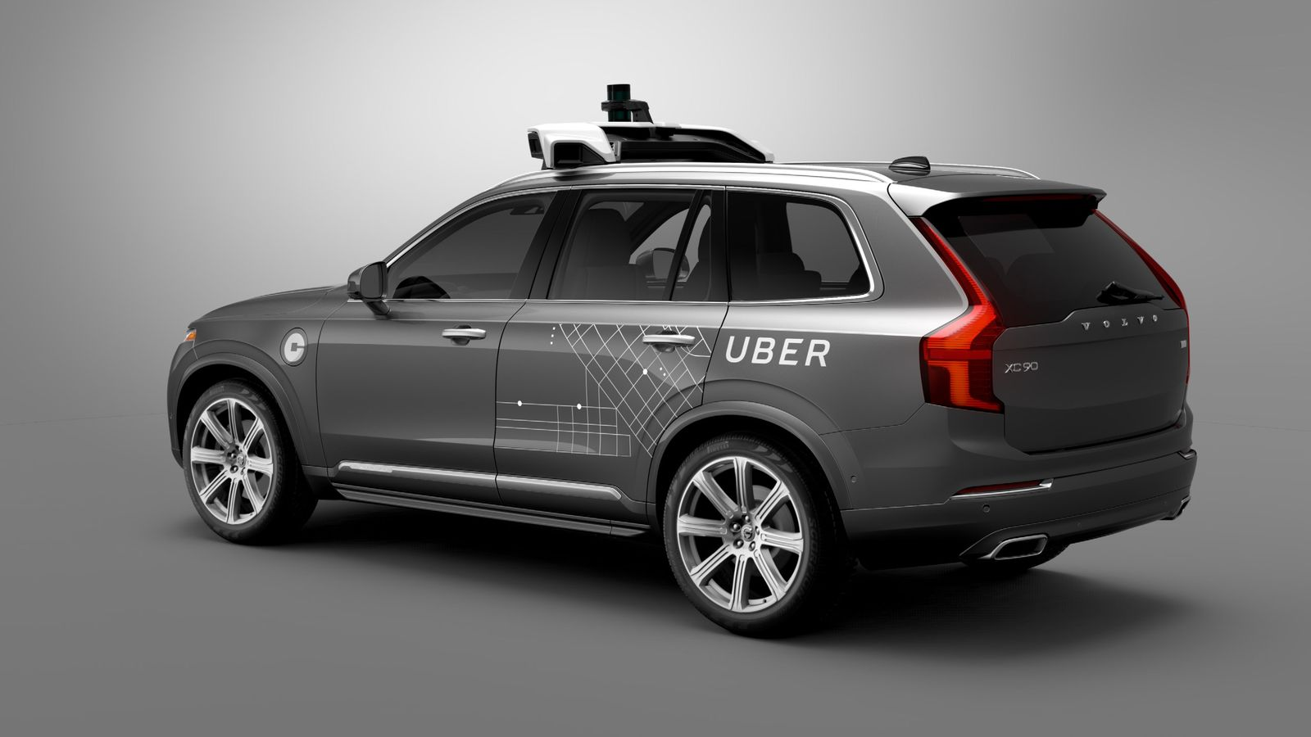

Slide 9
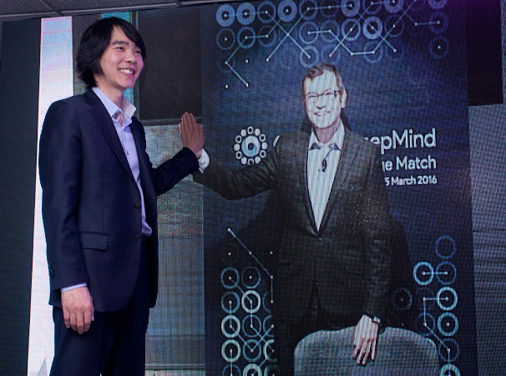

Slide 10
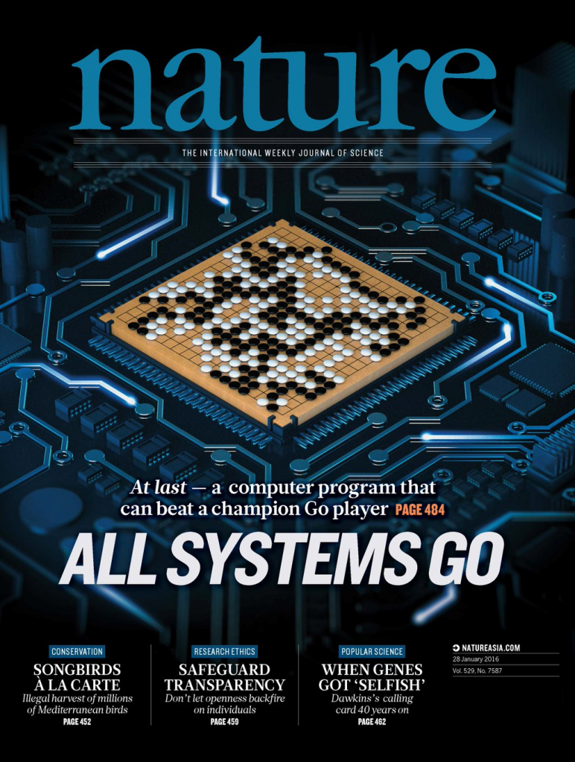

Slide 11
Machine Learning is making a significant impact
Billions of Dollars invested by industry
  Intel acquired Nervana Systems for 400M$
  Twitter acquired WhetLab
  Apple purchased GraphLab for 200M$
  …
Google, Facebook, Microsoft are integrating Deep Learning in major product offerings
Machine Learning and Statistics are established as key disciplines for this decade

Slide 12
Should scientists care about Machine Learning?
Hype? Passing Fad?
  ‘Deep Learning can learn any function, just a matter of finding enough training data'
  ‘End of hypothesis driven science’
  ‘Replace most simulation codes by Deep Learning’
  ‘Cognitive Computing’
  …
Experimental and Observational datasets are ubiquitous
  Scientific Discovery process is becoming more inferential in nature

Slide 13
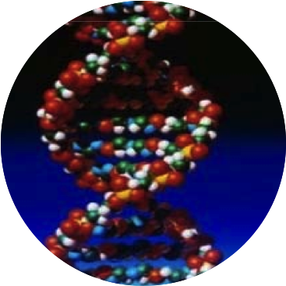
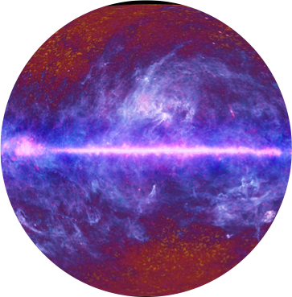
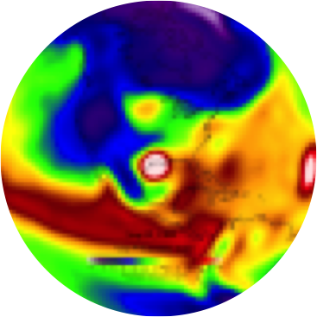
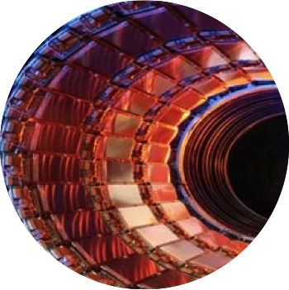
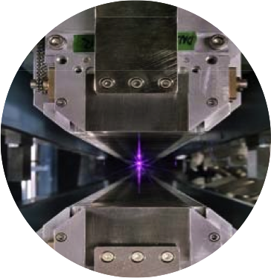
The Rise of Data-Intensive Science
Genomics
Astronomy
Climate
Physics
Light Sources

Slide 14
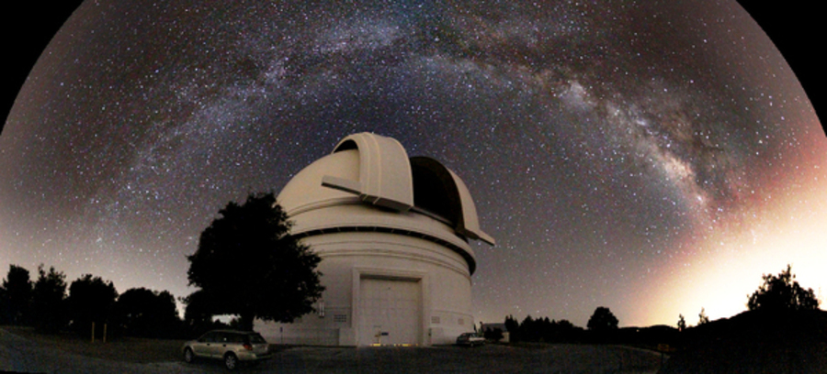
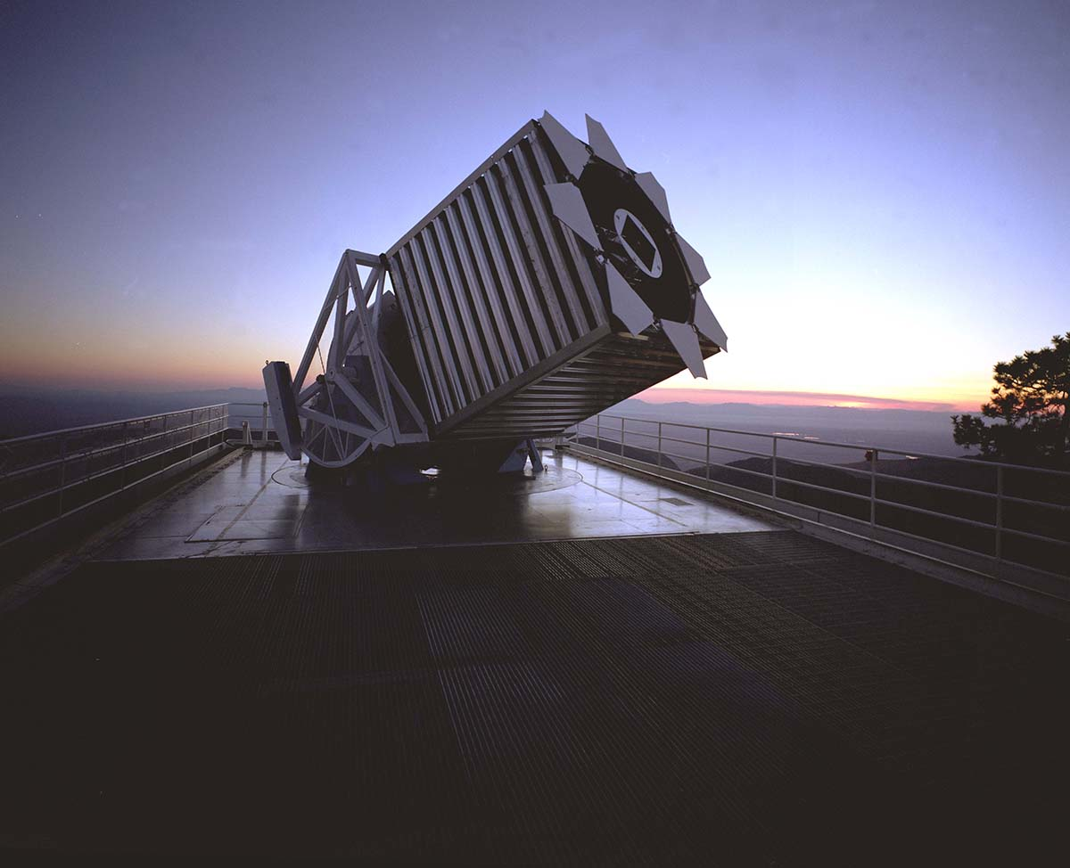
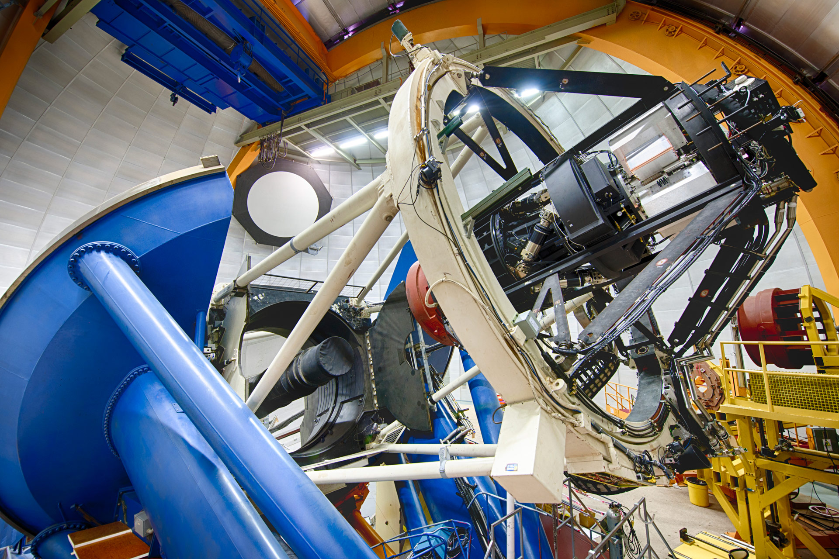

Slide 15
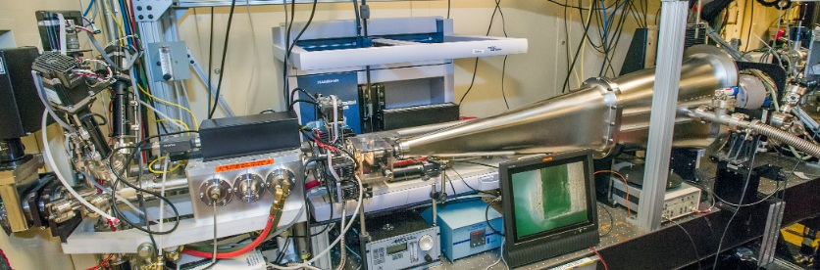
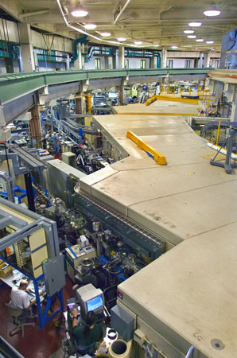
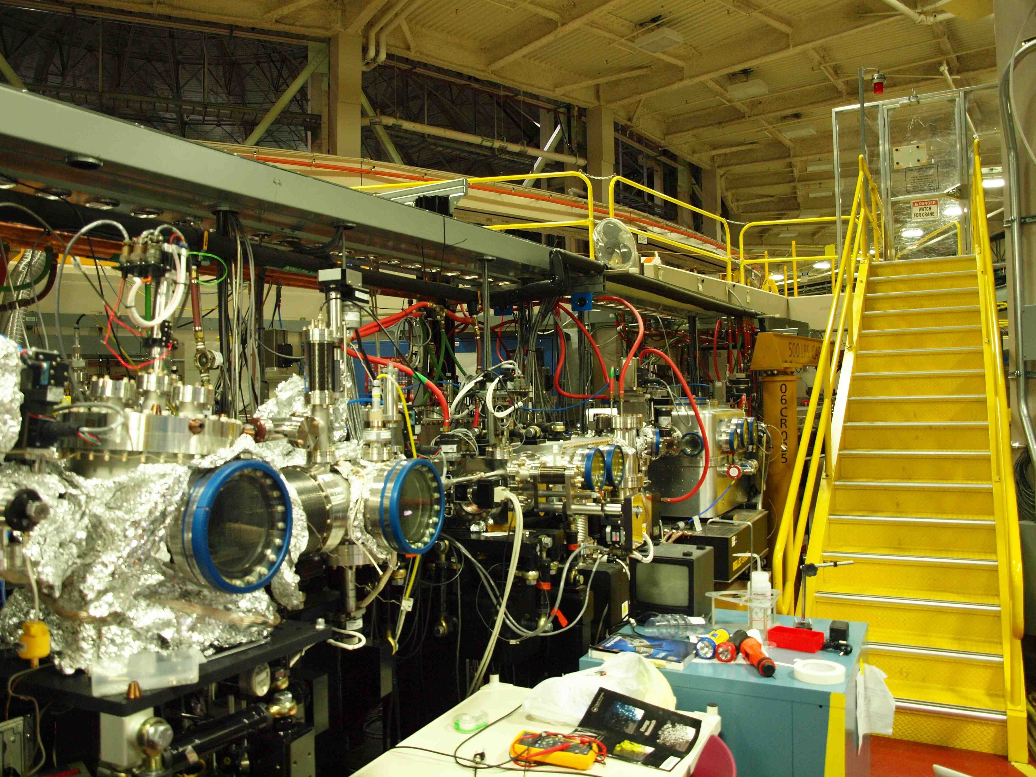

Slide 16
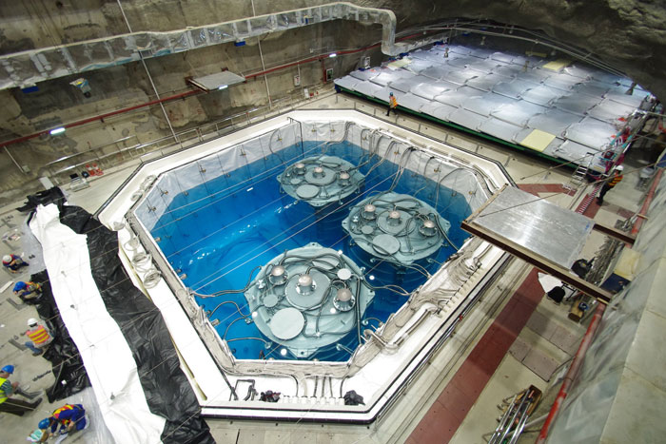

Slide 17
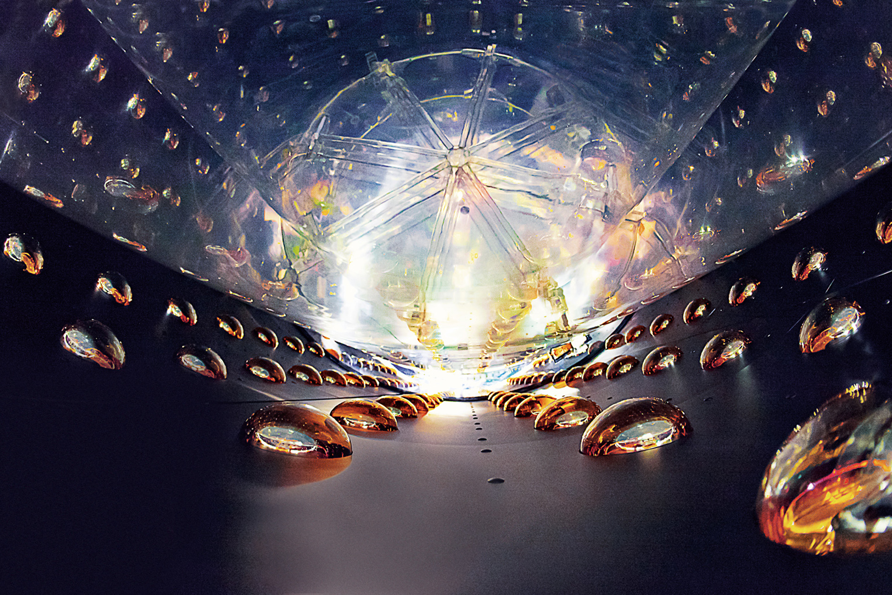

Slide 18
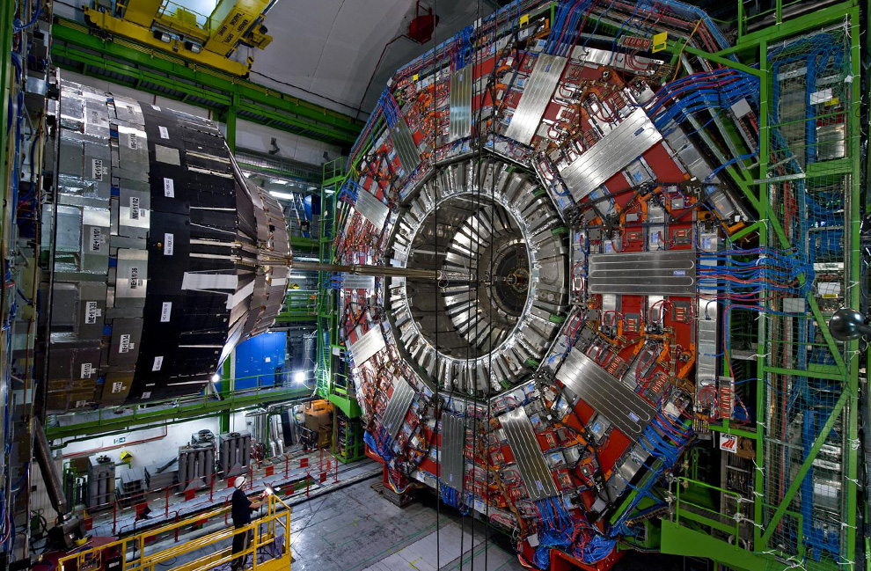

Slide 19
4 V’s of Scientific Big Data
Science Domain | Variety | Volume | Velocity | Veracity
Astronomy | Multiple Telescopes, multi-band/spectra | O(100) TB | 100 GB/night – 10 TB/night | Noisy, acquisition artefacts
Light Sources | Multiple imaging modalities | O(100) GB | 1 Gb/s-1 Tb/s | Noisy, sample preparation/acquisition artefacts
Genomics | Sequencers, Mass-spec, proteomics | O(1-10) TB | TB/week | Missing data, errors
High Energy Physics | Multiple detectors | O(100) TB – O(10) PB | 1-10 PB/s reduced to GB/s | Noisy, artefacts, spatio-temporal
Climate | Simulations Multi-variate, spatio-temporal | O(10) TB | 100 GB/s | ‘Clean’, need to account for multiple sources of uncertainty

Slide 20

What is Machine Learning?
                Wikipedia (1/5/2015)
Input Data
Machine Learning
(Model)
Prediction

Slide 21
What is Machine Learning?
Input Data
Machine Learning
(model)
Prediction
E-mail text | Spam Classifier | Spam/No-spam
Scanned Checks Postal Mail | Alphanumeric Classifier | Deposit amount Address
Audio Stream | Speech + Language Model | Question (+Answer)
Facebook photo YouTube video | Visual Object Classifier | Cats, Dogs, Humans?
Google Ads | User Activity, Preferences | Recommendations

Slide 22
Machine Learning Taxonomy
Machine Learning
Supervised Learning
Unsupervised Learning
Semi-supervised Learning
Reinforcement Learning
Is there a notion of a class or a label?
  What fraction of dataset is labeled?
Is there a notion of real-time control or feedback?

Slide 23
Machine Learning Tasks
What do you want the model to predict?
Class/Label: Classification
  Astronomy: Is this an image of a star or a galaxy?
  HEP: Is this background or signal?
Continuous valued quantity: Regression
  Material Science: What is the chemical reactivity of a molecule?
  Astronomy: What is the position and brightness of a star?
Clustering
  Metagenomics: How many species are present in a sample? How ‘close’ are various species to each other?
  Astronomy: What is the typical size/frequency distribution of dark matter halos?
Dimensionality Reduction
  Climate: What are the principal models of variability in global sea surface temperature?
  Mass Spectrometry: What are the pure spectra for chemical species?

Slide 24
Astronomy | Cosmology | Climate | Systems Biology | Neuroscience | EM/X-Ray Imaging | Mass-spec Imaging | Personalized Toxicology | Materials | Particle Physics
Classification
Regression
Clustering
Dimensionality Reduction
Inference
Model Estimation
Design of Experiments
Semantic Analysis
Feature Learning
Anomaly Detection
✗ |  | ✗ |  | ✗ | ✗ | ✗ |  |  | ✗
 |  |  |  | ✗ |  |  | ✗ | ✗
 | ✗ | ✗ |  | ✗ | ✗ | ✗ |  |  | ✗
 |  | ✗ |  | ✗ |  | ✗
✗ |  |  |  |  |  | ✗ |  |  | ✗
✗ |  |  |  | ✗ |  |  | ✗
 | ✗ | ✗ |  |  |  |  |  | ✗
 |  | ✗ | ✗ |  |  |  |  | ✗
 |  | ✗ |  | ✗ | ✗ | ✗ | ✗ | ✗ | ✗
✗ |  | ✗ |  |  | ✗ |  |  |  | ✗

Slide 25
Machine Learning
Supervised Learning
Classification
Regression
Dimensionality Reduction
PCA, ICA, MDS, NMF, CCA, Isomap, LLE, CX/CUR
K-means, hierarchical, EM, GMM, DBSCAN, OPTICS
Clustering
Instance based (k-NN, LVQ)
Bayesian (Naïve Bayes, BBN)
Kernel Methods (SVM, RBF, LDA)
Decision Trees (CART, Random Forest, MARS)
Artificial Neural Nets (Perceptron, Hopfield network, SOM, Back-Prop)
Ensemble Methods (Boosting, Bagging, AdaBoost)
Unsupervised Learning
OLS, Logistic, MARS, LOESS, Ridge, LASSO, Elastic Net
Deep Learning (RBM, DBN, CNN, RNN)
Linear Algebra, Graph Theory, Optimization, Statistical Learning Theory

Slide 26
Machine Learning
Supervised Learning
Classification
Regression
Dimensionality Reduction
PCA, ICA, MDS, NMF, CCA, Isomap, LLE, CX/CUR
K-means, hierarchical, EM, GMM, DBSCAN, OPTICS
Clustering
Instance based (k-NN, LVQ)
Bayesian (Naïve Bayes, BBN)
Kernel Methods (SVM, RBF, LDA)
Decision Trees (CART, Random Forest, MARS)
Artificial Neural Nets (Perceptron, Hopfield network, SOM, Back-Prop)
Ensemble Methods (Boosting, Bagging, AdaBoost)
Unsupervised Learning
OLS, Logistic, MARS, LOESS, Ridge, LASSO, Elastic Net
Deep Learning (RBM, DBN, CNN, RNN)
Deep Learning (RBM, DBN, CNN, RNN)
Linear Algebra, Graph Theory, Optimization, Statistical Learning Theory

Slide 27
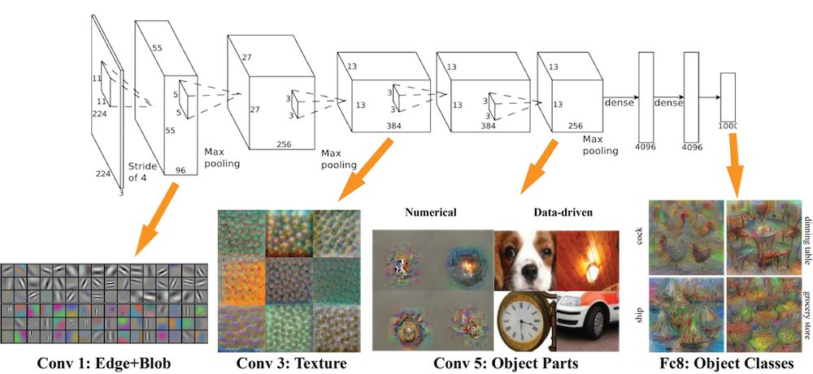
Deep Learning

Slide 28
Empirical Success with Deep Learning
Unsupervised Learning
  Astronomy: Modeling shapes of galaxies
  HEP: Clustering Daya Bay detector events
  Cosmology: Modeling patterns in mass maps
Supervised Learning
  Climate: Predicting extreme weather event types from multi-variate datasets
  Neuroscience: Predicting syllables from spike train data
  Genomics: Predicting genome sequence from raw signals

Slide 29
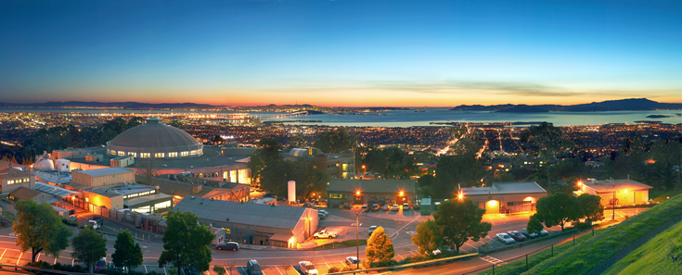
Thanks!
We are hiring:
Big Data Architects
Big Data Engineers
Data Scientists
Post-docs, interns
Contact: prabhat@lbl.gov

