Slide 1
Kristy Kallback-Rose
Senior HPC Storage Systems Analyst
NERSC
Site Update @HPCXXL

Slide 2
Agenda
General Systems and Storage Overview
Current Storage Challenges

Slide 3
Systems & Storage Overview

Slide 4

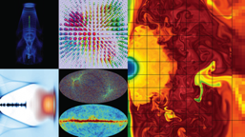
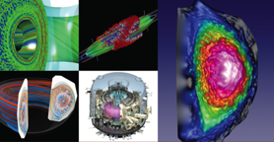
NERSC is the mission HPC computing center for the DOE Office of Science
HPC and data systems for the broad Office of Science community
Approximately 7,000 users and 750 projects
Diverse workload type and size
  Biology, Environment, Materials, Chemistry, Geophysics, Nuclear Physics, Fusion Energy, Plasma Physics, Computing Research
  Single core (not many, but some) to whole system jobs
Notes:
NERSC is a division of Lawrence Berkeley National Laboratory,

Slide 5



NERSC - Resources at a Glance 2018
Edison: Cray XC-30
7.6 PB Local Scratch
163 GB/s
136 GB/s
/project
7.1 PB
DDN SFA12KE
Sponsored Storage
5.1 PB
DDN SFA12KE
16x FDR IB
40 GB/s
5,576 nodes, 133K 2.4GHz Intel “IvyBridge” Cores, 357TB RAM
Cori: Cray XC-40
28 PB Local Scratch
>700 GB/s
275 TB
NetApp 5460
5 GB/s
/home
2PB “DataWarp” I/O Accl. Layer
>1.5 TB/s
HPSS
140 PB stored, 240 PB capacity, 40 years of community data
24 GB/s
2,004 nodes, 64K 2.3GHz Intel “Haswell” Cores, 203TB RAM
9,688 nodes, with 1.4GHz Intel “KNL” Cores, 1PB RAM
32x FDR IB
Data-Intensive Systems
PDSF, JGI, Materials
14x FDR IB
Ethernet &
IB Fabric
Science Friendly Security
Production Monitoring
Power Efficiency
WAN
2 x 10 Gb
2 x 100 Gb
Data Transfer Nodes
Science Gateways
Software Defined
Networking
Notes:
Cori - Heterogeneous compute architecture, installed in 2015-2016.
2004 Dual socket Haswell nodes (32 cores per node at 2.3 GHz)
9,300 Intel Knights Landing compute nodes
68 cores per node
16GB on-package high-bandwidth memory at ~490GB/s
96 GB DRAM
Storage
NVRAM Burst Buffer with 1.6PB of disk and 1.7TB/sec
28 PB of disk, >700 GB/sec I/O bandwidth in Lustre bandwidth
Plans for NERSC-9 Underway
The Burst Buffer is a layer of SSD storage in Cori that sits within the high-speed network.
per-job or "scratch" reservation:
persistent reservation: - Multiple compute jobs can access a persistent reservation, and if the permissions are set appropriately, multiple users as well.
Users have a quota of 50TB on the Burst Buffer.
The burst buffer is not mounted on the login nodes, so it must be accessed via a compute node. If you want to work interactively with the Burst Buffer, you can use the interactive queue
Plans for NERSC-9 Underway

Slide 6

Cori is NERSC’s Newest System
Heterogeneous compute architecture
2004 Dual socket Haswell nodes (32 cores per node at 2.3 GHz)
9,300 Intel Knights Landing compute nodes
  68 cores per node
  16GB on-package high-bandwidth memory at ~490GB/s
  96 GB DRAM
Storage
  NVRAM Burst Buffer with 1.6PB of disk and 1.7TB/sec
  28 PB of disk, >700 GB/sec I/O bandwidth in Lustre bandwidth
Plans for NERSC-9 Underway

Slide 7
File Systems
GPFS
Lustre scratch for Large Compute systems
  Edison: 7.6 PB with 168 GB/s aggregate bandwidth
  Cori: 28 PB with ~700 GB/s aggregate bandwidth
  Periodically purged
GPFS mounted across all compute platforms
  Home Directories: 275 TB, optimized (SSDs) for small files, and high number of I/O operations
  Project directories: 7.1 PB, 4TB/1M inode quota by default. Intended for larger files (SSD for metadata only), streaming I/O, and data that is actively being used. There is no purge policy, however inactive projects may be moved to the tape archive
  Sponsored File System Storage: 5.1 PB on a separate file system, but with the same I/O characteristics as the Project file system (minus SSDs). This is a ‘buy-in’ program for projects that need additional space on disk. Program has a fixed $/TB, and a 5 year service agreement
  GPFS file systems accessible from Cray compute nodes via DVS I/O forwarding

Slide 8
Tape Archive - HPSS
High Performance Storage System (HPSS)
  Developed over >20 years of collaboration among five Department of Energy laboratories and IBM, with significant contributions by universities and other laboratories worldwide.
  archival storage system for long term data retention since 1998
  Tiered storage system with a disk cache in front of a pool of tapes
    On tape: ~140PB PB
    Disk Cache: 4PB
  Contains 40 years of data archived by the scientific community
Data Transfers via transfer client - there is no direct file system interface
  We provide numerous clients: HSI/HTAR (proprietary tools), FTP, pFTP, gridFTP, Globus Online, etc. [VFS is an option which we don’t use]
Notes:
Primary goals for HPSS software
Stability
Performance
Scalability
It is unique in its ability to scale to support HPC workload

Slide 9
Current Storage Challenges

Slide 10
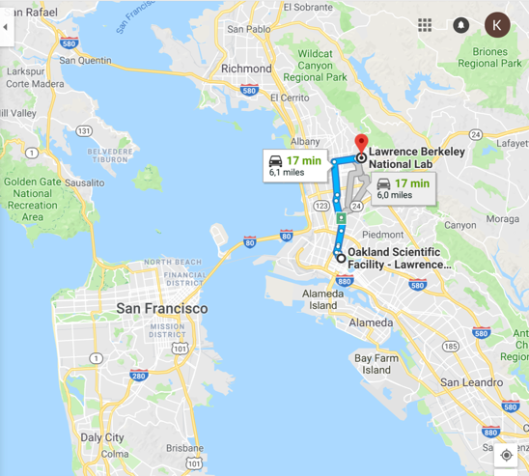
HPSS Archive – Two significant needs
Technology decision
  Discontinued Oracle Enterprise Tape Drive
    4 Fully configured Oracle SL8500 libraries (archive)
    60 Oracle T10KC tape drives (archive)
    1 IBM TS3500 (mainly system backups)
    36 IBM TS1150 tape drives (mainly system backups)
Physical move required
  Oakland to Berkeley (~6 mi/~9 km)

Slide 11
HPSS Archive – Tape Tech Decision
Value in staying with Enterprise drives over LTO
  Keep up with growth rates approaching 2 PB/month (2016-2017); 2018 so far is 3+ PB/month
    Especially, gains from reformatting media at higher density
      E.g. JC Media 4TB capacity with TS1140 drive→7TB with reformat and TS1150/TS1155 drives
  Read-back rate is high ~40%
  Data as old as 40 years, stewardship
Notes:
For enterprise drives now choice of 1…

Slide 12
HPSS Archive – Data Center Constraints
Berkeley Data Center (BDC) is green (LEED Gold)
  Reliance on ambient conditions for year-round “free” air and water cooling
    Intakes outside air, optionally cooled with tower water or heated with system exhaust
    No chillers
  (Ideally) take advantage of:
    <75°F (23.9C) air year round
    <70°F (21.1C)for 85% of year
    RH 10% to 80%, but can change quickly
      Usually more in 30% - 70% range
Space utilization goals and budget constraints make a room-within-a-room a less desirable choice
Notes:
Room within a room much larger foot print.
Eval’d doing colo or other off site options

Slide 13
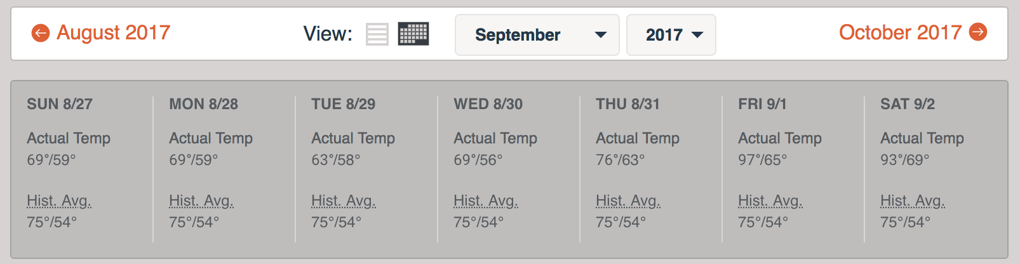
HPSS Archive – Data Center Realities
  And, sometimes it’s too sunny in California
Notes:
Building position with cool air coming in from the bay was a design point for the building and generally this is effiective.

Slide 14
HPSS Archive – Green Data Center Solution
IBM TS4500 Tape Library with Integrated Cooling
  seals off the library from ambient temperature and humidity
  built-in AC units (atop library) keeps tapes and drives within operating spec
Notes:
The Integrated Cooling TS4500 tape libraries to be installed in datacenters where the environmental controls are outside of the normal operating parameters for the tape library.

Slide 15
HPSS Archive – Tech Change
Slide from Lee Jesionowski: https://conference-indico.kek.jp/indico/event/28/session/12/contribution/30/material/slides/0.pdf
Notes:
Some discussions with IBM indicate dips outside of acceptable range are probably OK, as long as they are not prolonged
Red – what can be handled in the room

Slide 16
HPSS Archive – Tech Change
One “Storage Unit” (my term) [Cooling Zone]
  Two S25 frames sandwich, one L25 and one D25 frame
    S25: High-density frame, tape slots (798-1000)
    D25: Expansion frame, drive (12-16), tape slots (590-740)
    L25: Base frame, drive (12-16), tape slots (550-660), I/O station and control electronics (for subsequent libraries no L25)
  Each one of these storage units considered it’s own cooling zone
AC units go atop L and D frames
  Air recirculated, no special filters
  Fire suppression a little trickier, but possible
Notes:
he client must supply drains for air conditioning condensation that will have two drain hoses per air conditioner.
AC goes where top rack would normally be installed:
The top rack, 3584 Model TR1, provides an extra 10U of rack space on any frame in a library without requiring more floor space.
The optional top rack (Figure 1) reduces the storage footprint. It also simplifies cabling by providing extra rack space above the library for power distribution units, Fibre Channel switches, tape data movers, or IBM® Linear Tape File System™ (LTFS) nodes.

Slide 17
HPSS Archive – Tech Change
Slide from Lee Jesionowski: https://conference-indico.kek.jp/indico/event/28/session/12/contribution/30/material/slides/0.pdf

Slide 18
HPSS Archive – Tech Change (CRT)
Each library will be 4 cooling zones
  16 frames
  64 TS1155/3592-55F(FC)/Jag(uar)6 tape drivesf
  ~13,000 tape slots
    JD media @15TB/cartridge
    Capacity 15TB
We’ll install 2 of the above

Slide 19
HPSS Archive – Loose timeline
Now:
½ Disk Cache + ½ of disk movers moved to Berkeley DC (BDC)
  Not yet enabled, just in preparation
This month:
TS4500s w/integrated cooling delivered at BDC
June:
TS4500s w/integrated cooling installed at BDC
Move HPSS core server, remaining disk cache and disk movers to BDC
Enable Writes to new library at BDC
Oakland tapes now read-only [user access, repacks]
Data migrated to BDC via HPSS “repack” functionality
  ~20 Oracle T10KC source drives at Oakland
  ~20 TS1155 destination drives at BDC
  400Gbps Oakland <-> BDC link
2020 (or earlier?) data migration complete
We’re not in Oakland any more, Dorothy.
Notes:
Library install in June due to fire supression install and AC install

Slide 20
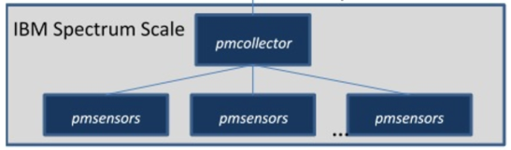
Filesystem Metric Project
Challenge - collect and visualize GPFS filesystem metrics
Exploration of Zimon metrics capabilities with GPFS as of 4.2+
  node designation: perfmon
  Nodes run the pmsensors code collecting performance and system information
    Reporting it to a pmcollector node
      typically the node running the Spectrum Scale GUI
  System metrics and health available via
    Spectrum Scale GUI
    mmperfmon
    mmhealth
    Restful API
    OpenTSDB Bridge + Grafana
Image: https://www.ibm.com/developerworks/community/wikis/home?lang=en#!/wiki/General%20Parallel%20File%20System%20(GPFS)/page/IBM%20Spectrum%20Scale%20Performance%20Monitoring%20Bridge
Notes:
Experimented with SS GUI but prefer flexibility of Grafana option

Slide 21
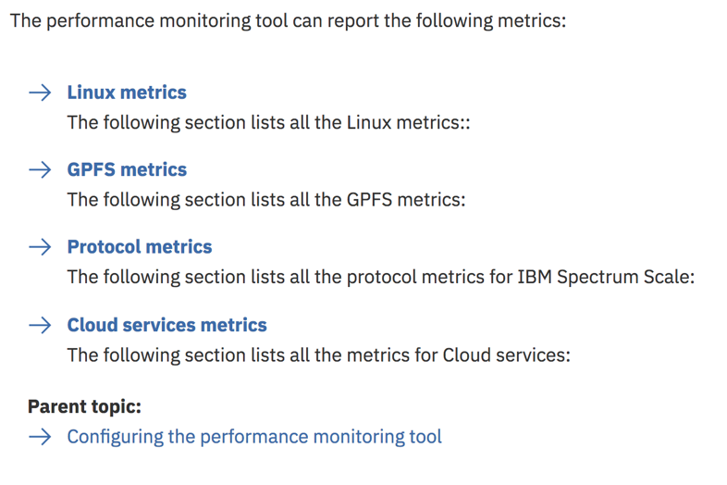
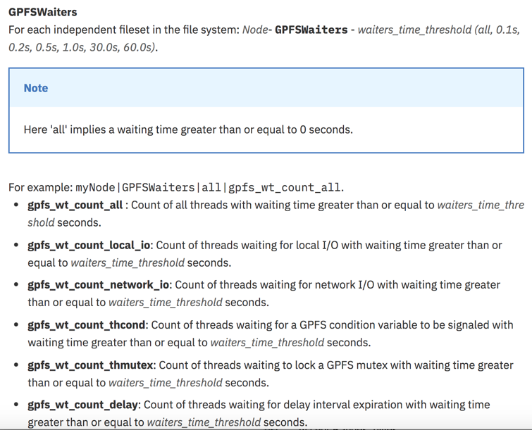
Filesystem Metric Project
LOTS of metrics can be collected, best documented here: https://www.ibm.com/support/knowledgecenter/en/STXKQY_5.0.0/com.ibm.spectrum.scale.v5r00.doc/bl1adv_listofmetricsPMT.htm
Notes:
Need to give thought to which metrics make sense to enable and at what period. Some metrics run infrequently, some only on one node.

Slide 22
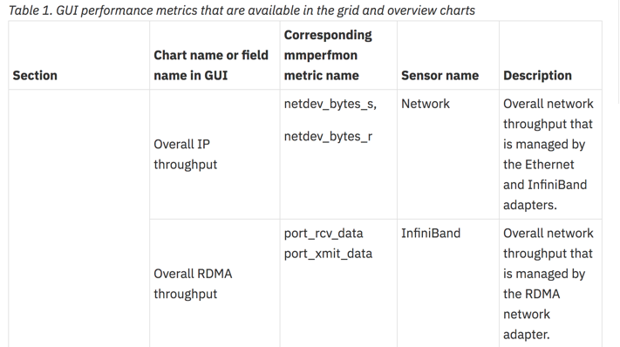
Filesystem Metric Project - Request
Good – but not with other metrics
https://www.ibm.com/support/knowledgecenter/en/STXKQY_5.0.0/com.ibm.spectrum.scale.v5r00.doc/bl1hlp_monnetworksmetrics.htm
Better – mailing list response:
“ZIMon is reporting values obtained from the IB counters (actually, delta values adjusted for time) and that yes, for port_xmit_data and port_rcv_data, one would need to multiply the values by 4 to make sense of them.
To obtain a port_xmit_data value, the ZIMon sensor first looks for /sys/class/infiniband/<ibdev>/ports/<port>/counters_ext/port_xmit_data_64, and if that is not found then looks for /sys/class/infiniband/<ibdev>/ports/<port>/counters/port_xmit_data. Similarly for other counters/metrics.”
Notes:
More details the better.
Define if metric should run on client vs NSD, e.g.
But then I also look here: https://community.mellanox.com/docs/DOC-2751
and see "Total number of data octets, divided by 4 (lanes), received on all VLs. This is 64 bit counter.” So I wasn’t sure if some multiplication by 4 was in order.

Slide 23
Filesystem Metric Project - Request
GPFSDisk For each NSD in the system, for example myMachine|GPFSDisk|myCluster|myFilesystem|myNSD|gpfs_ds_bytes_read
gpfs_ds_bytes_read: Number of bytes read.
GPFSFileSystem For each file system, for example myMachine|GPFSFilesystem|myCluster|myFilesystem|gpfs_fs_bytes_read
gpfs_fs_bytes_read: Number of bytes read.
GPFSFileSystemAPI These metrics gives the following information for each file system (application view). For example: myMachine|GPFSFilesystemAPI|myCluster|myFilesystem|gpfs_fis_bytes_read
gpfs_fis_bytes_read: Number of bytes read.
GPFSNSDDisk These metrics gives the following information about each NSD disk on the NSD server. For example: myMachine|GPFSNSDDisk|myNSDDisk|gpfs_nsdds_bytes_read.
gpfs_nsdds_bytes_read: Number of bytes read.
GPFSNSDFS These metrics gives the following information for each filesystem served by a specific NSD server. For example: myMachine|GPFSNSDFS|myFilesystem|gpfs_nsdfs_bytes_read.
gpfs_nsdfs_bytes_read: Number of NSD bytes read, aggregated to the file system.
GPFSNSDPool These metrics gives the following information for each filesystem and pool served by a specific NSD server. For example: myMachine|GPFSNSDPool|myFilesystem|myPool|gpfs_nsdpool_bytes_read.
gpfs_nsdpool_bytes_read: Number of NSD bytes read, aggregated to the file system.
GPFSNode These metrics gives the following information for a particular node. For example: myNode|GPFSNode|gpfs_ns_bytes_read
gpfs_ns_bytes_read: Number of bytes read.
GPFSNodeAPI These metrics gives the following information for a particular node from its application point of view. For example: myMachine|GPFSNodeAPI|gpfs_is_bytes_read.
gpfs_is_bytes_read: Number of bytes read.
Notes:
More details the better.
Define if metric should run on client vs NSD, e.g. and recommended frequency
Make it easy to know which metrics I’m interested in quickly.
With this many metrics of “bytes_read” a one line description doesn’t differentiate them enough.

Slide 24
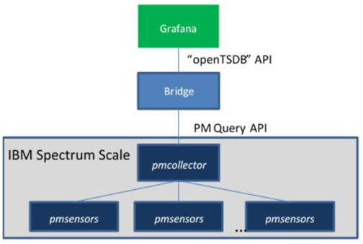
Filesystem Metrics Project
OpenTSDB bridge
a standalone Python application
developed by the IBM Research - Zurich team
translates perfmon data so it can appear to Grafana as an OpenTSDB data source
Bridge documented here: https://www.ibm.com/developerworks/community/wikis/home?lang=en#!/wiki/General%20Parallel%20File%20System%20(GPFS)/page/IBM%20Spectrum%20Scale%20Performance%20Monitoring%20Bridge

Slide 25
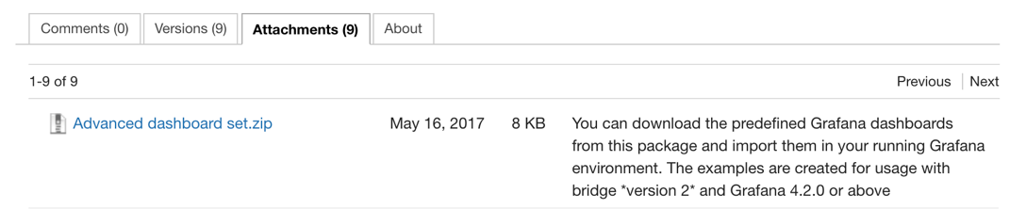
Filesystem Metrics Project
GPFS-specific Grafana Dashboards:
https://www.ibm.com/developerworks/community/wikis/home?lang=en#!/wiki/General%20Parallel%20File%20System%20%28GPFS%29/page/Importing%20predefined%20Grafana%20dashboards
Importantly:

Slide 26
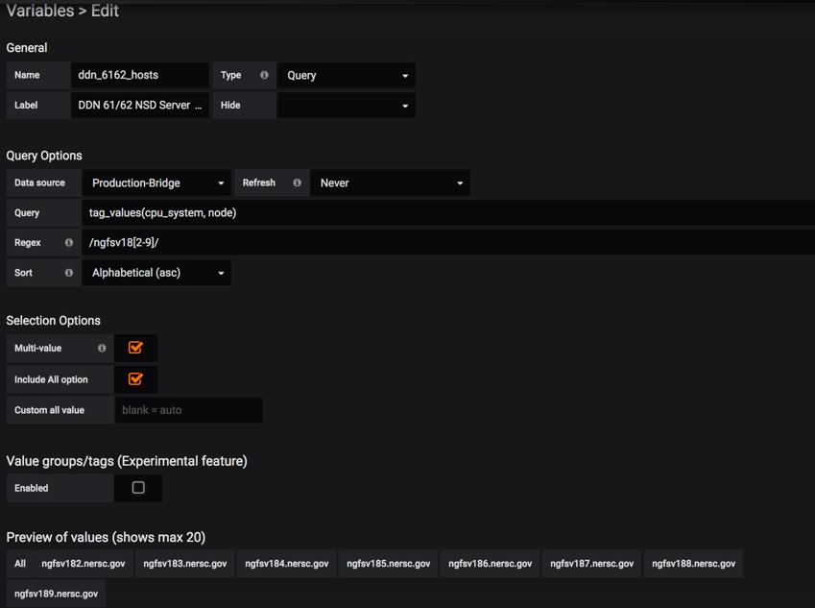
Filesystem Current Projects
Example, metrics for all NSD Servers on DDN12KE:
1) Use Grafana “templating”
Notes:
Use regex to, for example, return values returned

Slide 27
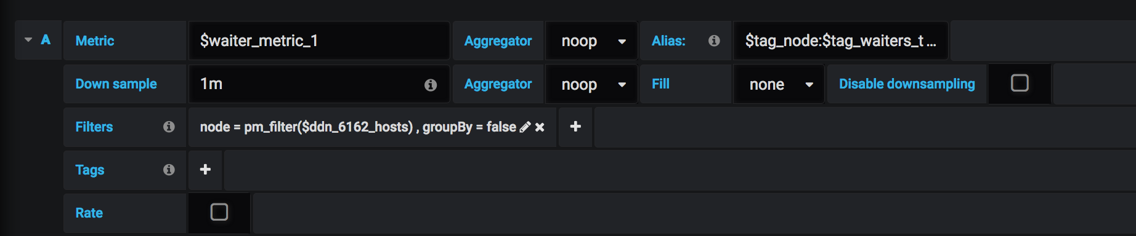
Filesystem Current Projects
2) Use these template variables

Slide 28
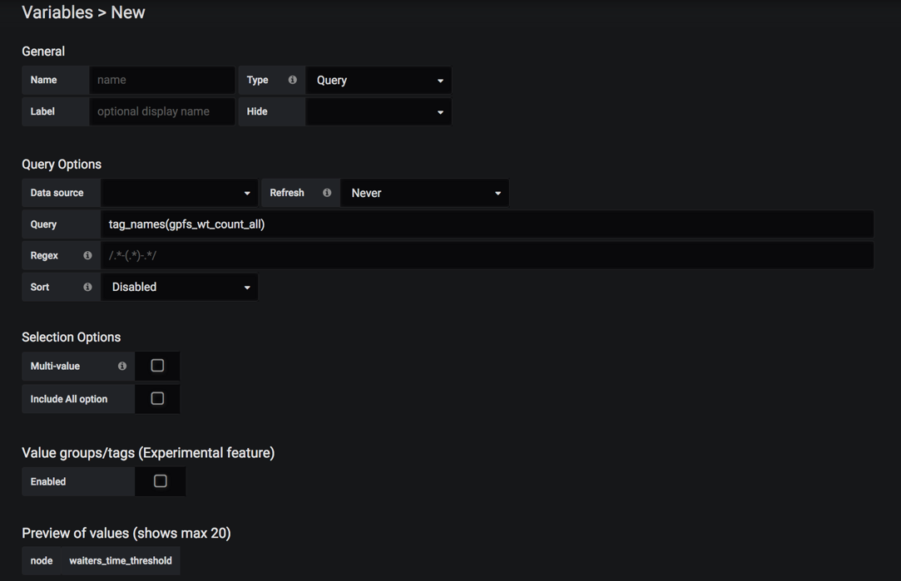
Filesystem Current Projects
2) Determine tag names

Slide 29
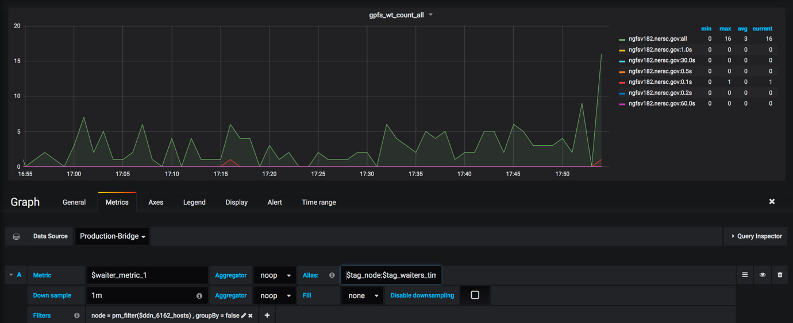
Filesystem Current Projects
3) Use these template variables and tag variables
$tag_node:$tag_waiters_time_threshold
Notes:
Use Noop
Use $tag_ vars

Slide 30
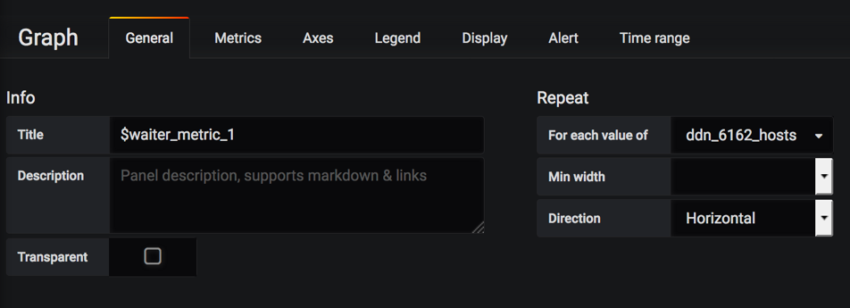
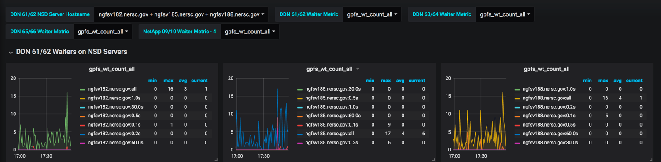
Filesystem Current Projects
4) Repeat for each value of $variable is your friend
Notes:
Graph auto generated for each host you select, or ALL if you choose ALL.

Slide 31
Filesystem Metrics Project – Next Steps
Establish dashboards for one filesytem
  Just about done, focus on server-side metrics
Sanity checks of data we’re collecting
Share dashboards with other teams (systems, infrastructure)
Use this as template to quickly rubber stamp out for other filesystems
Next, setup on GPFS clients, DTNs, etc.

Slide 32
Other Projects – Future Talks?
  GPFS HPSS Integration (GHI)– DMAPI-based integration of GPFS filesystem and HPSS tape archive (DR, Space Management)
  Storage 2020 – Discussion of storage strategy at NERSC looking forward to 2020 and 2025
  https://escholarship.org/uc/item/744479dp

Slide 33
NERSC Storage Team & Fellow Contributors
Right to Left:
Greg Butler
Kirill Lozinskiy
Nick Balthaser
Ravi Cheema
Damian Hazen (Group Lead)
Rei Lee
Kristy Kallback-Rose
Wayne Hurlbert
Thank you. Questions?

Slide 34
National Energy Research Scientific Computing Center

Slide 35
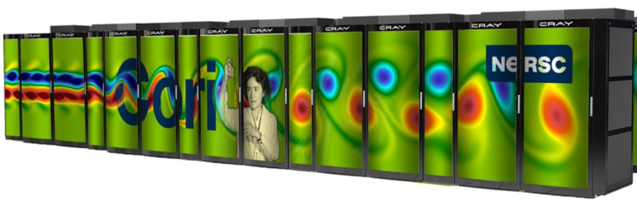
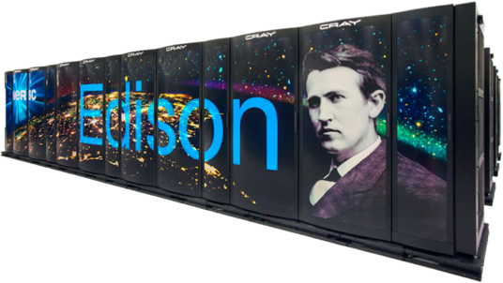
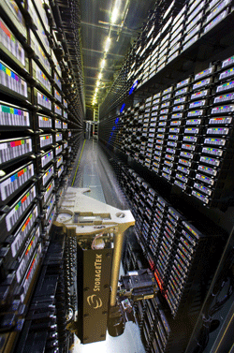
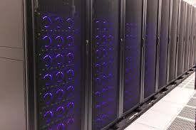
NERSC Resources at a Glance
Cori: 30PFs, 30PB disk
Deployed: 2015/2016
Edison: ~3PFs, 8PB disk
Deployed: 2013
Global File System: 20 PBs
HPSS Archive: ~140 PBs

