Slide 1
Important Note for this Hands-On Workshop
The following training materials were presented for hands-on workshops presented onsite at JGI, and at the JGI Users Meeting in March 2017.
The materials assume access to a Google Cloud Project, which were temporary and may not be available now. Please adjust accordingly!
What you need right now:
Docker installed, updated, and working on your laptop
A Google account
Your laptop connected to the Internet
Access to a Google Cloud Project - a free trial should work, but has not been tested

Slide 2
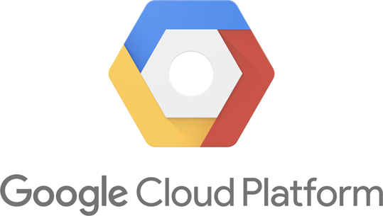
Compute on
with a private
Docker image
Intro
Prerequisites Q&A
Hands-on 1* - Basic Web GUI features
Hands-on 2 - Validate GCE creds on laptop
Hands-on 3 - Run computation in Docker in VM
Hands-on 4 - S3 bucket manipulation (GCS)
Hands-on 5 - Assemble genome in BioBox Docker image
Optional 6 - Bulk data transfer to S3 bucket
Documentation URLs

Slide 3
Prerequisites - summary
Before we get started, you need a Google Cloud account set up, with your account attached to the “JGI User Meeting” Project, and you must have Docker installed and functional.
Requirements:
Access to “JGI User Meeting” project at Google
http://console.cloud.google.com
Check that the right project is selected
Navigate to “Compute Engine”, and verify that you can “Create” a VM Instance
Ability to deploy ubuntu14-google-sdk on your laptop. This will be used to manipulate VMs & Docker images on Google Cloud with a command-line interface (CLI)
Verify that it can connect to the Internet
[laptop]$ $ docker run -it balewski/ubu14-google-sdk
[ubu14-instance]
root@d827a2:/# ping 8.8.8.8 -c 3 # check Ethernet speed
64 bytes from 8.8.8.8: icmp_seq=1 ttl=127 time=3.11 ms
Or
root@d827a2:/# curl http://www.google.com # prints lot of ‘junk’

Slide 4
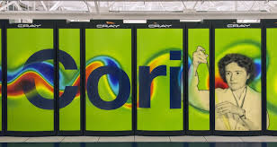
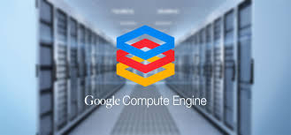
Google Cloud vs. NERSC’s Cori
academic
comercial
 | Cori | Google GCE
Computing power/user | large | unbound
Virtualization support | Only one format: Shifter ~ Docker | Many formats: Docker, VMware, KVM,..
Availability, agility | 90% days, long queue wait (hours,days) | 99.999% days, minute< and you run
User data storage | complimentary | Pay extra
Computing cost | PI takes care of it | Significant long term
Ease of access | Some bureaucracy | Just enter a credit card #, sleep 15
Software availability | large | any, just pay extra
User support | Friendly, competent & outstanding | For a fee

Slide 5
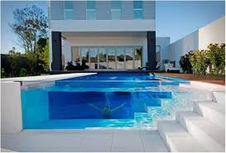
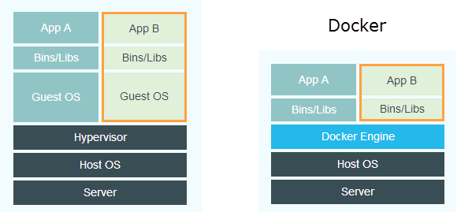
Docker container in 60 seconds
Your image is fully isolated, computations are private
Virtual Machine w/ containers
Boundaries w/o privacy
Your image is meshed with hardware OS, your resources are capped, but computations are public
Hardware controlled by some OS

Slide 6
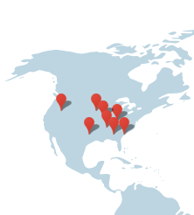
Run Docker image inside VM on Google Cloud
2 Virtual Machine instances run on one Google Cloud blade
Your computation
image
You
other clients do not see you
You’
Docker Hub at some undisclosed location
Google hardware at undisclosed location

Slide 7
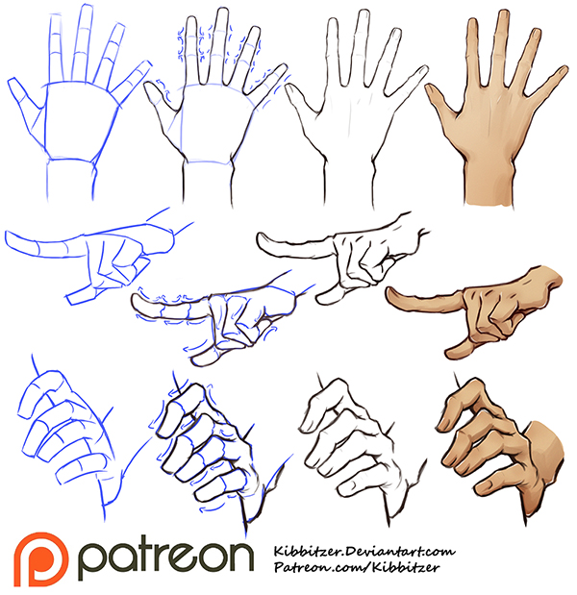
Hands-on Tutorials

Slide 8
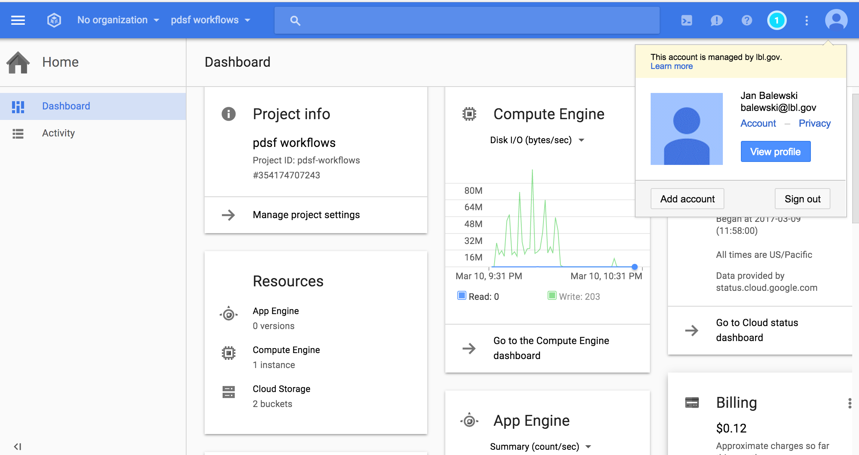
Worksheet 1.1 - GCP Web Dashboard
Go to JGI User Meeting @ GCP: https://console.cloud.google.com
Products & services
Project name
Your Google
account info
Your liability
Cost of research

Slide 9
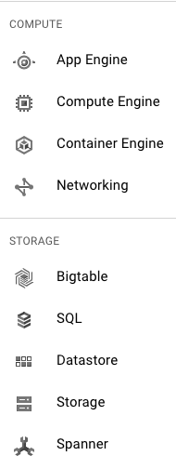
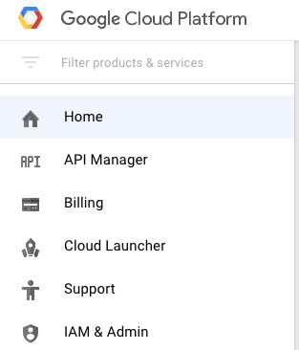
Worksheet 1.2 - ‘Products & Services’
1 VM at a time
Many VMs at once
S3 persistent data

Slide 10
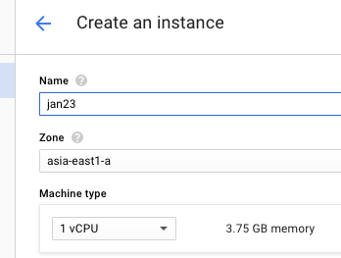
Worksheet 1.3 - Launch/monitor/kill VM
1.create
5. terminate
4.Wait, then fire console connecting to running VM
See previously
Launched VMs
2. set VM a name:
E.g. your first name+integer
3.Launch your VM

Slide 11
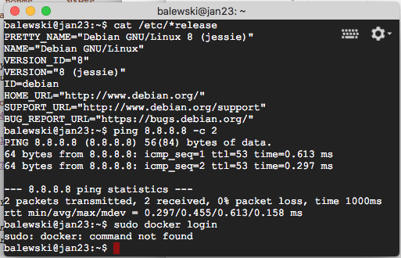
Worksheet 1.4 - execute task inside VM
Virtual Machine
Your Debian VM instance is fully isolated, computations are private
You
Your Debian VM:
Ping 8.8.8.8 has internet access
No Docker software - bad
Hardware controlled by some OS not visible for you

Slide 12
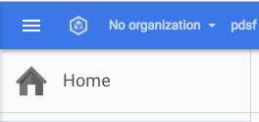
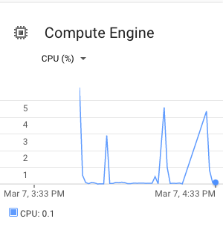
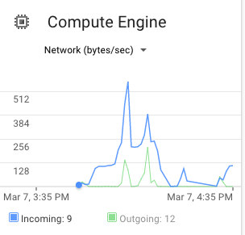
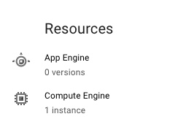
Worksheet 1.5 - Monitor load on VM
5% CPU use → very wasteful
Some data are copied in/out
1 VM is still running and generating cost - wasteful

Slide 13
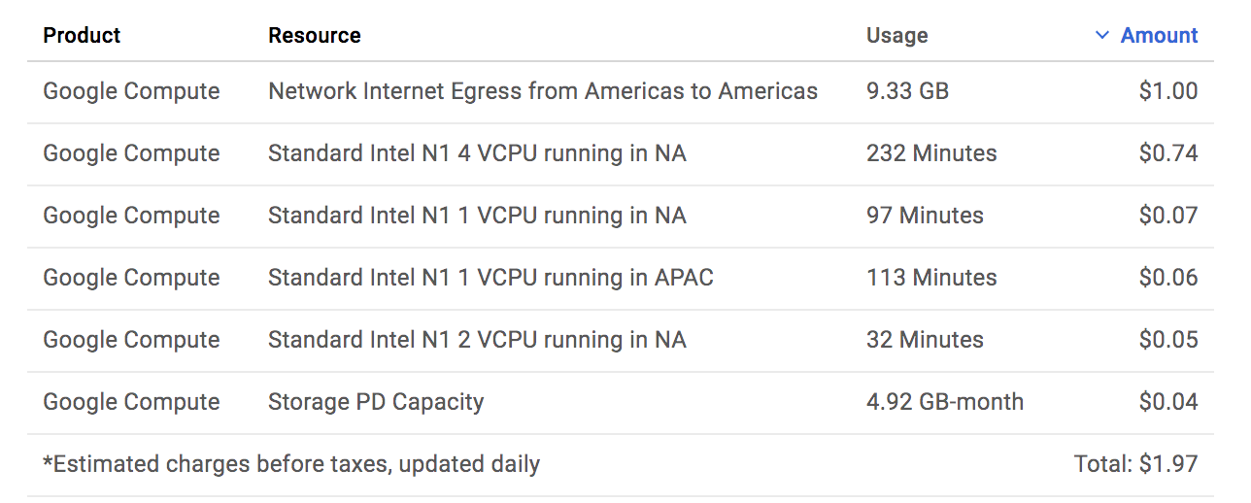
Billing example

Slide 14
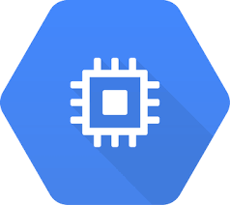
Are you ready for ‘level 4’ experience?
$ cat /etc/*release
1
2
5
3
4

Slide 15
Hands-on Tutorials 2-6
Earn your Google-Master points
Hands-on 2- validate GCE creds on laptop (10 min - 1pt)
Hands-on 3 - run computation in Docker in VM (30 min - 3 pt)
Hands-on 4 - S3 bucket manipulation (GCS) (8 min - 1 pt)
Hands-on 5 - assemble genome in Docker BioBox (10 min - 2 pt)
Optional 6 - Bulk data transfer to S3 bucket (15 min - 1 pt)
View worksheets https://goo.gl/VqAAKh
OR
git clone https://bitbucket.org/balewski/tutorNersc
cd tutorNersc/2017-03-google-gce

Slide 16
Hands-on 2 : Validate GCE creds on your laptop
(10 min - 1pt)
Docker Hub
image repository
Google Cloud
balewski/
google-sdk
Your
GCE
cert
Hands-on tinyURL https://goo.gl/VqAAKh
private/
google-sdk

Slide 17
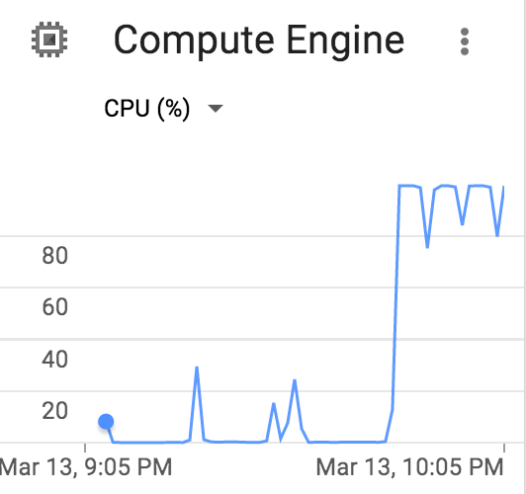
Hands-on 3(5) : run computation in Docker in VM
(30 min - 3pt)
Docker Hub
image repository
Google Cloud
4 vCore VM @GCE
balewski/
ubu-condor
ubu-condor
900GB
User code
vet3.cxx
GCE
cert
personal/
google-sdk

Slide 18
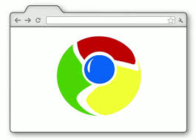
Hands-on 4 : S3 bucket manipulation (GCS)
(8 min - 1pt)
GCS
persistent
storage
Google
Cloud
Inspect manipulate
User
Local data
gs://yourName-tanker22
personal/
google-sdk
GCE
cert

