Slide 1
Clayton Bagwell
NERSC Account & Allocations Support
NIM Development Team
Oakland Scientific Facility
May 14, 2015
Allocating Fixed Hours to Users Instead of Repo Percentage in NIM

Slide 2
Background
The original model for allocating time to users within a repository has been to allow them access to a percentage of the repo’s total allocation.
  This meant that the number of hours a user could access would fluctuate with the changes to a repo’s allocation
Many of our PIs have requested the ability to allocate a fixed number of hours to their users.
On April 15th, the NIM Development Team released modifications to NIM to accommodate Fixed Hour Allocations.

Slide 3
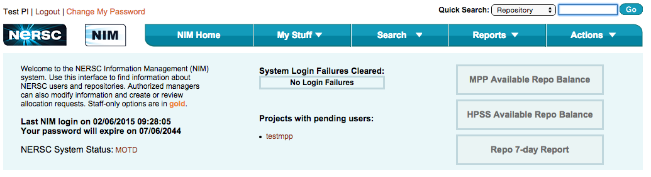
User Requests an Account
New user submits an account request
PIs and Proxies get email notification and reminder upon logging into NIM

Slide 4
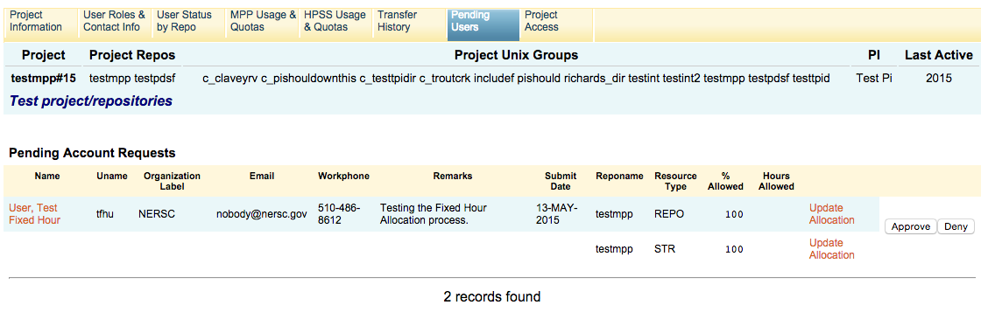
Pending Users tab info
Clicking on the reponame takes you to the Pending Users tab for the project

Slide 5
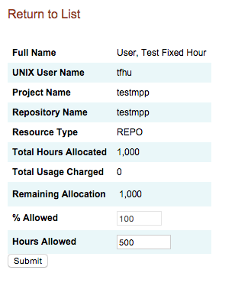

Updating Allocation before Approval
You can either adjust the % Allowed or enter a value for Hours Allowed

Slide 6
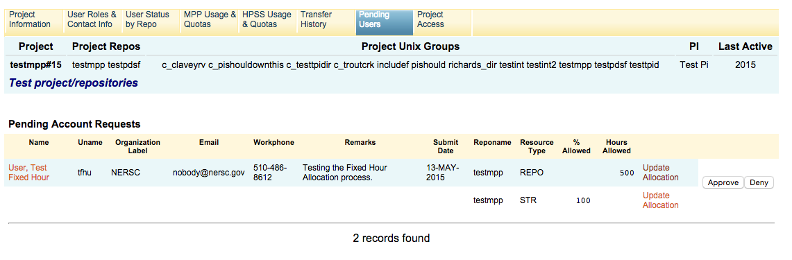
Approve Account Request
Clicking Return to List takes you back to the Pending Account Requests where you can now approve the account

Slide 7
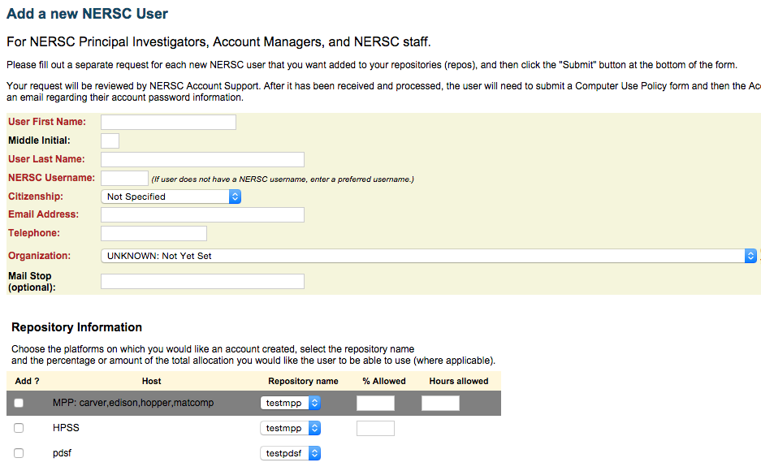
Manually Adding a User to Your Repo
When you use Add/Revive User to add a user to your repo, you can allocate either by % Allowed or Hours Allowed

Slide 8
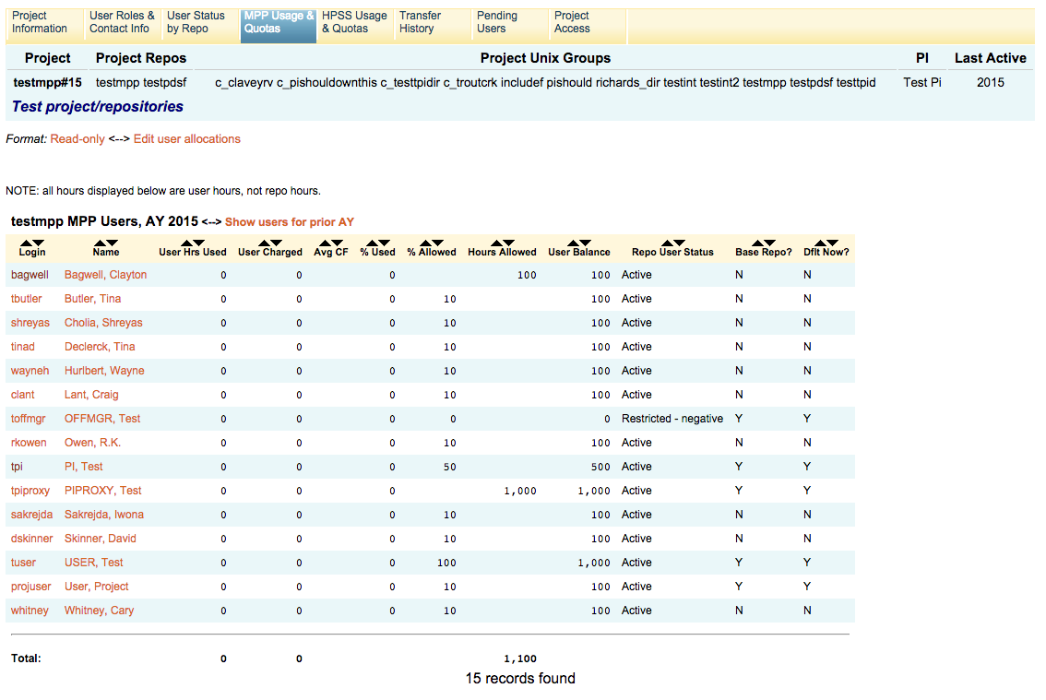
Allocating to Existing Users
You can set or adjust Fixed Hours for existing users through the MPP Usage & Quotas tab

Slide 9
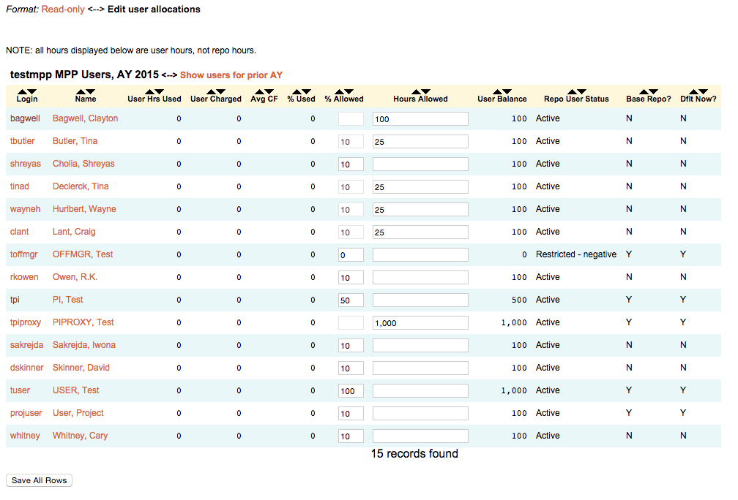
Adjusting User Allocations
Click on the Edit user allocations link, enter new % Allowed or Hours Allocated values, click on Save All Rows

Slide 10
Instructions in the NIM User’s Guide for PIs
You can find detailed instructions in the NIM Guide for PIs and Project Managers
http://www.nersc.gov/users/accounts/nim/nim-guide-for-pis/

Slide 11
Thank you.

