Slide 1
Transition from Edison to Cori KNL
How to compile and run on KNL
Zhengji Zhao
User Engagement Group
Edison to KNL User Training
December 12, 2018

Slide 2
Edison is scheduled to be retired on March 31, 2019
Edison is scheduled to be retired on March 31, 2019

Slide 3
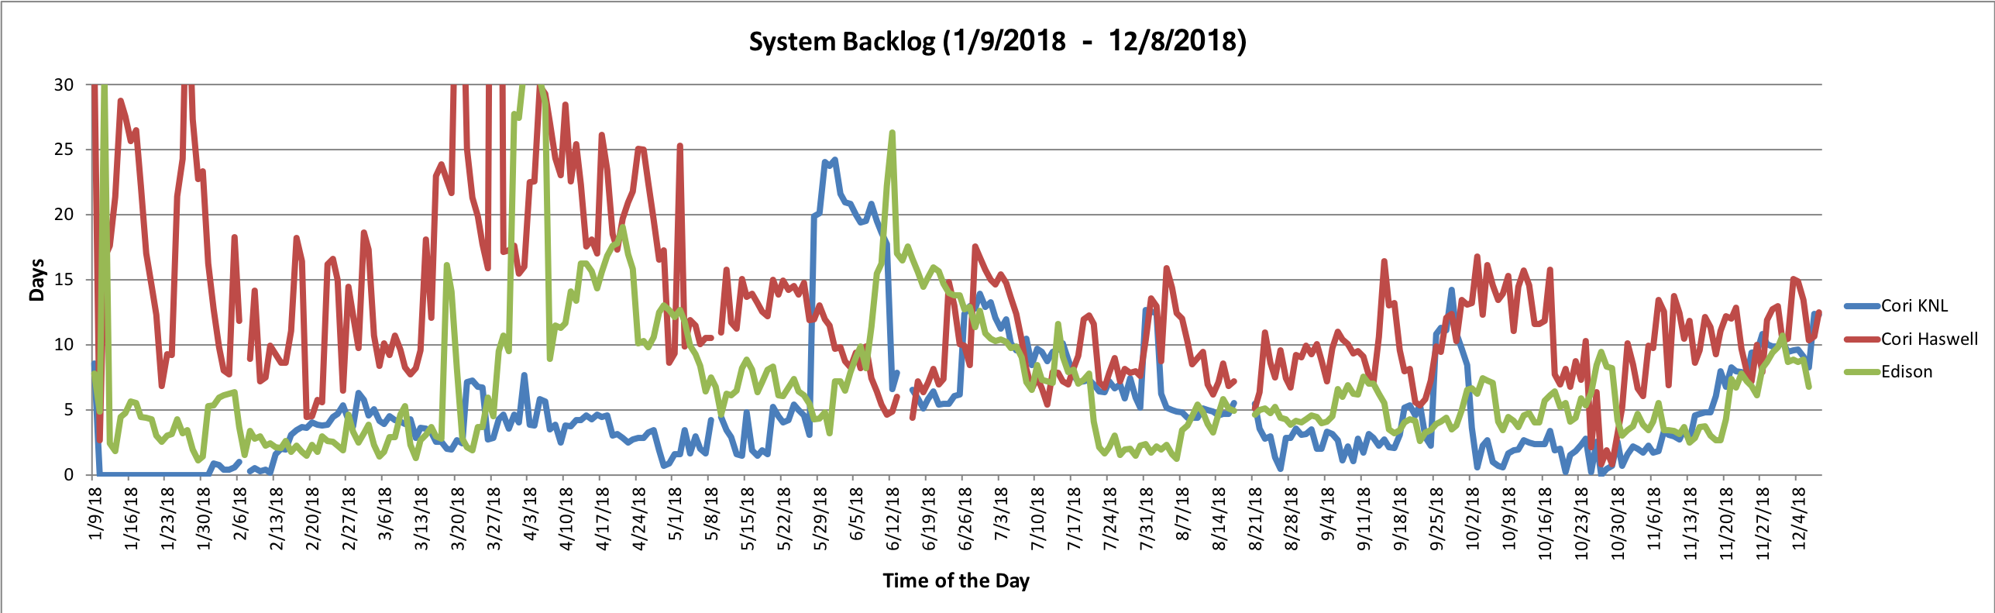
System Backlogs
For a better queue turnaround, we recommend Edison users transit to KNL.

Slide 4
Agenda
Presentation:
  Difference between Edison and Cori KNL (5min)
  How to compile for KNL (10min)
  How to run on KNL nodes (15min)
  Variable-time jobs (5min)
  Q/A (5min)
Hands-on
  Introduction (5min)
  Hands-on (1h 45min, ends at 11:30am)
Optional Hands-on (11:30am-3:30pm)

Slide 5
Difference between Edison and Cori KNL

Slide 6
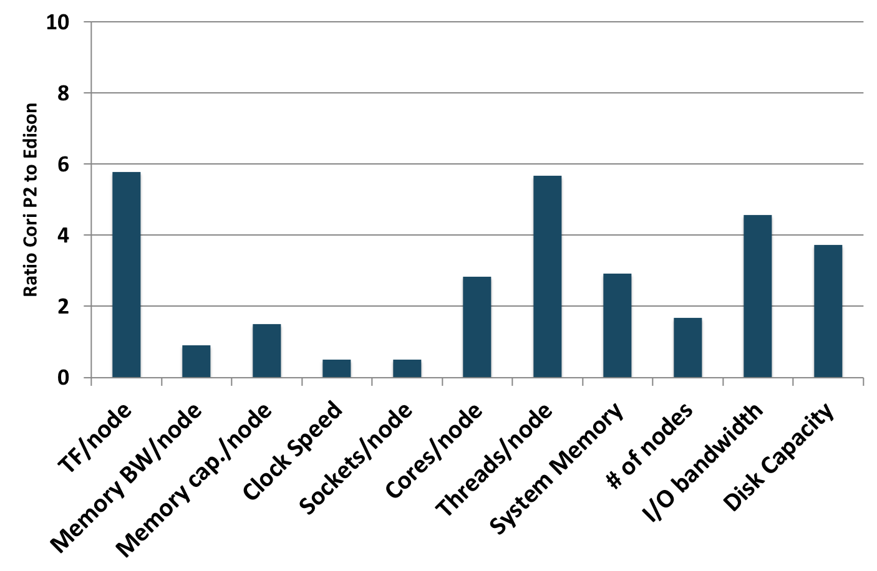
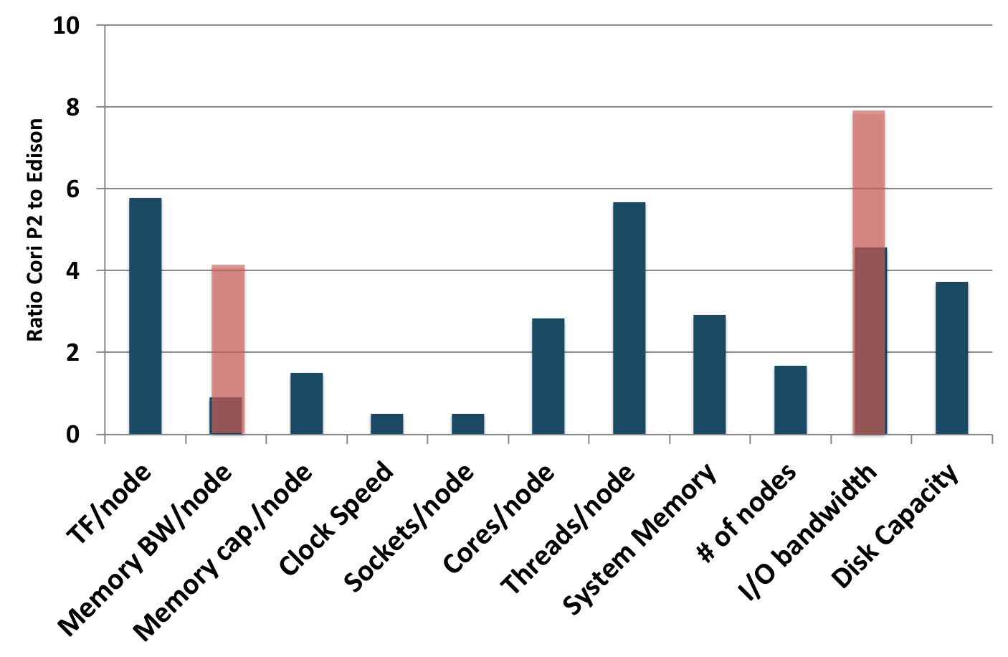
Configuration comparison between Edison and Cori KNL
1
 | Cores/node | Threads/node | Socket/Node | Memory (DDR + HBM)/node (GB) | Memory/Core (GB) | Clock speed (GHz)
Edison | 24 | 48 | 2 | 64 | 2.67 | 2.4
Cori KNL | 68 | 272 | 1 | 96 + 16 | 1.4 +0.24 | 1.4
Cori Haswell | 32 | 64 | 2 | 128 | 4.0 | 2.3

Slide 7
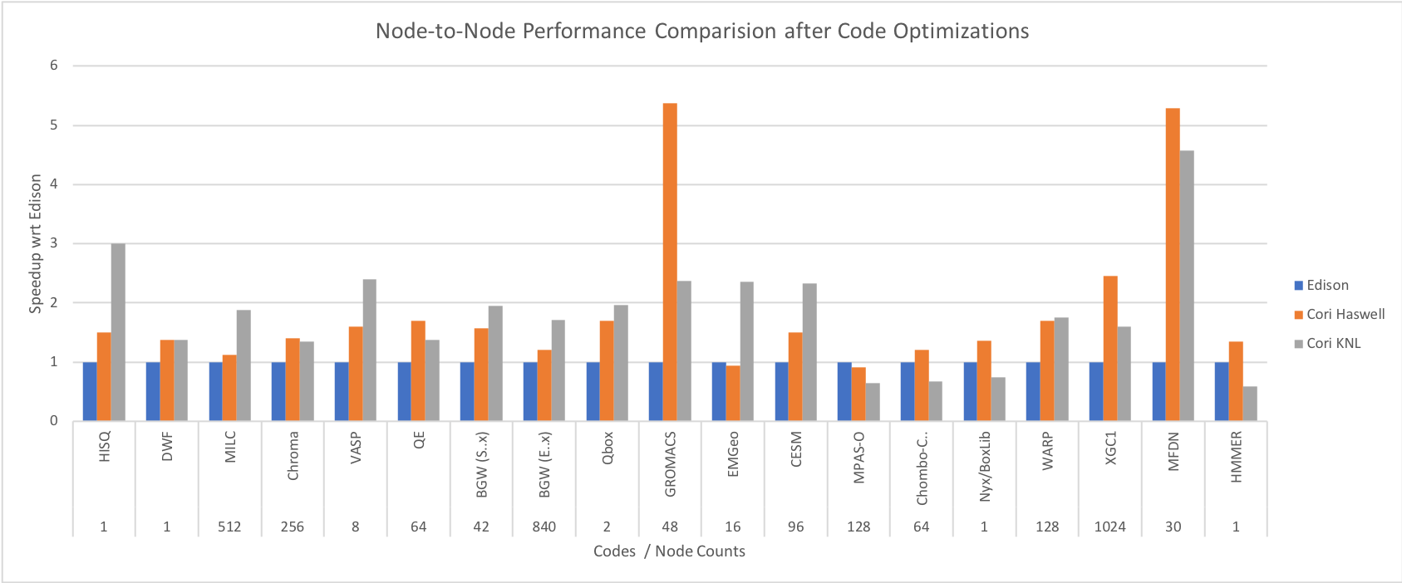
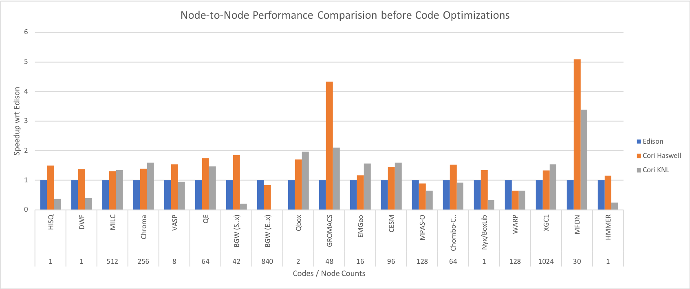
NESAP Code Performance before/after Optimizations
Notes:
Need a summary statement

Slide 8
Charging
 | Machine Charge factor (NERSC hours)
Edison | 48
Cori KNL | 96
Cori Haswell | 80
Machine charge factor: the charge per node hour used
Charging = <run time (hour) > * <node counts> * <machine charge factor> * <QOS charge factor>
Your application needs to be at least twice as fast on KNL when using the same number of nodes, or at most 33% slower than Edison when using the same core counts.

Slide 11
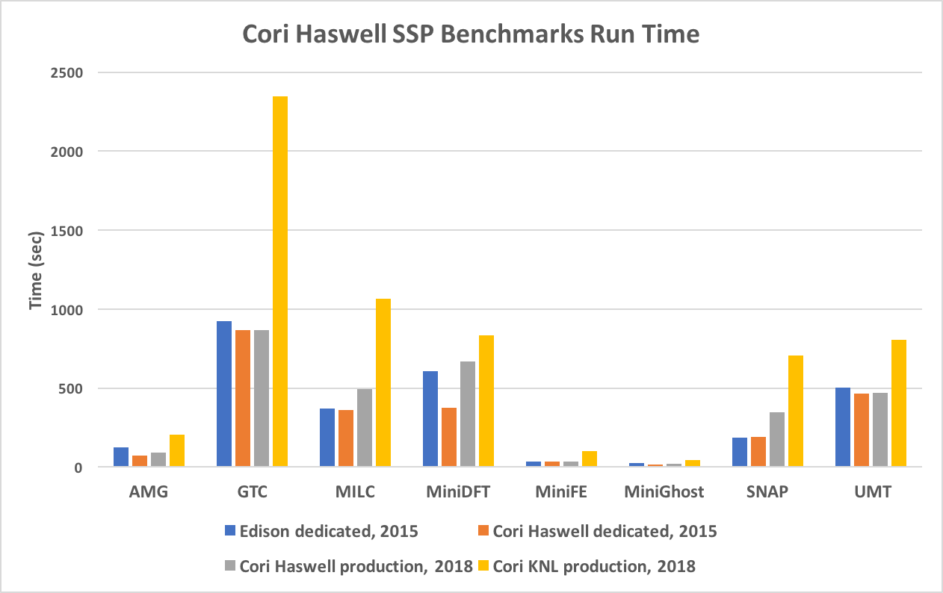
Slide from Helen He

Slide 12
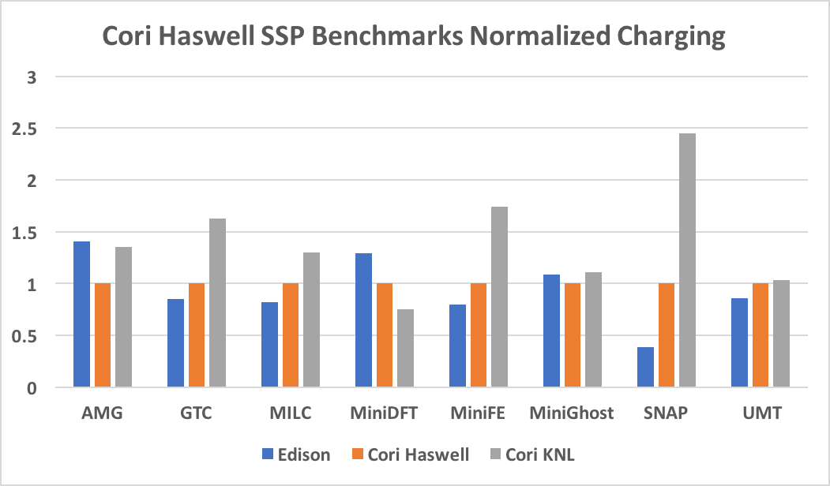
Slide from Helen He

Slide 13
What would be the expected performance of your applications?

Slide 14
How to compile for KNL

Slide 15
Binary compatibility
Build system | Edison | Cori Haswell | Cori KNL
Edison | ✅ | ✅ | ✅
Cori Haswell |  | ✅ | ✅
Cori KNL |  |  | ✅
  Edison binaries runs on Cori Haswell, and KNL; Haswell Binaries run on KNL
  We recommend a separate build for each platform for optimal performance.

Slide 16
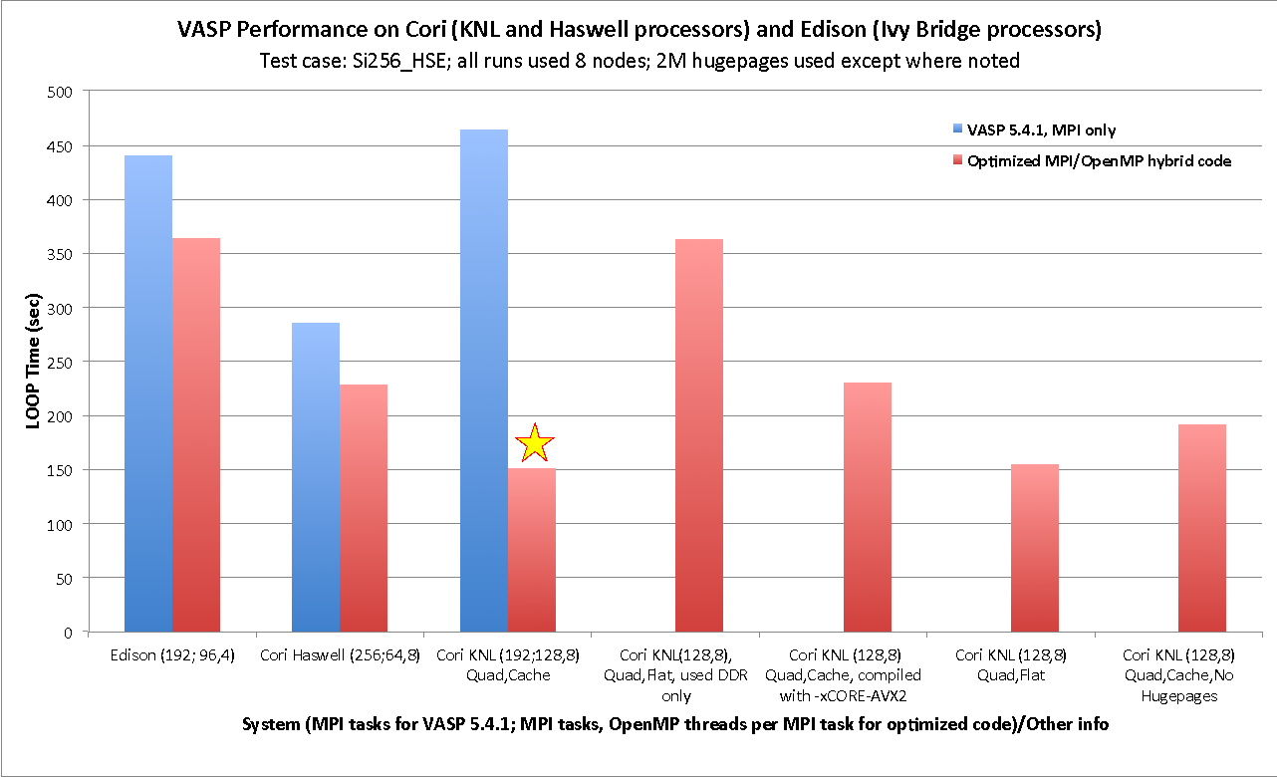
VASP built with the –xMIC-AVX512 flag runs 35% faster than built with the –xCORE-AVX2 flag on Cori KNL.
Building your application separately for each platform could be important to get optimal performance.

Slide 17
We will talk about only
Compilation for Cori KNL nodes
Compile/link lines
Compiler +
Compiler Flags +
–I/path/to/headers +
–L/path/to/library –l<library>
Available compilers, libraries, etc.
Users will need to apply these info to their build systems.

Slide 18
Compilations on Cori and Edison are very similar
Three programming environments are supported
  Intel, GNU and Cray compilers are available on Cori. Intel is the default.
  PrgEnv-intel, PrgEnv-gnu, and PrgEnv-cray loads the corresponding programming environment which includes the compilers and matching libraries.
  Using module swap PrgEnv-Intel PrgEnv-cray to swap programing environment.
  Unlike Edison, Cori has two types of compute nodes, Haswell, and KNL, and applications are compiled for both Haswell and KNL nodes on the login nodes (Haswell nodes).

Slide 19
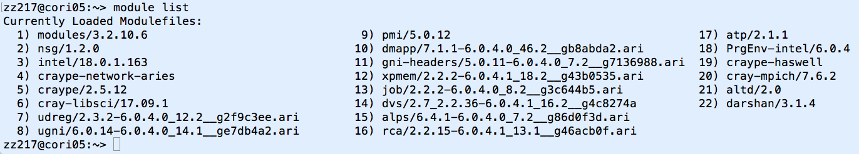
Compilations on Cori and Edison are very similar
  Cori default environment loads craype-haswell module, which sets the env CRAY_CPU_TARGET to haswell
  Compiler wrappers, ftn, cc and CC, are recommended instead of the native compiler invocations.
  Default programming environment on Cori:

Slide 20
Compiler recommendations
Will not recommend any specific compiler
  Intel - better chance of getting processor specific optimizations, especially for KNL
  Cray compiler – many new features and optimizations, especially with Fortran; useful tools like reveal work with Cray compiler only
  GNU - widely used by open software
Start with the compilers that vendor/code developers used so to minimize the chance to hit the compiler and code bugs, then explore different compilers for optimal performance.

Slide 21
Compiler flags
Validity check after compilation
Compilers’ default behavior could vary between compilers
  Default number of OpenMP threads used is all CPU slots available for Intel and GNU compilers; 1 for Cray compiler.
Intel | GNU | Cray | Description/ Comment
-O2 | -O0 | -O2 | default
default , or –O3 | -O2 or -O3,-Ofast | default | recommended
-qopenmp | -fopenmp | default, or –h omp | OpenMP
-g | -g | -g | debug
-v | -v | -v | verbose

Slide 22
Compiler wrappers, ftn, cc and CC, are recommended
Use ftn, cc, and CC to compile Fortran, C and C++ codes, respectively, instead of the underlying native compilers, such as ifort, icc, icpc, gfortran, gcc, g++, etc.
  The compiler wrappers wraps the underlying compilers with the additional compiler and linker flags depending on the modules loaded in the environment
  The same compiler wrapper command (e.g. ftn) is used to invoke any compilers supported on the system (Intel, GNU, Cray)
Compiler wrappers do cross compilation
  Compiling on login nodes to run on compute nodes

Slide 23
Compiler wrappers, ftn, cc and CC, are recommended
  Use the –host=x86_64 configure option when compiling for KNL from a login node
  To compile on a KNL node, do salloc –N 1 –q interactive –C knl –t 4:00:00 to get on a compute node
Compilers wrappers link statically by default
  Preferred for performance at scale
Use –dynamic or set an environment variable CRAYPE_LINK_TYPE=dynamic to link dynamically
  A dynamically linked executable may take a some time to load shared libraries when running with a large number of processes

Slide 24
Why compiler wrappers?
They include the architecture specific compiler flags into the compilation/link line automatically.
They automatically add the header and library paths and libraries on the compilation/link lines
  Compiler wrappers use the pkg-config tools to dynamically detect paths and libs from the environment (loaded cray modules and some NERSC modules)
  The architecture specific builds of libraries will be linked into
Yet allow user provided options to take the precedence
 | Intel*) | GNU | Cray | Module
Cori KNL | -xMIC-AVX512 | -march=knl | -h cpu=mic-knl | craype-mic-knl
Cori Haswell | -xCORE-AVX2 | -march=core-avx2 | -h cpu=haswell | craype-haswell
Edison Ivy Bridge | -xCORE-AVX-I | -march=corei7-avx | -h cpu=ivybridge | craype-ivybridge
*) for the latest Intel compilers, -march=knl,haswell,ivybridge can be used instead of –xcode.

Slide 25
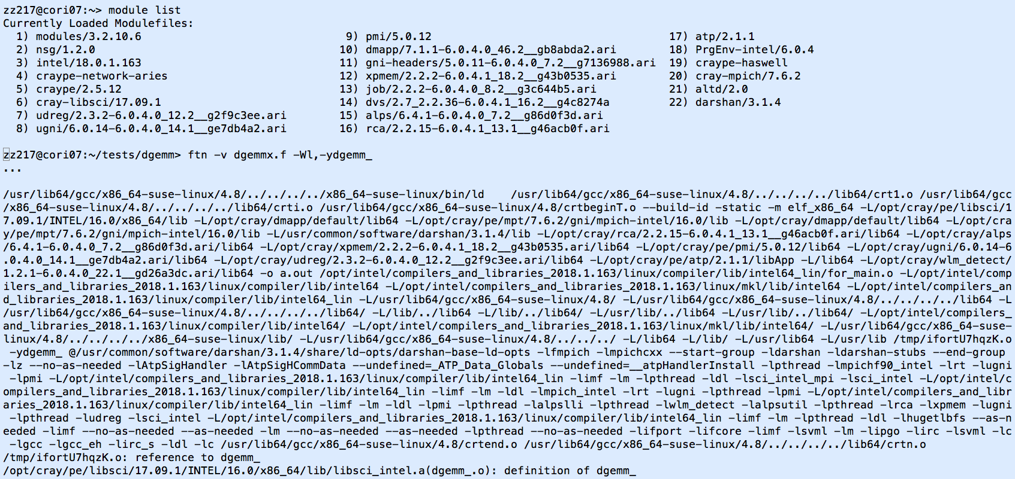
What do compiler wrappers link by default?
Depending on the modules loaded, compiler wrappers link to the MPI, LAPACK/BLAS/ScaLAPACK libraries, and more automatically
Library names could be different from what you used before

Slide 26
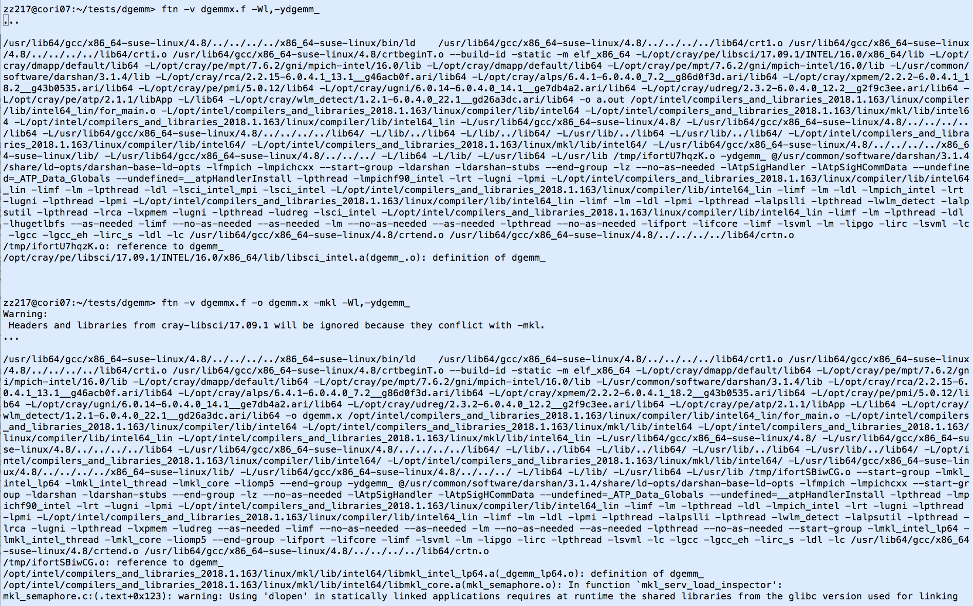
More on the verbose output from compiler wrappers
Note, -Wl,--start-group … -Wl,--end-group for static linking

Slide 27
To compile for KNL
do module swap craype-haswell craype-mic-knl before compiling for Cori KNL nodes
  module swap craype-haswell craype-mic-knl
  ftn –O3 mycode.f90. # Fortran:
  cc –O3 mycode.c # for C
  CC –O3 myC++code.C. # for C++

Slide 28
Available libraries
Cray supports many software packages – Cray Developer Toolkits (CDT)
  Access via modules, type “module avail” or “module avail –S” to see the available modules
  There are different builds for different compilers
  Programming environment modules allow the libraries built with the matching compilers to be linked to
NERSC also supports many libraries
  Many of them interact with the Cray compiler wrappers while some of them do not.
Where are the libraries ?
  Use “module show <module name> “ to see the installation paths

Slide 29
Examples of linking to the Cray provided libraries
Linking to Cray MPI and Cray Scientific libraries are automatic by default if compiler wrappers are used
    CC parallel_hello.cpp or ftn dgemmx1.f90
Linking to HDF5 and NETCDF libraries are automatic, user just need to load the cray-hdf5 or cray-netcdf modules
module load cray-hdf5; cc h5write.c
  Note The library name could be different. Using the –v option to see the library names and other details link line information.

Slide 30
Examples of linking to the Cray provided libraries
Linking to PETSc libraries are automatic, but users need to choose a proper module (real/complex,32/64 bit integer)
  E.g., module load cray-petsc-complex-64
  Use cc –v test1.c to see the linking detail
Linking to fftw libraries – fftw 3 is the default
  module load cray-fftw
  Loading the cray-fftw module always links to the pthread version of the library, -lfftw3f_mpi -lfftw3f_threads -lfftw3f -lfftw3_mpi -lfftw3_threads -lfftw3, to link with OpenMP implementation, need to manually provide the libraries.

Slide 31
Examples of linking to the NERSC provided library modules
Some of the NERSC provided modulefiles are written to be recognized by the compiler wrappers, e.g., elpa module on Cori
    module load elpa
    ftn –qopenmp –v test2.f90 # this will automatically link to elpa and MKL ScaLAPACK libraries
  Type module show <module name> to check if the envs <libname>_PKGCONFIG_LIBS, PE_PKGCONFIG_PRODUCTS, and PKG_CONFIG_PATH are defined in the modulefile, which compiler wrappers look for.
Most of the NERSC provided modulefiles do not interact with the compiler wrappers, user need to provide the include path and library path and libraries manually, e.g. GSL
    module load gsl; ftn test3.f90 $GSL
  GSL is set as -I/usr/common/software/gsl/2.1/intel/include -L/usr/common/software/gsl/2.1/intel/lib -lgsl -lgslcblas

Slide 32
Linking to Intel MKL library
Resource:
  Intel® Math Kernel Library Link Line Advisor, https://software.intel.com/en-us/articles/intel-mkl-link-line-advisor/
  Learn from Intel compiler verbose output, -mkl={parallel,sequential,cluster}
For intel compiler, use –mkl flag
  ftn test1.f90 –mkl # default to parallel –multi-threaded lib
  The loaded cray-libsci will be ignored if –mkl is used.
For GNU compiler (e.g., to link to 32-bit integer build):
  Save the MKLROOT from the Intel compiler module, and then
  Threaded: -L$MKLROOT/lib/intel64 –Wl,--start-group -lmkl_gf_lp64 -lmkl_gnu_thread -lmkl_core -liomp5 -Wl,--end-group –lpthread –lm –ldl
  ScaLAPACK: -L$MKLROOT/lib/intel64 -Wl,--start-group -lmkl_gf_lp64 -lmkl_gnu_thread -lmkl_scalapack_lp64 -lmkl_blacs_intelmpi_lp64 -lmkl_core -Wl,--end-group -lgomp –lpthread –lm -ldl
  Note that mkl modules could be out-dated

Slide 33
Linking to Intel MPI library – Use native compilers
Cray MPICH libraries are recommended for performance especially at scale.
Compiler wrappers links to Cray MPICH libraries.
However, if you need to link to Intel MPI library, do
    module load impi
    mpiifort test1.f90
  Note that the binaries linked to the Intel MPI need to run with srun instead of mpirun to get a proper process/thread affinity, http://www.nersc.gov/users/computational-systems/cori/running-jobs/advanced-running-jobs-options/#toc-anchor-6
  Native Intel compilers link dynamically

Slide 34
Summary
Use compiler wrappers where possible, they
  add architecture specific optimization flags
  link to the Cray MPI and LibSci libraries and other Cray provided libraries
Use available libraries where possible
  Use module show <module name> to see the installation paths if needed
To compile for Cori KNL, do
    module swap craype-haswell craype-mic-knl
    Then compile as you would for Edison.
Learn from the compiler verbose output (-v)

Slide 35
How to Run jobs on KNL

Slide 36
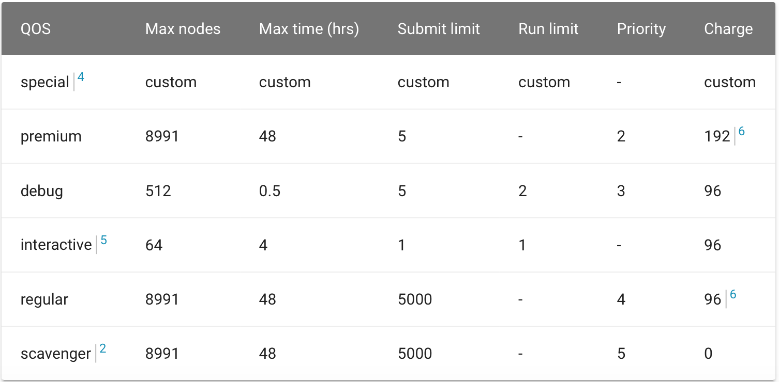
Cori KNL Queue Policy (as of Nov 2018)
Jobs use 1024+ nodes on Cori KNL get 20% charging discount
“interactive” qos available on Cori Haswell and KNL, job starts immediately or get canceled in 5 minutes, up to 64 nodes on Cori per repo
“bigmem” available on Cori (run on external login nodes)

Slide 37
Difference between Edison and Cori KNL
 | Cores/node | Threads/node | Socket/Node | Memory (DDR + HBM)/node (GB) | Memory/Core (GB) | Clock speed (GHz)
Edison | 24 | 48 | 2 | 64 | 2.67 | 2.4
Cori KNL | 68 | 272 | 1 | 96 + 16 | 1.4 +0.24 | 1.4
Cori Haswell | 32 | 64 | 2 | 128 | 4.0 | 2.3
KNL has a lot more (slower) cores on the node
A much reduced per core memory

Slide 38
Interactive batch job on KNL nodes
Edison:
salloc -N 2 –q debug –t 30:00
Cori KNL:
  salloc -N 2 –q debug –t 30:00
  salloc -N 2 –q interactive –t 4:00:00 -C knl
Use of interactive queue is highly recommended!

Slide 39
Sample job script to run a MPI job
Edison:
#!/bin/bash -l
#SBATCH –N 2
#SBATCH –q regular
#SBATCH –t 1:00:00
#SBATCH –L SCRATCH
srun –n 48 ./a.out
#or srun –n48 –c2 --cpu_bind=cores ./a.out
Cori KNL:
#!/bin/bash -l
#SBATCH –N 1
#SBATCH -C knl
#SBATCH –q regular
#SBATCH –t 1:00:00
#SBATCH –L SCRATCH
srun –n68 -c4 --cpu_bind=cores ./a.out

Slide 40
Sample job script to run an MPI + OpenMP code
#!/bin/bash -l
#SBATCH –N 1
#SBATCH –q regular
#SBATCH –t 1:00:00
#SBATCH -C knl
export OMP_PROC_BIND=true
export OMP_PLACES=threads
export OMP_NUM_THREADS=4
#running 1 task/core
srun –n16 –c16 --cpu_bind=cores ./a.out
#!/bin/bash -l
#SBATCH –N 1
#SBATCH –q regular
#SBATCH –t 1:00:00
#SBATCH -C knl
export OMP_PROC_BIND=true
export OMP_PLACES=threads
export OMP_NUM_THREADS=4
#running 2 tasks/core
srun –n32 –c8 --cpu_bind=cores ./a.out
In the examples above, 64 cores out of 68 are used.

Slide 41
Sample job script to run an MPI + OpenMP code
#!/bin/bash -l
#SBATCH –N 2
#SBATCH –q regular
#SBATCH –t 1:00:00
#SBATCH -C knl
export OMP_PROC_BIND=true
export OMP_PLACES=threads
export OMP_NUM_THREADS=4
srun –n32 –c16 --cpu_bind=cores ./a.out
#!/bin/bash -l
#SBATCH –N 2
#SBATCH –q regular
#SBATCH –t 1:00:00
#SBATCH -C knl
export OMP_PROC_BIND=true
export OMP_PLACES=threads
export OMP_NUM_THREADS=4
srun –n64 –c8 --cpu_bind=cores ./a.out

Slide 42
Use Burst Buffer for Faster IO
Cori has 1.8PB of SSD-based “Burst Buffer” to support I/O intensive workloads
Jobs can request a job-temporary BB filesystem, or a persistent (up to a few weeks) reservation
Sample job script for using BB as a scratch:
More info at http://www.nersc.gov/users/computational-systems/cori/burst-buffer/
#!/bin/bash
#SBATCH -q regular
#SBATCH -N 1
#SBATCH -C knl
#SBATCH -t 01:00:00
#DW jobdw capacity=10GB access_mode=striped type=scratch
#DW stage_in source=/global/cscratch1/sd/username/path/to/filename destination=$DW_JOB_STRIPED/filename type=file
#DW stage_out source=$DW_JOB_STRIPED/dirname destination=/global/cscratch1/sd/username/path/to/dirname type=directory
srun a.out INSERT_YOUR_CODE_OPTIONS_HERE

Slide 43
bigmem Jobs
#!/bin/bash –l
#SBATCH -M escori
#SBATCH -q bigmem
#SBATCH -N 1
#SBATCH -t 01:00:00
#SBATCH -J my_big_job
#SBATCH -L SCRATCH
#SBATCH --mem=250GB
srun -N 1 -n 1 my_big_executable
Only exists on Cori.
Runs on external login nodes, via Slurm Server “escori”

Slide 44
A few useful commands
sinfo –format=“%F %b” for available features of nodes, or sinfo –format=“%C %b”
  A/I/O/T (allocated/idle/other/total)
scontrol show node <nid>
ssh_job <jobid> to ssh to the head compute nodes of your running jobs

Slide 45
Summary
The “-C knl” is used to request KNL nodes
Always explicitly use srun’s --cpu_bind and -c option to spread the MPI tasks evenly over the cores/CPUs on the nodes
Use OpenMP envs, OMP_PROC_BIND and OMP_PLACES to fine pin threads to the CPUs allocated to the tasks
Consider using 64 cores out of 68 in most cases
The interactive queue is highly recommended
Use Burst Buffer for I/O intensive jobs
bigmem qos is available for big memory jobs.
More sample job scripts can be found at
  http://www.nersc.gov/users/computational-systems/cori/running-jobs/running-jobs-on-cori-knl-nodes/

Slide 46
Variable-time jobs

Slide 47
Who is relevant to variable-time jobs?
Users who want to a improved the queue turnaround
Users who need to run long jobs, including jobs running for more than 48 hours - the max time allowed on Cori and Edison.
Provided the code can do checkpointing by itself

Slide 48
Variable-Time jobs
Slurm allows jobs submitted with a minimum time limit in addition to the time limit, e.g.,
    #SBATCH –time=48:00:00
    #SBATCH –time-min=2:00:00
Jobs specified the --time-min can start the execution earlier than they would otherwise with a time limit anywhere between the time-min and the time limit.
  This is performed by a backfill scheduling algorithm to allocate resources otherwise reserved for higher priority jobs.
Notes:
Sbatch man page:
--time-min=<time>
Set a minimum time limit on the job allocation. If specified, the job may have it's --time limit lowered to a value no lower than --time-min if doing so permits the job to
begin execution earlier than otherwise possible. The job's time limit will not be changed after the job is allocated resources. This is performed by a backfill scheduling
algorithm to allocate resources otherwise reserved for higher priority jobs. Acceptable time formats include "minutes", "minutes:seconds", "hours:minutes:seconds",
"days-hours", "days-hours:minutes" and "days-hours:minutes:seconds".

Slide 49
Variable-Time jobs - continued
The pre-terminated job can be requeued to resume from where the previous execution left off.
  #SBATCH –requeue
  Scontrol requeue <jobid>
Requeuing the pre-terminated job can be done automatically until the cumulative execution time reaches the requested time limit or the job completes earlier before the requested time limit.
Notes:
Adaptive Time Allocation (ATA) - allows a job with application-level checkpointing to request a min and max walltime. Slurm will find a window within this range that the job can
fit into. This increases the likelihood of a job chunk being backfilled and improves the time-to-results of long-running jobs.
If the time allocated is less than the total runtime, the job will be requeued and a new allocation within the range will be requested. The checkpoint, requeue, and restart
process will continue until either the job terminates to the cumulative amount of time allocated has reached the total estimated walltime.

Slide 50
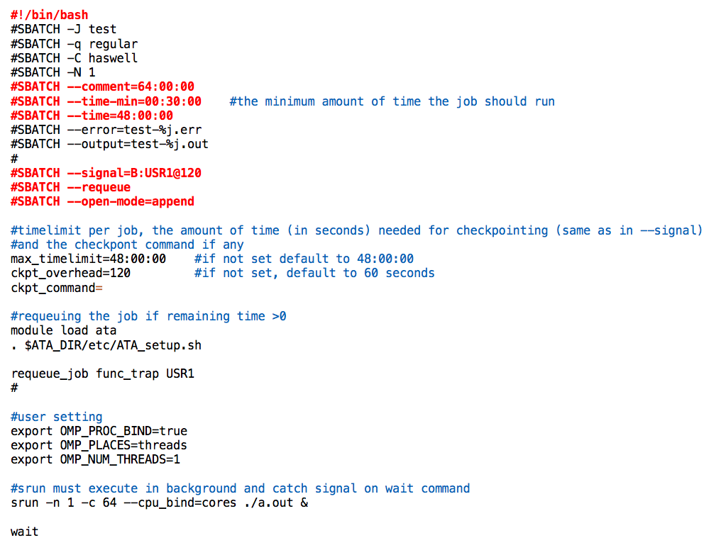
Sample job script for variable-time jobs
Provide ckpt-command only if your application needs external trigger to initiate the checkpointing. Leave blank if none
Notes:
--signal=[B:]<sig_num>[@<sig_time>]
When a job is within sig_time seconds of its end time, send it the signal sig_num. Due to the resolution of event handling by Slurm, the signal may be sent up to 60 seconds
earlier than specified. sig_num may either be a signal number or name (e.g. "10" or "USR1"). sig_time must have an integer value between 0 and 65535. By default, no signal is
sent before the job's end time. If a sig_num is specified without any sig_time, the default time will be 60 seconds. Use the "B:" option to signal only the batch shell, none
of the other processes will be signaled. By default all job steps will be signaled, but not the batch shell itself.
--requeue
Specifies that the batch job should eligible to being requeue. The job may be requeued explicitly by a system administrator, after node failure, or upon preemption by a higher
priority job. When a job is requeued, the batch script is initiated from its beginning. Also see the --no-requeue option. The JobRequeue configuration parameter controls the
default behavior on the cluster.
--open-mode=append|truncate
Open the output and error files using append or truncate mode as specified. The default value is specified by the system configuration parameter JobFileAppend.

Slide 51
Variable-time script for CP2K
#!/bin/bash -l
#SBATCH -q regular
#SBATCH -N 1
#SBATCH -C knl
#SBATCH -J md
#SBATCH --comment=96:00:00
#SBATCH --time-min=00:30:00 #the minimum amount of time the job should run
#SBATCH --time=48:00:00
#SBATCH --signal=B:USR1@60
#SBATCH --requeue
#SBATCH --open-mode=append
#timelimit per job, and the amount of time (in seconds) needed for checkpointing (same as in --signal)
max_timelimit=48:00:00
ckpt_overhead=60
ckpt_command=
#requeueing the job if remaining time >0
. /global/common/cori/software/ata/1.0/etc/ATA_setup.sh
requeue_job func_trap USR1
module load cp2k
srun -n 68 ./cp2k.popt run.inp >> run.out &
wait

Slide 52
Variable-time script for VASP atomic relaxation jobs
#!/bin/bash
#SBATCH -J ata_vasp
#SBATCH -q regular
#SBATCH -C knl
#SBATCH -N 2
#SBATCH --time=48:0:00
#SBATCH --error=ata-%j.err
#SBATCH --output=ata-%j.out
#SBATCH --mail-user=zz217@nersc.gov
#
#SBATCH --comment=96:00:00
#SBATCH --time-min=02:0:00
#SBATCH --signal=B:USR1@300
#SBATCH --requeue
#SBATCH --open-mode=append
#user setting
export OMP_PROC_BIND=true
export OMP_PLACES=threads
export OMP_NUM_THREADS=8
#srun must execute in background and catch signal on wait command
module load vasp/20171017-knl
srun -n 8 -c32 --cpu_bind=cores vasp_std &
# put any commands that need to run to continue the next job (fragment) here
ckpt_vasp() {
set -x
restarts=`squeue -h -O restartcnt -j $SLURM_JOB_ID`
echo checkpointing the ${restarts}-th job
#to terminate VASP at the next ionic step
echo LSTOP = .TRUE. > STOPCAR
#wait until VASP to complete the current ionic step, write out WAVECAR file and quit
srun_pid=`ps -fle|grep srun|head -1|awk '{print $4}'`
echo srun pid is $srun_pid
wait $srun_pid
#copy CONTCAR to POSCAR
cp -p CONTCAR POSCAR
set +x
}
ckpt_command=ckpt_vasp
max_timelimit=48:00:00
ckpt_overhead=300
# requeueing the job if remaining time >0
. /global/common/cori/software/ata/1.0/etc/ATA_setup.sh
requeue_job func_trap USR1
wait

Slide 53
More information
NERSC website, especially,
  http://www.nersc.gov/users/computational-systems/cori/programming/compiling-codes-on-cori/
  http://www.nersc.gov/users/computational-systems/edison/programming/
  Transitioning to NERSC Docs: https://docs.nersc.gov/development/compilers/
  For further compiler optimizations read intel slides: e.g., https://www.nersc.gov/users/training/events/intel-compilers-tools-and-libraries-training-march-6-2018/
  Cori KNL: http://www.nersc.gov/users/computational-systems/cori/running-jobs/example-batch-scripts-for-knl/
  https://docs.nersc.gov/jobs/

Slide 54
Hands-on (9:45am-11:30am)
Please use the “–reservation=edi2knl –A nintern” options to use the reservation and also charge to the nintern repo instead of your own. There are 128 KNL and 256 Edison nodes reserved for you.
Use the interactive queue if all reserved nodes are used.
Please upload your performance number at https://join.slack.com/t/edison2knl/shared_invite/enQtNTAxNjE1MzUwNjQ3LWY0ZGUyOGU4NzFhNjI2OTlhNWVmOWRhMGRjY2QwYTRlZmNlM2FjNzA5NTRkNjc0M2JkODc1OTYzOGMzNzUxNDg

Slide 55
Optional Hands-on (11:30am-3:30pm)

Slide 56
Thank You!

Slide 57
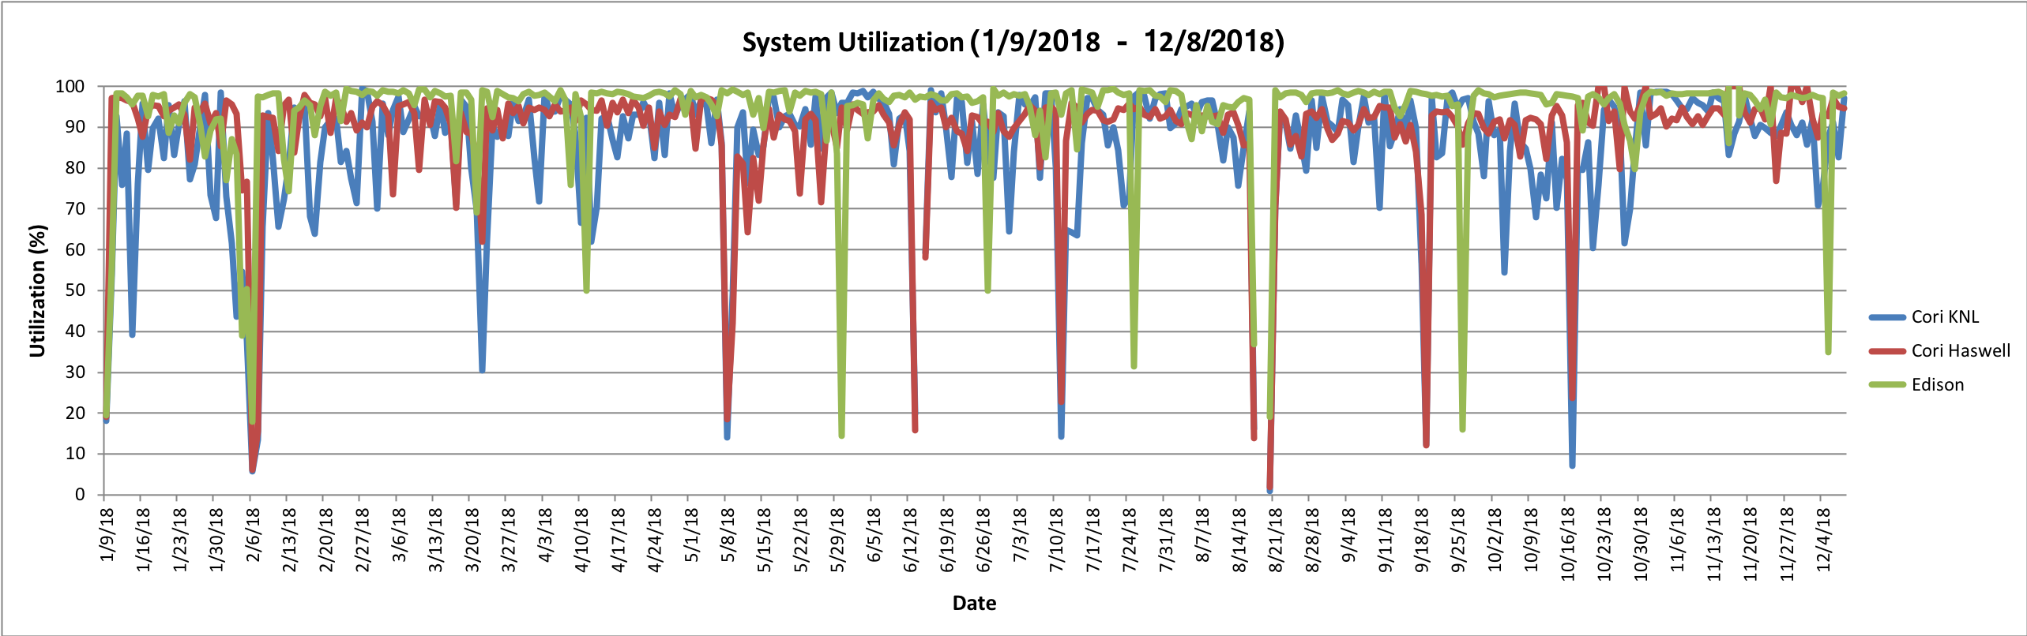
System Utilizations

Slide 58
Affinity Verification Methods
NERSC has provided pre-built binaries from a Cray code (xthi.c) to display process thread affinity: check-mpi.intel.cori, check-mpi.cray.cori, check-hybrid.intel.cori, etc.
% srun -n 32 -c 8 --cpu_bind=cores check-mpi.intel.cori|sort -nk 4
Hello from rank 0, on nid02305. (core affinity = 0,1,68,69,136,137,204,205)
Hello from rank 1, on nid02305. (core affinity = 2,3,70,71,138,139,206,207)
Hello from rank 2, on nid02305. (core affinity = 4,5,72,73,140,141,208,209)
Hello from rank 3, on nid02305. (core affinity = 6,7,74,75,142,143,210,211)
Intel compiler has a run time environment variable KMP_AFFINITY, when set to "verbose”:
  OMP: Info #242: KMP_AFFINITY: pid 255705 thread 0 bound to OS proc set {55}
  OMP: Info #242: KMP_AFFINITY: pid 255660 thread 1 bound to OS proc set {10,78}
  OMP: Info #242: OMP_PROC_BIND: pid 255660 thread 1 bound to OS proc set {78} …
Cray compiler has a similar env CRAY_OMP_CHECK_AFFINITY, when set to "TRUE”:
  [CCE OMP: host=nid00033 pid=14506 tid=17606 id=1] thread 1 affinity: 90
  [CCE OMP: host=nid00033 pid=14510 tid=17597 id=1] thread 1 affinity: 94 …
Slide from Helen He

