Slide 1
Checkpointing and Restarting Jobs with DMTCP
User Training on Checkpoint/Restart (I)
Zhengji Zhao
User Engagement Group
NERSC User Training, Berkeley CA
November 6, 2019

Slide 2
Outline
Introduction
DMTCP overview
Checkpoint/restart serial and threaded applications on Cori
Automatic job resubmission of checkpoint/restart jobs with DMTCP
Summary

Slide 3
Introduction

Slide 4
What is Checkpointing/Restarting?
Checkpointing is the action of saving the state of a running process to a checkpoint image file
  Dump a running process’s memory, state, etc. into a file
The process can be restarted later from the checkpoint file: continuing the execution from where it left off, on the same or different computer

Slide 5
Why Checkpoint/Restart?
User Perspective
Enable my jobs to run longer than walltime limit
Improve my jobs’ throughput by exploiting the holes in the Slurm schedule
Extend interactive sessions by saving & restarting where I left off
Debug long-running jobs by pausing just before the error & restarting from that point multiple times
NERSC Perspective
Increased flexibility in scheduling jobs
(Potentially) enables preempting of jobs for more important or time-sensitive jobs
Better backfill when reserving nodes for large job, increasing utilization
Run checkpointing jobs right up to system maintenance
(Potentially) checkpoint all jobs before unexpected power outage
Cori (All) system utilization in Oct 2019
PSPS
PSPS

Slide 6
Checkpoint/Restart: A Great Idea, Hard to Implement
Requires extensive effort to create transparent-to-users implementation
  MPI support is especially challenging: combination of MPI implementations (e.g., MPICH, OpenMPI) & networks (e.g., ethernet, Cray Aries) means multiple versions required (MxN problem)
Earlier checkpoint/restart project, BLCR, shifted development/ maintenance burdens to MPI developers, OS kernels, and batch system developers
  Required cooperation from all these entities
  No longer being developed

Slide 7
Checkpoint/Restart: A Great Idea, Hard to Implement
DMTCP (topic of today’s training) takes a different approach & lives completely in user space
  No kernel modifications or hooks into MPI or lower communication layers are required
A new implementation of DMTCP, MANA, has addressed the MPI MxN maintainability issue, and proven to be scalable to large number of processes
  Work in progress: need to experiment with production workloads at NERSC to further harden the code
  Subject of future training

Slide 8
Schedule of NERSC User Trainings on Checkpoint/Restart
A series of user training sessions on C/R are planned in November, January, and February
  November (today): focus on using DMTCP with serial/threaded applications
  January: focus on applications with internal C/R support - get good job throughput with variable-time jobs
  February: Checkpoint/restart MPI applications with DMTCP (MANA)

Slide 9
DMTCP: Distributed MultiThreaded CheckPointing
DMTCP website, http://dmtcp.sourceforge.net/index.html
This work was partially supported by National Science Foundation Grants OAC-1740218 and ACI-1440788.

Slide 10
DMTCP: Distributed MultiThreaded CheckPointing
DMTCP transparently checkpoints a single-host or distributed computation in user-space -- with no modifications to user code or to the O/S.
DMTCP supports a variety of applications, including MPI (various implementations over TCP/IP or InfiniBand), OpenMP, MATLAB, Python, and many programming languages including C/C++/Fortran, shell scripting languages, and resource managers (e.g., Slurm)

Slide 11
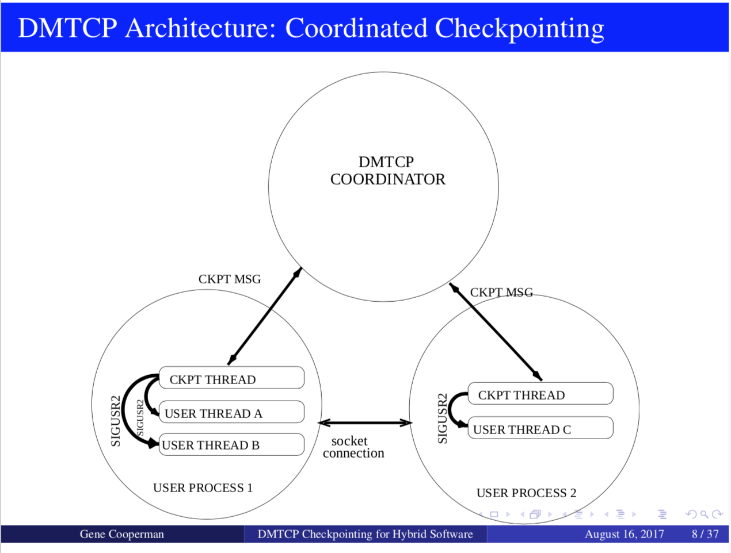
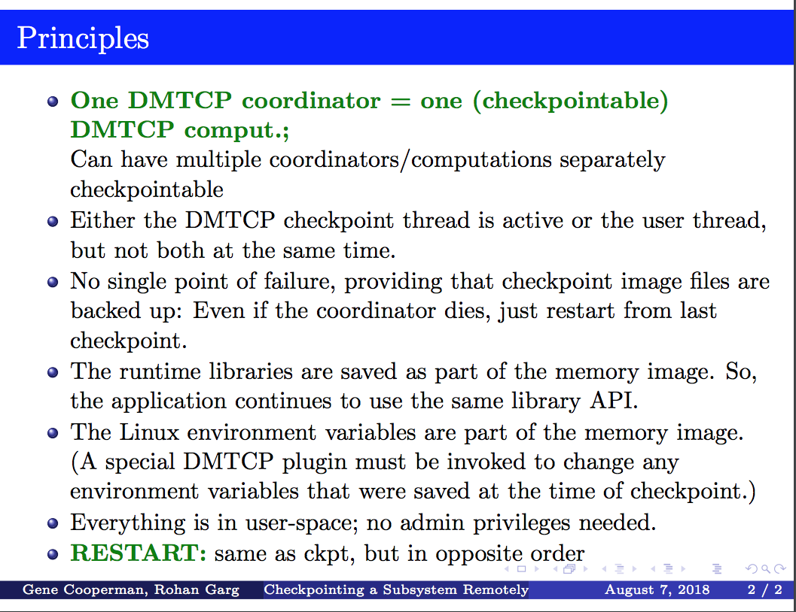
How does DMTCP Work?
Notes:
Notes from Gene and Twinkle:
DMTCP uses plugins internally, and it's easy to extend DMTCP with
plugins (similarly to browser plugins). Two useful user plugins that
are already provided with DMTCP are:
a. pathvirt - Change prefix of all paths.
EXAMPLE: /home/batch/slot5 -> /home/batch/slot7 (on restart)
b. modify-env
EXAMPLE: Assume the user's code frequently reads the
the environment variable DEBUG, using getenv().
Then: DEBUG=0 [on launch]
On restart, use the plugin with modify-env.txt to set DEBUG=1

Slide 12
DMTCP Usage
Terminal 1
Terminal 2
rm -f ckpt_a.out*.dmtcp
dmtcp_launch -j ./a.out arg1 …
^C
dmtcp_restart ckpt_a.out*.dmtcp
dmtcp_coordinator --interval 30
dmtcp_launch --interval 30 ./a.out
^C
dmtcp_restart ckpt_a.out*.dmtcp
Or
dmtcp_launch ./a.out arg1 …
^C
dmtcp_restart ckpt_a.out*.dmtcp
dmtcp_command --checkpoint
Or

Slide 13
DMTCP Commands
dmtcp_coordinator -- coordinates checkpoints between multiple processes.
Usage: dmtcp_coordinator [OPTIONS] [port]
Options:
-p, --coord-port PORT_NUM (env DMTCP_COORD_PORT), Port to listen on (default: 7779)
--port-file filename, File to write listener port number. (Useful with '--port 0', which is used to assign a random port)
--exit-on-last, Exit automatically when last client disconnects
--exit-after-ckpt, Kill peer processes of computation after first checkpoint is created
--daemon, Run silently in the background after detaching from the parent process.
-i, --interval (env DMTCP_CHECKPOINT_INTERVAL): Time in seconds between automatic checkpoints (default: 0, disabled)
COMMANDS:
type '?<return>' at runtime for list

Slide 14
DMTCP Commands (cont.)
dmtcp_launch -- Start a process under DMTCP control.
Usage: dmtcp_launch [OPTIONS] <command> [args...]
-h, --coord-host HOSTNAME (env DMTCP_COORD_HOST), hostname where dmtcp_coordinator is run (default: localhost)
-p, --coord-port PORT_NUM (env DMTCP_COORD_PORT), port where dmtcp_coordinator is run (default: 7779)
--port-file FILENAME, file to write listener port number.
-j, --join-coordinator, join an existing coordinator, raise error if one doesn't already exist
-i, --interval SECONDS (env DMTCP_CHECKPOINT_INTERVAL), time in seconds between automatic checkpoints.
--ckpt-signal signum, signal number used internally by DMTCP for checkpointing (default: SIGUSR2 (signal 12)).
Notes:
--batch-queue, --rm, Enable support for resource managers (Torque PBS and SLURM), (default: disabled)
--ib, --infiniband, Enable InfiniBand plugin. (default: disabled)
--spades Enable support for spades.py (-o <output-dir> spades.py option is required) (default: disabled).

Slide 15
DMTCP Commands (cont.)
dmtcp_restart -- Restart processes from a checkpoint image.
Usage: dmtcp_restart [OPTIONS] <ckpt1.dmtcp> [ckpt2.dmtcp...]
-h, --coord-host HOSTNAME (env DMTCP_COORD_HOST), Hostname where dmtcp_coordinator is run (default: localhost)
-p, --coord-port PORT_NUM (env DMTCP_COORD_PORT), Port where dmtcp_coordinator is run (default: 7779)
--port-file FILENAME, File to write listener port number.
-j, --join-coordinator, Join an existing coordinator, raise error if one doesn't already exist
-i, --interval SECONDS (env DMTCP_CHECKPOINT_INTERVAL), Time in seconds between automatic checkpoints.

Slide 16
DMTCP Commands (cont.)
dmtcp_command -- Send a command to the dmtcp_coordinator remotely.
Usage: dmtcp_command [OPTIONS] COMMAND [COMMAND...]
-s, --status Print status message
-l, --list List connected clients
-c, --checkpoint Checkpoint all nodes
-bc, --bcheckpoint Checkpoint all nodes, blocking until done
-i, --interval <val> Update ckpt interval to <val> seconds (0=never)
-k, --kill Kill all nodes
-q, --quit Kill all nodes and quit

Slide 17
MPI Status of DMTCP on Cori
We are working with the DMTCP developers to get “MANA for MPI: MPI-Agnostic Network-Agnostic Transparent Checkpointing”, which works with Cray MPICH, to work on Cori.
  The openmpi module (tcp/ip) may work with your MPI applications now
  However, we recommend the to-be-released MANA version of DMTCP for MPI applications (target date Feb 2020)
Confirmed that serial/threaded apps work with DMTCP on Cori
  We invite users to experiment DMTCP with their production workloads, and report bugs
  DMTCP development team will prioritize bugs reported by NERSC

Slide 18
Checkpoint/Restart Serial/Threaded Applications with DMTCP on Cori

Slide 19
Demo: C/R Jobs with DMTCP Interactively
Terminal 1 (batch session)
Terminal 2
Step 1
module load dmtcp
#get a compute node
salloc –N1 –C knl –t 1:00:00 -q interactive
#launch job under DMTCP control
dmtcp_launch -j ./a.out arg1 ...
^c kill the running job
#restart from checkpoint image file
dmtcp_restart ckpt-*.dmtcp
#or run dmtcp_restart_script.sh
#ssh to the compute node of your running job
ssh_job <jobid>
#launch dmtcp_coordinator
module load dmtcp
dmtcp_coordinator
#checkpoint
c
q
--------
#or use dmtcp_command to send checkpoint command remotely
dmtcp_command -c
Step 2
Step 3
Step 4
Step 5
Step 6
Step 7
The application (a.out) must be linked dynamically!
Notes:
try dmtcp_coordinator with different options:

Slide 20
Notes on DMTCP Usage
Must link applications dynamically
Use --help option with dmtcp_* commands to see available options
Checkpoint options:
  checkpoint periodically
  checkpoint once and quit (detect allocated time)
  checkpoint remotely as needed
  for batch jobs, use --port-file number (-p), because host (-h) could be different between restarted jobs
For restart jobs, can use dmtcp_coordinator-generated restart script dmtcp_restart_script.sh instead of dmtcp_restart ckpt*
  This file is a link to the most recent restart script

Slide 21
Sample Job Script: C/R Using DMTCP on Cori Haswell
Original job script
run.slurm
restart.slurm
#!/bin/bash
#SBATCH –J test
#SBATCH -q regular
#SBATCH -N 1
#SBATCH -C haswell
#SBATCH -t 48:00:00
#SBATCH –o test-%j.out
#SBATCH –e test-%j.err
#user settings
export OMP_PROC_BIND=true
export OMP_PLACES=threads
export OMP_NUM_THREADS=32
./a.out
#!/bin/bash
#SBATCH –J test_cr
#SBATCH -q regular
#SBATCH -N 1
#SBATCH -C haswell
#SBATCH -t 48:00:00
#SBATCH –o test_cr-%j.out
#SBATCH –e test_cr-%j.err
#SBATCH --time-min=6:00:00
#user settings
export OMP_PROC_BIND=true
export OMP_PLACES=threads
export OMP_NUM_THREADS=32
#for c/r with dmtcp
module load dmtcp nersc_cr
#checkpointing once every hour
start_coordinator -i 3600
#run job under dmtcp control
dmtcp_launch ./a.out
#!/bin/bash
#SBATCH –J test_cr
#SBATCH -q regular
#SBATCH -N 1
#SBATCH -C haswell
#SBATCH -t 48:00:00
#SBATCH –o test_cr-%j.out
#SBATCH –e test_cr-%j.err
#SBATCH --time-min=6:00:00
#user settings
export OMP_PROC_BIND=true
export OMP_PLACES=threads
export OMP_NUM_THREADS=32
#for c/r with dmtcp
module load dmtcp nersc_cr
#checkpointing once every hour
start_coordinator -i 3600
#restart the job from dmtcp checkpoint files
./dmtcp_restart_script.sh
To run: sbatch run.slurm; sbatch restart.slurm; sbatch restart.slurm; …
or submit dependency jobs
Notes:
bash ./dmtcp_restart_script.sh -h $DMTCP_COORD_HOST -p $DMTCP_COORD_PORT
bash ./dmtcp_restart_script.sh

Slide 22
The “flex” QOS is Available for You (on Cori KNL Only)
The flex QOS is for user jobs that can produce useful work with a relatively short amount of run time before terminating
  For example, jobs that are capable of checkpointing and restarting from where they left off
Benefits to using the flex QOS include improved job throughput and a 75% discount in charging.
Access via “#SBATCH -q flex” and must use “#SBATCH --time-min=2:00:00” or less
A flex QOS job can use up to 256 KNL nodes for 48 hours

Slide 23
Sample Job Script: C/R Using DMTCP with flex QOS on Cori KNL
original job script
run.slurm
restart.slurm
#!/bin/bash
#SBATCH –J test
#SBATCH -q regular
#SBATCH -N 1
#SBATCH -C knl
#SBATCH -t 48:00:00
#SBATCH –o test-%j.out
#SBATCH –e test-%j.err
#user settings
export OMP_PROC_BIND=true
export OMP_PLACES=threads
export OMP_NUM_THREADS=64
./a.out
#!/bin/bash
#SBATCH –J test_cr
#SBATCH -q flex
#SBATCH -N 1
#SBATCH -C knl
#SBATCH -t 48:00:00
#SBATCH –o test_cr-%j.out
#SBATCH –e test_cr-%j.err
#SBATCH --time-min=2:00:00
#user settings
export OMP_PROC_BIND=true
export OMP_PLACES=threads
export OMP_NUM_THREADS=64
#for c/r with dmtcp
module load dmtcp nersc_cr
#checkpointing once every hour
start_coordinator -i 3600
#run job under dmtcp control
dmtcp_launch ./a.out
#!/bin/bash
#SBATCH –J test
#SBATCH -q flex
#SBATCH -N 1
#SBATCH -C knl
#SBATCH -t 48:00:00
#SBATCH –o test_cr-%j.out
#SBATCH –e test_cr-%j.err
#SBATCH --time-min=2:00:00
#user settings
export OMP_PROC_BIND=true
export OMP_PLACES=threads
export OMP_NUM_THREADS=64
#for c/r with dmtcp
module load dmtcp nersc_cr
#checkpointing once every hour
start_coordinator -i 3600
#restart the job from dmtcp checkpoint files
./dmtcp_restart_script.sh
To run: sbatch run.slurm; sbatch restart.slurm; sbatch restart.slurm; …
or submit depency jobs
Notes:
./dmtcp_restart_script.sh -h $DMTCP_COORD_HOST -p $DMTCP_COORD_PORT
./dmtcp_restart_script.sh

Slide 24
Notes on the DMTCP Job Script
nersc_cr module provides a set of bash functions to manage C/R jobs
  See /global/common/sw/cray/cnl7/haswell/nersc_cr/19.10/etc/env_setup.sh
start_coordinator is a bash function (from nersc_cr module) that wraps the dmtcp_coordinator command and sets two envs to save coordinator host & port number, and generate dmtcp_command.<jobid> file in the run directory for communication with your running jobs as needed
dmtcp_coordinator --daemon --exit-on-last -p 0 --port-file $fname $@ 1>/dev/null 2>&1
export DMTCP_COORD_HOST=$h
export DMTCP_COORD_PORT=$p
User selects checkpoint interval (-i option for coordinator): periodic checkpoint vs checkpoint only once before the job terminates
  The checkpoint overhead should be less than the time needed to dump the full memory on the node to the disk

Slide 25
Automatic Resubmission of Checkpoint/Restart Jobs with DMTCP

Slide 26
Automatic Resubmission of DMTCP Restart Jobs Using flex QOS (KNL Only)
Original Job script
#!/bin/bash
#SBATCH -J test
#SBATCH -q flex
#SBATCH -N 1
#SBATCH -C KNL
#SBATCH --time=48:00:00
#SBATCH --error=test%j.err
#SBATCH --output=test%j.out
#SBATCH --time-min=02:00:00
module load dmtcp nersc_cr
start_coordinator -i 3600
#checkpoint/restart job
if [[ $(restart_count) == 0 ]]; then
#user setting
export OMP_NUM_THREADS=64
export OMP_PROC_BIND=spread
export OMP_PLACES=threads
dmtcp_launch -j ./a.out &
elif [[ $(restart_count) > 0 ]] && [[ -e dmtcp_restart_script.sh ]]; then
bash ./dmtcp_restart_script.sh &
else
echo "Failed to restart the job, exit”; exit
fi
C/R jobs with DMTCP
Automatic resubmission
#!/bin/bash
#SBATCH –J test
#SBATCH -q regular
#SBATCH -N 1
#SBATCH -C knl
#SBATCH -t 48:00:00
#SBATCH –o test-%j.out
#SBATCH –e test-%j.err
#user setting
export OMP_PROC_BIND=true
export OMP_PLACES=threads
export OMP_NUM_THREADS=64
./a.out
#!/bin/bash
#SBATCH –J test_cr
#SBATCH -q flex
#SBATCH -N 1
#SBATCH -C knl
#SBATCH -t 48:00:00
#SBATCH –o test_cr-%j.out
#SBATCH –e test_cr-%j.err
#SBATCH –time-min=2:00:00
#user setting
export OMP_PROC_BIND=true
export OMP_PLACES=threads
export OMP_NUM_THREADS=64
module load dmtcp nersc_cr
#checkpointing once every hour
start_coordinator -i 3600
#run job under dmtcp control
dmtcp_launch ./a.out
#SBATCH --comment=48:00:00
#SBATCH --signal=B:USR1@300
#SBATCH --requeue
#SBATCH --open-mode=append
#!/bin/bash
#SBATCH –J test
#SBATCH -q flex
#SBATCH -N 1
#SBATCH -C knl
#SBATCH -t 48:00:00
#SBATCH –o test_cr-%j.out
#SBATCH –e test_cr-%j.err
#SBATCH –time-min=2:00:00
#for c/r with dmtcp
module load dmtcp nersc_cr
#checkpointing once every hour
start_coordinator -i 3600
#restart the job from dmtcp checkpoint files
bash ./dmtcp_restart_script.sh
C/R jobs with DMTCP
Manual resubmission
# requeueing the job if remaining time >0
ckpt_command=
requeue_job func_trap USR1
wait

Slide 27
Automatic Resubmissions of DMTCP Jobs (cont.)
#SBATCH --time-min=02:00:00
Specify the minimum time for your job. Flex QOS requires time-min to be no more than 2 hours.
#SBATCH --comment=48:00:00
        A flag to add comments about the job, used by the script to specify the desired walltime and to track the remaining walltime for the requeued jobs (after pre-termination). You can specify any length of time, e.g., a week or even longer
#SBATCH --signal=B:USR1@<sig_time>
Request the batch system to send user-defined signal USR1 to the batch shell (where the job is running) sig_time seconds (e.g., 300) before the job hits the wall clock limit
#SBATCH --requeue
Specify the job is eligible to requeue
#SBATCH --open-mode=append
Append the standard output/error of the requeued job to the
same standard out/error files from the previously terminated job.
#SBATCH --comment=48:00:00
#SBATCH --signal=B:USR1@300
#SBATCH --requeue
#SBATCH --open-mode=append
Notes:
--requeue
Specifies that the batch job should eligible to being requeue. The job may be requeued explicitly by a system administrator, after
node failure, or upon preemption by a higher priority job. When a job is requeued, the batch script is initiated from its beginning.
Also see the --no-requeue option. The JobRequeue configuration parameter controls the default behavior on the cluster.

Slide 28
Automatic Resubmission of DMTCP Jobs (cont.)
Bash functions used to automate job resubmission: requeue_job, func_trap, start_coordinator, ...
requeue_job
This function traps the user defined signal (e.g., USR1). Upon receiving the signal, it executes a function (e.g., func_trap below) provided on the command line.
func_trap
This function contains the list of commands to be executed to initiate checkpointing, prepare inputs for the next job, requeue the job, and update the remaining walltime.
requeue_job() {
parse_job # to calculate the remaining walltime
if [ -n $remainingTimeSec ] && [ $remainingTimeSec -gt 0 ]; then
commands=$1
signal=$2
trap $commands $signal
fi
}
func_trap() {
$ckpt_command
scontrol requeue ${SLURM_JOB_ID}
scontrol update JobId=${SLURM_JOB_ID} TimeLimit=${requestTime}
}
# requeueing the job if remaining time >0
ckpt_command=
requeue_job func_trap USR1
wait

Slide 29
How Does Automatic Resubmission of DMTCP Jobs Work?
User submits job script.
The batch system looks for a backfill opportunity for the job. If it can allocate the requested number of nodes for this job for any duration (e.g., 6 hours) between the specified minimum time (2 hours) and the time limit (48 hours) before those nodes are used for other higher priority jobs, the job starts execution.
The job runs until it receives signal USR1 (--signal=B:USR1@300) 300 seconds before it hits the allocated time limit (6 hours).
Upon receiving the signal, the func_trap function gets executed, which in turn executes
  ckpt_command if specified
  Requeues the job and then updates remaining walltime for requeued job.
Steps 2-4 repeat until job runs for the desired amount of time (48 hours) or job completes.
User checks results.
func_trap() {
$ckpt_command
scontrol requeue ${SLURM_JOB_ID}
scontrol update JobId=${SLURM_JOB_ID} TimeLimit=${requestTime}
}

Slide 30
Summary
DMTCP works with serial and threaded applications on Cori
  You are encouraged to experiment with your workloads, and report bugs at help.nersc.gov
  Benefits of checkpoint/restart jobs with DMTCP using the flex QOS on Cori KNL include increased job throughput, a large charging discount, and capability of running jobs of any length
  For Haswell you can use DMTCP with regular QOS, just no charging discount
For MPI applications, we recommend the to-be-released MANA implementation of DMTCP, which will work with Cray MPICH. We will host user training on MANA DMTCP in Feb 2020

Slide 31
Resources
DMTCP website, http://dmtcp.sourceforge.net/index.html
DMTCP github site https://github.com/dmtcp/dmtcp/blob/master/QUICK-START.md
NERSC website, https://docs.nersc.gov/development/checkpoint-restart/
  will be available on Nov 7, 2019
Presentation slides will be posted in our training site after the training
Our dmtcp module used Twinkle Jain’s DMTCP fork,
https://github.com/JainTwinkle/dmtcp.git (branch: spades-v2)

Slide 32
Acknowledgements
Rebecca Hartman-Baker for her vision on C/R, leading the C/R effort at NERSC
  worked with a summer student (Tiffany Connors, now NERSC staff) developed the variable-time job script, automated the job resubmissions
  Initiated the collaboration with DMTCP team
Steve Leak - for working on improving/rewriting the variable-time job scripts (work in progress)
Gene Cooperman, Twinkle Jain, and Rohan Garg for collaborations on getting DMTCP into production at NERSC (technical support, quick bug fixes, etc.)
JGI SPADES team to adopt DMTCP in their workflow, resulting in multiple bug fixes
NERSC team members, Chris Samuel, Eric Roman for helping system side debugging, batch system incorporation, etc.
Thanks Rebecca, Gene and Twinkle help with preparing the training slides
DMTCP work (Gene Cooperman’s research group at Northeastern Univ.) was partially supported by National Science Foundation Grants OAC-1740218 and ACI-1440788.

Slide 33
Thank You!

Slide 34
Backup slides

Slide 35
Running dmtcp_command from Cori Login Nodes
From a Cori login node
mom_local.py dmtcp_command.<jobid> --checkpoint
  mom_local.py script transfers current user environment, wd, and command line arguments precisely to the remote nodes and execs the command there
zz217@cori04:~> mom_local.py ./dmtcp_command.25583470 -s
Coordinator:
Host: nid02471
Port: 35241
Status...
NUM_PEERS=0
RUNNING=no
CKPT_INTERVAL=3600
Otherwise get on to the compute node first
ssh_job <jobid>
dmtcp_command.<jobid> --checkpoint

Slide 36
For a Quick Hands-on on Cori
Using the binaries available at the test directory of the dmtcp modules, e.g., dmtcp1
module load dmtcp
append_testpath #so the DMTCP test directory in your path
cd $SCRATCH #run on your scratch directory, because the image file could be large
Or use the jacobi.f90 available at /global/csratch1/sd/zz217/dmtcp_demo
cp -pr /global/csratch1/sd/zz217/dmtcp_demo $SCRATCH
cd $SCRATCH/dmtcp_demo
./compile.sh
then run the jac.x under DMTCP control

Slide 37
System Utilizations
Cori KNL
Cori Haswell
Can we make use of the idle nodes when the system drains for larger jobs? Yes, we can! We just need many shorter jobs to backfill.
The jobs submitted with a short ---time-min (on both Haswell and KNL nodes) will get higher job throughput, provided your jobs can do checkpoint/restart.

Slide 38
Automatic Resubmissions of VASP flex Jobs
# put any commands that need to run to continue the next job here
ckpt_vasp() {
set -x
restarts=`squeue -h -O restartcnt -j $SLURM_JOB_ID`
echo checkpointing the ${restarts}-th job
# to terminate VASP at the next ionic step
echo LSTOP = .TRUE. > STOPCAR
# wait until VASP to complete the current ionic step, write WAVECAR file and quit
srun_pid=`ps -fle|grep srun|head -1|awk '{print $4}’`
wait $srun_pid
# copy CONTCAR to POSCAR
cp -p CONTCAR POSCAR
set +x
}
ckpt_command=ckpt_vasp
max_timelimit=48:00:00
ckpt_overhead=300
# requeueing the job if remaining time >0
. /global/common/cori/software/variable-time-job/setup.sh
requeue_job func_trap USR1
For automatic resubmissions of pre-terminated jobs
#!/bin/bash
#SBATCH -q regular
#SBATCH -N 2
#SBATCH -C knl
#SBATCH -t 48:00:00
module load vasp/20181030-knl
export OMP_NUM_THREADS=4
# launching 1 task every 4 cores (16 CPUs)
srun –n32 –c16 --cpu_bind=cores vasp_std
Regular QOS VASP jobs
#!/bin/bash
#SBATCH -q flex
#SBATCH –N 2
#SBATCH -C knl
#SBATCH –t 48:00:00
#SBATCH --time-min=2:00:00
module load vasp/20181030-knl
export OMP_NUM_THREADS=4
# launching 1 task every 4 cores (16 CPUs)
srun –n32 –c16 --cpu-bind=cores vasp_std
#SBATCH --comment=48:00:00
#SBATCH --signal=B:USR1@300
#SBATCH --requeue
#SBATCH --open-mode=append
#!/bin/bash
#SBATCH -q flex
#SBATCH –N 2
#SBATCH -C knl
#SBATCH –t 48:00:00
#SBATCH --time-min=2:00:00
module load vasp/20181030-knl
export OMP_NUM_THREADS=4
# launching 1 task every 4 cores (16 CPUs)
srun –n32 –c16 --cpu_bind=cores vasp_std
Flex QOS VASP jobs
(manual resubmissions)
# srun must execute in background and catch signal on wait command
&
wait
https://docs.nersc.gov/jobs/examples/#vasp-example

