Slide 1
Brian Friesen 2017 Jan 26
Getting started on Cori KNL

Slide 2
Topics
How is KNL different to Haswell?
Faster and slower
MCDRAM and clustering modes
How to compile for KNL
How to submit to KNL nodes

Slide 3
Key Messages
Don’t Panic!
Using KNL is mostly the same as you already use Cori
Recompile
module swap craype-haswell craype-mic-knl
Submit with:
#SBATCH -C knl,cache,flat
See notes (downloads) at:
http://www.nersc.gov/users/training/events/2016-nesap-workshop-and-hack-a-thon/

Slide 4
KNL vs Haswell
KNL can run Haswell executables

Slide 5
KNL vs Haswell
But ..
Haswell Executables can’t fully use KNL hardware
AVX2 (haswell)
Operation on 4 DP words
AVX-512 (knl)
Hardware can compute 8 DP words per instruction
Notes:
(pic illustrating half of vector units unused)

Slide 6
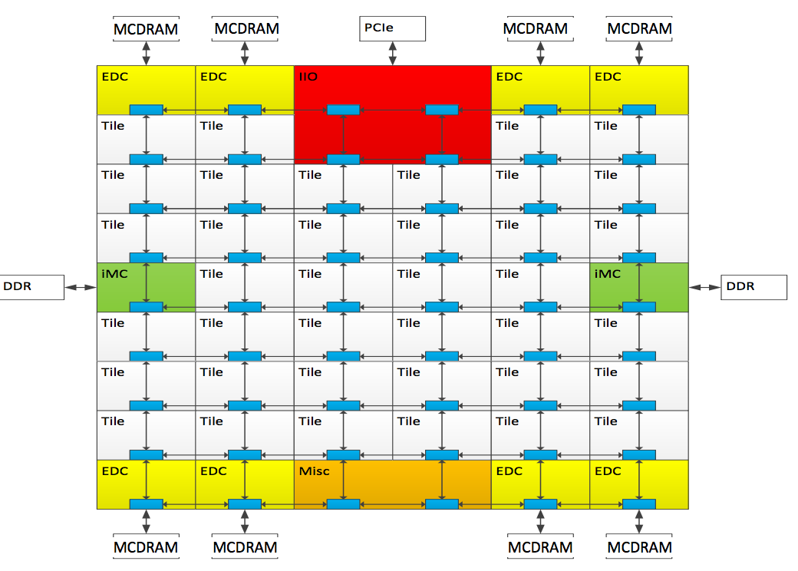
KNL vs Haswell
And ..
KNL has a lot more cores (and even more hyperthreads)
68 cores (2 per tile)
4 threads / core
= 272 threads
Notes:
(pic of rooflines with/without vectorization - highlight diffs in peak due to vectorization/half-width)

Slide 7
KNL vs Haswell
And ..
KNL has MCDRAM (high-bandwidth memory)

Slide 8
MCDRAM/Clustering Modes
You’ll hear a lot about these …
Quad, flat, cache, snc, …
2 “knobs” to turn
MCDRAM mode: “cache”, “flat”, “hybrid”
Clustering mode: “quad”, “snc4”, ...

Slide 9
MCDRAM in a nutshell
16GB on-chip memory
96GB off-chip DDR (Cori)
High bandwidth
~5x DDR
2 ways to use it:
“Cache” mode: invisible to OS, memory pages are cached in MCDRAM
“Flat” mode: appears to OS as separate NUMA node, with no local CPUs. Accessible via numactl, libnuma

Slide 10
MCDRAM modes
Cache mode
Flat mode
DDR
DDR
“memory 0”
MCDRAM
Cores & cache
“memory”
MCDRAM
Cache mode:
No need to do anything
Most of the flat-mode performance, most of the time
“memory 1”
Cores & cache
Flat mode: better achievable performance
Which memory do I want to use?
For which arrays?
Hybrid mode: a bit of each

Slide 11
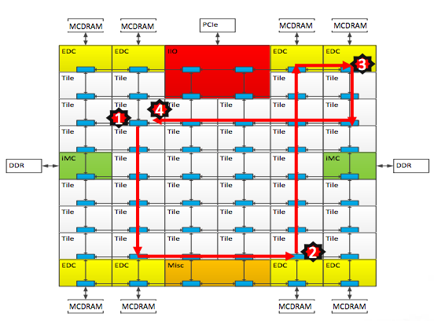
Clustering Modes
Cache coherency
does another cache hold this memory address?
“Tag directory”
list of address:cache-id
Distributed tag directory, each tile looks after part of the address space
On local cache miss:
Check tag-directory-part for other-cache-id
Fetch from other-cache (or memory)
Takes time! (latency)

Slide 12
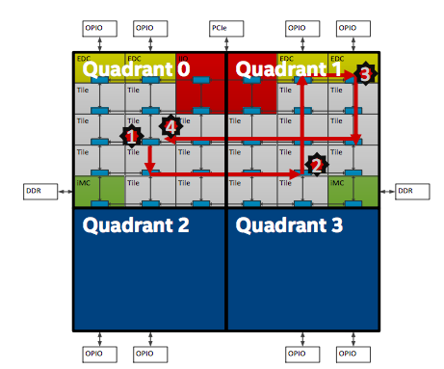
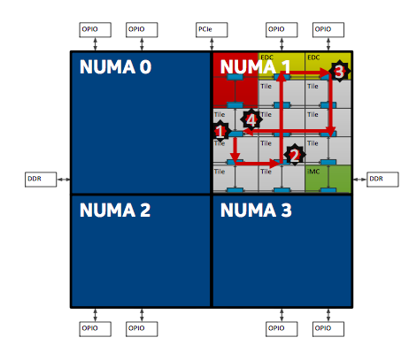
Clustering modes
Quadrant (“quad”)
distribute tag directories so each manages only memory nearby
Invisible to user, but improves memory access latency
Sub-NUMA-clustering (“snc4”)
Expose each quadrant and its managed memory as a NUMA node
Even lower latency, but less flexible
We recommend quadrant mode for most users

Slide 13
Topics
How is KNL different to Haswell?
Faster and slower
MCDRAM and clustering modes
How to compile for KNL
How to submit to KNL nodes

Slide 14
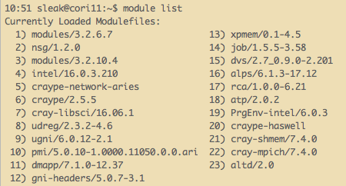
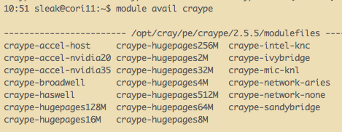
How to compile
Best: Use Cray compiler wrappers
module swap craype-haswell craype-mic-knl
The loaded craype-* module sets the target that the compiler wrappers (cc, CC, ftn) build for
Eg -mknl (GNU compiler), -hmic-knl (Cray compiler)
craype-haswell is default on login nodes

Slide 15
Topics
How is KNL different to Haswell?
Faster and slower
MCDRAM and clustering modes
How to compile for KNL
How to submit to KNL nodes

Slide 16
How to run on KNL
#SBATCH -C knl,quad,cache
Tells SLURM you want to run on this type of node
If insufficient nodes in that configuration, will reboot some to change mode
This takes time!
*Currently reboots are temporarily disabled*
Which modes are there now?
sinfo -p knl --format="%15b %8D %A"
See notes (downloads) at:
http://www.nersc.gov/users/training/events/2016-nesap-workshop-and-hack-a-thon/
(affinity etc)

Slide 17
Key Messages
Don’t Panic!
Using KNL is mostly the same as you already use Cori
Recompile
module swap craype-haswell craype-mic-knl
Submit with:
#SBATCH -C knl,cache,flat
See notes (downloads) at:
http://www.nersc.gov/users/training/events/2016-nesap-workshop-and-hack-a-thon/

