Slide 1
Daniel Udwary Tony Wildish NERSC Data Science Engagement Group
Where is Genepool headed, and why does Anaconda matter?

Slide 2
Outline
Upcoming changes to Genepool
Intro to Anaconda
Time for hands-on building your own Anaconda environments
This is not a Python programming tutorial!

Slide 3
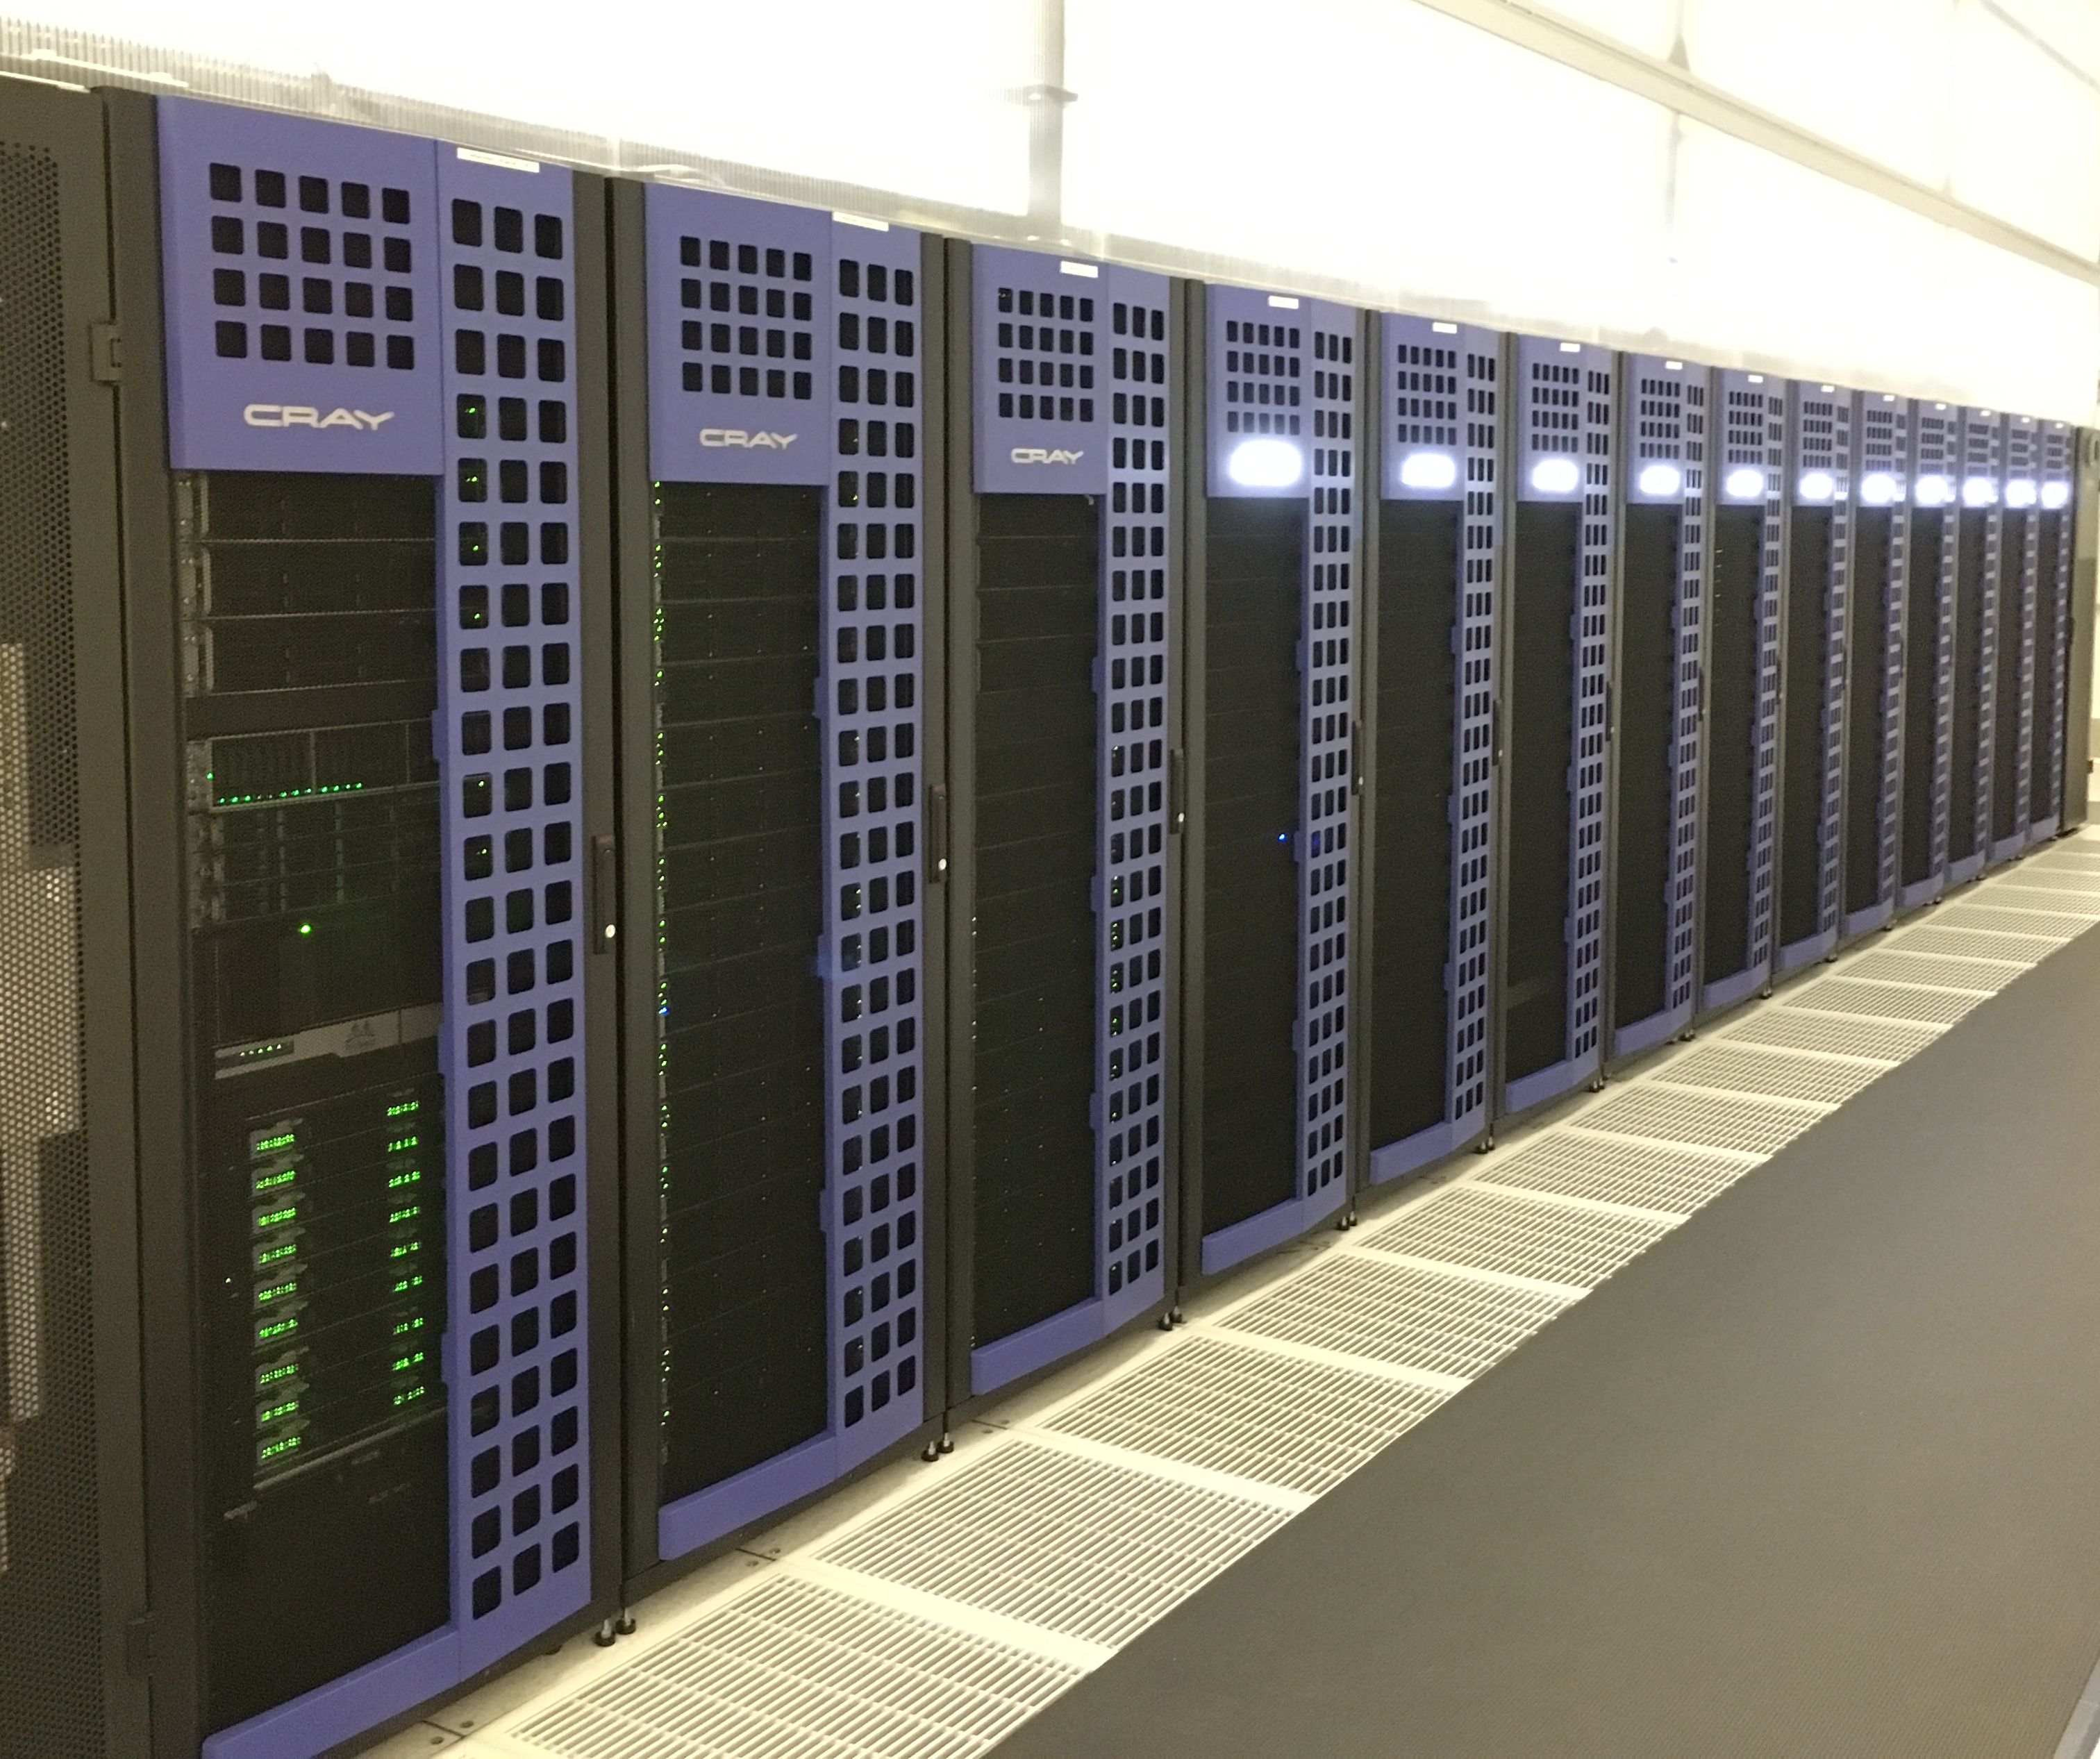
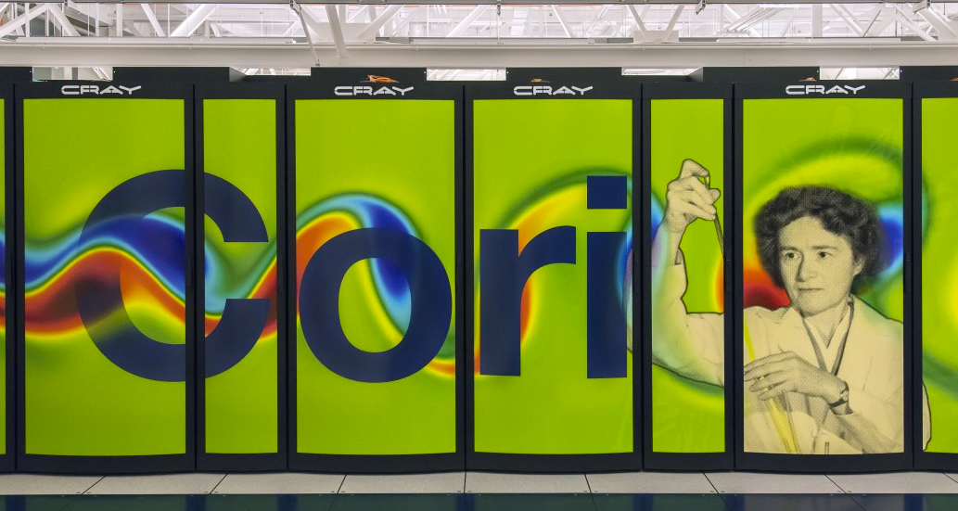
NERSC Systems
Genepool
Mendel cluster
Genepool is aging. Replacement uncertain.
NERSC will keep building Cori-like supercomputers.
So, can we transition JGI’s workload to Cori-like systems?

Slide 4
Genepool node count warranty lifespan

Slide 5
Profile with Cori
Extra capacity for a year to help with transition to Cori
Renew Mendel Phase 2 for at least 1 year – replace large memory capacity FY18/19

Slide 6
How do we start migrating workloads?
Answer: make Genepool more like the systems we need to move to
SLURM Scheduler
Anaconda as default python
Major OS Upgrade
Availability of Shifter to run containers
But, the systems are different enough, that we should take the opportunity to produce programs/pipelines/workflows that can run anywhere code can run.
ie, let’s not just adapt to Denovo or Cori

Slide 7
Genepool System Upgrade Roadmap
Genepool must transition to SLURM by August 2017
Parity with other NERSC systems (Cori, Edison, N9)
More consultants and admins available to help
More training and educational resources
Ability to run your software/pipelines on other NERSC systems
Avoid costly licensing fee for UGE
Interesting features that may be useful to JGI
Shifter integration
Better resource management
Opportunities for more customization than UGE

Slide 8
Genepool also needs an OS upgrade
361 nodes
8
Genepool
Denovo
default “deb6gp”
“sl6gp”
CHOS
environments
“sles12”
Scientific Linux 6.3 (->6.8)
Scientific Linux 7.2
Root OS
Different modules on each CHOS environment
deb6gp (Genepool default) = 933 modules
Switching OSs:
env CHOS=deb6gp chos /bin/bash -l
env CHOS=sl6gp chos /bin/bash -l
env CHOS=sles12 chos /bin/bash -l

Slide 9
What we’d like to do
Current
Denovo
Denovo’s
final form
Genepool
default “deb6gp”
“sl6gp”
“sles12”
openSUSE
Scientific Linux 6.3 (->6.8)
Scientific Linux 7.2
free version of SLES12
SLURM
Shifter-capable
More Cori-compatible
Explicit versioning of modules
(ie no defaults!)
Removal of inefficient/outdated bioinformatics software

Slide 10
Talk with a consultant about adapting your pipelines
Help us help you adapt, test, benchmark your pipeline on the new OS and scheduler
Work out a schedule with us, and you’ll get focused consulting attention
When you’re ready, we’ll open up more Denovo nodes to accommodate your pipeline
Now
June?
August

Slide 11
Goals for JGI-NERSC computing
Short term:
Transition to adaptable pipelines that can run on Genepool/Denovo, Cori, N9, or the cloud
Adapt job submissions to SLURM
Get away from module dependency for bioinformatics code
Adopt usage of containers
Adopt Anaconda for user-controlled Python (and R and Perl?) package management
Long term:
Build a portable, reproducible set of containers that can be used by all of JGI, or by external scientists

Slide 12
The Current State of Python on Genepool
Many python versions available
Installed packages differ across versions
Default python is very old (2.7.4)
Packages installed by consultants
requested via ticketing system

Slide 13
What is Anaconda and why will it make things better?
Anaconda is an open-source distribution of Python.
Provides software tools for:
Easy access to hundreds of packages
“conda install” for pre-compiled packages
pip still available
Simplifies virtual environments
Puts python package management in hands of the user
No waiting for consultants to install packages
Control over which versions of packages are installed
Provides some package management routes for other languages

Slide 14
Pros and Cons of Adopting Anaconda
Advantages:
Portability of environments
Build once, use on all NERSC machines
Anaconda is default Python on Cori, Edison
Future CPU architectures may require re-download
Reproducibility and transparency
Opportunity to revisit some stale workflows
Users have control of the software
Disadvantages
Users have control of the software
Some duplication of packages in user environments
Time and effort might be required to adapt

Slide 15
Anaconda simplifies virtual environments
Anaconda is built around creating and using virtual environments
Python installed to a central location
You create an “environment”, which contains packages and executables that differ from central python installation
You can install any packages you want in your environment, without NERSC involvement
When activated, your python environment takes PATH precedence
You can have as many environments as you like, and swap between them

Slide 16
How you’ll use Python at NERSC
Load a python module
$ module load python/2.7-anaconda
Create an environment with any packages you need
$ conda create --name mypythonenv biopython
Activate the environment
$ source activate mypythonenv
(mypythonenv)$
Do your python stuff
Deactivate or swap environments as needed
$ source deactivate
$

Slide 17
Accessing Anaconda on NERSC machines
On Denovo, Cori and Edison:
$ module load python/2.7-anaconda
or
$ module load python/3.5-anaconda
Currently on Genepool:
python/2.7-anaconda_4.3.0
python/3.5-anaconda_4.2.0
python/3.6-anaconda_4.3.0
NERSC will keep modules and anaconda itself up to date.

Slide 18
Creating an Anaconda environment
$ conda create -n <env name>
By default, will create a new env in ~/.conda/envs
$ conda create --mkdir --path
/global/projectb/scratch/dudwary/mynewenv
Would create a new envs directory in my $BSCRATCH dir
Name of this env would be “mynewenv”
$ conda create --clone <firstenv> -n <newenv>
Duplicate an existing env (could be a path to an env)

Slide 19
Installing and finding packages
Anaconda distribution comes with >150 packages pre-installed
$ conda list
If an environment is active, will only list packages installed to that environment
Several hundred more available
$ anaconda search –t conda <package>
Search for ~700 pre-compiled conda packages
https://docs.continuum.io/anaconda/pkg-docs.html
$ anaconda search –t pypi <package>
Search the Python Package Index (>100k)
install with pip

Slide 20
Installing packages
Easiest route:
$ conda install scipy biopython
Install as many packages as possible at same time to make it easier to resolve dependencies
“conda install” pulls from continuum.io’s custom repo
Pre-compiled executables
Can specify versions, if available:
$ conda install biopython=1.65
Anaconda keeps track of revisions to your environments
$ conda list --revisions
Pip also available
Custom packages, or packages from PyPI
Many packages pre-installed to Anaconda central location, and linked. You don’t need to install common packages, unless you want to define a version explicitly.

Slide 21
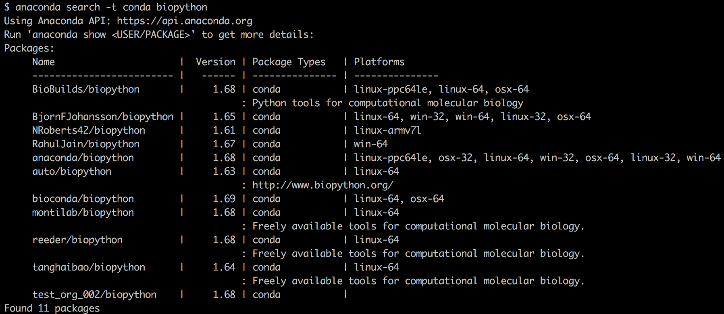
Installing packages
Anaconda packages might be in a “channel”
$ conda install –c NRoberts42 biopython

Slide 22
Other languages in Anaconda
You can also install R and R packages
$ conda install –c r r-essentials
And Perl
$ conda install –c BioBuilds perl-bioperl
Activating an environment with R or Perl installed to it will supercede loaded NERSC modules.
Pre-pending of directories to $PATH

Slide 23
Removing packages or environments
Remove a package from an environment
$ conda remove --name myenv biopython
Remove an environment completely
$ conda remove --name myenv --all
Revert to a previous revision
$ conda install --revision 3

Slide 24
Sharing environments
At NERSC:
Put shared environment in a shared directory
Projectdirs, DnA
env directory and files within must be readable+executable
$ source activate /global/projectb/scratch/dudwary/sharetest
Extract and Re-Import an environment
$ source activate myenv
$ conda env extract > environment.yml
$ conda create -f environment.yml

Slide 25
Some words of caution
Not all packages are available for all OSs
So, extracting an environment built on Denovo often won’t work on Mac or Windows, and vice versa
This is not a truly portable solution, like containers are
Don’t put Anaconda in a container.
Miniconda might be a much better option if you want to containerize a python environment. Same environment management, but no pre-installed packages.
Like with containers, avoid “jack-of-all-trades” environments
Especially if using other languages or setting env variables.
Keep them simple and swap as needed. \
Be aware that NERSC will do “conda update --all”
Package upgrades will happen, may introduce bugs or lose backward compatibility
Creating an environment and defining needed versions of packages will avoid that issue

Slide 26
Where to get more help
Add a “--help” to almost any conda command
$ conda create –help
Anaconda cheatsheet:
https://conda.io/docs/_downloads/conda-cheatsheet.pdf
Anaconda online documentation
https://conda.io/docs/
NERSC Office Hours
consult@nersc.gov

