Slide 1
Crash Course in Supercomputing
Rebecca Hartman-Baker, PhD
User Engagement Group Lead
Charles Lively III, PhD
Science Engagement Engineer June 22, 2023
Computing Sciences Summer Student Program & NERSC/ALCF/OLCF
Supercomputing User Training 2022

Slide 2
Course Outline
Parallelism & MPI (01:00 - 3:00 pm)
Parallelism
Supercomputer Architecture
Basic MPI
(Interlude 1: Computing Pi in parallel)
MPI Collectives
(Interlude 2: Computing Pi using parallel collectives)
OpenMP & Hybrid Programming (3:30 - 5 pm)

Slide 3
Course Outline
Parallelism & MPI (01:00 – 3:00 pm)
OpenMP & Hybrid Programming (3:30 - 5 pm)
About OpenMP
OpenMP Directives
Data Scope
Runtime Library Routines & Environment
Using OpenMP
(Interlude 3: Computing Pi with OpenMP)
Hybrid Programming
(Interlude 4: Computing Pi with Hybrid Programming)

Slide 4
Parallelism & MPI

Slide 5
I. PARALLELISM
“Parallel Worlds” by aloshbennett from http://www.flickr.com/photos/aloshbennett/3209564747/sizes/l/in/photostream/

Slide 6
I. Parallelism
Concepts of parallelization
Serial vs. parallel
Parallelization strategies

Slide 7
What is Parallelism?
Generally Speaking:
Parallelism lets us work smarter, not harder, by simultaneously tackling multiple tasks.
How?
the concept of dividing a task or problem into smaller subtasks that can be executed simultaneously.
Benefit?
Work can get done more efficiently, thus quicker!

Slide 8
Parallelization Concepts
This concept applies to both everyday activities like preparing dinner:
Imagine preparing a lasagna dinner with multiple tasks involved.
Some tasks, such as making the sauce, assembling the lasagna, and baking it, can be performed independently and concurrently.
These tasks do not depend on each other's completion, allowing for parallel execution.
r

Slide 9
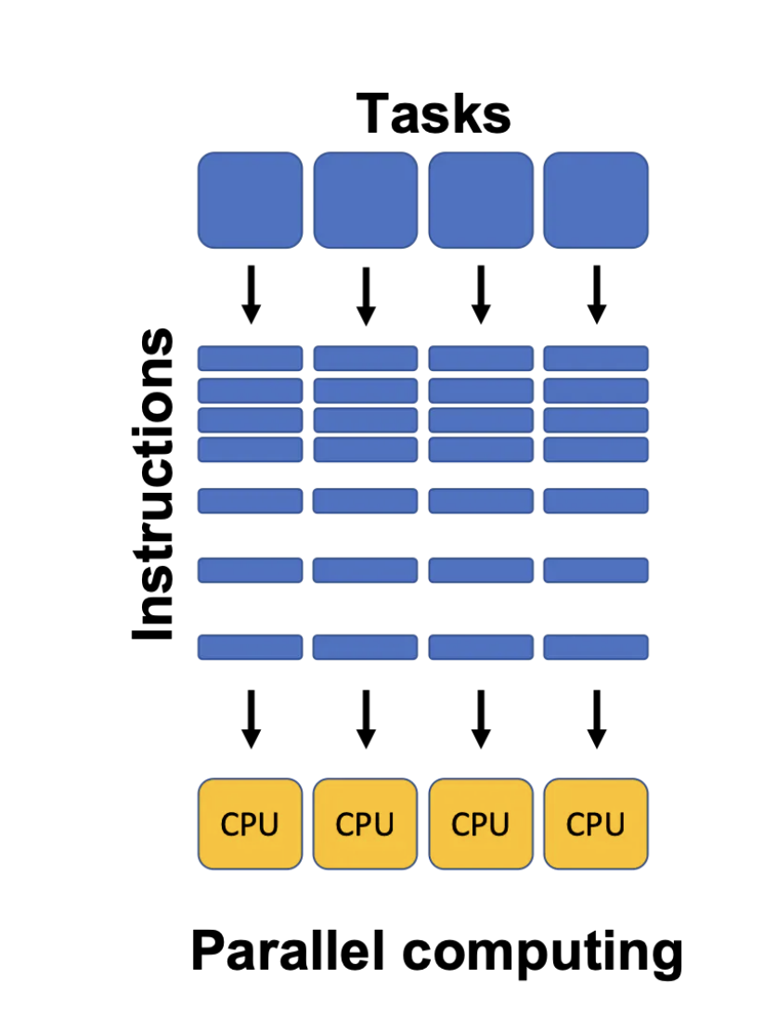
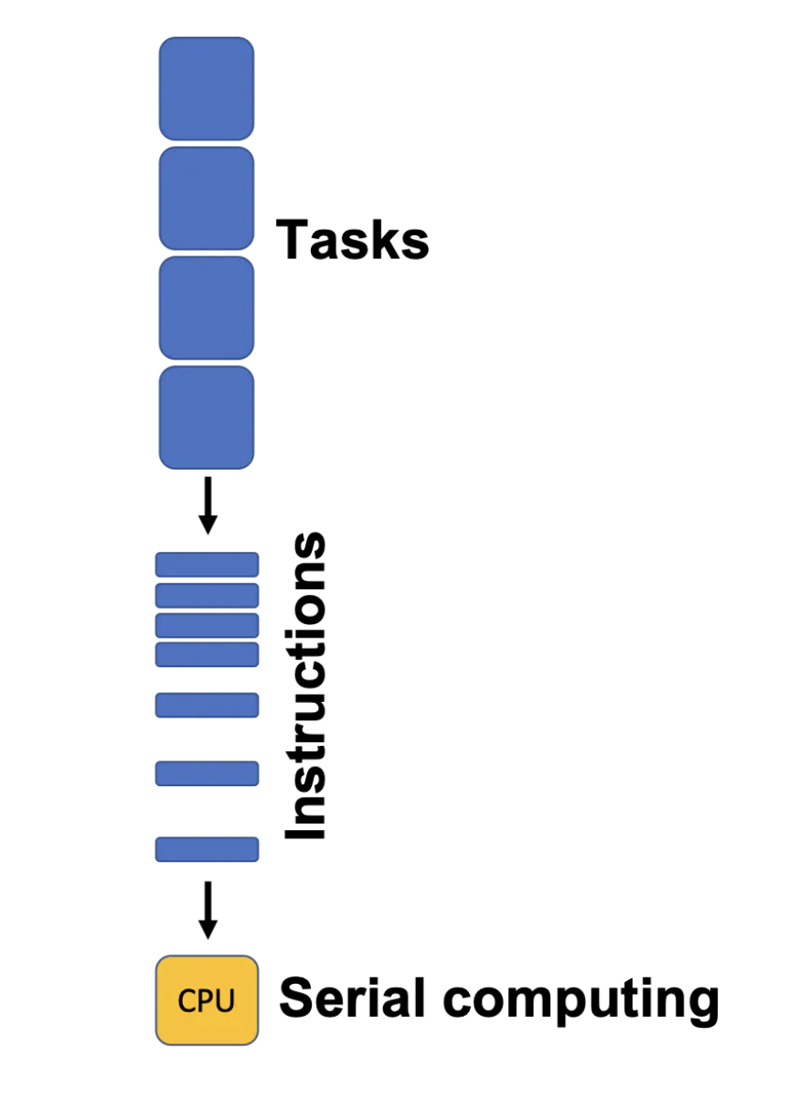
Serial vs. Parallel
Serial: tasks must be performed in sequence
Parallel: tasks can be performed independently in any order
“Unlocking the Power of Parallel Computing in Julia Programming” by Ombar Karacharekar, from https://omkaracharekar.hashnode.dev/unlocking-the-power-of-parallel-computing-in-julia-programming

Slide 10
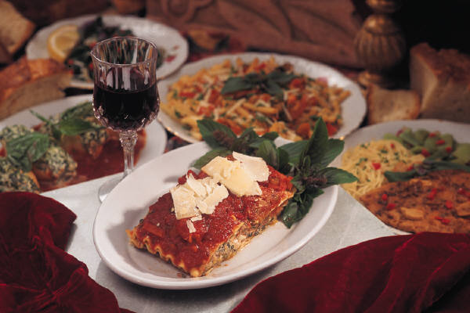
Serial vs. Parallel: Example
Preparing lasagna dinner
SERIAL TASKS
Making the sauce
Assembling the lasagna
Baking the lasagna
Washing lettuce
Cutting vegetables
Assembling the salad
PARALLEL TASKS
Making the lasagna
Making the salad
Setting the table

Slide 11
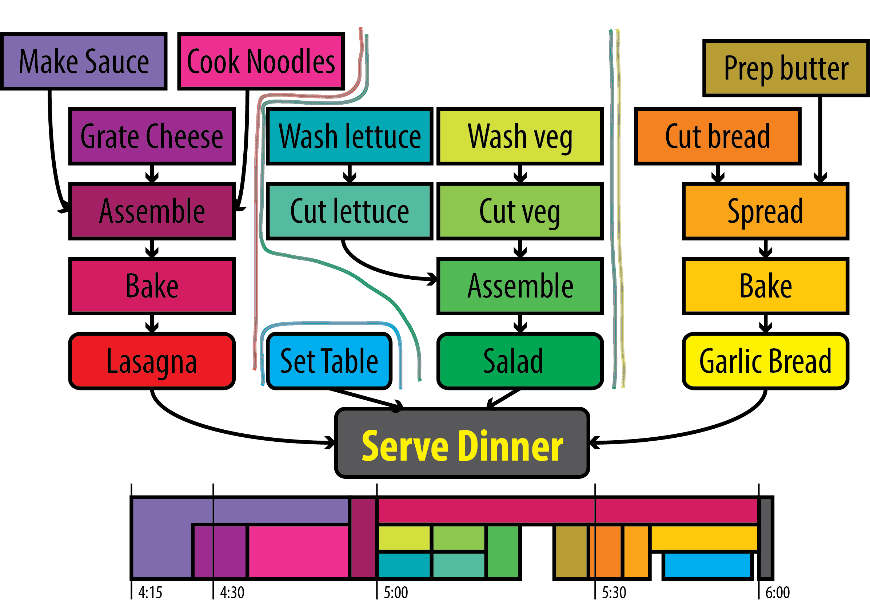
Serial vs. Parallel: Graph

Slide 12
Serial vs. Parallel: Graph
Synchronization Points

Slide 13
Serial vs. Parallel: Graph

Slide 14
Serial vs. Parallel: Example
Could have several chefs, each performing one parallel task
This is concept behind parallel computing

Slide 15
Discussion: Jigsaw Puzzle*
Suppose we want to do a large, N-piece jigsaw puzzle (e.g., N = 10,000 pieces)
Time for one person to complete puzzle: T hours
How can we decrease walltime to completion?

Slide 16
Discussion: Jigsaw Puzzle
Impact of having multiple people at the table
Walltime to completion
Communication
Resource contention
Let number of people = p
Think about what happens when p = 1, 2, 4, … 5000

Slide 17
Discussion: Jigsaw Puzzle
Alternate setup: p people, each at separate table with N/p pieces each
What is the impact on
Walltime to completion
Communication
Resource contention?

Slide 18
Discussion: Jigsaw Puzzle
Alternate setup: divide puzzle by features, each person works on one, e.g., mountain, sky, stream, tree, meadow, etc.
What is the impact on
Walltime to completion
Communication
Resource contention?

Slide 19
Parallel Algorithm Design: PCAM
Partition
Decompose problem into fine-grained tasks to maximize potential parallelism
Communication
Determine communication pattern among tasks
Agglomeration
Combine into coarser-grained tasks, if necessary, to reduce communication requirements or other costs
Mapping
Assign tasks to processors, subject to tradeoff between communication cost and concurrency
(from Heath: Parallel Numerical Algorithms)

Slide 20
II. ARCHITECTURE
“Architecture” by marie-ll, http://www.flickr.com/photos/grrrl/324473920/sizes/l/in/photostream/

Slide 21
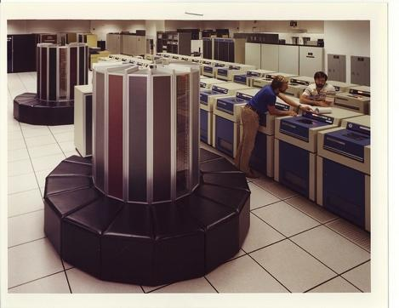
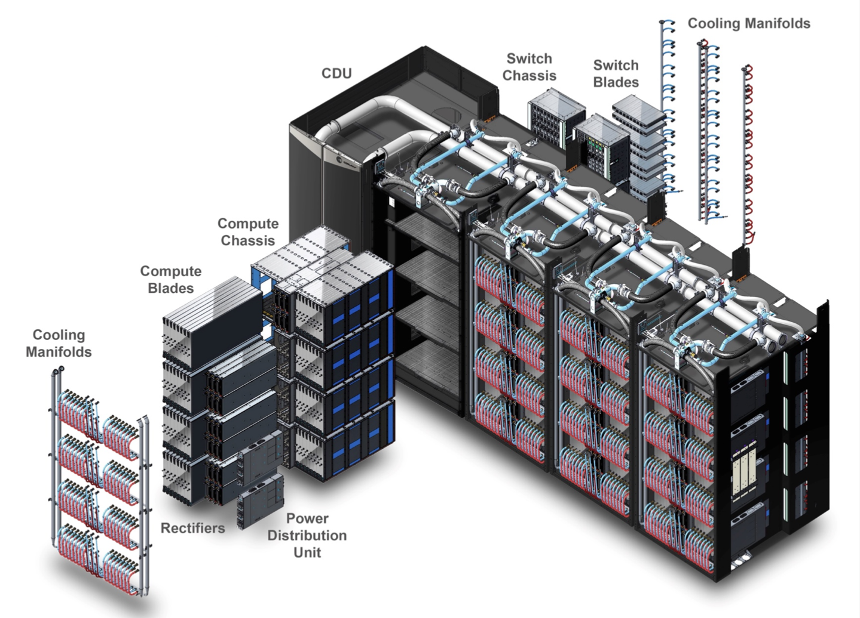
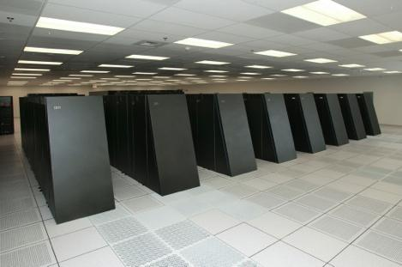
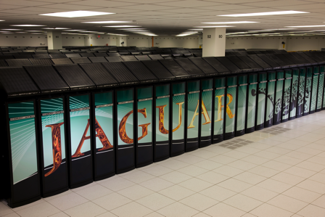
II. Supercomputer Architecture
What is a supercomputer?
Conceptual overview of architecture
HPE-Cray Shasta Architecture (2021)
Cray 1 (1976)
IBM Blue Gene (2005)
Cray XT5 (2009)

Slide 22
What Is a Supercomputer?
“The biggest, fastest computer right this minute.” – Henry Neeman
Generally, at least 100 times more powerful than PC
This field of study known as supercomputing, high-performance computing (HPC), or scientific computing
Scientists utilize supercomputers to solve complex problems.
Really hard problems need really LARGE (super)computers

Slide 23
SMP Architecture
SMP stands for Symmetric Multiprocessing architecture
commonly used in supercomputers, servers, and high-performance computing environments.
all processors have equal access to memory and input/output devices.
Massive memory, shared by multiple processors
Any processor can work on any task, no matter its location in memory
Ideal for parallelization of sums, loops, etc.
SMP systems and architectures allow for better load balancing and resource utilization across multiple processors.

Slide 24
Cluster Architecture
CPUs on racks, do computations (fast)
Communicate through networked connections (slow)
Want to write programs that divide computations evenly but minimize communication

Slide 25
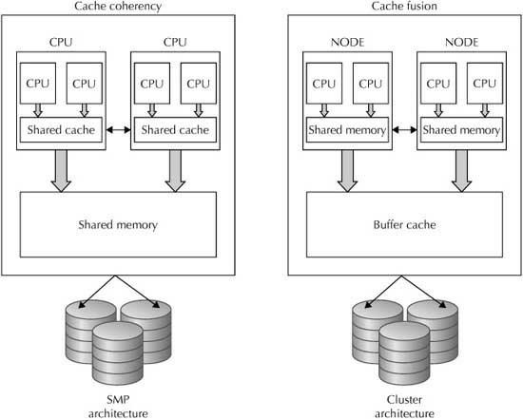
SMP Architecture vs Cluster Architecture

Slide 26
State-of-the-Art Architectures
Today, hybrid architectures very common
Multiple {16, 24, 32, 64, 68, 128}-core nodes, connected to other nodes by (slow) interconnect
Cores in node share memory (like small SMP machines)
Machine appears to follow cluster architecture (with multi-core nodes rather than single processors)
To take advantage of all parallelism, use MPI (cluster) and OpenMP (SMP) hybrid programming

Slide 27
State-of-the-Art Architectures
Hybrid CPU/GPGPU architectures also very common
Nodes consist of one (or more) multicore CPU + one (or more) GPU
Heavy computations offloaded to GPGPUs
Separate memory for CPU and GPU
Complicated programming paradigm, outside the scope of today’s training
Often use CUDA to directly program GPU offload portions of code
Alternatives: standards-based directives, OpenACC or OpenMP offloading; programming environments such as Kokkos or Raja

Slide 28
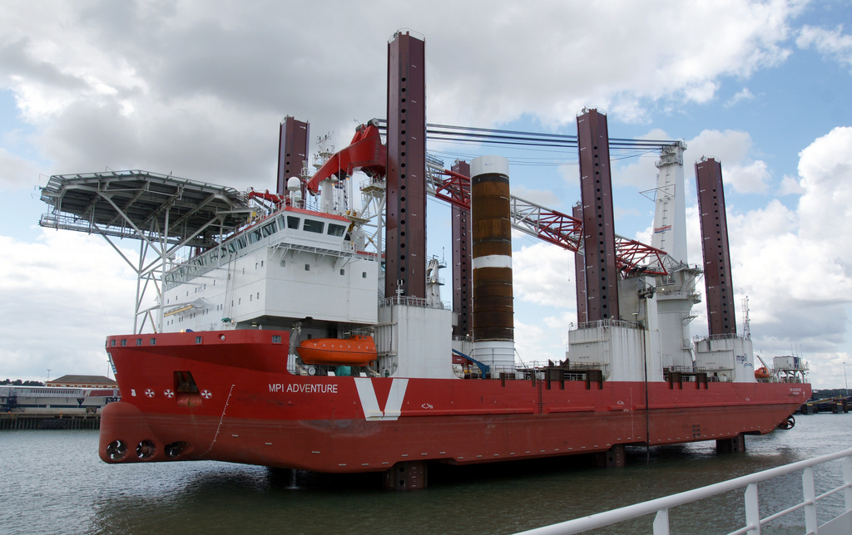
III. BASIC MPI
“MPI Adventure” by Stefan Jürgensen, from http://www.flickr.com/photos/94039982@N00/6177616380/sizes/l/in/photostream/

Slide 29
III. Basic MPI
Introduction to MPI
Parallel programming concepts
The Six Necessary MPI Commands
Example program

Slide 30
Introduction to MPI
Stands for Message Passing Interface
Industry standard for parallel programming (200+ page document)
MPI implemented by many vendors; open source implementations available too
Cray, IBM, HPE vendor implementations
MPICH, LAM-MPI, OpenMPI (open source)
MPI function library is used in writing C, C++, or Fortran programs in HPC

Slide 31
Introduction to MPI
MPI-1 vs. MPI-2: MPI-2 has additional advanced functionality and C++ bindings, but everything learned in this section applies to both standards
MPI-3: Major revisions (e.g., nonblocking collectives, extensions to one-sided operations), released September 2012, 800+ pages
MPI-3.1 released June 2015
MPI-3 additions to standard will not be covered today
MPI-4: Standard released June, 2021
MPI-4 additions to standard will also not be covered today

Slide 32
Parallelization Concepts
Two primary programming paradigms:
SPMD (single program, multiple data)
MPMD (multiple programs, multiple data)
MPI can be used for either paradigm

Slide 33
SPMD vs. MPMD
SPMD: Write single program that will perform same operation on multiple sets of data
Multiple chefs baking many lasagnas
Rendering different frames of movie
MPMD: Write different programs to perform different operations on multiple sets of data
Multiple chefs preparing four-course dinner
Rendering different parts of movie frame
Can also write hybrid program in which some processes perform same task

Slide 34
The Six Necessary MPI Commands
int MPI_Init(int *argc, char **argv)
int MPI_Finalize(void)
int MPI_Comm_size(MPI_Comm comm, int *size)
int MPI_Comm_rank(MPI_Comm comm, int *rank)
int MPI_Send(void *buf, int count, MPI_Datatype datatype, int dest, int tag, MPI_Comm comm)
int MPI_Recv(void *buf, int count, MPI_Datatype datatype, int source, int tag, MPI_Comm comm, MPI_Status *status)

Slide 35
Initiation and Termination
MPI_Init(int *argc, char **argv) initiates MPI
Place in body of code after variable declarations and before any MPI commands
MPI_Finalize(void) shuts down MPI
Place near end of code, after last MPI command

Slide 36
Environmental Inquiry
MPI_Comm_size(MPI_Comm comm, int *size)
Find out number of processes
Allows flexibility in number of processes used in program
MPI_Comm_rank(MPI_Comm comm, int *rank)
Find out identifier of current process
0 ≤ rank ≤ size-1

Slide 37
Message Passing: Send
MPI_Send(void *buf, int count, MPI_Datatype datatype, int dest, int tag, MPI_Comm comm)
Send message of length count items and datatype datatype contained in buf with tag tag to process number dest in communicator comm
E.g., MPI_Send(&x, 1, MPI_DOUBLE, manager, me, MPI_COMM_WORLD)

Slide 38
Message Passing: Receive
MPI_Recv(void *buf, int count, MPI_Datatype datatype, int source, int tag, MPI_Comm comm, MPI_Status *status)
Receive message of length count items and datatype datatype with tag tag in buffer buf from process number source in communicator comm, and record status status
E.g. MPI_Recv(&x, 1, MPI_DOUBLE, source, source, MPI_COMM_WORLD, &status)

Slide 39
Message Passing
WARNING! Both standard send and receive functions are blocking
MPI_Recv returns only after receive buffer contains requested message
MPI_Send may or may not block until message received (usually blocks)
Must watch out for deadlock

Slide 40
Message Passing Interface

Slide 41
Deadlocking Example (Always)
#include <mpi.h>
#include <stdio.h>
int main(int argc, char **argv) {
int me, np, q, sendto;
MPI_Status status;
MPI_Init(&argc, &argv);
MPI_Comm_size(MPI_COMM_WORLD, &np);
MPI_Comm_rank(MPI_COMM_WORLD, &me);
if (np%2==1) return 0;
if (me%2==1) {sendto = me-1;}
else {sendto = me+1;}
MPI_Recv(&q, 1, MPI_INT, sendto, sendto, MPI_COMM_WORLD, &status);
MPI_Send(&me, 1, MPI_INT, sendto, me, MPI_COMM_WORLD);
printf(“Sent %d to proc %d, received %d from proc %d\n”, me, sendto, q, sendto);
MPI_Finalize();
return 0;
}

Slide 42
Deadlocking Example (Sometimes)
#include <mpi.h>
#include <stdio.h>
int main(int argc, char **argv) {
int me, np, q, sendto;
MPI_Status status;
MPI_Init(&argc, &argv);
MPI_Comm_size(MPI_COMM_WORLD, &np);
MPI_Comm_rank(MPI_COMM_WORLD, &me);
if (np%2==1) return 0;
if (me%2==1) {sendto = me-1;}
else {sendto = me+1;}
MPI_Send(&me, 1, MPI_INT, sendto, me, MPI_COMM_WORLD);
MPI_Recv(&q, 1, MPI_INT, sendto, sendto, MPI_COMM_WORLD, &status);
printf(“Sent %d to proc %d, received %d from proc %d\n”, me, sendto, q, sendto);
MPI_Finalize();
return 0;
}

Slide 43
Deadlocking Example (Safe)
#include <mpi.h>
#include <stdio.h>
int main(int argc, char **argv) {
int me, np, q, sendto;
MPI_Status status;
MPI_Init(&argc, &argv);
MPI_Comm_size(MPI_COMM_WORLD, &np);
MPI_Comm_rank(MPI_COMM_WORLD, &me);
if (np%2==1) return 0;
if (me%2==1) {sendto = me-1;}
else {sendto = me+1;}
if (me%2 == 0) {
MPI_Send(&me, 1, MPI_INT, sendto, me, MPI_COMM_WORLD);
MPI_Recv(&q, 1, MPI_INT, sendto, sendto, MPI_COMM_WORLD, &status);
} else {
MPI_Recv(&q, 1, MPI_INT, sendto, sendto, MPI_COMM_WORLD, &status);
MPI_Send(&me, 1, MPI_INT, sendto, me, MPI_COMM_WORLD);
}
printf(“Sent %d to proc %d, received %d from proc %d\n”, me, sendto, q, sendto);
MPI_Finalize();
return 0;
}

Slide 44
Explanation: Always Deadlocking Example
Logically incorrect
Deadlock caused by blocking MPI_Recvs
All processes wait for corresponding MPI_Sends to begin, which never happens

Slide 45
Explanation: Sometimes Deadlocking Example
Logically correct
Deadlock could be caused by MPI_Sends competing for buffer space
Unsafe because depends on system resources
Solutions:
Reorder sends and receives, like safe example, having evens send first and odds send second
Use non-blocking sends and receives or other advanced functions from MPI library (see MPI standard for details)

Slide 46
INTERLUDE 1: COMPUTING PI IN PARALLEL
“Pi of Pi” by spellbee2, from http://www.flickr.com/photos/49825386@N08/7253578340/sizes/l/in/photostream/

Slide 47
Interlude 1: Computing 𝝅 in Parallel
Project Description
Serial Code
Parallelization Strategies
Your Assignment

Slide 48
Project Description
We want to compute 𝝅
One method: method of darts*
Ratio of area of square to area of inscribed circle proportional to 𝝅
* This is a TERRIBLE way to compute pi! Don’t do this in real life!!!! (See Appendix 1 for better ways)
“Picycle” by Tang Yau Hoong, from http://www.flickr.com/photos/tangyauhoong/5609933651/sizes/o/in/photostream/

Slide 49
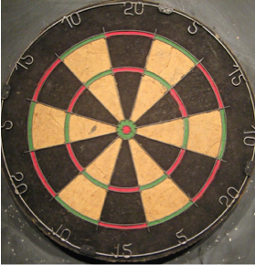
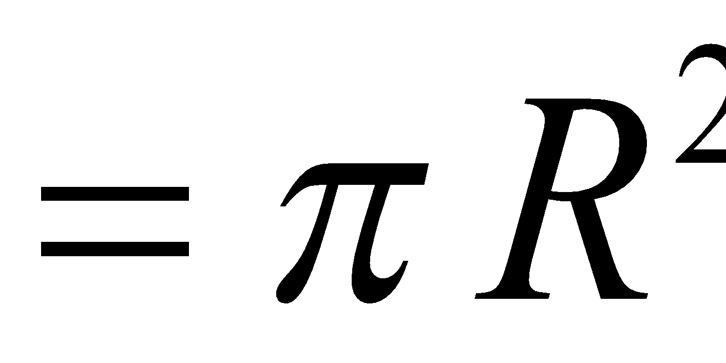
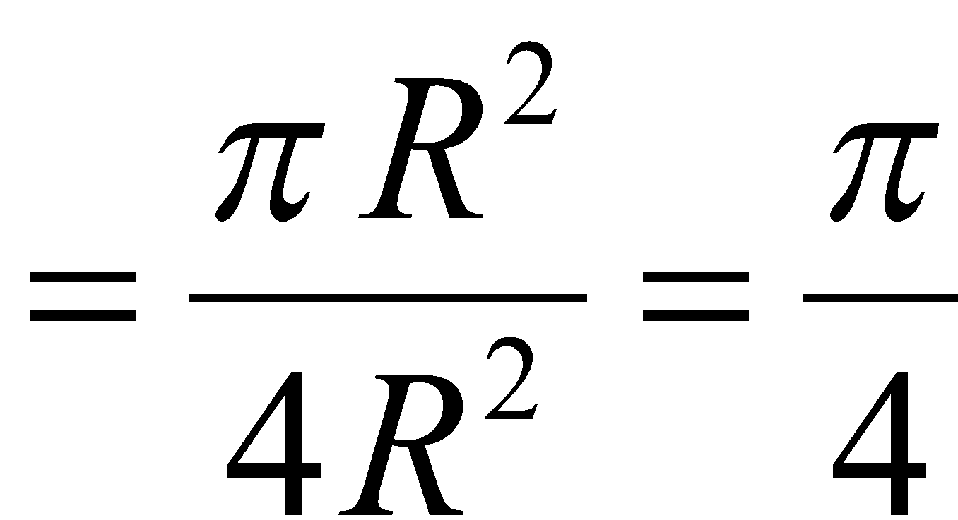
Method of Darts
Imagine dartboard with circle of radius R inscribed in square
Area of circle
Area of square
Area of circle Area of square
“Dartboard” by AndyRobertsPhotos, from http://www.flickr.com/photos/aroberts/2907670014/sizes/o/in/photostream/

Slide 50
Method of Darts
Ratio of areas proportional to 𝝅
How to find areas?
Suppose we threw darts (completely randomly) at dartboard
Count # darts landing in circle & total # darts landing in square
Ratio of these numbers gives approximation to ratio of areas
Quality of approximation increases with # darts thrown

Slide 51
Method of Darts
𝝅 = 4 × # darts inside circle
# darts thrown
Method of Darts cake in celebration of Pi Day 2009, Rebecca Hartman-Baker

Slide 52
Method of Darts
Okay, Rebecca and Charles, but how in the world do we simulate this experiment on a computer?
Decide on length R
Generate pairs of random numbers (x, y) s.t.
-R ≤ (x, y) ≤ R
If (x, y) within circle (i.e., if (x²+y²) ≤ R²) add one to tally for inside circle
Lastly, find ratio

Slide 53
Serial Code (darts.c)
#include "lcgenerator.h"
static long num_trials = 1000000;
int main() {
long i;
long Ncirc = 0;
double pi, x, y;
double r = 1.0; // radius of circle
double r2 = r*r;
for (i = 0; i < num_trials; i++) {
x = r*lcgrandom();
y = r*lcgrandom();
if ((x*x + y*y) <= r2)
Ncirc++;
}
pi = 4.0 * ((double)Ncirc)/((double)num_trials);
printf("\n For %ld trials, pi = %f\n", num_trials, pi);
return 0;
}

Slide 54
Serial Code (lcgenerator.h)
// Random number generator -- and not a very good one, either!
static long MULTIPLIER = 1366;
static long ADDEND = 150889;
static long PMOD = 714025;
long random_last = 0;
// This is not a thread-safe random number generator
double lcgrandom() {
long random_next;
random_next = (MULTIPLIER * random_last + ADDEND)%PMOD;
random_last = random_next;
return ((double)random_next/(double)PMOD);
}

Slide 55
Serial Code (darts.f) (1)
! First, the pseudorandom number generator
real function lcgrandom()
integer*8, parameter :: MULTIPLIER = 1366
integer*8, parameter :: ADDEND = 150889
integer*8, parameter :: PMOD = 714025
integer*8, save :: random_last = 0
integer*8 :: random_next = 0
random_next = mod((MULTIPLIER * random_last + ADDEND), PMOD)
random_last = random_next
lcgrandom = (1.0*random_next)/PMOD
return
end

Slide 56
Serial Code (darts.f) (2)
! Now, we compute pi
program darts
implicit none
integer*8 :: num_trials = 1000000, i = 0, Ncirc = 0
real :: pi = 0.0, x = 0.0, y = 0.0, r = 1.0
real :: r2 = 0.0
real :: lcgrandom
r2 = r*r
do i = 1, num_trials
x = r*lcgrandom()
y = r*lcgrandom()
if ((x*x + y*y) .le. r2) then
Ncirc = Ncirc+1
end if
end do
pi = 4.0*((1.0*Ncirc)/(1.0*num_trials))
print*, ‘ For ‘, num_trials, ‘ trials, pi = ‘, pi
end

Slide 57
Parallelization Strategies
What tasks independent of each other?
What tasks must be performed sequentially?
Using PCAM parallel algorithm design strategy

Slide 58
Partition
“Decompose problem into fine-grained tasks to maximize potential parallelism”
Finest grained task: throw of one dart
Each throw independent of all others
If we had huge computer, could assign one throw to each processor

Slide 59
Communication
“Determine communication pattern among tasks”
Each processor throws dart(s) then sends results back to manager process

Slide 60
Agglomeration
“Combine into coarser-grained tasks, if necessary, to reduce communication requirements or other costs”
To get good value of π, must use millions of darts
We don’t have millions of processors available
Furthermore, communication between manager and millions of worker processors would be very expensive
Solution: divide up number of dart throws evenly between processors, so each processor does a share of work

Slide 61
Mapping
“Assign tasks to processors, subject to tradeoff between communication cost and concurrency”
Assign role of “manager” to processor 0
Processor 0 will receive tallies from all the other processors, and will compute final value of π
Every processor, including manager, will perform equal share of dart throws

Slide 62
Your Assignment
Clone the whole assignment (including answers!) to Perlmutter from the repository with: git clone https://github.com/NERSC/crash-course-supercomputing.git
Copy darts.c/lcgenerator.h or darts.f (your choice) from crash-course-supercomputing/darts-suite/{c,fortran}
Parallelize the code using the 6 basic MPI commands
Rename your new MPI code darts-mpi.c or darts-mpi.f

Slide 63
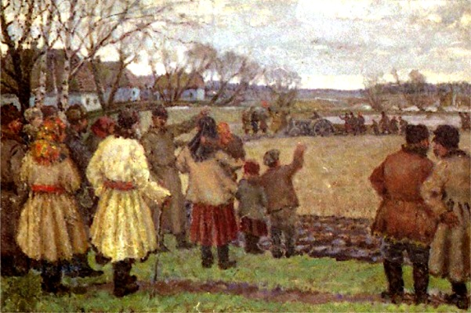
IV. MPI COLLECTIVES
“The First Tractor” by Vladimir Krikhatsky (socialist realist, 1877-1942). Source: http://en.wikipedia.org/wiki/File:Wladimir_Gawriilowitsch_Krikhatzkij_-_The_First_Tractor.jpg

Slide 64
MPI Collectives
Communication involving group of processes
Collective operations
Broadcast
Gather
Scatter
Reduce
All-
Barrier

Slide 65
Broadcast
Perhaps one message needs to be sent from manager to all worker processes
Could send individual messages
Instead, use broadcast – more efficient, faster
int MPI_Bcast(void* buffer, int count, MPI_Datatype datatype, int root, MPI_Comm comm)

Slide 66
Gather
All processes need to send same (similar) message to manager
Could implement with each process calling MPI_Send(…) and manager looping through MPI_Recv(…)
Instead, use gather operation – more efficient, faster
Messages concatenated in rank order
int MPI_Gather(void* sendbuf, int sendcount, MPI_Datatype sendtype, void* recvbuf, int recvcount, MPI_Datatype recvtype, int root, MPI_Comm comm)
Note: recvcount = # items received from each process, not total

Slide 67
Gather
Maybe some processes need to send longer messages than others
Allow varying data count from each process with MPI_Gatherv(…)
int MPI_Gatherv(void* sendbuf, int sendcount, MPI_Datatype sendtype, void* recvbuf, int *recvcounts, int *displs, MPI_Datatype recvtype, int root, MPI_Comm comm)
recvcounts is array; entry i in displs array specifies displacement relative to recvbuf[0] at which to place data from corresponding process number

Slide 68
Scatter
Inverse of gather: split message into NP equal pieces, with ith segment sent to ith process in group
int MPI_Scatter(void* sendbuf, int sendcount, MPI_Datatype sendtype, void* recvbuf, int recvcount, MPI_Datatype recvtype, int root, MPI_Comm comm)
Send messages of varying sizes across processes in group: MPI_Scatterv(…)
int MPI_Scatterv(void* sendbuf, int *sendcounts, int *displs, MPI_datatype sendtype, void* recvbuf, int recvcount, MPI_Datatype recvtype, int root, MPI_Comm comm)

Slide 69
Reduce
Perhaps we need to do sum of many subsums owned by all processors
Perhaps we need to find maximum value of variable across all processors
Perform global reduce operation across all group members
int MPI_Reduce(void* sendbuf, void* recvbuf, int count, MPI_Datatype datatype, MPI_Op op, int root, MPI_Comm comm)

Slide 70
Reduce: Predefined Operations
MPI_Op | Meaning | Allowed Types
MPI_MAX | Maximum | Integer, floating point
MPI_MIN | Minimum | Integer, floating point
MPI_SUM | Sum | Integer, floating point, complex
MPI_PROD | Product | Integer, floating point, complex
MPI_LAND | Logical and | Integer, logical
MPI_BAND | Bitwise and | Integer, logical
MPI_LOR | Logical or | Integer, logical
MPI_BOR | Bitwise or | Integer, logical
MPI_LXOR | Logical xor | Integer, logical
MPI_BXOR | Bitwise xor | Integer, logical
MPI_MAXLOC | Maximum value & location | *
MPI_MINLOC | Minimum value & location | *

Slide 71
Reduce: Operations
MPI_MAXLOC and MPI_MINLOC
Returns {max, min} and rank of first process with that value
Use with special MPI pair datatype arguments:
MPI_FLOAT_INT (float and int)
MPI_DOUBLE_INT (double and int)
MPI_LONG_INT (long and int)
MPI_2INT (pair of int)
See MPI standard for more details
User-defined operations
Use MPI_Op_create(…) to create new operations
See MPI standard for more details

Slide 72
All- Operations
Sometimes, may want to have result of gather, scatter, or reduce on all processes
Gather operations
int MPI_Allgather(void* sendbuf, int sendcount, MPI_Datatype sendtype, void* recvbuf, int recvcount, MPI_Datatype recvtype, MPI_Comm comm)
int MPI_Allgatherv(void* sendbuf, int sendcount, MPI_Datatype sendtype, void* recvbuf, int *recvcounts, int *displs, MPI_Datatype recvtype, MPI_Comm comm)

Slide 73
All-to-All Scatter/Gather
Extension of Allgather in which each process sends distinct data to each receiver
Block j from process i is received by process j into ith block of recvbuf
int MPI_Alltoall(void* sendbuf, int sendcount, MPI_Datatype sendtype, void* recvbuf, int recvcount, MPI_Datatype recvtype, MPI_Comm comm)
Corresponding MPI_Alltoallv function also available

Slide 74
All-Reduce
Same as MPI_Reduce except result appears on all processes
int MPI_Allreduce(void* sendbuf, void* recvbuf, int count, MPI_Datatype datatype, MPI_Op op, MPI_Comm comm)

Slide 75
Barrier
In algorithm, may need to synchronize processes
Barrier blocks until all group members have called it
int MPI_Barrier(MPI_Comm comm)

Slide 76
Bibliography/Resources: MPI/MPI Collectives
Snir, Marc, Steve W. Otto, Steven Huss-Lederman, David W. Walker, and Jack Dongarra. (1996) MPI: The Complete Reference. Cambridge, MA: MIT Press. (also available at http://www.netlib.org/utk/papers/mpi-book/mpi-book.html)
MPICH Documentation http://www.mpich.org/documentation/guides/

Slide 77
Bibliography/Resources: MPI/MPI Collectives
Message Passing Interface (MPI) Tutorial https://hpc-tutorials.llnl.gov/mpi/
MPI Standard at MPI Forum: https://www.mpi-forum.org/docs/
MPI 1.1: http://www.mpi-forum.org/docs/mpi-11-html/mpi-report.html
MPI-2.2: http://www.mpi-forum.org/docs/mpi22-report/mpi22-report.htm
MPI 3.1: https://www.mpi-forum.org/docs/mpi-3.1/mpi31-report.pdf
MPI 4.0: https://www.mpi-forum.org/docs/mpi-4.0/mpi40-report.pdf

Slide 78
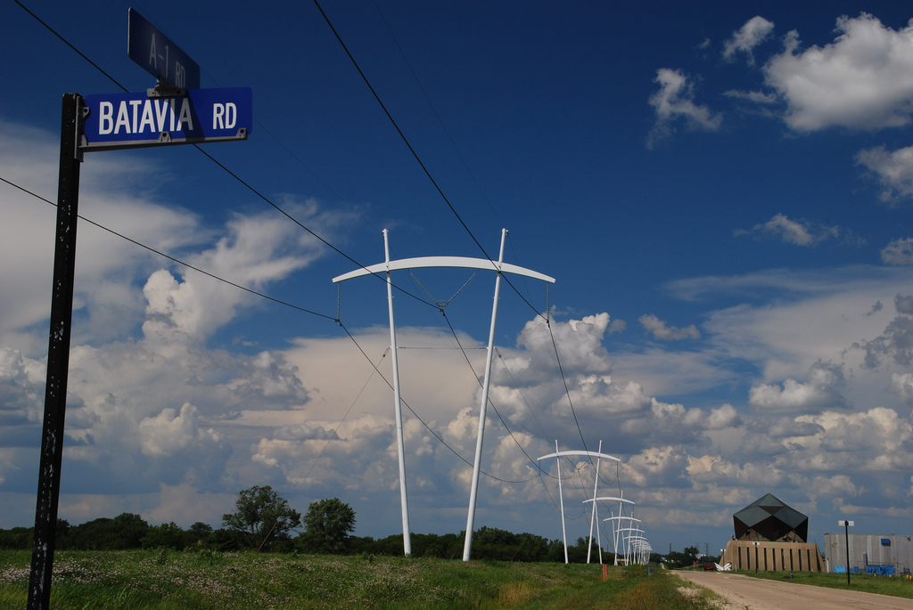
INTERLUDE 2: COMPUTING PI WITH MPI COLLECTIVES
“Pi-Shaped Power Lines at Fermilab” by Michael Kappel from http://www.flickr.com/photos/m-i-k-e/4781834200/sizes/l/in/photostream/

Slide 79
Interlude 2: Computing 𝝅 with MPI Collectives
In previous Interlude, you used the 6 basic MPI routines to develop a parallel program using the Method of Darts to compute 𝝅
The communications in previous program could be made more efficient by using collectives
Your assignment: update your MPI code to use collective communications
Rename it darts-collective.c or darts-collective.f

Slide 80
OpenMP & Hybrid Programming

Slide 81
Outline
About OpenMP
OpenMP Directives
Data Scope
Runtime Library Routines and Environment Variables
Using OpenMP
Hybrid Programming

Slide 82
I. ABOUT OPENMP

Slide 83
About OpenMP
Industry-standard shared memory programming model
Developed in 1997
OpenMP Architecture Review Board (ARB) determines additions and updates to standard
Current standard: 5.2 (November 2021)
Standard includes GPU offloading (since 4.5), not discussed today

Slide 84
Advantages to OpenMP
Parallelize small parts of application, one at a time (beginning with most time-critical parts)
Can express simple or complex algorithms
Code size grows only modestly
Expression of parallelism flows clearly, so code is easy to read
Single source code for OpenMP and non-OpenMP – non-OpenMP compilers simply ignore OMP directives

Slide 85
OpenMP Programming Model
Application Programmer Interface (API) is combination of
Directives
Runtime library routines
Environment variables
API falls into three categories
Expression of parallelism (flow control)
Data sharing among threads (communication)
Synchronization (coordination or interaction)

Slide 86
Parallelism
Shared memory, thread-based parallelism
Explicit parallelism (parallel regions)
Fork/join model
Source: https://hpc-tutorials.llnl.gov/openmp/

Slide 87
II. OPENMP DIRECTIVES
Star Trek: Prime Directive by Judith and Garfield Reeves-Stevens, ISBN 0671744666

Slide 88
II. OpenMP Directives
Syntax overview
Parallel
Loop
Sections
Synchronization
Reduction

Slide 89
Syntax Overview: C/C++
Basic format
#pragma omp directive-name [clause] newline
All directives followed by newline
Uses pragma construct (pragma = Greek for “thing done”)
Case sensitive
Directives follow standard rules for C/C++ compiler directives
Use curly braces (not on pragma line) to denote scope of directive
Long directive lines can be continued by escaping newline character with \

Slide 90
Syntax Overview: Fortran
Basic format:
sentinel directive-name [clause]
Three accepted sentinels: !$omp *$omp c$omp
Some directives paired with end clause
Fixed-form code:
Any of three sentinels beginning at column 1
Initial directive line has space/zero in column 6
Continuation directive line has non-space/zero in column 6
Standard rules for fixed-form line length, spaces, etc. apply
Free-form code:
!$omp only accepted sentinel
Sentinel can be in any column, but must be preceded by only white space and followed by a space
Line to be continued must end in & and following line begins with sentinel
Standard rules for free-form line length, spaces, etc. apply

Slide 91
OpenMP Directives: Parallel
A block of code executed by multiple threads
Syntax:
#pragma omp parallel private(list) shared(list)
{
/* parallel section */
}
!$omp parallel private(list) &
!$omp shared(list)
! Parallel section
!$omp end parallel

Slide 92
Simple Example (C/C++)
#include <stdio.h>
#include <omp.h>
int main (int argc, char *argv[]) {
int tid;
printf(“Hello world from threads:\n”);
#pragma omp parallel private(tid)
{
tid = omp_get_thread_num();
printf(“<%d>\n”, tid);
}
printf(“I am sequential now\n”);
return 0;
}

Slide 93
Simple Example (Fortran)
program hello
integer tid, omp_get_thread_num
write(*,*) ‘Hello world from threads:’
!$omp parallel private(tid)
tid = omp_get_thread_num()
write(*,*) ‘<‘, tid, ‘>’
!$omp end parallel
write(*,*) ‘I am sequential now’
end

Slide 94
Simple Example: Output
Output 1
Hello world from threads:
<0>
<1>
<2>
<3>
<4>
I am sequential now
Output 2
Hello world from threads:
<1>
<2>
<0>
<4>
<3>
I am sequential now
Order of execution is scheduled by OS!!!

Slide 95
OpenMP Directives: Loop
Iterations of the loop following the directive are executed in parallel
Syntax (C):
#pragma omp for schedule(type [,chunk]) private(list)\ shared(list) nowait
{
/* for loop */
}

Slide 96
OpenMP Directives: Loop
Syntax (Fortran):
!$omp do schedule (type [,chunk]) &
!omp private(list) shared(list)
C do loop goes here
!$omp end do nowait
type = {static, dynamic, guided, runtime}
If nowait specified, threads do not synchronize at end of loop

Slide 97
OpenMP Directives: Loop Scheduling
Default scheduling determined by implementation
Static
ID of thread performing particular iteration is function of iteration number and number of threads
Statically assigned at beginning of loop
Best for known, predictable amount of work per iteration
Low overhead
Dynamic
Assignment of threads determined at runtime (round robin)
Each thread gets more work after completing current work
Load balance is possible for variable work per iteration
Introduces extra overhead

Slide 98
OpenMP Directives: Loop Scheduling
Type | Chunks? | Chunk Size | # Chunks | Overhead | Description
static | N | N/P | P | Lowest | Simple Static
static | Y | C | N/C | Low | Interleaved
dynamic | N | N/P | P | Medium | Simple dynamic
dynamic | Y | C | N/C | High | Dynamic
guided | N/A | ≤ N/P | ≤ N/C | Highest | Dynamic optimized
runtime | Varies | Varies | Varies | Varies | Set by environment variable
Note: N = size of loop, P = number of threads, C = chunk size

Slide 99
Which Loops are Parallelizable?
Parallelizable
Number of iterations known upon entry, and does not change
Each iteration independent of all others
No data dependence
Not Parallelizable
Conditional loops (many while loops)
Iterator loops (e.g., iterating over std:: list<…> in C++)
Iterations dependent upon each other
Data dependence
Trick: If a loop can be run backwards and get the same results, then it is almost always parallelizable!

Slide 100
Example: Parallelizable?
/* Gaussian Elimination (no pivoting): x = A\b */
for (int i = 0; i < N-1; i++) {
for (int j = i; j < N; j++) {
double ratio = A[j][i]/A[i][i];
for (int k = i; k < N; k++) {
A[j][k] -= (ratio*A[i][k]);
b[j] -= (ratio*b[i]);
}
}
}

Slide 101
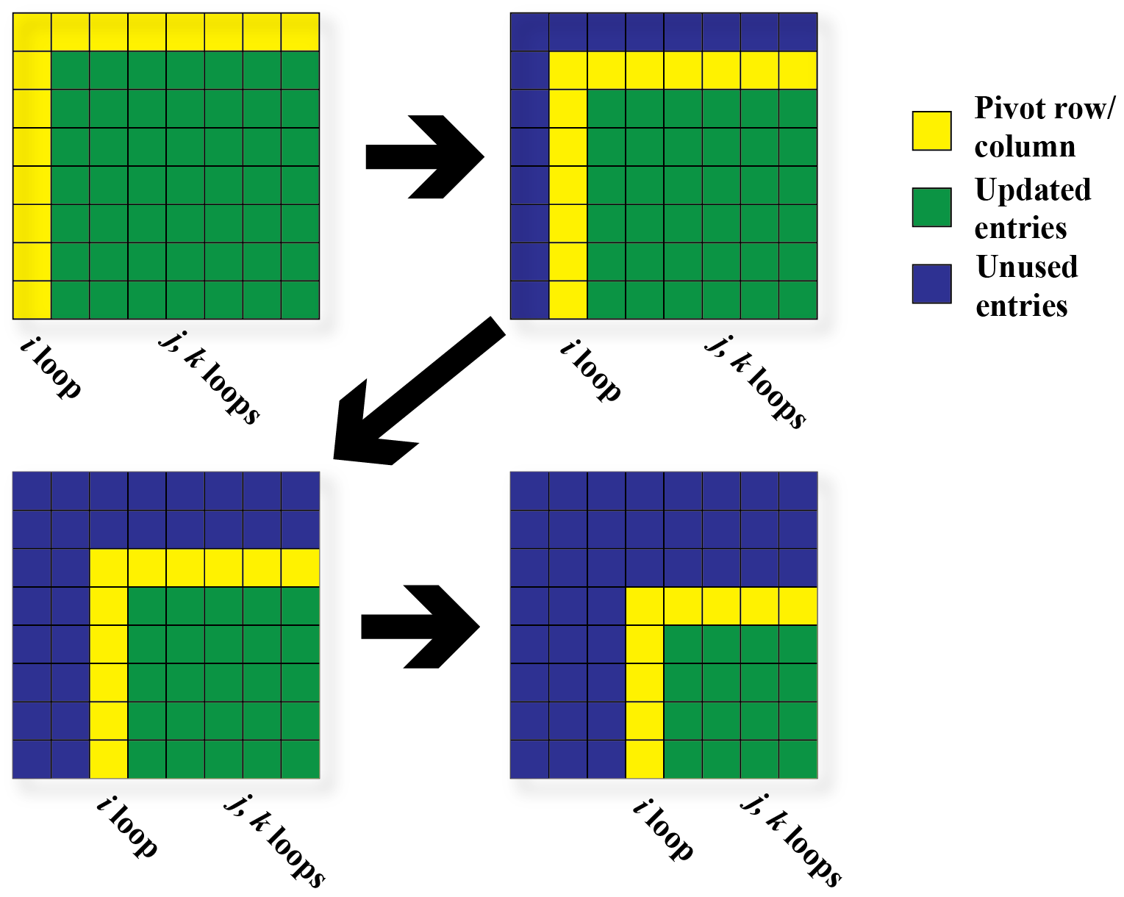
Example: Parallelizable?

Slide 102
Example: Parallelizable?
Outermost Loop (i):
N-1 iterations
Iterations depend upon each other (values computed at step i-1 used in step i)
Inner loop (j):
N-i iterations (constant for given i)
Iterations can be performed in any order
Innermost loop (k):
N-i iterations (constant for given i)
Iterations can be performed in any order

Slide 103
Example: Parallelizable?
/* Gaussian Elimination (no pivoting): x = A\b */
for (int i = 0; i < N-1; i++) {
#pragma omp parallel for
for (int j = i; j < N; j++) {
double ratio = A[j][i]/A[i][i];
for (int k = i; k < N; k++) {
A[j][k] -= (ratio*A[i][k]);
b[j] -= (ratio*b[i]);
}
}
}
Note: can combine parallel and for into single pragma

Slide 104
OpenMP Directives: Sections
Non-iterative work-sharing construct
Divide enclosed sections of code among threads
Section directives nested within sections directive
Syntax: C/C++ Fortran
#pragma omp sections !$omp sections
{
#pragma omp section !$omp section
/* first section */ c First section
#pragma omp section !$omp section
/* next section */ c Second section
} !$omp end sections

Slide 105
Example: Sections
#include <omp.h>
#define N 1000
int main () {
int i;
double a[N], b[N];
double c[N], d[N];
/* Some initializations */
for (i=0; i < N; i++) {
a[i] = i * 1.5;
b[i] = i + 22.35;
}
#pragma omp parallel shared(a,b,c,d) private(i)
{
#pragma omp sections nowait
{
#pragma omp section
for (i=0; i < N; i++)
c[i] = a[i] + b[i];
#pragma omp section
for (i=0; i < N; i++)
d[i] = a[i] * b[i];
} /* end of sections */
} /* end of parallel section */
return 0;
}

Slide 106
OpenMP Directives: Synchronization
Sometimes, need to make sure threads execute regions of code in proper order
Maybe one part depends on another part being completed
Maybe only one thread need execute a section of code
Synchronization directives
Critical
Barrier
Single

Slide 107
OpenMP Directives: Synchronization
Critical
Specifies section of code that must be executed by only one thread at a time
Syntax: C/C++
#pragma omp critical (name)
Fortran
!$omp critical (name)
!$omp end critical
Names are global identifiers – critical regions with same name are treated as same region

Slide 108
OpenMP Directives: Synchronization
Single
Enclosed code is to be executed by only one thread
Useful for thread-unsafe sections of code (e.g., I/O)
Syntax: C/C++ Fortran
#pragma omp single !$omp single
!$omp end single

Slide 109
OpenMP Directives: Synchronization
Barrier
Synchronizes all threads: thread reaches barrier and waits until all other threads have reached barrier, then resumes executing code following barrier
Syntax: C/C++ Fortran
#pragma omp barrier !$OMP barrier
Sequence of work-sharing and barrier regions encountered must be the same for every thread

Slide 110
OpenMP Directives: Reduction
Reduces list of variables into one, using operator (e.g., max, sum, product, etc.)
Syntax
#pragma omp reduction(op : list)
!$omp reduction(op : list)
where list is list of variables and op is one of following:
C/C++: +, -, *, &, ^, |, &&, ||, max, min
Fortran: +, -, *, .and., .or., .eqv., .neqv., max, min, iand, ior, ieor

Slide 111
III. VARIABLE SCOPE
“M119A2 Scope” by Georgia National Guard, source: http://www.flickr.com/photos/ganatlguard/5934238668/sizes/l/in/photostream/

Slide 112
III. Variable Scope
About variable scope
Scoping clauses
Common mistakes

Slide 113
About Variable Scope
Variables can be shared or private within a parallel region
Shared: one copy, shared between all threads
Single common memory location, accessible by all threads
Private: each thread makes its own copy
Private variables exist only in parallel region

Slide 114
About Variable Scope
By default, all variables shared except
Index values of parallel region loop – private by default
Local variables and value parameters within subroutines called within parallel region – private
Variables declared within lexical extent of parallel region – private
Variable scope is the most common source of errors in OpenMP codes
Correctly determining variable scope is key to correctness and performance of your code

Slide 115
Variable Scoping Clauses: Shared
Shared variables: shared (list)
By default, all variables shared unless otherwise specified
All threads access this variable in same location in memory
Race conditions can occur if access is not carefully controlled

Slide 116
Variable Scoping Clauses: Private
Private: private (list)
Variable exists only within parallel region
Value undefined at start and after end of parallel region
Private starting with defined values: firstprivate (list)
Private variables initialized to be the value held immediately before entry into parallel region
Private ending with defined value: lastprivate(list)
At end of loop, set variable to value set by final iteration of loop

Slide 117
Common Mistakes
A variable that should be private is public
Something unexpectedly gets overwritten
Solution: explicitly declare all variable scope
Nondeterministic execution
Different results from different executions
Race condition
Sometimes you get the wrong answer
Solutions:
Look for overwriting of shared variable
Use a tool such as Cray Reveal or Codee to rescope your loop

Slide 118
Find the Mistake(s)!
/* Gaussian Elimination (no pivoting): x = A\b */
int i, j, k;
double ratio;
for (i = 0; i < N-1; i++) {
#pragma omp parallel for
for (j = i; j < N; j++) {
ratio = A[j][i]/A[i][i];
for (k = i; k < N; k++) {
A[j][k] -= (ratio*A[i][k]);
b[j] -= (ratio*b[i]);
}
}
}
k & ratio are shared variables by default. Depending on compiler, k may be optimized out & therefore not impact correctness, but ratio will always lead to errors! Depending how loop is scheduled, you will see different answers.

Slide 119
Fix the Mistake(s)!
/* Gaussian Elimination (no pivoting): x = A\b */
int i, j, k;
double ratio;
for (i = 0; i < N-1; i++) {
#pragma omp parallel for private (j, k, ratio) \
shared (A, b, N) default (none)
for (j = i; j < N; j++) {
ratio = A[j][i]/A[i][i];
for (k = i; k < N; k++) {
A[j][k] -= (ratio*A[i][k]);
b[j] -= (ratio*b[i]);
}
}
}
By setting default (none), compiler will catch any variables not explicitly scoped

Slide 120
IV. RUNTIME LIBRARY ROUTINES & ENVIRONMENT VARIABLES
Panorama with snow-capped Mt. McKinley in Denali National Park, Alaska, USA, May 2011, by Rebecca Hartman-Baker.

Slide 121
OpenMP Runtime Library Routines
void omp_set_num_threads(int num_threads)
Sets number of threads used in next parallel region
Must be called from serial portion of code
int omp_get_num_threads()
Returns number of threads currently in team executing parallel region from which it is called
int omp_get_thread_num()
Returns rank of thread
0 ≤ omp_get_thread_num() < omp_get_num_threads()

Slide 122
OpenMP Environment Variables
Set environment variables to control execution of parallel code
OMP_SCHEDULE
Determines how iterations of loops are scheduled
E.g., export OMP_SCHEDULE=”dynamic, 4”
OMP_NUM_THREADS
Sets maximum number of threads
E.g., export OMP_NUM_THREADS=4

Slide 123
V. USING OPENMP

Slide 124
Conditional Compilation
Can write single source code for use with or without OpenMP
Pragmas are ignored if OpenMP disabled
What about OpenMP runtime library routines?
_OPENMP macro is defined if OpenMP available: can use this to conditionally include omp.h header file, else redefine runtime library routines

Slide 125
Conditional Compilation
#ifdef _OPENMP
#include <omp.h>
#else
#define omp_get_thread_num() 0
#endif
…
int me = omp_get_thread_num();
…

Slide 126
Enabling OpenMP
Most standard compilers support OpenMP directives
Enable using compiler flags
Compiler | Intel | GNU | PGI/Nvidia | Cray
Flag | -qopenmp | -fopenmp | -mp | -h omp

Slide 127
Running Programs with OpenMP Directives
Set OpenMP environment variables in batch scripts (e.g., include definition of OMP_NUM_THREADS in script)
Example: to run a code with 8 MPI processes and 4 threads/MPI process on Cori:
export OMP_NUM_THREADS=4
export OMP_PLACES=threads
export OMP_PROC_BIND=spread
srun -n 8 -c 8 --cpu_bind=cores ./myprog
Use the NERSC jobscript generator for best results: https://my.nersc.gov/script_generator.php

Slide 128
INTERLUDE 3: COMPUTING PI WITH OPENMP
“Happy Pi Day (to the 69th digit)!” by Mykl Roventine from http://www.flickr.com/photos/myklroventine/3355106480/sizes/l/in/photostream/

Slide 129
Interlude 3: Computing 𝝅 with OpenMP
Think about the original darts program you downloaded (darts.c/lcgenerator.h or darts.f)
How could we exploit shared-memory parallelism to compute 𝝅 with the method of darts?
What possible pitfalls could we encounter?
Your assignment: parallelize the original darts program using OpenMP
Rename it darts-omp.c or darts-omp.f

Slide 130
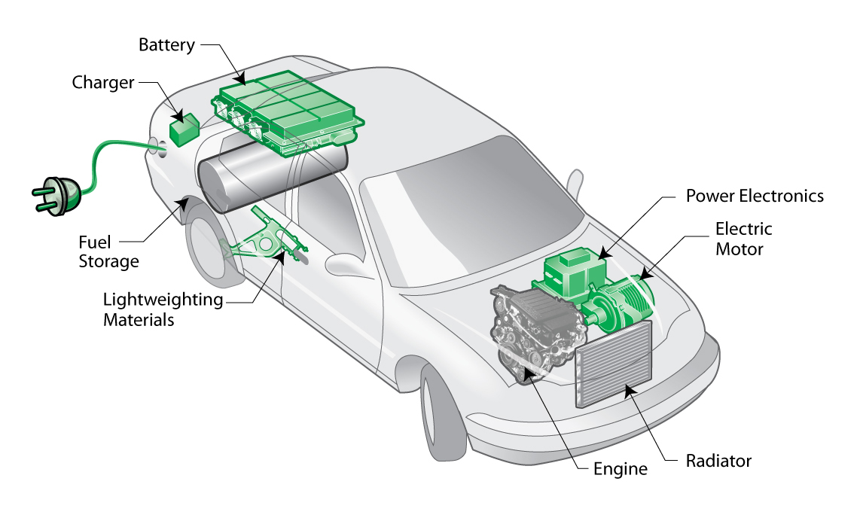
VI. HYBRID PROGRAMMING

Slide 131
VI. Hybrid Programming
Motivation
Considerations
MPI threading support
Designing hybrid algorithms
Examples

Slide 132
Motivation
Multicore architectures are here to stay
Macro scale: distributed memory architecture, suitable for MPI
Micro scale: each node contains multiple cores and shared memory, suitable for OpenMP
Obvious solution: use MPI between nodes, and OpenMP within nodes
Hybrid programming model

Slide 133
Considerations
Sounds great, Rebecca, but is hybrid programming always better?
No, not always
Especially if poorly programmed ☺
Depends also on suitability of architecture
Think of accelerator model
in omp parallel region, use power of multicores; in serial region, use only 1 processor
If your code can exploit threaded parallelism “a lot”, then try hybrid programming

Slide 134
Considerations
Hybrid parallel programming model
Are communication and computation discrete phases of algorithm?
Can/do communication and computation overlap?
Communication between threads
Communicate only outside of parallel regions
Assign a manager thread responsible for inter-process communication
Let some threads perform inter-process communication
Let all threads communicate with other processes

Slide 135
MPI Threading Support
MPI-2 standard defines four threading support levels
(0) MPI_THREAD_SINGLE only one thread allowed
(1) MPI_THREAD_FUNNELED master thread is only thread permitted to make MPI calls
(2) MPI_THREAD_SERIALIZED all threads can make MPI calls, but only one at a time
(3) MPI_THREAD_MULTIPLE no restrictions
(0.5) MPI calls not permitted inside parallel regions (returns MPI_THREAD_SINGLE) – this is MPI-1

Slide 136
What Threading Model Does My Machine Support?
#include <mpi.h>
#include <stdio.h>
int main(int argc, char **argv) {
int provided;
MPI_Init_thread(&argc, &argv, MPI_THREAD_MULTIPLE, &provided);
printf("Supports level %d of %d %d %d %d\n", provided,
MPI_THREAD_SINGLE, MPI_THREAD_FUNNELED,
MPI_THREAD_SERIALIZED, MPI_THREAD_MULTIPLE);
MPI_Finalize();
return 0;
}

Slide 137
What Threading Model Does My Machine Support?
rjhb@perlmutter> cc -o threadmodel threadmodel.c
rjhb@perlmutter> salloc -C cpu -q interactive
salloc: Granted job allocation 10504403
salloc: Waiting for resource configuration
salloc: Nodes nid005664 are ready for job
rjhb@nid005664:~/test> srun -n 1 ./threadmodel
Supports level 3 of 0 1 2 3

Slide 138
MPI_Init_thread
MPI_Init_thread(int required, int *supported)
Use this instead of MPI_Init(…)
required: the level of thread support you want
supported: the level of thread support provided by implementation (ideally = required, but if not available, returns lowest level > required; failing that, largest level < required)
Using MPI_Init(…) is equivalent to required = MPI_THREAD_SINGLE
MPI_Finalize() should be called by same thread that called MPI_Init_thread(…)

Slide 139
Other Useful MPI Functions
MPI_Is_thread_main(int *flag)
Thread calls this to determine whether it is main thread
MPI_Query_thread(int *provided)
Thread calls to query level of thread support

Slide 140
Supported Threading Models: Single
Use single pragma
#pragma omp parallel
{
#pragma omp barrier
#pragma omp single
{
MPI_Xyz(…);
}
#pragma omp barrier
}

Slide 141
Supported Threading Models: Funneled
Cray & Intel MPI implementations support funneling
Use master pragma
#pragma omp parallel
{
#pragma omp barrier
#pragma omp master
{
MPI_Xyz(…);
}
#pragma omp barrier
}

Slide 142
Supported Threading Models: Serialized
Cray & Intel MPI implementations support serialized
Use single pragma
#pragma omp parallel
{
#pragma omp barrier
#pragma omp single
{
MPI_Xyz(…);
}
//Don't need omp barrier
}

Slide 143
Supported Threading Models: Multiple
Intel MPI implementation supports multiple!
(Cray MPI can turn on multiple support with env variables, but performance is sub-optimal)
No need for pragmas to protect MPI calls
Constraints:
Ordering of MPI calls maintained within each thread but not across MPI process -- user is responsible for preventing race conditions
Blocking MPI calls block only the calling thread
Multiple is rarely required; most algorithms can be written without it

Slide 144
Which Threading Model Should I Use?
Depends on the application!
Model | Advantages | Disadvantages
Single | Portable: every MPI implementation supports this | Limited flexibility
Funneled | Simpler to program | Manager thread could get overloaded
Serial | Freedom to communicate | Risk of too much cross-communication
Multiple | Completely thread safe | Limited availability; sub-optimal performance

Slide 145
Designing Hybrid Algorithms
Just because you can communicate thread-to-thread, doesn’t mean you should
Tradeoff between lumping messages together and sending individual messages
Lumping messages together: one big message, one overhead
Sending individual messages: less wait time (?)
Programmability: performance will be great, when you finally get it working!

Slide 146
Example: Mesh Partitioning
Regular mesh of finite elements
When we partition mesh, need to communicate information about (domain) adjacent cells to (computationally) remote neighbors

Slide 147
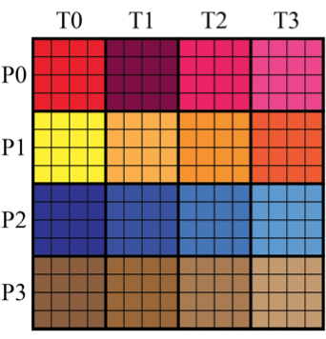
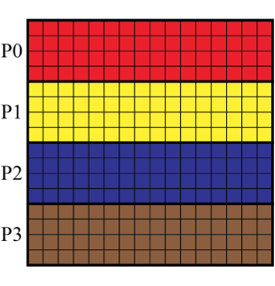
Example: Mesh Partitioning

Slide 148
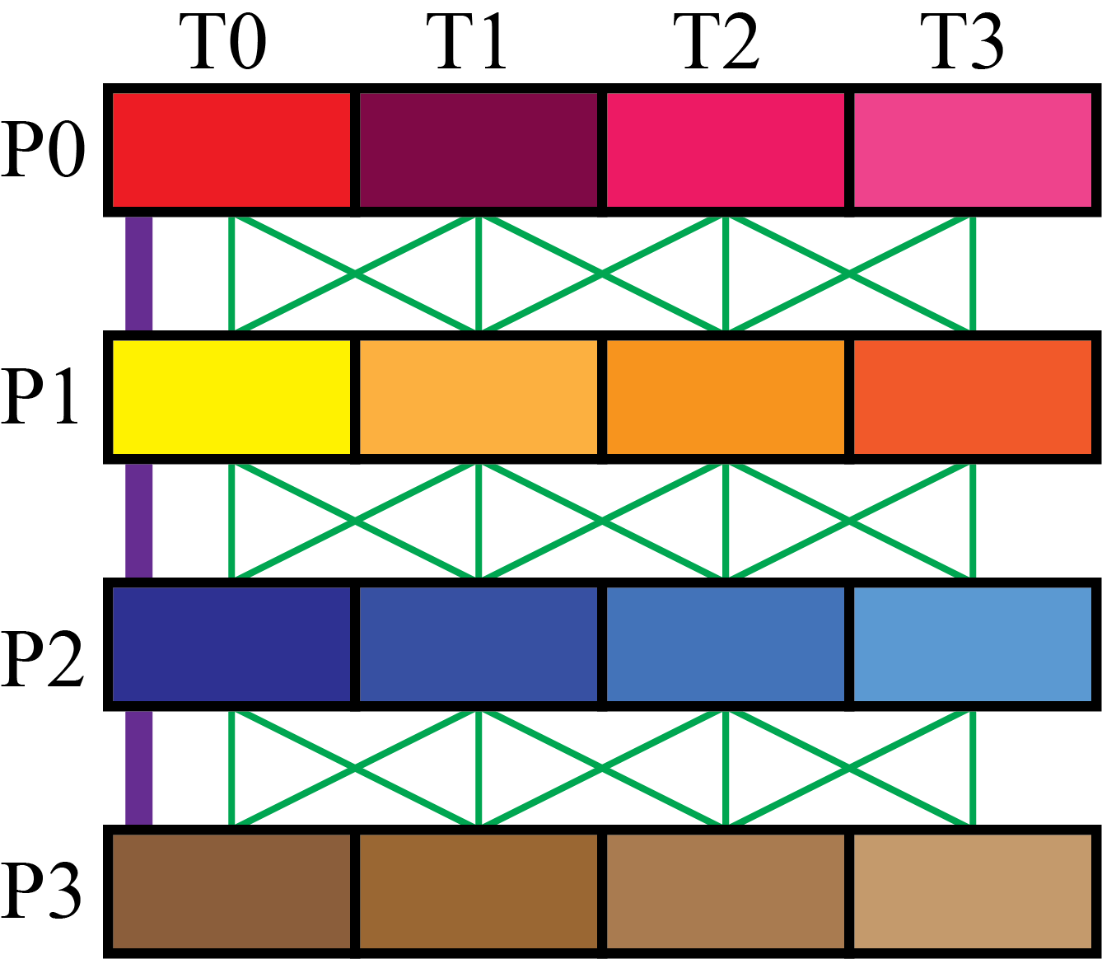
Example: Mesh Partitioning

Slide 149
INTERLUDE 4: COMPUTING PI WITH HYBRID PROGRAMMING
“pi” by Travis Morgan from http://www.flickr.com/photos/morgantj/5575500301/sizes/l/in/photostream/

Slide 150
Interlude 4: Computing π with Hybrid Programming
Putting it all together:
How can we combine inter-node and intra-node parallelism to create a hybrid program that computes π using the method of darts?
What potential pitfalls do you see?
Your assignment: create a code, darts-hybrid.c or darts-hybrid.f, developed from darts-collective.c/darts-collective.f and darts-omp.c/darts-omp.f, that uses OpenMP to exploit parallelism within the node, and MPI for parallelism between nodes

Slide 151
Bibliography/Resources: OpenMP
Mattson, Timothy, Yun (Helen) He, Alice Koniges (2019) The OpenMP Common Core, Cambridge, MA: MIT Press
Chapman, Barbara, Gabrielle Jost, and Ruud van der Pas. (2008) Using OpenMP, Cambridge, MA: MIT Press.
LLNL OpenMP Tutorial, https://computing.llnl.gov/tutorials/openMP/
Mattson, Tim, and Larry Meadows (2008) SC08 OpenMP “Hands-On” Tutorial, https://www.openmp.org/wp-content/uploads/omp-hands-on-SC08.pdf
Bull, Mark (2018) OpenMP Tips, Tricks and Gotchas, http://www.archer.ac.uk/training/course-material/2018/09/openmp-imp/Slides/L10-TipsTricksGotchas.pdf

Slide 152
Bibliography/Resources: OpenMP
Logan, Tom, The OpenMP Crash Course (How to Parallelize your Code with Ease and Inefficiency), http://ffden-2.phys.uaf.edu/608_lectures/OmpCrash.pdf
OpenMP.org: https://www.openmp.org/
OpenMP Standard: https://www.openmp.org/specifications/
5.2 Specification: https://www.openmp.org/wp-content/uploads/OpenMP-API-Specification-5-2.pdf
5.2 code examples: https://www.openmp.org/wp-content/uploads/openmp-examples-5-2.pdf

Slide 153
Bibliography/Resources: Hybrid Programming
Cuma, Martin (2015) Hybrid MPI/OpenMP Programming, https://www.chpc.utah.edu/presentations/images-and-pdfs/MPI-OMP15.pdf
INTERTWinE (2017) Best Practice Guide to Hybrid MPI + OpenMP Programming, http://www.intertwine-project.eu/sites/default/files/images/INTERTWinE_Best_Practice_Guide_MPI%2BOpenMP_1.1.pdf
Rabenseifner, Rolf, Georg Hager, Gabriele Jost (2013) SC13 Hybrid MPI and OpenMP Parallel Programming Tutorial, https://openmp.org/wp-content/uploads/HybridPP_Slides.pdf

Slide 154
APPENDIX 1: COMPUTING PI
“Pi” by Gregory Bastien, from http://www.flickr.com/photos/gregory_bastien/2741729411/sizes/z/in/photostream/

Slide 155
Computing 𝝅
Method of Darts is a TERRIBLE way to compute 𝝅
Accuracy proportional to square root of number of darts
For one decimal point increase in accuracy, need 100 times more darts!
Instead,
Look it up on the internet, e.g., http://www.geom.uiuc.edu/~huberty/math5337/groupe/digits.html
Compute using BBP (Bailey-Borwein-Plouffe) formula:
For less accurate computations, try your programming language’s constant, or quadrature or power series expansions

Slide 156
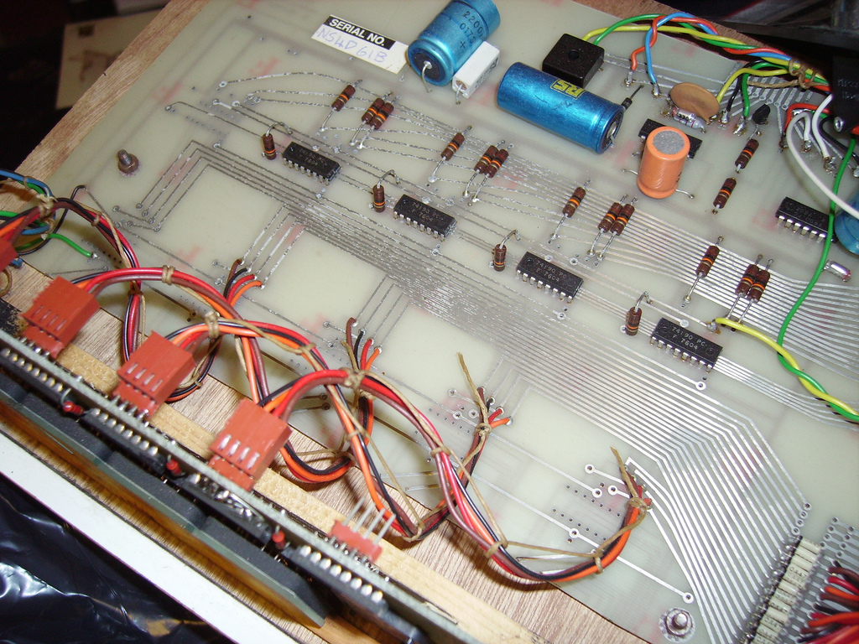
APPENDIX 2: ABOUT RANDOM NUMBER GENERATION
“Random Number Generator insides” by mercuryvapour, from http://www.flickr.com/photos/mercuryvapour/2743393057/sizes/l/in/photostream/

Slide 157
About Random Number Generation
No such thing as random number generation – proper term is pseudorandom number generator (PRNG)
Generate long sequence of numbers that seems “random”
Properties of good PRNG:
Very long period
Uniformly distributed
Reproducible
Quick and easy to compute

Slide 158
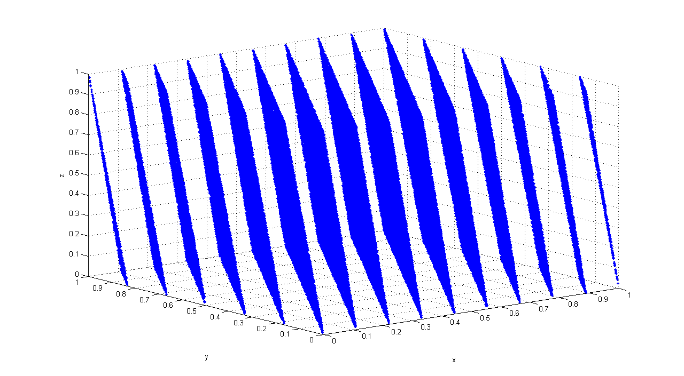
Pseudorandom Number Generator
Generator from lcgenerator.h is a Linear Congruential Generator (LCG)
Short period (= PMOD, 714025)
Not uniformly distributed – known to have correlations
Reproducible
Quick and easy to compute
Poor quality (don’t do this at home)
Correlation of RANDU LCG (source: http://upload.wikimedia.org/wikipedia/commons/3/38/Randu.png)

Slide 159
Good PRNGs
For serial codes
Mersenne twister
GSL (GNU Scientific Library), many generators available (including Mersenne twister) http://www.gnu.org/software/gsl/
Also available in Intel MKL
For parallel codes
SPRNG, regarded as leading parallel pseudorandom number generator http://sprng.cs.fsu.edu/

