Slide 1
Katie Antypas NP Requirements Review April 29, 2014
NERSC Data Services Update and Plans (Draft)

Slide 2
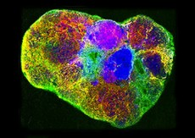
Data intensive science is a growing part of the NERSC workload
Biology
Light Sources
Particle Physics
Leadership in analysis + simulation of data from international facilities
High throughput functional analysis; multimodal imaging
Handle intensity growth & use simulation-driven experiments
Climate & Environment
Materials & Chemistry
Machine learning for analysis; new simulation models to interpret data
Cosmology & Astronomy
Beyond materials genome to fuse with experiments; re-use & reanalysis of data
Virtual Lab to analyze carbon, water, climate, in a region or across scales
Data intensive science requires different services and expertise.
Notes:
Notation consistent + & and (,s)

Slide 3
In the strategic plan we highlighted a data initiative
Increase the productivity, usability and impact of SC’s data intensive science by providing comprehensive data systems and services to store, analyze, manage and share data.

Slide 4
OSP Group and Analytics Team have merged into Data and Analytics Services Group
Outreach Software and Programming Group
Analytics Team
Data and Analytics Services (DAS) Group
Shreyas Cholia is acting Group Lead
DAS Group Lead position has been posted and interviews will begin soon
We want DAS Group Lead to have significant input into our Data Services plans

Slide 5
Strategic Partnership Lead – David Skinner
Develop relationships that will broaden NERSC’s impact in science and HPC communities
Identify new science communities that could benefit from NERSC resources
Lead industrial partnerships initiative
Advocate for NERSC and users in shaping policies that have impact on the scientific community
Act as NERSC liaison for cross divisional projects and opportunities
Position will report to Services Dept Head
Notes:
Filter and liaison – been happening in an adhoc way

Slide 6
New Org Chart for Services
SERVICES DEPARTMENT
KATIE ANTYPAS
Department Head
ADVANCED TECHNOLOGIES
NICHOLAS WRIGHT
Group Leader
Brian Austin
Matt Cordery
Chris Daley
Lenny Oliker
Jon Rood
2 LDRD Post-docs
USER SERVICES
RICHARD GERBER
Group Leader
Clayton Bagwell
Jack Deslippe
Kirsten Fagnan
Lisa Gerhardt
Helen He
Mark Heer
Doug Jacobsen
Alice Koniges
Mike Stewart
David Turner
Harvey Wasserman
Woo-Sun Yang
Zhengji Zhao
Open Position
DATA AND ANALYTICS
SHREYAS CHOLIA
Acting Group Leader
Bek Baymuradov
Joaquin Correa
Annette Greiner
Hari Krishnan
Peter Nugent
R.K. Owen
Jeff Porter
Prabhat
Oliver Rubel
Michael Urashka
Dani Ushizima
Gunther Weber
Yushu Yao
STRATEGIC PARTNERSHIP
LEAD
DAVID SKINNER
Notes:
Make clear – no group has monopoly on data
Will be many cross group projects across the dept and the center.

Slide 7
The 4 V’s (Now there are 5?)
Velocity
Volume
Variety
Veracity
Value
There are many ways to dissect the data space. My goal today is:
Describe the data services we have today and coming soon
Discuss some longer term goals surrounding the data initiative
Keep you happy and allow you to do what you want to do without major barriers.

Slide 8
What do users need to do with data?
Transfer
Store
Manage/Access
Process
Analyze/Visualize/Understand
Share/Curate
Services Offered Today
New Services or services in progress

Slide 9
Transfer
The fastest network in the world is located at NERSC with ESnet, 100 Gb/sec.
More labs and universities connected at this rate every month
Data Transfer Nodes are configured for high bandwidth connectivity
Online Data Xfer Software – Globus Online
Pre-defined grid transfer endpoints with all NERSC machines identified
Transparent certificate management with NERSC identity provider

Slide 10
Store
Project NERSC Global File System
Default project space of 1TB
Quota up to 40TB available on request and justification
“Sponsored” storage offering, users can purchase additional storage
Every repo now given a /project directory by default
Scratch file systems
Temporary storage for large datasets
Tape archive
Transparent Hierarchical storage management
Beginning to help user communities manage data such that they are not aware, where exactly it is located.
Metadata stored in database, pulls requested data from appropriate location (ALS demo)
JAMO/IRODS

Slide 11
Access/Manage
Scientific databases (SciDB, mongoDB, pgsql, mysql)
NX support
Darshan I/O profiling tool
Usable, high performing I/O formats, (HDF5)
Burst Buffer solution on NERSC-8
Option for a layer of NVRAM/Flash that sits between memory and file system to accelerate I/O
Deploy internal infrastructure to better manage our services. Currently testing:
Spark
Docker
NIM Integration with more Data Services
collaboration accounts and NGF quotas

Slide 12
Share/Curate
All projects have group space on /project as of Allocation year 2014
Science Gateways
Allow users to serve up data in /project directory and HPSS to be shared/analyzed by users outside of NERSC.
Sophisticated web interfaces to interact with/visualize/compute on scientific data
NEWT REST API
enables access to NERSC Data and Compute resources as an HTTP API
Collaboration accounts
Securely allows users to access common files. Currently by request only.

Slide 13
Process
High throughput and serial queues
New serial queue coming on Edison
Workflow Tools
Several projects using custom tools
qdo (cosmo), Fireworks (MP), SPADE (ALS)
Gap: Cross-domain workflow tool and expertise
‘Immediate’ access queue for select projects who need real time access
Example: beamline scientist needs real-time analysis to configure next experiment

Slide 14
Analyze, Visualize, Understand
Visualization Software tools
Visit, Paraview, AVX Express
Image Analysis Tools
IDL, ImageJ, Fiji
GAP, providing other image analysis tools, image segmentation tools, graph methods, topological methods, graphlab
Analytics tools
R, python, numPy, sciPy
GAP, Machine Learning tools – MLBase, TECA
Data Science Workload Analysis
Internal LDRD, Mantissa project
Data Science requirements gathering and outreach to users

Slide 15
Short/Medium Term Roadmap
Build a excellent Data and Analytics Services team with relevant expertise
Fill gaps in data science software services
ML, image analysis, workflow tools
Continue to analyze and understand data science workloads important to the DOE SC so we can communicate requirements to vendors
Improve queue structures to support data intensive science
Make the NERSC-8 Burst Buffer a highly productive and usable service
Increase engagement with data science communities and user facilities

Slide 16
Draft longer term roadmap
Collaborate with our research division to leverage new algorithms, methods and software for analyzing data
Searchable data
Query driven analysis
Efficient inference on graph methods
Provide life cycle data management tools for users
Co-design for data science
Build out NERSC infrastructure to support data science
Users will need a host of services from databases, web portals, supercomputers and storage and security.
Create a re-usable ‘plug-in’ for experimental facilities needing to compute at NERSC, to avoid recreating the wheel.

Slide 17
Eye candy

Slide 18
Darshan profiling tool
Compile your application on Hopper or Edison with the Darshan module loaded and you’ll see I/O profiling results on the ‘completed jobs’ webpage.
https://www.nersc.gov/users/job-logs-and-analytics/completed-jobs/

Slide 19
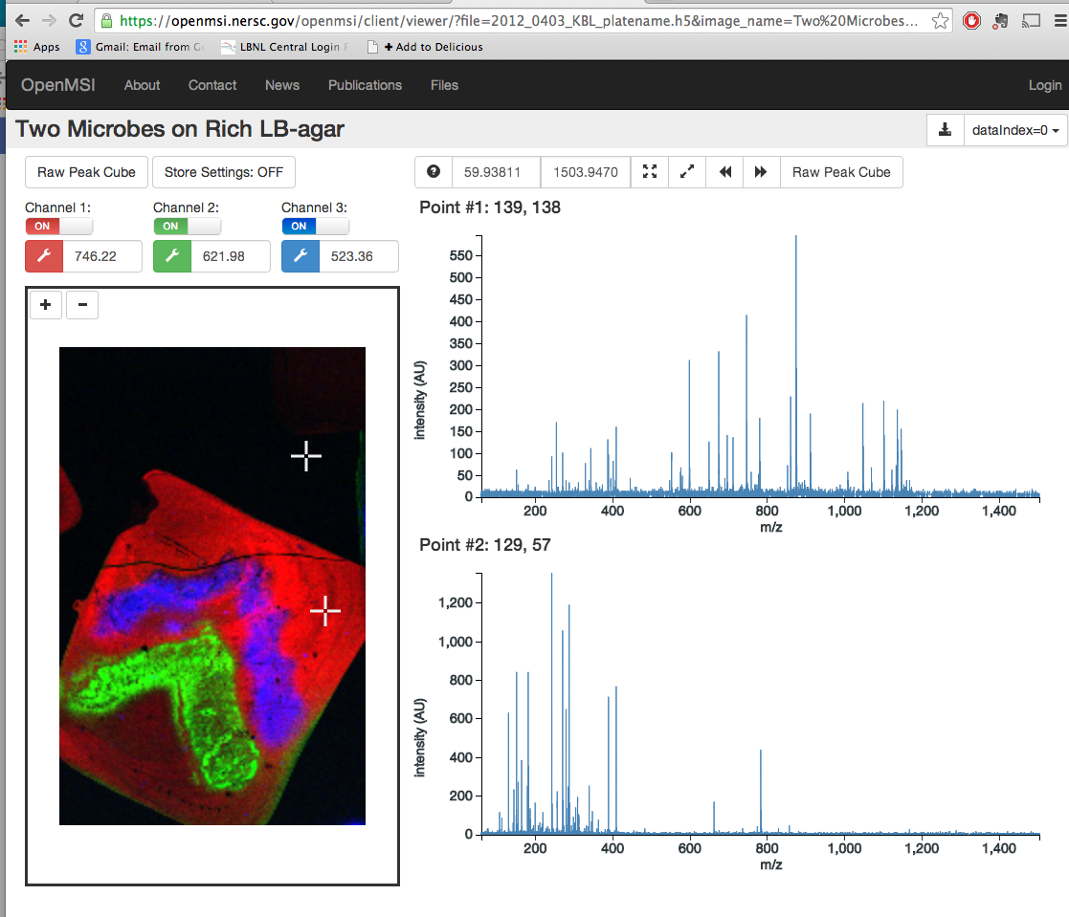
Science Gateways
Materials Project
OpenMSI

