Slide 1
Accelerating Scientific Data Analysis with RAPIDS and CuPy
Nick Becker, RAPIDS Engineering

Slide 2
Workflow Overview
Analysis of neutron scattering experimental data
  Conversion from laboratory geometry to reciprocal fractional coordinates
  Exploratory data analysis to identify the zero energy transfer points (gamma points)
  Clustering the gamma points (K-Means clustering)
  Correcting the gamma points based on the clustering results
Data
  60 GB of data, spread across 154 HDF5 files
  Each file pre-processed independently, with the results aggregated for downstream analytics
Notes:
Overview of the general workflow.
Geometry conversion is array manipulation
Exploratory analysis is dataframe operations + visualization
Clustering is clustering
Correction is linear algebra / matrix operations

Slide 3
Workflow Benchmarking Setup
CPU System
  Intel Xeon Gold 6130
  64 vCPUs
NVIDIA T4 GPU
  Turing Architecture
  2560 CUDA Cores
  320 Tensor Cores
  16 GB memory
PySpark Setup
  Spark Local[64] (Jupyter Notebook)
  Default RDD parallelism (64)
  50 GB driver memory
  70 GB executor memory
  Offheap memory enabled (16 GB)
Notes:
Can switch to Volta if we benchmark on it.
Spark uses all the available cores on the worker in local mode, all within a single JVM. It doesn’t really matter for this workflow, as more executors would not materially speed up this workflow as it’s primarily bottlenecked by the numpy portion, as we’ll see.

Slide 4
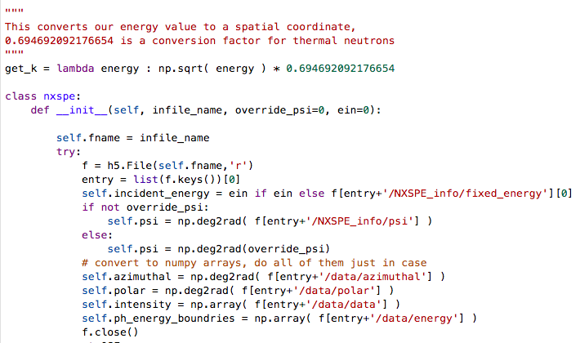
Reciprocal Fractional Coordinates
Notes:
These slides show the pre-processing for each NXSPE/HDF5 file. This is the coordinate conversion process.
Class initialization loads the data, converts degrees to radians, and sets up some arrays.

Slide 5
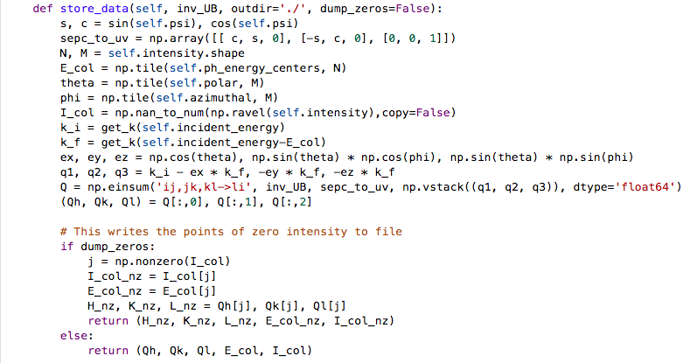
Reciprocal Fractional Coordinates
Notes:
These slides show the pre-processing for each NXSPE/HDF5 file. This is the coordinate conversion process.
This function does the actual hard work of array math, array expansion, binary operations, einstein summation, removing zero values, etc.

Slide 6
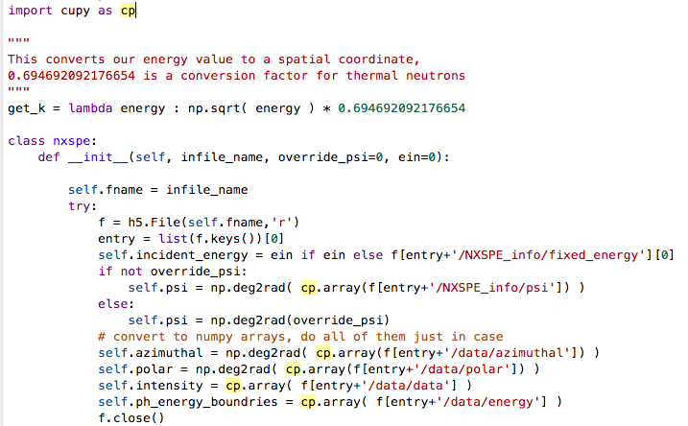
Reciprocal Fractional Coordinates - GPU
Notes:
Leverage the array function protocol. Create cupy arrays, and then use your numpy functions on them (under the hood it’ll use the cupy function).
Let’s you easily switch workflows to cupy arrays without changing every line of code.
Better than importing cupy as np, because then you need to worry about what happens if you need both cupy and numpy functionality (heterogeneous computing)

Slide 7
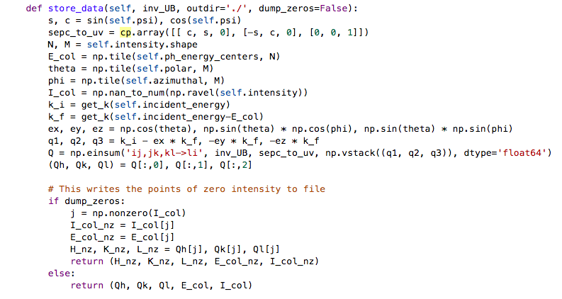
Reciprocal Fractional Coordinates - GPU
Notes:
Leverage the array function protocol. Create cupy arrays, and then use your numpy functions on them (under the hood it’ll use the cupy function).
Let’s you easily switch workflows to cupy arrays without changing every line of code.
Better than importing cupy as np, because then you need to worry about what happens if you need both cupy and numpy functionality (heterogeneous computing)

Slide 8
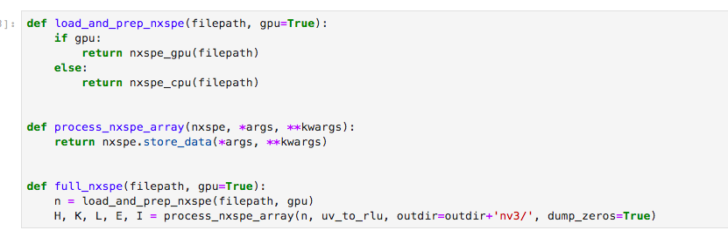
Time Testing Helper Functions
Notes:
We created a few helper functions for timing tests

Slide 9
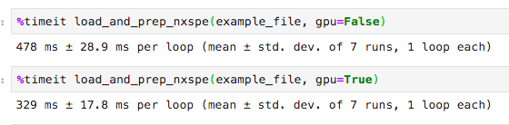
Data Loading and Prep
Bringing the HDF5 data into GPU arrays takes the bulk of the time
Not a significant GPU speedup here (only 30% faster)
Notes:
We can’t yet easily read the HDF5 data stored as arrays directly into GPU memory, but give us time!

Slide 10
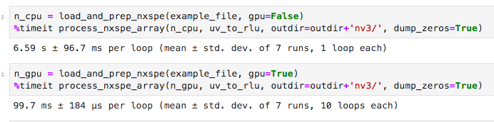
Coordinate Conversion
Almost all of the time is spent on array operations
GPU coordinate conversation is 65x faster than CPU coordinate conversation
Notes:
The array math/operations/tiling/etc are simply way faster on a T4 using CuPy than NumPy.

Slide 11
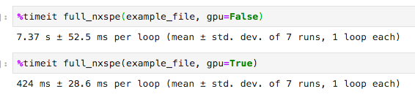
End-to-End Conversion
Loading HDF5 Data
Tiling arrays (array expansion)
Array concatenation
Array math
Elementise operations (cosine, deg2rad, etc.)
Einstein summation
Array indexing
GPU coordinate conversation is 17x faster overall than CPU coordinate conversation per file
1135 seconds for 154 files on CPU (~19 minutes)
65 seconds for 154 files on GPU (~1 minute)
Notes:
This shouldn’t be surprising, since we saw the individual component time tests.
This is about 17x faster on a single NVIDIA T4 GPU.
Every time you want to try something new during coordinate conversion, you need to wait 20 minutes if you’re not using GPUs.
CPU Info:
Hardware
376 GB of Memory
Specs
Architecture: x86_64
CPU op-mode(s): 32-bit, 64-bit
Byte Order: Little Endian
CPU(s): 64
On-line CPU(s) list: 0-63
Thread(s) per core: 2
Core(s) per socket: 16
Socket(s): 2
NUMA node(s): 2
Vendor ID: GenuineIntel
CPU family: 6
Model: 85
Model name: Intel(R) Xeon(R) Gold 6130 CPU @ 2.10GHz
Stepping: 4
CPU MHz: 2095.088
BogoMIPS: 4191.32
Virtualization: VT-x
L1d cache: 32K
L1i cache: 32K
L2 cache: 1024K
L3 cache: 22528K
GPU: NVIDIA T4 16GB memory

Slide 12
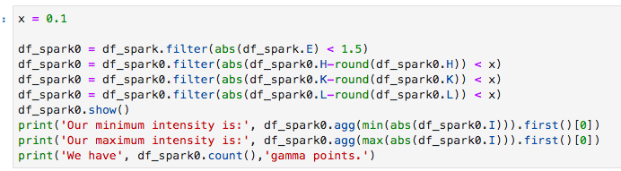
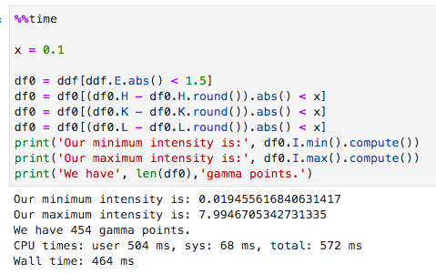
DataFrame Operations in PySpark vs CuDF
cuDF/Dask looks more like pandas than PySpark
cuDF/Dask was about 50% faster than PySpark
  1.0 seconds in PySpark
  0.5 seconds in Dask-cuDF
Notes:
Why do we do the coordinate conversion? So we can do the exploratory dataframe analysis to identify and correct gamma points across all the data.
This is dataframe style work that happens was previously in PySpark. Won’t go into as much detail due to time, but cuDF is faster than CPU PySpark.
This isn’t the core bottleneck though. 1 vs 0.5 seconds for exploratory analytics isn’t a huge deal (obviously dependent on spark setup, but at this data size you won’t get much benefit from using a giant spark cluster -- probably would be worse actually).
We solved the core problem in the prior slides. You could make the rest of this workflow faster by a small amount by switching to dask from pyspark, but since the scale of the data isn’t a huge issue it may not be necessary. If the data was larger scale (such as processing the full 60 gb, not just a few million rows), the benefit would be more than a 50% speed increase.
The RAPIDS and GPU PyData ecosystem it designed to let users do what they prefer, but still get the acceleration. Using PySpark after CuPy is totally fine.

Slide 13
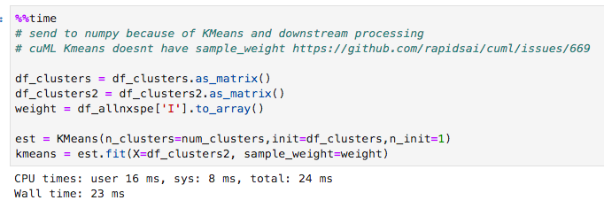
K-Means Clustering
Going to CPU/sklearn doesn’t add much time, but we’d prefer to keep this on the GPU
cuML’s KMeans doesn’t yet support weighting observations
Notes:
Not trying to paint a falsely rosy picture. RAPIDS is at version 0.8 as of last week, and not all functionality is there yet.
We’re actively working on these libraries, and feature requests like these from workflows like this directly lead to development.

Slide 14
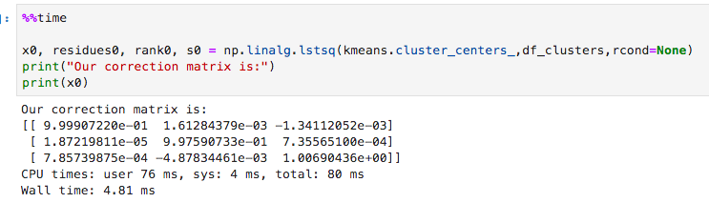
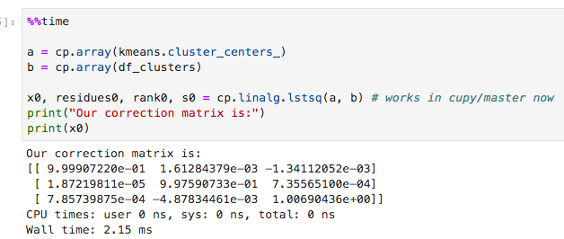
Ordinary Least Squares Gamma Points Correction
Next CuPy release includes ordinary least squares
OLS on small data leads to a small gain, OLS on big data leads to big gain
Notes:
Doing the error correction requires using things like the least squares coefficients (essentially multivariate linear regression). Could literally just run linear regression, but we want to meet the code where it is when bringing it onto the GPU. Don’t want to change the fundamental way it’s being done.
CuPy is slightly faster, but it’s not relevant at this small data size (hundreds of records). The point is that we can do it!
(Soon, you won’t need to build from source to use this functionality).

Slide 15

Summary
Porting this NumPy/PySpark workflow to GPUs was smooth with RAPIDS + CuPy
Coordinate conversation is 17x faster on an NVIDIA T4, with only six lines of code changed
Entire workflow is 15x faster
  Coordinate conversion
  Dataframe filtering / statistical operations
  Visualizing
  Clustering
  Etc.
Notes:
RAPIDS makes using GPUs to get 15x faster results smooth and simple, even if it’s only at v0.8. Some functionality isn’t available yet, but that’s okay. We’re working hard to bring features to this ecosystem
Visualizing currently requires using the CPU for matplotlib/plotly, so that portion can’t be accelerated.

Slide 16
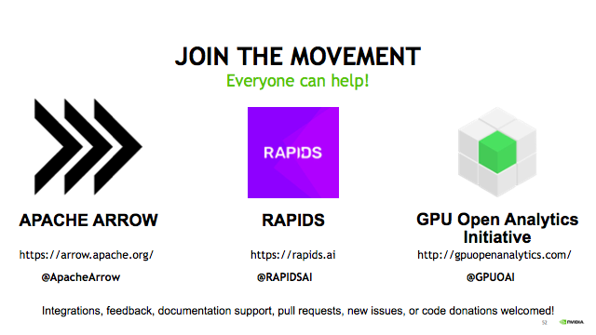
Notes:
Want to learn more? Check out rapids.ai to get started, and join the movement to bring GPU acceleration to the entire ecosystem.

