Slide 1
High Performance Python Components
Randy Gelhausen, RAPIDS Performance Engineering

Slide 2
We’ll discuss four components
Compilation
Parallelism
GPU Accelerators
Networking

Slide 3




We’ll discuss four components
Compilation with Numba
Parallelism with Dask
A Python to LLVM compiler
JIT compiles numeric Python code to C speeds
We can have for loops again!
A Dynamic task scheduler
Runs Python task graphs on
distributed hardware
MPI. But easier and slower
Spark. But more flexible and without the JVM!
GPUs - RAPIDS, CuPy
UCX
CUDA-backed GPU libraries
Like NumPy/Pandas/Scikit-Learn,
but backed by CUDA code
Python helped you to forget C
Now you can forget CUDA too!
High Performance Networking
Provides interfaces and routing to high performance networking libraries like InfiniBand and NVLink
Because once computation is fast
we need to focus on everything else
Notes:
These libraries stand alone, but also integrate well

Slide 4
Numba
JIT Compiler for Python with LLVM

Slide 5
Numba
JIT Compiler for Python with LLVM
Write Python function
  Use C/Fortran style for loops
  Large subset of Python language
  Mostly for numeric data
Wrap it in @numba.jit
  Compiles to native code with LLVM
  JIT compiles on first use with new type signatures
Runs at C/Fortran speeds
See also: Cython, Pythran, pybind, f2py
def sum(x):
total = 0
for i in range(x.shape[0]):
total += x[i]
return total
>>> x = numpy.arange(10_000_000)
>>> %time sum(x)
1.34 s ± 8.17 ms

Slide 6
Numba
JIT Compiler for Python with LLVM
Write Python function
  Use C/Fortran style for loops
  Large subset of Python language
  Mostly for numeric data
Wrap it in @numba.jit
  Compiles to native code with LLVM
  JIT compiles on first use with new type signatures
Runs at C/Fortran speeds
See also: Cython, Pythran, pybind, f2py
import numba
@numba.jit
def sum(x):
total = 0
for i in range(x.shape[0]):
total += x[i]
return total
>>> x = numpy.arange(10_000_000)
>>> %time sum(x)
55 ms

Slide 7
Numba
JIT Compiler for Python with LLVM
Write Python function
  Use C/Fortran style for loops
  Large subset of Python language
  Mostly for numeric data
Wrap it in @numba.jit
  Compiles to native code with LLVM
  JIT compiles on first use with new type signatures
Runs at C/Fortran speeds
See also: Cython, Pythran, pybind, f2py
import numba
@numba.jit
def sum(x):
total = 0
for i in range(x.shape[0]):
total += x[i]
return total
>>> x = numpy.arange(10_000_000)
>>> %time sum(x)
55 ms # mostly compile time

Slide 8
Numba
JIT Compiler for Python with LLVM
Write Python function
  Use C/Fortran style for loops
  Large subset of Python language
  Mostly for numeric data
Wrap it in @numba.jit
  Compiles to native code with LLVM
  JIT compiles on first use with new type signatures
Runs at C/Fortran speeds
See also: Cython, Pythran, pybind, f2py
import numba
@numba.jit
def sum(x):
total = 0
for i in range(x.shape[0]):
total += x[i]
return total
>>> x = numpy.arange(10_000_000)
>>> %time sum(x)
5.09 ms ± 110 µs # subsequent runs

Slide 9
Numba
JIT Compiler for Python with LLVM
Write Python function
  Use C/Fortran style for loops
  Large subset of Python language
  Mostly for numeric data
Wrap it in @numba.jit
  Compiles to native code with LLVM
  JIT compiles on first use with new type signatures
Runs at C/Fortran speeds
Supports
  Normal numeric code
  Dynamic data structures
  Recursion
  CPU Parallelism (thanks Intel!)
  CUDA, AMD ROCm, ARM
  ...
import numba
@numba.jit
def sum(x):
total = 0
for i in range(x.shape[0]):
total += x[i]
return total
>>> x = numpy.arange(10_000_000)
>>> %time sum(x)
5.09 ms ± 110 µs

Slide 10
Dask
Parallel task scheduler for Python

Slide 11
Dask Parallelizes PyData
Natively
PyData Native
  Built on top of NumPy, Pandas Scikit-Learn, … (easy to migrate)
  With the same APIs (easy to train)
  With the same developer community (well trusted)
Scales
  Scales out to thousand-node clusters
  Easy to install and use on a laptop
Popular
  Most common parallelism framework today at PyData and SciPy conferences
Deployable
  HPC: SLURM, PBS, LSF, SGE
  Cloud: Kubernetes
  Hadoop/Spark: Yarn

Slide 12
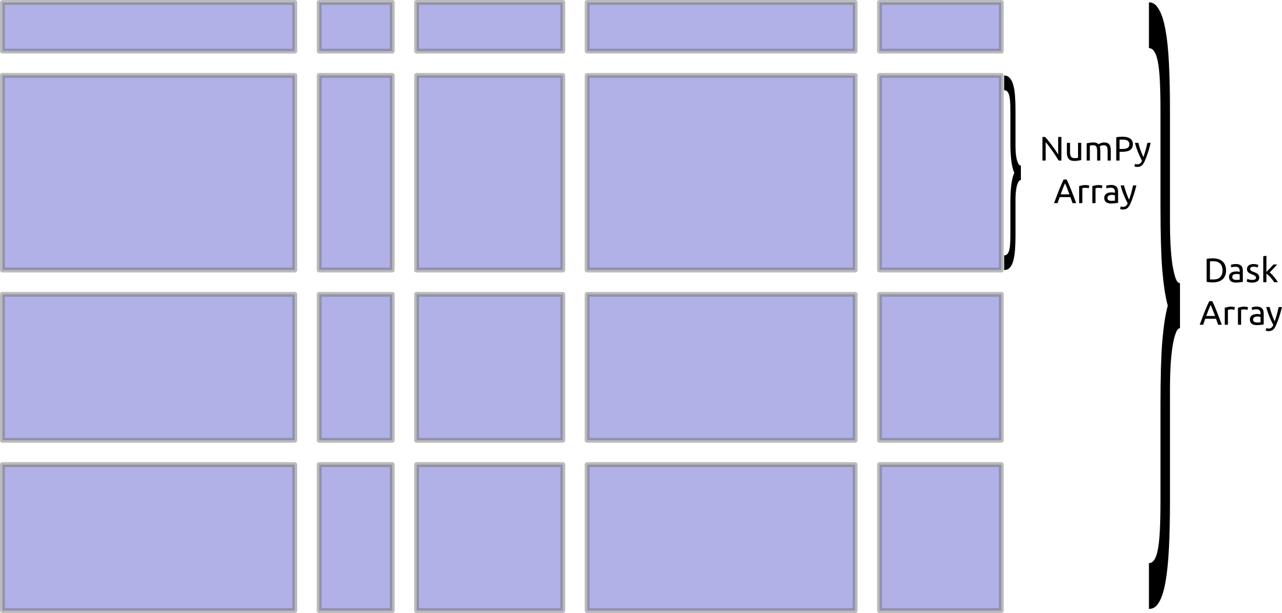
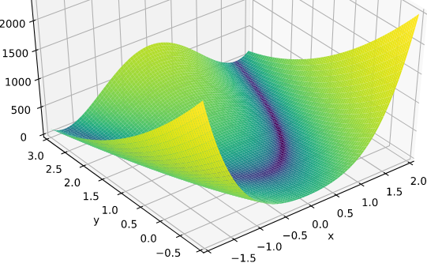


Parallel NumPy
For imaging, simulation analysis, machine learning
Same API as NumPy
import dask.array as da
x = da.from_hdf5(...)
x + x.T - x.mean(axis=0)
One Dask Array is built from many NumPy arrays
Either lazily fetched from disk
Or distributed throughout a cluster
Notes:
https://blog.dask.org/2019/06/20/load-image-data

Slide 13
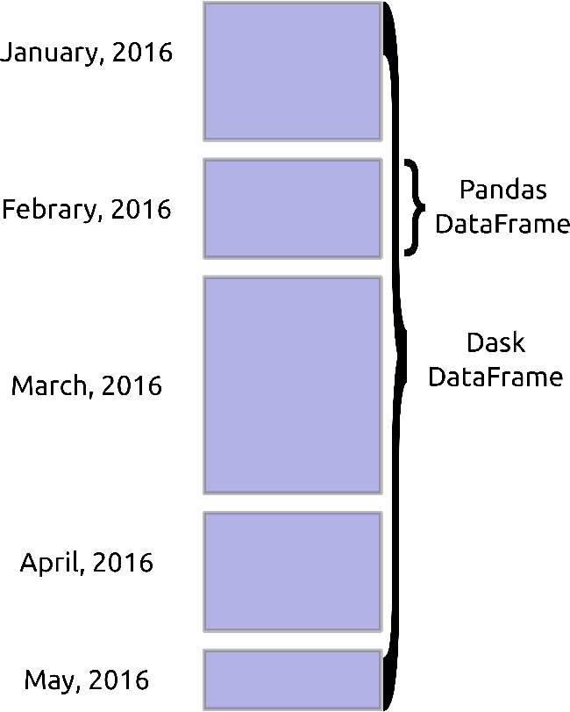
Parallel Pandas
For ETL, time series, data munging
Same API as Pandas
import dask.dataframe as dd
df = dd.read_csv(...)
df.groupby(‘name’).balance.max()
One Dask DataFrame is built from many Pandas DataFrames
Either lazily fetched from disk
Or distributed throughout a cluster

Slide 14

Parallel Scikit-Learn
For Hyper-Parameter Optimization, Random Forests, ...
Same API
from scikit_learn.externals import joblib
with joblib.parallel_backend(‘dask’):
estimator = RandomForest()
estimator.fit(data, labels)
Same exact code, just wrap with a decorator
Replaces default threaded execution with Dask
Allowing scaling onto clusters
Available in most Scikit-Learn algorithms where joblib is used
Thread
Pool

Slide 15
Parallel Scikit-Learn
For Hyper-Parameter Optimization, Random Forests, ...
Same API
from scikit_learn.externals import joblib
with joblib.parallel_backend(‘dask’):
estimator = RandomForest()
estimator.fit(data, labels)
Same exact code, just wrap with a decorator
Replaces default threaded execution with Dask
Allowing scaling onto clusters
Available in most Scikit-Learn algorithms where joblib is used
Thread
Pool

Slide 16
Parallel Python
For custom systems, ML algorithms, workflow engines
Parallelize existing codebases
results = {}
for x in X:
for y in Y:
if x < y:
result = f(x, y)
else:
result = g(x, y)
results.append(result)

Slide 17
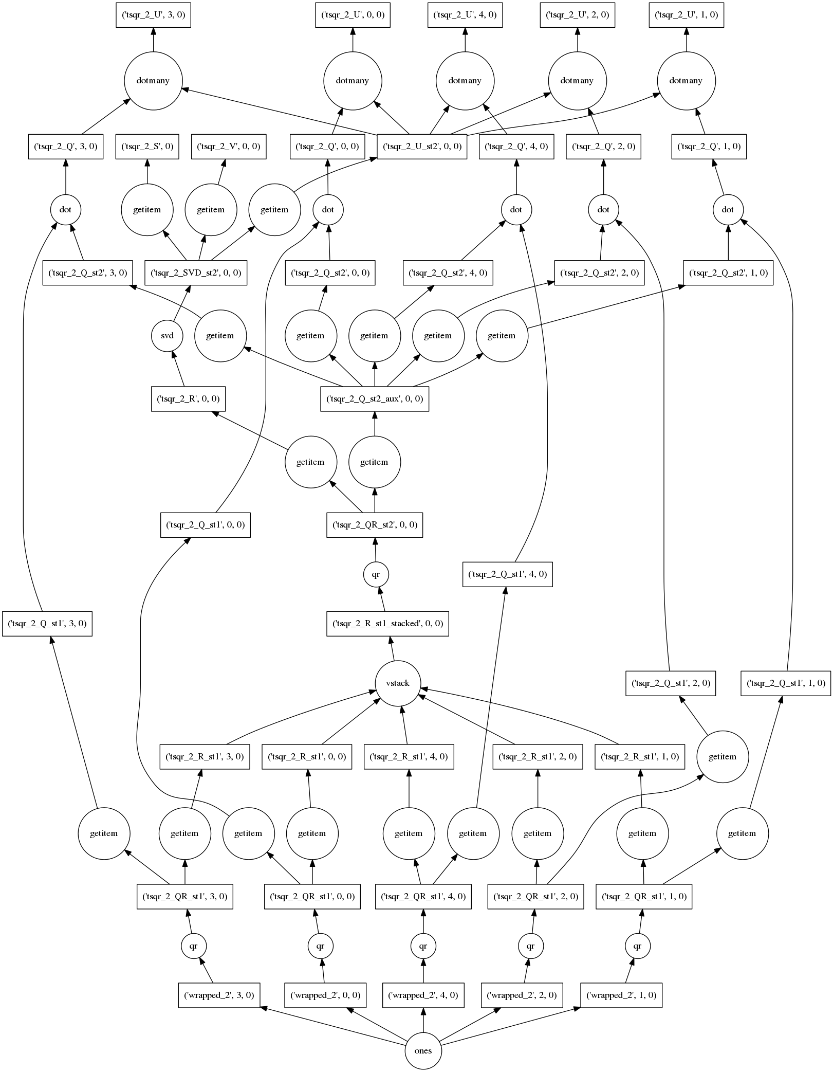
Parallel Python
For custom systems, ML algorithms, workflow engines
Parallelize existing codebases
f = dask.delayed(f)
g = dask.delayed(g)
results = {}
for x in X:
for y in Y:
if x < y:
result = f(x, y)
else:
result = g(x, y)
results.append(result)
result = dask.compute(results)
M Tepper, G Sapiro “Compressed nonnegative matrix factorization is fast and accurate”, IEEE Transactions on Signal Processing, 2016

Slide 18
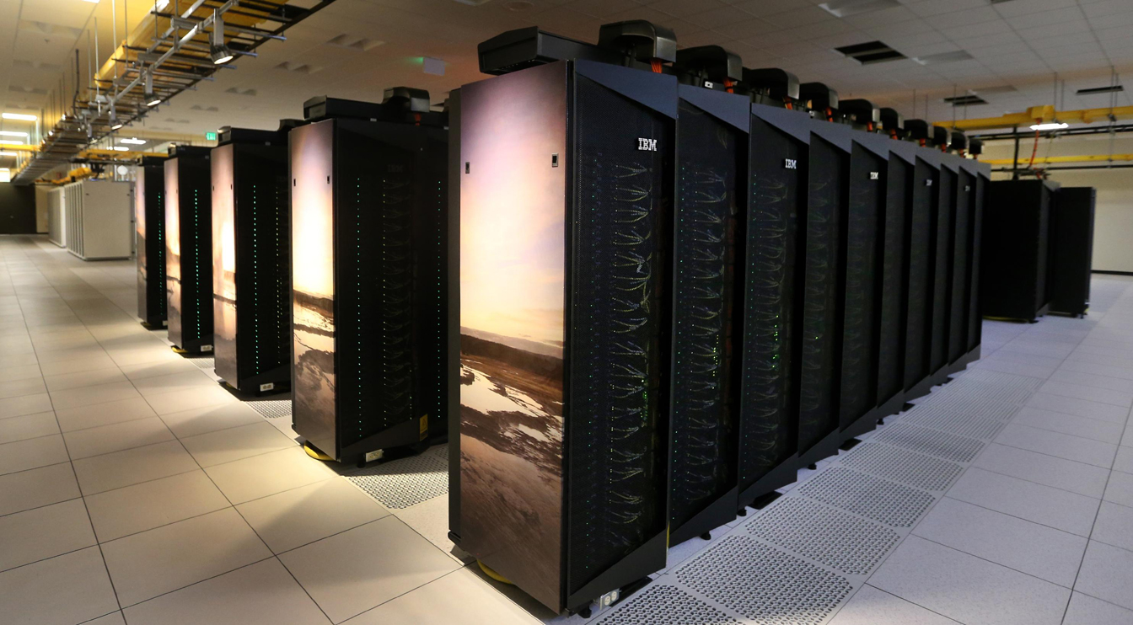
Easy to Deploy
Personal laptops, HPC machines, Cloud
Easy to run on HPC machines
from dask_jobqueue import PBSCluster
cluster = PBSCluster(project=..., queue=...)
# Ask for ten nodes
cluster.scale(10)
# Or scale dynamically based on load
cluster.adapt(minimum=1, maximum=100)
Notes:
& LSFCluster, SGE, SLURM, YARN, Kubernetes, and LocalCluster
examples.dask.org

Slide 19
Community Driven
Hundreds of people work on Dask
dask/ $ git shortlog -ns | wc -l
288
distributed/ $ git shortlog -ns | wc -l
151

Slide 20

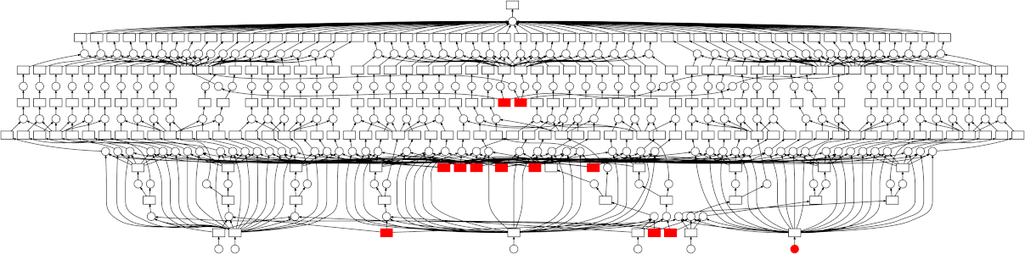
Dask Connects Python users to Hardware
Writes high level code
(NumPy/Pandas/Scikit-Learn)
Turns into a task graph
Executes on distributed hardware
User

Slide 21
RAPIDS
CUDA libraries with high level Python APIs

Slide 22
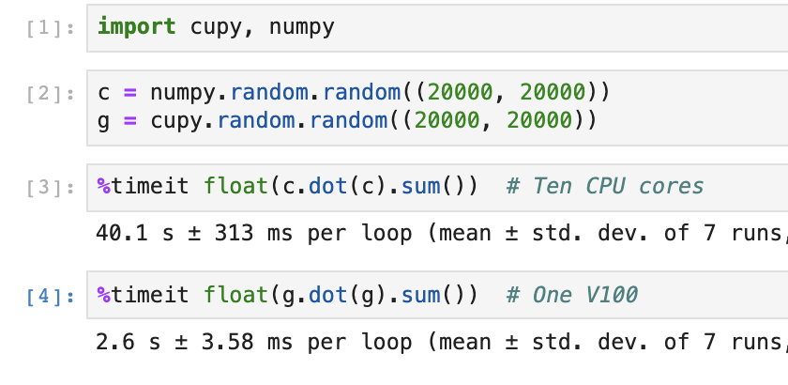
RAPIDS
GPU variants of PyData libraries
NumPy -> CuPy, PyTorch, TensorFlow
  Array computing
  Mature due to deep learning boom
  Also useful for other domains
  Obvious fit for GPUs
Pandas -> cuDF
  Tabular computing
  New development
  Parsing, joins, groupbys
  Not an obvious fit for GPUs
Scikit-Learn -> cuML
  Traditional machine learning
  Somewhere in between

Slide 23
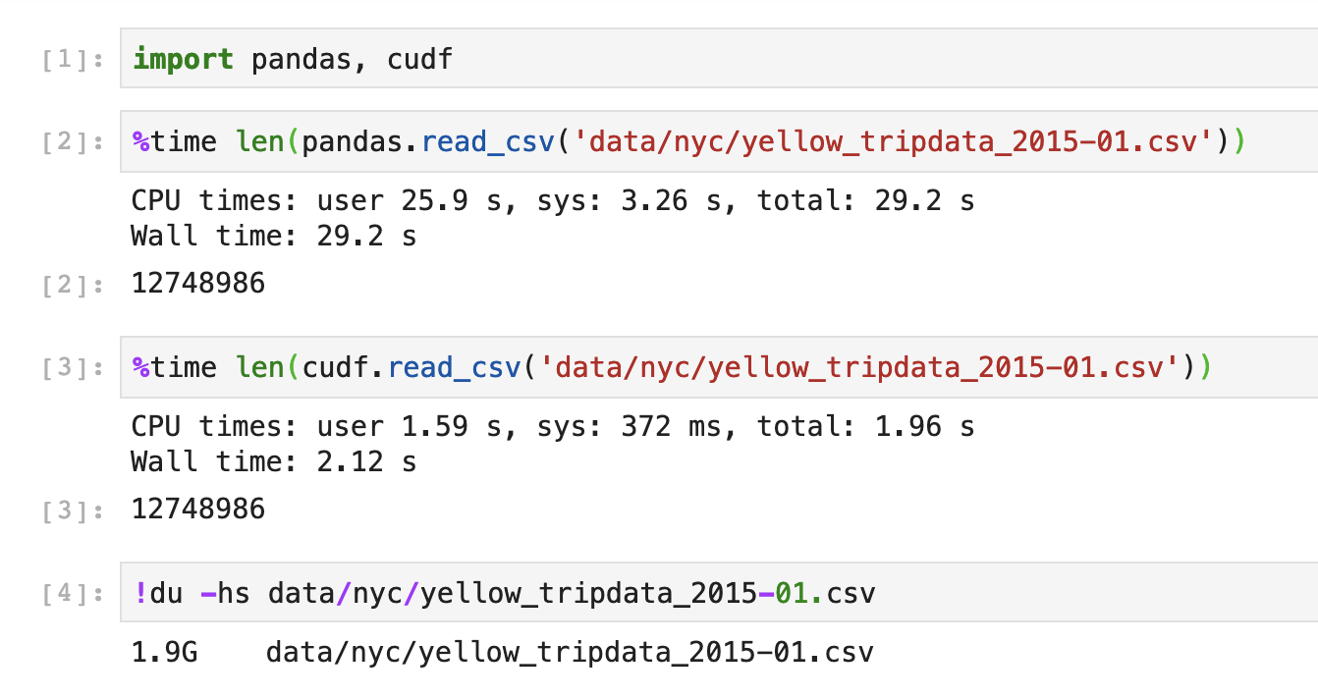
RAPIDS
GPU variants of PyData libraries
NumPy -> CuPy, PyTorch, TensorFlow
  Array computing
  Mature due to deep learning boom
  Also useful for other domains
  Obvious fit for GPUs
Pandas -> cuDF
  Tabular computing
  New development
  Parsing, joins, groupbys
  Not an obvious fit for GPUs
Scikit-Learn -> cuML
  Traditional machine learning
  Somewhere in between

Slide 24
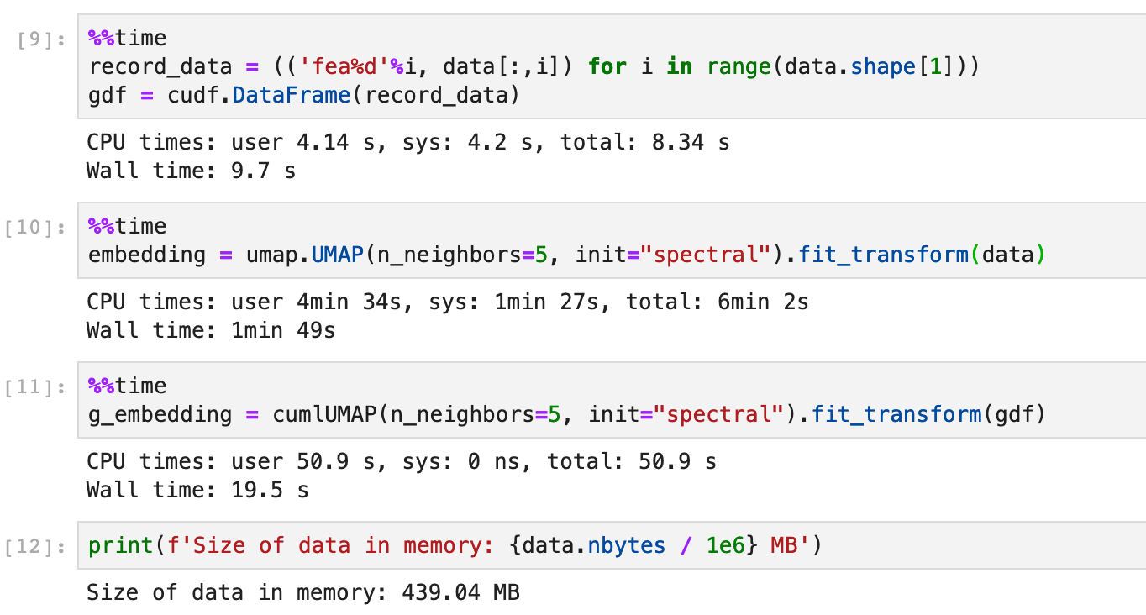
RAPIDS
GPU variants of PyData libraries
NumPy -> CuPy, PyTorch, TensorFlow
  Array computing
  Mature due to deep learning boom
  Also useful for other domains
  Obvious fit for GPUs
Pandas -> cuDF
  Tabular computing
  New development
  Parsing, joins, groupbys
  Not an obvious fit for GPUs
Scikit-Learn -> cuML
  Traditional machine learning
  Somewhere in between

Slide 25
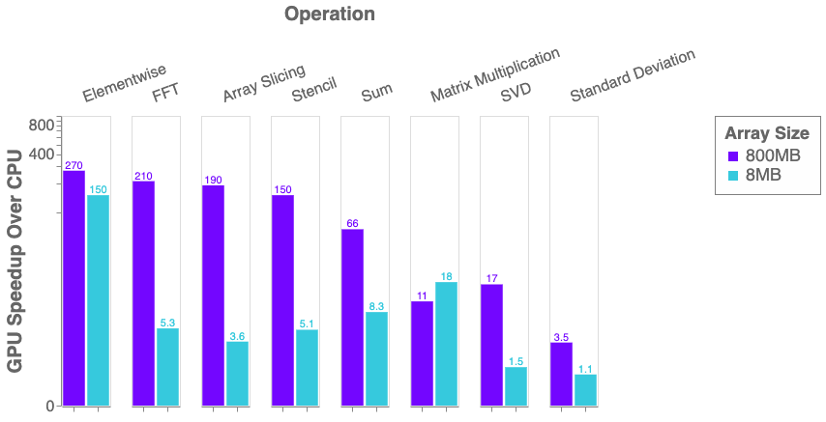
RAPIDS
CuPy Performance Comparison

Slide 26
Mix and Match
These libraries play nicely together

Slide 27
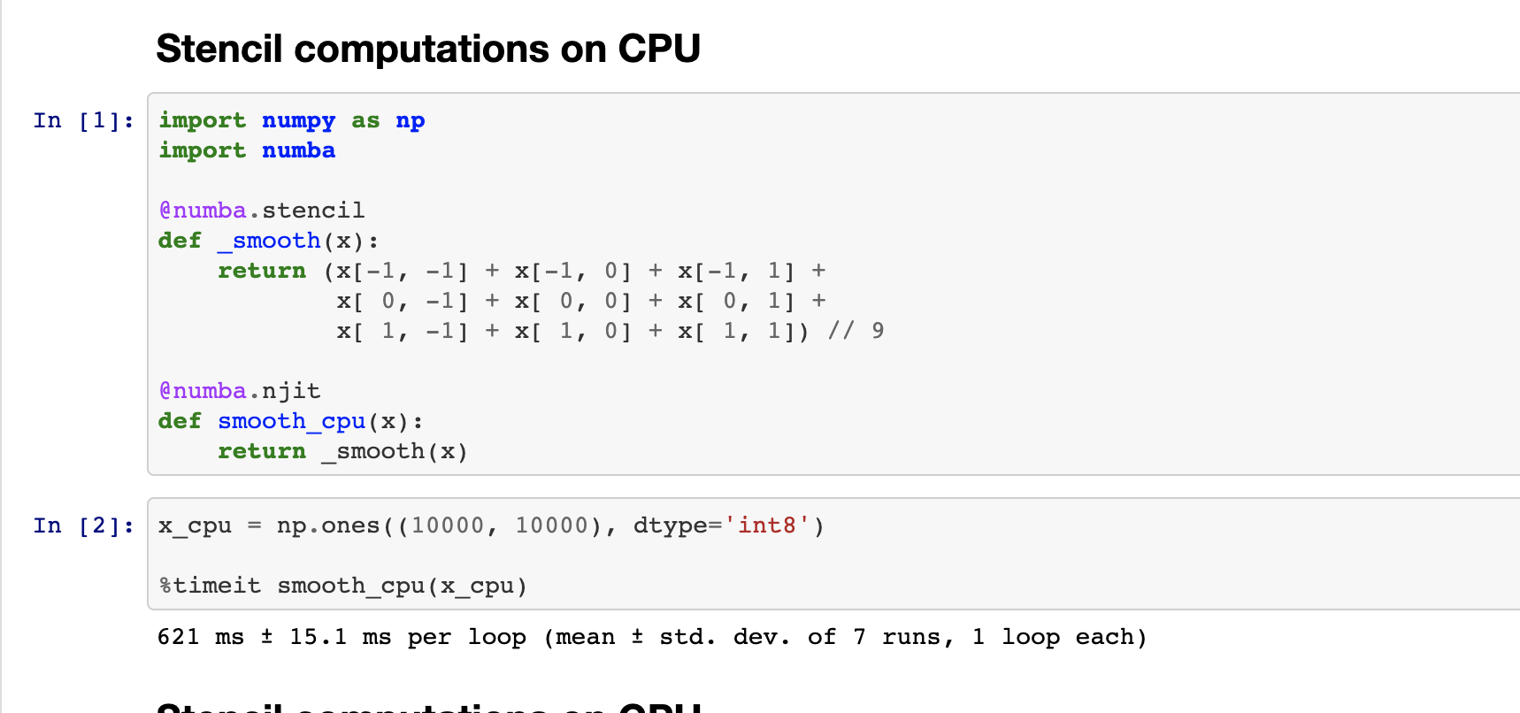
Combine Numba with CuPy
Write custom CUDA code from Python

Slide 28
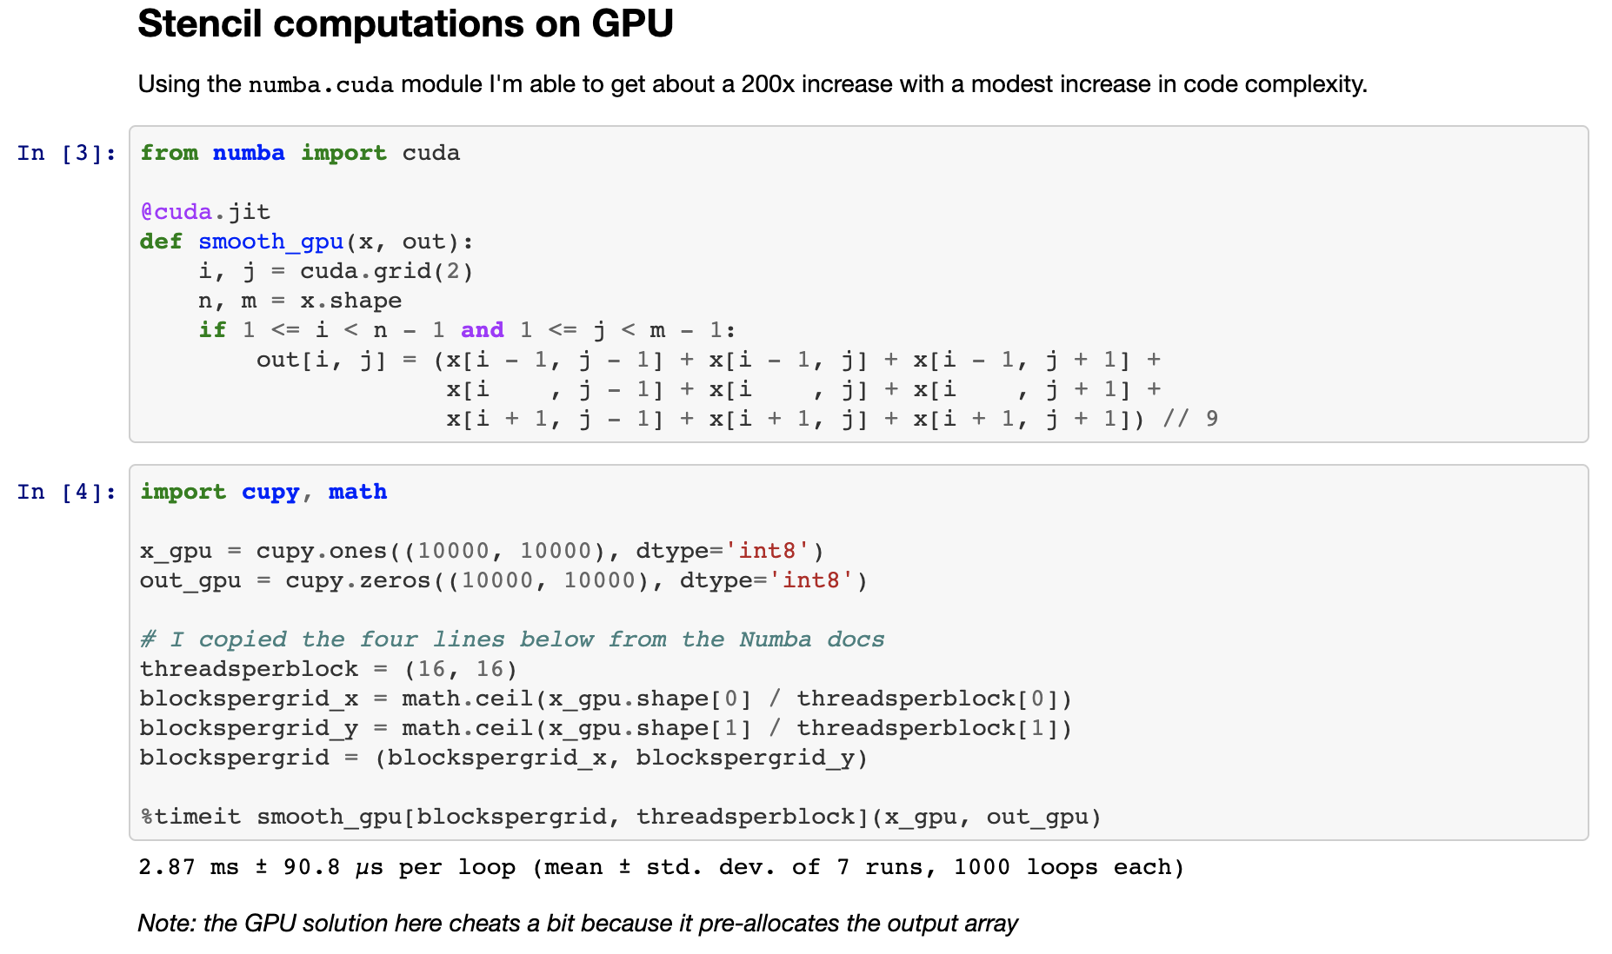
Combine Numba with CuPy
Write custom CUDA code from Python

Slide 29
Combine Numba with CuPy
CPU: 600 ms
GPU: 3 ms

Slide 30
Combine Dask with CuPy
Many GPU arrays form a Distributed GPU array

Slide 31
Combine Dask with CuPy
Many GPU arrays form a Distributed GPU array
GPU

Slide 32
Combine Dask with cuDF
Many GPU DataFrames form a distributed DataFrame

Slide 33
Combine Dask with cuDF
Many GPU DataFrames form a distributed DataFrame
cuDF

Slide 34

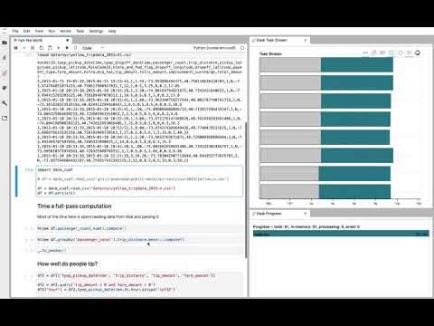
Experiments
...
SVD with Dask Array
NYC Taxi with Dask DataFrame

Slide 35
UCX
High Performance Networking

Slide 36
UCX
High performance Networking
Makes high performance networking transports accessible in Python
  InfiniBand
  NVLink
  Shared Memory
Decides transport to use based on topology
  Moving CPU data locally? Use shared memory.
  Moving GPU data locally? Use NVLink.
  Moving CPU/GPU data remotely? Use Infiniband.
Asynchronous Python API
  Supports traditional send/recv MPI API
  Also non-blocking client/server API
  Fully dynamic
Used today within OpenMPI, also Dask

Slide 37
COROUTINES
Co-operative concurrent functions
Preempted when
read/write from disk
perform communication
sleep, etc
Scheduler/event loop manages execution of all coroutines
Single thread utilization increases
def zzz(i):
print("start", i)
time.sleep(2)
print("finish", i)
def main():
zzz(1)
zzz(2)
main()
Ouput:
start 1 # t = 0
finish 1 # t = 2
start 2 # t = 2 + △
finish 2 # t = 4 + △
async def zzz(i):
print("start" , i)
await asyncio.sleep(2)
print("finish“, i)
f = asyncio.create_task
async def main():
task1 = f(zzz(1))
task2 = f(zzz(2))
await task1
await task2
asyncio.run(main())
start 1 # t = 0
start 2 # t = 0 + △
finish 1 # t = 2
finish 2 # t = 2 + △
UCX Slides taken from Akshay Venkatesh’s presentation at GTC ‘19

Slide 38
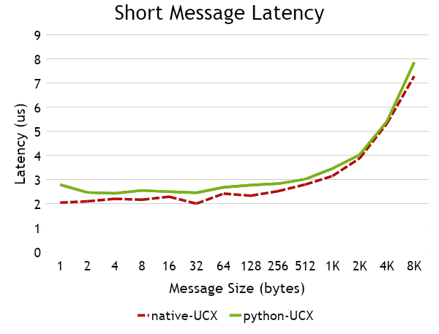
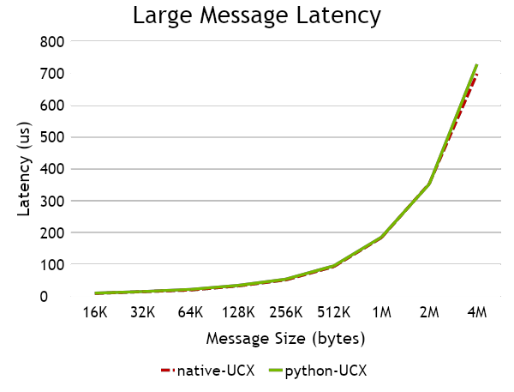
HOST MEMORY LATENCY
Latency-bound host transfers
Note: these numbers don’t include async-await overhead of around 50us if you use that API

Slide 39
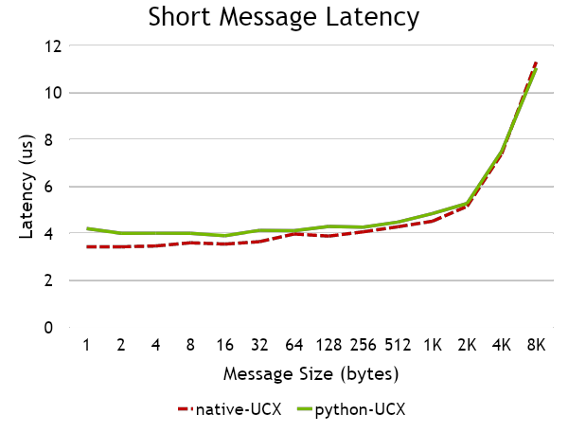
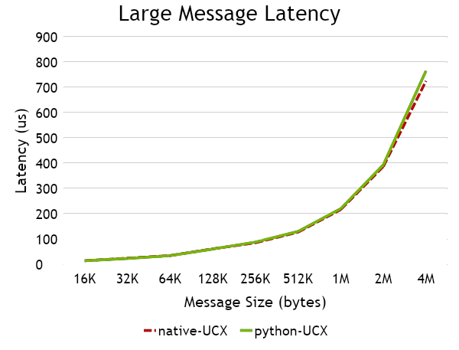
DEVICE MEMORY LATENCY
Latency-bound device transfers
Note: these numbers don’t include async-await overhead of around 50us if you use that API

Slide 40
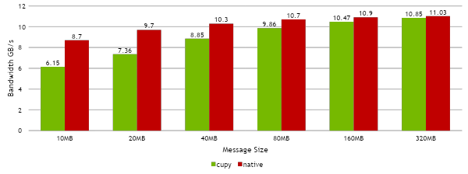
DEVICE MEMORY BANDWIDTH
Bandwidth-bound transfers (cupy)
UCX Slides taken from Akshay Venkatesh’s presentation at GTC ‘19

Slide 41
UCX
High performance Networking
GTC 2019 Talk by Akshay Venkatesh
Slides

Slide 42
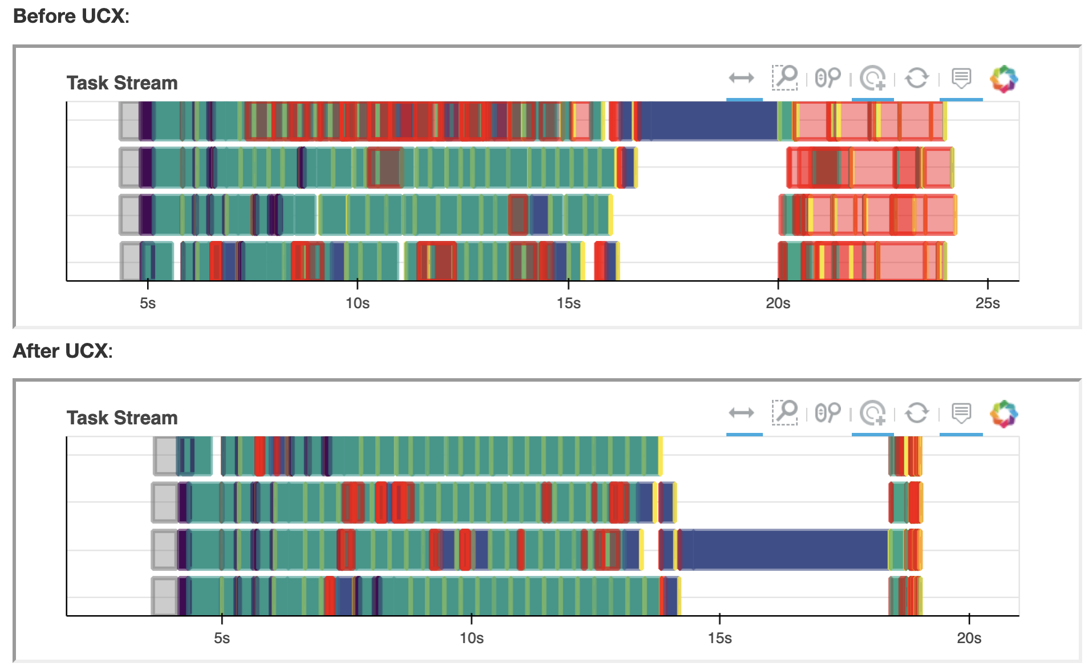
UCX
Dask Array SVD + CuPy Experiment with and without UCX
https://blog.dask.org/2019/06/09/ucx-dgx

Slide 43
We saw four HPC Python components
Compilation with Numba
Parallelism with Dask
A Python to LLVM compiler
JIT compiles numeric Python code to C speeds
We can have for loops again!
A Dynamic task scheduler
Runs Python task graphs on
distributed hardware
MPI! But easier and slower!
Spark! But more flexible and without the JVM!
GPUs - RAPIDS, CuPy
UCX
CUDA-backed GPU libraries
Like NumPy/Pandas/Scikit-Learn,
but backed by CUDA code
Python helped you to forget C
Now you can forget CUDA too!
High Performance Networking
Provides interfaces and routing to high performance networking libraries like InfiniBand and NVLink
Because once computation is fast
we need to focus on everything else

Slide 44
We saw four HPC Python components
Each stands on its own
Each plays well with others, forming an ecosystem

Slide 45
Learn More
Thank you for your time
PyData: pydata.org
Numba: numba.pydata.org
Dask: dask.org
Rapids: rapids.ai
UCX: openucx.org
examples.dask.org

