Slide 1

RAJA: An Applications Perspective
NERSC GPUs for Science Day
July 2-3, 2019
Rich Hornung

Slide 2
Transforming the LLNL multi-physics code base for Sierra presents daunting portability challenges
Large codes
  Each app is O(100K) – O(1M) SLOC and has many loop kernels O(1K) – O(10K)
Long service lives
  Used daily in production for decades, covering a large mission space
Diverse platform requirements
  Codes must run on laptops, commodity clusters (CTS), advanced technology systems (ATS)
  The ASC program buys large CTS and ATS systems in 3-5 year cycles; thus, codes must be viable over multiple platform generations
Codes are under continual development
  New modeling capabilities added throughout lifetimes of codes
  Adopting new technologies (hardware & software) cannot disrupt users

Slide 3
The development of RAJA is driven by requirements and constraints of large, production applications
Initially our goal was to get LLNL apps to run efficiently on Sierra…GPUs!
A complete rewrite in CUDA was not an option
  Not portable
  Cannot afford to maintain multiple versions of large codes
OpenMP was not viable early on and is still deficient (features & compilers)
  Even if OpenMP was feature complete with mature compilers, managing verbose pragma statements on thousands of loops is a nightmare
Plus, future DoE platforms (Frontier, Aurora, Perlmutter,…) are based on GPUs from different vendors
  Accessing different technologies in a portable way is critical!

Slide 4
These tools are key for LLNL ASC/ATDM applications to run on Sierra and future platforms
Major LLNL Weapons Simulation and Computing Program Unclassified Applications
 | Ares | ALE3D | Kull | MARBL | Ardra | Mercury | Teton | Hydra
Language | C++ | C++ | C++ | C++ & Fortran | C++ | C++ | Fortran | C++/C
GPU Execution Model | RAJA | RAJA | RAJA | RAJA + MFEM & OpenMP | RAJA | CUDA & RAJA | OpenMP & CUDA-C | Exploring OpenMP, CUDA, RAJA
Data Transfer | UM + Explicit | CHAI | UM | UM + Explicit | CHAI | UM | Explicit | Explicit, Exploring CHAI
Memory Allocation | Umpire | Umpire | Umpire | Umpire | Umpire | Explicit (Umpire in progress) | Explicit (Umpire in progress) | Explicit, Exploring Umpire
Each application integrates the tools in a unique way that matches its needs and code style.

Slide 5
These tools are also used in other libraries and applications…
LLNL apps and libraries (ASC, CASC, etc.)
  LEOS
  Overlink
  Selene
ECP Application, Software Technology, and Co-design projects
  SW4 (EQSIM)
  GEOS (Subsurface)
  SUNDIALS
  DevilRay (ALPINE)
  CEED Co-design (via MFEM)
MFEM
SAMRAI
NIF VBL
Umpire and RAJA are part of the ECP ST ecosystem and the new LLNL RADIUSS project.

Slide 6
It is difficult to set expectations for GPU performance based on CPU performance
We check node-for-node speedup compared with CTS-1 (what users will experience)
Most of our codes are primarily memory-bandwidth bound on the CPU
To set GPU expectations, compare relevant effective memory bandwidths of architectures
 | CTS-1 (Broadwell) | Sierra EA (2× P8 CPU + 4× P100 GPU) | Sierra (2× P9 CPU + 4× V100 GPU)
DRAM B/W per node | 130 GB/s | 2,200 GB/s | 3,400 GB/s
L2 B/W per node | 3,870 GB/s
Shared memory B/W per node |  | 31,052 GB/s | 48,320 GB/s
16.9×
1.5×
8.0×
1.6×
How does performance scale with relevant memory bandwidth?
  This is not a perfect measure, but it is a good place to start
Memory bandwidth is a first-order predictor of performance (as opposed to peak FLOPS).

Slide 7
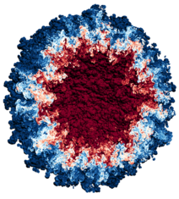
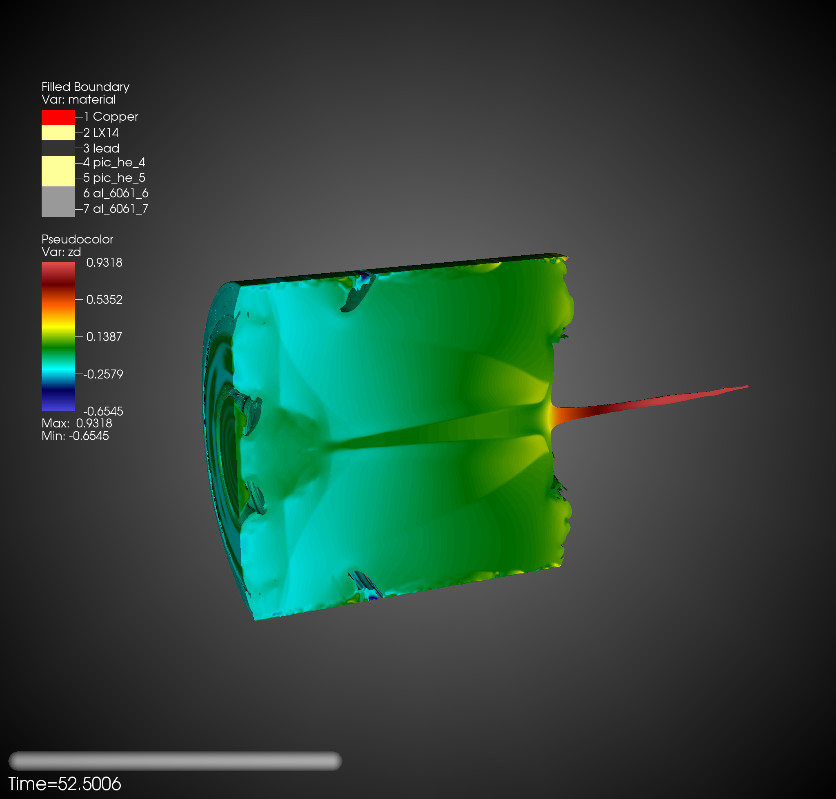
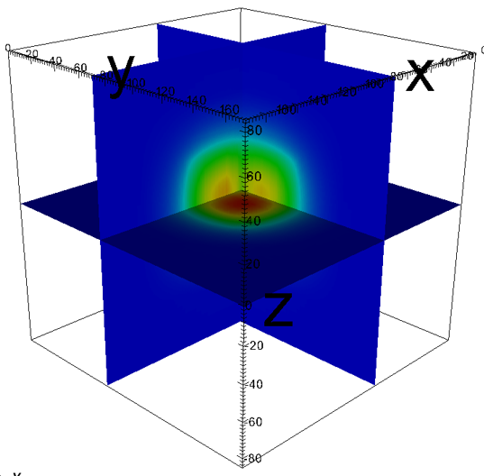
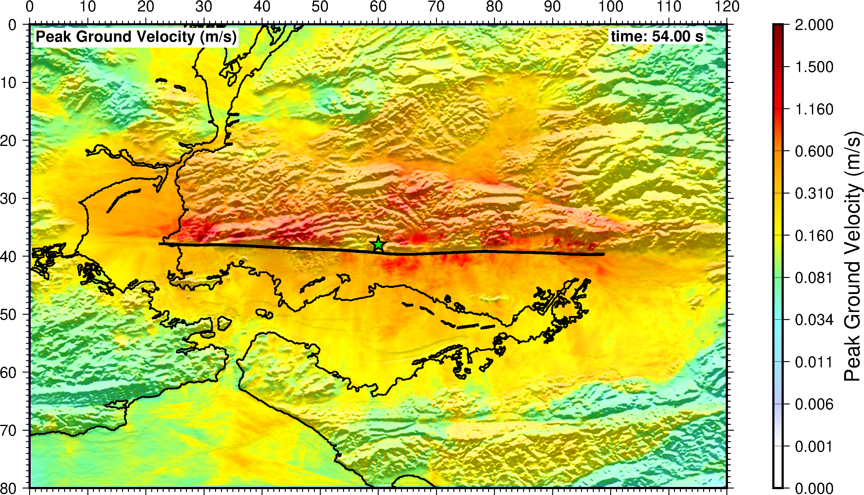
LLNL investment in GPU-based computing (Sierra) is paying off with performance gains aligned with our expectations
Ares RT Mixing
13x speedup
ALE3D Shaped Charge
8x speedup
Sierra speedups over CTS-1,
node-for-node
Ardra Reactor Safety
26x speedup
SW4 Hayward Fault, 28x speedup
Notes:
SW4 5 Hz simulation: Cori (KNL) 8192 nodes (524k cores, 85%): 9.2 hours. Lassen 256 nodes (1024 GPUs): 7.8 hours

Slide 8
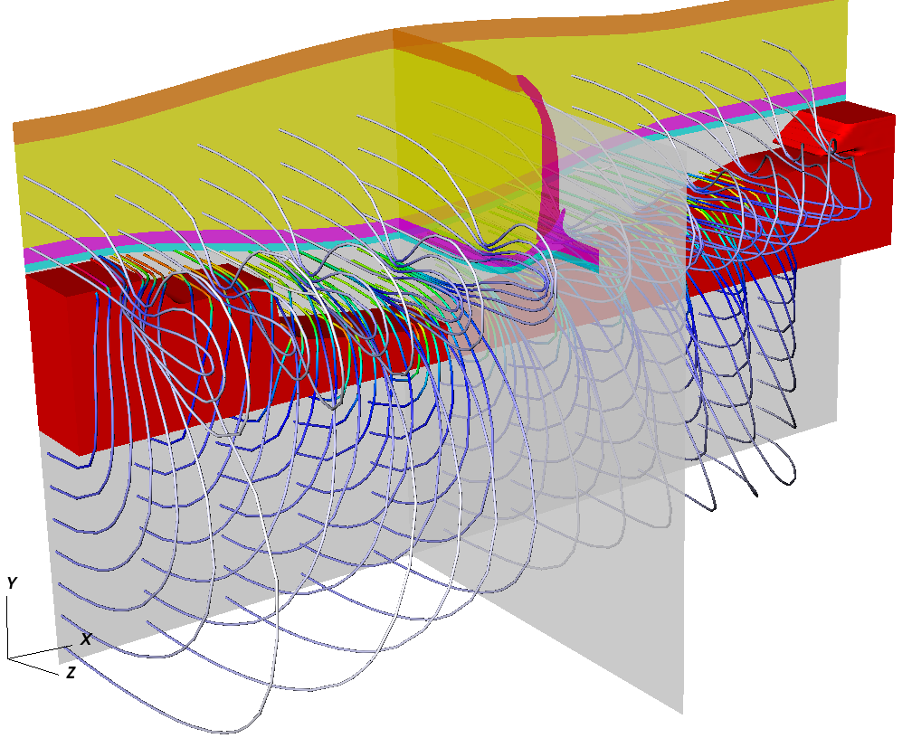
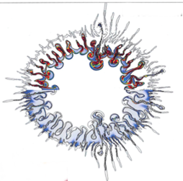
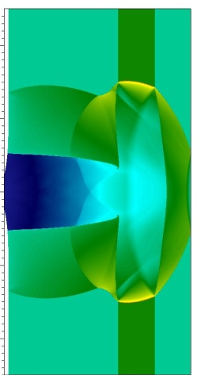
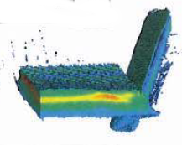
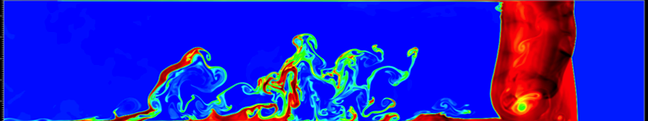
Ares is a massively-parallel, multi-dimensional, multi-physics code
Physics capabilities:
ALE-AMR hydrodynamics
High-order Eulerian hydrodynamics
Elastic-plastic flow
3T plasma physics
High-explosive (HE) modeling
Diffusion and deterministic thermal radiative transfer
Multiphase particle flow
Laser ray-tracing
MHD
Dynamic mixing
Non-LTE opacities
Applications:
  Inertial Confinement Fusion (ICF)
  Pulsed power
  National Ignition Facility debris
  HE experiments

Slide 9
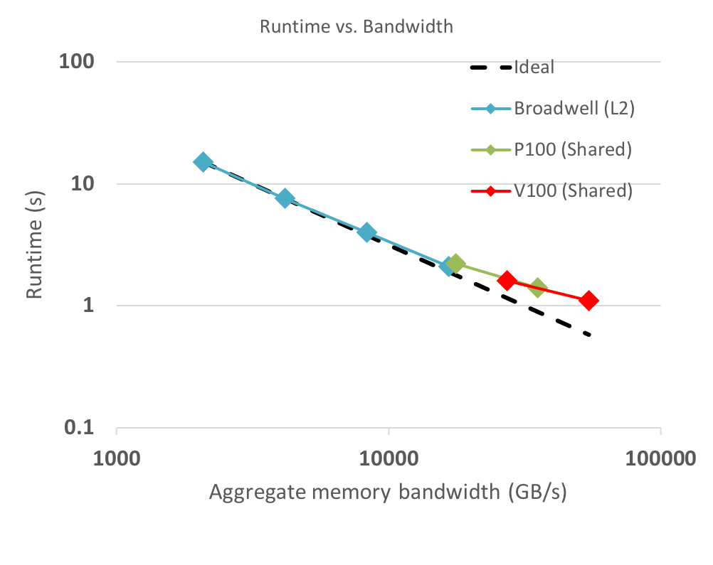
GPUs show great promise for increasing throughput for Ares applications
 | Resources | Nodes | Runtime (hours) | Speedup (×)
CTS-1 Broadwell | 576 cores | 16 | 15.2 | 1.00
 | 1152 cores | 32 | 7.6 | 2.00
 | 2304 cores | 64 | 4.0 | 3.80
 | 4608 cores | 128 | 2.1 | 7.24
Sierra EA P8 + P100 | 32 P100 GPUs | 8 | 2.2 | 6.91
 | 64 P100 GPUs | 16 | 1.4 | 10.86
Sierra P9 + V100 | 32 V100 GPUs | 8 | 1.6 | 9.5
 | 64 V100 GPUs | 16 | 1.1 | 13.82
14× speedup has been achieved, but further optimizations are being explored.

Slide 10
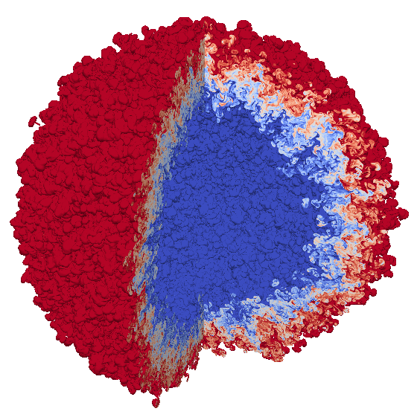
For Sierra acceptance (October 2018), we ran a massive turbulent fluid mixing simulation with Ares
First simulation to run on all of Sierra – 4,096 compute nodes, 16,384 GPUs
  97.8 billion spatial elements
  27 hours wallclock time; 249,100 timesteps (0.39 sec/timestep)
Resources (V100s) | Nodes | Zones | Runtime (hours)
32 | 8 | 191M | 1.6
256 | 64 | 1.52B | 3.5
2048 | 512 | 12.2B | 7.8
16384 | 4096 | 97.8B | 13.05
In-situ visualization
(w/ Ascent) of
ICF-like mixing Layer
Performance scales with memory bandwidth.
Opportunities exist for further improvement.
Such calculations show that we will be able to study mixing phenomena in ICF at unprecedented resolutions!

Slide 11
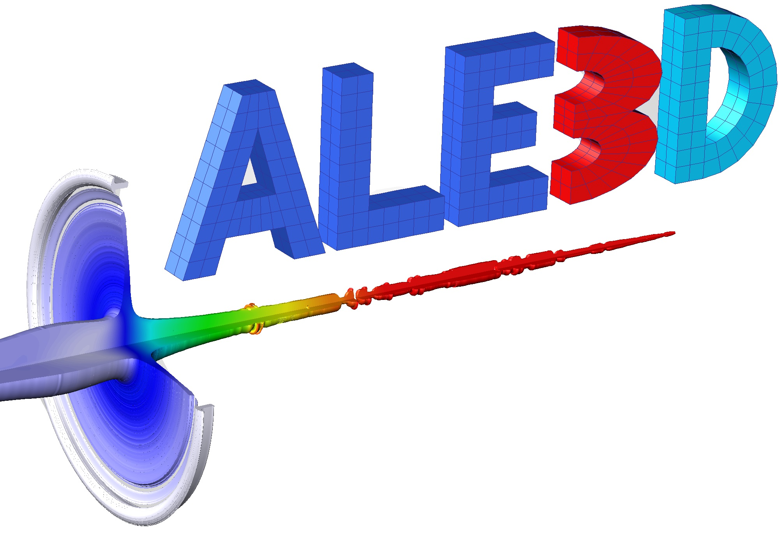
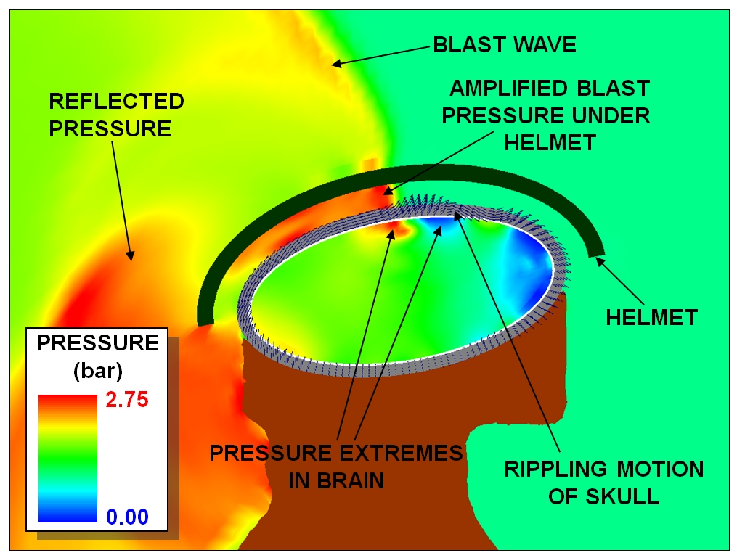
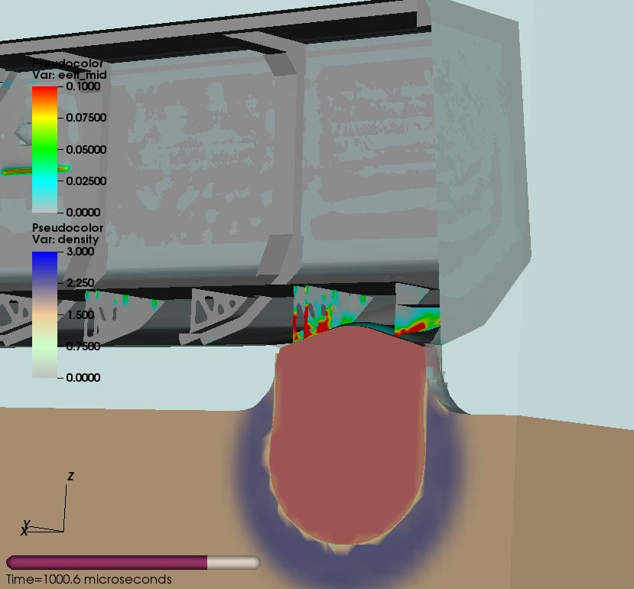
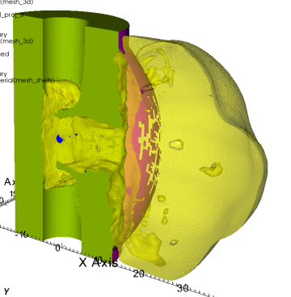
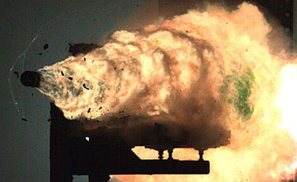
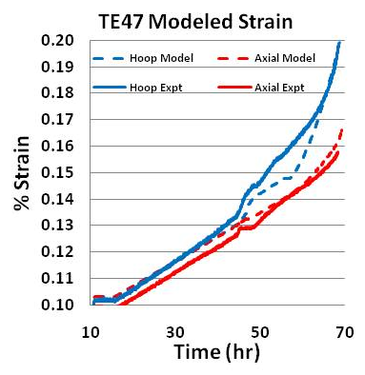
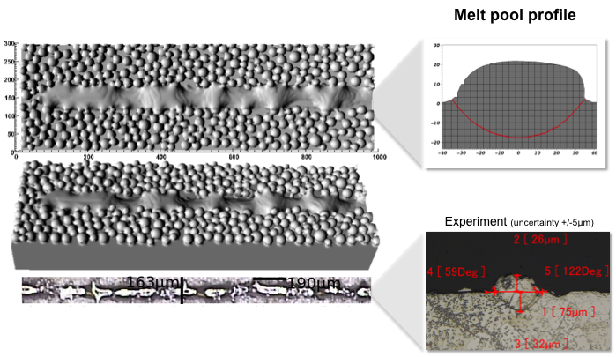
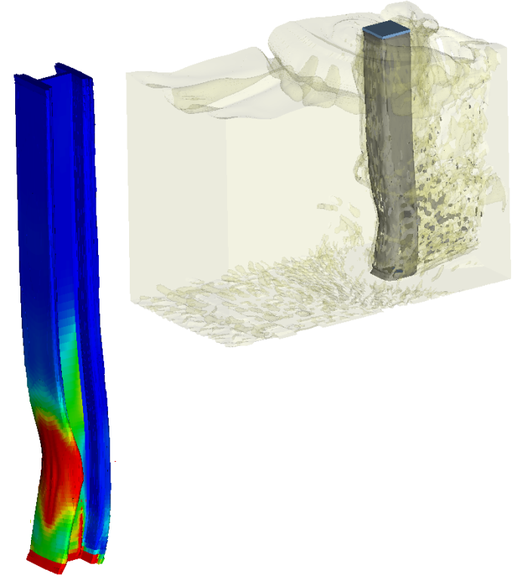
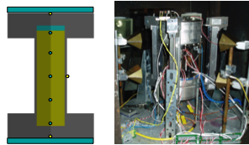
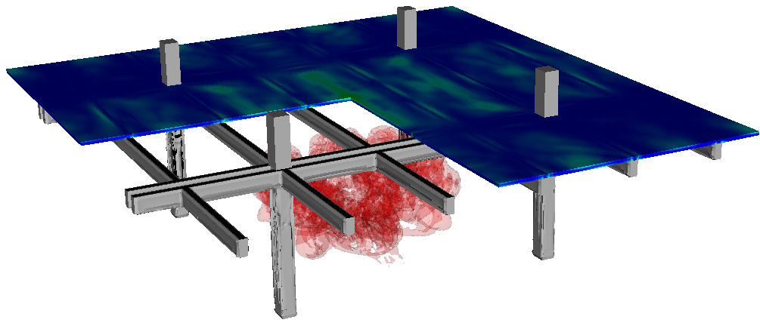
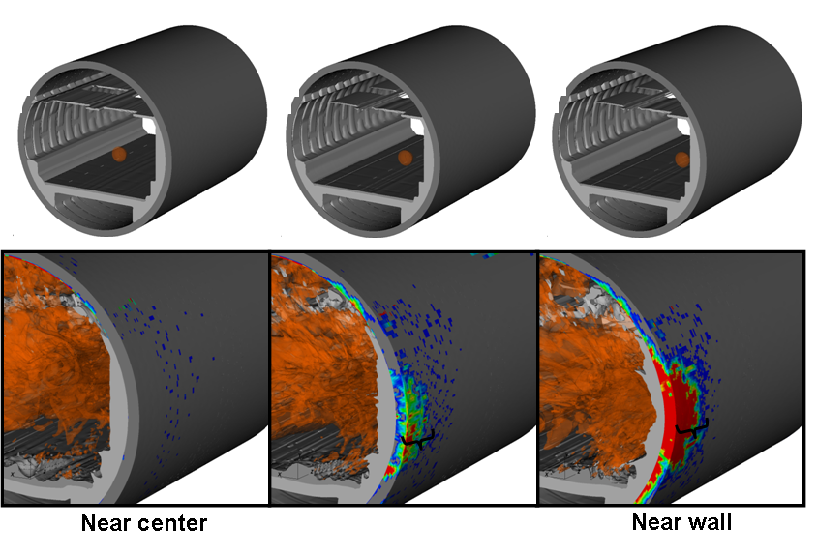
ALE3D is a massively-parallel, multi-dimensional, multi-physics code with a large application space
Required physics capabilities
  3D/2D ALE hydrodynamics
  3D arbitrarily connected hexahedral mesh
  High-explosive modeling
  Material contact
  Advanced material models
DoD: Munitions and rocket design performance, lethality, vulnerabilities, and safety
Blast/Impact for TBI
Buried Blast
Rocket Motor
Rail Gun
DOE: Stockpile Stewardship,
other NNSA programs
Other: Additive Manufacturing
DHS: Transit and structures vulnerabilities and safeguard designs
Explosive Cookoff
Violence of Reaction
Fully Coupled Blast/Structural
Component and System-Level Analysis
Sierra goal: turn around in a weekend complex calculations that currently take a month to run (10× speedup or more).

Slide 12
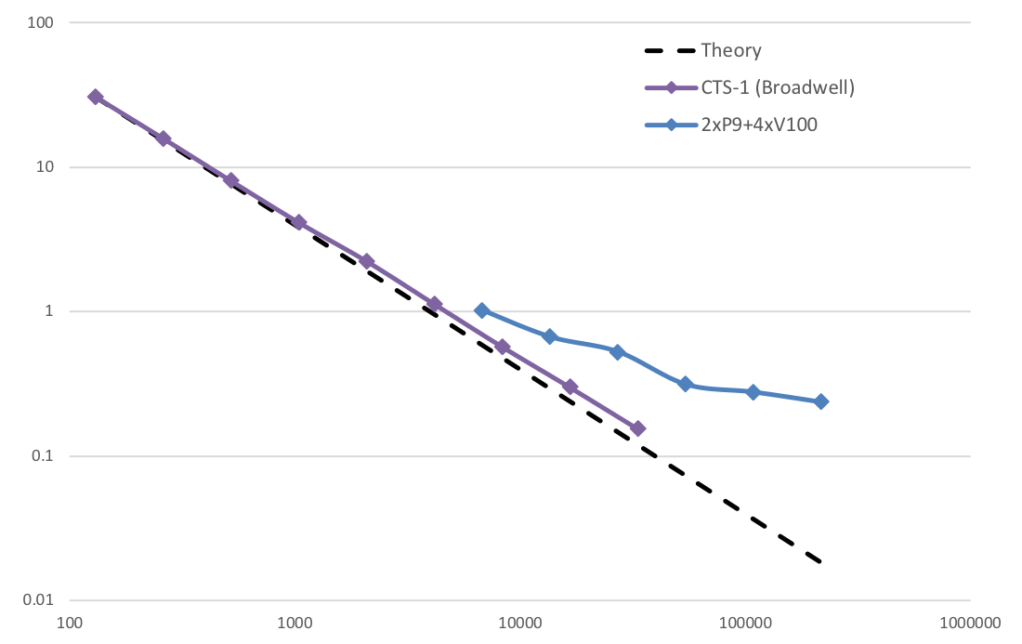
We are making great progress, but focused performance optimization work (identified) is required
 | Resources | Nodes | Runtime (hours)
CTS-1 | 36 cores | 1 | 30.7
 | 72 cores | 2 | 15.8
 | 144 cores | 4 | 8.1
 | 288 cores | 8 | 4.2
 | 576 cores | 16 | 2.2
 | 1152 cores | 32 | 1.1
 | 2304 cores | 64 | 0.6
 | 4608 cores | 128 | 0.3
 | 9216 cores | 256 | 0.2
Sierra | 8 GPUs | 2 | 1.1
 | 16 GPUs | 4 | 0.7
 | 32 GPUs | 8 | 0.5
 | 64 GPUs | 16 | 0.3
 | 128 GPUs | 32 | 0.3
 | 256 GPUs | 64 | 0.2
Runtime vs. Bandwidth
Node-Node
Speedup
14.5×
Runtime (s)
Identified major bottlenecks
  Kernel launch overhead
  GPU register pressure
Performance bottlenecks must be overcome to achieve memory bandwidth scaling.

Slide 13
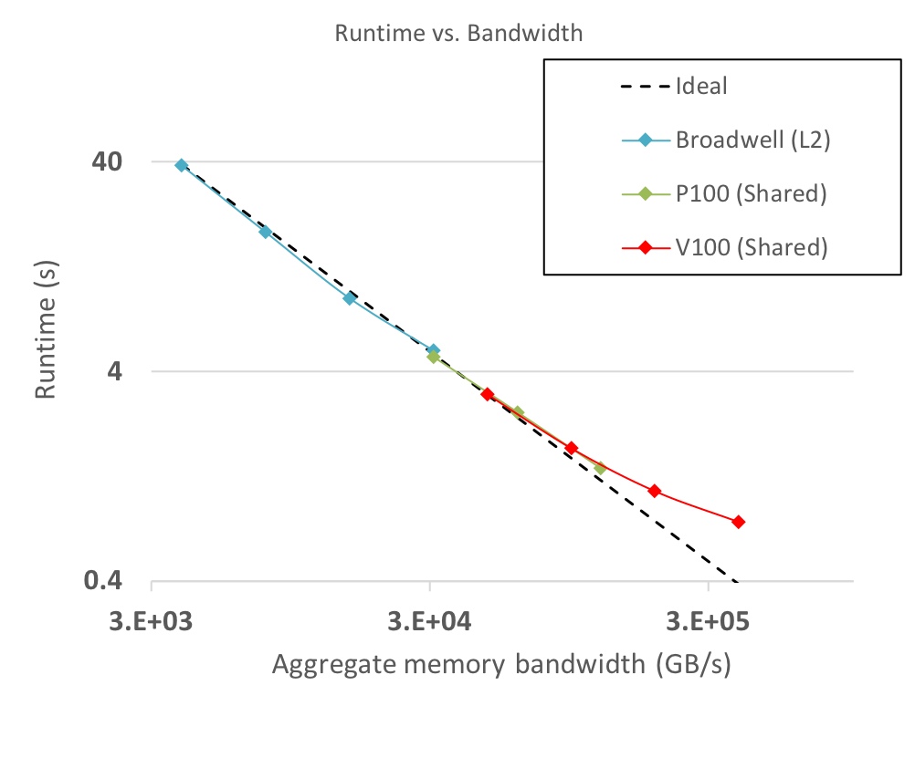
Ardra performance is closely tracking cache bandwidth across architectures
Runtime vs. Bandwidth
Criticality search solver
Resources | Nodes | Runtime (s) | Speedup (×)
36 CPU cores | 1 | 38.76 | 1.0
72 cores | 2 | 18.57 | 2.1
144 cores | 4 | 8.95 | 4.3
288 cores | 8 | 5.03 | 7.7
4 P100 GPUs | 1 | 4.69 | 8.3
8 GPUs | 2 | 2.56 | 15.1
16 GPUs | 4 | 1.39 | 27.8
4 V100 GPUs | 1 | 3.13 | 12.4
8 GPUs | 2 | 1.73 | 22.4
16 GPUs | 4 | 1.08 | 35.8
32 GPUs | 8 | 0.77 | 50.5
CTS-1
(Broadwell)
EA (P8+P100)
Sierra (P9+V100)

Slide 14

SW4 is running high resolution earthquake simulations much more efficiently on Sierra than KNL
Cori-II (SW4): PGV = 2.1797349453 m/s
Sierra(SW4-RAJA): PGV = 2.1797349453 m/s
25.8B grid points, 63,063 timesteps – solver wallclock time 10.3 hours
85% of Cori-II: 8,192 nodes (524,288 CPU cores) | 6% of Sierra: 256 nodes (1024 GPUs)
27 PF total peak (#12 Top 500) | 125 PF total peak (#2 Top 500)
Two codes, different platforms: Peak Ground Velocity maps agree to machine precision!

Slide 15
Each application has taken years of effort to get where we are….
Ares’ Sierra porting timeline:
Code base prep, early GPU runs, incremental performance improvements
Other apps are similar….
2015
2016
2017
‘18

Slide 16
Each optimization step improves performance and reveals the next problem to solve
GPUs have performance overheads that we don’t see on CPUs
Kernel launch overhead
  Can be hidden with asynchronous kernel launches
Data transfer between memory spaces
  Must be avoided or hidden behind other kernels
Memory allocation is significantly more expensive on the GPU
  Memory pools are a must!
Coordinating many parts
Libraries have different porting strategies/timelines
  Un-ported parts → costly CPU/GPU data transfers
GPU memory is a scarce resource to share
  Memory pools can help

Slide 17
RAJA has enabled us to write high performance code for Sierra while maintaining portability…
It helps insulate applications from technology disruption and doesn’t inhibit using new or platform-specific tools
It insulates apps from variability of programming model and architecture considerations
  “Easy to do most things, possible to do really hard things” (apologies to Larry Wall)
It’s easy for one application to adopt features and/or optimizations developed in RAJA for another application (just grab a newer version)
It is reasonably easy to grasp for all application developers (esp. non CS experts)
It’s easy to integrate with apps and easy to adopt incrementally
It facilitates application flexibility by promoting clean encapsulation
The performance gains we are observing on Sierra are game changing for us –
allowing us to dramatically enhance physics fidelity and simulation throughput.

Slide 18
Acknowledgements
  RAJA Team and contributors
  Rich Hornung (PL)
  David Beckingsale
  Jason Burmark
  Noel Chalmers (AMD)
  Robert Chen
  Matt Cordery (IBM)
  Chip Freitag (AMD)
  Jeff Hammond (Intel)
  Holger Jones
  Jeff Keasler
  Will Killian (Millersville University)
Umpire Team and contributors
  David Beckingsale (PL)
  Johann Dahm (IBM)
  Rich Hornung
  Marty McFadden
  Adam Kunen
  Scott Moe (AMD)
  Olga Pearce
  Tom Scogland
  Arturo Vargas
CHAI Team and contributors
  David Beckingsale (PL)
  Alan Dayton
  Holger Jones
  Adam Kunen
  David Poliakoff
  Peter Robinson
Plus, all the application developers, Livermore Computing staff, vendor contributors and compiler teams, and others who have helped make these projects more robust and viable for production codes.

