Slide 1
NERSC to NVIDIA: A Perspective
Zahra Ronaghi, Senior Solutions Architect

Slide 2
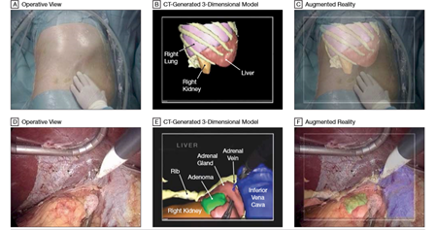
Clemson to
NERSC
Remote Processing of Laparoscopic Video
Image guided surgery augmented with laparoscopic video can display 3D images of structures with respect to depth
Real-time image guidance requires accurate segmentation and registration of medical images during surgery
Process, render and visualize augmented data on high performance computing cluster and minimize risk to patient

Slide 3
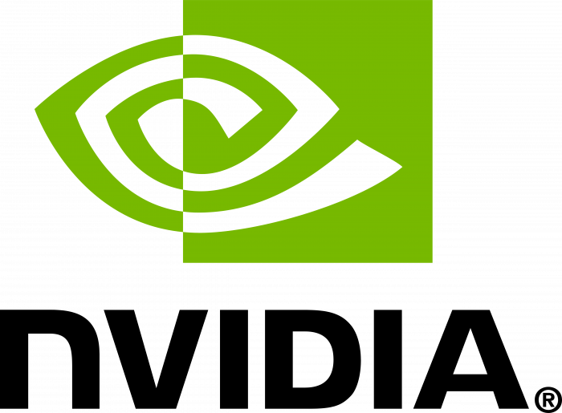
NERSC to NVIDIA
NESAP for Data Postdoc at NERSC
TomoPy - Tomographic Reconstruction in Python
Performance Portability - BoxLib/AMReX
Deep Networks for Neutrino Telescopes
Workshops and Hackathons
Solutions Architect at NVIDIA
Higher Education and Research
High Performance Graph Frameworks for GPUs
RAPIDS - ORNL, NASA, NERSC

Slide 4
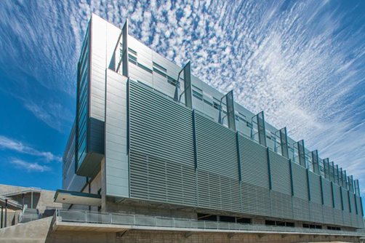
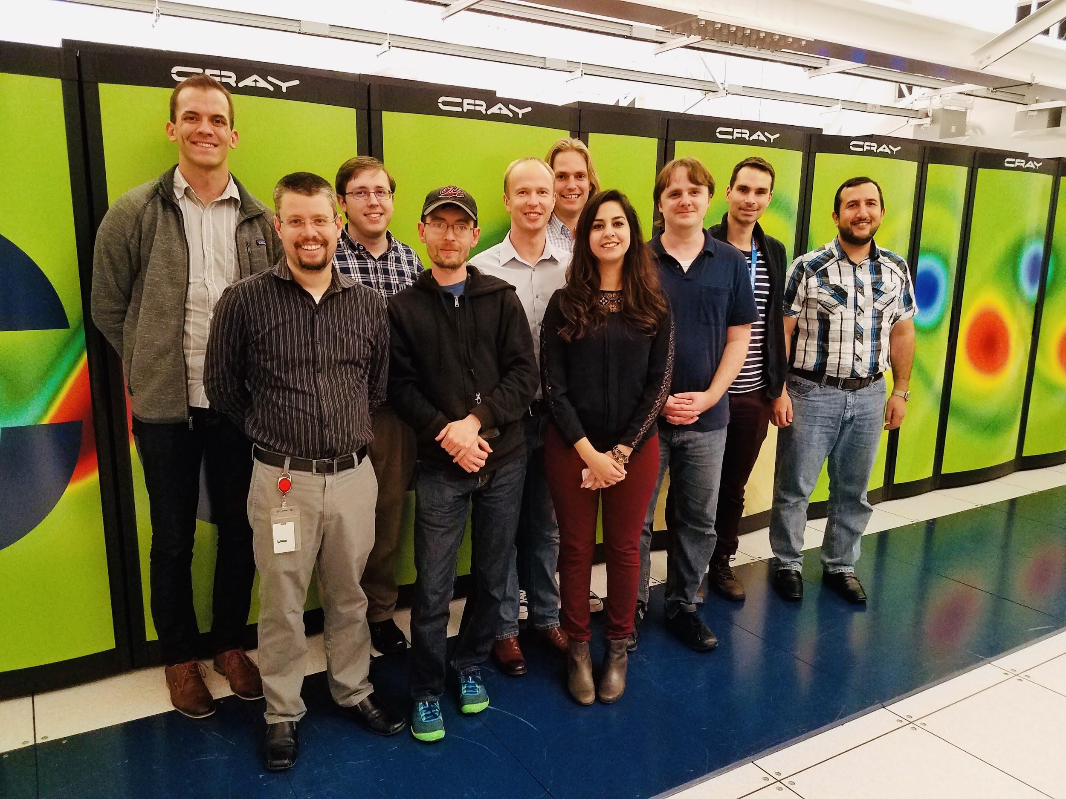
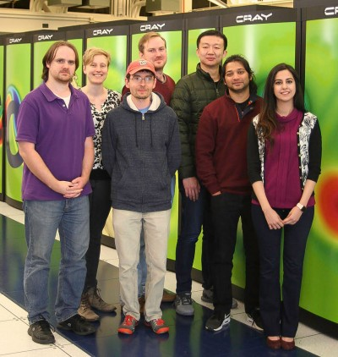
NERSC Exascale Science Applications Program
Simulations, Data Analytics, and Learning
National Energy Research Scientific Computing Center

Slide 5
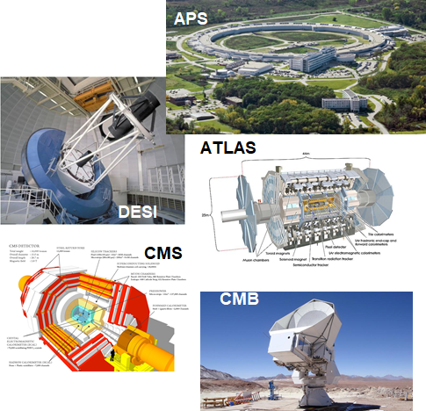
NESAP for Data
Applications that process and analyze big data
streams from experiments and instrumentation
supported by DOE to prepare for exascale
Cori architecture
Intel Xeon “Haswell” processors
Intel Xeon Phi “Knights Landing” (KNL) processors
Early engagement with code teams,
expanded access to KNL,
vendor collaboration,
extra support from NERSC staff

Slide 6
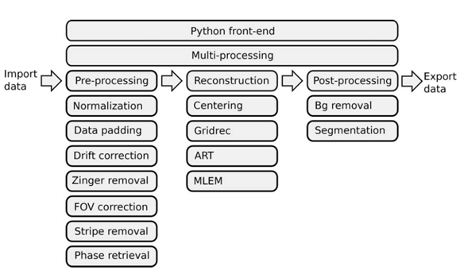
TomoPy
Tomographic Reconstruction in Python
Framework for analysis of synchrotron tomographic data
Tomographic reconstruction: 2D projections taken from different orientations are processed to generate 3D structures
Primarily in Python with some code (~25%) in C/C++
Inter-node parallelization:
MPI by distributing sinograms
Intra-node parallelism:
Python’s multiprocessing and concurrent futures modules

Slide 7
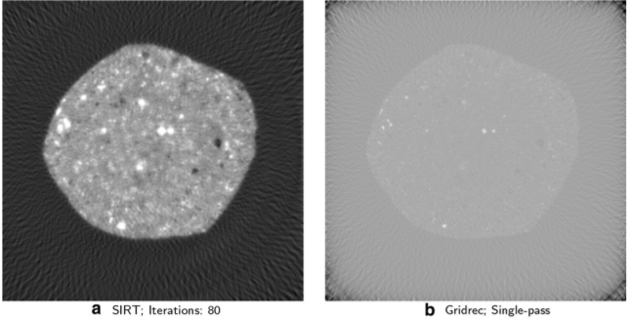
TomoPy Optimizations
Superfacility: TomoPy as a CUDA Case Study
Jonathan Madsen
Trace: a high-throughput tomographic reconstruction engine for large-scale datasets
Reconstruction methods:
Direct algorithms: Filtered back-projection - Gridrec
Iterative reconstruction:
Simultaneous Iterative Reconstruction Technique (SIRT)
Fine grained parallelism to exploit the 68 cores per node
Structure code to maximize memory access
Use optimized, threaded, and vectorized math libraries (Intel Math Kernel Library) through Python extensions: NumPy, SciPy, Numexpr, Scikit-Learn
Use performance analysis tools to identify, understand, and restructure hotspot kernels
Ronaghi, Z., Thomas, R., Deslippe, J., Bailey, S., Gursoy, D., Kisner, T., Keskitalo, R. and Borrill, J., 2017, November. Python in the NERSC exascale science applications program for data. In Proceedings of the 7th Workshop on Python for High-Performance and Scientific Computing (p. 4). ACM.

Slide 8
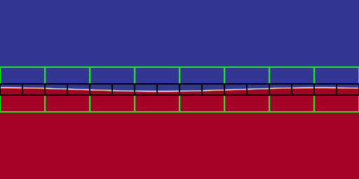
Performance Portability
Portability across DOE office of science HPC facilities:
ALCF - Theta, Intel Xeon-Phi, 3624 nodes
NERSC - Cori, Intel Xeon-Phi, 9688 nodes
OLCF - Titan, AMD Opteron+NVIDIA K20X, 18,688 nodes
Approaches:
Libraries: BLAS/LAPACK, FFTW, PETSc
Directives: OpenACC, OpenMP
Frameworks: Kokkos, RAJA
DSLs: NMODL (computational neuroscience), AMRStencil (solvers on AMR meshes)
BoxLib/AMReX:
Framework for parallel, block-structured,
adaptive mesh refinement (AMR) applications
Yang, C., Gayatri, R., Kurth, T., Basu, P., Ronaghi, Z., Adetokunbo, A., Friesen, B., Cook, B.,Doerfler, D.,
Oliker, L. and Deslippe, J., 2018, November.
An empirical roofline methodology for quantitatively assessing performance portability.
In 2018 IEEE/ACM International Workshop on Performance, Portability and Productivity in HPC (P3HPC)
https://amrex-codes.github.io/amrex/overview.html

Slide 9
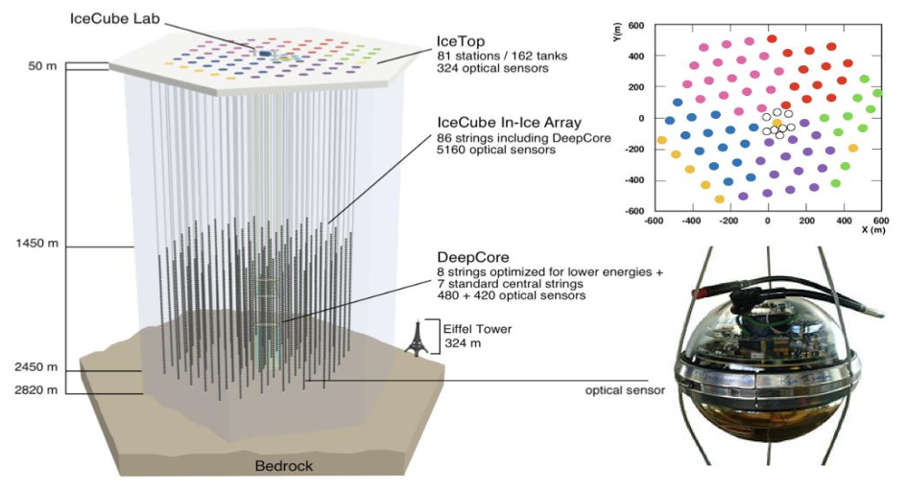
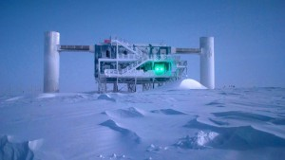
Deep Networks for Neutrino Telescopes
Graph neural networks (GNNs) for neutrino detection in the IceCube observatory
Neutrinos produced by distant astrophysical phenomenon
Searching for traces of these particles against a background of muons
Irregular geometry of detectors, sparse nature of signal recorded by IceCube detectors, large asymmetry between positive and negative events
IceCube Neutrino Observatory
Choma, N., Monti, F., Gerhardt, L., Palczewski, T., Ronaghi, Z., Prabhat, P., Bhimji, W., Bronstein, M., Klein, S. and Bruna, J., 2018, December. Graph Neural Networks for IceCube Signal Classification. In 2018 17th IEEE International Conference on Machine Learning and Applications

Slide 10
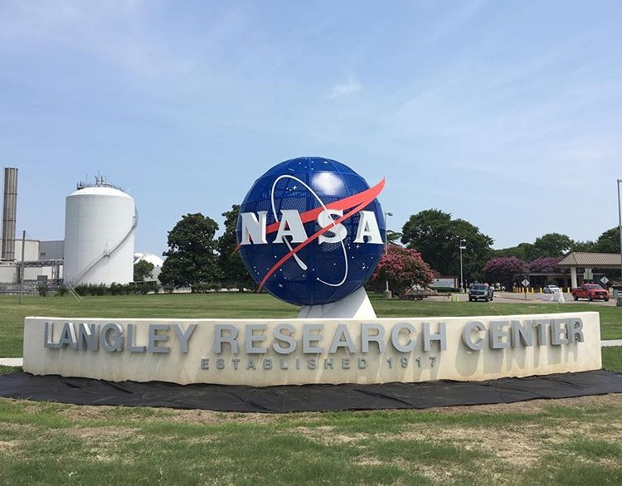
Hackathons
NERSC
NASA GPU hackathon
Performance portability with Kokkos workshop
NERSC roofline, Intel compilers and libraries training
Cori KNL hackathon

Slide 11
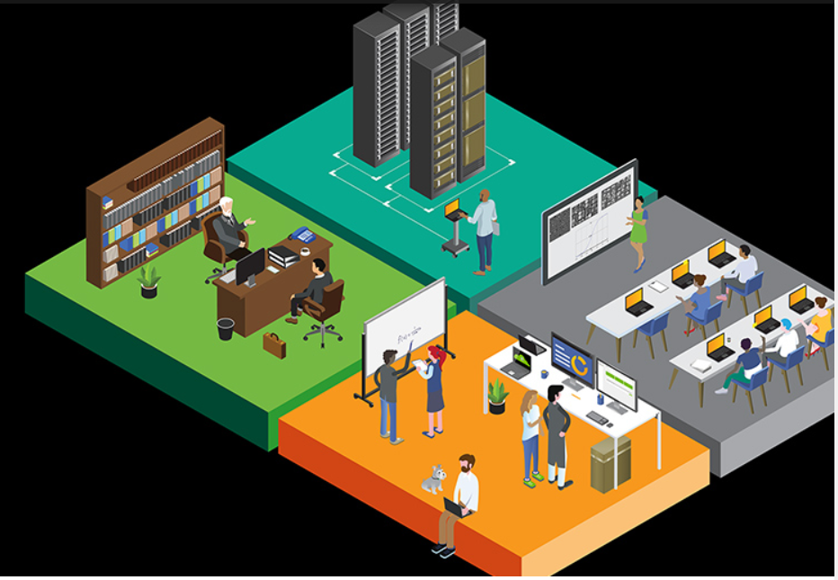
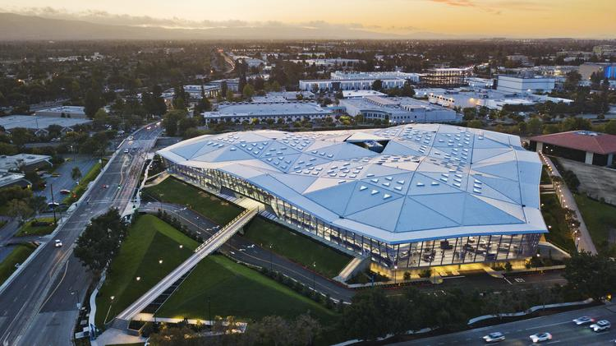
NVIDIA Solutions Architect
Higher Education and Research
https://developer.nvidia.com/higher-education-and-research
Higher Education Webinars
Hackathons and Workshops
Deep Learning Institute (DLI)
DLI Ambassador
DLI Teaching Kits
NVIDIA AI Labs (NVAILs)
NVIDIA HQ - Endeavor

Slide 12
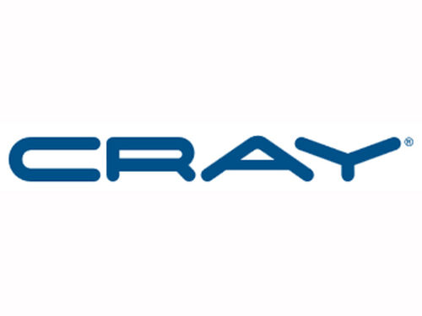
Perlmutter
NERSC-9
CPU only nodes:
Next generation AMD CPU
CPU + GPU nodes:
Next generation NVIDIA GPUs with tensore cores, high bandwidth memory and NVLink-3
Cori-GPU
NVIDIA V100 GPUs
5,120 CUDA Cores
640 Tensor Cores
7.8 FP64 TFLOPS, 15.7 FP32 TFLOPS, 125 Tensor TFLOPS
16GB HBM2 @ 900GB/s
NESAP for Perlmutter

Slide 13
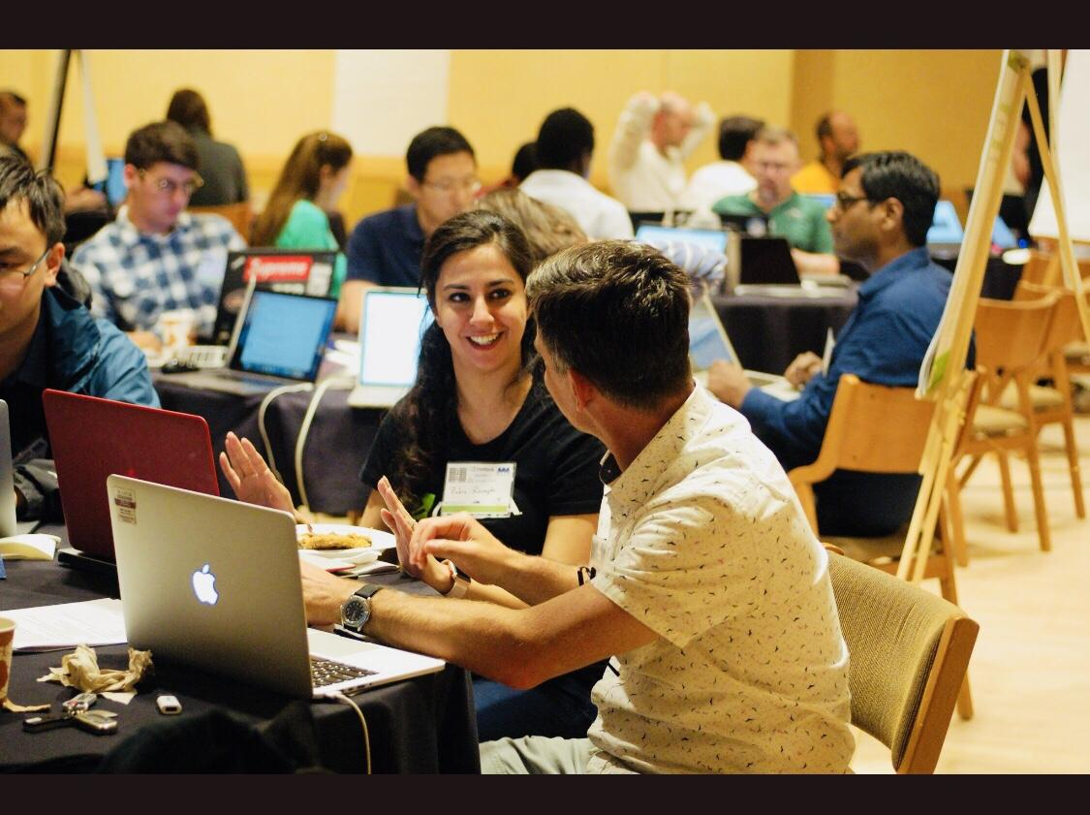
Hackathons
NVIDIA
Perlmutter GPU hackathon
JGI GPU hackathon
GTC:Fundamentals of Deep Learning for Computer Vision
PEARC:​Accelerating Data Science Workflows with RAPIDS

Slide 14
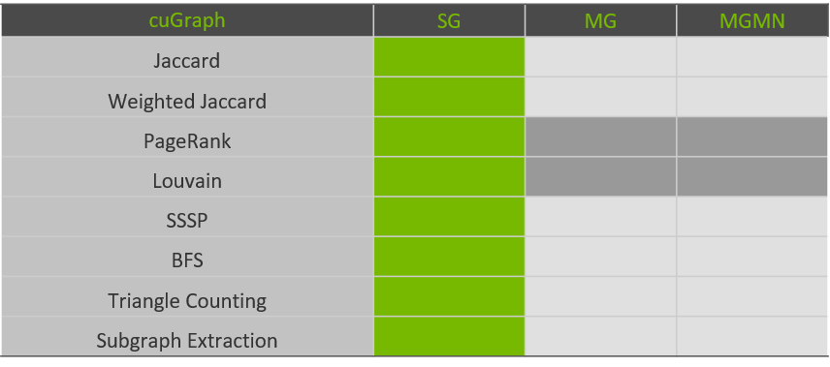
GPU Accelerated Graph Analytics
RAPIDS cuGraph
nvGraph from NVIDIA
Gunrock from UC Davis
Hornet from Georgia Tech (also HornetsNest)
https://medium.com/rapids-ai/rapids-cugraph-1ab2d9a39ec6

Slide 15
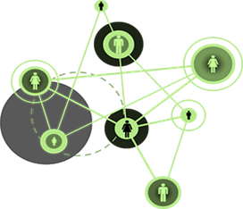
GPU Accelerated Graph Analytics
HiBench Websearch PageRank
PageRank - compute user behavior changes in user’s importance
Influence social networks
Each iteration involves computing:
y = Ax, x = y/norm(y)
Merge-path load balancing for graphs
Power iteration for largest eigenpair by default
Implicit Google matrix to preserve sparsity
Advanced eigensolvers for ill-conditioning
Kim, E., Ronaghi, Z., Kannan, R., Fender, A., Rees, B., Eaton, J., Osama, M., Pan, Y., Owens, J., Bader, D., and Green, O.,
Evaluating High Performance Graph Frameworks for GPUs, under review

Slide 16
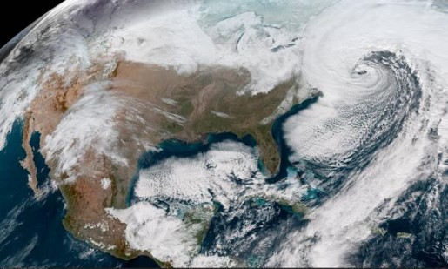
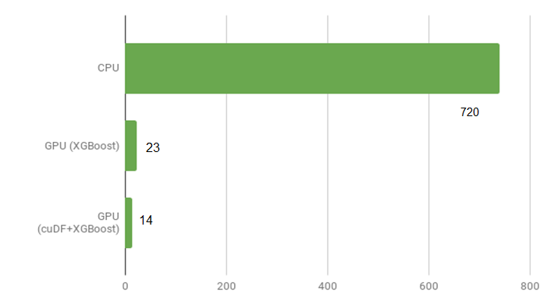
RAPIDS
Accelerating Data Science Workflows on GPUs
ORNL: ML for climate prediction
Enhance simulation of water cycle in the earth system and better characterize the nature and occurrence of extreme events, such as floods and droughts
NASA Goddard: atmospheric chemistry modeling
Replace chemical integrator with model
trained by ML to predict
surface concentrations of ozone
NERSC:
RAPIDS - Randy Gelhausen
Case study - Nick Becker
Keller, C., Clune, T., Thompson, M., Evans, M., and Ronaghi, Z.,
Atmospheric chemistry modeling and air quality forecasting using machine learning, under review

Slide 17
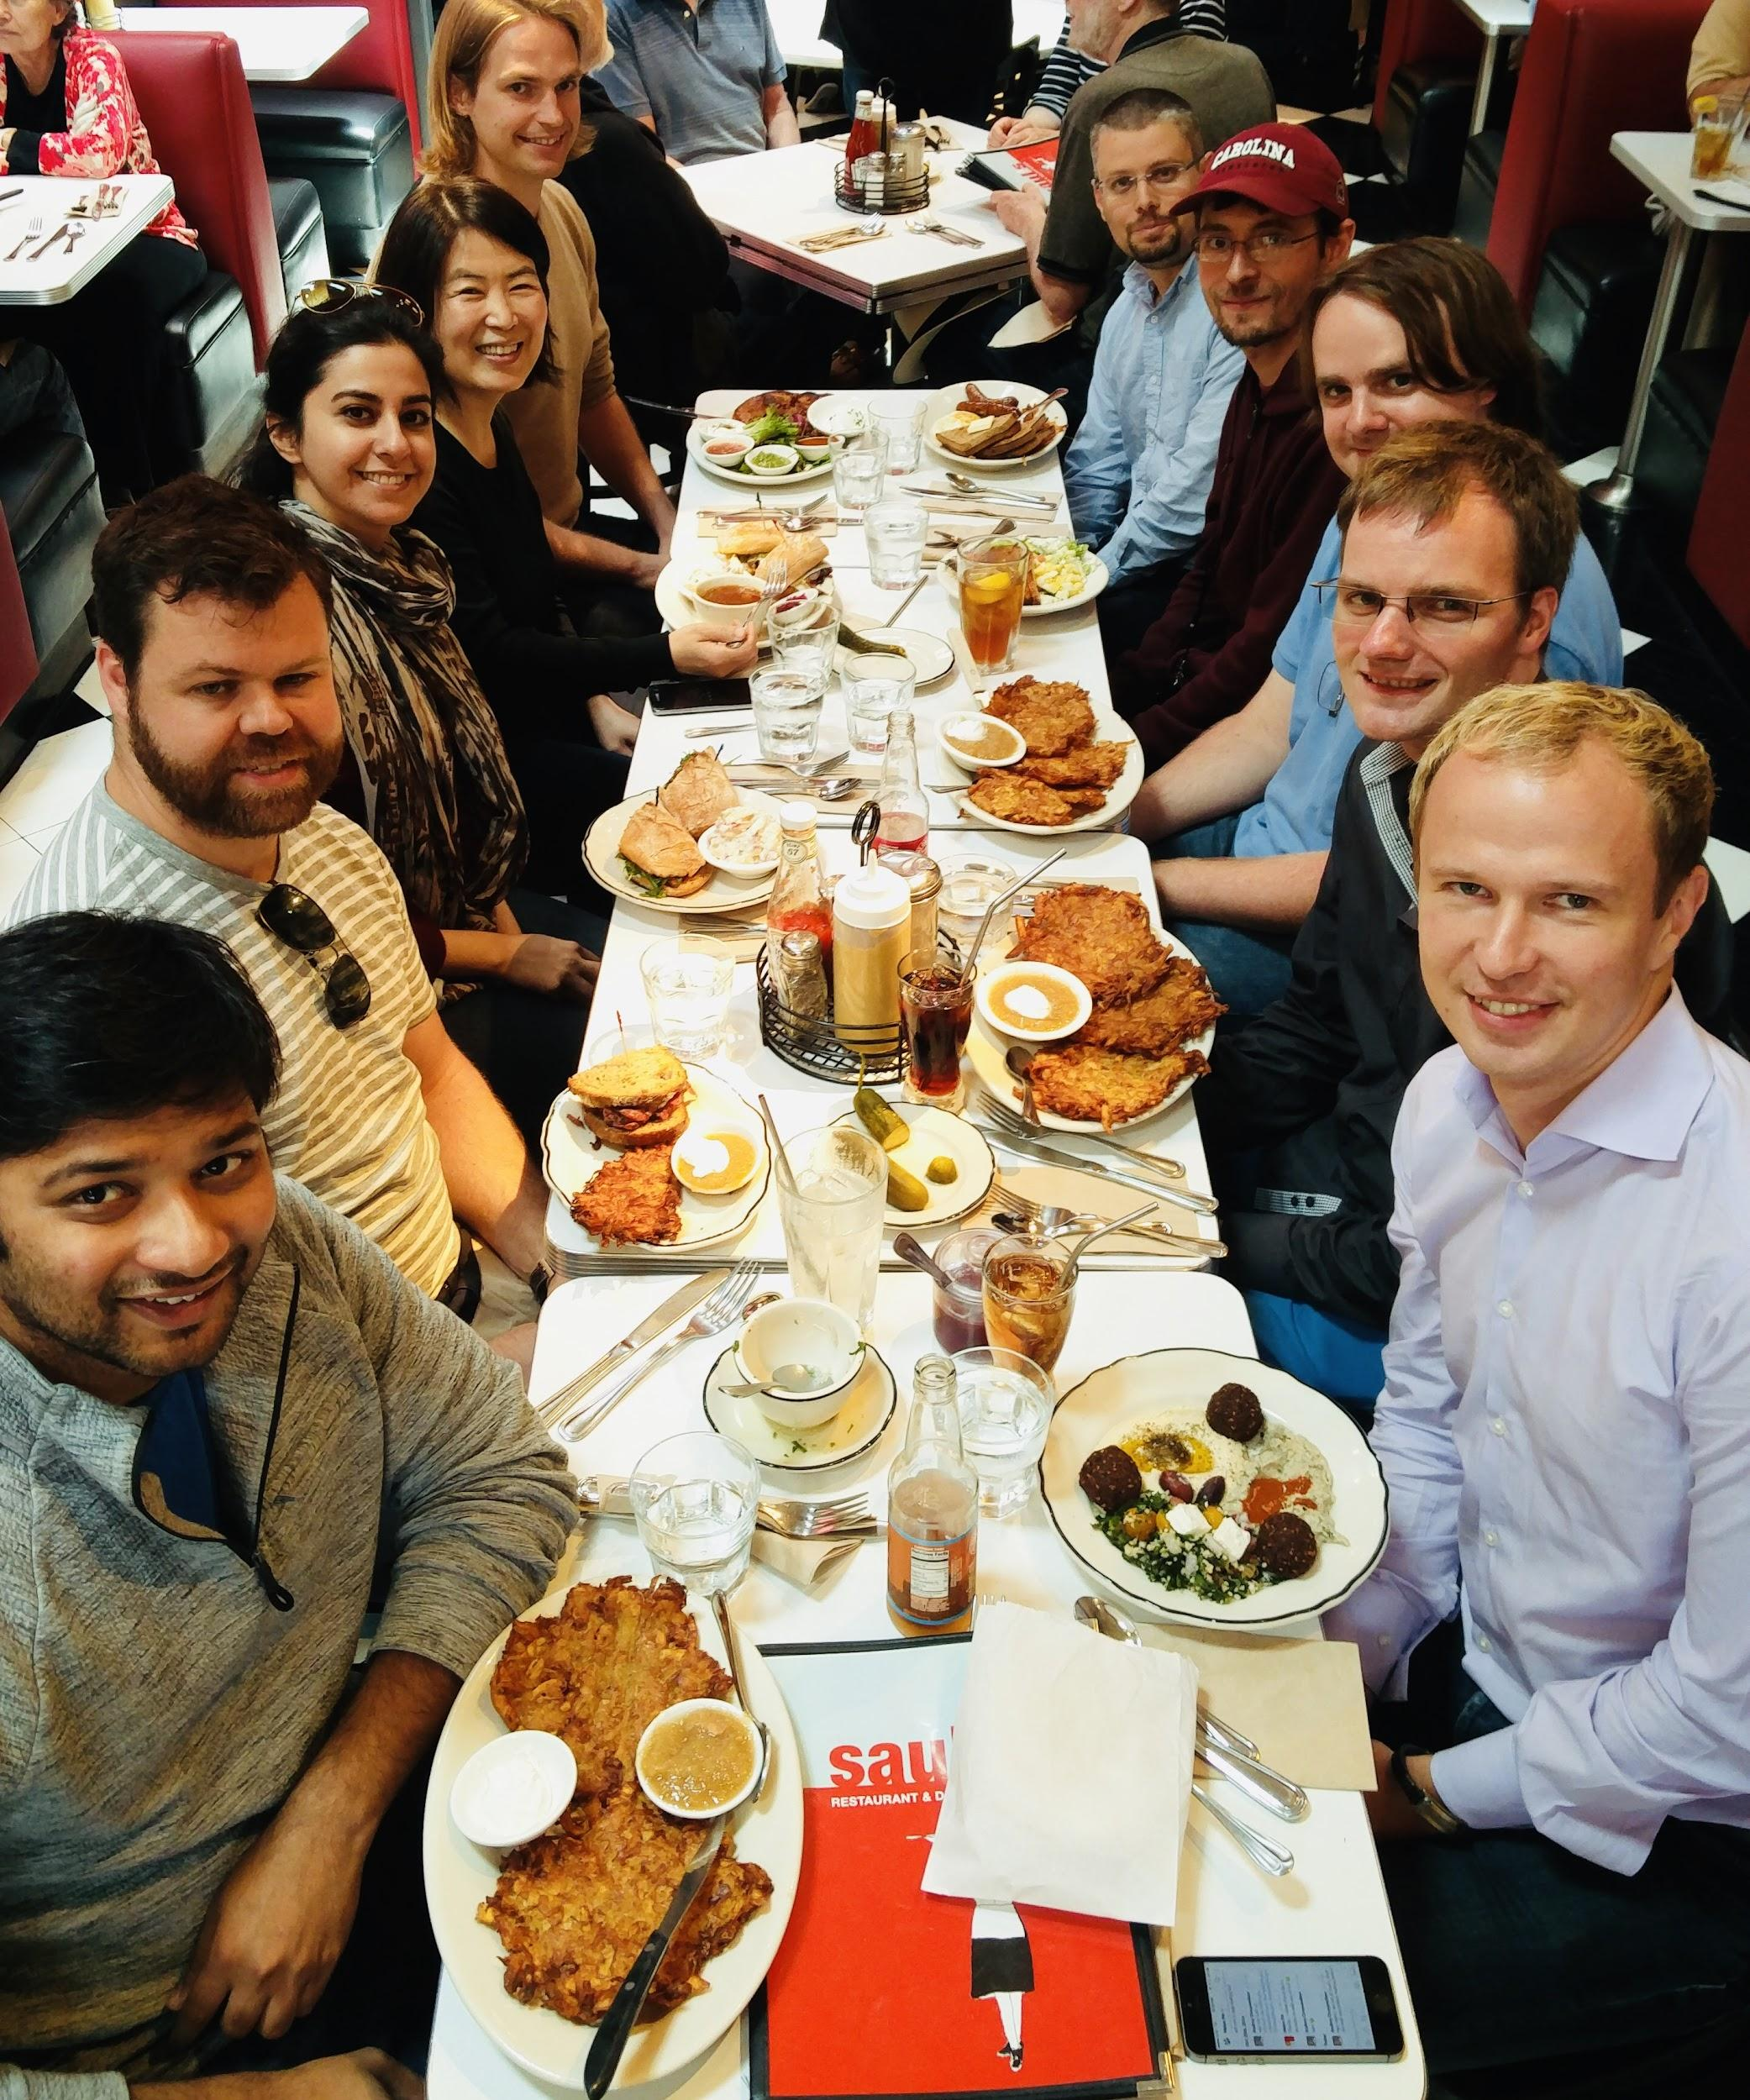
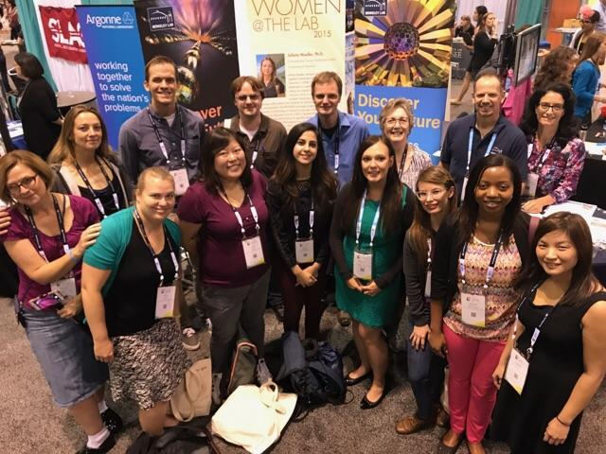
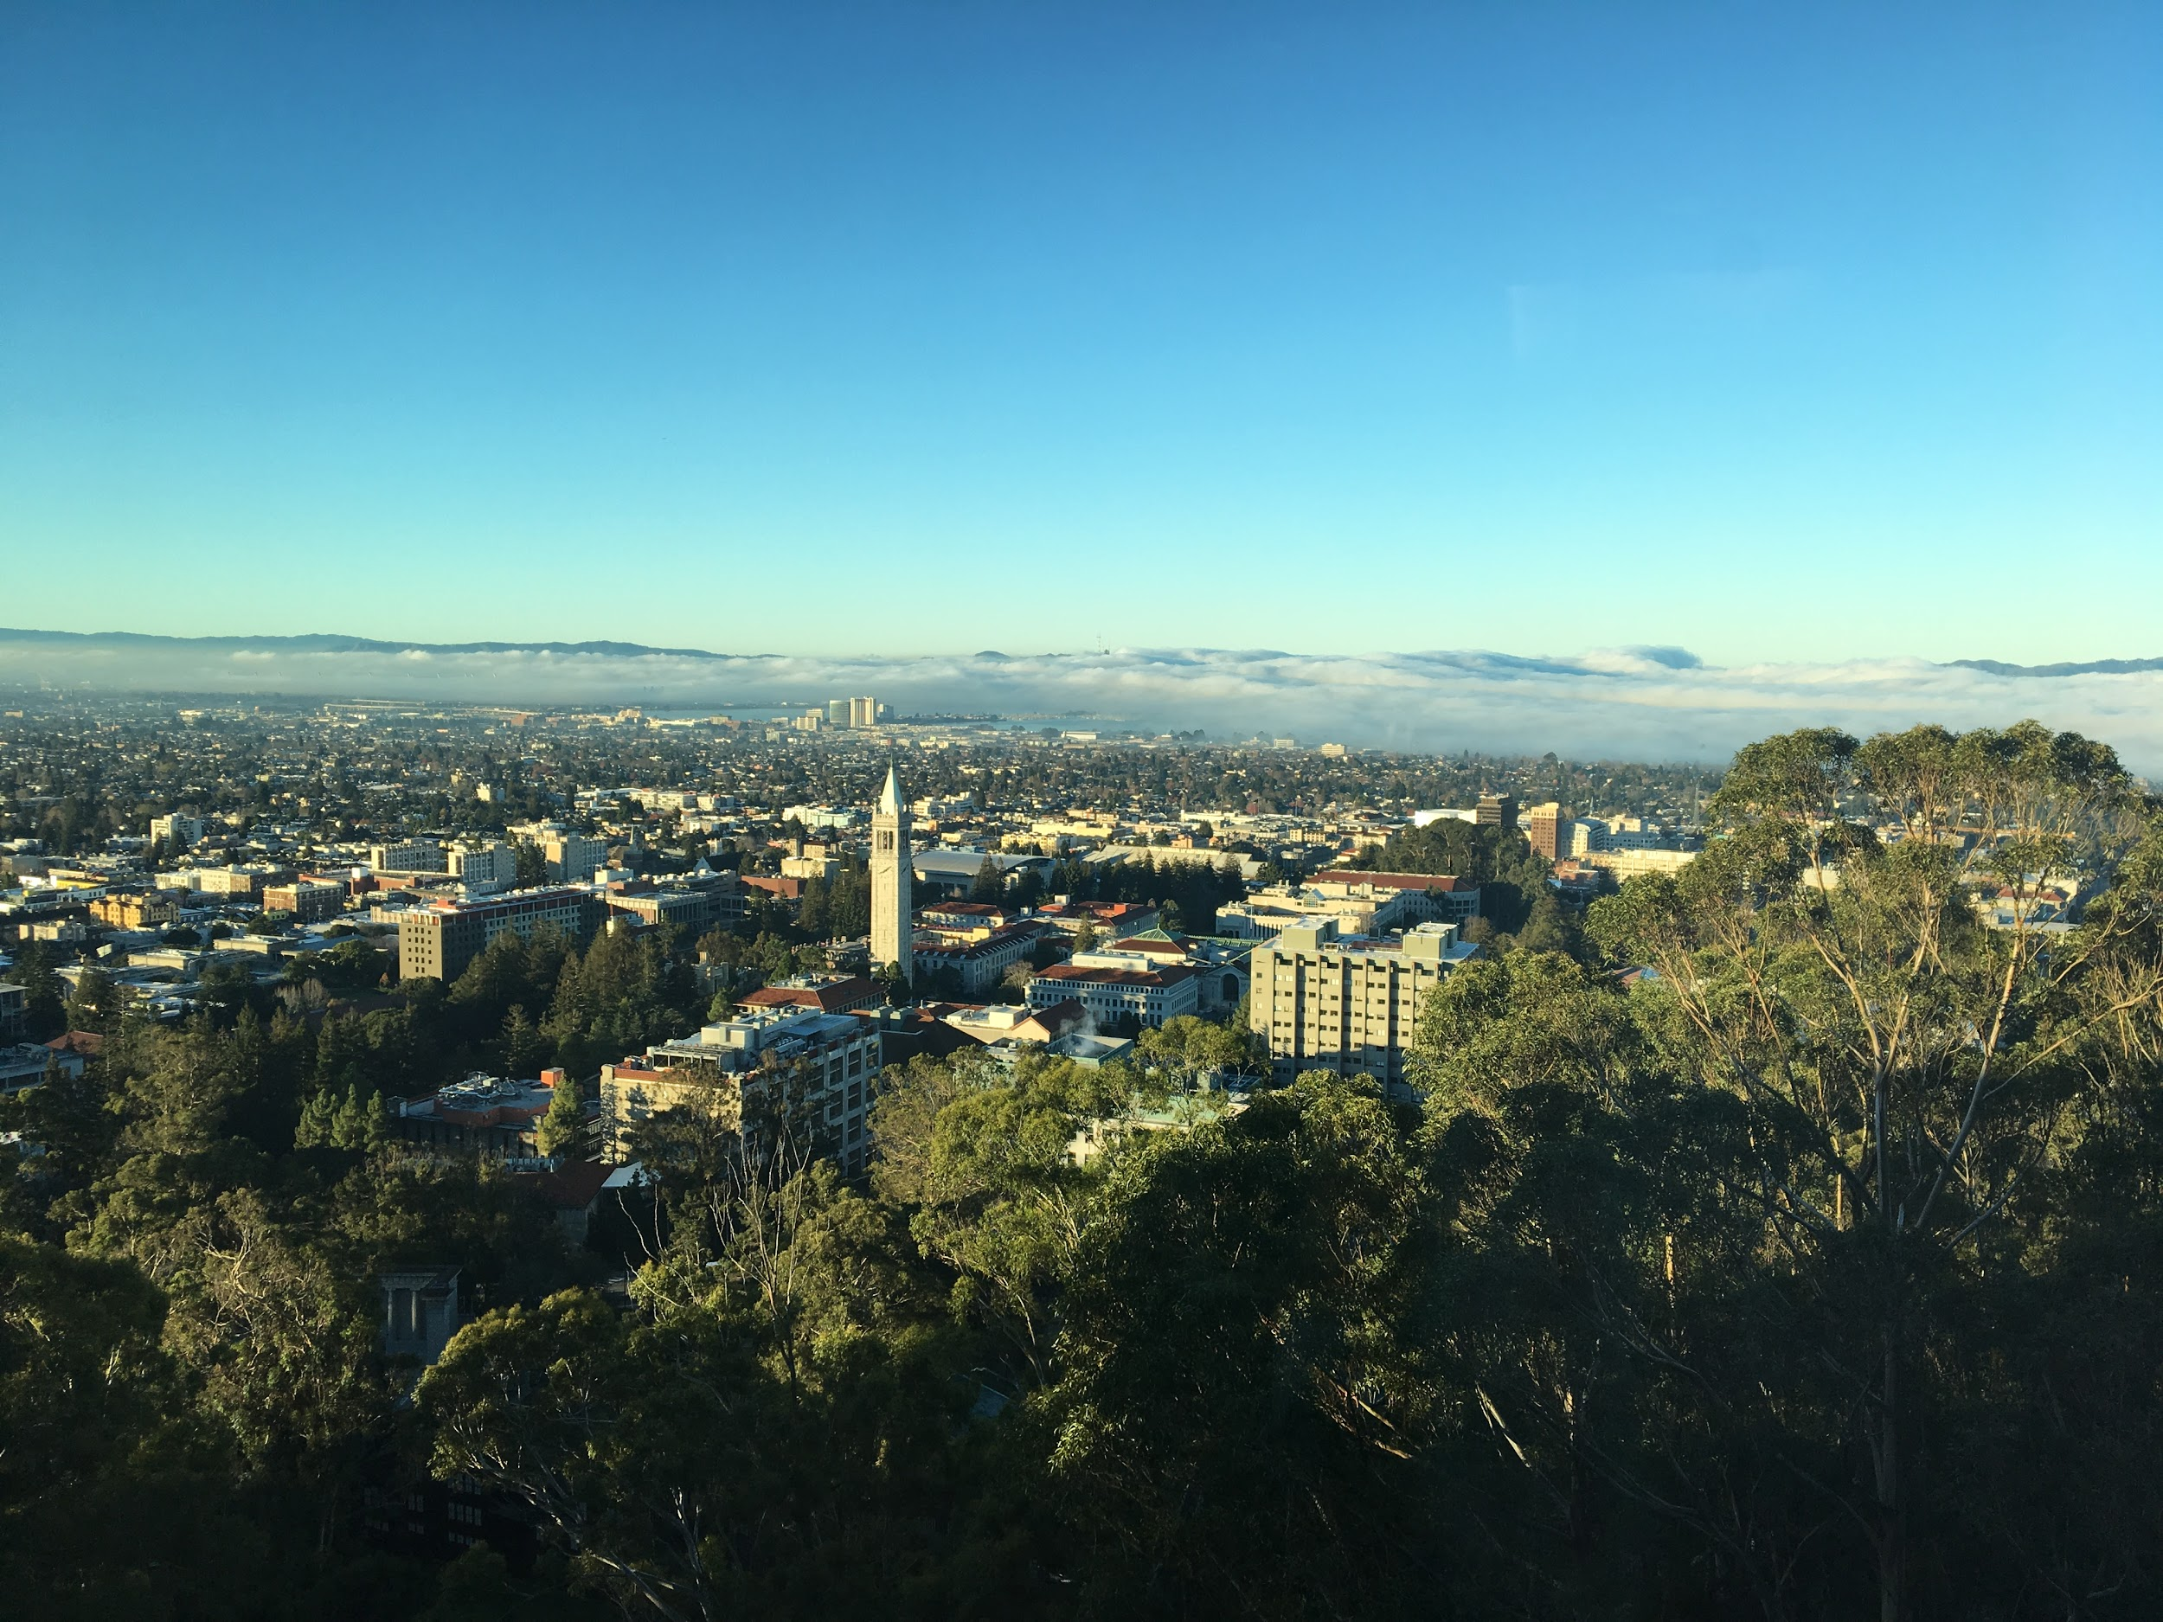
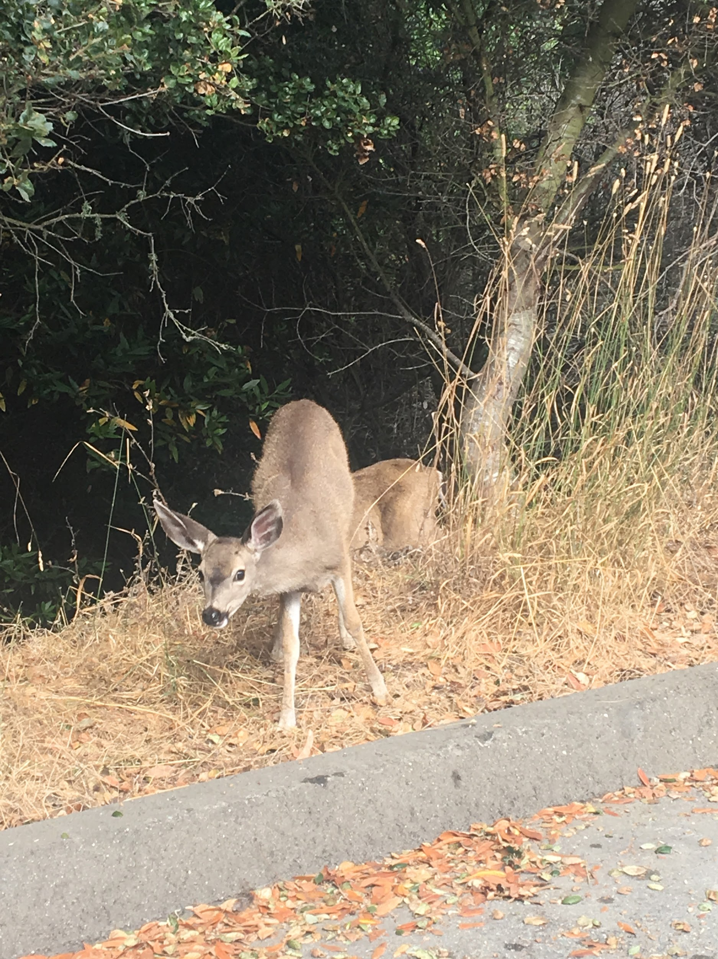
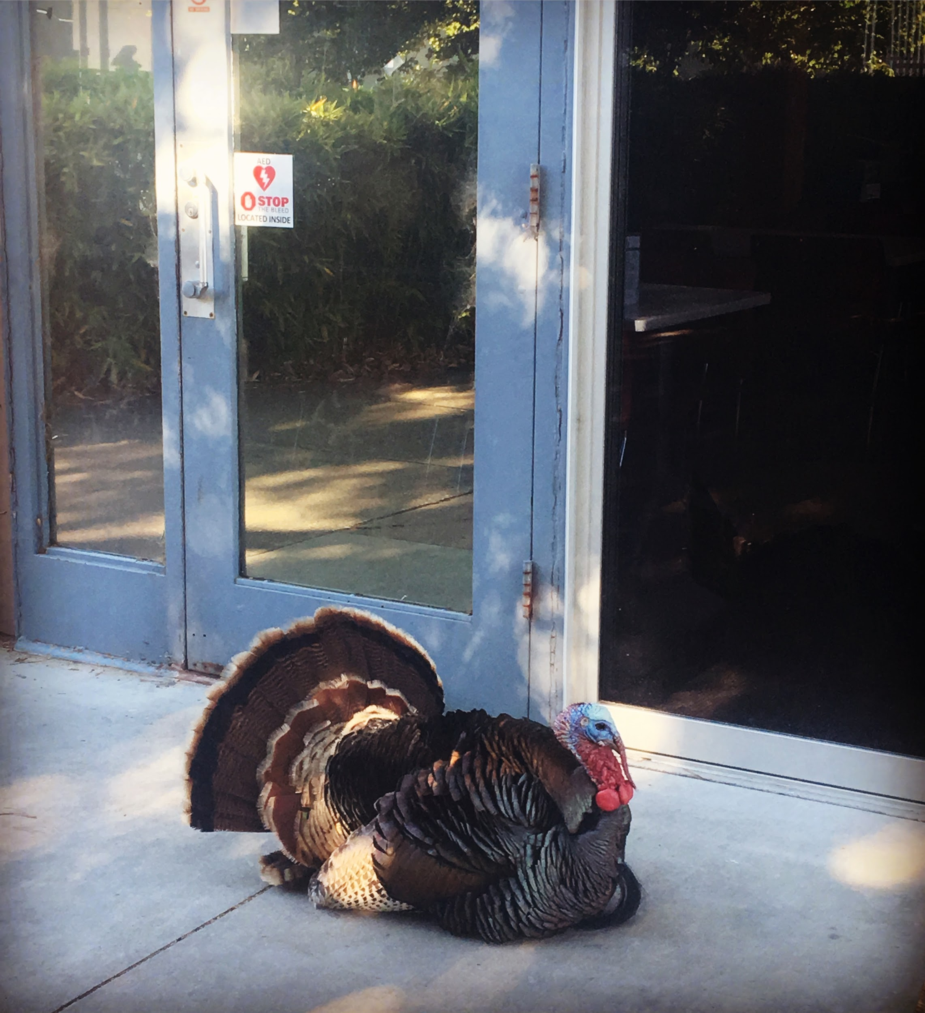
GHC

Slide 18
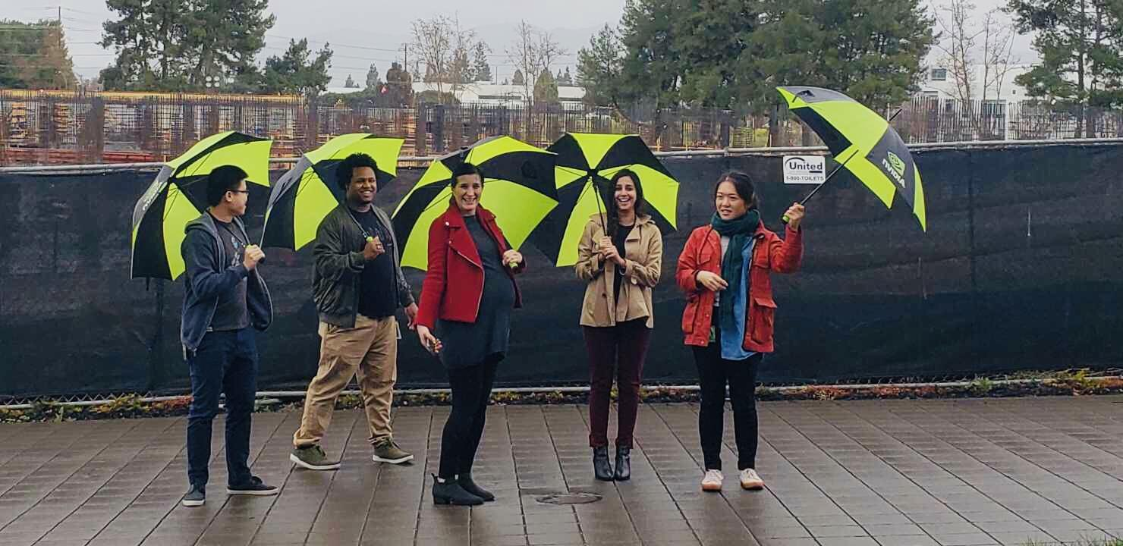
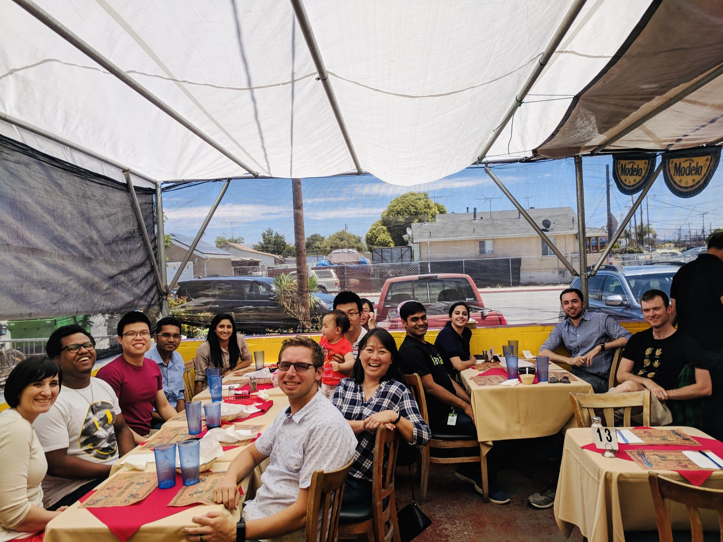
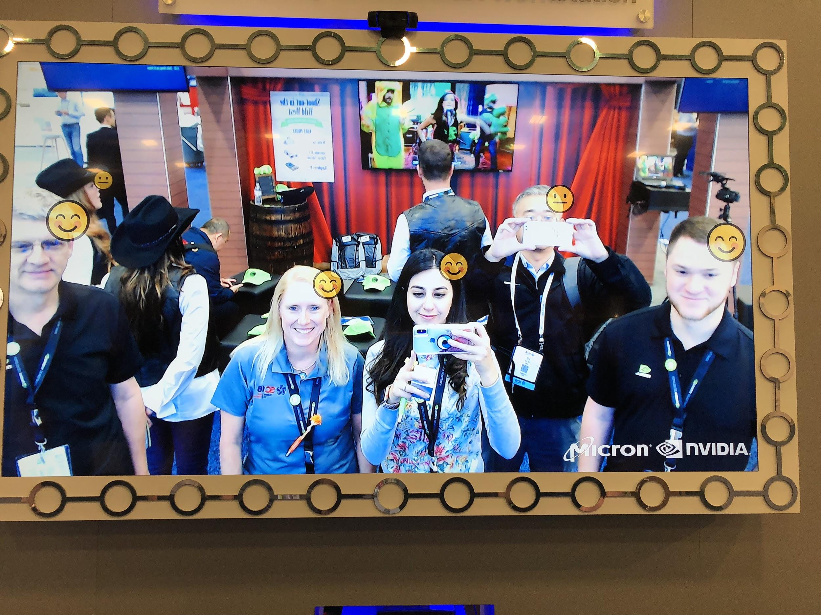
SC18

Slide 19
THANK YOU!

