Slide 1
Kjiersten Fagnan
JGI/NERSC Consultant
JGI Data Migration Party!

Slide 2
Agenda
Objectives
  Describe the file systems and where data should be stored
  Gain hands-on experience with data migration tools
  Develop strategies for data management in your analysis
Motivation
  Where is my data???
  Why so many file systems – can’t we keep /house?
  What is a “high-performance” file system?
Transferring data between file systems
  File transfer protocols
  Moving data from /house
  Reading and writing data from my scripts
Introduction to the NERSC Archive
  background
  mistakes to avoid

Slide 3
File system overview

Slide 4
Pop quiz!!
What’s the name of the file system that’s retiring?
Where should you write data from your compute jobs on the cluster?
What file system do you land in when you log into Genepool (login nodes, gpints, etc)?
How many file systems are available to the JGI?
Where do you have personal directories? What are the quotas on those directories?
When was the last time you accessed a file on /house?

Slide 5
Timeline refresher
We’re here already
8 weeks to go!

Slide 6


Don’t let this be you in December!

Slide 7
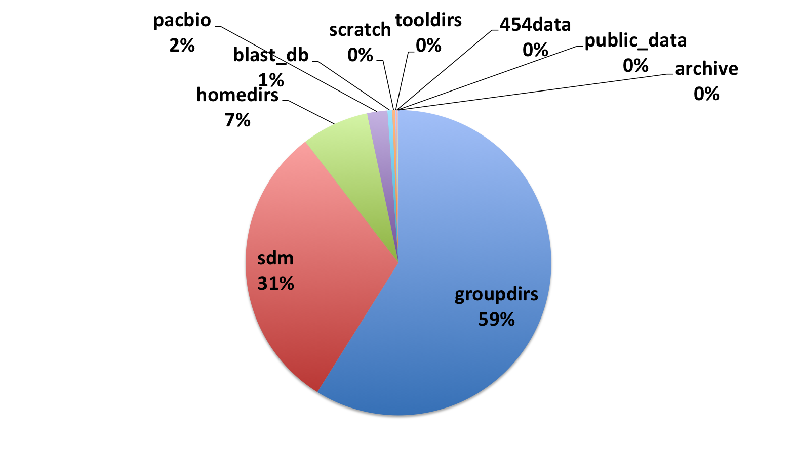
Old strategy
House was a collection of ALL the data at the JGI
Number of files: 583 Million
Average time since file last accessed: 2 years!!!!
Backup policy: snapshots on some directories, backups of entire system have not worked properly for ~1 year

Slide 8
New strategy – Multiple file systems
  /projectb
    2.6PB
    SCRATCH/Sandboxes = “Wild West”
    Write here from compute jobs
  WebFS
    small file system for web servers
    mounted on gpwebs and in xfer queue
Working Directories
2.6 PB
Web Services
100TB
Shared Data
1 Pb
Sequencer Data
500TB
  DnA
    Project directories, finished products
    NCBI databases, etc
    Read-only on compute nodes, read-write in xfer queue
  SeqFS
    500 TB File system
    accessible to sequencers at JGI

Slide 9
ProjectB
SCRATCH (/projectb/scratch/<username>)
  Each user has 20TB of SCRATCH space
  There are 300 users with SCRATCH space on ProjectB – if all these directories fill up, how much space would that require?
  PURGE POLICY – any file not used for 90+ days will be deleted
SANDBOXES (/projectb/sandbox/<program>)
  Each program has a sandbox area, quotas total 1PB
  Directories are meant for active projects that require more than 90 days to complete – managed by each group
  Quotas are not easily increased – requires JGI management approval
  This space is expensive
Notes:
5.95 PB >> the entirety of projectb

Slide 10
DnA – Data n’ Archive
dm_archive (/global/dna/dm_archive)
  JAMO’s data repository (where files will stay on spinning disk until they expire); owned by JGI archive account
shared (migrating from ProjectB)
  /global/projectb/shared/<dir name>
  /global/dna/shared/<dir name>
  NCBI databases
  Test datasets for benchmarks, software tests
projectdirs (migrating from ProjectB)
  /global/projectb/projectdirs/<dir name>
  /global/dna/projectdirs/<dir name>
  place for data shared between groups that you do not want to register with JAMO (shared code, configuration files)
  will be backed up if less than 5TB (backups not in place yet)

Slide 11
WebFS
Small file system for the web server configuration files
Ingest for files uploaded through web services
VERY SMALL and LOW PERFORMANCE file system – NOT intended for heavy I/O

Slide 12
SeqFS
File system for the Illumina sequencers
Predominantly used by the SDM group
Raw data is moved from SeqFS to DnA with JAMO – you will only read the raw data from DnA, you will never use SeqFS directly

Slide 13
Summary
 | PURPOSE | PROS | CONS
$HOME | Store application code, compile files | Backed up, not purged | Low performing; Low quota
/projectb/scratch | Large temporary files, checkpoints | Highest performing | Purged
/projectb/sandbox | Large temporary files, checkpoints | Highest performing | No purge; low quota
$DNAFS /global/dna/ | For groups needing shared data access | Optimized for reading data | Shared file performance; read-only on compute nodes
$GSCRATCH | Alternative scratch space | Data available on almost all NERSC systems | Shared file performance; Purged

Slide 14
A high-performance parallel file system efficiently manages concurrent file access
Compute Nodes
Internal Network
I/O Servers
MDS
I/O
I/O
I/O
I/O
I/O
I/O
I/O
External Network - (Likely FC)
Disk controllers - manage failover
Storage Hardware -- Disks
Notes:
Your laptop has a file system, referred to as a “local file system”
A networked file system allows multiple clients to access files
Treats concurrent access to the same file as a rare event
A parallel file system builds on concept of networked file system
Efficiently manages hundreds to thousands of processors accessing the same file concurrently
Coordinates locking, caching, buffering and file pointer challenges
Scalable and high performing
Files
Directories
Access permissions
File pointers
File descriptors
Moving data between memory and storage devices
Coordinating concurrent access to files
Managing the allocation and deletion of data blocks on the storage devices
Data recovery

Slide 15
Moving Data

Slide 16
Transfers within NERSC
Recommended nodes for transfers from /house
  dtn03.nersc.gov, dtn04.nersc.gov (DTNs)
  schedule jobs in the xfer queue
Recommended nodes for transfers to/from ProjectB
  schedule jobs in the xfer queue for transfers to DnA
  DTNs or Genepool phase 2 nodes for transfers to the archive
Recommended nodes for transfers to DnA
  schedule jobs in the xfer queue for transfers to DnA
  use the DTNs or genepool{10,11,12}.nersc.gov

Slide 17
Using the xfer queue on Genepool
The batch system (UGE) is a great way to transfer data from ProjectB to DnA
kmfagnan@genepool12 ~ $ cat projb_to_dna.sh
#!/bin/bash –l
#$ -N projb2dna
#$ -q xfer.q (or –l xfer.c)
rsync files $DNAFS/projectdirs/<dir>
kmfagnan@genepool12 ~ $ qsub projb_to_dna.sh

Slide 18
Using the xfer queue on Genepool
The batch system (UGE) is a great way to transfer data from ProjectB to DnA
kmfagnan@genepool12 ~ $ cat projb_to_dna.sh
#!/bin/bash –l
#$ -N projb2dna
#$ -q xfer.q (or –l xfer.c)
rsync files $DNAFS/projectdirs/<dir>
kmfagnan@genepool12 ~ $ qsub projb_to_dna.sh
Each user can run up to 2 transfers at a time
Only meant for transfer, no CPU-intensive jobs

Slide 19
Data Transfer Nodes
Nodes that are well-connected to the file systems and outside world
10Gb/s connection to the /house file system
Optimized for data transfer
Interactive
No time limit
Limited environment – NOT the same as the Genepool nodes

Slide 20
Let’s move some data
Log in to Genepool
What directory are you in?
Do the following:
  echo $HOME
  echo $SCRATCH
  echo $BSCRATCH
  echo $GSCRATCH
  echo $DNAFS
Pick a file and decide where you want to move it

Slide 21
Archive Basics

Slide 22
What is an archive?
Long-term storage of permanent records and information
  Often data that is no longer modified or regularly accessed
  Storage time frame is indefinite or as long as possible
  Archive data typically has, or may have, long-term value to the organization
An archive is not a backup
  A backup is a copy of production data
  Value and retention of backup data is short-term
A backup is a copy of data. An archive is the data.

Slide 23
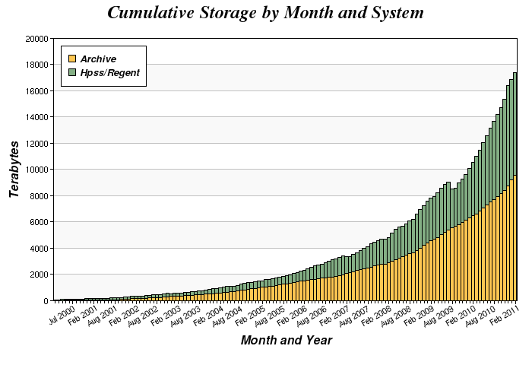
Why should I use an archive?
Data growth is exponential
File system space is finite
  80% of stored data is never accessed after 90 days
  The cost of storing infrequently accessed data on spinning disk is prohibitive
  Important, but less frequently accessed data should be stored in an archive to free faster disk for processing workload

Slide 24
Features of the NERSC archive
NERSC implements an “active archive”
  NERSC archive supports parallel high-speed transfer and fast data access
    Data is transferred over parallel connections to the NERSC internal 10Gb network
    Access to first byte in seconds or minutes as opposed to hours or days
    The system is architected and optimized for ingest
The archive uses tiered storage internally to facilitate high speed data access
  Initial data ingest to high-performance FC disk cache
  Data migrated to enterprise tape system and managed by HSM software (HPSS) based on age and usage
The NERSC archive is a shared multi-user system
  Shared resource, no batch system. Inefficient use affects others.
  Session limits are enforced

Slide 25
Features of the NERSC archive, continued
The NERSC archive is a Hierarchical Storage Management system (HSM)
Highest performance requirements and access characteristics at top level
Lowest cost, greatest capacity at lower levels
Migration between levels is automatic, based on policies
Fast
Disk
High Capacity Disk
Latency
Local
Disk or Tape
Remote
Disk or Tape
Capacity

Slide 26
Using the NERSC Archive

Slide 27
How to Log In
The NERSC archive uses an encrypted key for authentication
  Key placed in ~/.netrc file at the top level of the user’s home directory on the compute platform
  All NERSC HPSS clients use the same .netrc file
  The key is IP specific. Must generate a new key for use outside the NERSC network.
Archive keys can be generated in two ways
  Automatic: NERSC auth service
    Log into any NERSC compute platform using ssh
    Type “hsi”
    Enter NERSC password
  Manual: https://nim.nersc.gov/ web site
    Under “Actions” drop down, select “Generate HPSS Token”
    Copy/paste content into ~/.netrc
    chmod 600 ~/.netrc

Slide 28
Storing and Retrieving Files with HSI
HSI provides a Unix-like command line interface for navigating archive files and directories
  Standard Unix commands such as ls, mkdir, mv, rm, chown, chmod, find, etc. are supported
FTP-like interface for storing and retrieving files from the archive (put/get)
  Store from file system to archive:
-bash-3.2$ hsi
A:/home/n/nickb-> put myfile
put 'myfile' : '/home/n/nickb/myfile' ( 2097152 bytes, 31445.8 KBS (cos=4))
  Retrieve file from archive to file system:
A:/home/n/nickb-> get myfile
get 'myfile' : '/home/n/nickb/myfile' (2010/12/19 10:26:49 2097152 bytes, 46436.2 KBS )
  Full pathname or rename file during transfer:
A:/home/n/nickb-> put local_file : hpss_file
A:/home/n/nickb-> get local_file : hpss_file

Slide 29
Storing and Retrieving Directories with HTAR
HTAR stores a Unix tar-compatible bundle of files (aggregate) in the archive
  Traverses subdirectories like tar
  No local staging space required--aggregate stored directly into the archive
Recommended utility for storing small files
Some limitations
  5M member files
  64GB max member file size
  155/100 path/filename character limitation
  Max archive file size* currently 10TB
Syntax: htar [options] <archive file> <local file|dir>
  Store
  -bash-3.2$ htar –cvf /home/n/nickb/mydir.tar ./mydir
  List
  -bash-3.2$ htar –tvf /home/n/nickb/mydir.tar
  Retrieve
  -bash-3.2$ htar –xvf /home/n/nickb/mydir.tar [file…]
  * By configuration, not an HPSS limitation

Slide 30
Avoiding Common Mistakes

Slide 31
Small Files
Tape storage systems do not work well with large numbers of small files
  Tape is sequential media—tapes must be mounted in drives and positioned to specific locations for IO to occur
Mounting and positioning tapes are the slowest system activities
  Small file retrieval incurs delays due to high volume of tape mounts and tape positioning
  Small files stored periodically over long periods of time can be written to hundreds of tapes—especially problematic for retrieval
Use HTAR when possible to optimize small file storage and retrieval
Recommend file sizes in the 10s – 100s of GB

Slide 32
Large Directories
Each HPSS system is backed by a single metadata server
  Metadata is stored in a single SQL database instance
  Every user interaction causes database activity
Metadata-intensive operations incur delays
  Recursive operations such as “chown –R ./*” may take longer than expected
  Directories containing more than a few thousand files may become difficult to work with interactively
-bash-3.2$ time hsi –q ‘ls –l /home/n/nickb/tmp/testing/80k-files/’ > /dev/null 2>&1
real 20m59.374s
user 0m7.156s
sys 0m7.548s

Slide 33
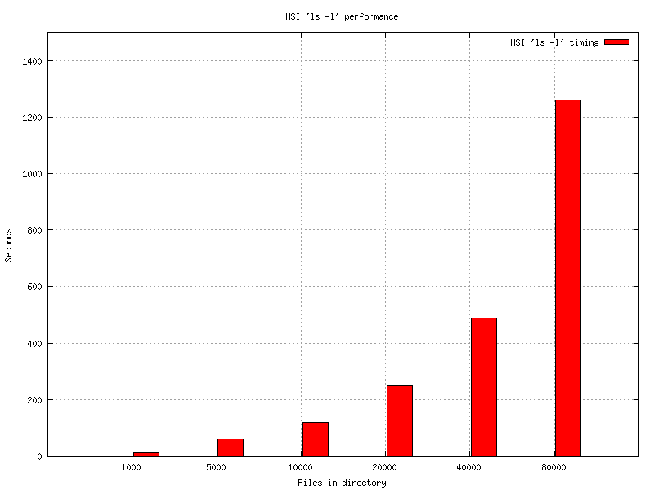
Large Directories, continued
hsi “ls –l” exponential delay:

Slide 34
Long-running Transfers
Failure prone for a variety of reasons
  Transient network issues, planned/unplanned maintenance, etc.
Many clients do not have capability to resume interrupted transfers
Can affect archive internal data management (migration) performance
Recommend keeping transfers to 24hrs or less if possible

Slide 35
Hands-on Examples

Slide 36
Logging into archive: Hands-on
Using ssh, log into any NERSC compute platform
-bash-3.2$ ssh dtn01.nersc.gov
Start HPSS storage client “hsi”
-bash-3.2$ hsi
Enter NERSC password at prompt (first time only)
Generating .netrc entry...
nickb@auth2.nersc.gov's password:
You should now be logged into your archive home directory
Username: nickb UID: 33065 Acct: 33065(33065) Copies: 1 Firewall: off [hsi.3.4.5 Wed Jul 6 16:14:55 PDT 2011][V3.4.5_2010_01_27.01]
A:/home/n/nickb-> quit
Subsequent logins are now automated

Slide 37
Using HSI: Hands-on
Using ssh, log into any NERSC compute platform
-bash-3.2$ ssh dtn01.nersc.gov
Create a file in your home directory
-bash-3.2$ echo foo > abc.txt
Start HPSS storage client “hsi”
-bash-3.2$ hsi
Store file in archive
A:/home/n/nickb-> put abc.txt
Retrieve file and rename
A:/home/n/nickb-> get abc_1.txt : abc.txt
A:/home/n/nickb-> quit
Compare files*
-bash-3.2$ sha1sum abc.txt abc_1.txt
f1d2d2f924e986ac86fdf7b36c94bcdf32beec15 abc.txt
f1d2d2f924e986ac86fdf7b36c94bcdf32beec15 abc_1.txt
  * Note: checksums supported in the next HSI release with: ‘hsi ‘put –c on local_file : remote_file’

Slide 38
Using HTAR: Hands-on
Using ssh, log into any NERSC compute platform
-bash-3.2$ ssh dtn01.nersc.gov
Create a subdirectory in your home directory
-bash-3.2$ mkdir mydir
Create a few files in the subdirectory
-bash-3.2$ echo foo > ./mydir/a.txt
-bash-3.2$ echo bar > ./mydir/b.txt
Store subdirectory in archive as “mydir.tar” with HTAR
-bash-3.2$ htar –cvf mydir.tar ./mydir
List newly created aggregate in archive
-bash-3.2$ htar –tvf mydir.tar
Remove local directory and contents
-bash-3.2$ rm –rf ./mydir
Extract directory and files from archive
-bash-3.2$ htar –xvf mydir.tar

Slide 39
National Energy Research Scientific Computing Center

Slide 40
Section Title

