Slide 1
Performance portability: An implementer’s Perspective
Barbara Chapman
October 13, 2022

Slide 2
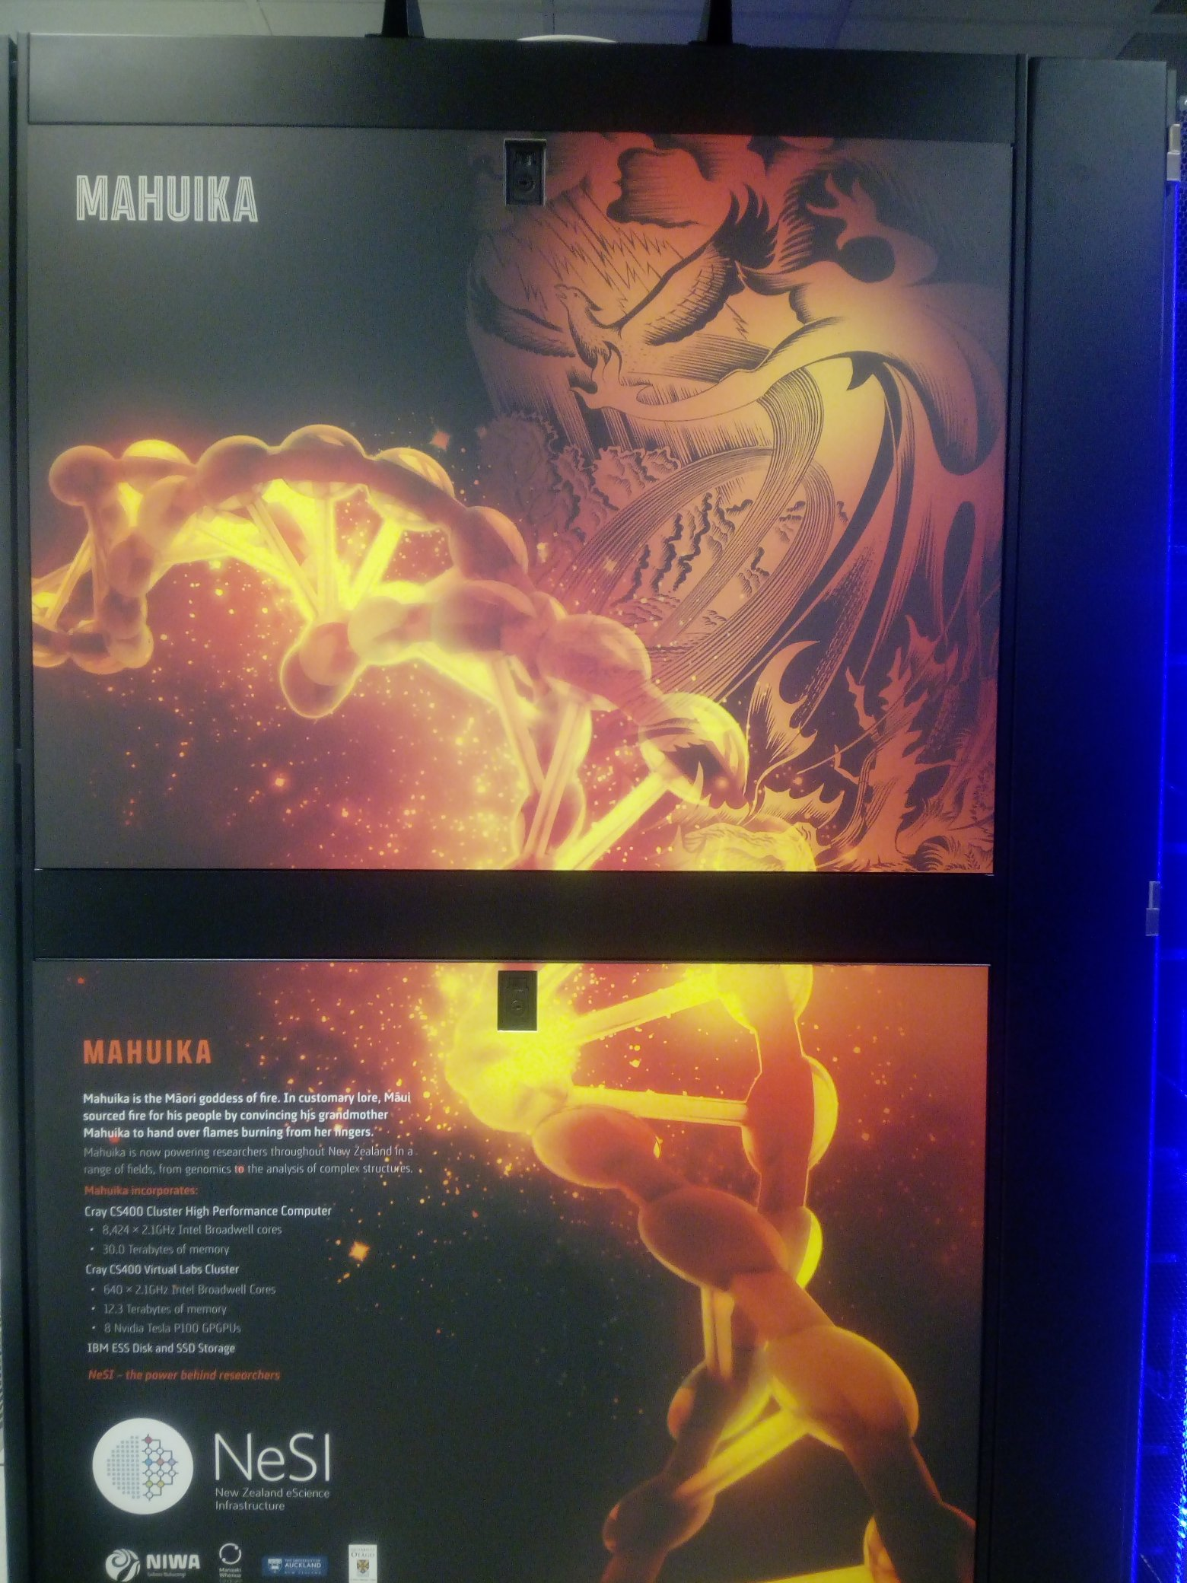
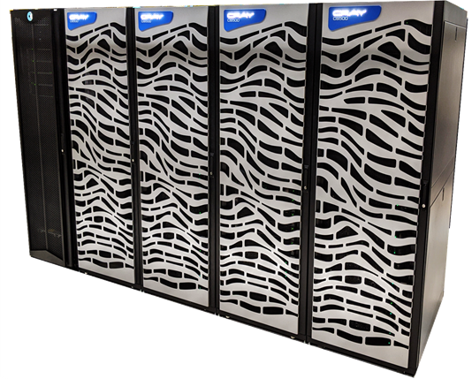
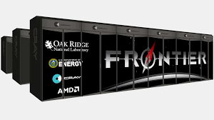
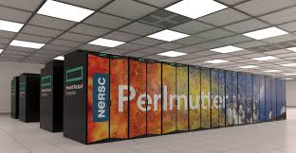
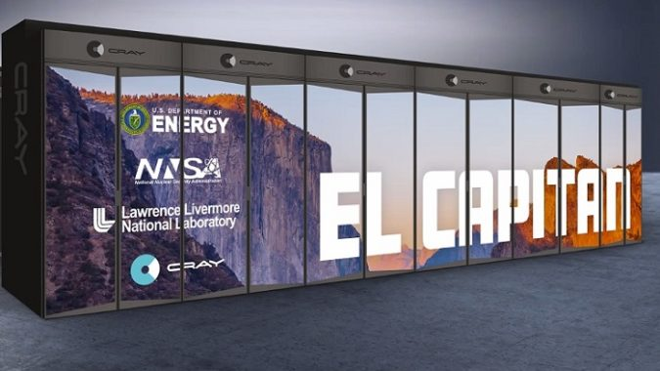
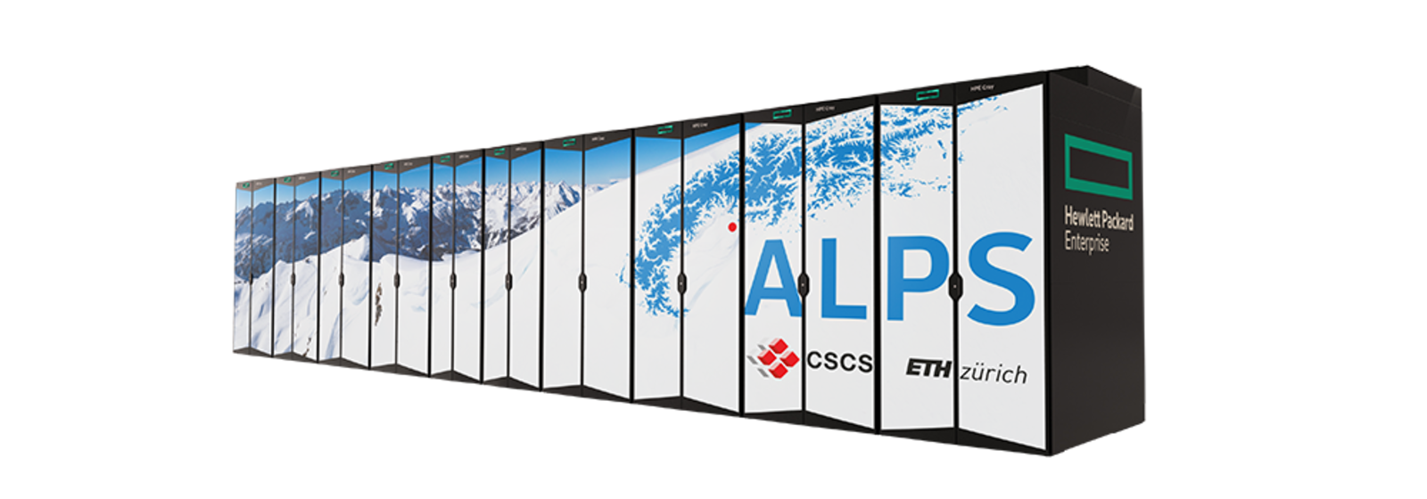
Versatility of HPE Cray Programming Environment (CPE)
Intel CPUs and NVIDIA GPUs
Platforms from HPE/Cray
Supported by CPE
ARM CPUs
AMD CPUs and AMD GPUs
AMD CPUs and NVIDIA GPUs
Integrated CPU and GPU from AMD
Intel CPUs
Integrated ARM CPUs and NVIDIA GPUs

Slide 3
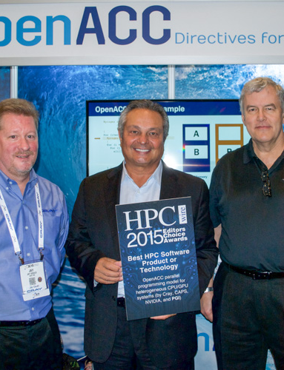
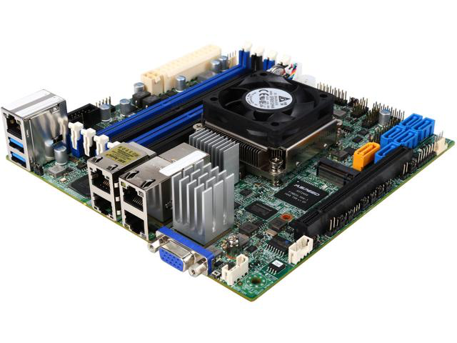
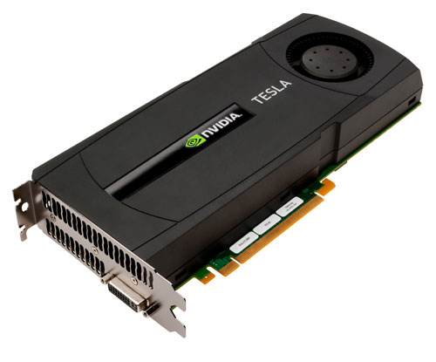
CPE TODAY
Portability via adherence to HPC-relevant standards
Active engagement in standards organizations
Supports:
Fortran, C/C++
MPI; OpenMP, OpenACC; OpenSHMEM; UPC
Enables popular frameworks (e.g. Kokkos)
One or more devices attached
Attached accelerator(s)
Host Device
(CPU Multicore)
GPU(s)
Tom Tabor presents HPCWire Editor’s Choice Award for OpenACC to Jay Gould (Cray) and Michael Wolfe (PGI)
Notes:
Supporting this many platforms is a major team effort so this is a large team
Many different performance challenges
Need for different kinds of analyses
All the while paying attention to scale
Legacy Cray systems, Cray EX and Apollo
Coverage, portability across range of platforms

Slide 4
IESP Programming Models International Exascale Software Project
Proposed timeline
Exascale programming model(s) adopted
Exascale programming models implemented
Standard programming model for
heterogeneous nodes
Your Metric
Fault-tolerant MPI
Candidate exascale programming models defined
Interoperability among existing programming models
System-wide high-level programming model
2010
2011
2012
2013
2014
2015
2016
2017
2018
2019
www.exascale.org
Notes:
International Exascale Software Project
Experts from many countries, seek commonality and consider how to collaborate on major topics as well as sharing ideas
Evolution and revolution

