Slide 1
Nicholas Balthaser LBNL/NERSC Storage Systems
NERSC
Tape Tech
@MSST

Slide 2
Agenda
General Systems and Storage Overview
(Just one of our) Current Storage Challenges

Slide 3
Systems & Storage Overview

Slide 4
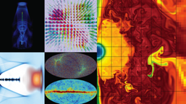
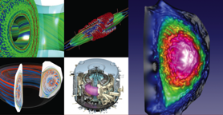
NERSC is the mission HPC computing center for the DOE Office of Science
HPC and data systems for the broad Office of Science community
Approximately 7,000 users and 750 projects
Diverse workload type and size
Biology, Environment, Materials, Chemistry, Geophysics, Nuclear Physics, Fusion Energy, Plasma Physics, Computing Research
Single-core (not many, but some) to whole-system jobs
Notes:
NERSC is a division of Lawrence Berkeley National Laboratory,

Slide 5
NERSC - Resources at a Glance 2018
Edison: Cray XC-30
7.6 PB Local Scratch
163 GB/s
136 GB/s
/project
7.1 PB
DDN SFA12KE
Sponsored Storage
5.1 PB
DDN SFA12KE
16x FDR IB
40 GB/s
5,576 nodes, 133K 2.4GHz Intel “IvyBridge” Cores, 357TB RAM
Cori: Cray XC-40
28 PB Local Scratch
>700 GB/s
275 TB
NetApp 5460
5 GB/s
/home
2PB “DataWarp” I/O Accl. Layer
>1.5 TB/s
HPSS
150 PB stored, 240 PB capacity, 42 years of community data
24 GB/s
2,004 nodes, 64K 2.3GHz Intel “Haswell” Cores, 203TB RAM
9,688 nodes, with 1.4GHz Intel “KNL” Cores, 1PB RAM
32x FDR IB
Data-Intensive Systems
PDSF, JGI, Materials
14x FDR IB
Ethernet &
IB Fabric
Science Friendly Security
Production Monitoring
Power Efficiency
WAN
2 x 10 Gb
2 x 100 Gb
Data Transfer Nodes
Science Gateways
Software Defined
Networking
Notes:
Cori - Heterogeneous compute architecture, installed in 2015-2016.
2004 Dual socket Haswell nodes (32 cores per node at 2.3 GHz)
9,300 Intel Knights Landing compute nodes
68 cores per node
16GB on-package high-bandwidth memory at ~490GB/s
96 GB DRAM
Storage
NVRAM Burst Buffer with 1.6PB of disk and 1.7TB/sec
28 PB of disk, >700 GB/sec I/O bandwidth in Lustre bandwidth
Plans for NERSC-9 Underway
The Burst Buffer is a layer of SSD storage in Cori that sits within the high-speed network.
per-job or "scratch" reservation:
persistent reservation: - Multiple compute jobs can access a persistent reservation, and if the permissions are set appropriately, multiple users as well.
Users have a quota of 50TB on the Burst Buffer.
The burst buffer is not mounted on the login nodes, so it must be accessed via a compute node. If you want to work interactively with the Burst Buffer, you can use the interactive queue
Plans for NERSC-9 Underway

Slide 6
File Systems
Lustre scratch for Large Compute systems
Edison: 7.6 PB with 168 GB/s aggregate bandwidth
Cori: 28 PB with ~700 GB/s aggregate bandwidth
Periodically purged
GPFS mounted across all compute platforms
Home Directories: 275 TB, optimized (SSDs) for small files, and high number of I/O operations
Project directories: 7.1 PB, 4TB/1M inode quota by default. Intended for larger files (SSD for metadata only), streaming I/O, and data that is actively being used. There is no purge policy, however inactive projects may be moved to the tape archive
Sponsored File System Storage: 5.1 PB on a separate file system, but with the same I/O characteristics as the Project file system (minus SSDs). This is a ‘buy-in’ program for projects that need additional space on disk. Program has a fixed $/TB, and a 5 year service agreement
GPFS file systems accessible from Cray compute nodes via DVS I/O forwarding

Slide 7
Tape Archive - HPSS
High Performance Storage System (HPSS)
Developed over >20 years of collaboration among five Department of Energy laboratories and IBM, with significant contributions by universities and other laboratories worldwide.
archival storage system for long term data retention since 1998
Tiered storage system with a disk cache in front of a pool of tapes
On tape: ~150 PB
Disk Cache: 4 PB
Contains 42 years of data archived by the scientific community
Data Transfers via transfer client - there is no direct file system interface
We provide numerous clients: HSI/HTAR (proprietary tools), FTP, pFTP, gridFTP, Globus Online, etc. [VFS is an option which we don’t use]
Notes:
Primary goals for HPSS software
Stability
Performance
Scalability
It is unique in its ability to scale to support HPC workload

Slide 8
Top 5 HPSS Sites by PB Stored
Site | PBs Stored | # of files
ECMWF (European Weather) | 318.63 | 330,047,386
UKMO (UK Weather) | 239.49 | 241,498,397
NOAA R&D (US Weather) | 133.86 | 94,260,512
Brookhaven Nat’l Lab | 132.75 | 146,448,877
LBNL-NERSC (Archive) | 123.75 | 224,571,569
LBNL-NERSC (Backup) | 22.51 | 19,674,746
146.26 PB
244,246,315
Notes:
Primary goals for HPSS software
Stability
Performance
Scalability
It is unique in its ability to scale to support HPC workload
https://hpss-collaboration.clearlake.ibm.com/adminwiki/doku.php?id=support:hpss_site_stats

Slide 9
Current Storage Challenge

Slide 10
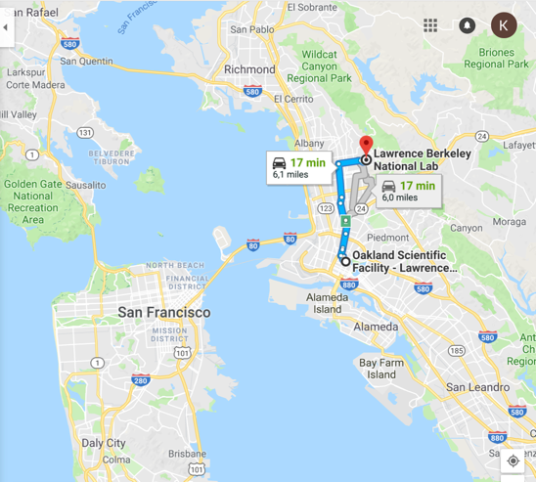
HPSS Archive – Two significant needs
Technology decision needed
Discontinued Oracle Enterprise Tape Drive
4 fully-configured Oracle SL8500 libraries (archive)
60 Oracle T10KC tape drives (archive)
1 IBM TS3500 (mainly system backups)
36 IBM TS1150 tape drives (mainly system backups)
Physical move required
Oakland to Berkeley (~6 mi/~9 km)

Slide 11
HPSS Archive – Data Center Constraints
Berkeley Data Center (BDC) is green (LEED Gold)
Reliance on ambient conditions for year-round “free” air and water cooling
Intakes outside air, optionally cooled with tower water or heated with system exhaust
No chillers
(Ideally) take advantage of:
<75°F (23.9C) air year round
<70°F (21.1C)for 85% of year
RH 10% to 80%, but can change quickly
Usually more in 30% - 70% range
Notes:
Room within a room much larger foot print.
Eval’d doing colo or other off site options

Slide 12
HPSS Archive – Data Center Realities
And, sometimes it’s too sunny in California
Notes:
Building position with cool air coming in from the bay was a design point for the building and generally this is effective.

Slide 13
Alternatives to Consider
Co-lo to a data center elsewhere
Costly
System management concerns
Cloud
not performant enough
queue issues – need my data now
too costly
General expectation that data retrieval is the cloud killer,
but just letting 150PBs sit is more expensive
Room-within-a-room
Space utilization goals and budget constraints
Disk-only
Too costly
Increased power consumption
Notes:
Space utilization goals and budget constraints make a room-within-a-room a less desirable choice
https://aws.amazon.com/about-aws/whats-new/2014/12/30/amazon-glacier-is-now-available-in-the-aws-govcloud-us-region/

Slide 14
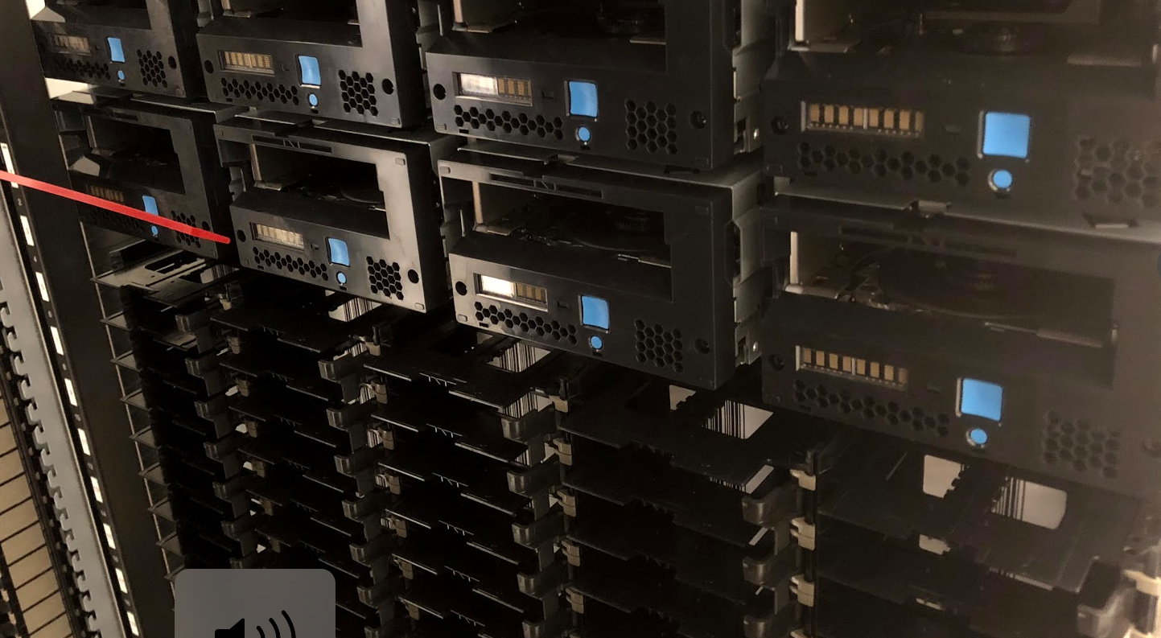
HPSS Archive – Green Data Center Solution
IBM TS4500 Tape Library with Integrated Cooling
seals off the library from ambient temperature and humidity
built-in AC units (atop library) keeps tapes and drives within operating spec
Notes:
The Integrated Cooling TS4500 tape libraries to be installed in datacenters where the environmental controls are outside of the normal operating parameters for the tape library.

Slide 15
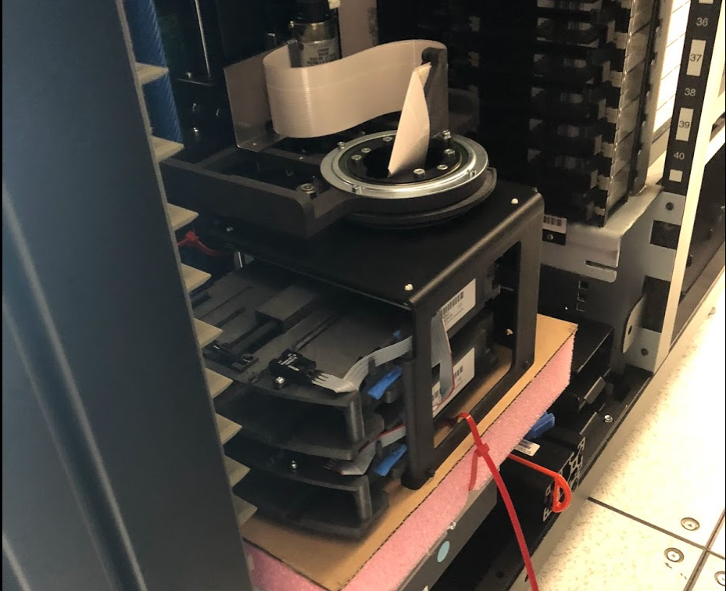
HPSS Archive – Tape Tech Decision
IBM had the library tech ready
We have experience with TS3500/3592 drives for our backup system
Notes:
For enterprise drives now choice of 1…

Slide 16
HPSS Archive – Tech Change
Slide from Lee Jesionowski: https://conference-indico.kek.jp/indico/event/28/session/12/contribution/30/material/slides/0.pdf
Notes:
Some discussions with IBM indicate dips outside of acceptable range are probably OK, as long as they are not prolonged
Red – what can be handled in the room

Slide 17
HPSS Archive – Tech Change
One “Storage Unit” (my term) [Cooling Zone]
Two S25 frames sandwich, one L25 and one D25 frame
S25: High-density frame, tape slots (798-1000)
D25: Expansion frame, drive (12-16), tape slots (590-740)
L25: Base frame, drive (12-16), tape slots (550-660), I/O station and control electronics (for subsequent zones no L25, D25 instead)
Each one of these storage units considered it’s own cooling zone
AC units go atop L and D frames
Air recirculated, no special filters
Fire suppression a little trickier, but possible
Notes:
he client must supply drains for air conditioning condensation that will have two drain hoses per air conditioner.
AC goes where top rack would normally be installed:
The top rack, 3584 Model TR1, provides an extra 10U of rack space on any frame in a library without requiring more floor space.
The optional top rack (Figure 1) reduces the storage footprint. It also simplifies cabling by providing extra rack space above the library for power distribution units, Fibre Channel switches, tape data movers, or IBM® Linear Tape File System™ (LTFS) nodes.
Frame defintions: p. 6 IBM TS4500 R4 Tape Library Guide

Slide 18
HPSS Archive – Tech Change
Slide from Lee Jesionowski: https://conference-indico.kek.jp/indico/event/28/session/12/contribution/30/material/slides/0.pdf

Slide 19
HPSS Archive – Tech Change (CRT)
Each library will be 4 “cooling zones”
Cooling zone –logical separation
16 frames
64 TS1155/3592-55F(FC)/Jag(uar)6 tape drives
~13,000 tape slots
JD media @15TB/cartridge
We’ll install 2 of the above

Slide 20
HPSS Archive – Tech Change (CRT)
Some things to get used to/improve
No ACSLS
Can get some data out of IBM library, but
Need to re-do/build some tools
AFAIK, no pre-aggregated data like ACSLS
No Pass Through Port (PTP)
One Physical Volume Repository (PVR) per library
Since no shuttle option with IBM libraries
Could need more drives
But time to first byte should improve
PTP can fail, be slow

Slide 21
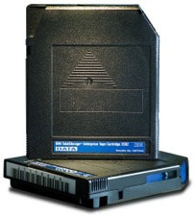
Value of Enterprise over LTO
NERSC Growth Rates:
2016-2017: 2PB/mo.
2018: > 3PB/mo.
Ability to up-format at higher density; gain capacity with same media, same DC footprint
Notes:
For enterprise drives now choice of 1…
Compariosn of T10KD to LTO 8 is not a reasonable comparison…IMO. T10KD release 2013
Type M Media Support - LTO 8 Drives will be able to format new, unused LTO 7 tapes as Type M-8 media. This will allow the use of LTO 7 tapes in the LTO 8 Drive and increase the normal capacity of an LTO 7 tape by 50%, up to 22.5TB.
Only new, unused LTO Ultrium 7 cartridges can be initialized as M8 cartridges. Once a cartridge is initialized as M8, it cannot be changed back to L7. Initialized M8 cartridges can only be written and read in an LTO 8 tape drive; LTO 7 tape drives cannot read initialized M8 cartridges.
https://www.redbooks.ibm.com/redbooks/pdfs/sg248235.pdf p.68-69:
Cartridge memory
The cartridge memory (CM), which is a passive, contactless silicon storage device that is physically a part of the cartridge, is contained within the cartridge. The CM is used to hold information about that specific cartridge, the media in the cartridge, and the data on the media.
The 3592 uses the same CM module as LTO media, with a capacity of 4 KiB, which is extended to 8 KiB on JB or JX media (and JC, JY, or JK media), and enhanced to 16 KiB for JD or JZ media. The CM was designed for 3592 to support the high-resolution tape directory feature. The CM differs from the LTO specification because it supports the high-resolution tape directory feature. See “High-resolution tape directory” on page 68.
Communication between the drive and the CM occurs through a noncontact, passive radio frequency interface (RFI), which eliminates the need for physical connections to the cartridge for power or signals.
High-resolution tape directory
The 3592 drive maintains a tape directory structure with a higher granularity of information about the physical position of data blocks and file marks on the media. This feature gives the 3592 drive improved nominal and average access times for locate operations. Locate times are uniform.
Important: These features are generic for all 3592 tape drives. The TS1155, TS1150 and TS1140 offer other advanced features that are described in 2.2, “IBM TS1155 and TS1150 tape drive” on page 81 and 2.3, “IBM TS1140 tape drive (Model 3592 EH7)” on page 99.
68 IBM TS4500 R4 Tape Library Guide
They are based on the position of the block or file mark on the tape, independently of the uniformity of the block size or file mark distribution along the length of the tape. Therefore, the 3592 locate and space performance is targeted to be completely and individually dependent on the longitudinal position on tape of the target block or file mark.

Slide 22
Value of Enterprise over LTO
Time to first byte is important
Recommended Access Order (RAO)
NERSC read-back rate is high ~40%
Supported under HPSS as Tape Ordered Recall
High Resolution Tape Directory
1/128th of a tape wrap resolution per block versus 1⁄2 wrap for LTO
reach the target data block more efficiently
Higher search and rewind velocity about 30% faster then LTO
Notes:
For enterprise drives now choice of 1…
Compariosn of T10KD to LTO 8 is not a reasonable comparison…IMO. T10KD release 2013
https://www.redbooks.ibm.com/redbooks/pdfs/sg248235.pdf p.68-69:
Cartridge memory
The cartridge memory (CM), which is a passive, contactless silicon storage device that is physically a part of the cartridge, is contained within the cartridge. The CM is used to hold information about that specific cartridge, the media in the cartridge, and the data on the media.
The 3592 uses the same CM module as LTO media, with a capacity of 4 KiB, which is extended to 8 KiB on JB or JX media (and JC, JY, or JK media), and enhanced to 16 KiB for JD or JZ media. The CM was designed for 3592 to support the high-resolution tape directory feature. The CM differs from the LTO specification because it supports the high-resolution tape directory feature. See “High-resolution tape directory” on page 68.
Communication between the drive and the CM occurs through a noncontact, passive radio frequency interface (RFI), which eliminates the need for physical connections to the cartridge for power or signals.
High-resolution tape directory
The 3592 drive maintains a tape directory structure with a higher granularity of information about the physical position of data blocks and file marks on the media. This feature gives the 3592 drive improved nominal and average access times for locate operations. Locate times are uniform.
Important: These features are generic for all 3592 tape drives. The TS1155, TS1150 and TS1140 offer other advanced features that are described in 2.2, “IBM TS1155 and TS1150 tape drive” on page 81 and 2.3, “IBM TS1140 tape drive (Model 3592 EH7)” on page 99.
68 IBM TS4500 R4 Tape Library Guide
They are based on the position of the block or file mark on the tape, independently of the uniformity of the block size or file mark distribution along the length of the tape. Therefore, the 3592 locate and space performance is targeted to be completely and individually dependent on the longitudinal position on tape of the target block or file mark.

Slide 23
Value of Enterprise over LTO
42 years of data, reliability & stewardship are important
Media Physical durability
Improved materials/construction over LTO
Loader supports 3x more load/unloads than LTO
Pro-active drive and media alerts
Notes:
For enterprise drives now choice of 1…
Compariosn of T10KD to LTO 8 is not a reasonable comparison…IMO. T10KD release 2013
https://www.redbooks.ibm.com/redbooks/pdfs/sg248235.pdf p.68-69:
Cartridge memory
The cartridge memory (CM), which is a passive, contactless silicon storage device that is physically a part of the cartridge, is contained within the cartridge. The CM is used to hold information about that specific cartridge, the media in the cartridge, and the data on the media.
The 3592 uses the same CM module as LTO media, with a capacity of 4 KiB, which is extended to 8 KiB on JB or JX media (and JC, JY, or JK media), and enhanced to 16 KiB for JD or JZ media. The CM was designed for 3592 to support the high-resolution tape directory feature. The CM differs from the LTO specification because it supports the high-resolution tape directory feature. See “High-resolution tape directory” on page 68.
Communication between the drive and the CM occurs through a noncontact, passive radio frequency interface (RFI), which eliminates the need for physical connections to the cartridge for power or signals.
High-resolution tape directory
The 3592 drive maintains a tape directory structure with a higher granularity of information about the physical position of data blocks and file marks on the media. This feature gives the 3592 drive improved nominal and average access times for locate operations. Locate times are uniform.
Important: These features are generic for all 3592 tape drives. The TS1155, TS1150 and TS1140 offer other advanced features that are described in 2.2, “IBM TS1155 and TS1150 tape drive” on page 81 and 2.3, “IBM TS1140 tape drive (Model 3592 EH7)” on page 99.
68 IBM TS4500 R4 Tape Library Guide
They are based on the position of the block or file mark on the tape, independently of the uniformity of the block size or file mark distribution along the length of the tape. Therefore, the 3592 locate and space performance is targeted to be completely and individually dependent on the longitudinal position on tape of the target block or file mark.

Slide 24
That being said…
We will have some LTO drives and media for second copies
Gain experience
Diversity of technology

Slide 25
HPSS Archive – Loose timeline
April:
TS4500s w/integrated cooling were delivered at BDC
May - July:
Fire suppression, system integration
Oakland facility becomes read-only
Data migrated to BDC via HPSS “repack” functionality
>= 20 Oracle T10KC source drives at Oakland
>= 20 TS1155 destination drives at BDC
400Gbps Oakland <-> BDC link
2020 (or earlier?) data migration complete
Notes:
Library install in June due to fire suppression install and AC install

Slide 26
Future
GPFS HPSS Integration (GHI)– DMAPI-based integration of GPFS filesystem and HPSS tape archive (DR, Space Management)
Upgrade HPSS – Leverage recent HPSS Features:
RAIT
RAO
E2EDI
Globus DSI support
Storage 2020 – Discussion of storage strategy at NERSC looking forward to 2020 and 2025
https://escholarship.org/uc/item/744479dp

Slide 27
NERSC Storage Team & Fellow Contributors
Right to Left:
Greg Butler
Kirill Lozinskiy
Nick Balthaser
Ravi Cheema
Damian Hazen (Group Lead)
Rei Lee
Kristy Kallback-Rose
Wayne Hurlbert
Thank you. Questions?

Slide 28
National Energy Research Scientific Computing Center

Slide 29
Backup Slides

Slide 30
Library Eval Notes…
Mount rates
SL8500 complex avg. 1600 mounts/day
TS3500 @OSF can sustain 600 mounts/hr in current config
TS4500s in Berkeley should be able to sustain similar rate
2011 Spectra TFinity Eval
Capacity Projection through 2021
Expect 300PB by end 2019, 450PB by 2021
2xTS4500 max capacity 400PB
3rd library will increase max capacity to 585PB
Drive/media capacity bump to 20TB in 2019 – 2020
Drive quantity TS1155s
Handle projected load + data migration from OSF
No PTP required more drives to reduce cartridge mount wait

Slide 31
Glacier Eval Notes…
2 – 5x more expensive incl. staffing costs
Plus limitations:
4 hour retrieval
4GB file limit
In house/DIY spec
TS3500 w/2000 10TB cartridges – 20PB
expandable to 100PB with additional $2M media
$5.5M for 100PB for 5 years
Glacier
Retention cost for 77PB is $10M/yr
Allows 5% retrieval for free – retention in this case is more expensive

Slide 32
3592 Cartridge Details

Slide 33
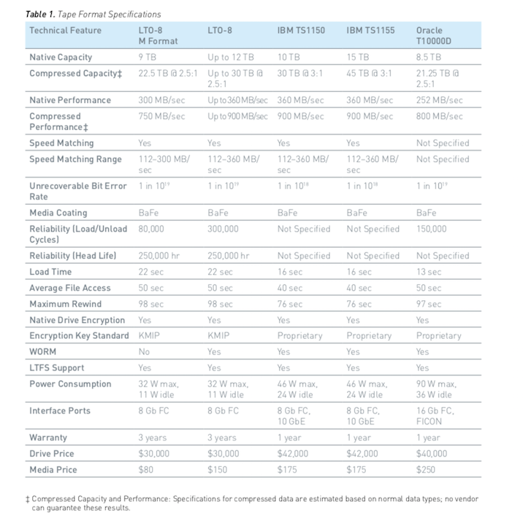
LTO v. Enterprise Media
Notes:
https://iq.quantum.com/exLink.asp?49663734OA24V33I185023536&WP00233A&view=1

Slide 34
LTO vs. 3592 Media

Slide 35
Cori is NERSC’s Newest System
Heterogeneous compute architecture
2004 Dual socket Haswell nodes (32 cores per node at 2.3 GHz)
9,300 Intel Knights Landing compute nodes
68 cores per node
16GB on-package high-bandwidth memory at ~490GB/s
96 GB DRAM
Storage
NVRAM Burst Buffer with 1.6PB of disk and 1.7TB/sec
28 PB of disk, >700 GB/sec I/O bandwidth in Lustre bandwidth
Plans for NERSC-9 Underway

Slide 36
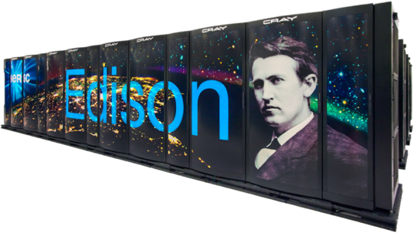
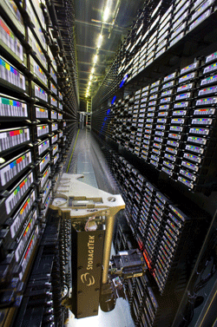
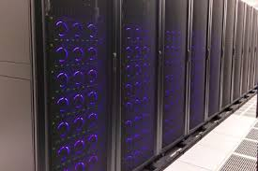
NERSC Resources at a Glance
Cori: 30PFs, 30PB disk
Deployed: 2015/2016
Edison: ~3PFs, 8PB disk
Deployed: 2013
Global File System: 20 PBs
HPSS Archive: ~140 PBs

Slide 37
HPSS Archive – Loose timeline
April:
TS4500s w/integrated cooling were delivered at BDC
May:
½ Disk Cache + ½ of disk movers moved to Berkeley DC (BDC)
Not yet enabled, just in preparation
½ Disk Cache + ½ of disk movers remain at Oakland
June:
TS4500s w/integrated cooling installed at BDC
July:
Move HPSS core server to BDC
Enable ½ Disk Cache, ½ disk movers at BDC
Enable Writes to new library at BDC
Oakland tapes now read-only [user access, repacks]
Remaining ½ disk cache made read-only, drained
Move remaining ½ disk cache, movers to BDC
Data migrated to BDC via HPSS “repack” functionality
>= 20 Oracle T10KC source drives at Oakland
>= 20 TS1155 destination drives at BDC
400Gbps Oakland <-> BDC link
2020 (or earlier?) data migration complete
We’re not in Oakland any more, Dorothy.
Notes:
Library install in June due to fire suppression install and AC install

