Slide 1
SAVE THE DATE
LUSTRE USER GROUP (LUG) 2020
JUNE 9 - 12, 2020
BERKELEY, CALIFORNIA
Hosted by LBNL/NERSC,
UC Berkeley Research IT,
and OpenSFS

Slide 2
NERSC's Perlmutter System:
Deploying 30 PB of all-NVMe Lustre at scale
Glenn K. Lockwood
Kirill Lozinskiy
Kristy Kallback-Rose
Storage Systems Group National Energy Research Scientific Computing Center Lawrence Berkeley National Laboratory

Slide 3
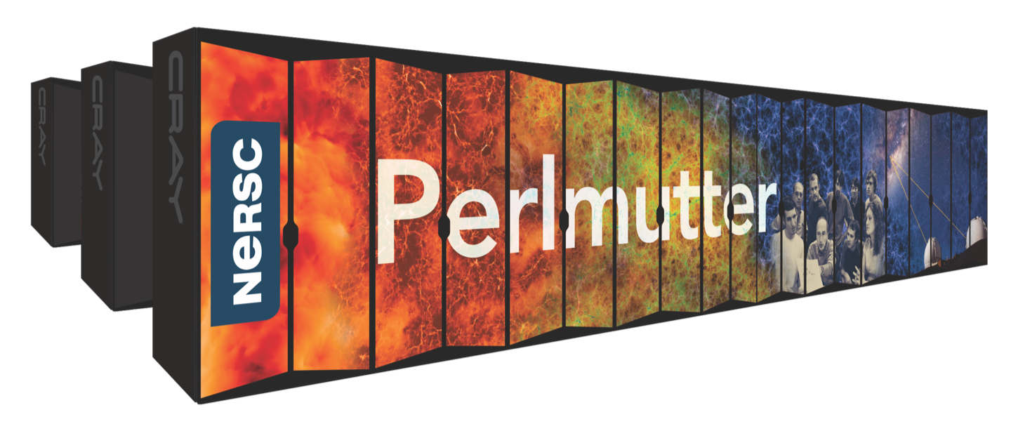
NERSC’s 2020 System: Perlmutter
Cray Shasta
3x to 4x capability of Cori
GPU-accelerated and CPU-only nodes
Cray Slingshot interconnect
Single-tier, all-flash Lustre
Cray E1000F-based system
30 PB usable capacity
≥ 4.0 TB/s sustained bandwidth
≥ 7,000,000 IOPS (read and write)
≥ 3,200,000 file creates/sec
CPU-only nodes
AMD Epyc™
Milan CPUs
High-memory workflow nodes
CPU-GPU nodes
Future NVIDIA GPUs
Tensor Cores
Login nodes
“Slingshot” Interconnect Ethernet Compatible
External file systems & networks
All-flash platform integrated storage

Slide 4
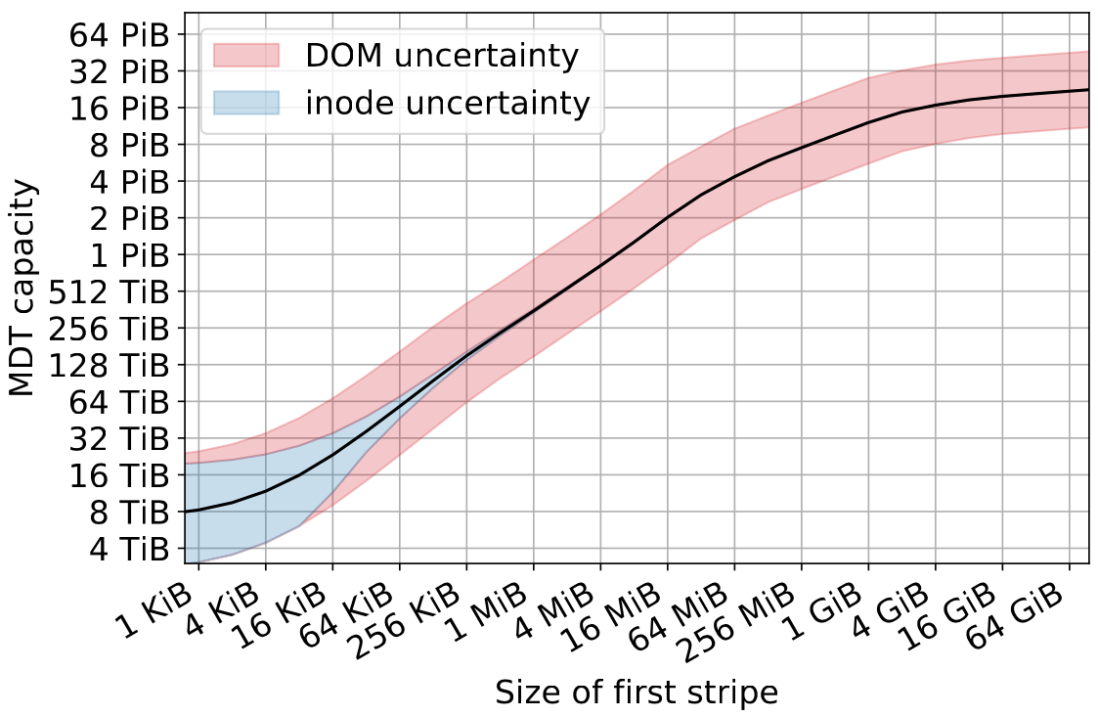
NERSC-Cray Collaboration
How much capacity? How much endurance?
DNE, DOM configuration?
ldiskfs or ZFS? Which meets performance spec?
Above: optimal MDT capacity for different DOM component sizes.
See Lockwood et al.,"A Quantitative Approach to Architecting All-Flash Lustre File Systems" in High Performance Computing, Chapter 16. https://doi.org/10.1007/978-3-030-34356-9_16

Slide 5
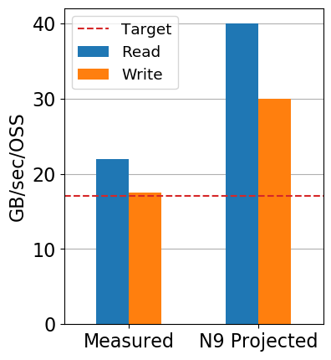
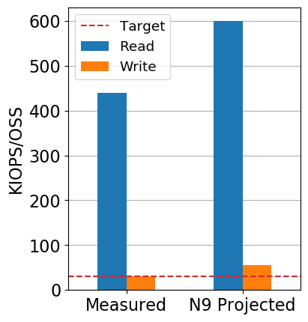
Cray's work on all-NVMe Performance - IOR
22 GB/s/OSS read
18 GB/s/OSS write
440 KIOPS/OSS read
30 KIOPS/OSS write
Cray's Test OSS | Perlmutter (Cray E1000F)
24c AMD Rome | ≥24c AMD Rome
2x EDR (100G) | ≥2x Slingshot (200G)
PCIe Gen3 SSDs | PCIe Gen4 SSDs
Cray Lustre (community + forward-ported patches)
Declustered RAID6 8+2+1 (GridRAID)

Slide 6
Thank you—and we're hiring! Ask any NERSC staff for more info

