Slide 1
Present and Future Computing Requirements for Simulation and Analysis of Reacting Flow
John Bell
CCSE, LBNL
NERSC ASCR Requirements for 2017
January 15, 2014
LBNL

Slide 2
1. Simulation and Reacting Flow Overview John Bell, Ann Almgren, Marc Day, Andy Nonaka / LBNL
Integrated approach to algorithm development for multiphysics applications
Mathematical formulation – exploit structure of the problems
Discretization – match discretization to mathematical properties of the underlying processes
Software / solvers – evolving development of software framework to enable efficient implementation of applications
Prototype applications – real world testing of approaches
Current focus
Coupling strategies for multiphysics coupling
Higher-order discretizations
AMR for next generation architectures
Application areas
Combustion
Environmental flows
Astrophysics
Micro / meso scale fluid simulation
Notes:
No notes for this slide, other slides do have notes

Slide 3
1. Simulation and Reacting Flow Overview – cont’d
Target future applications
Combustion – Complex oxygenated fuels at high pressure; integration of simulation and experimental data to improve predictive capability
Environmental flow -- High fidelity simulation of cloud physics with low Mach number stratified flow model with detailed microphysics
Astrophysics – 3D simulation of X-ray bursts on surface of neutron stars with detailed nucleosynthesis; high fidelity cosmological simulations
Microfluidics – mesoscale modeling of non-ideal multicomponent complex fluids
Notes:
No notes for this slide, other slides do have notes

Slide 4
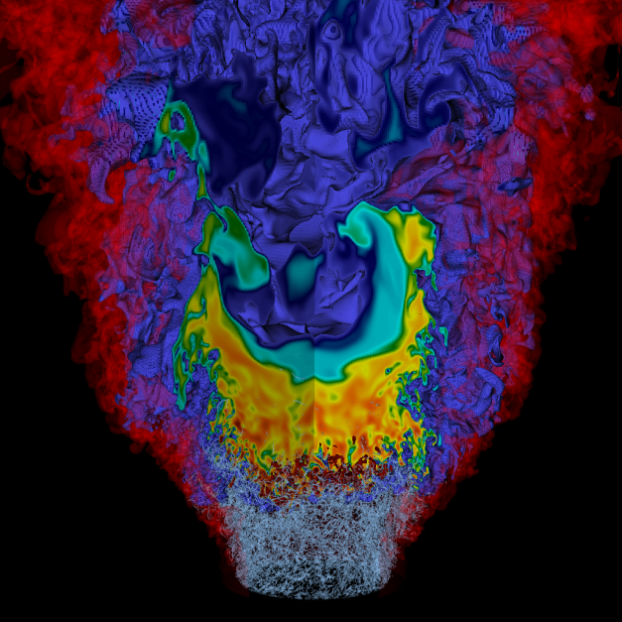
2. Computational Strategies -- Overview
Core algorithm technology
Finite volume discretization methods
Geometric multigrid
Block-structured AMR
Implemented in BoxLib framework
Class structure to support development of structured AMR methods
Manages data distribution and load balancing
Efficient metadata manipulation
Hybrid parallelization strategy
Distribute patches to nodes using MPI
Thread operations on patches using OpenMP
Simulation of NOx emissions in a low swirl burner fueled by hydrogen. Effective resolution is 4096³
Notes:
Discuss your responses to the Current HPC USAGE and Methods questions https://www.nersc.gov/projects/science_requirements/template.php
Please list your current primary codes and their main mathematical methods and/or algorithms. Include quantities that characterize the size or scale of your simulations or numerical experiments; e.g., size of grid, number of particles, basis sets, etc. Also indicate how parallelism is expressed (e.g., MPI, OpenMP, MPI/OpenMP hybrid)

Slide 5
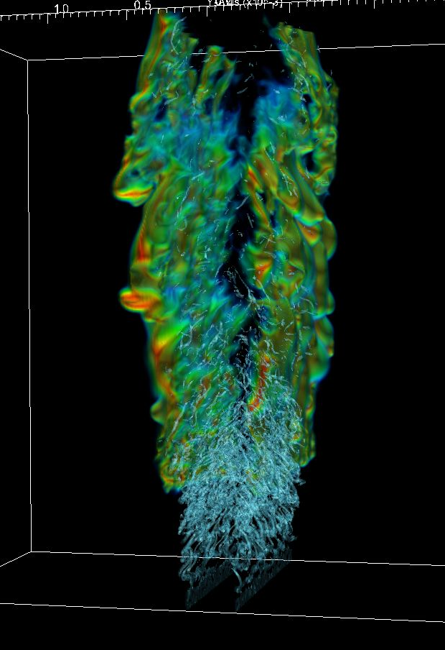
2. Computational strategies -- Combustion
Formulation
Low Mach number model derived from asymptotic analysis
Removes acoustic wave propagation
Retains compressibility effects due to thermal processes
Numerics
Adaptive projection formulation
Spectral deferred correction to couple processes
Dynamic estimation of chemistry work for load balancing
LMC
Dimethyl ether jet at 40 atm
Notes:
Discuss your responses to the Current HPC USAGE and Methods questions https://www.nersc.gov/projects/science_requirements/template.php
Please list your current primary codes and their main mathematical methods and/or algorithms. Include quantities that characterize the size or scale of your simulations or numerical experiments; e.g., size of grid, number of particles, basis sets, etc. Also indicate how parallelism is expressed (e.g., MPI, OpenMP, MPI/OpenMP hybrid)

Slide 6
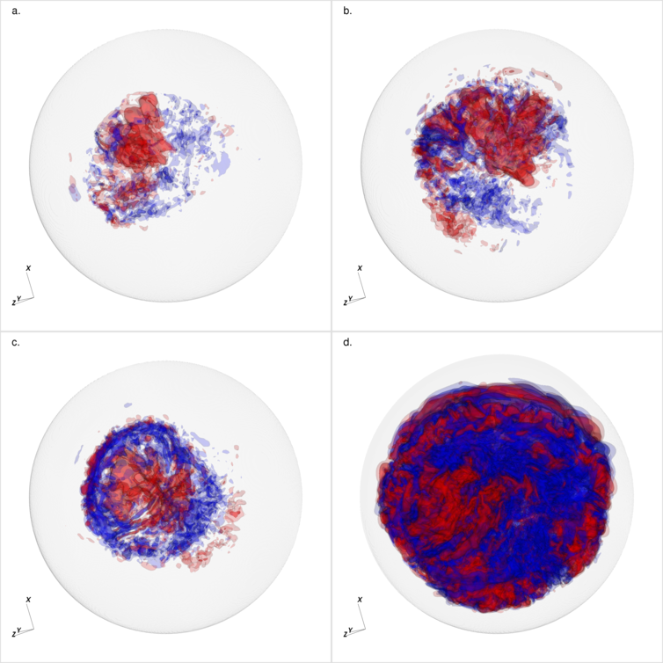
2. Computational strategies – Stratified flows
Formulation
Low Mach number formulation with evolving base state
General equation of state
Numerics
Unsplit PPM
Multigrid
AMR
Code – Maestro
Astrophysics
Atmospheric flows
Simulation of advection leading up to ignition in a Chandrasakar white dwarf
Notes:
Discuss your responses to the Current HPC USAGE and Methods questions https://www.nersc.gov/projects/science_requirements/template.php
Please list your current primary codes and their main mathematical methods and/or algorithms. Include quantities that characterize the size or scale of your simulations or numerical experiments; e.g., size of grid, number of particles, basis sets, etc. Also indicate how parallelism is expressed (e.g., MPI, OpenMP, MPI/OpenMP hybrid)

Slide 7
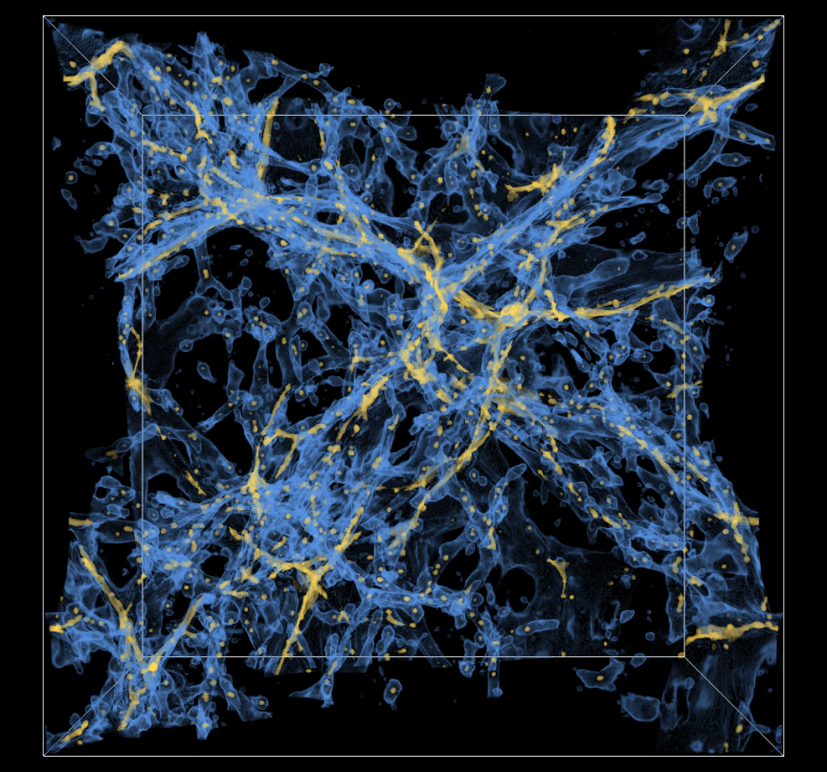
2. Computational strategies -- Astrophysics
Formulation
CASTRO
Compressible flow formulation
Self-gravity
Models for turbulent flame propagation
Multigroup flux-limited diffusion
NYX
CASTRO + collision-less particles to represent dark matter
Numerics
Unsplit PPM
Multigrid
AMR
Baryonic matter from Nyx simulation
Notes:
Discuss your responses to the Current HPC USAGE and Methods questions https://www.nersc.gov/projects/science_requirements/template.php
Please list your current primary codes and their main mathematical methods and/or algorithms. Include quantities that characterize the size or scale of your simulations or numerical experiments; e.g., size of grid, number of particles, basis sets, etc. Also indicate how parallelism is expressed (e.g., MPI, OpenMP, MPI/OpenMP hybrid)

Slide 8
2. Computational Strategies – future direction
We expect our computational approach and/or codes to change (or not) by 2017 in this way …
Higher-order discretizations
Spectral deferred corrections for multiphysics coupling
Alternative time-stepping strategies
More sophisticated hybrid programming model
Integration of analysis with simulation
Combining simulation with experimental data
Notes:
Please list your current primary codes and their main mathematical methods and/or algorithms. Include quantities that characterize the size or scale of your simulations or numerical experiments; e.g., size of grid, number of particles, basis sets, etc. Also indicate how parallelism is expressed (e.g., MPI, OpenMP, MPI/OpenMP hybrid)

Slide 9
3. Current HPC Usage (see slide notes)
Machines currently using (NERSC or elsewhere)
Hopper, Edison, Titan
Hours used in 2012-2013 (list different facilities)
NERSC – 21 Million hours (MP111); OLCF -- ??
Typical parallel concurrency and run time, number of runs per year
20+K cores ; one study is 100-1000 hours; many smaller runs
Data read/written per run
1-2 Tbytes / hour
Memory used per (node | core | globally)
Hopper: (12 G | .5 G | 12 T )
Necessary software, services or infrastructure
MPI / OpenMP / C++ and F90 / HPSS / Parallel file system / Visit / htar / hypre / Petsc
Data resources used (/scratch,HPSS, NERSC Global File System, etc.) and amount of data stored
/scratch, HPSS, /project --- 250 Tbytes
Notes:
Please list any required or important software, services, or infrastructure (beyond supercomputing and standard storage infrastructure) provided by HPC centers or system vendors.
Please list the known limitations/obstacles/bottleneck of resources currently available HPC systems, and in particular, those at NERSC.

Slide 10
4. HPC Requirements for 2017 (Key point is to directly link NERSC requirements to science goals)
Compute hours needed (in units of Hopper hours)
500 M hours
Changes to parallel concurrency, run time, number of runs per year
Increase of factor of 20-40 in concurrency; longer run times, 2 x number of runs per year
Changes to data read/written
5 x increase in data read / written
Changes to memory needed per ( core | node | globally )
We tend to select number of cores based on available memory so that problem will fit
Need to maintain reasonable level of memory per core and node
Changes to necessary software, services or infrastructure
Improved thread support
Programming model to support mapping data to cores within a node (respect NUMA)
Tools to query how job is mapped onto machines so we can optimize communication
Improved performance analysis tools
Notes:
Discuss your responses to the HPC usage and methods for 2017
Anticipated changes to codes, mathematical methods and/or algorithms needed to achieve this project's scientific objectives.
Computational Hours Required per Year
Anticipated Number of Cores to be Used in a Typical Production Run
Anticipated Wallclock to be Used in a Typical Production Run Using the Number of Cores Given Above
Anticipated Total Memory Used per Run GB
Anticipated Minimum Memory Required per Core GB
Anticipated total data read & written per run GB
Anticipated size of checkpoint file(s) GB
Anticipated On-Line File Storage Required (Directly Accesible from a Running Job)
GB Files Anticipated Off-Line Archival Storage Required GB Files
Known or Anticipated architectural requirements (e.g., 2 GB memory/core).
Please list any additional required or important software, services, or infrastructure beyond those listed in the previous section.
It is believed that the dominant HPC architecture in the next 3-5 years will incorporate processing elements composed of 10s-1,000s of individual cores. It is unlikely that a programming model based solely on MPI will be effective, or even supported, on these machines. Do you have a strategy for computing in such an environment? If so, please briefly describe it.

Slide 11
5. Strategies for New Architectures (1 of 2)
Does your software have CUDA/OpenCL directives; if yes, are they used, and if not, are there plans for this?
No
Some limited plans to move chemistry integration to GPU’s
Does your software run in production now on Titan using the GPUs?
No
Does your software have OpenMP directives now; if yes, are they used, and if not, are there plans for this?
We routinely use OpenMP for production runs
Does your software run in production now on Mira or Sequoia using threading?
No
Is porting to, and optimizing for, the Intel MIC architecture underway or planned?
Yes. We have developed a tiling based implementation of one of our codes that got a speedup of a factor of 86 on a 61 core MIC

Slide 12
5. Strategies for New Architectures (2 of 2)
Have there been or are there now other funded groups or researchers engaged to help with these activities?
CS researcher funded by ExaCT Co-design Center and various X-stack projects have interacted with us on these activities
If you answered "no" for the questions above, please explain your strategy for transitioning your software to energy-efficient, manycore architectures
N/A
What role should NERSC play in the transition to these architectures?
Provide high quality tools needed to make this transition
Support development of new programming models needed to effectively implement algorithms on these types of architectures
What role should DOE and ASCR play in the transition to these architectures?
Continue to fund applied math research groups working to develop algorithms for these architectures
Provide support for software developed by these groups to facilitate availability of libraries / frameworks on new architectures
Other needs or considerations or comments on transition to manycore:

Slide 13
5. Special I/O Needs
Does your code use checkpoint/restart capability now?
Yes
Do you foresee that a burst buffer architecture would provide significant benefit to you or users of your code?
Burst buffer would be useful in two ways
Stage latest checkpoint to burst buffer before jobs begins
Write more frequent checkpoints to burst buffer and migrate last complete checkpoint to rotating disk at end of run
Scenarios for possible Burst Buffer use are on http://www.nersc.gov/assets/Trinity--NERSC-8-RFP/Documents/trinity-NERSC8-use-case-v1.2a.pdf

Slide 14
6. Summary
What new science results might be afforded by improvements in NERSC computing hardware, software and services?
Significant increase in multiphysics simulation (math hat)
Recommendations on NERSC architecture, system configuration and the associated service requirements needed for your science
Maintain system balance as much as possible
Keep (at least) memory per node fairly large
Aggressively pursue new programming models to facilitate intranode, fine-grained parallelization
Aggressively pursue programming model support for in situ analysis
NERSC generally refreshes systems to provide on average a 2X performance increase every year. What significant scientific progress could you achieve over the next 5 years with access to 32X your current NERSC allocation?
Higher-order AMR capability for target applications such as those discussed above
Integration of simulation and experimental data to improve predictive capability
What "expanded HPC resources" are important for your project?
???
General discussion

