Slide 1
Zhengji Zhao NERSC User Engagement Group
HBM tools and Applications in VASP code
NERSC User Group Meeting,
Berkeley, CA, Mar 23, 2016

Slide 2
HBM tools

Slide 3
Two tools to allocate arrays on the HBM or MCDRAM
1. Code change required:
Intel compiler/Memkind APIs
Memkind library (with jemalloc)
2. No code change required:
AutoHBW library (with memkind library)
We can estimate the HBM performance on dual-socket Edison/Cori nodes today.
Notes:
jemalloc is a general purpose malloc(3) implementation that emphasizes fragmentation avoidance and scalable concurrency support.

Slide 4
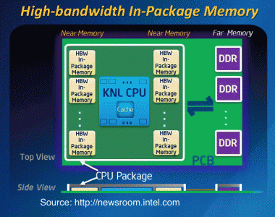
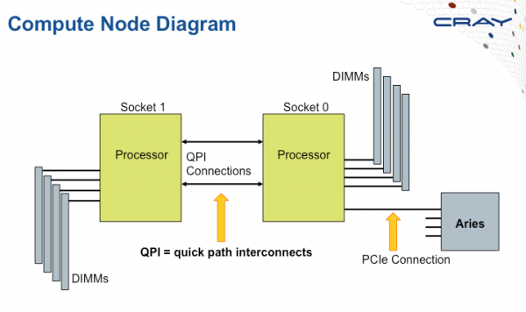
Memkind library – a development tool for HBW memory from Intel
The memkind library is a user extensible heap manager. It can be used to test/simulate the benefit of high hand width memory (HBM or HBW) on the dual socket Edison compute nodes today.
Use the QPI bus to simulate slow memory
This is not an accurate model of the bandwidth and latency characteristics of the KNL on package memory, but is a reasonable way to determine which data structures rely critically on bandwidth.
http://memkind.github.io/memkind
http://memkind.github.io/memkind/memkind_arch_20150318.pdf
http://ihpcc2014.com/pdf/100_KNL_HPC_Developer_Forum_SC_14.pdf

Slide 5
Steps to use Memkind library on Edison
Add compiler directive !DIR$ ATTRIBUTES FASTMEM in the Fortran codes
real, allocatable :: a(:,:), b(:,:), c(:)
!DIR$ ATTRIBUTES FASTMEM :: a, b, c
Use hbw_malloc, hbw_calloc to replace the malloc, calloc calls in the C/C++ codes
#include <hbwmalloc.h>
malloc(size) -> hbw_malloc(size)
Link the codes to the memkind and jemalloc libraries
module load memkind
ftn -dynamic -g -O3 -openmp mycode.f90
# compiler wrappers link the code to the –lmemkind –ljemalloc libraries.
https://www.nersc.gov/users/computational-systems/cori/application-porting-and-performance/using-high-performance-libraries-and-tools#toc-anchor-1
Notes:
Staic vs

Slide 6
Steps to use Memkind library on Edison
Run the codes with the numactl and env MEMKIND_HBW_NODES
module load memkind # only needed for dynamically linked apps
export MEMKIND_HBW_NODES=0
srun –n 1 numactl --membind=1 --cpunodebind=0 ./a.out
Notes:
Memkind can only allocate heap variables to the HBW memory. There is no way to allocate stack variables to HBW currently.
The FASTMEM directive may be supported by other compilers in the future, e.g., Cray, but may have slightly different from the Intel FASTMEM directive.

Slide 7
AutoHBW tool – a development tool from Intel
AutoHBW Tool – automatically allocate the arrays in certain size range to the HBW memory at run time.
No code change is required
This library intercepts the standard heap allocations (e.g., malloc, calloc) and allocate them out of HBW memory using the memkind API.
Included in the memkind distribution: http://memkind.github.io/memkind
Available both on Edison and Cori as a module
http://www.nersc.gov/users/computational-systems/cori/application-porting-and-performance/using-high-performance-libraries-and-tools/#toc-anchor-2

Slide 8
AutoHBW tool uses the environment variables to control its behavior
AUTO_HBW_SIZE=x[:y]
Indicates that any allocation larger than x and smaller than y should be allocated in HBW memory. x,y (in K, M, or G)
AUTO_HBW_SIZE=1M:5M # allocations between 1M and 5M allocated in HBW
AUTO_HBW_LOG=level
Sets the verbosity If the logging level:
0 = no messages are printed for allocations
1 = a log message is printed for each allocation (Default)
2 = a log message is printed for each allocation with a backtrace.
Using the autohbw_get_src_lines.pl script to find source lines for each allocation.
Logging adds extra overhead. Use 0 for performance critical runs
Reference
/global/common/edison/usg/memkind/0.2.2+dev52gf73f5c9/intel/examples/autohbw_README
Notes:
zz217@edison05:/global/common/edison/usg/memkind/0.2.2+dev52gf73f5c9/intel/examples> cat autohbw_README
README for auothbw library
Ruchira Sasanka (ruchira.sasanka AT intel.com)
2015 April 8
PURPOSE
-------
The autohbw library is used to automatically allocate high-bandwidth (HBW)
memory without any modifications to source code of your application.
This library intercepts the standard heap allocations (e.g., malloc, calloc)
in your program so that it can serve those allocations out of HBW memory.
There are two libraries installed at the same location as memkind library:
1) libautohbw.so -- dynamic library
2) libautohbw.a -- static library (provided for static linking)
USAGE
-----
To use the dynamic library, insert LD_PRELOAD=libautohbw.so and libmekind.so
before your commandline. For instance,
LD_PRELOAD=libautohbw.so:libmemkind.so /bin/ls
executes Unix ls utility with autohbw library. You can execute the
above command on the prompt or put it in a shell script. An example of
the latter approach is given in ./autohbw_test.sh. Make sure that
LD_LIBRARY_PATH enviornment variable contains the path to libautohbw.so
and libmekind.so before you exeute the above command.
To use the statically linked library, inset -lautohbw -lmemkind -ljemalloc
on your link line. You will have to provide the library path with -L to
point to the above libraries. If you are linking your program statically
(e.g., with -static or -fast flags in ifort/icc), you must use the static
version of autohbw library (libautohbw.a).
Usage with MPI programs
-----------------------
To use with MPI programs, you need to create a shell script to do the
LD_PRELOAD. E.g.,
mpirun -n 2 ./autohbw_test.sh
ENVIORNMENT VARIABLES
---------------------
The following enviornment variables control the behavior of the autohbw
library:
AUTO_HBW_SIZE=x[:y]
Indicates that any allocation larger than x and smaller than y should be
allocated in HBW memory. x and y can be followed by a K, M, or G to
indicate the size in Kilo/Memga/Giga bytes (e.g., 4K, 3M, 2G).
Examples:
AUTO_HBW_SIZE=4K # all allocation larger than 4K allocated in HBW
AUTO_HBW_SIZE=1M:5M # allocations betwen 1M and 5M allocated in HBW
AUTO_HBW_LOG=level
Sets the value of logging (printing) level. If level is:
0 = no messages are printed for allocations
1 = a log message is printed for each allocation (Default)
2 = a log message is printed for each allocation with a backtrace.
Redirect this output and use autohbw_get_src_lines.pl to find
source lines for each allocation. Your application must be compiled
with -g to see source lines.
Notes:
1. Logging adds extra overhead. Therefore, performance critical runs,
logging level should be 0
2. The amount of free memory printed with log messages is only
approximate -- e.g. pages that are not touched yet are excluded
Examples:
AUTO_HBW_LOG=1
AUTO_HBW_MEM_TYPE=memory_type
Sets the type of memory type that should be automatically allocated. By
default, this type is MEMKIND_HBW. The names of memory types are defined
in memkind(3) man page. If you are requesting any huge TLB pages, please
make sure that the requested type is currently enabled in your OS.
Examples:
AUTO_HBW_MEM_TYPE=MEMKIND_HBW (default)
AUTO_HBW_MEM_TYPE=MEMKIND_HBW_HUGETLB
AUTO_HBW_MEM_TYPE=MEMKIND_HUGETLB
AUTO_HBW_DEBUG=0|1|2
Set the debug message printing level. Default is 0. This is mainly for
development.

Slide 9
AutoHBW tool – more envs
MEMKIND_HBW_NODES=<list of numa nodes>
Sets a comma separated list of NUMA nodes as HBW nodes, e.g., MEMKIND_HBW_NODES=0
For non-KNL node this env must be set
AUTO_HBW_MEM_TYPE=<memory_type>
Sets the type of memory that should be automatically allocated. Default: MEMKIND_HBW.
Examples:
AUTO_HBW_MEM_TYPE=MEMKIND_HBW (Default)
AUTO_HBW_MEM_TYPE=MEMKIND_HBW_HUGETLB
AUTO_HBW_MEM_TYPE=MEMKIND_HUGETLB
Make sure the malloc calls intercepted by the autohbw library APIs:
For dynamic builds, using LD_PRELOAD or LD_LIBRARY_PATH to allow libautohbw.so:libmemkind.so in front of the system default path.
For static builds, make the autohbw and memkind libraries in front of the link line. May use -Wl,-ymalloc to check

Slide 10
How to use AutoHBW tool on Edison
Link the codes to the autohbw, memkind and jemalloc libraries
module load autohbw
ftn -g -O3 -openmp mycode.f90
Run the codes with the numactl and proper environment variables
export MEMKIND_HBW_NODES=0
export AUTO_HBW_LOG=0
export AUTO_HBW_MEM_TYPE=MEMKIND_HBW
export AUTO_HBW_SIZE=1K:5K # all allocations between sizes 1K and 5K allocated in HBW memory
Srun –n 1 numactl --membind=1 --cpunodebind=0 ./a.out
Monitor with the numastat –p <pid> command
displays the memory allocations among sockets for a running process
Notes:
Sample job script on Edison
#!/bin/bash -l
#SBATCH -J test_HBM
#SBATCH -N 1
#SBATCH -p debug
#SBATCH -t 30:00
#SBATCH -o test_HBM.o%j
## to compile, do
#module load memkind
#ftn -dynamic -g -O3 -openmp mycode.f90 # dynamic linking is recommended
#to run
module load memkind
export MEMKIND_HBW_NODES=0 #let socket 0 is the HBW memory node
export OMP_NUM_THREADS=12
# binding processes on to the socket 0 but allocating memory from socket 1. This is an analogy for using the DDR memory only if no fastmem directive or hbw apis are used
srun -n 1 numactl --membind=1 --cpunodebind=0 ./a.out
# binding processes on to the socket 0 and allocating memory from socket 0. This is an analogy for using the HBW memory only
srun -n 1 numactl --membind=0 --cpunodebind=0 ./a.out
#############################
# tests with authhbw
## to compile, do
#module load autohbw
#ftn -dynamic -g -O3 -openmp mycode.f90 # dynamic linking is recommended
export MEMKIND_HBW_NODES=0
export AUTO_HBW_LOG=0
export AUTO_HBW_MEM_TYPE=MEMKIND_HBW
export OMP_NUM_THREADS=12
export AUTO_HBW_SIZE=1M:5M # allocation sizes betwen 1M and 5M allocated in HBW memory
srun -n 1 numactl --membind=1 --cpunodebind=0 ./a.out

Slide 11
Identifying the candidate arrays for HBM

Slide 12
Identifying if your code is memory bandwidth bound
Running on half packed nodes
In comparison with the fully packed runs, if doubling the memory available per task helps the performance or not
VTune memory analysis – can identify the memory objects for HBM
http://www.nersc.gov/users/software/performance-and-debugging-tools/vtune/
Test with autoHBW

Slide 13
VASP Case Study --Dungeon report, Hillsboro, OR, Oct. 2015
The work described here was performed by the VASP developer, Martijn Marsman, at the University of Vienna, Zhengji Zhao and Jack Deslippe at NERSC, and Jeongnim Kim, Martyn Corden, Sumedh Naik, Christopher Cantalupo, Gregory Junker, Ruchira Sasanka and other engineers at Intel.
https://www.nersc.gov/users/computational-systems/cori/application-porting-and-performance/application-case-studies/vasp-case-study/

Slide 14
Code description and computational problem
The Vienna Ab-initio Simulation Package (VASP) [1-2] is a widely used materials science application.
The fundamental mathematical problem that VASP solves is a non-linear eigenvalue problem that has to be solved iteratively via self-consistent iteration cycles until a desired accuracy is achieved. FFTs and Linear Algebra libraries (BLAS/LAPACK/ScaLAPACK) are heavily depended on.
Currently, the released production code (5.3.5) is a pure MPI code, and the developers have been working on adding the OpenMP directives to prepare for the next generation multi-core/many-core HPC systems.

Slide 15
Starting point: Preparation for the Dungeon
Test Case
The benchmark test case used in profiling the MPI/OpenMP hybrid VASP code (the development version up-to 9/29/2015). The test system contains 150 Palladium (Pd) atoms and 24 Oxygen atoms (O) (denoted as PdO@Pd-slab hereafter), 1644 electrons in 1024 bands, and 33967 planewaves per band. The RMM-DIIS iteration scheme was tested, and it was executed over multiple bands simultaneously.

Slide 16
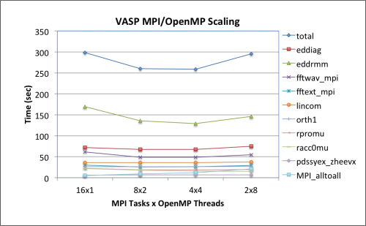
VASP profiling – thread scaling

Slide 17
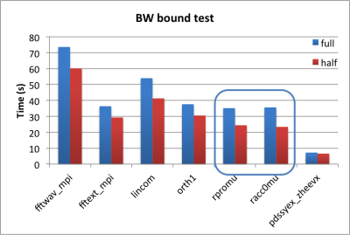
VASP profiling- memory bandwidth bound?

Slide 18
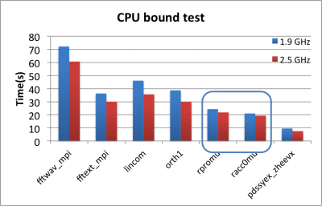
VASP profiling – CPU bound?

Slide 19
Estimating the performance impact of HBW memory to VASP code using AutoHBW tool on Edison
VASP 5.3.5
Test case: B.hR105-s
Edison, a Cray XC30, with dual-socket Ivy Bridge nodes interconnected with Cray’s Aries network, the bandwidths of the near socket memory (simulating MCDRAM) and the far socket memory via QPI (simulating DDR) differ by 33%

Slide 20
Optimizations attempted during dungeon session
Analyzed the HBM performance impact by allocating a few selected arrays to HBM using the Memkind library and the Intel compiler directive !DIR$ ATTRIBUTES FASTMEM.
Attempted to optimize the real space projection routines and developed a four-step optimization strategy. Two of the steps were implemented during the dungeon session and the rest remained to be used after.
Attempted to use Libxsmm.

Slide 21
Opt 1: Allocating arrays in HBM using the Memkind library and the FASTMEM Intel compiler directive
Simple cases
SUBROUTINE RACC0MU(NONLR_S, WDES1, CPROJ_LOC, CRACC, LD, NSIM, LDO)
...
REAL(qn),ALLOCATABLE:: WORK(:),TMP(:,:)
GDEF,ALLOCATABLE :: CPROJ(:,:)
...
ALLOCATE(WORK(ndata*NSIM*NONLR_S%IRMAX),TMP(NLM,ndata*2*NSIM),CPROJ(WDES1%NPRO_TOT,NSIM))
...
END SUBROUTINE RACC0MU
The only change needed to allocate the arrays WORK, TMP, and CPROJ to the HBM was to add the following line to the code right below the GDEF,ALLOCATABLE :: CPROJ(:,:)).
!DIR$ ATTRIBUTES FASTMEM :: WORK,TMP,CPROJ
Notes:
Code optimizations during the dungeon session

Slide 22
FASTMEM: Working with Fortran array pointers
INTEGER, POINTER :: NLI (:,:) ! index for gridpoints
REAL(qn),POINTER, CONTIGUOUS :: RPROJ (:) ! projectors on real space grid
COMPLEX(q),POINTER, CONTIGUOUS::CRREXP(:,:,:) ! phase factor exp (i k (R(ion)-r(grid)))
...
ALLOCATE(NONLR_S%NLI(IRMAX,NIONS),NONLR_S%RPROJ(NONLR_S%IRALLOC))
ALLOCATE(NONLR_S%CRREXP(IRMAX,NIONS,1))
The FASTMEM directive does not work directly with the pointers.
To allocate array pointers NLI, RPROJ and CRREXP to HBM, need to introduce intermediate allocatable arrays.

Slide 23
FASTMEM: Working with Fortran array pointers
INTEGER, POINTER :: NLI (:,:) ! index for gridpoints
REAL(qn),POINTER, CONTIGUOUS :: RPROJ (:) ! projectors on real space grid
COMPLEX(q),POINTER, CONTIGUOUS::CRREXP(:,:,:) ! phase factor exp (i k (R(ion)-r(grid)))
! To exploit fastmem
INTEGER, ALLOCATABLE :: fm_NLI (:,:) ! index for gridpoints
REAL(qn), ALLOCATABLE :: fm_RPROJ (:) ! projectors on real space grid
COMPLEX(q), ALLOCATABLE :: fm_CRREXP(:,:,:) ! phase factor exp (i k (R(ion)-r(grid)))
!DIR$ ATTRIBUTES FASTMEM :: fm_RPROJ,fm_CRREXP,fm_NL
...
! put NLI and RPROJ into fastmem
ALLOCATE(NONLR_S%fm_NLI(IRMAX,NIONS),NONLR_S%fm_RPROJ(NONLR_S%IRALLOC))
NONLR_S%NLI =>NONLR_S%fm_NLI
NONLR_S%RPROJ=>NONLR_S%fm_RPROJ
ALLOCATE(NONLR_S%fm_CRREXP(IRMAX,NIONS,1))
NONLR_S%CRREXP=>NONLR_S%fm_CRREXP

Slide 24
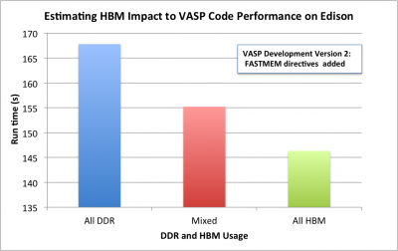
VASP+FASTMEM performance on Edison
VASP performance comparison between runs when everything was allocated in the DDR memory (blue/slow), when only a few selected arrays were allocated to HBM (red/mixed), and when everything was allocated to HBM (green/fast). The test case PdO@Pd-slab was used, and the tests were run on a single Edison node.

Slide 25
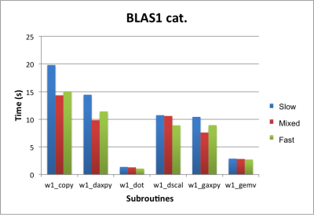
VASP+FASTMEM performance on Edison
DDR
Mixed
HBM
Allocating a few arrays in HBM (red:Mixed) showed a promising speedup (up to 30%) with the BLAS1-like subroutines

Slide 26
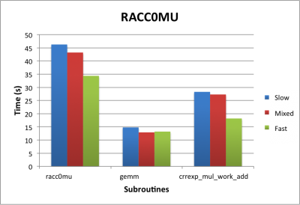
VASP+FASTMEM performance on Edison
DDR
Mixed
HBM
The real-space projection subroutine RACC0MU had a modest speedup (7%).

Slide 27
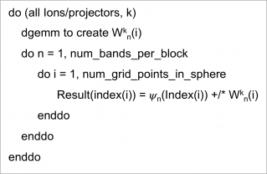
Opt 2: Developing a four-step optimization plan for the real space projection routines
Real space projection routines in VASP
A real-space projection subroutine code structure (left). The right panel illustrates the three loop regions over the ions/projectors, the number of bands in a group, and the number of grid points in each group.

Slide 28
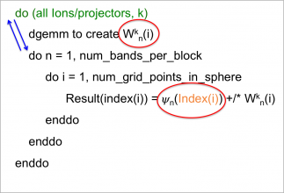
A four-step optimization plan for the real space projection routines
Optimizations attempted during dungeon - to detect the stride 1 block in the index array, and vectorized loops over those indices only.
while (i < n):
ip = Index(i)
if (Index(i+veclength) == ip + veclength:
do j = 1, veclength
A(ip+j) = B(i+j)
i += veclength
else ...
do i = 1, n
A(Index(i))=B(i)

Slide 29
Post dungeon follow-up
The developers further added the Intel FASTMEM directive to the code. The resulting code is KNL ready as far as the HBM is concerned.
VASP optimization collaboration between Intel engineers, the developers, NERSC and ZIB, has been ongoing. Major progress towards this effort was the profiling of the code on early KNL nodes.
A feature request for the Intel compiler was filed to make OpenMP private copies allocate in HBM if the parent copy in the master thread is in HBM.

Slide 30
Lessons learned
HBM may have a significant performance benefit to applications.
Selectively allocating arrays to HBM is a key optimization tactic to use the small amount of available HBM efficiently on KNL nodes.
The VTune profiling, especially the memory-access analysis, is useful to identify the candidate arrays for HBM.
Intel development tools like Memkind and AutoHBW are very helpful for users and developers to carry out HBM optimization for KNL on today's architectures. Early adoption of these tools is key to produce the KNL ready codes.
The available tools such as Memkind and AutoHBW are only capable of allocating heap arrays in HBM, and there is no good way of allocating stack arrays so far.
This prevents OpenMP private arrays from using HBM.
It is also necessary to change stack arrays (where applicable) to allocatable arrays to use HBM

Slide 31
Lessons learned --continued
The Intel compiler directive !DIR$ ATTRIBUTES FASTME does not work with array pointers directly. Allocatable work arrays must be introduced and allocated to the HBM first before associating to the array pointers.
The FASTMEM directive is an Intel compiler specific directive, and is not supported by other compilers.
This may cause the HBM optimization portability issue.
Cray compilers will support this directive (with slight modification) in the future.
Restructuring codes by changing loop orders among the nested loops may improve the data locality.
VTune and compiler optimization (-qopt-report) output are very helpful for checking if a specific loop is vectorized or not.

Slide 32
Thank you!
Try Memkind and autoHBW with your applications!
http://www.nersc.gov/users/computational-systems/cori/application-porting-and-performance/using-high-performance-libraries-and-tools

